Slide 1
East Africa Disasters
Assessing Landslide Characteristics and Developing a Landslide Potential Hazard Map in Rwanda and Uganda Using NASA Earth Observations
Leigh Sinclair (Project Lead)
Tyler Finley
Padraic Conner (Co-Project Lead)
Jeanné le Roux

Slide 2
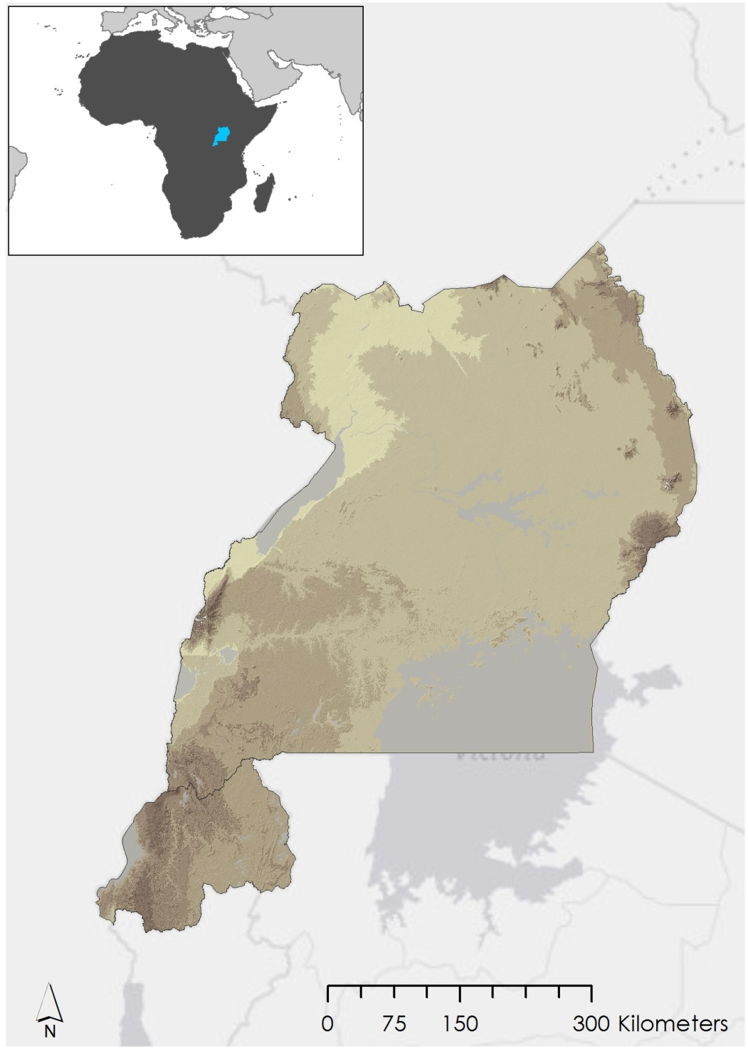
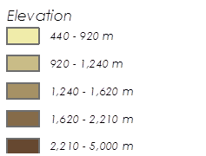



Study Area
This study focused on the East African countries of Uganda and Rwanda.
 | Uganda | Rwanda
Area | 236,040 km² | 26,338 km²
Climate | Tropical | Temperate
Notes:
This study focused on the East African countries of Uganda and Rwanda.
Uganda has a total area of approximately 240,000 square kilometers while Rwanda is a much smaller country with a total area of approximately 26,000 square kilometers.
These are neighboring land locked countries located along the equator.
Uganda is mostly characterized as a plateau consisting of savannah covered in elephant grass. The plateau regions are surrounded by mountains with some equatorial forest.
Uganda is recognized as having a tropical climate, with temperatures ranging from 16 – 28 degrees Celsius (60 – 80 degrees F). The weather is usually rainy and wet, although there are two dry seasons from December to January and from June to August.
Rwanda is on a plateau (the East Africa plateau) with land cover characterized by grasslands, hills, valleys, and mountains.
Although Rwanda is very close to the equator, it is considered to have a temperate climate due to the countries’ high elevation. Most of the country is 1.5 kilometers (about 1 mile) above sea level and has an average temperature of 20 degrees Celsius (68 degrees F). This temperature stays relatively constant throughout the year.
Rwanda has a rainy season from February to May, and from September to December, coinciding with Uganda’s rainy seasons.
Fun Fact: Uganda and Rwanda are home to the last two populations of endangered mountain gorillas.
Sources:
Painter, Rebekah. "Rwanda." Our World: Rwanda (2011): 1. MasterFILE Premier. Web. 3 June 2015.
White, C. Todd. "Uganda." Our World: Uganda (2011): 1-6. Book Collection: Nonfiction. Web. 3 June 2015.
Service Layer Credits: Esri, HERE, DeLorme, MapmyIndia, OpenStreetMap contributors, and the GIS user community.
Uganda has a total area of 236,040 km² with a tropical climate, while Rwanda has a total area of 26,338 km² and a temperate climate.

Slide 3
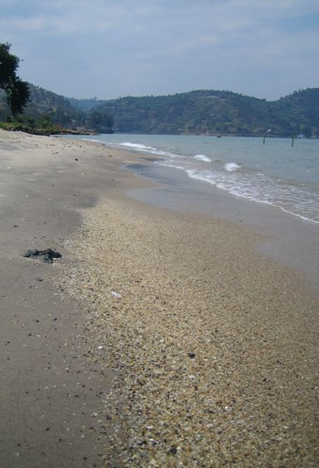
Study Period
January 2010 – Present Day
Rainy seasons of each year (Feb-May, Sept-Dec) were of particular interest
Source: Guillaume Lederrey
Notes:
January 2010: as far back as gathered in-situ data goes
Image: https://commons.wikimedia.org/wiki/Rwanda#/media/File:Lake_Kivu_shore_at_Gisenyi.jpg

Slide 4
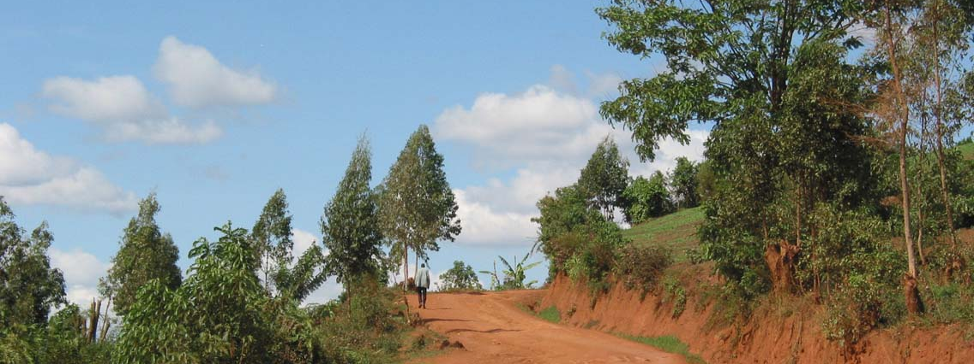
Source: Micah Zarnke
Objectives
Supply updates to SERVIR’s Global Landslide Catalog (GLC)
Create a Landslide Susceptibility Map and a Landslide Hazard Map for the study area
Assess performance of rainfall measuring satellites at identifying landslide conditions
Notes:
GLC: online database documenting rainfall triggered landslides around the world. Compiles info on landslides, including date and time occurred, location, size, and fatalities through news reports, published articles, etc.
Satellites: RMM, GPM, CHIRPS
Image: https://commons.wikimedia.org/wiki/File:DirtRoadRwanda.jpg

Slide 5
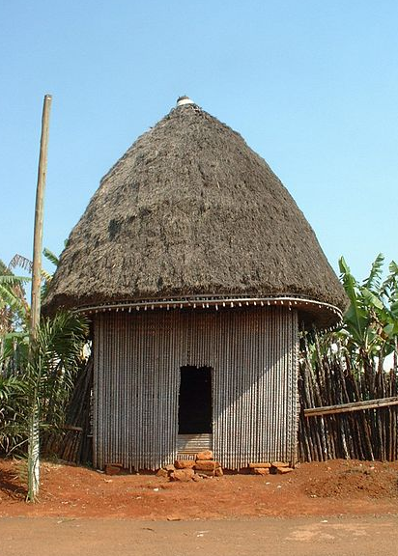
Community Concerns
Threat to life and infrastructure
Increasing population and poor farming practices
Unwillingness to relocate for economic and cultural reasons
Source: Tatoute
Notes:
Landslides threaten life and infrastructure in Uganda and Rwanda.
Some of the most profitable land is located in landslide prone regions. One of example of this is the growth of Arabica coffee in the Mt.Elgon region in Uganda, a hilly area with frequent landslide occurrences and fatalities.
There has been some efforts from the government to relocate people in high risk areas, but these efforts have been met with resistance due to ancestral links to land and fertile soils.
Uganda and Rwanda have a growing populations which place pressure on the land and force people to live in less safe areas.
Poor farming practices are also leading to the loosening of soil which can be a recipe for a landslide when mixed with rainfall.
Sources:
"UGANDA: Learning Lessons from Lethal Landslides." IRINnews. 1 June 2012. Web. 23 June 2015.
Photograph: https://commons.wikimedia.org/wiki/File:Case_%C3%A0_la_chefferie_de_Bana.jpg (Public Domain).

Slide 6



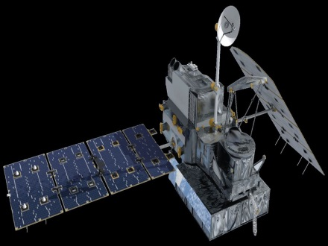
NASA Satellites/Sensors Used
Imaging
Rainfall Measuring
Landsat 8 OLI
TRMM TMPA
SRTM-V2 C-band
GPM DPR
Notes:
OLI: Operational Land Imager
SRTM: Shuttle Radar Topography Mission
TRMM: Tropical Rainfall Measuring Mission 3b42 data
TMPA: TRMM Multi-Satellite Precipitation Analysis
GPM: Global Precipitation Measurement IMERG version 3 data
DPR: Dual-Frequency Precipitation Radar

Slide 7
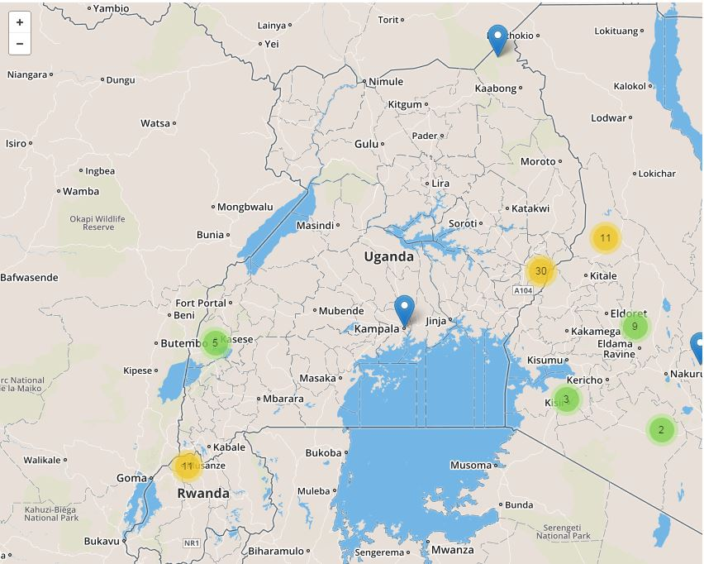
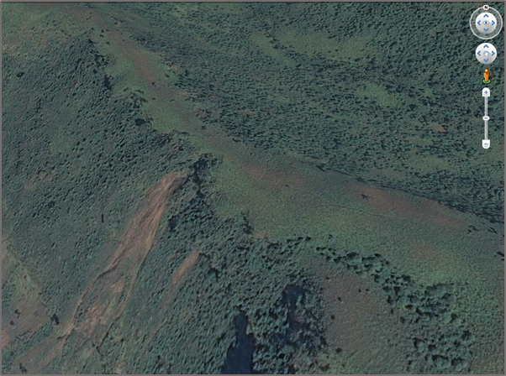
Methodology
Global Landslide Catalog
The Global Landslide Catalog (GLC) was created by Dr. Dalia Kirschbaum of SERVIR.
Credit: NASA
Credit: Google Earth
Notes:
The global landslide catalog created by Dr. Daliah Kirschbaum of SERVIR is an online database recording time, approximate location, size, and damages of landslides through the use of news reports and other media.
Google Earth was used to locate landslides within the study area, with the historical imagery slider used to determine an approximate time frame for the landslide. Where available, relevant news articles were supplied along with landslide location and date.
http://ojo-streamer.herokuapp.com/

Slide 8
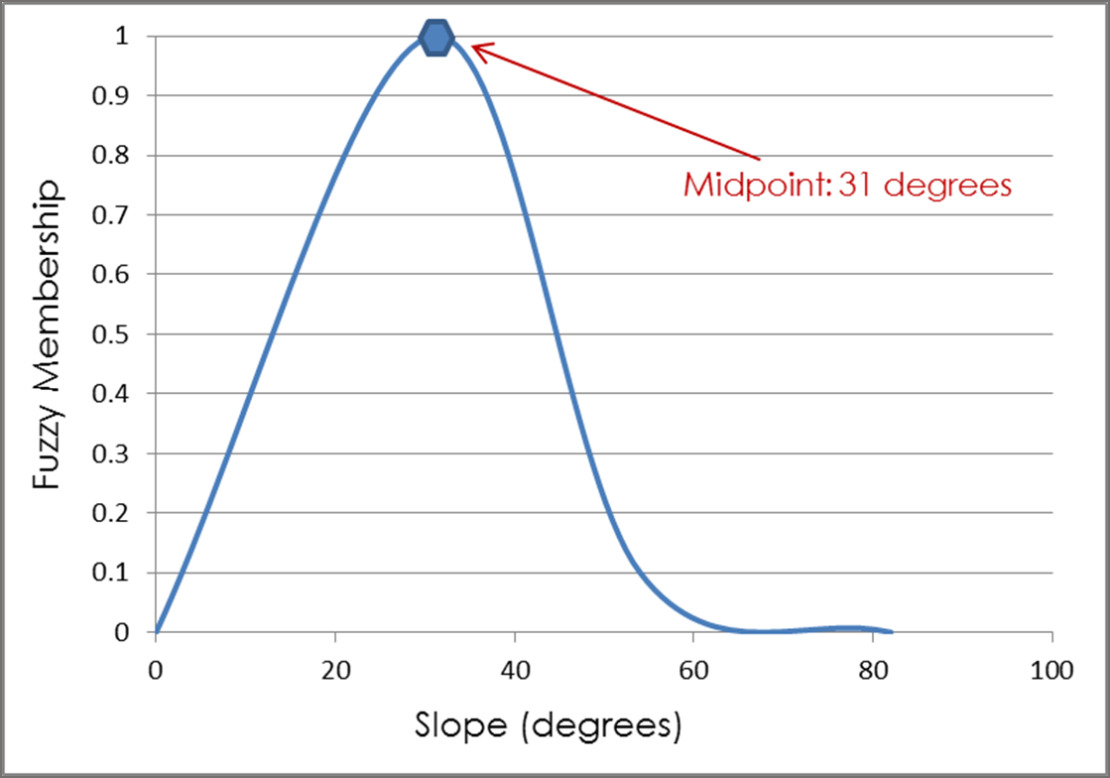
Methodology
Landslide Susceptibility Map
Assign Fuzzy Membership Type
Elevation | Large
Slope | Near
Plan Curvature | Near
Profile Curvature | Near
Distance from Roads | Linear
Distance from Streams | Linear
Distance from Ridge | Small
Terrain Roughness | Near
Soil Depth | Large
Topographic Wetness Index | Near
Variables
Elevation
Slope
Plan Curvature
Profile Curvature
Distance from Roads
Distance from Streams
Distance from Ridge
Terrain Roughness
Soil Depth
Topographic Wetness Index
Notes:
A heuristic approach was used to make a landslide susceptibility map over the study area. This basically means that a list of variables and their causative effect on landslides were determined based on a combination of expert opinion from scientific journal articles as well as educated guesses on behalf of the team. Such an approach is appropriate for landslide studies because the details of what causes any individual landslide to occur can be uncertain or difficult to pinpoint. This approach was executed with a fuzzy logic model.
First, 10 variables were selected for this study (see list on slide). Each variable was represented as a raster layer covering the study area.
Next, a fuzzy membership tool in ArcMap was used to rescale the variables on a scale from 0 to 1, with values closer to 0 representing lower landslide susceptibility, and values closer to 1 representing higher landslide susceptibility.

Slide 9
Methodology
Landslide Susceptibility Map
Fuzzy
Overlay
Landslide
Susceptibility
Map
Notes:
Once all variables were assigned a fuzzy membership, they were all combined with the Fuzzy Overlay tool in ArcMap.
The “AND” operator was used to combine the layers. What this operator does is take the lowest value amongst all variables and assign that value on a pixel per pixel basis, resulting in a single layer with values form 0 to 1.

Slide 10
Methodology
Landslide Hazard Map: Taking a Look at Population Density
Landslide
Susceptibility
Map
Potential Hazard Map
1 km Buffer
Landslide Susceptibility Map with Buffer
Intersect
Population Density
Notes:
- Pixels with a value of 0.5 or greater were chosen to represent areas that are highly susceptible to landslides.
A 1 km buffer was added to this selection to include areas that could potentially be affected by landslide debris outflow (this is a worst case scenario for our study area).
The buffered susceptibility map was intersected with SEDAC population data to show the spatial distribution of population density within susceptible areas.
The result was a landslide potential hazard map showing the spatial distribution of at risk populations.

Slide 11
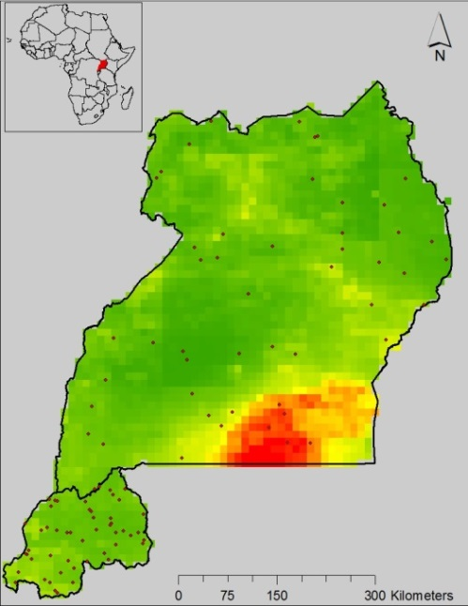
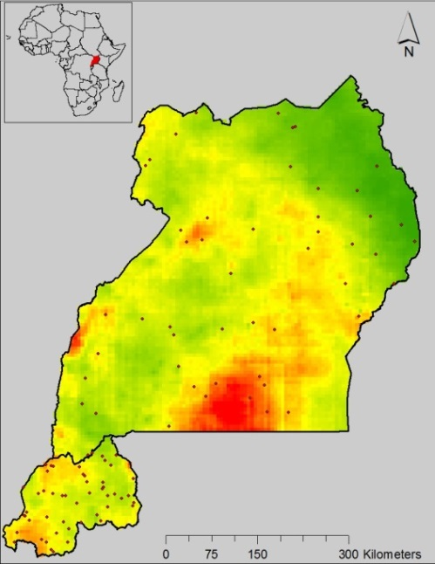
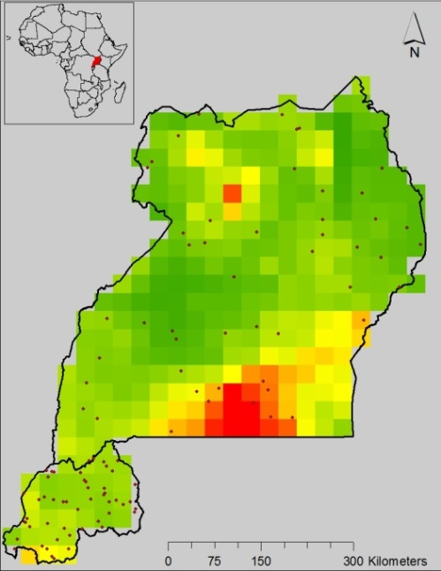
Methodology
Assessment of GPM and TRMM
Daily and Monthly Totals
Generate random points
Extract values to points
Correlate data using Excel
GPM
CHIRPS
TRMM
Notes:
We generated 100 random points within the study area for each month that TRMM and GPM overlapped. This was a total of 11 months from April 2014 to February 2015. We then used ArcMap to collect the TRMM, GPM, and CHIRPS rain value for each point. We used the same method taking 100 points per day over 30 days for September 2014 which was the rainiest month of the study period.

Slide 12
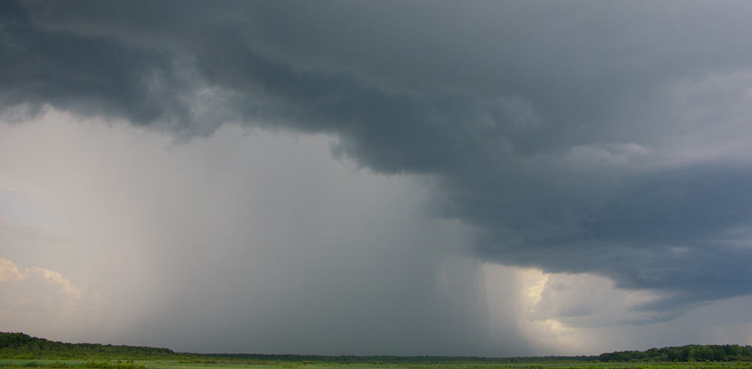
Methodology
Assessment of GPM and TRMM
Extreme Rainfall Events
Separate upper quartile-extreme rainfall events
Correlate data using Excel
Source: Bidgee
Notes:
The upper quartile of the highest rain totals in the CHIRPS , TRMM, and GPM datasets were separated in order to test how well the measures compared in extreme rain events. These values were then correlated separately from the rest of the data, again using Pearson’s r.
https://commons.wikimedia.org/wiki/Rain#/media/File:FoggDam-NT.jpg

Slide 13
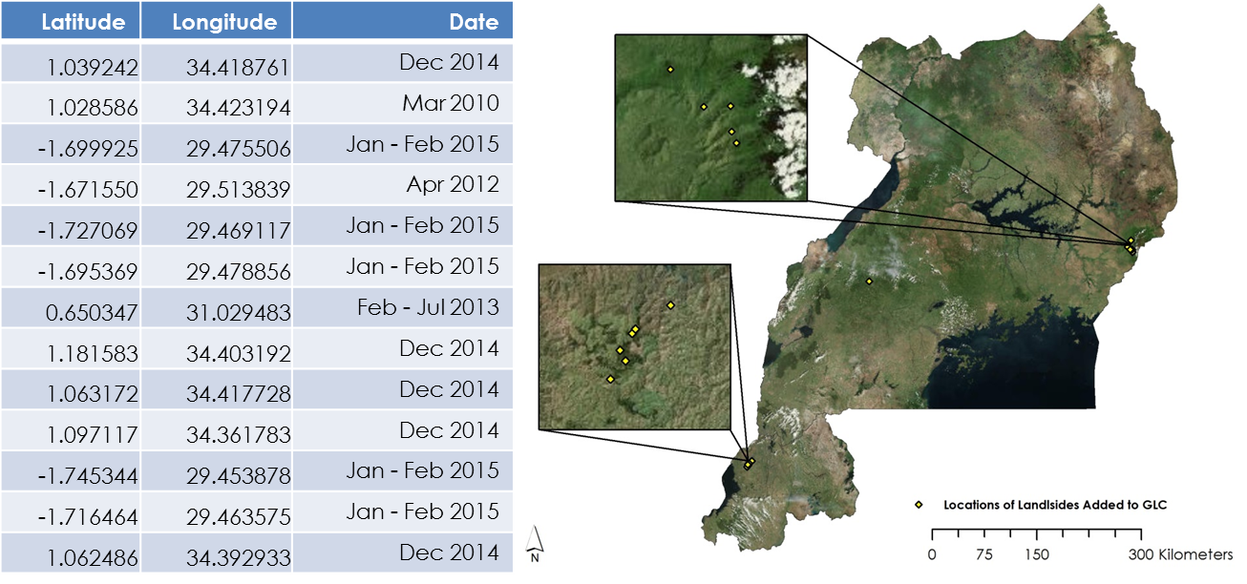
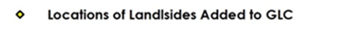
Results
Global Landslide Catalog
Notes:
The East Africa disasters project contributed to the Global landslide catalog by adding a total of 13 landslides to the catalog.

Slide 14
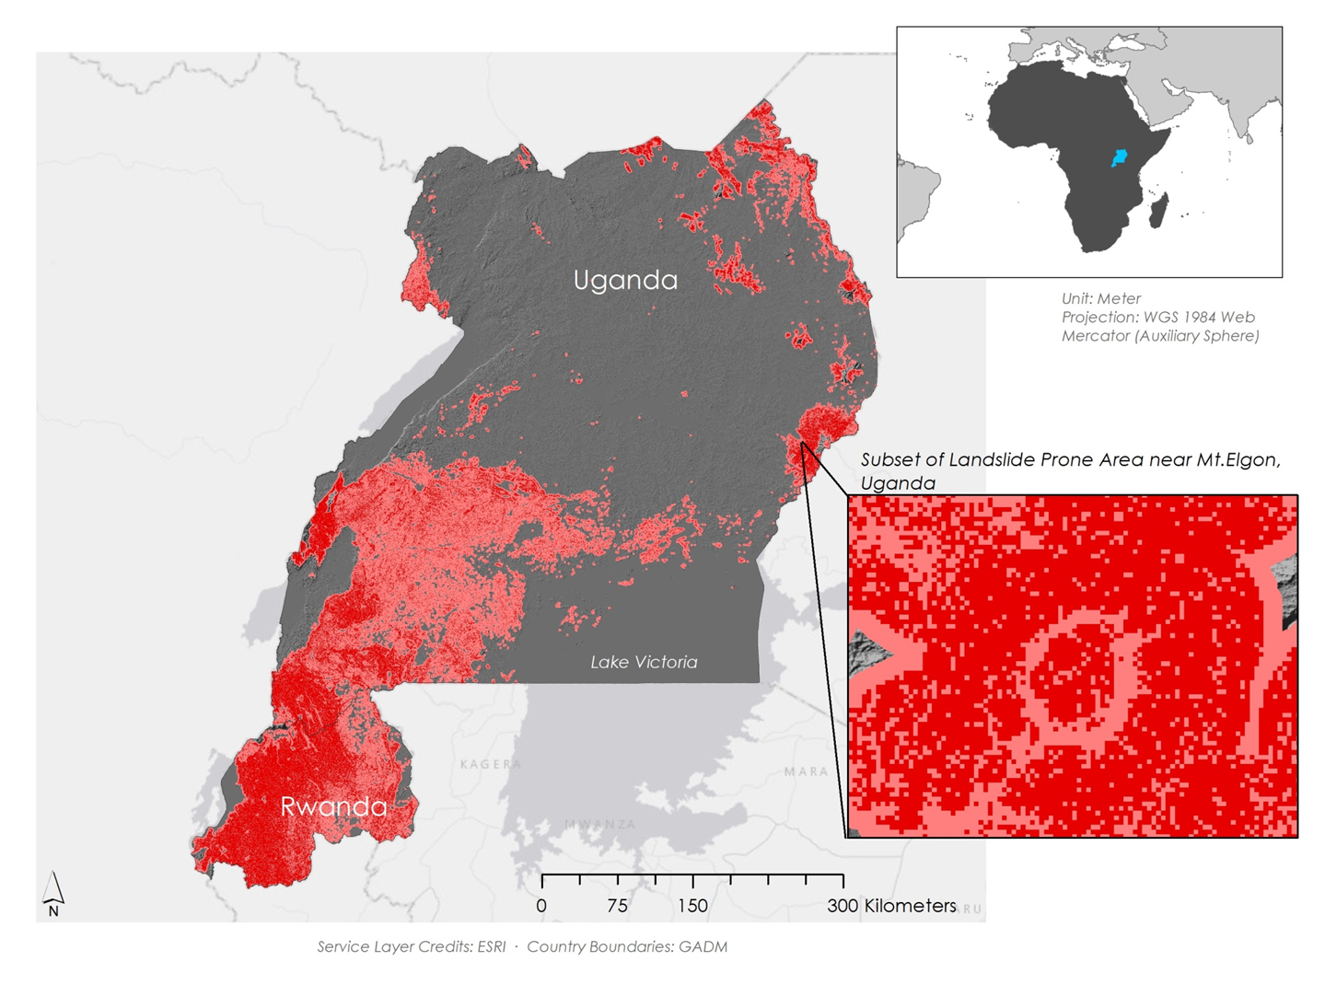
Results
Landslide Susceptibility Map
Area Susceptible to Landslides
Within 1km of Susceptible Area
Notes:
This map shows areas with a probable landslide occurrence of 50% or greater. The Landslide Susceptibility Map showed that Eastern Uganda around Mount Elgon, Southwestern Uganda, and Western Rwanda are at severe risk of landslides

Slide 15
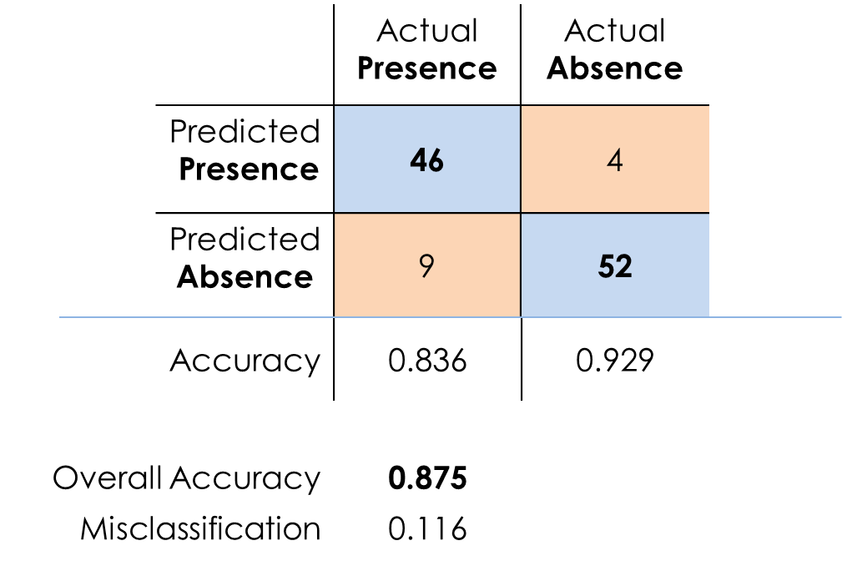
Results
Landslide Susceptibility Map
Notes:
We performed a cross validation using the 56 landslide points that we identified as our presence data and 56 randomly generated points as our absence data. We used Google maps to double check the absence points for landslides. We then entered the susceptibility values into a table to create the error matrix. We correctly predicted landslide locations 83 percent of the time and accurately predicted absence 92 percent of the time. The overall accuracy of the model was .87 and the misclassification rate was .116

Slide 16
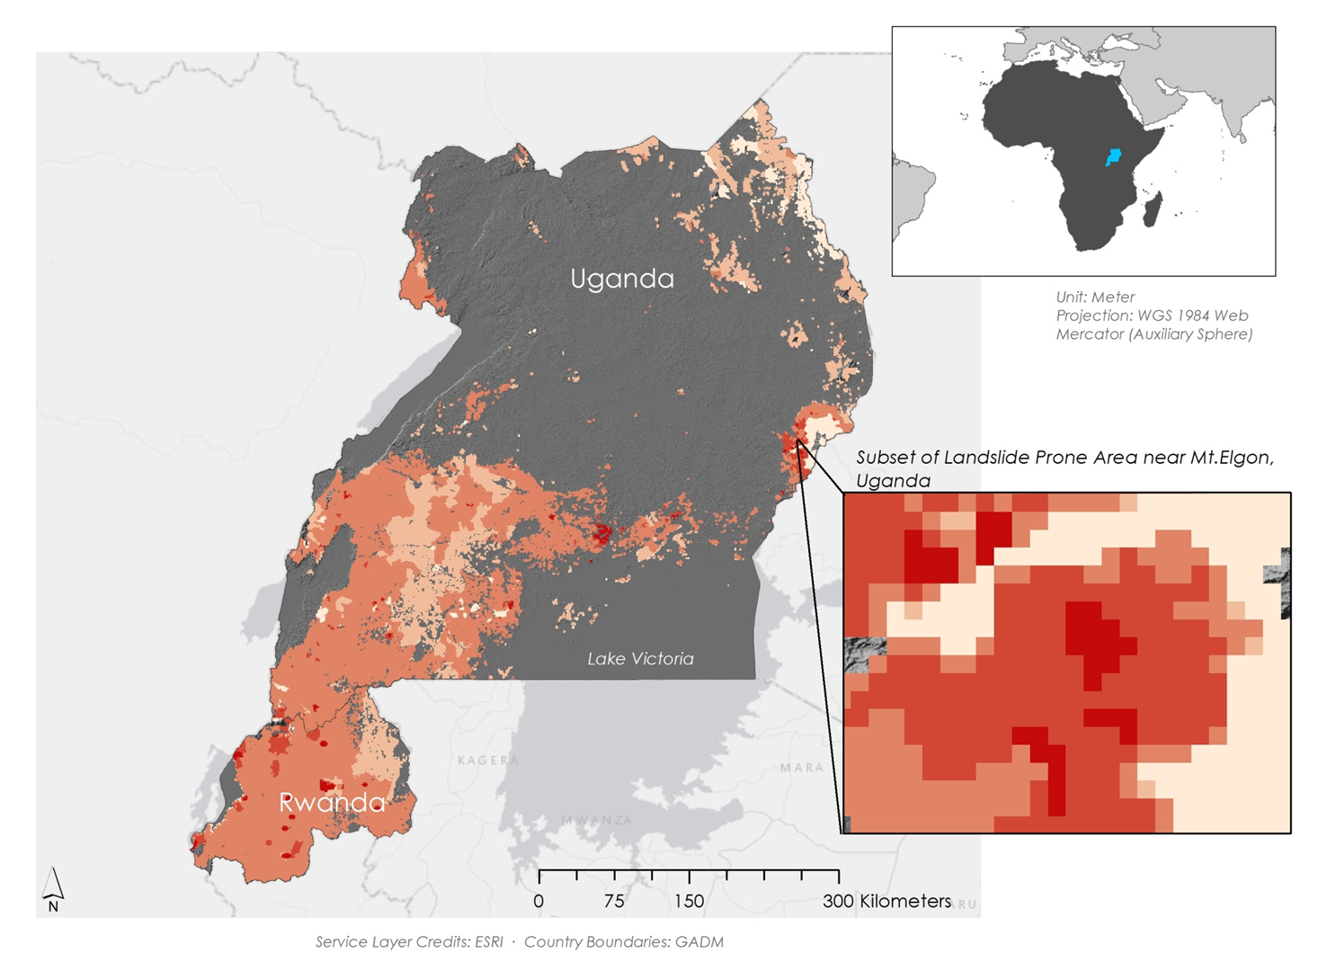
Results
Landslide Hazard Map
16 million + people living in prone areas
Population/km²
0 - 5: Low Density
5 - 50
50 - 500
500 - 1,000
1,000 - 25,000: High Density
Notes:
The Landslide Hazard Map was created by intersecting the Landslide Susceptibility Map and SEDAC’s population data. This shows how many people are potentially at risk of a landslide. It is estimated that there are about 16 million people are susceptible to landslides.

Slide 17

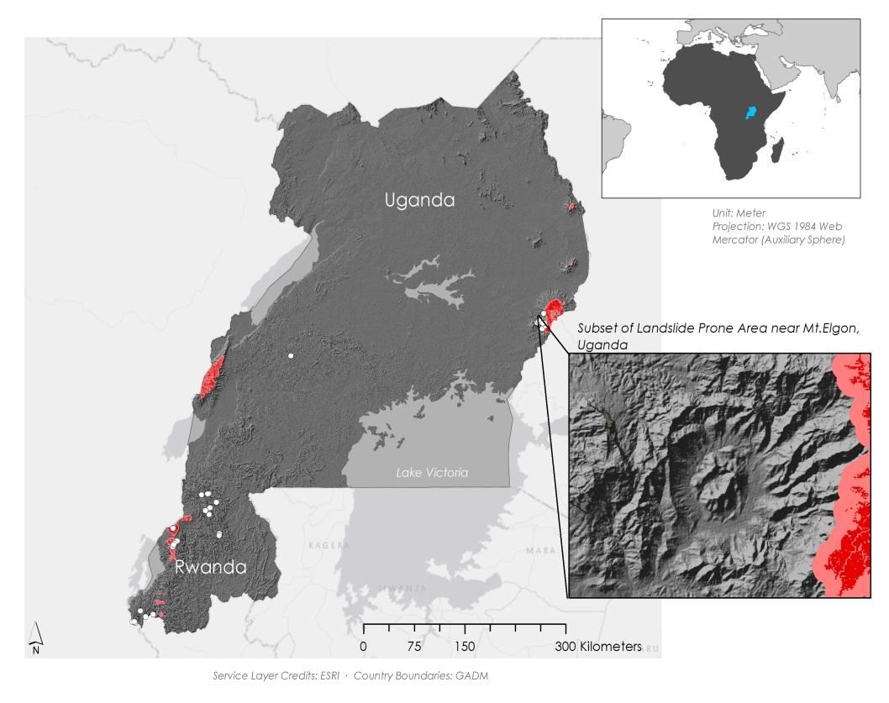
Results
Landslide Susceptibility Map Comparison
30m resolution
90m resolution
Area Susceptible to Landslides
Within 1km of Susceptible Area
Notes:
A 90m resolution map was also created using fuzzy membership, but instead derived variables from 90m DEM data. This was done to determine if the SRTM2 30m DEM dataset is better at predicting landslides than the old low resolution data.
The 30m map shows a much larger area of >0.5 susceptibility than the 90m map. The inset shows that the 30m map included all of the historically susceptible Mt. Elgon area, while the 90m did not.

Slide 18
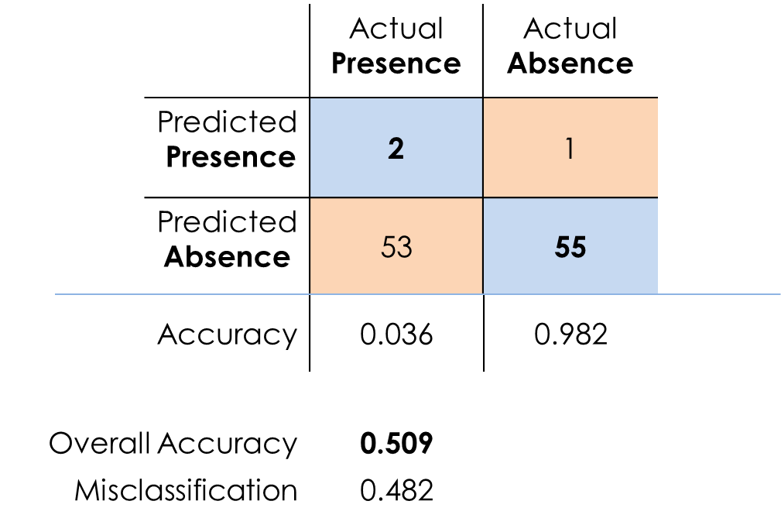
Results
Landslide Hazard Map Comparison
30m DEM
(Landslide Presence)
90m DEM
(Landslide Presence)
Notes:
When we compare the results of the error matrixes performed on the 30m and 90m resolution susceptibility maps we see that the higher resolution dataset is far more accurate with an overall accuracy of .87 compared to .5 for the 90m resolution data.

Slide 19

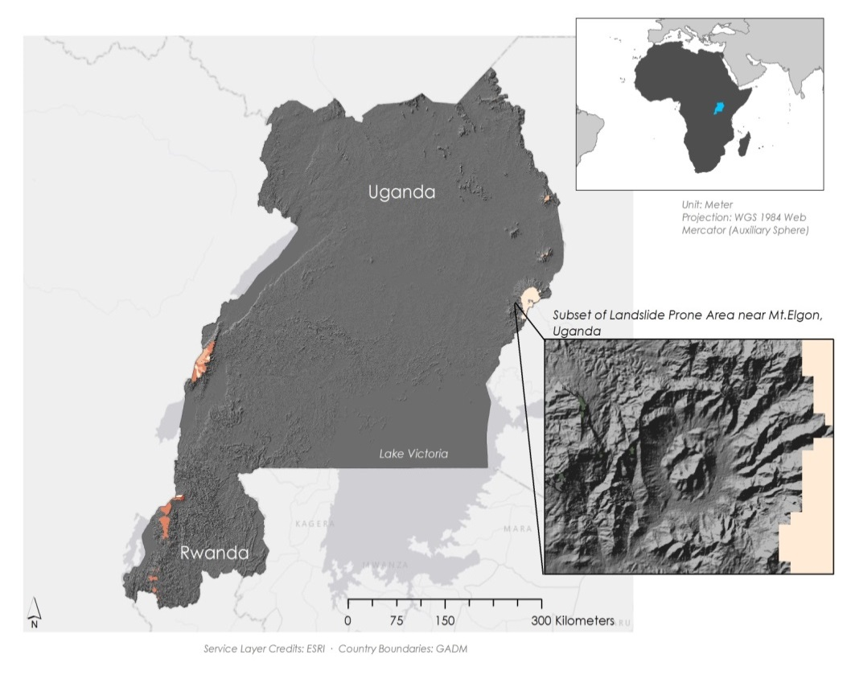
Results
Landslide Hazard Map Comparison
16 million +
30m resolution
~560,000
90m resolution
Population/km²
0 - 5: Low Density
5 - 50
50 - 500
500 - 1,000
1,000 - 25,000: High Density
Notes:
Because the lower resolution 90m Hazard map predicts far less area at risk, the number of people predicted to face landslide hazard is also far lower. The 90m resolution data predicted approximately 560 thousand people would be at risk of landslide compared to the actual hazard map which predicted over 16 million at risk. Most major at-risk areas with dense population are left out of the 90m map, resulting in the large decrease in at-risk population (Mt. Elgon, Kampala, Kigali, Goma)

Slide 20
Results
Rainfall Assessment
Monthly Total Rainfall (N=1,100)
Monthly Extreme Rainfall (N=276)
Daily Total Rainfall (N=3,000)
Daily Extreme Rainfall (N=751)
Notes:
As you can see TRMM, GPM, and CHIRPS strong positive correlation to each other at the monthly time scale across our study area and strong positive correlation at the daily scale. When looking at extreme rainfall events TRMM and GPM correlated very strongly with each other but weakly to CHIRPS at the monthly scale. At the daily scale, extreme rainfall events TRMM and GPM correlated strongly to each other but weakly to CHIRPS.

Slide 21
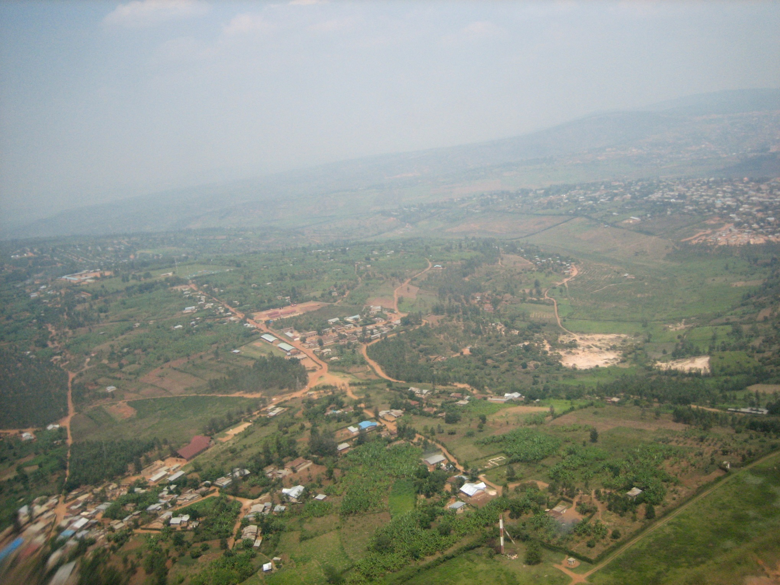
Conclusions
Source: Fanny Schertzer
Western Uganda and Southeastern Rwanda are susceptible to landslides
Approximately 16 million people are at risk of a landslide
TRMM, GPM and CHIRPS correlate well at both daily and monthly scales, but in extreme rainfall events neither TRMM nor GPM correlate strongly with CHIRPS
Notes:
We demonstrated that western Uganda and southeastern Rwanda are susceptible to landslides and that across the study are approximately 16 million people are at risk of being affected by a landslide. TRMM, GPM and CHIRPS correlate well at both daily and monthly scales, but in extreme rainfall events neither TRMM nor GPM correlate strongly with CHIRPS.
https://commons.wikimedia.org/wiki/Rwanda#/media/File:Kigali_from_above.jpg
cc Fanny Schertzer https://creativecommons.org/licenses/by-sa/2.5/

Slide 22
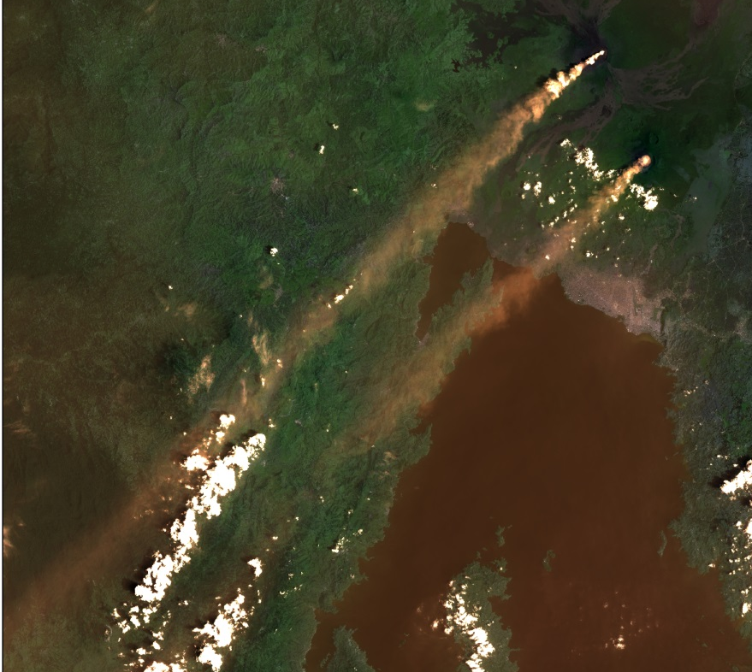
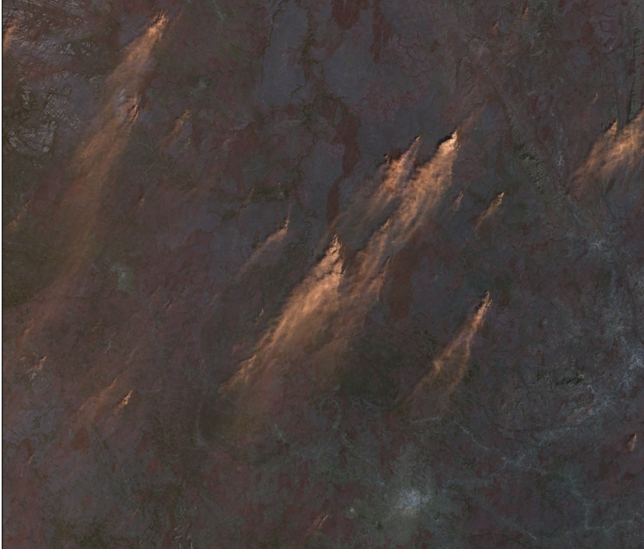
Errors & Uncertainties
Smoke and clouds
Finding locations
Estimating landslide occurrence
Sample size
Ground data
Credit: Landsat 8 OLI
Notes:
Due to volcanic activity and recurrent brush fires in the East African rift there was a considerable amount of smoke in the Landsat data. There was also difficulty with cloud cover. In addition, small villages named in news articles were frequently not documented on any accessible maps. We would have liked to include a temporal aspect but were unable to identify enough landslides specific date or even month of occurrence. We had a sample size of 56 identified landslide locations which was adequate for creating the map but we would have preferred a larger dataset. We wanted to use CHIRPS as a ground value based estimation for precipitation, but there were very few rain stations operating in the study area during the study period. We were also unable to acquire any rain gauge values from the study area.

Slide 23
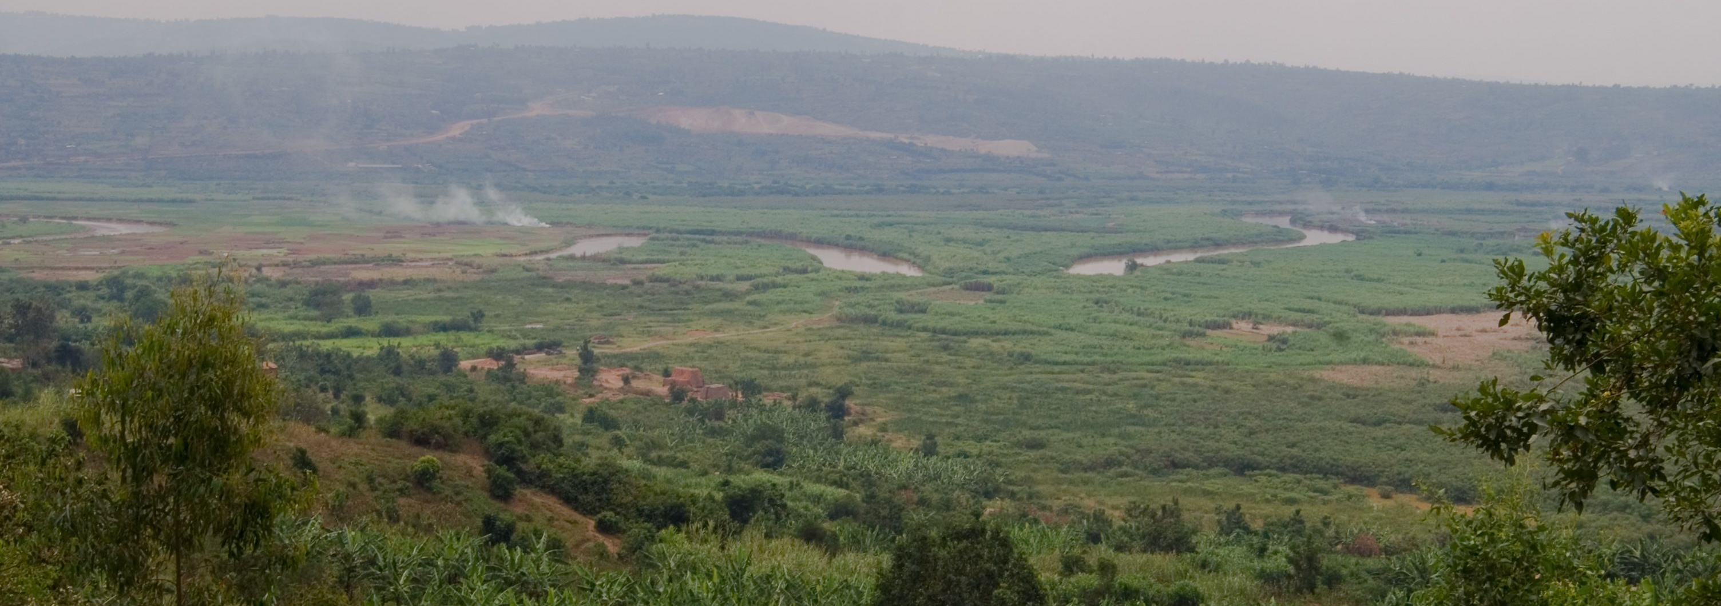
Future Work
Rainfall intensity-duration threshold for East Africa
Fire scars and their effect on landslide susceptibility
Watershed cutoff
SMAP: direct soil moisture data
Source: Fanny Schertzer
Notes:
One piece of information that could be very useful in future studies of the region would be the rainfall intensity-duration threshold. This is the theoretical threshold of rainfall that would saturate the soil to the point of causing a landslide. It is usually calculated on a regional scale, but we found no study that has calculated this for East Africa. A team could also look at how fires and landslides are related. Effects of potential watershed blockage by landslide could also be examined. This could lead to flooding upstream of the blockage and changes in water availability and quality downstream of the blockage. Finally, it would be useful to incorporate SMAP data when it becomes available.
https://commons.wikimedia.org/wiki/Rwanda#/media/File:Nyabarongo.jpg
cc Fanny Schertzer https://creativecommons.org/licenses/by-sa/2.5/

Slide 24



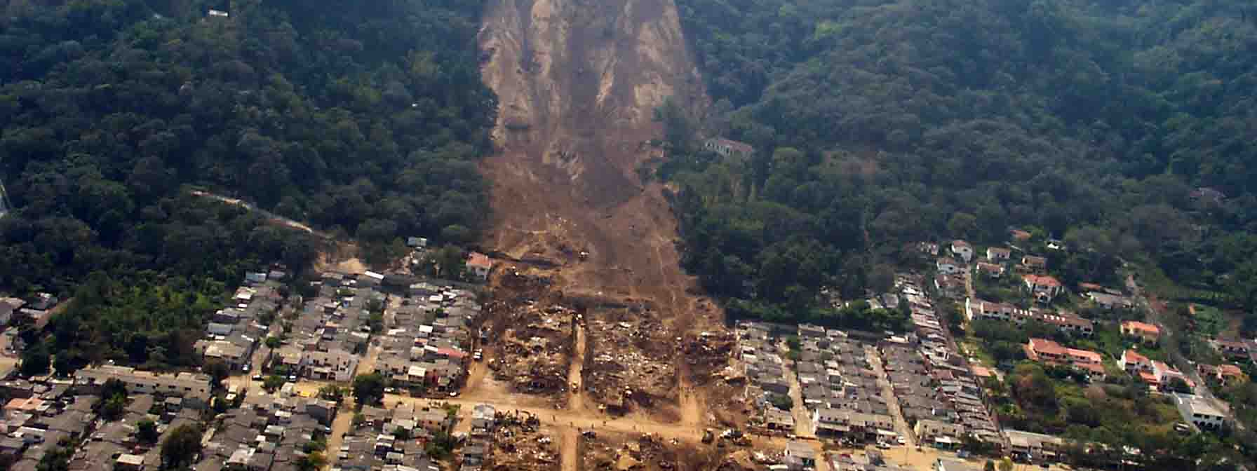
Future Work
Malawi
Kenya
Tanzania
Source: USGS
Notes:
Future areas that could be studied include Malawi, Kenya, and Tanzania which all face the challenge of landslide hazard. Malawi was specifically mentioned for future study by a project partner.
https://commons.wikimedia.org/wiki/Kenya#/media/File:Flag_of_Kenya.svg
https://commons.wikimedia.org/wiki/Malawi#/media/File:Flag_of_Malawi.svg
https://commons.wikimedia.org/wiki/Tanzania#/media/File:Flag_of_Tanzania.svg

Slide 25
Advisors
Dr. Jeffrey Luvall, NASA at NSSTC
Dr. Robert Griffin, University of Alabama in Huntsville
Partners
Eric Anderson, NASA SERVIR Coordination Office at MSFC
Dr. Dalia Kirschbaum, SERVIR Applied Sciences Team at NASA GSFC
Denis Macharia, Regional Centre for Mapping of Resources for Development
Others
Hannah Ballard, SERVIR Intern
Angela Piller, SERVIR Intern
Notes:
At this time I would like to acknowledge our advisors, Dr. Luvall and Dr. Griffin. I would also like to acknowledge our project partners at SERVIR, especially Eric Anderson, Dr. Dalia Kirschbaum and Denis Macharia.

Slide 26
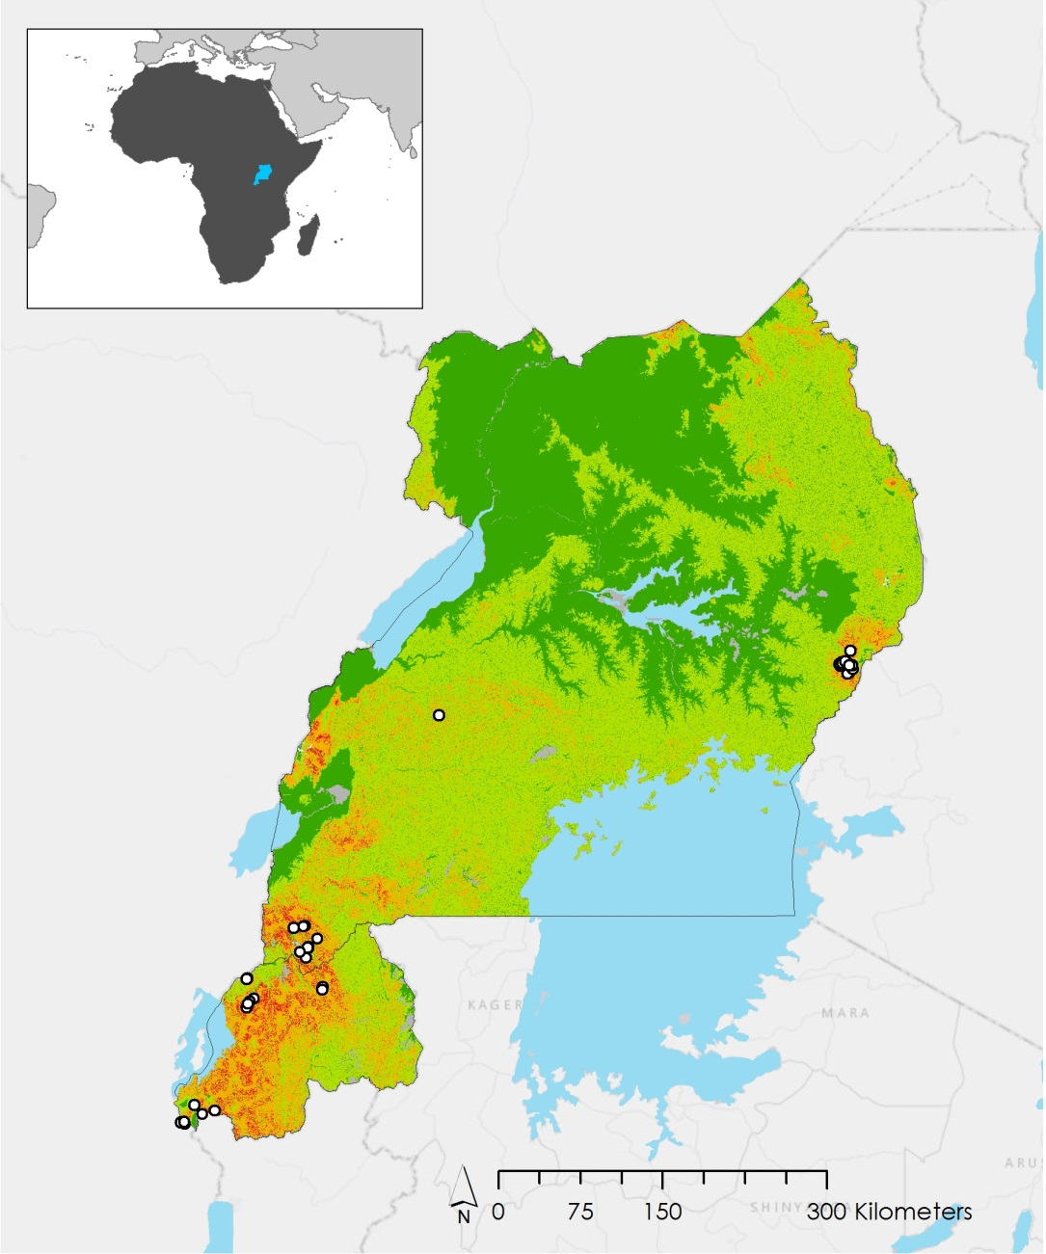
Questions?
Notes:
At this time if anyone has any questions we would be happy to try to answer them.

Slide 27
Backup Slide: Methodology
Elevation
Downloaded SRTM-V2 tiles covering study area and mosaicked together in ArcMap
Slope
Created in ArcMap using Slope tool
Notes:
SRTM2 data was downloaded from Earth Explorer, re-projected to a projected coordinate system (WGS 1984 Web Mercator Auxiliary Sphere), then mosaicked together in ArcMap using Mosaic to New Raster tool
Slope: Spatial Analyst extension

Slide 28
Backup Slide: Methodology
Landslide Susceptibility Map
Plan & Profile Curvature
Created in ArcMap using SRTM-V2 DEMs and Curvature tool
Topographic Wetness Index
Ln((“Flow Accumulation” * 900) / Tan(“Slope”))

Slide 29
Backup Slide: Methodology
Landslide Susceptibility Map
Distance to Roads
Created in ArcMap using roads and boundaries shapefiles with Euclidean Distance tool
Terrain Roughness
Created in ArcMap using Focal Statistics and Raster Calculator with the formula: (“Mean DEM” – “Min DEM”) / (“Max DEM” – “Min DEM”)

Slide 30
Backup Slide: Methodology
Landslide Susceptibility Map
Distance to Stream
ArcMap “Euclidian distance” tool
Distance to Ridge
ArcMap “Euclidian distance” tool

Slide 31
Backup Slide: Methodology
Landslide Susceptibility Map
Slope Length
Power(“flow accumulation raster”*[cell resolution in meters]/22.1,0.4)*Power(Sin(“slope raster in degrees”*0.01745))/0.09, 1.4)*1.4
Distance to Bedrock
Downloaded from International Soil Reference and Information Center
Notes:
Slope length-LS factor
Slope length (LS) factor is a combination of slope length and slope angle that represents the effect of slope length on erosion. It is calculated with the following equations:
L=(m+1)(A/22.1)m
Where,
L is the slope length factor at some point on the landscape,
λ_A is the area of upland flow,
m is an adjustable value depending on the steepness of the slope,
22.1 is the unit plot length.
S=(sin(0.01745xdeg)/0.09)n
Where,
θ is the slope in degrees,
0.09 is the slope gradient constant, and
n is an adjustable value depending on the soil’s susceptibility to erosion
These equations were combined and input into “Raster Calculator” in ArcMap. Values for m and n were taken from published literature to give good results in high spatial variability (Oliveira et al. 2013) (Lui et al. 1999) The final equation as entered in to “Raster Calculator” was:
Power(“flow accumulation raster”*[cell resolution in meters]/22.1,0.4)*Power(Sin(“slope raster in degrees”*0.01745))/0.09, 1.4)*1.4

Slide 32
Backup Slide: Precipitation Assessment
Monthly
TRMM |  |  | GPM |  |  | CHIRPS
Mean | 0.100943041 |  | Mean | 0.102725915 |  | Mean | 0.108321
Standard Error | 0.002073633 |  | Standard Error | 0.002415297 |  | Standard Error | 0.002393
Median | 0.092604 |  | Median | 0.090084 |  | Median | 0.096115
Mode | 0 |  | Mode | 0 |  | Mode | 0.062216
Standard Deviation | 0.068774612 |  | Standard Deviation | 0.080106354 |  | Standard Deviation | 0.079381
Sample Variance | 0.004729947 |  | Sample Variance | 0.006417028 |  | Sample Variance | 0.006301
Range | 0.395543 |  | Range | 0.471795 |  | Range | 0.34644
Minimum | 0 |  | Minimum | 0 |  | Minimum | 0.001537
Maximum | 0.395543 |  | Maximum | 0.471795 |  | Maximum | 0.347977
Count | 1100 |  | Count | 1100 |  | Count | 1100
Sum | 111.037345 |  | Sum | 112.998507 |  | Sum | 119.1533

Slide 33
Backup Slide: Precipitation Assessment
Daily
GPM |  |  | TRMM |  |  | CHIRPS
Mean | 3.726313 |  | Mean | 3.576872 |  | Mean | 3.32359
Standard Error | 0.187239 |  | Standard Error | 0.138658 |  | Standard Error | 0.101235
Median | 0.085528 |  | Median | 0 |  | Median | 0
Mode | 0 |  | Mode | 0 |  | Mode | 0
Standard Deviation | 10.25549 |  | Standard Deviation | 7.594588 |  | Standard Deviation | 5.544873
Sample Variance | 105.175 |  | Sample Variance | 57.67776 |  | Sample Variance | 30.74562
Range | 110.0584 |  | Range | 87.96191 |  | Range | 40.31186
Minimum | 0 |  | Minimum | 0 |  | Minimum | 0
Maximum | 110.0584 |  | Maximum | 87.96191 |  | Maximum | 40.31186
Sum | 11178.94 |  | Sum | 10730.62 |  | Sum | 9970.769
Count | 3000 |  | Count | 3000 |  | Count | 3000
Sum | 11178.94 |  | Sum | 10730.62 |  | Sum | 9970.769

Slide 34
Backup Slide: Precipitation Assessment
Interpretation of Strength of Correlation
If r = +.70 or higher | Very strong positive relationship
+.40 to +.69 | Strong positive relationship
+.30 to +.39 | Moderate positive relationship
+.20 to +.29 | Weak positive relationship
+.01 to +.19 | No or negligible relationship
-.01 to -.19 | No or negligible relationship
-.20 to -.29 | Weak negative relationship
-.30 to -.39 | Moderate negative relationship
-.40 to -.69 | Strong negative relationship
-.70 or lower | Very strong negative relationship

