Slide 1
Utilizing NASA EOS to Assess Turbidity and its Effects on Kansas Wetland Areas
Kansas Ecological Forecasting
Langley Research Center
Amanda Bordeaux, Christopher Newport University
Katie Nohe, Plymouth State University
Allison Bowman, Old Dominion University
Lauren Steel, Christopher Newport University
Peter Marinescu, Stony Brook University
Tiffani Orne, Liberty University
Dr. Kenton Ross, LaRC DEVELOP

Slide 2
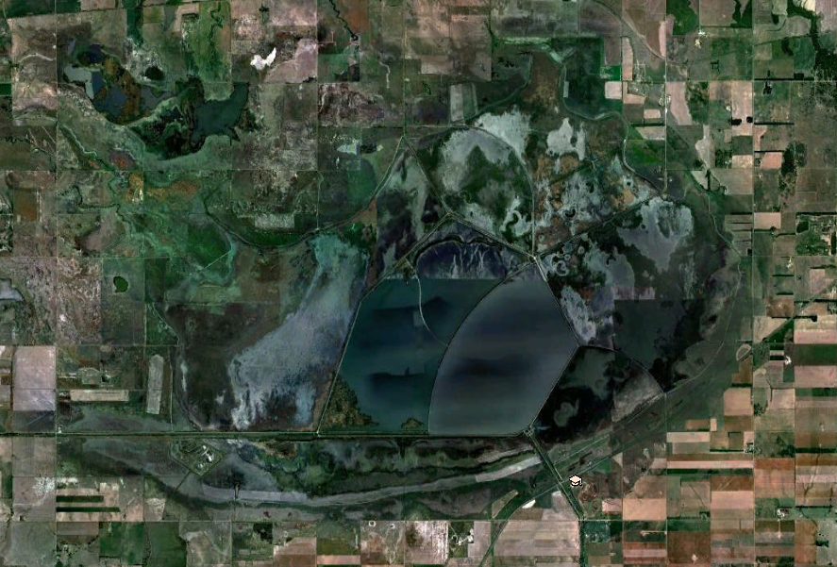
Community Concerns
Cheyenne Bottoms Wildlife Area (CHBW)
Wetland of International Importance (20,000 acres)
A migratory bird stop for over 328 waterfowl and shorebird species
Sediment loading, flooding, and drought hinder water quality and efficient management
Silt and shallow water allow
invasive species to thrive
Large tourist attraction revenues
~2.8 million annually
Google Earth imagery showing Cheyenne Bottoms Wildlife Area, Kansas
Notes:
Documented as a wetland of international importance, the Cheyenne Bottoms Wildlife Area is comprised of 20,000 acres of wetlands in central Kansas. It is the largest marsh in the interior United States and an important migratory stop for over 45% of birds in the western hemisphere. Sediment loading, flooding, and drought hinder water quality and efficient management. Silt and shallow water allow invasive species to thrive (cattail and phragmites), which cuts down on the available food supply for migrating birds. This area creates a positive economic impact of approximately 2.8 million dollars annually for the State of Kansas, mainly from hunters and bird watchers.

Slide 3
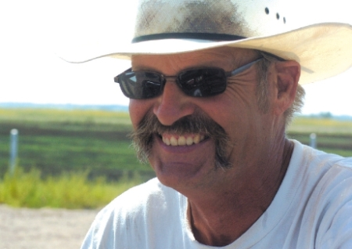
Project Partner
Karl Grover
Field Supervisor and Area Wildlife Manager, Kansas Department of Wildlife, Parks and Tourism
Cheyenne Bottoms Wildlife Area (CHBW)
Notes:
Our partner for this project was Mr. Karl Grover, the field supervisor for Cheyenne Bottoms.

Slide 4
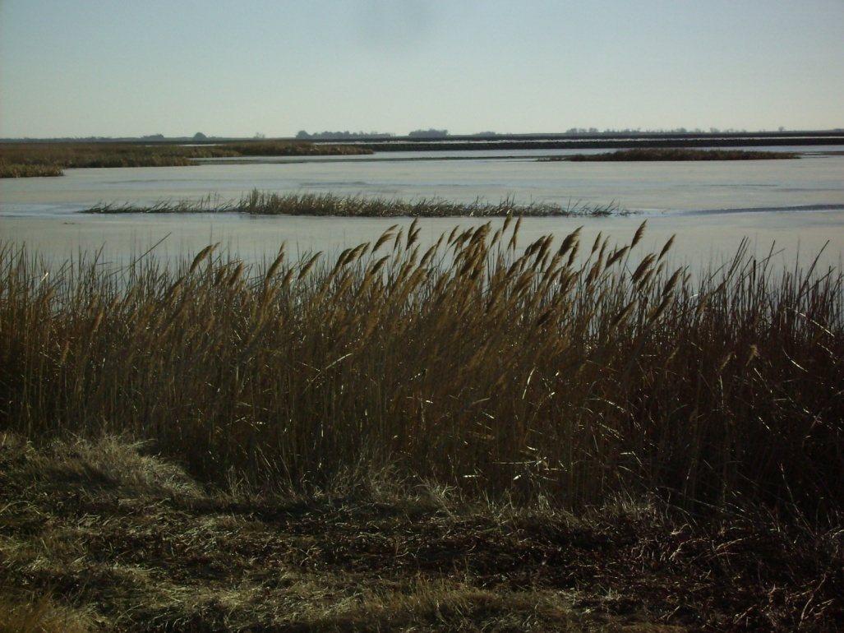
Project Objectives
Turbidity
Estimate suspended sediment in pools using NASA EOS
Track trends to better understand sediment loading at CHBW
Evaluate trends in pool size using NDVI
Land Cover Classification
Track vegetation change
over time
Evaluate risk of ecological
change
Notes:
The purpose of this project was to provide Mr. Grover with two decision support tools. The first tool, a turbidity product, provide an understanding of suspended sediment concentrations within the pools. Turbidity measures the cloudiness of a body of water and correlates to the amount of suspended sediment in that body of water. The second tool, land cover classification maps, help to determine areas that are at the highest risk of ecological change through the use of NASA earth observation data. These tools will assist our partner in managing the invasive species and protecting the infrastructure of the area.

Slide 5
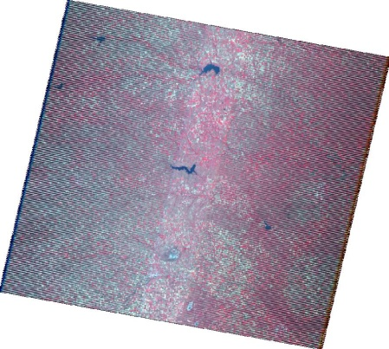
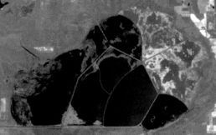
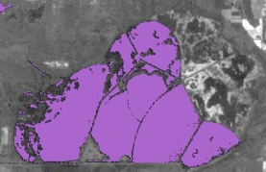
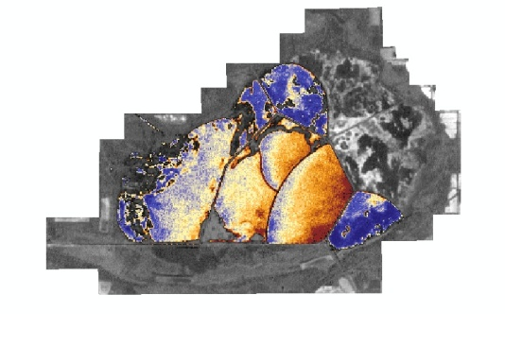
Methodology Turbidity
Earth Observations
Landsat 5 TM and 7 ETM+
Data Acquisition
All available cloudless days 2005-2012
Data Processing
Reflectance calculated for bands 1-4
Calculate NDVI to create water masks
Calculate turbidity using specific TSS algorithm
Use water masks and shapefiles to compare sediment over interest regions
Landsat 5 and 7 Scenes:
2005-2012
NDVI calculated to find open water areas
Turbidity Index
Suspended Sediment Analysis
Notes:
All available cloudless days from 2005-2012 were acquired from USGS Glovis. Reflectance was calculated to create a Normalized Differential Vegetation Index. From there the land was subtracted out to create a water mask. A specific algorithm for turbidity was run on the water mask to show regions of high and low sediment.

Slide 6
Results & Discussion Turbidity
Results
Line graphs tracking changes in sediment concentrations across the seasons
Spring is typically higher in turbidity values
Higher turbidity tends to become a source for sediment accumulation
May 4, 2007-CHBWA experienced a flood taking the wildlife area from a drought period to a wet season
Notes:
Line graphs were created from the turbidity algorithm to track changes in sediment over time. When plotting turbidity over the years 2005-2012 by season it was clear that spring had higher turbidity values than any other season. When graphing the turbidity by pool, pool 1A showed a higher turbidity than pool 1B or 1C.

Slide 7
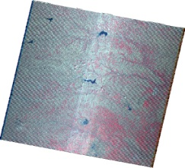
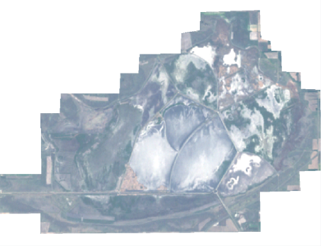
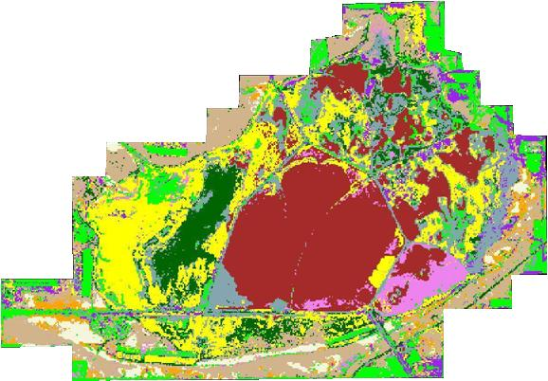
Methodology Land Cover Classification
Earth Observations
Landsat 7 ETM+
Data Acquisition
Early autumn data for 2005, 2010, 2011, & 2012
Data Processing in ERDAS IMAGINE 2011
Layers were stacked and subset to show only CHBW
Subset images were then used to create supervised land classification maps.
Supervised Classification
for 2012
Notes:
Early autumn Landsat 7 ETM+ data from with minimal to no cloud over CHBW were acquired and processed using ERDAS IMAGINE. One image per year, 2005, 2010, 2011, and 2012 were acquired to classify. First, the layers were stacked and the image was clipped to show only the study area. The clipped images were then used to create a time series of supervised land cover classification maps.
2005 was chosen because of a prior land classification map completed by KARS at the University of Kansas. This map was used to verify the accuracy of a land cover map not using aerial imagery.
2010-2012 was used to complete a time series to show how CHBW’s recent management practices have affected the land cover in the area.

Slide 8
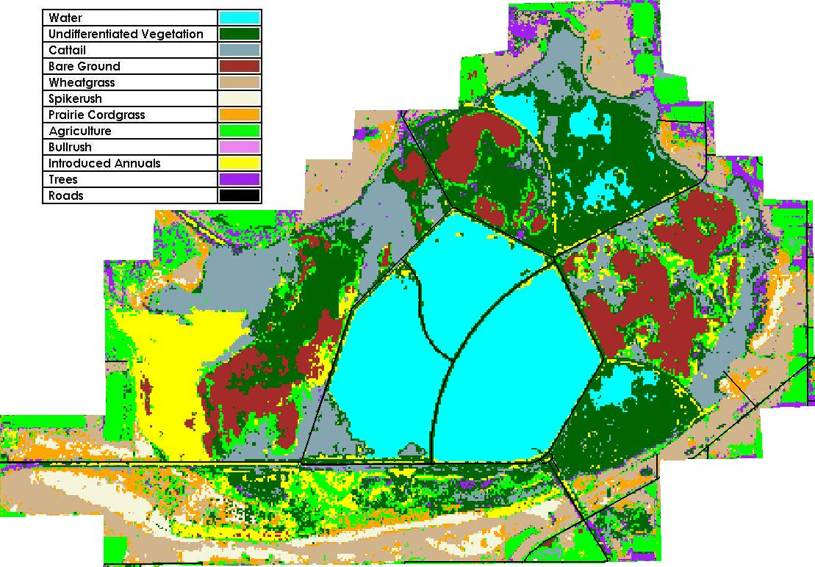
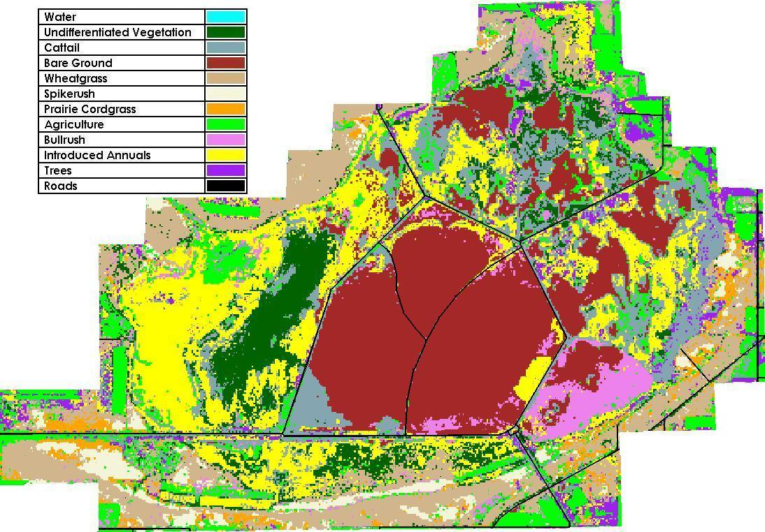
Results & Discussion Land Cover Classification
Supervised Classification for 2011
Supervised Classification for 2012
Time series of classification maps
Supervised classification with 11 classes
Agriculture, bare ground, bullrush, cattail, introduced annuals, prairie cordgrass, spikerush, trees, undifferentiated emergent vegetation, water, and wheatgrass
Notes:
Eleven classes were used for the land cover classification maps: agriculture, bare ground, bullrush, cattail, introduced annuals, prairie cordgrass, spikerush, trees, undifferentiated emergent vegetation, water, and wheatgrass. These classes were selected based on a previous classification completed in 2005, as well as the specific areas that our partner, Mr. Grover, expressed interest in. The end product provided to the partner was a time series of classified maps showing changes in ground cover in the Cheyenne Bottoms Wildlife Area. Comparing these maps will aid in assessing the effectiveness of their current management practices by showing areas of Cheyenne Bottoms that are experiencing vegetative change.

Slide 9
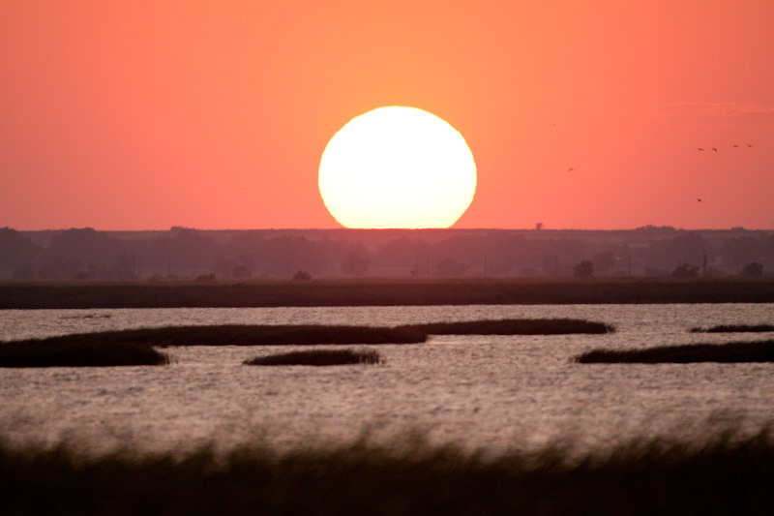
Conclusions
Conclusions
Turbidity product will enable management to prevent damage to their infrastructure and hinder the future development of invasive species that are caused by high sediment concentrations
Land cover classification demonstrates that invasive species dominate fewer areas than in previous years, especially in areas focused on by the management
Potential Future Work
Developing a tutorial in an open source software such as Quantum GIS
Notes:
Conclusions
Turbidity product assesses recent trends in suspended sediment, enabling management to prevent damage to their infrastructure and hinder the future development of invasive species that are caused by high sediment concentrations
Land cover classification demonstrates that invasive species dominate fewer areas than in previous years, especially in areas focused on by the management
Potential Future Work
Increased tracking will allow Cheyenne Bottoms' management to better preserve their wetland habitat and provide a sustainable destination for migrating birds, local wildlife, and outdoor enthusiasts.

