Slide 1
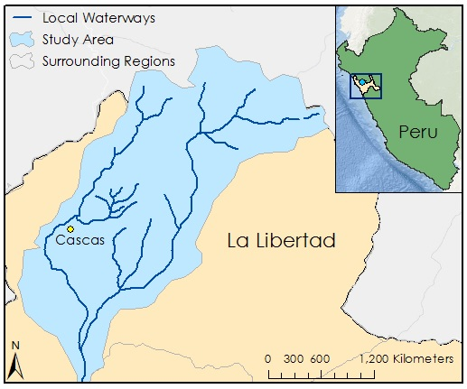

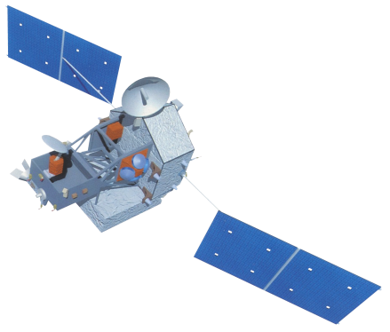

Peru Disasters II
Identifying and mapping flood prone regions in the La Libertad Region of Peru using NASA's Earth Observation Systems
William Wilson (Project Lead), Grant Bloomer, Allison Daniel, Anthony Donzella, Josh Hammes
Abstract
Objectives
In recent years, natural disasters have affected the rural regions of Peru. Large flooding events in 2008, 2013, and 2014 disrupted central highlands districts, including the Cascas district of the Gran Chimu province about 110 km inland from the coastal city of Trujillo. The primary study area is the Ochape river sub-basin near the city of Cascas, the capital of the Gran Chimu province. In partnership with Water for People and the Instituto Nacional de Defensa Civil Del Peru (INDECI), this project aims to create resources and tools necessary for flood risk assessment projects in the Cascas district of Peru. NASA Earth observations were used in this project to provide input datasets for the Coupled Routing and Excess Storage (CREST) Distributed Hydrological Model, which was developed by the University of Oklahoma in collaboration with NASA SERVIR. These inputs include Digital Elevation Models (DEM) and related data from the HydroSHEDS portfolio of NASA’s Shuttle Radar Topography Mission (SRTM), rainfall data collected by Tropical Rainfall Measuring Mission (TRMM), and Landsat 8 imagery. All final maps, models, datasets, and tutorials developed in this project will enable Water for People and the Peruvian government to better prepare for flooding based on historical examples.
Improve upon the resources necessary to provide a preliminary flood risk analysis
Produce historic and predictive flood maps utilizing NASA Earth Observation Systems and mathematical models for requested area within the La Libertad region of Peru
Obtain a successful calibration of the CREST 2.0 model.
Study Area
Methodology
Shapefile of Study Area
DIVA-GIS
Digital Elevation Model
Flow Direction Map
HydroSHEDS
Flow Accumulation Map
Rainfall Data
Evapotranspiration Data
SRTM
HydroSHEDS
METRIC
TRMM
Earth Observations
TRMM
SRTM
Terra
Results
Conclusions
.
Team Members
Project Partners
Acknowledgements
William Wilson (Project Lead)
Grant Bloomer
Allison Daniel
Anthony Donzella
Josh Hammes
Water For People
Instituto Nacional de Defensa Civil del Peru (INDECI)
Dr. Kenton Ross, NASA DEVELOP National Program (Science Advisor)
Dr. DeWayne Cecil, Global Science and Technology Inc. (Science Advisor)
Ms. Melanie Salyer, NASA DEVELOP Wise Principal Investigator
Lance Watkins. NASA DEVELOP Geoinformatics Team
Dr. Xinyi Shen, Hydrometeorology and Remote Sensing Laboratory, University of Oklahoma
Manabendra Saharia, Graduate Research Assistant, University of Oklahoma
Wise County Clerk of Court’s Office

