Slide 1
Mesoamerica
Ecological Forecasting
Assessing Land Cover Change to Inform Management Planning for the Mesoamerican Biological Corridor
Hanna Jung (Deliverables Lead)
Ross Kalter (Technical Lead)
Amelia Untiedt
Cristina Villalobos-Heredia
Alabama – Marshall | Fall 2022
Notes:
Good afternoon! We are the Mesoamerica Ecological Forecasting team.

Slide 2
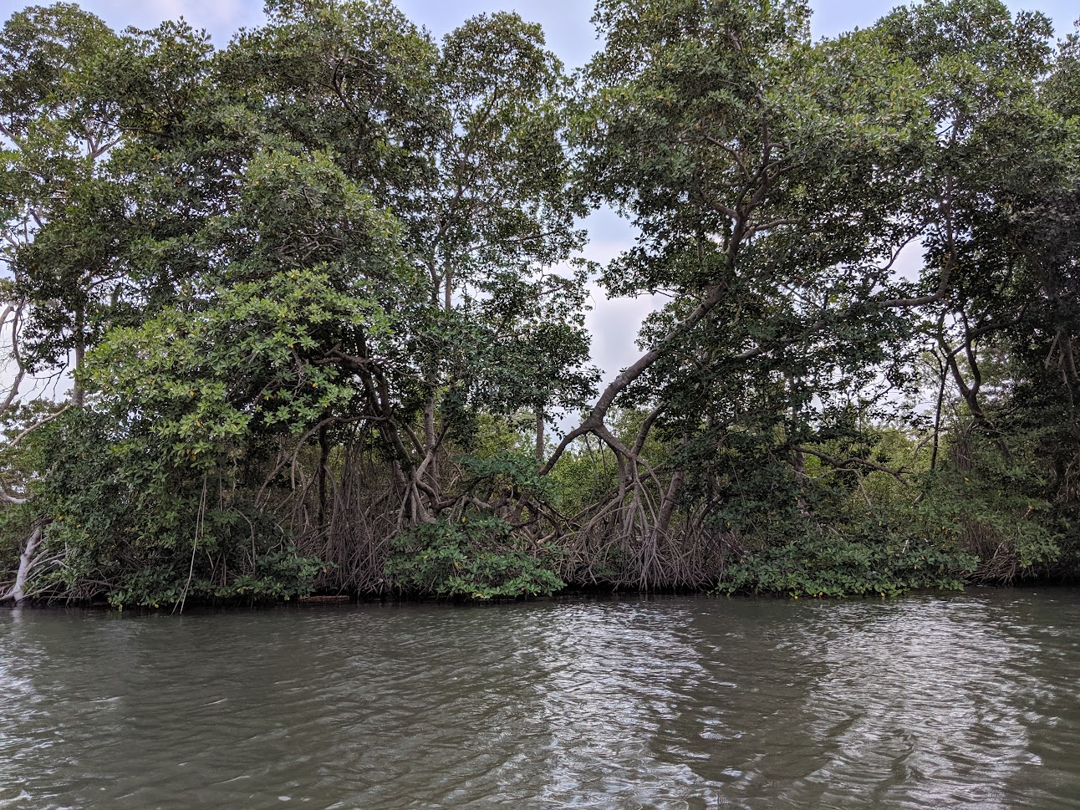
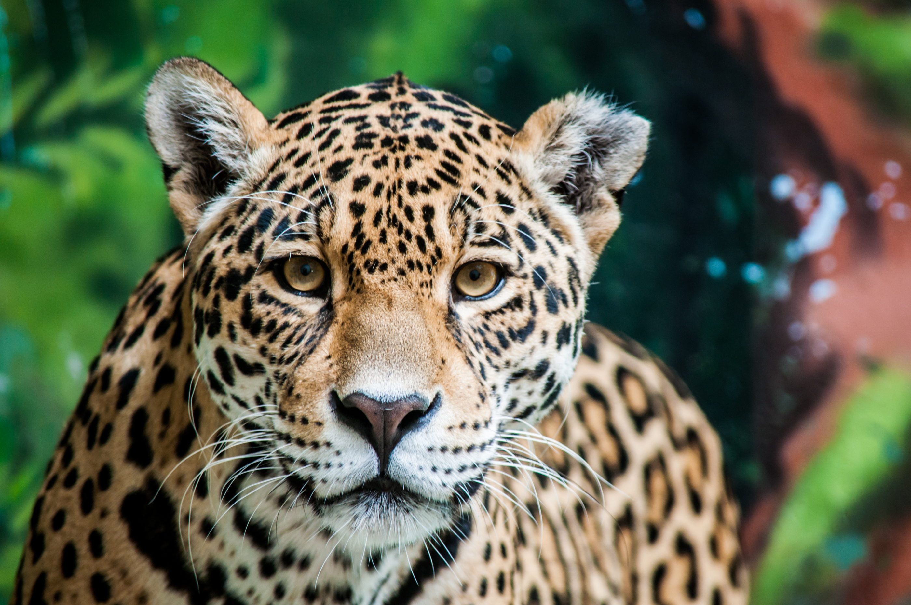
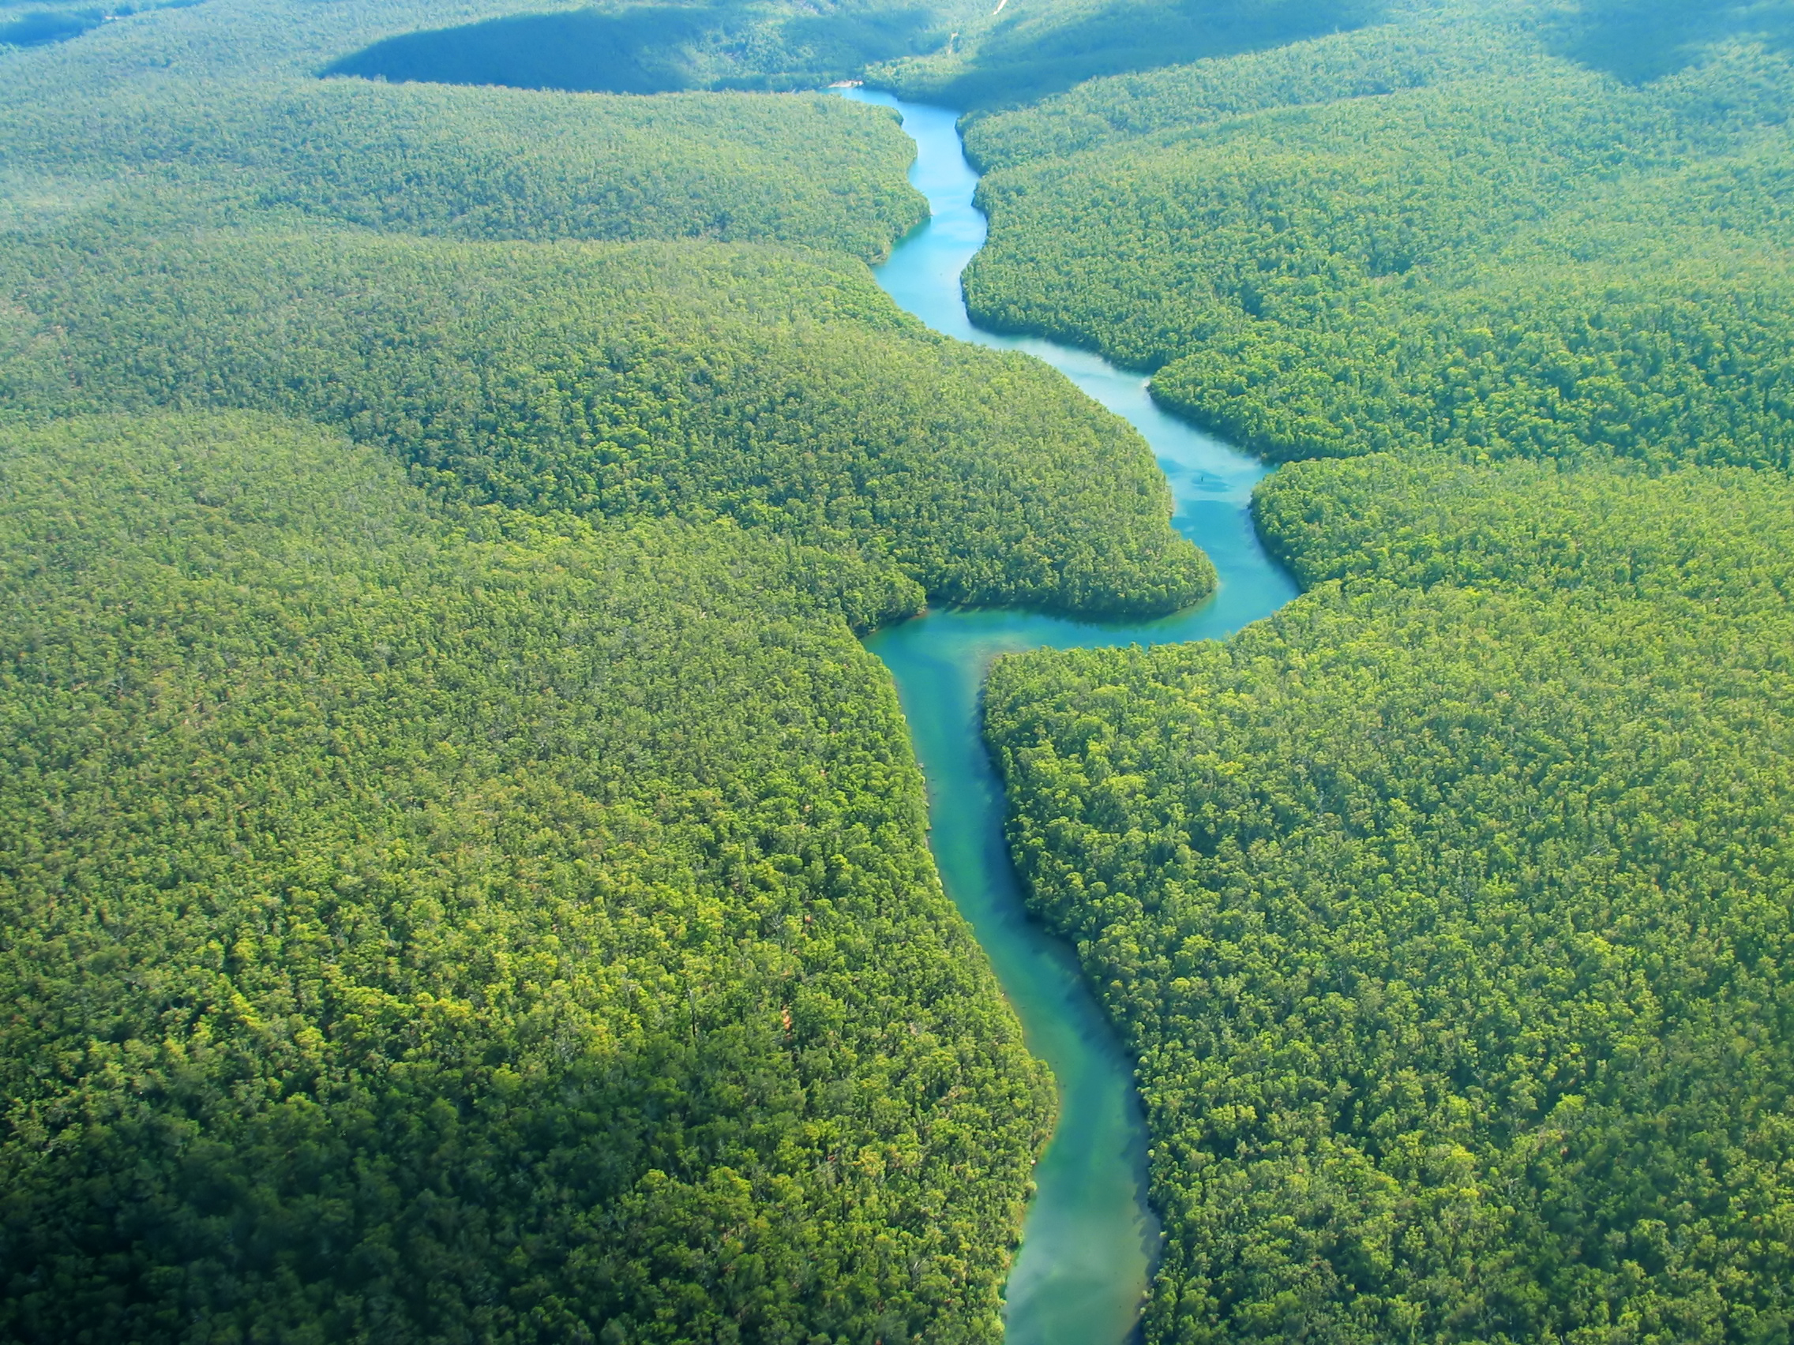
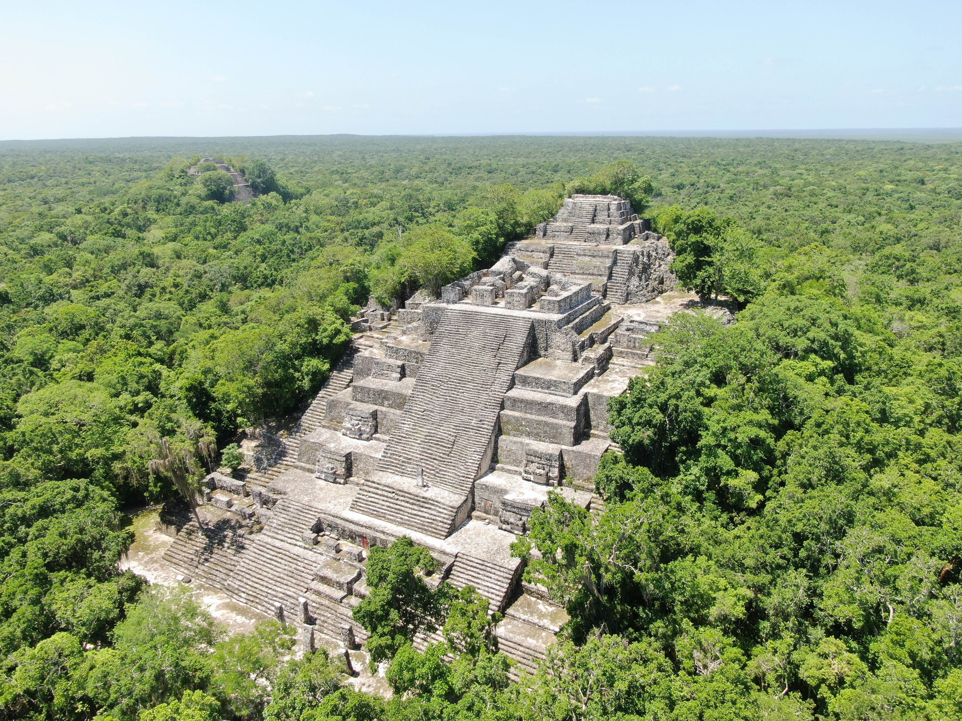
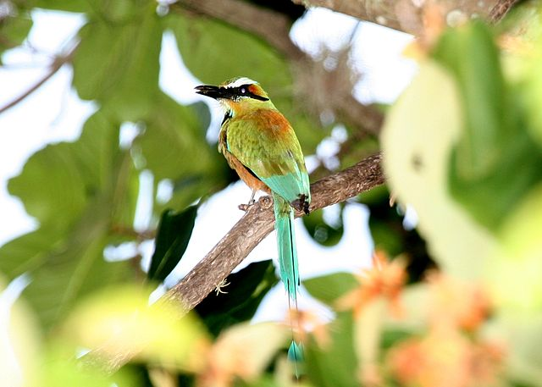
MESOAMERICAN BIOLOGICAL CORRIDOR
Image Credit: Emil Cherrington
Image credit: Microsoft Office 365
Image Credit: Microsoft Office 365
Image Credit: Rafael Vargas
Image Credit: Dominic Sherony
Mexico, Belize, Honduras, El Salvador, Guatemala, Nicaragua, Costa Rica, Panama
Notes:
The Mesoamerican Biological Corridor (MBC) is a multinational initiative for conservation and development and it includes Mexico, Belize, Honduras, Guatemala, Nicaragua, Costa Rica, and Panama. This vast area is made up of 600 protected areas and connecting corridors and is home to 7% of the world's biodiversity making it a biological hotspot. Unfortunately it faces many threats from environmental and social influences.
Stock image photos of the river and jaguar are courtesy of Microsoft PowerPoint
Photos of the mangroves and architecture were provided by partners for use in the presentation
Image source for Torogoz bird: dominic sherony, CC BY-SA 2.0 <https://creativecommons.org/licenses/by-sa/2.0>, via Wikimedia Commons
https://commons.wikimedia.org/wiki/File:Turquoise-browed_Motmot_2495425451.jpg

Slide 3
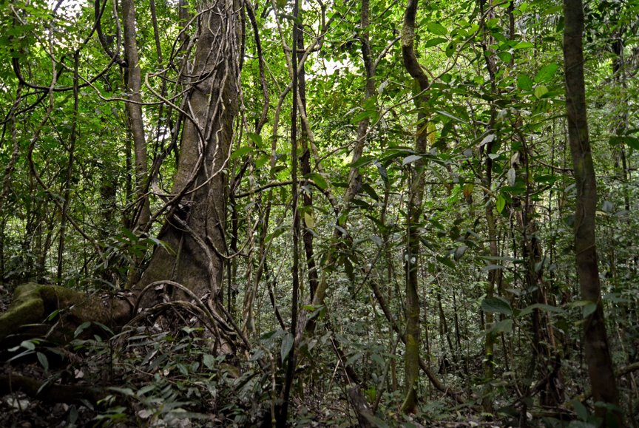
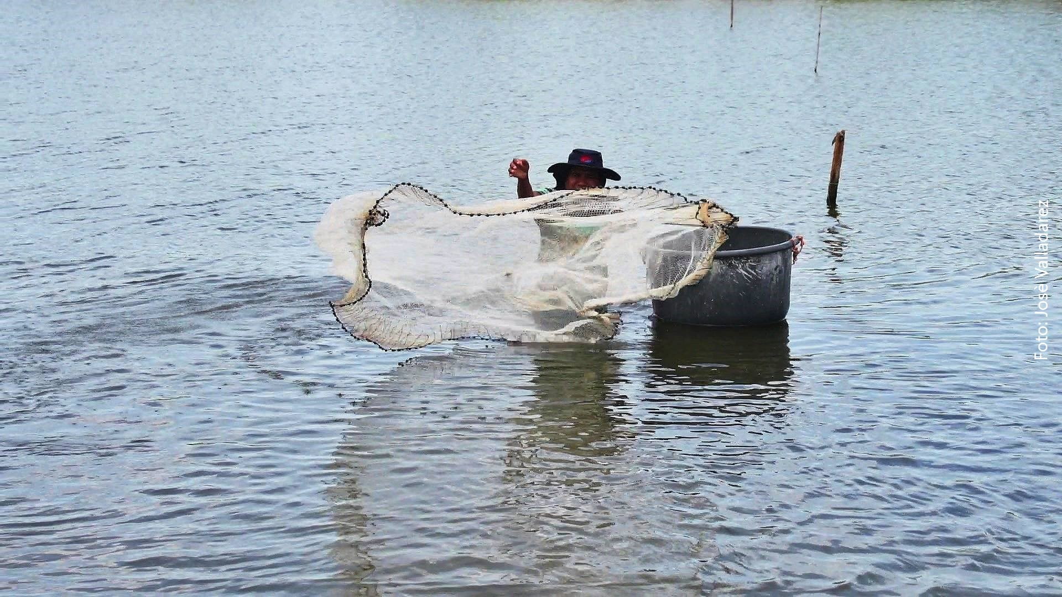
COMMUNITY CONCERNS
Intensifying deforestation
Threats to biodiversity
Including all voices, especially Indigenous communities, in decision making
Image Credit: Geoff Gallice
Reduce tensions at borders between countries
Maintain international relationships
Supporting regional economy
Image Credit: Rafael Vargas
Notes:
The MBC has multiple initiatives beyond environmental impacts. One of the main aims is to create corridors for wildlife to move through along with social, economic, and political goals. The initiatives behind the MBC aims to help create stability and increase sustainability. Due to the variety of focuses in the MBC there are many different community concerns. The main concerns our team focused on are intensifying deforestation, threats to biodiversity (which is the variety of life forms in a particular ecosystem), and including all of the diverse communities living in the MBC. Intensifying deforestation affects all the countries that comprise the MBC, meaning international relationships must be maintained in order for these various countries to come to a consensus to take action. Various voices are important in MBC decision and policy making. For example, indigenous communities have been able to provide effective conservation management practices that mitigate deforestation in indigenous areas.
Image source: Geoff Gallice from Gainesville, FL, USA, CC BY 2.0 <https://creativecommons.org/licenses/by/2.0>, via Wikimedia Commons
Or https://commons.wikimedia.org/wiki/File:Flickr_-_ggallice_-_Rainforest_(1).jpg
Photo of the fishing person was provided by our partners Rafael Vargas

Slide 4
SOCIAL AND POLITICAL INFLUENCES
Many voices
impacting management
Recent conflict
and territorial disputes
Diverse communities
within this large area
Notes:
Since the MBC operates with a multinational structure and crosses national borders, its maintenance requires many different voices to maintain impactful management.
Maintenance of the MBC requires many voices in order to maintain impacting management as it operates using a multinational structure, crossing national borders. This results in the need for different agencies such as The Central American Commission on Environment and Development (CCAD) and the Ministries of Environment from the eight countries of the MBC to manage regional decision-making and implementation for the corridor. (López and Jiménez, 2007). The varying demands and political perspectives of these decision makers can cause challenges in the management of the corridor. There are also social influences in the MBC. Alongside designated protected areas, there are human settlements like indigenous communities that live within the corridor. There has also been recent civil unrest and conflict in many of the countries within the MBC which plays an strong influence on the management of the corridor.
Image credit: these icons are from PowerPoint

Slide 5
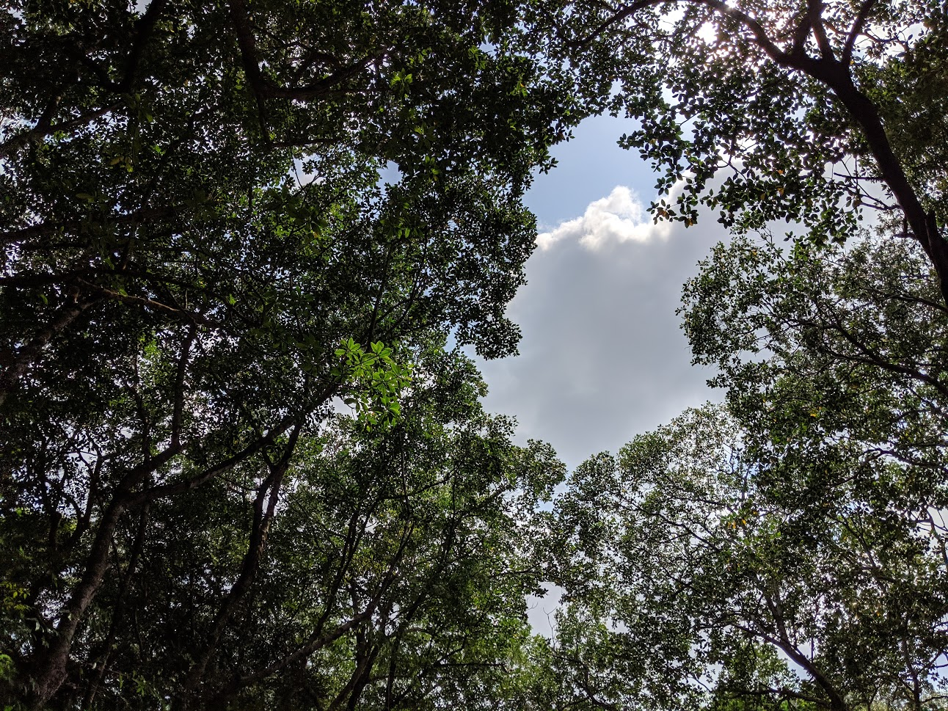
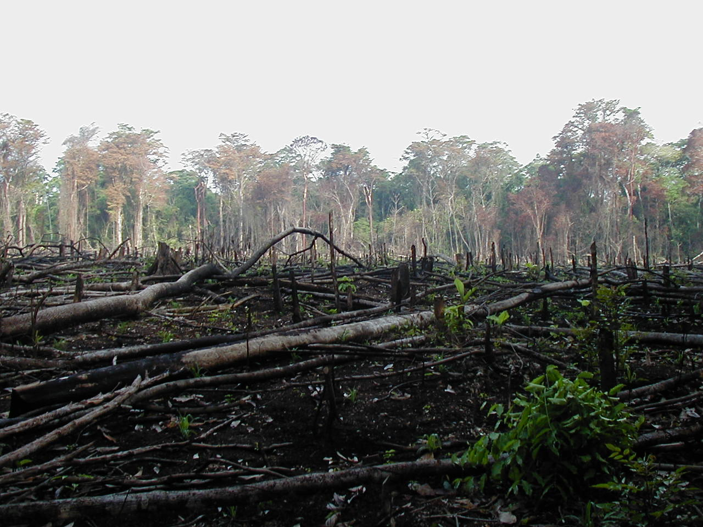
DEFORESTATION AND FRAGMENTATION
One of the largest threats to biodiversity
Estimated that 400,000 ha of forest removed annually
Image Credit: Emil Cherrington
Deforestation can lead to fragmentation
Further isolates populations
Image Credit: Jami Dwyer
Notes:
Human activities have become a severe environmental threat to the MBC. Activities such as logging, mining, agriculture, and urban expansion have contributed to an estimated 400,000 ha of forest that are removed annually. This clearing of wide areas of trees, or deforestation, has reduced the size of the environment and led to forest fragmentation, the splintering of ecosystems. This has become a great threat to biodiversity and has caused species within the MBC to become isolated.
Top image credit: provided by Emil Cherrington (partner)
Bottom image source: https://commons.wikimedia.org/wiki/File:Lacanja_burn.JPG
Bottom image credit: Jami Dwyer, Public domain, via Wikimedia Common

Slide 6
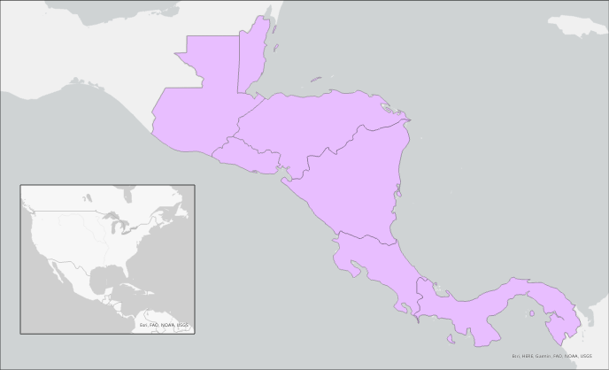
STUDY AREA AND STUDY PERIOD
Mesoamerican Biological Corridor
Study area: Honduras, Belize, El Salvador, Guatemala, Nicaragua, Costa Rica, and Panama
Belize
N
Guatemala
Honduras
El Salvador
Nicaragua
Study Period: 1992 to 2022
Costa Rica
Panama
0
250
500 km
Basemap: ESRI, HERE, Garmin, FAO NOAA, USGS
Notes:
Our project focused on the Mesoamerican Biological Corridor, including the countries of Belize, Guatemala, El Salvador, Honduras, Nicaragua, Costa Rica, and Panama. While the southern states of Mexico are included in the Mesoamerican biological corridor, they were not included in our study area for this project. Even though deforestation is present in those areas, the project focused on Central America because the entire corridor is too large to analyze within the project's time frame.
The study period we collected and analyzed data for was from 1992 to 2022.
Basemap credit: ESRI, HERE, Garmin, FAO NOAA, USGS
Image Credit
-all images created by DEVELOP team

Slide 7
OBJECTIVES
Identify forest cover change in the past thirty years by producing LULC trend map of 1992 and 2022
Visualize deforestation at the regional level by generating
deforestation time series analysis
Classify forest/non-forest land cover in the
MBC by using a Minimum Distance Classifier
Notes:
The team had three objectives: classify, identify, and visualize deforestation in the MBC. We created a forest/non-forest classification using Earth Observations for a 30-year time span. Then we used this classification to identify forest cover change by creating a LULC trend map. We also visualized the changes in forest cover trends by creating a time series analysis.

Slide 8
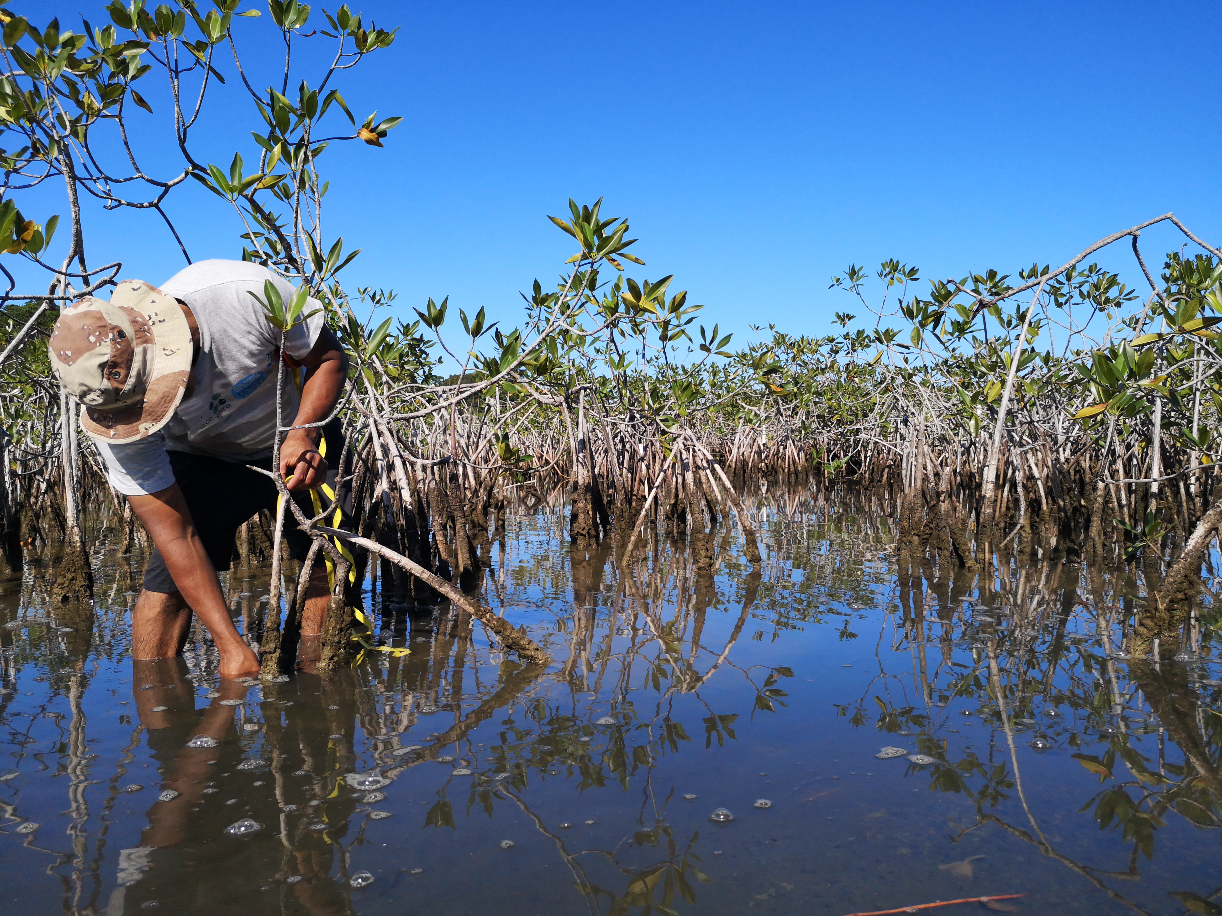
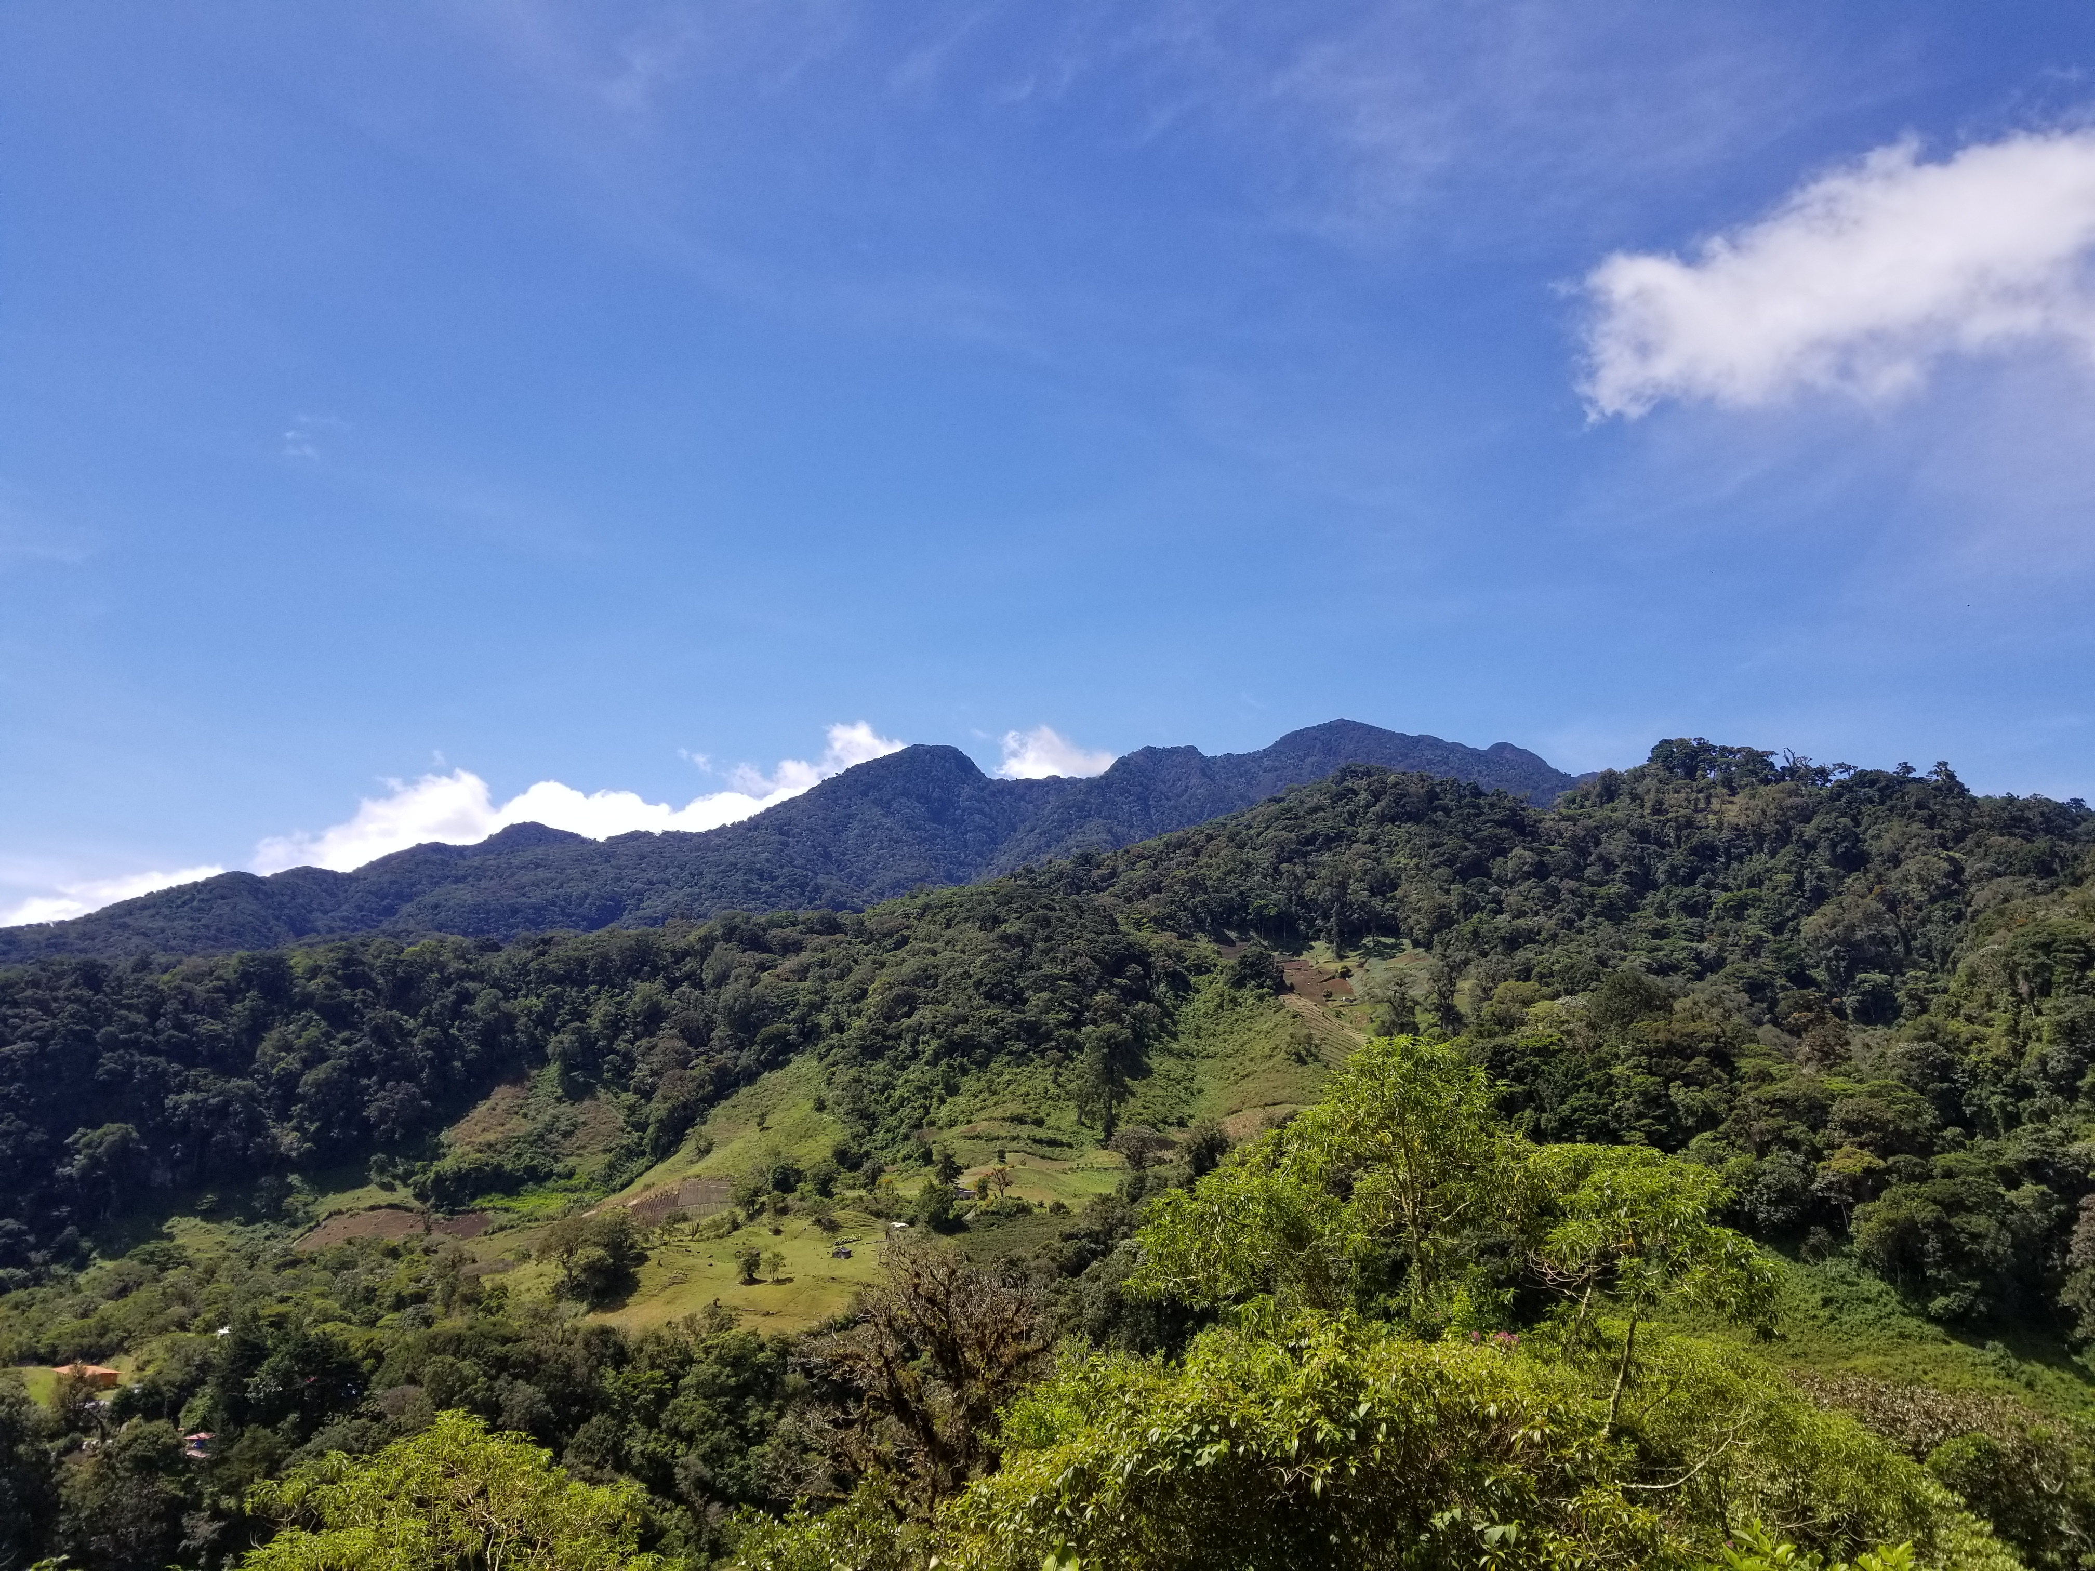
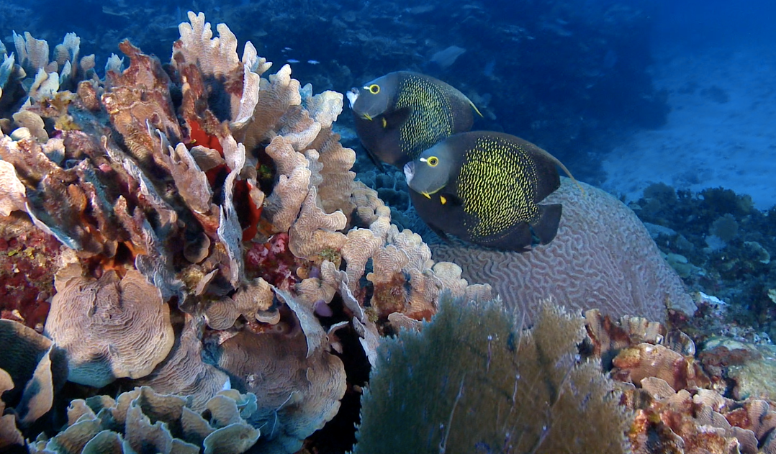
PARTNERS
Tropical Agriculture Research and High Education Center (CATIE)
Sistema de la Integración
Centroamericana (SICA)
Image Credit:
Cesar J Zacarías
Ministry of the Environment & Natural Resources (MARN) of Guatemala
Ministry of the Environment & Natural Resources (MARN) of El Salvador
Ministry of the Environment & Energy (MINAE) of Costa Rica
Image Credit:
Amelia Untiedt
Image Credit:
Ana Giro Peterson
Notes:
To best accomplish these goals while also taking into consideration the community concerns of the area, we partnered with the Central American Integration system (SICA) and the Tropical Agriculture Research and High Education Center (CATIE). SICA and CATIE are two regional wide organizations committed to promoting peace and development for all people in the region. We also partnered with the Ministries of the Environment for Costa Rica, El Salvador, and Guatemala. All of our partners are concerned about deforestation and want a better understanding of the trends in order to help guide their decision and policy making.
Landscape Image source: Amelia Untiedt (DEVELOPer)
Photo of mangroves and fish were provided by partners for use in this presentation

Slide 9
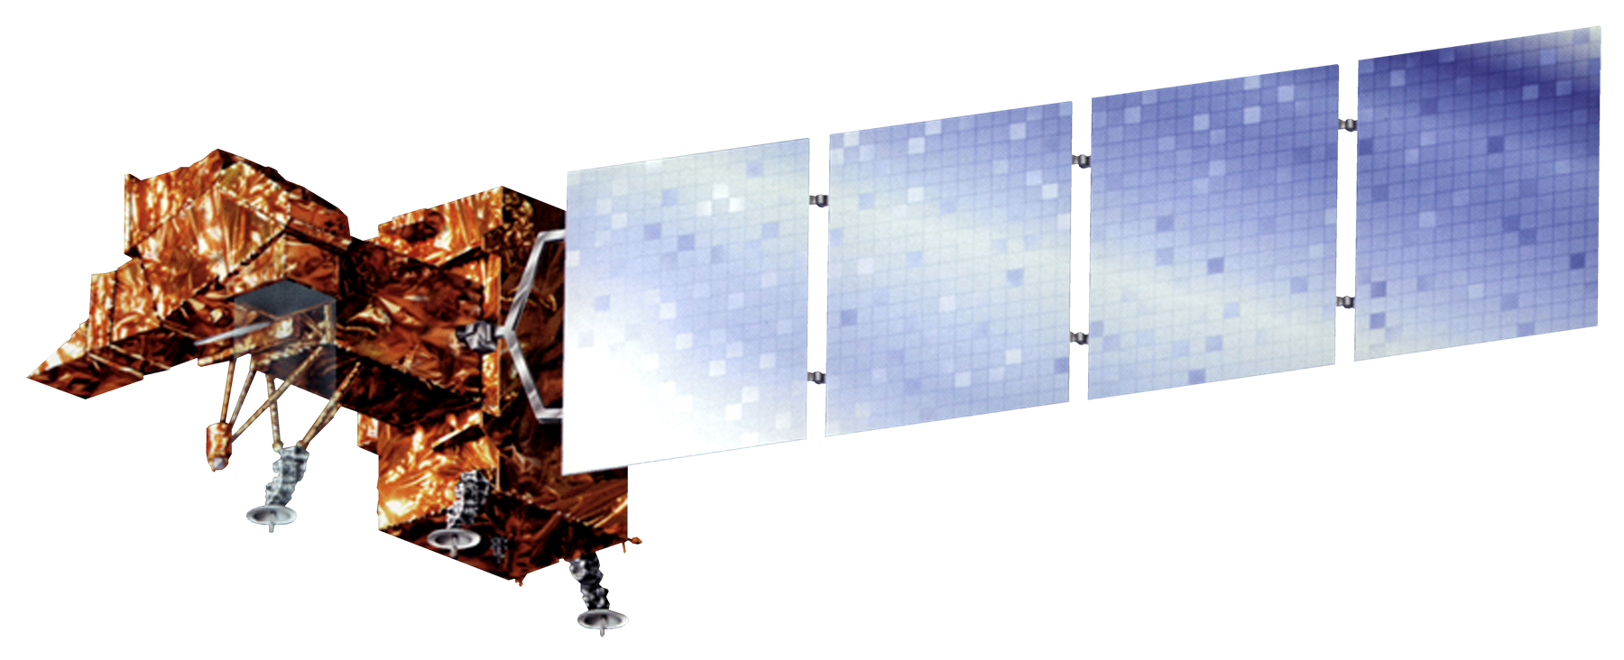
NASA SATELLITES
Landsat 7 ETM+
Landsat 8 OLI
Landsat 9 OLI-2
Landsat 5 TM
Image Credit: USGS/NASA
Notes:
The satellite imagery used to accomplish our objectives are displayed in this slide.
Since the time period from our study stretched back to 1992 up to the current year of 2022, we had to go all the way back to Landsat 5 and all the way up to Landsat 9 to collect this broad collection of images. Specifically, we used Landsat 5 Thematic Mapper (TM) sensor, Landsat 7 Enhanced Thematic Mapper plus (ETM+) sensor, Landsat 8 Operational Land Imager (OLI), and Landsat 9 Operational Land Imager 2 (OLI-2).
Image source: NASA https://www.nasa.gov/content/landsat-9-instruments
Image source: NASA http://www.devpedia.developexchange.com/dp/images/6/69/01_Landsat5.png
Image source: NASA https://www.devpedia.developexchange.com/dp/images/3/39/02_Landsat7.png
Image source: NASA http://www.devpedia.developexchange.com/dp/images/c/c2/03_Landsat8.png

Slide 10
DATA ACQUISITION
Image credit: NASA SERVIR
Image credit: Betzy Hernández Sandoval
2022 mosaiced Landsat 9 OLI-2 derived true color image
2010 CATHALAC map
Notes:
The team acquired Landsat data from NASA SERVIR through Google earth engine. This data contained mosaiced, cloud free images of the MBC for every year between 1992 and 2022 at 30m and 100m resolution. Landsat data were aggregated to 100m to process data quicker across the large study area. The team also received a 2010 CATHALAC land cover classification of the MBC as well as boundaries of protected areas and international borders. The imagery used to collect these images were Landsat 5, 7, 8, and 9. We would like to express our gratitude to our science advisors at SERVIR for providing this valuable data as it would have taken a large portion of the term trying to collect cloud free images of this region being that the region is a very humid and cloudy area.
Image Credits 2022 True color image: NASA SERVIR
Image Credits CATHALAC map: Betzy Hernández Sandoval

Slide 11
DATA PROCESSING
Mangrove
Broadleaf Forest
Combine and select cloud-free, mosaiced imagery from assets
Train Minimum Distance Classifier
Mixed Type Forest
Coniferous Forests
Pastures
Forest
Non-forest
Water
Savannas
Water
Randomly sample training data
from 15 land cover classes
Permanent Crops
Generate Forest/Non-forest classification for 1992 and 2022
Annual crops
Monocrops
Urban Areas
Plateaus
Wetlands
Shrubs
Bare Areas
Notes:
The mosaiced Landsat imagery from SERVIR was stored as an image collection containing a band for every year from 1984 to 2022 such as "B1_1992" or "B2_1992". The team created a script to extract the red, green, blue, NIR, and SWIR bands for each year. The 100m aggregated Landsat imagery was clipped to the area of interest and then used as the predictor images for landcover classification. The team used another asset from SERVIR which was the 2010 CATHALAC land cover classification scheme. The CATHALAC image had a single band which ranged from 1 – 15 which corresponded to 15 different land cover types. They were mangrove, broadleaf forest, coniferous forest, mixed type forest, shrubs, pastures, annual crops, monocrops, permanent crops, urban areas, bare areas, wetlands, plateaus, water bodies, and savannas. The team used a stratified random sample to split the image into these 15 categories and then randomly select 300 points from each of the categories. They were assigned to a feature collection to store all of the points in their corresponding class assignment. The points were sorted into a binary classification of forest and non-forest. The team did this because only the accuracy of distinguishing the forest and non-forest was important. The forest category had mangrove, broadleaf forest, mixed type forest, and pine. Non-forest had permanent crops, annual crops, monocrops, urban areas, plateaus, wetlands, shrubs, bare areas, savanna, and pasture. Water was in a class on it's own.
Initially, we used a RandomForest classifier to train and classify the images, but the results came out very granular. We then tested and decided on a minimum distance classifier because it smooths out the classification and picks up forest/non-forest differently. A minimum distance classifier was trained on the 2010 CATHALAC predictor image using the training points. The classifier was run on the 2010 predictor image because the training points were collected from the same classification scheme. Since the testing points were from the same year as the predictor image it reduced model bias. After the supervised classification model was trained on the 2010 predictor image it was then applied to the 1992 100m and the 2022 100m images to obtain the classification of forest and non-forest landcover of the MBC. We also added a reducer to take the mode pixel value amongst the neighboring values to help with smoothing the images.

Slide 12
DATA ANALYSIS
Additional layers:
World Country border,
World Database Protected Areas,
Indigenous Communities
Import classification images from GEE into ArcGIS Pro
Raster Calculator
LULC Change Detection Maps
Forest & Non-forest 2022
Forest & Non-forest 1992
Notes:
The team imported the completed land cover classification maps from Google Earth Engine to ArcGIS Pro. These land cover classification maps were of forest & non-forest for the years of 1992, 2002, 2012, and 2022. The Raster Calculator was used
between the years of 1992 to 2022, this slide shows the process of using the Raster Calculator function in ArcGIS Pro to produce a Land Use Land Cover (LULC) Change Detection map.
After generating this map, various layers were imported to further analyze both the area as a whole and further case study areas of interest. The layers that the team used for this visual analysis were the World Countries – Generalized, World Database of Protected Areas (WDPA), and Indigenous Communities. This allowed the team to visualize in what areas there were higher levels of forest loss or forest growth.
The format used with Raster Calculator was repeated for LULC change detection for decades between 1992 and 2022 time frame.
To calculate percent change in forest cover, we did an equation of variable pixel count divided by total pixel count times 100 to obtain a percentage.
Image credit: these icons are from PowerPoint

Slide 13
DATA ANALYSIS
Forest & Non-forest 1992
Time Series Analysis
Forest & Non-forest 2002
Animate tool in ArcGIS Pro
Forest & Non-forest 2012
Forest & Non-forest 2022
Notes:
In order to create a Time Series Analysis, the Animation tool in ArcPro was used to create a GIF displaying forest cover from decade to decade between the years 1992-2022. Each layer (1992, 2002, 2012, and 2022) was essentially stacked on top of each other and the animation tool ran through the images like a movie.
Image credit: these icons are from PowerPoint

Slide 14
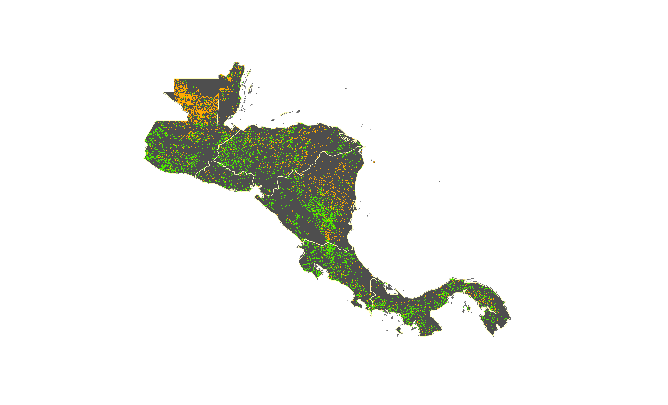
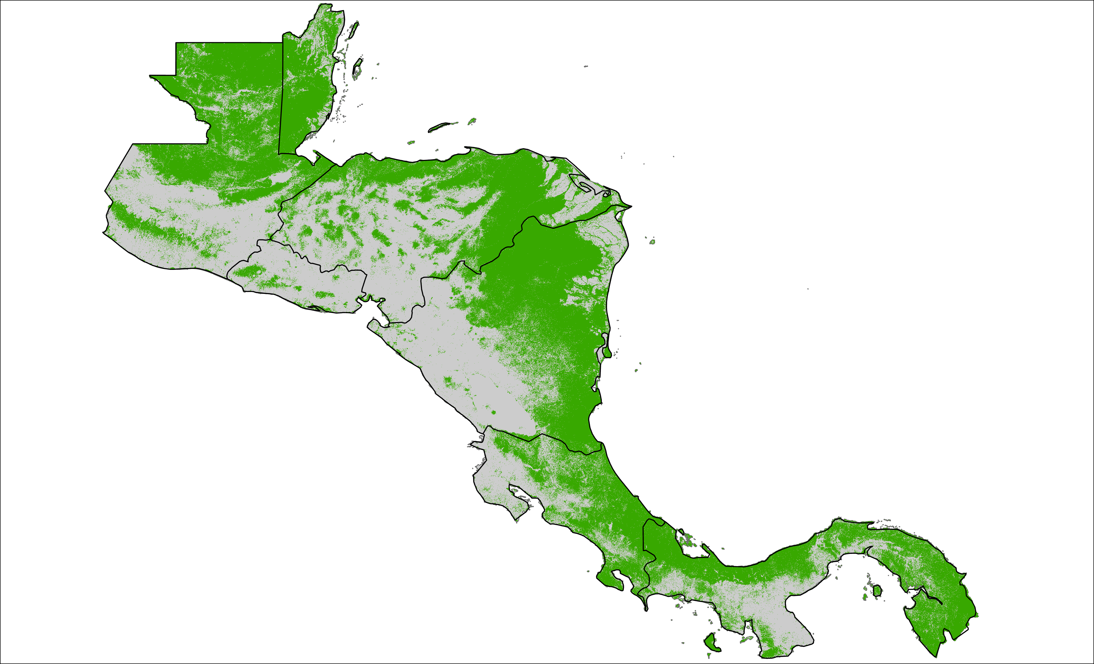
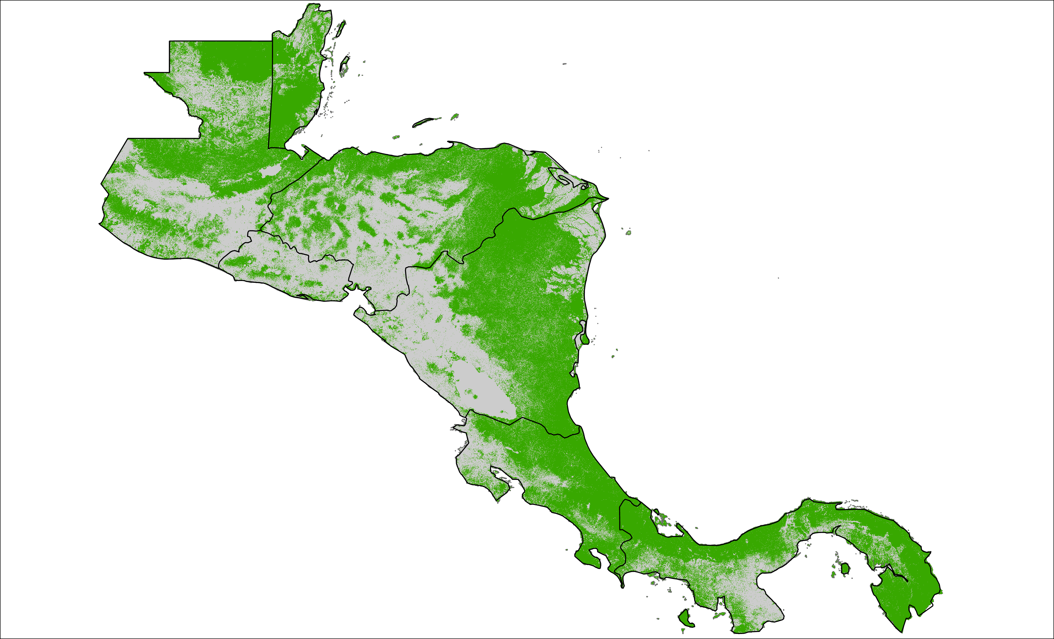
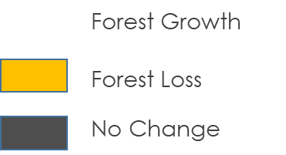
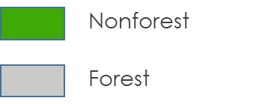
RESULTS
Change between 1992 and 2022
1992 Forest/Non-forest
2022 Forest/Non-forest
N
N
N
Notes:
This is the change detection between 1992 and 2022. The green is forest growth, yellow is forest loss, and gray is no change. The forest growth that is shown on the change detection is both agricultural and forest growth. Due to time constraints during our project, our classification was not effectively able to determine the difference of spectral signatures between forest and agricultural forest like palm oil and shade grown coffee. Overall we saw a % of forest growth and % of forest loss. It is also important to consider no change. If an area was well preserved in 1992 and has shown little change in 2022, that suggests that it continues to be well preserved three decades later. Our literature review and partners suggested that much of the changes were caused by agricultural practices, either deforestation to make room for crops or altering the canopy for crops like palm oil.
All visuals on this slide were created by the DEVELOP team

Slide 15
RESULTS
% Forest Cover Change
8
7
6
5
Percent
4
3
2
1
0
1992-2022
2002-2012
2012-2022
Forest loss
Forest gain
Notes:
This graph visualizes the trends the data showed between the years of 1992-2002, 2002-2012, and 2012-2022. The yellow bar represents the amount of land cover that shifted from forest to non-forest, or forest loss, for that time span and the green represents the amount of forest that shifted from non-forest to forest, or forest growth.

Slide 16
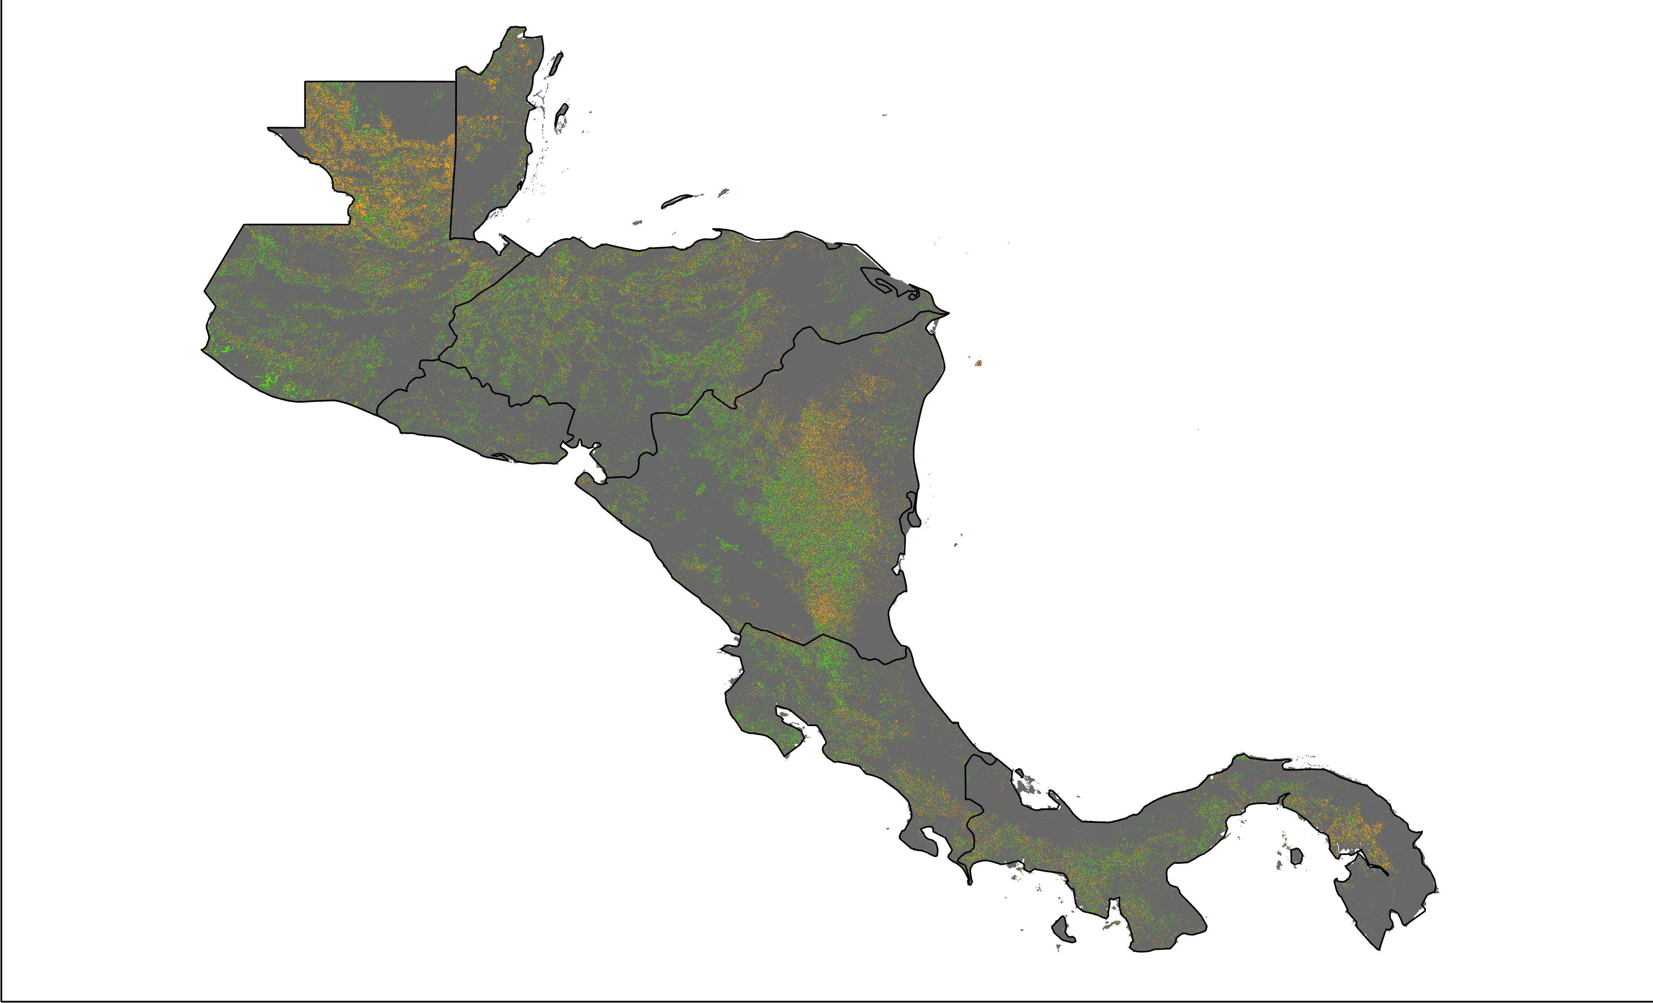
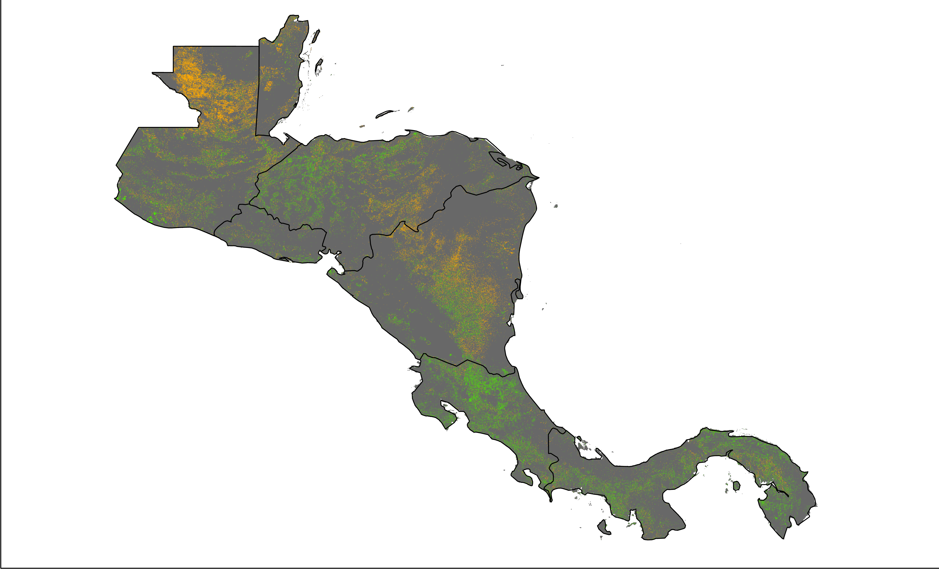
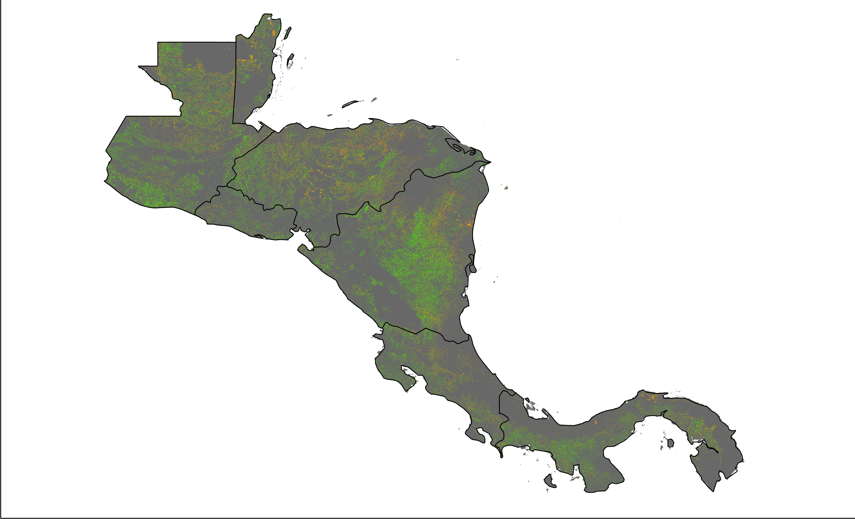
RESULTS
1992 to 2002 Forest Cover Change
2002-2012 Forest Cover Change
2012-2022 Forest Cover Change
N
N
N
Forest Growth
Forest Growth
Forest Growth
Forest Loss
Forest Loss
Forest Loss
Protected Areas
Protected Areas
Protected Areas
Notes:
We also calculated the change in forest cover for every ten years. Looking at Northern Guatemala (hit animation 1 now), you can see the change of forest loss to forest growth, possibly from an introduction of palm oil. It is also important to note areas of no change that stayed consistent over time. In Belize (hit animation 2 now, hit animation 3 now), for example there is a pocket of no change in the southern part of the country that is a series of protected areas. There has consistently been no change suggesting that the management of these protected areas is effective. Isolated areas and areas difficult to access have also seen periods of consistent no change.
All visuals on this slide were created by the DEVELOP team

Slide 17
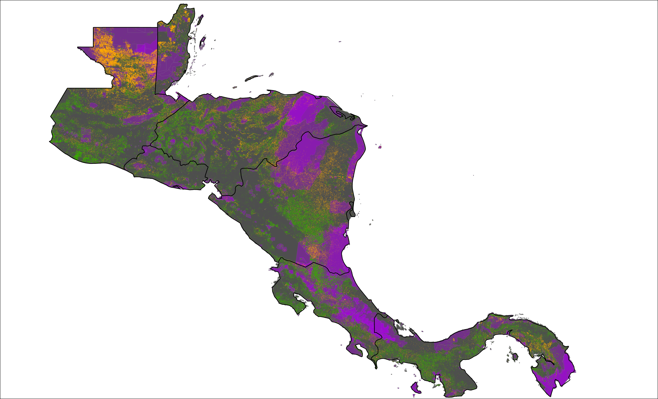
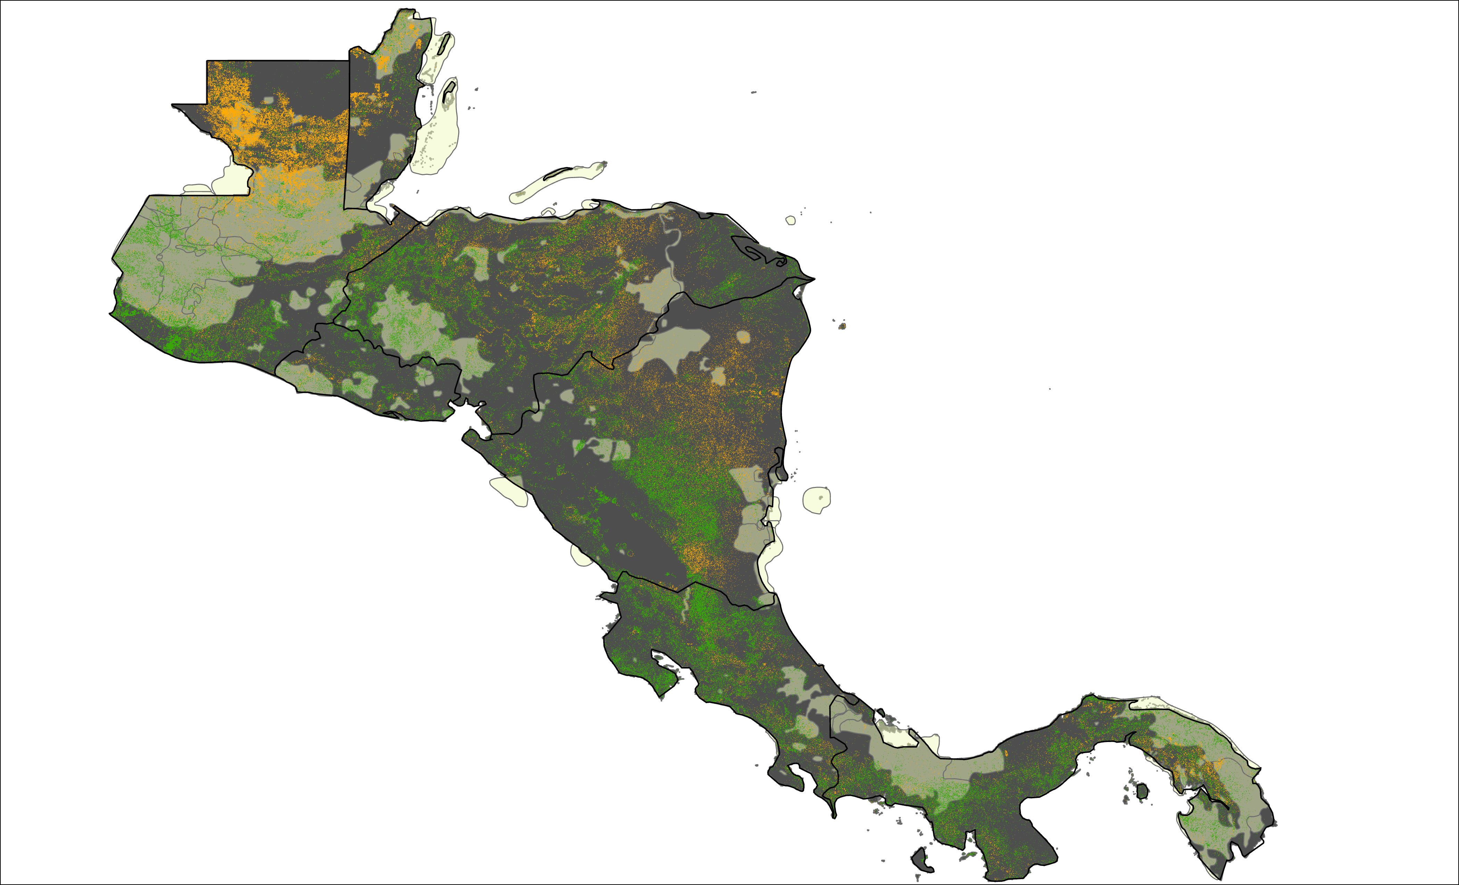
RESULTS
N
N
Forest Growth
Forest Growth
Forest Loss
Forest Loss
Protected Areas
Indigenous Communities
Notes:
We also overlayed protected areas and indigenous communities layers over the forest change detection. Both of these layers were provided by NASA SERVIR. One area of interest was La Mosquitia (hit animation 1 now), a region of pine forests, swamps, and tropical rainforests in Eastern Honduras extending into Northern Nicaragua. The Rio Platano Biosphere reserve is located in this region and the Bosawas reserve is in Northern Nicaragua. There is forest loss on the periphery and the edges of the reserves but the internal areas show no change in forest cover. The Sumu-Mayangna, Tawalhca, Miskito, and Pech communities also live in these areas of no change within the reserves. These groups practice agriculture within the park. There have been recent initiatives for enhanced protection for the interior of the park, but there is still mining, logging, and cattle in the area. There is also conflict between the indigenous communities who live in the area and non-indigenous communities migrating to the area, which challenges indigenous land claims.
As mentioned in the previous slide (hit animation 2 now, hit animation 3 now), there is a series of protected areas in Southern Belize that shows no change. The (name of indigenous communities) live in this area.
All visuals on this slide were created by the DEVELOP team

Slide 18
RESULTS
Guatemala
N
N
N
Forest Growth
Forest Growth
Forest Growth
Forest Loss
Forest Loss
Forest Loss
Protected Areas
Protected Areas
Indigenous Communities
Indigenous Communities
Notes:
We looked specifically at Guatemala at the request of our partners. The Maya Biosphere Reserve is located at the very northern part of Guatemala on the border with Mexico. (Hit animation 1) There has been a large amount of forest lost on the west side of the reserve, especially in Laguna del Tigre National Park. Guatemala was in a civil war from the 1960's to the 1990's. The Maya Biosphere Reserve was established in 1992 and the civil war ended in 1996. After the end of the civil war there was a migration towards Northern Guatemala where much of the land was converted for agricultural use. The western side of the reserve had more water and lower elevation which has allowed for more agricultural expansion. The eastern side of the reserve is more challenging to access. There are more indigenous communities on the eastern side of the preserve as well.
All visuals on this slide were created by the DEVELOP team

Slide 19
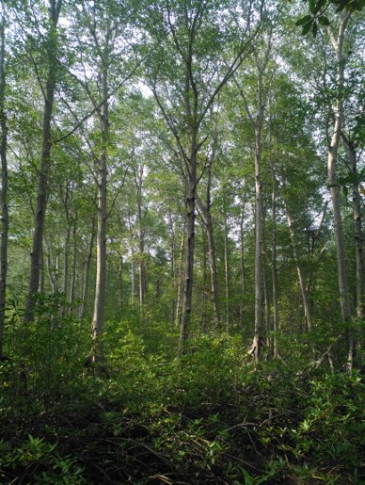
CONCLUSIONS
Accounting for spectral variation in land cover types requires holistic training data
Minimum Distance Classification was the most effective classifier of Forest/Non-forest
Analysis showed an overall 6.18% forest loss and a 10.99% forest growth in the MBC
Image Credit: Cesar J. Zacarias
Notes:
Differentiating between land cover types in a large area requires holistic training data. The MBC includes over 200 different ecosystems therefore it is very challenging to adequately represent these ecosystems into a classification of the entire region.
In conclusion, using a minimum distance classification scheme is feasible for our study area. We tested multiple classifiers, such as random forest for our classification (results not included in this presentation), and concluded that minimum distance was the most effective. Minimum distance picks up on surrounding pixels more accurately in order to not have a grainy classification output.
A brief qualitative assessment was carried out to compare forest change. This showed that over the 30 year study period, there was a 6.18% change to forest loss and a 10.99% change to forest growth
Image credit: image was provided by our partner Cesar J. Zacarias for use in this presentation

Slide 20
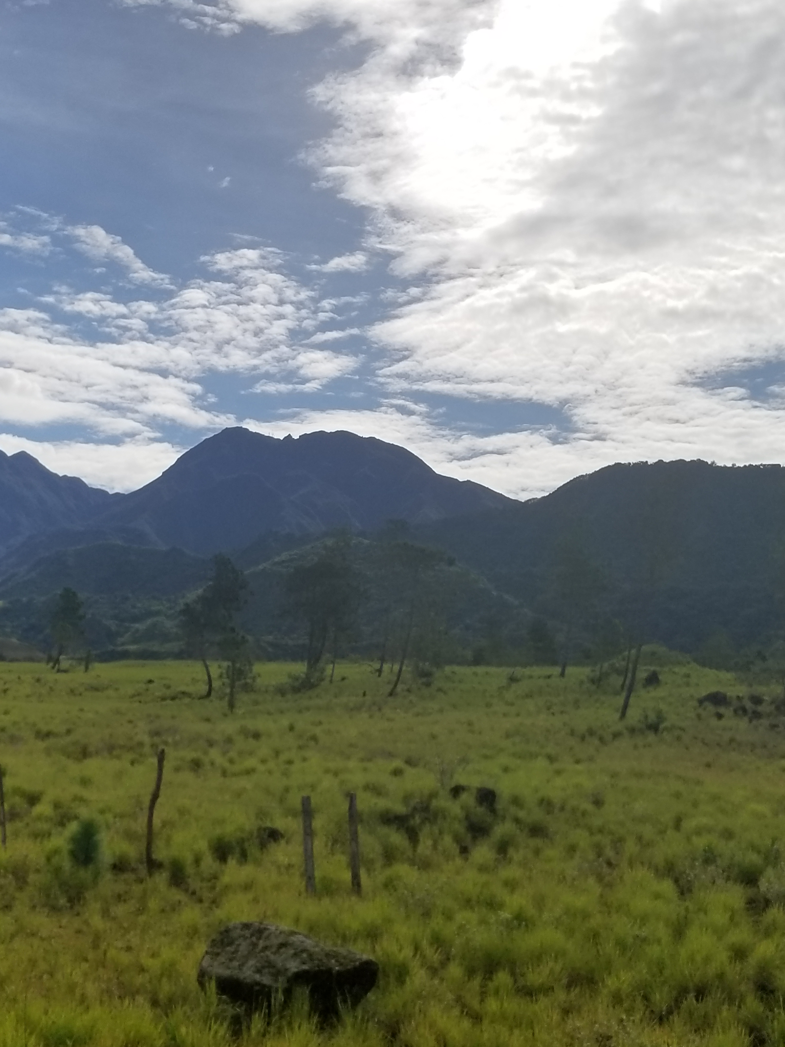
ERRORS AND LIMITATIONS
Image Design: 100m imagery
of a cloud-dense region
Sampling Design:
Source of training points
Training Design: Splitting
Forest/Non-forest into sub-classes
Image Credit: Amelia Untiedt
Notes:
Image Design
Because the MBC is a cloud-dense, tropical area, it was imperative to mask out pixels that indicated cloud cover which would have otherwise been interpreted incorrectly. Unfortunately, the availability of cloud-free imagery from 1992-2022 was very limited. Additionally, using EO's at 100m resolution versus 30m resolution can lead to inaccurate capturing of true landcover beneath each pixel value, which are essentially aggregates of surrounding pixels
Sampling Design:
Using 2010 training data to classify cover in 1992 and 2022 assumes conditions were the same across these years when in reality the variation in spectral properties of land cover types differs annually.
A standardized classification was necessary for a regional study. The CATHALAC classification utilized Landsat imagery, was ground verified at many points, contained diverse land cover classes, and offered the best proxy for true land cover in 2010
Training Design:
We opted to collect and train our classifier on 15 landcover groups and placed them into 5 overall land cover types, then grouped the classified results into Forest and Non-forest. This allowed for us to collect adequate training point from each class. The classifier struggled to differentiate between some spectral signatures such as savannas, pastures, and pine forest. For example the classifier could distinguish savannas in Costa Rica but failed to identify them in Guatemala. This misclassification changed the accuracy of our forest and non-forest categories. By creating the 5 land cover classes we avoided an exhaustive classification yet maintained the diversity of classes.
Image credits: Amelia Untiedt
Image credit: these icons are from PowerPoint

Slide 21
FUTURE WORK
Improve the classification
Use LIDAR to study impacts of forested agriculture
Investigate
forest regrowth​
Notes:
As noted in our limitations, we faced many challenges regarding the classification. Given more time, we would have been able to continue working with the classification to account for similar spectral signatures. A future study could be to continue refining the classification to achieve higher accuracy.
One of the questions the team encountered was how much of the forest cover is shade coffee plantations and other agriculture types that could fall into forest cover. Coffee is one of main exported products of Central America so we were curious how much of the canopy accounted for shade grown coffee. Unfortunately it is not possible ( or just very challenging?) to differentiate shade grown coffee from other forest cover using Landsat satellites. A future study could use LIDAR instead to answer this question.
The team noticed that there was forest regrowth in regions of Central America and we were wondering exactly what was growing back. One study by Redo et al stated that the forest regrowth often was not the same forest that was originally there. After deforestation the area becomes dryer so it tends to be a dryer type of forest that grows back. This is concerning considering wet forest types have higher biodiversity. So even though there is forest regrowth, it may be lower quality and a threat to the biodiversity in the area.
Image credit: these icons are from PowerPoint

Slide 22
Science Advisors
NASA DEVELOP Fellow
Brianne Kendall
Marshall Space Flight Center Node
Dr. Robert Griffin
University of Huntsville Alabama
Dr. Jeffery Luvall
NASA Marshall Space Flight Center
Betzy Hernández
NASA SERVIR
Dr. Emil Cherrington
NASA SERVIR
Lauren Casey
NASA SERVIR
Africa Flores
NASA SERVIR
Slyvia Wilson
USGS SilvaCarbon
Dr. Kenton Ross
NASA Langley
Rafael Monge
Ministry of the Environment of Costa Rica
Giovanni Molina
Ministry of the Environment and Natural Resources of El Salvador
Kenset Rosales
Ministry of the Environment and Natural Resources of Guatemala
Partners
Jorge Cabrera
SICA
Juan Carlos Mendez
CATIE
Pablo Ibach
CATIE
Christian Brenes
CATIE
Notes:
The Mesoamerica Biological Corridor Eco forecasting team would like to thank our advisors from NASA SERVIR and our partners from Sistema de la Integración Centroamericana (SICA), Tropical Agriculture Research and High Education Center (CATIE), and Ministries of the Environment for Costa Rica, El Salvador, and Guatemala for their guidance and support throughout this project. Thank you to our science advisors Betzy Hernández, Dr. Emil Cherrington, Lauren Carey, Africa Flores, Sylvia Wilson, Dr. Robert Griffin, and Dr. Jeffrey Luvall for their technical support. Thank you to our fellow Brianne Kendall for her leadership and guidance throughout the duration of our project, as well as Dr. Ross and Laramie Plott for their assistance with the project. We would also like to thank the DEVELOP network for fostering an inclusive and supportive work environment.

Slide 23
BACKUP SLIDES

Slide 24
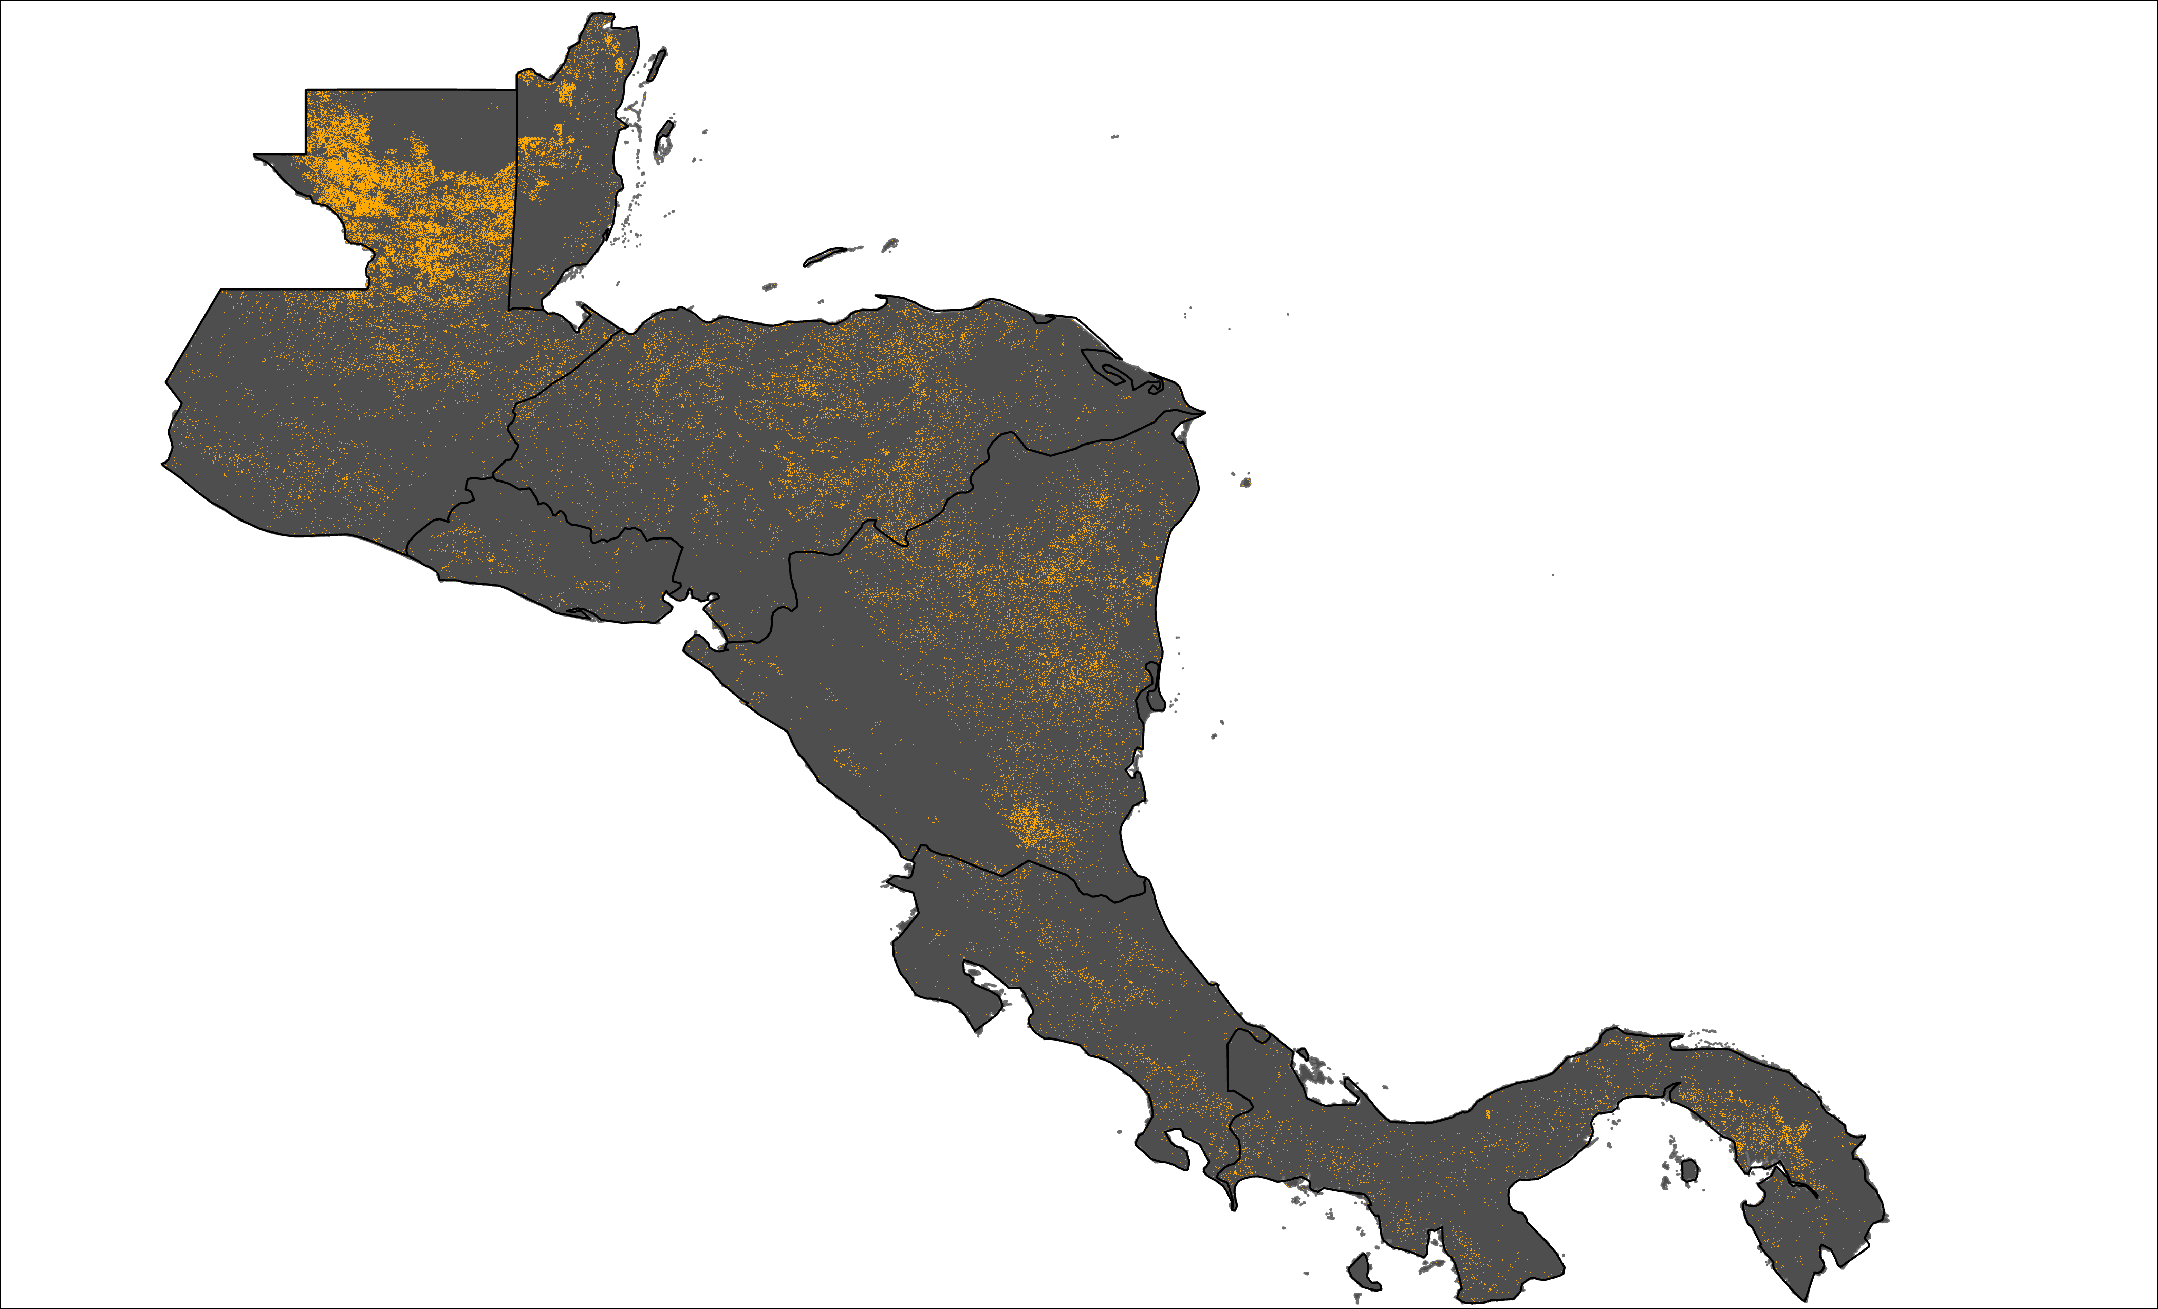
RESULTS
Forest Loss
N
Notes:
Forest loss from 1992 – 2022 F/NF Change Detection. This slide is just for partners and results are still being analyzed.

Slide 25
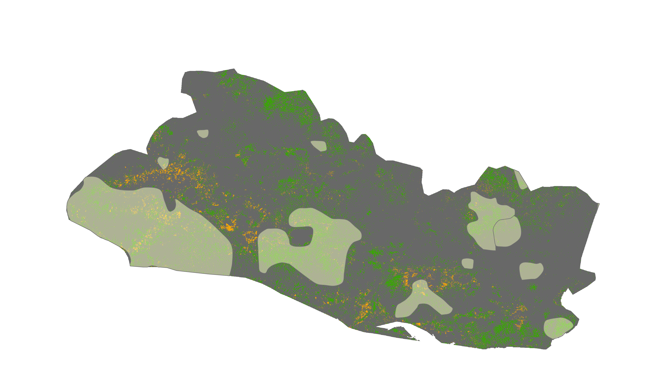
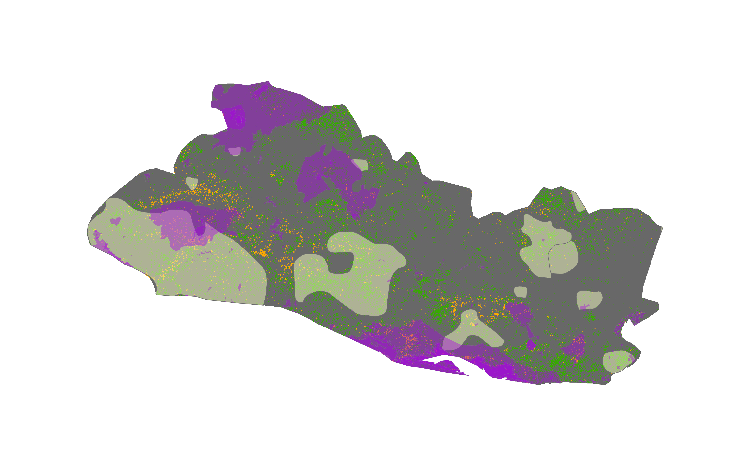
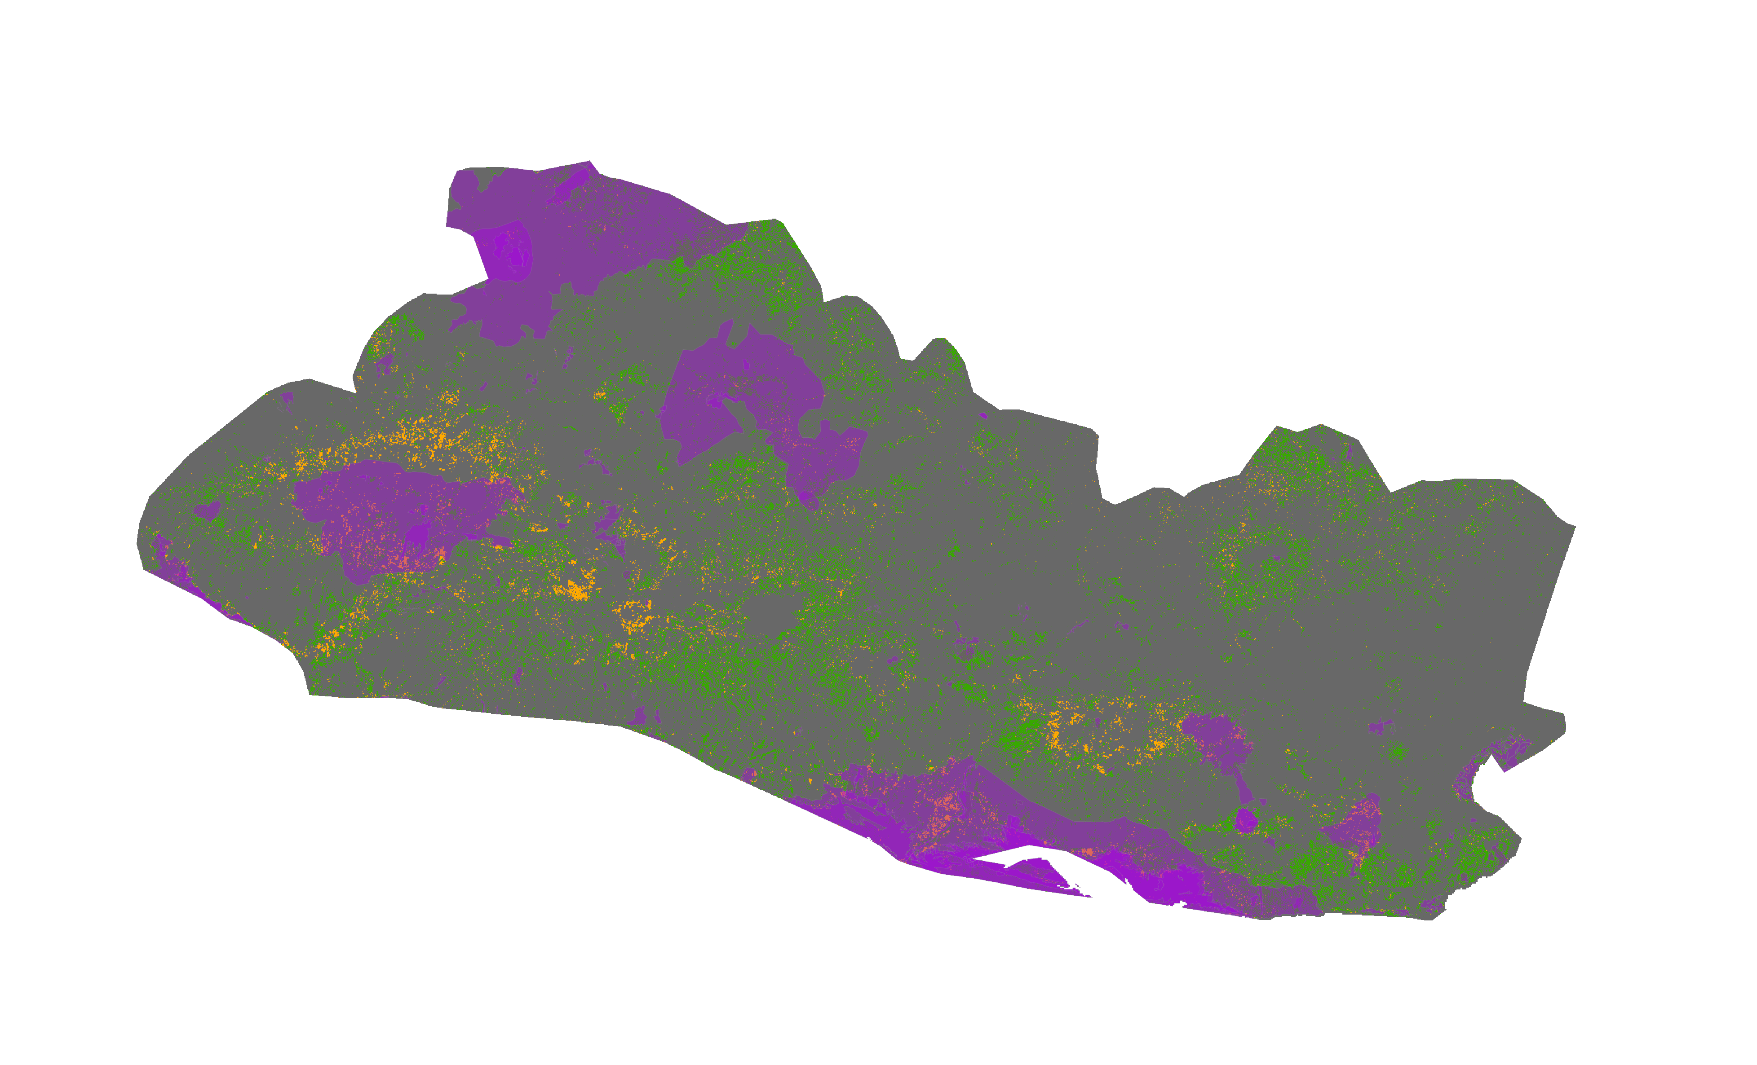
RESULTS
El Salvador
N
N
N
Forest Growth
Forest Growth
Forest Growth
Forest Loss
Forest Loss
Forest Loss
Protected Areas
Protected Areas
Indigenous Communities
Indigenous Communities
Notes:
There appears to be a trend of forest growth in the indigenous communities, the Nahua Pipil and Lenca. This slide is just for partners and results are still being analyzed.
All visuals on this slide were created by the DEVELOP team

Slide 26
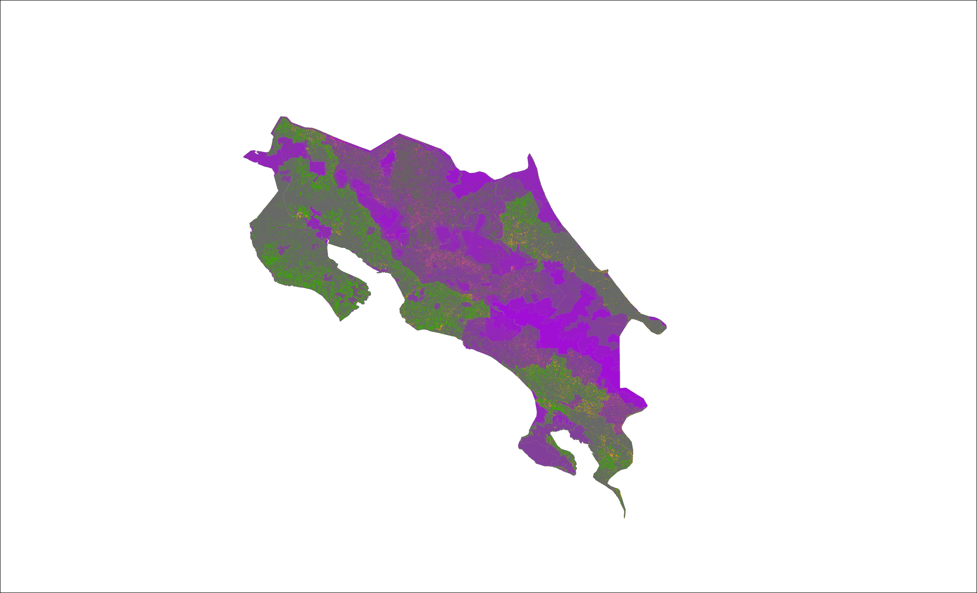
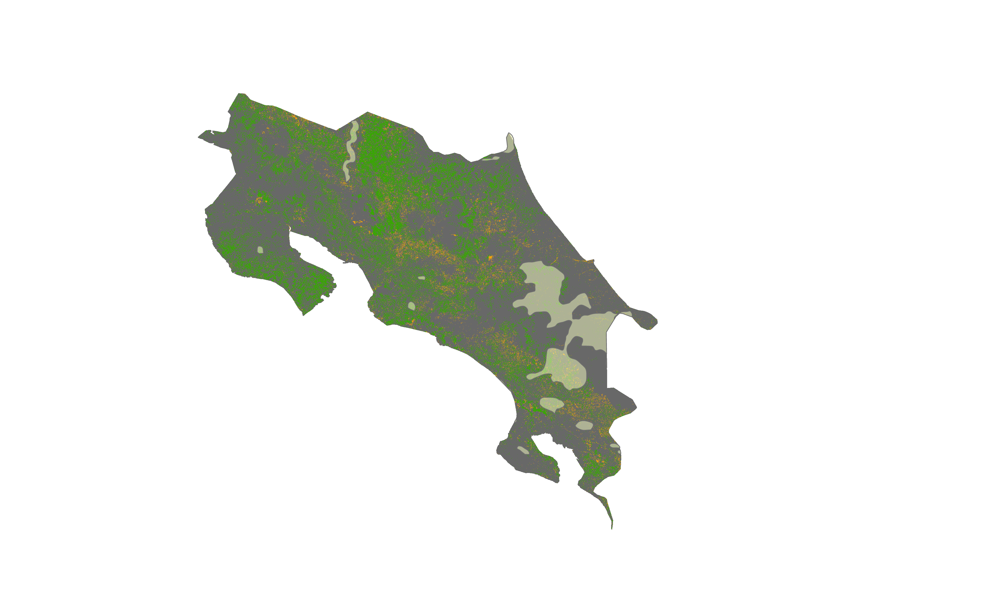
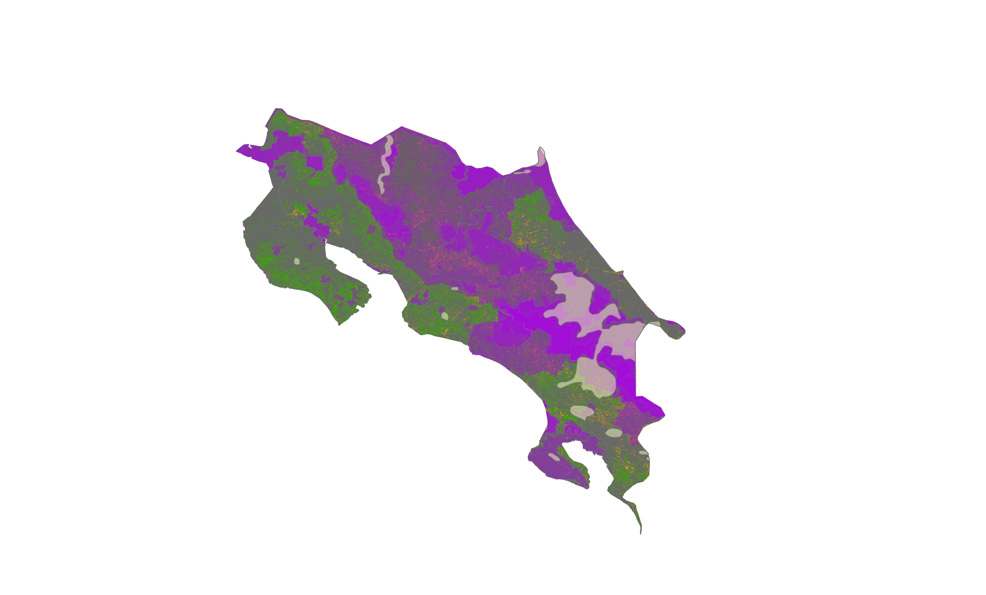
RESULTS
Costa Rica
N
N
N
Forest Growth
Forest Growth
Forest Growth
Forest Loss
Forest Loss
Forest Loss
Protected Areas
Protected Areas
Indigenous Communities
Indigenous Communities
Notes:
Costa Rica has shown large amounts of forest growth. In the 1990's the Costa Rican government focused conservation and used payment for ecosystem services as a way to encourage citizens to preserve and develop forest. This has been very effective and Costa Rica is see a model for forest regrowth. This slide is just for partners and results are still being analyzed.
All visuals on this slide were created by the DEVELOP team

Slide 27
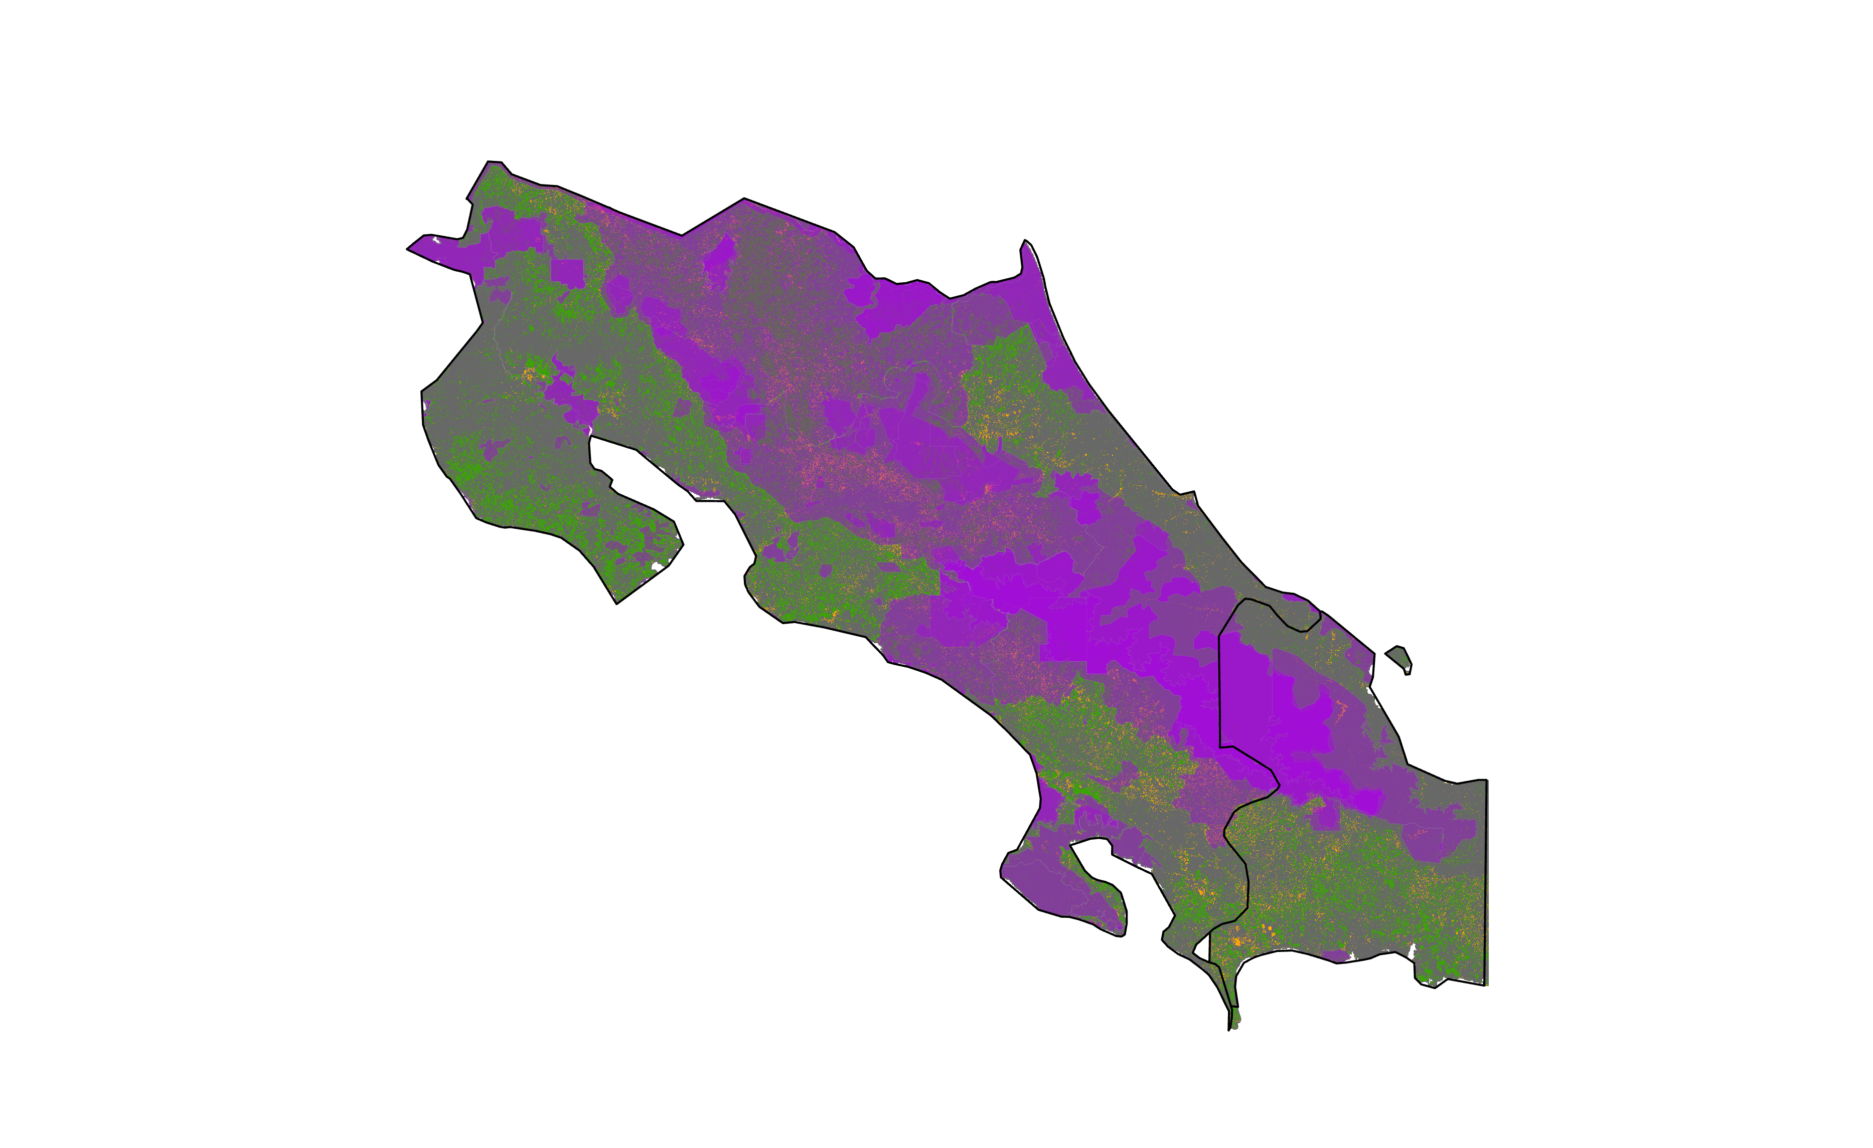
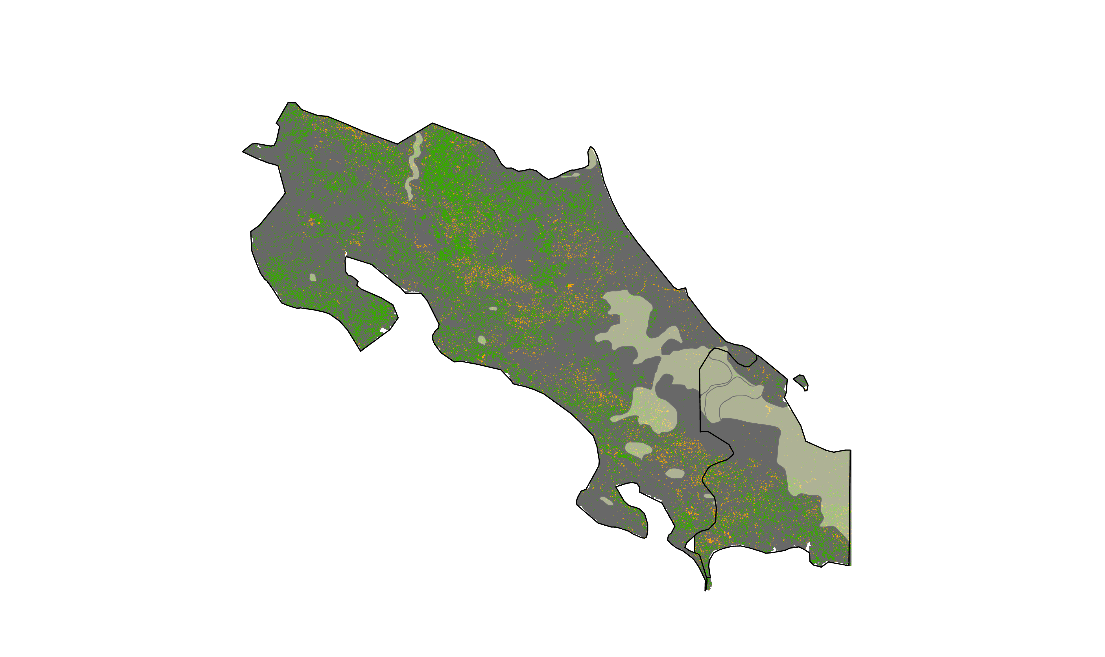
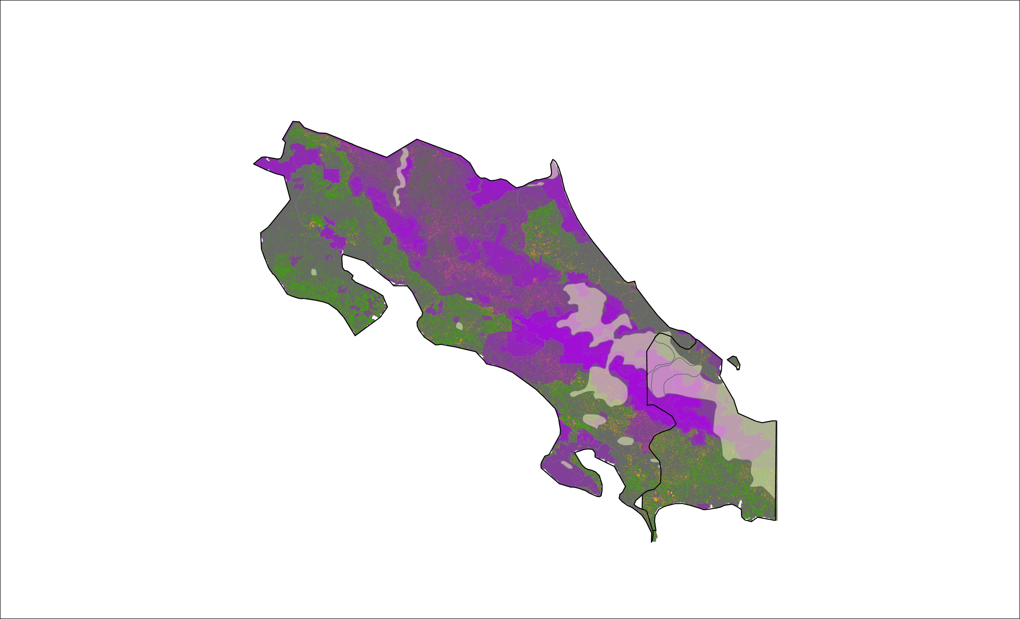
RESULTS
Parque Internacional La Amistad
N
N
N
Forest Growth
Forest Growth
Forest Growth
Forest Loss
Forest Loss
Forest Loss
Protected Areas
Protected Areas
Indigenous Communities
Indigenous Communities
Notes:
La Amistad Internation Park is a transboundary park that is located in Costa Rica and Panama. There has been little change in La Amistad International Park. The park has difficult terrain to navigate which may help to prevent any changes to the ecosystem. The Bri-Bri, Nogbe-Bugle, and Naso live within the boundary of the park. There is some infringement of agriculture on the borders of the park as well as within. Much of the agriculture by the indigenous communities is subsistence based. There are threats from oil palm and cattle ranching on the edges of the park.
This slide is just for partners and results are still being analyzed.
All visuals on this slide were created by the DEVELOP team

