Slide 1
2021 Spring
NATIONAL
ORIENTATION
MODULE 4. Projects

Slide 2
Project Characteristics
40-50 projects take place each year – at their core they share these characteristics:
Highlight the applications and capabilities of NASA Earth observations
Address community concerns relating to decision-making for real-world environmental issues
Partner with organizations who can benefit from using NASA Earth observations to enhance decision making by providing decision support tools
Align with at least one of the eight NASA Applied Sciences Program’s National Application Areas
Create a consistent set of deliverables
Research is conducted by teams with diverse backgrounds under the scientific guidance of Science Advisors and mentors from NASA and partner organizations

Slide 3
Project Ideas Sources
National
Science
Objectives
Environmental
Decision
Makers
NASA
Program
Managers
End-User Needs
State & Local
Policy
Makers
DEVELOP
Science
Advisors
DEVELOP
Leads/Fellows & Participants
NSF
Decadal
Survey
Local
Communities &
Tribal Entities
New
NASA
Missions
Federal
Agencies &
Organizations
By The Way
Ideas can come from anywhere as long as they connect to a decision-making end user! Have an idea? Tell your Fellow!

Slide 4
Conversations w/ Potential Partners to Identify Needs Surrounding Their Decision-Making Process
Project Idea Collection
- Submission to NPO
- NPO Reviews & Discusses w/ Node
Proposal Process
- Leads Draft Proposals
- NPO Reviews
- NASA HQ Reviews
Project Execution
- Literature Review
- Data Acquisition & Processing
- End Products & Deliverables Created
Hand Off to Partners & Conference Presentations
Project Lifecycle
All DEVELOP projects center around a decision.
DEVELOP identifies the information that would be helpful to the partner when making this decision. This is the partner’s need.
Project end products are designed to fit into the partner’s decision-making process.
The end deliverable package is handed off for partners to explore further and assess integration into their decision-making process.

Slide 5
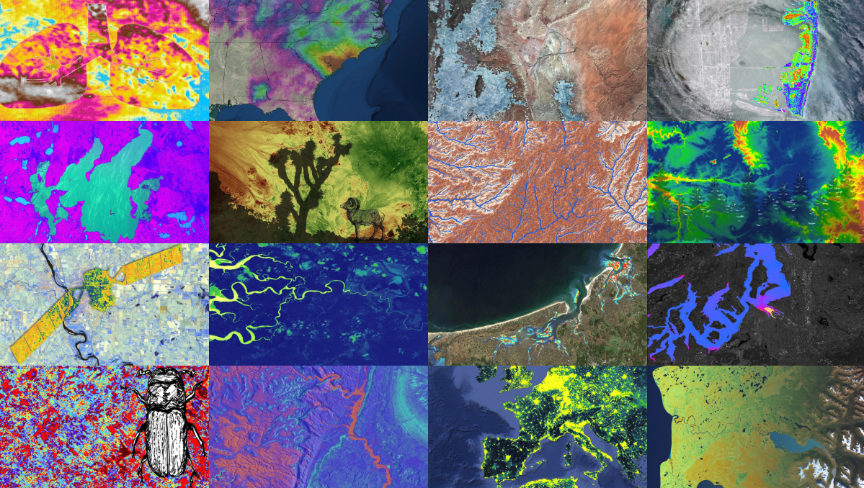
Deliverables
All projects create:
Project Summary
Study Area Shapefile
Presentation
Tech Paper
DEVELOPedia Page
Website Image
Feedback Form
Some projects create:
Video & Transcript
Code
Software Release Forms (required if team plans to share code w/partner)
Poster
Tutorial
ArcGIS StoryMap

Slide 6
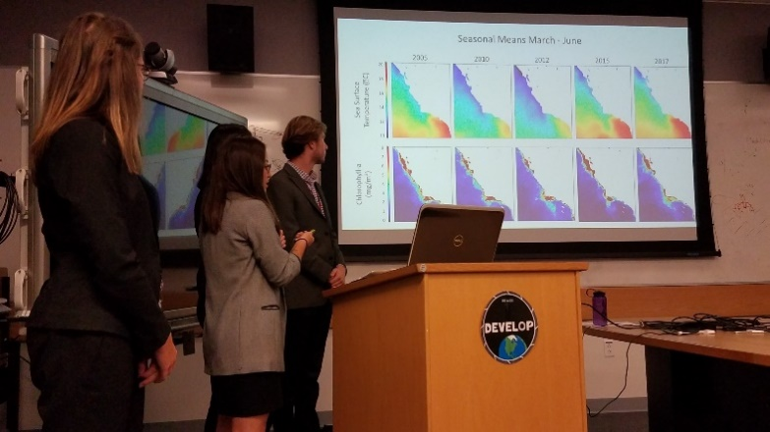
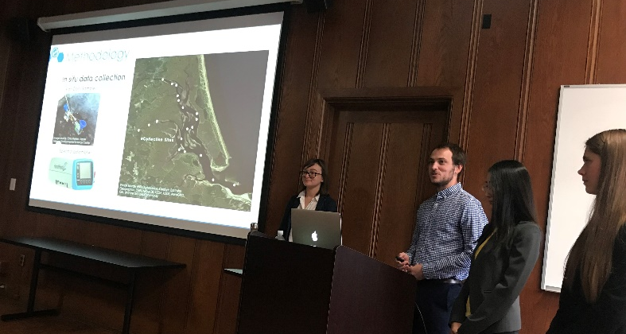
Project Handoff
Handoffs are an important step in transitioning results and methodologies to end users and working towards the goal of the end users integrating NASA Earth observations into their decision-making processes.
Depending on what you are handing off, be cognizant that you must get materials approved by NASA prior to handoff.
Commonly Used Handoff Styles
Email deliverables (Tech Paper, Tutorials, Presentation, etc.)
Teleconference or videoconference presenting the results and methodologies
In-person presentation of results and methodologies
By The Way
Get creative in how and what you hand off. Interesting idea? Speak to your Fellow about it!

Slide 7
Project Assessment – Partner Inputs
A Pre-Project Partner Form was sent out before the term to gather information about partner needs and expectations. A Post-Project Partner Form will follow the completion of the term to collect information regarding the perceptions of success of collaborating with DEVELOP.
Were the project results and methodologies useful?
Was the experience a good one?
Is the partner using the results or methodologies in their decision-making process?
Timeline: Fellows sent out the Pre-Project survey link a couple weeks before the beginning of the term. The Post-Project survey link will be sent to partners at the end of the term. In case of a project that has multiple terms, the survey does not go out until after the project’s final term.
Please communicate to your partners that DEVELOP will stay in touch and send a brief survey at the end of the project’s final term.

Slide 8
Feasibility Considerations
DEVELOP projects are 10-week feasibility studies.
In 10 weeks, validation efforts are limited at best.
Be mindful in how you communicate with partners – do not overpromise or oversell your products and results.
NASA does not develop or prescribe policy, thus DEVELOP projects do not either.
DEVELOP projects simply demonstrate the feasibility of integrating NASA Earth observations into decision-making processes.
Other agencies and organizations may use the data and scientific results in their policy analysis and development.
NASA funds DEVELOP, thus DEVELOP projects are focused on the application of freely-available NASA Earth observations.
The North Carolina node receives NOAA funds, so they have an additional directive to highlight NOAA CDRs.

Slide 9
2021 Spring Portfolio
Northern Great Plains Disasters – ARC
Austin Health & Air Quality – AZ
San Diego Urban Development – AZ
Colorado River Basin Water Resources – CO
Colorado Front Range Disasters – CO
Africa Food Security & Agriculture II – GA
Midwest Food Security & Agriculture – GA
Bhutan Ecological Forecasting II – GSFC
Western Montana Ecological Forecasting – GSFC
Southern Idaho Health & Air Quality II – ID
Coastal California Ecological Forecasting – JPL
Fairfax Water Resources – LaRC
Tonlé Sap Food Security & Agriculture – LaRC
Cincinnati & Covington Urban Development – MA
Bhutan Water Resources II – MSFC
Cheat Water Resources – MSFC
Montana Water Resources II – NC
By The Way
Feel free to reach out to other teams! They may be using similar EO, working with similar partners, or working in a similar geographic area!

Slide 10
Quiz Time!
How many projects does DEVELOP conduct a year?
What do all DEVELOP projects center around?
What is the last step in the DEVELOP project lifecycle?
What is DEVELOP’s project assessment called?
Does NASA prescribe policy?
Can teams pursuing similar projects reach out to other nodes?

Slide 11
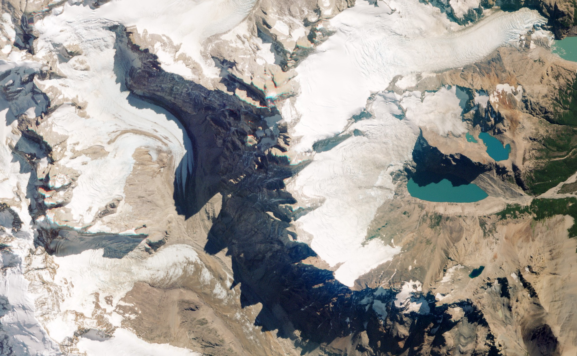
THANK YOU!
“A place for everything and everything in its place.”
-- Benjamin Franklin --

