Slide 1
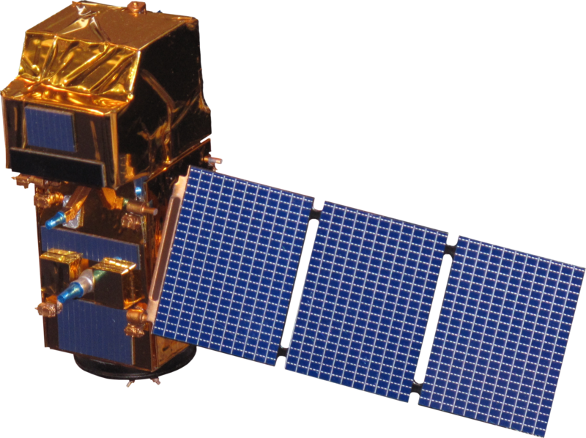
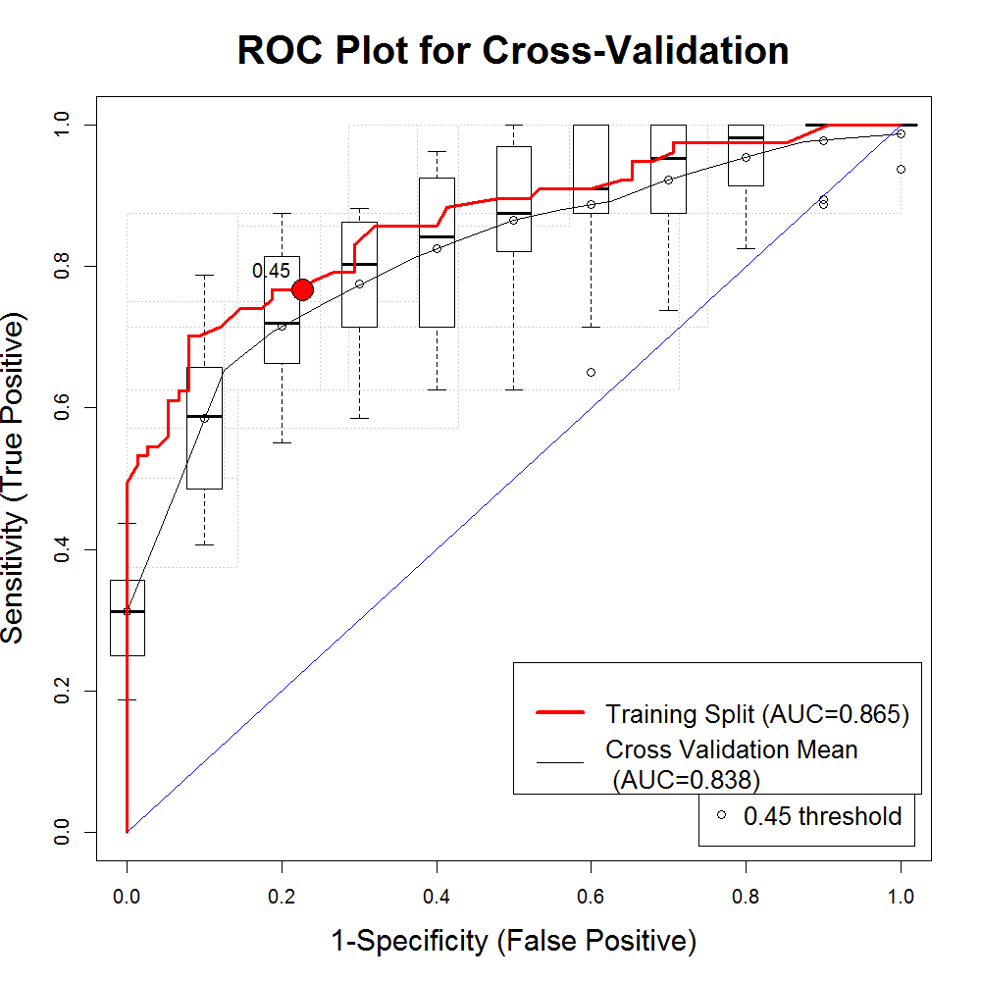
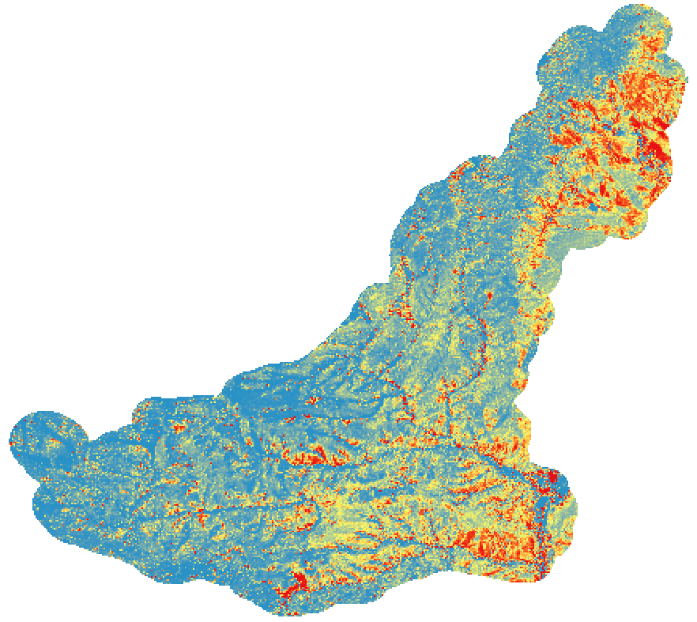
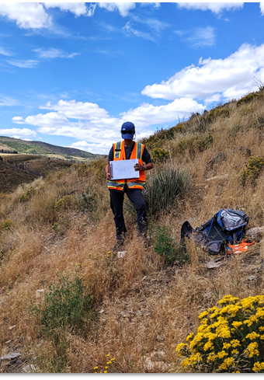
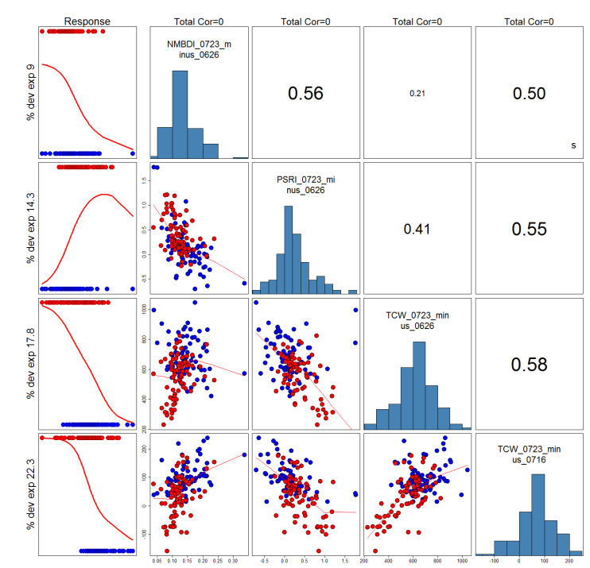
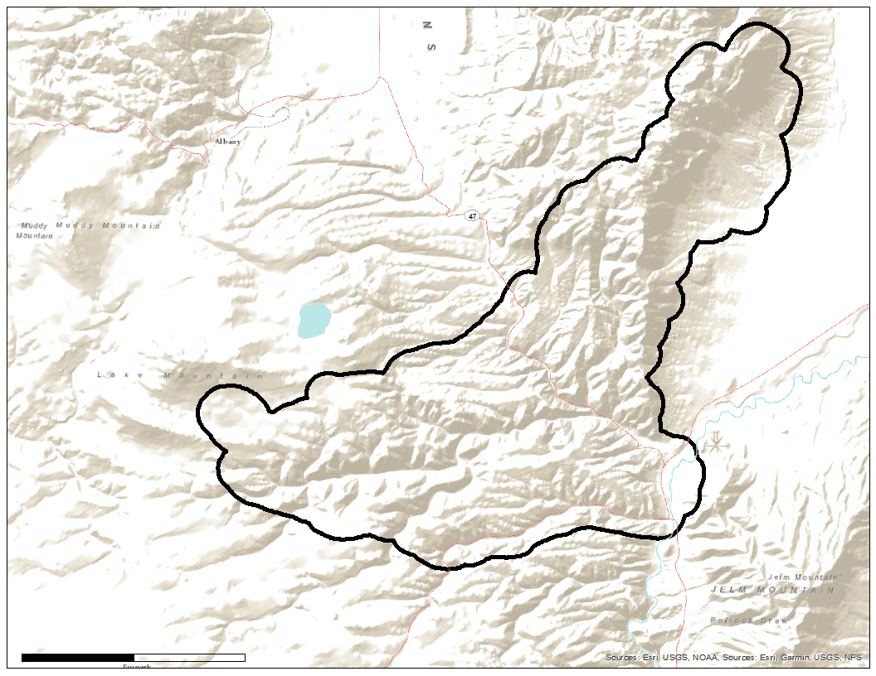
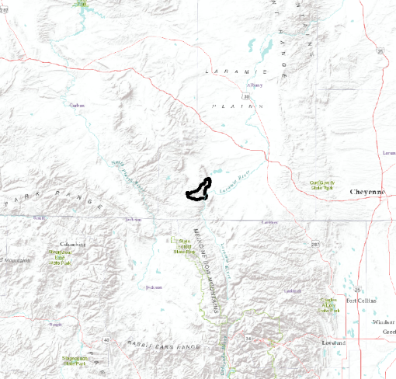
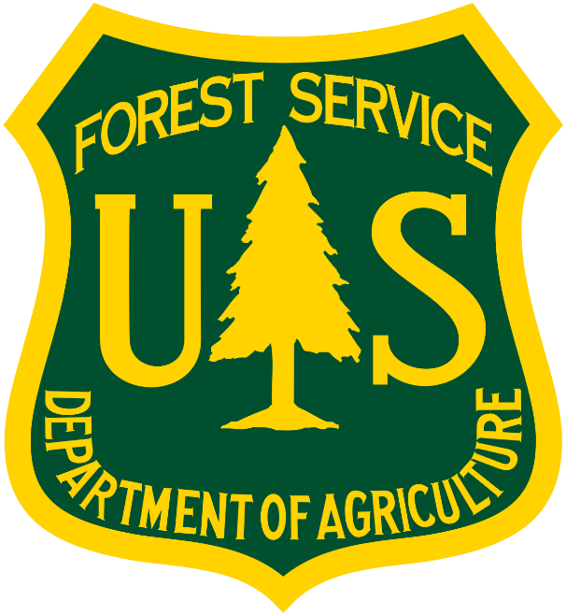
Utilizing Remote Sensing to Evaluate Herbicide Treatment Efficacy on Invasive Cheatgrass in Medicine Bow National Forest, Wyoming
Abstract
Objectives
Medicine Bow Disasters
The Medicine Bow National Forest (MBNF) consists of approximately 1,383,790 acres of forested land, grassland, and sagebrush steppe in southeastern Wyoming. Cheatgrass (Bromus tectorum), an invasive plant species in the Western US, occurs in the grasslands throughout MBNF. Cheatgrass is known to rapidly colonize disturbed sites and dramatically alter historic fire regimes and nutrient/water dynamics as well as outcompete native plant species that are important forage for mule deer (Odocoileus hemionus) and elk (Cervus canadensis). In 2012, the Squirrel Creek Fire burned approximately 10,587 acres of land within MBNF, exacerbating the spread of cheatgrass. In 2015, the Wyoming Ecological Forecasting DEVELOP team identified areas of high cheatgrass abundance within the fire boundary in order to guide US Forest Service (USFS) herbicide spraying efforts to reduce cheatgrass in 2016. This research used Landsat 8 Operational Land Imager (OLI) and Sentinel-2 MultiSpectral Instrument (MSI) data to create a 2019 probabilistic cheatgrass occurrence map. This map allowed an analysis of the effectiveness of aerial spraying to inform future land management techniques for the USFS. Based on the results of the Generalized Linear Model, we found that treated areas decreased in cheatgrass cover by 36% while untreated areas increased in cheatgrass cover by 6%, suggesting that herbicide treatment has been effective.
Generate a probabilistic cheatgrass occurrence map for 2019
Analyze the effectiveness of aerial herbicide spraying on cheatgrass populations
Earth Observations
Landsat 8 Operational Land Imager
NASA/USGS Mission
Sentinel-2 MultiSpectral Instrument
ESA Mission
Results
ROC Plot for Cross-Validation
GLM Input Variables
Tasseled Cap Wetness Difference (06/26, 07/23)
Tasseled Cap Wetness Difference (07/16, 07/23)
Plant Senescence Reflectance Index (07/16, 07/23)
Normalized Multiband Drought Index (06/26, 07/23)
1.0
Methodology
0.8
Gather in situ data and satellite imagery of the study area for 2019
Calculate indices on pre-processed imagery
Run machine learning models using dissimilar index raster imagery as inputs
Evaluate model accuracy
Compare cheatgrass extent between the 2019 and 2014 models
0.6
Sensitivity (True Positive)
0.4
Response
NMBDI (0723 – 0626)
0.2
Training Split(AUC=0.865)
Cross Validation Mean (AUC=0.838)
% dev exp 9
0.56
0.21
0.50
0.0
0.45 threshold
0.0
0.2
0.4
0.6
0.8
1.0
% dev exp 14.3
PSRI
(0723 – 0626)
0.41
0.55
Specificity (False Positive)
% dev exp 17.8
TCW (0723 – 0626)
0.58
% dev exp 22.3
TCW (0723 – 0716)
Study Area
= Study Area
2019 Probability >= 40% Cheatgrass
Low High
WYOMING
Conclusions
The GLM best simulates cheatgrass populations.
The herbicide treatment in 2016 was effective in decreasing cheatgrass cover.
Cheyenne
Squirrel Creek Fire
Boundary
Project Partners
Columbine
Jacquilyn Roaque (USDA, US Forest Service)
Katie Haynes (USDA, US Forest Service)
Wyatt Good (USDA, US Forest Service)
John Kenney (USDA, US Forest Service)
COLORADO
0 1.5 3
N
km
This map showcases the boundary of the 2012 Squirrel Creek Fire in the Medicine Bow National Forest, Wyoming.
Team Members
Acknowledgements
Nicholas Young (Colorado State University, Natural Resource Ecology Laboratory)
Tony Vorster (Colorado State University, Natural Resource Ecology Laboratory)
Kristen Dennis (NASA DEVELOP)
Dr. Paul Evangelista (Colorado State University, Natural Resource Ecology Laboratory)
Dr. Catherine Jarnevich (USGS, Fort Collins Science Center)
Peder Engelstad (Colorado State University, Natural Resource Ecology Laboratory)
Chiara Phillips
Project Lead
Stacy Armbruster
Forrest Corcoran
Byron Schuldt
Colorado – Fort Collins | Fall 2019
This material contains modified Copernicus Sentinel data 2019, processed by ESA.

