Slide 1
Perú Climate II
Monitoring and Forecasting Shifting Climate and Land Change Impacts in Perú’s Parque de la Papa for Enhanced Agricultural Management
Caren Remillard (Project Lead)
Brandon Hays
Benjamin Page
Adam Salway
Sam Weber
Xuan Zhang
Notes:
This is a continuation of a Fall 2015 project started at Langley Research Center.

Slide 2
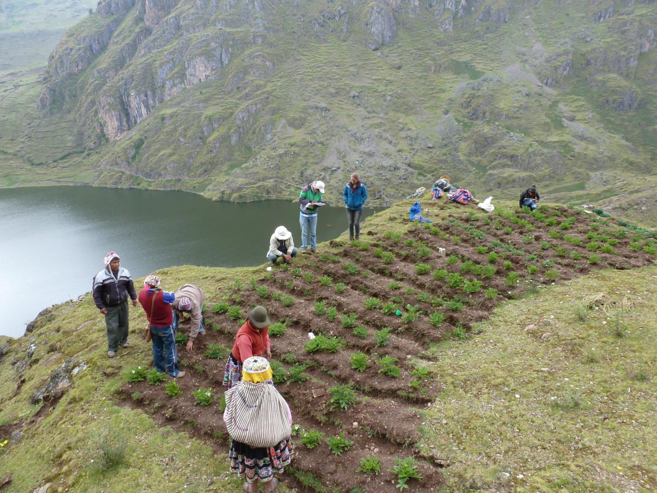
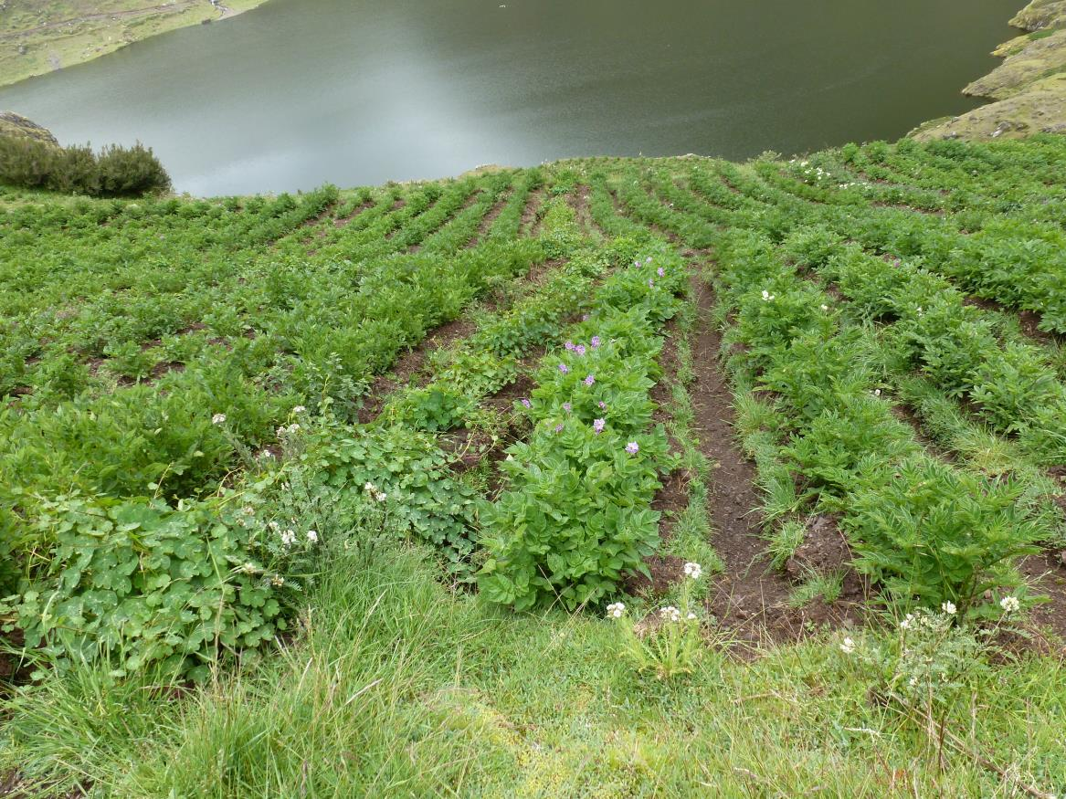
Background
Climate change is increasingly affecting agriculture around the world
Tropical montane areas are particularly vulnerable
The livelihoods of people in these areas are threatened
Image Credits: David Ellis
Notes:
Shifting precipitation patterns and increases in average global temperatures due to climate change are likely to impact agricultural systems around the world. Tropical montane regions such as the Andean Highlands will be especially affected

Slide 3
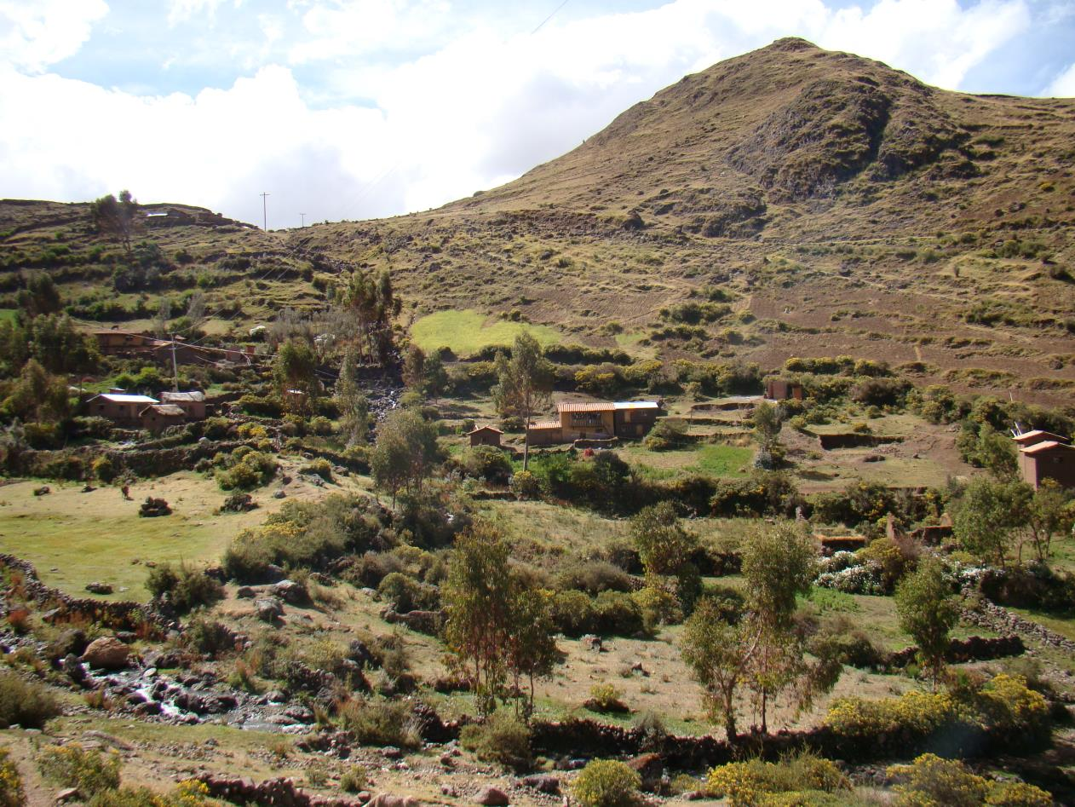
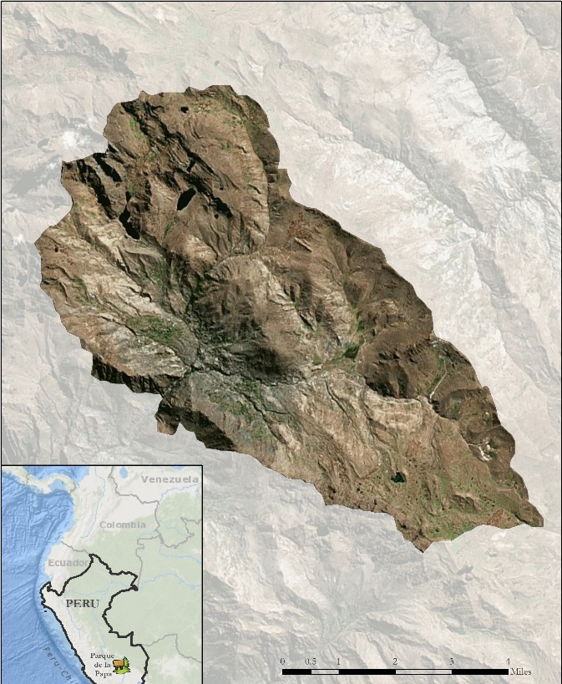

Study Area
Parque de la Papa, Perú
8,661 hectares
3,200-5,000m above sea level
Indigenous biocultural heritage area
Some 7,000 people in 6 indigenous Quechua communities
Image Credit: David Ellis
Notes:
This project was conducted in the Parque de la Papa (Figure 1), located in the Cusco region of Southeastern Perú. The Parque de la Papa is an Indigenous Biocultural Heritage Area collectively owned by six local communities belonging to the Quechua people. The park is managed by the local communities with input from two NGO’s: the International Center for Potatoes (CIP) and Association for Nature and Sustainable Development (ANDES). The primary objective is to preserve the cultural and agricultural traditions of the indigenous people living within the park.

Slide 4
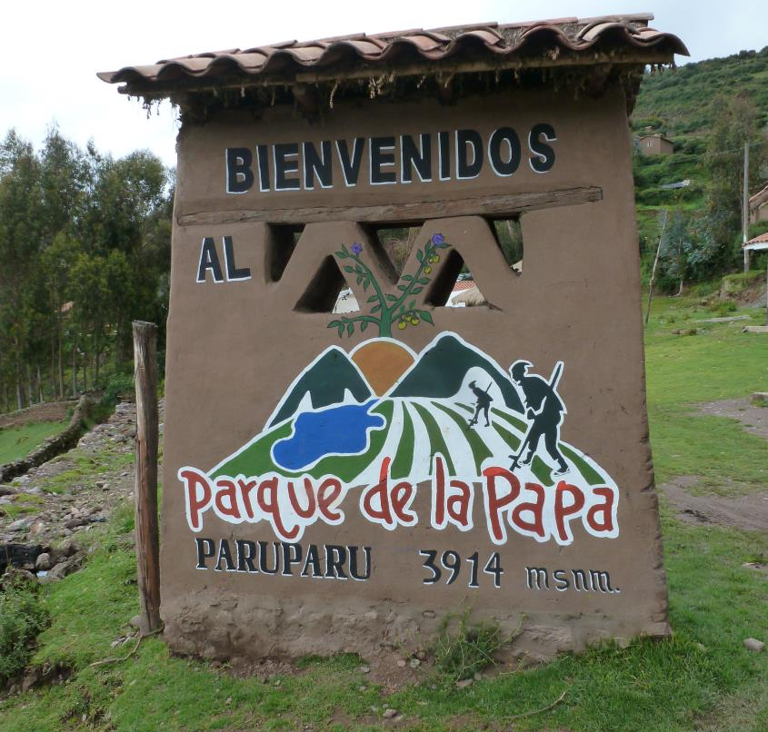
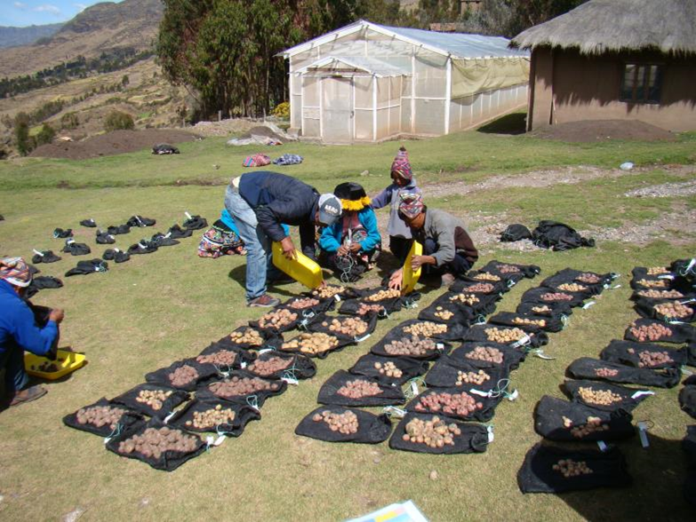
Partner Organizations
Centro Internacional de la Papa (CIP)
Asociación para la Naturaleza y el Desarrollo Sostenible (ANDES)
Image Credits: David Ellis
Notes:
We collaborated with ANDES and CIP. These NGO’s work with the indigenous communities within the Parque de la Papa and help them to translate field data and scientific research into management plans that they can implement.

Slide 5
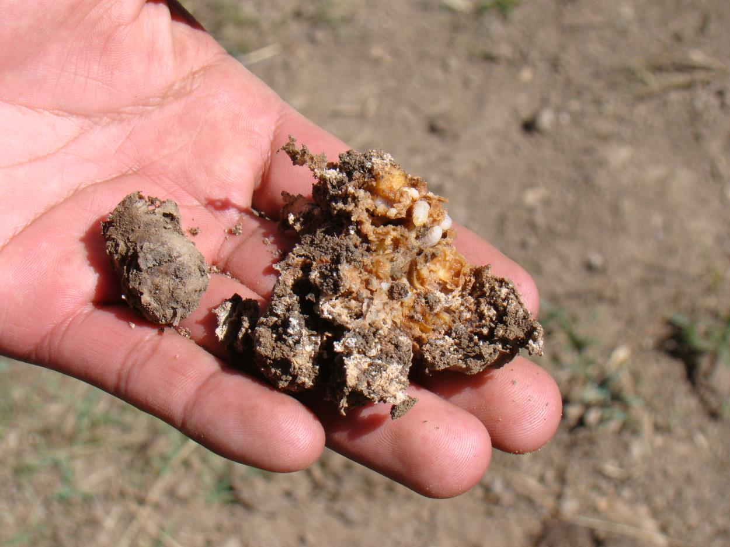
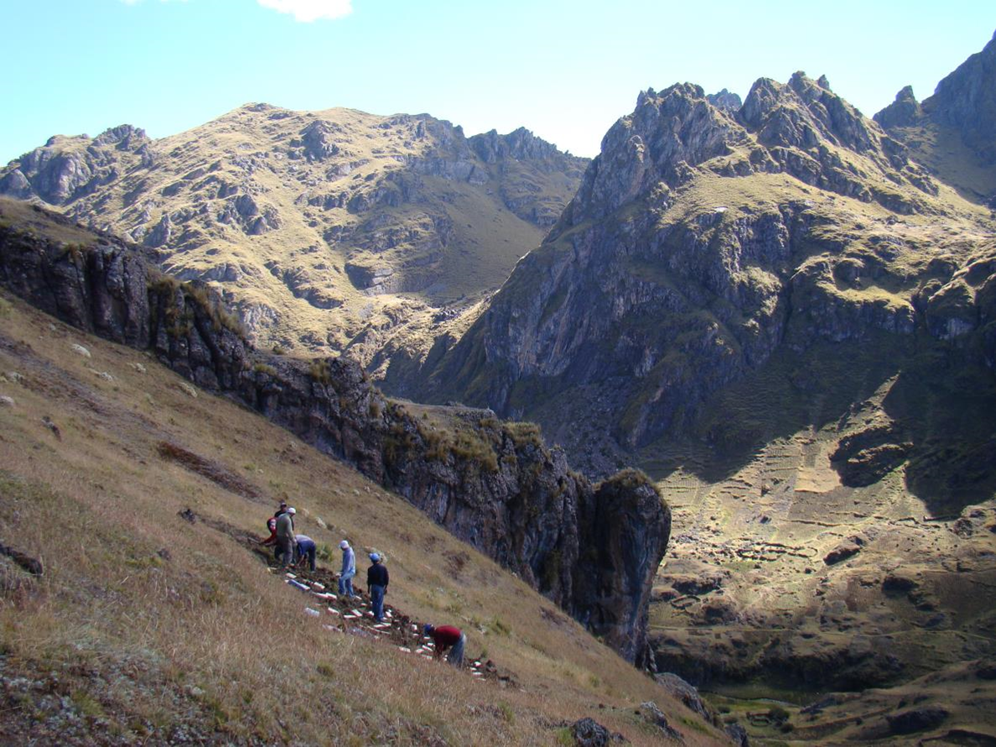
Community Concerns
Anecdotal evidence of potatoes being steadily pushed up to higher elevations
Increased predation by crop pests
Traditional agricultural practices and way of life being threatened
Image Credits: David Ellis
Notes:
The indigenous Quechua farmers have moved their potato crops to ever higher elevations in the face of increasing temperatures at lower elevations and increasing crop predation by weevils. Because they are determined not to resort to pesticides and to continue traditional farming practices, their way of life is becoming increasingly imperiled.

Slide 6
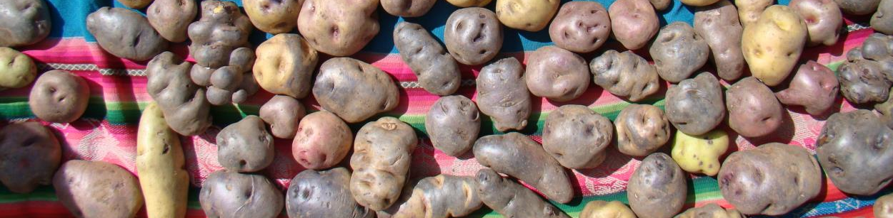
Objectives
Identify changes in growing patterns in Parque de la Papa
Quantify changes in climatic patterns in Parque de la Papa
Develop a predictive model to assess areas for optimal potato cultivation
Enable indigenous communities to continue using traditional agricultural methods
Image Credit: David Ellis
Notes:
Our objectives were to quantify changes in growing conditions and climatic patterns within the park and to create a predictive model to assess areas for optimal potato cultivation.

Slide 7
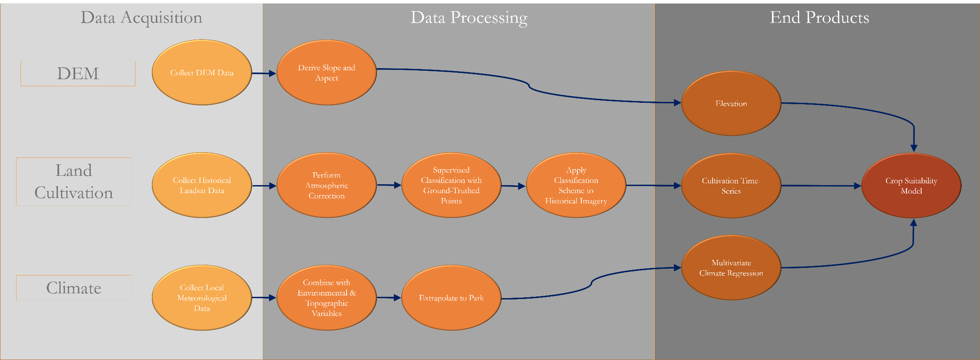
Methodology
Notes:
Broadly, we created a crop suitability model by combining three different elements: Elevation, Land Cultivation History, and Climate.

Slide 8
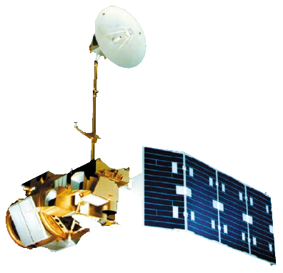


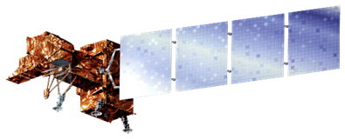
Data Acquisition
Multispectral imagery from Landsat 8 used to create classification
Weather station data used to create climate model
Both were combined with information on weevils to create habitat suitability model
Landsat 5, TM
Landsat 8, OLI
Terra, ASTER
Landsat 7, ETM+
Image Credits: NASA
Notes:
Level 1 GeoTIFF imagery for Landsat 5 Thematic Mapper (TM), 7 Enhanced Thematic Mapper+ (ETM+), and 8 Operational Land Imager (OLI) were downloaded from the United States Geological Survey (USGS) GloVis server for path 4, row 69. All imagery was collected for the month of May, just before the harvest and, therefore, a time of maximum reflective vegetation. If more than 10% of the study area was covered with clouds, the image was excluded.

Slide 9
Data Processing – Classification
Ground-control points Supervised Classification
Classification Scheme New Points
Point Validation Refined Classification Scheme
Notes:
Initially, a series of ground-control points collected in 2016 by field technicians were used to train a classification scheme . This classification scheme was applied to the most recently available Landsat imagery. A second set of points predicted by the model were sent back to the field technicians for validation and were subsequently used for further model training.

Slide 10
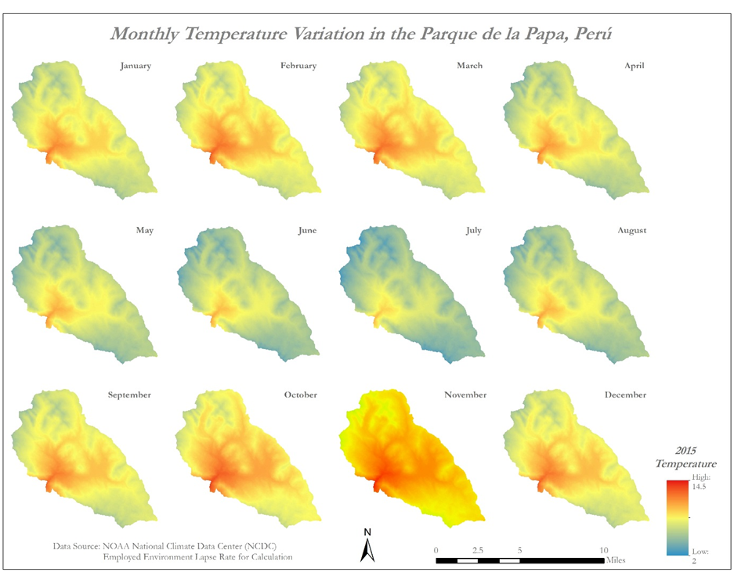
Data Processing – Climate
*We will create an editable version of this figure
Notes:
Weather data, including precipitation and temperature, were collected from the National Climatic Data Center’s (NCDC) Global Summary of the Day (GSOD) interface. The weather station used was located at the Teniente Alejandro Velasco Astete International Airport in Cusco, located at 3310 m above sea level and 25 km away from the park. Temperature, light intensity, relative humidity and dew point data were also provided by the CIP partners from HOBO data logging units placed at different locations throughout the park. These units, from which hourly weather data were extracted, are placed at higher elevations than the airport. The HOBO data falls within distinct time ranges from 2012-2013, 2013-2014 and 2014-2015 .

Slide 11
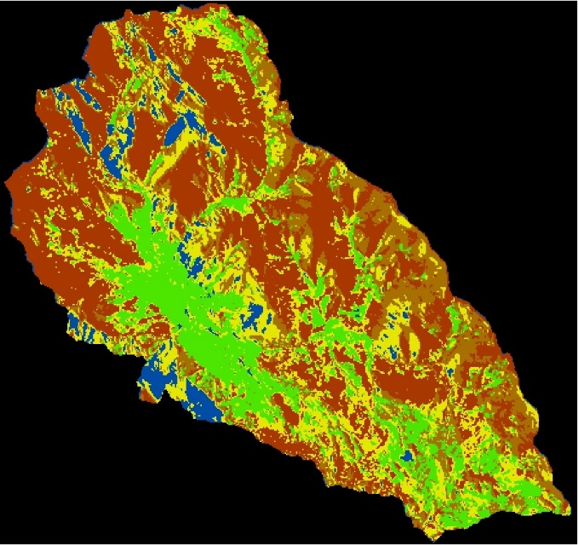
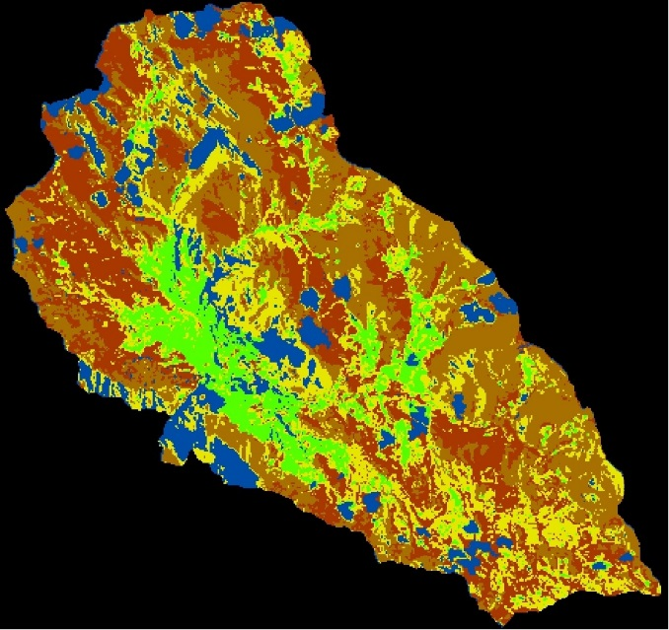
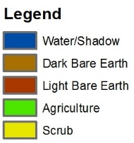
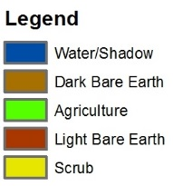


Results – Classification
Classification of 1990 Landsat 5 Image
Classification of 2007 Landsat 5 Image
Vs.
Notes:
These are our preliminary classification results.

Slide 12
Results – Climate Trends
Notes:
Annual average temperatures have increased since 1980, however it is impossible to say if this is due to long term global climate shifts or more localized mesoscale climate events. Five year average temperatures have remained largely the same.

Slide 13
Results – Climate Trends
Notes:
It is noteworthy that temperature variation between months has increased, particularly at the beginning and end of the year during the growing season.

Slide 14
Results – Crop Suitability Model
TBD

Slide 15
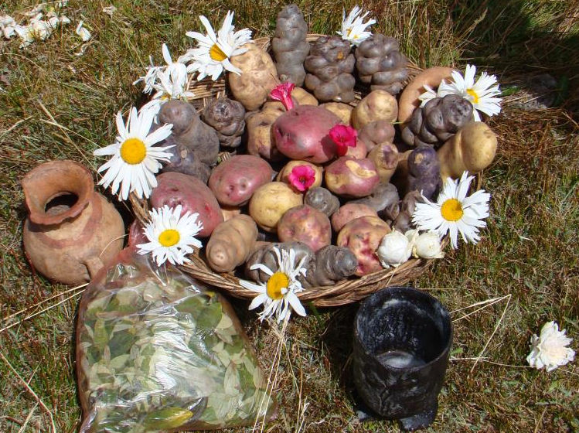
Conclusions
Image Credit: David Ellis

Slide 16
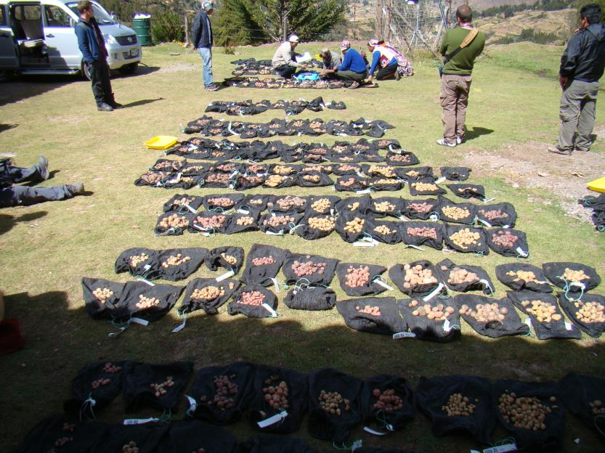
Errors & Uncertainties
Missing values in weather station data
Weather data limited to one station
Image Credit: David Ellis
Notes:
The HOBO data looging units used had a limited temporal resolution. The weather station used was located at the Teniente Alejandro Velasco Astete International Airport in Cusco, located at 3310 m above sea level and 25 km away from the park and had to be extrapolated to the study area.

Slide 17
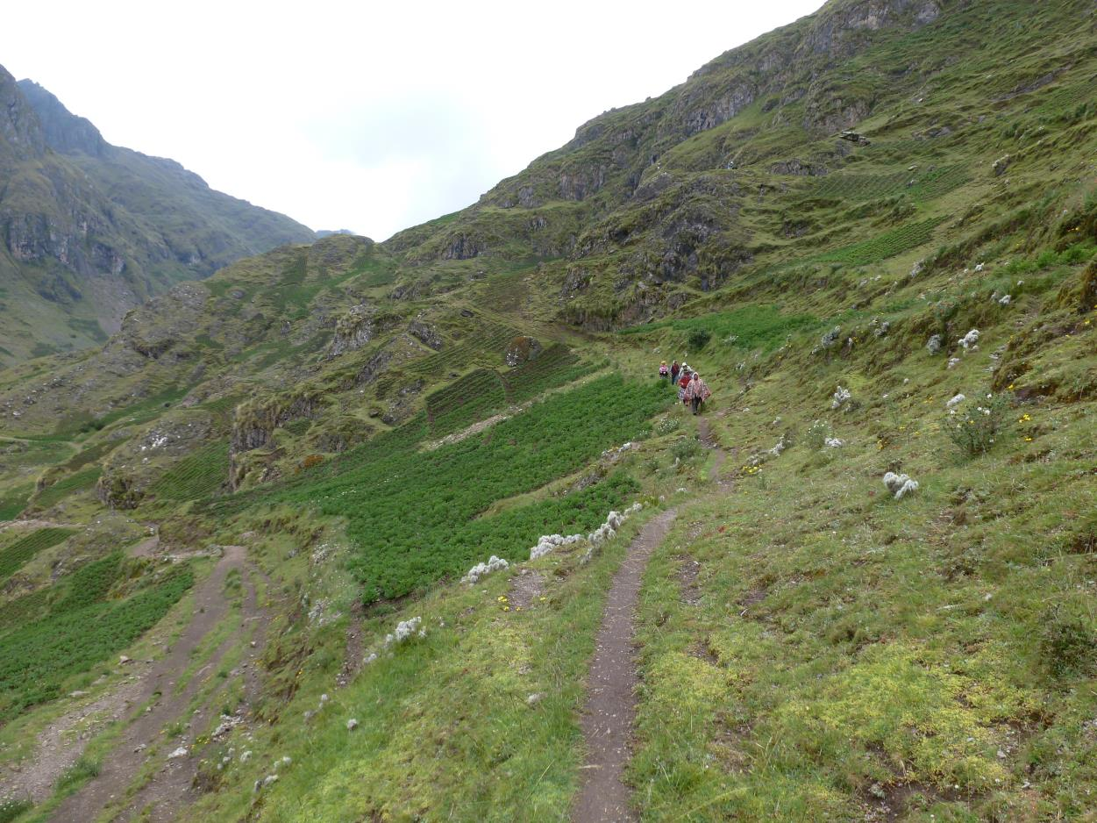
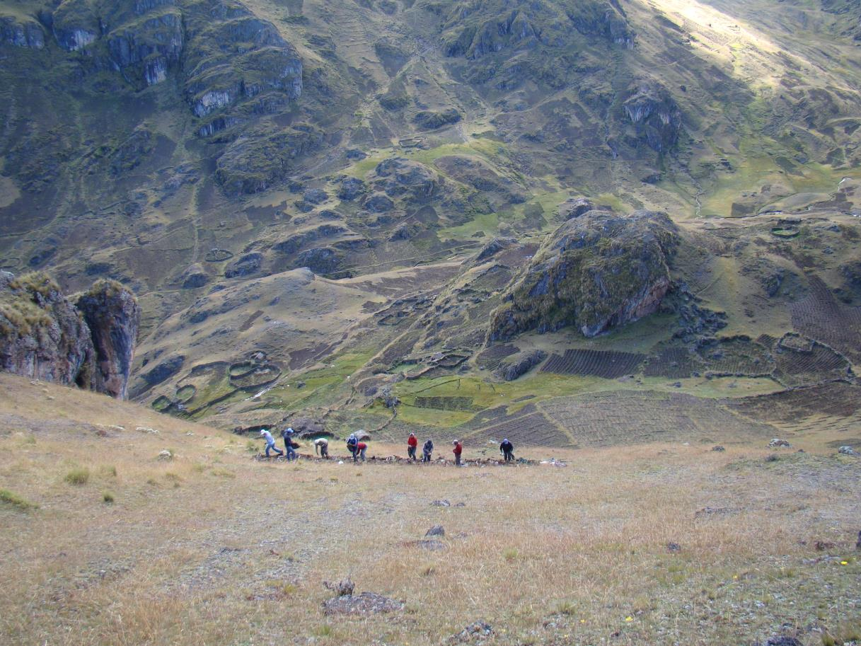
Future Work
Refine classification with high resolution imagery
Develop habitat suitability model for potatoes
Image Credit: David Ellis
Notes:
This project is planned to continue in the Summer 2016 term.

Slide 18
Advisors
Dr. Marguerite Madden, UGA Center for Geospatial Research
Dr. Kenton Ross, NASA DEVELOP National Program
Partners
Genesis Abreu and Alejandro Argumedo, ANDES
Noelle Barkley, David Ellis, Rene Gomez, and Henry Juarez, CIP
Others
We would also like to acknowledge the contributions of the Perú Climate I team: Rebekke Muench, Kayla McDonald, Michael Sclater, Richard Rose, and Dajon Begin.

