Slide 1
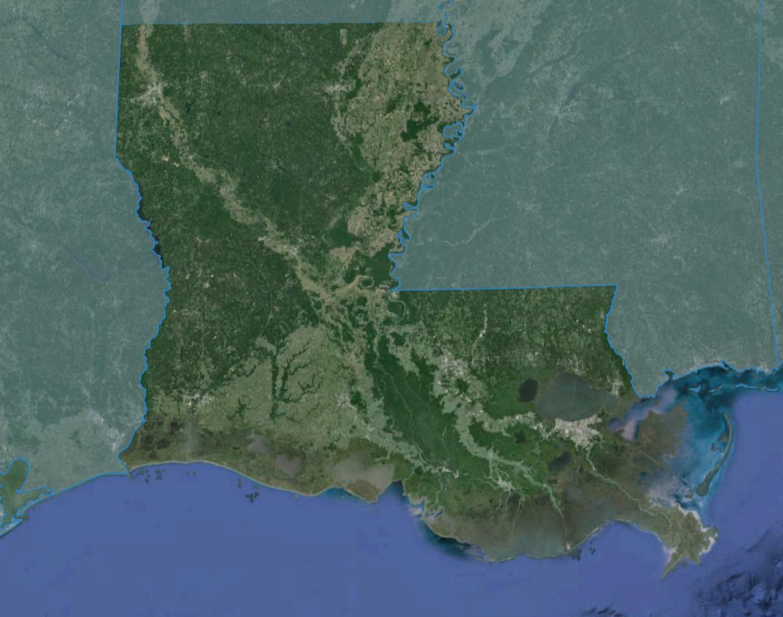
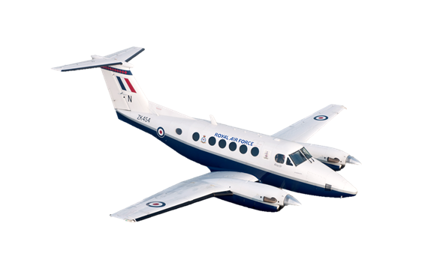
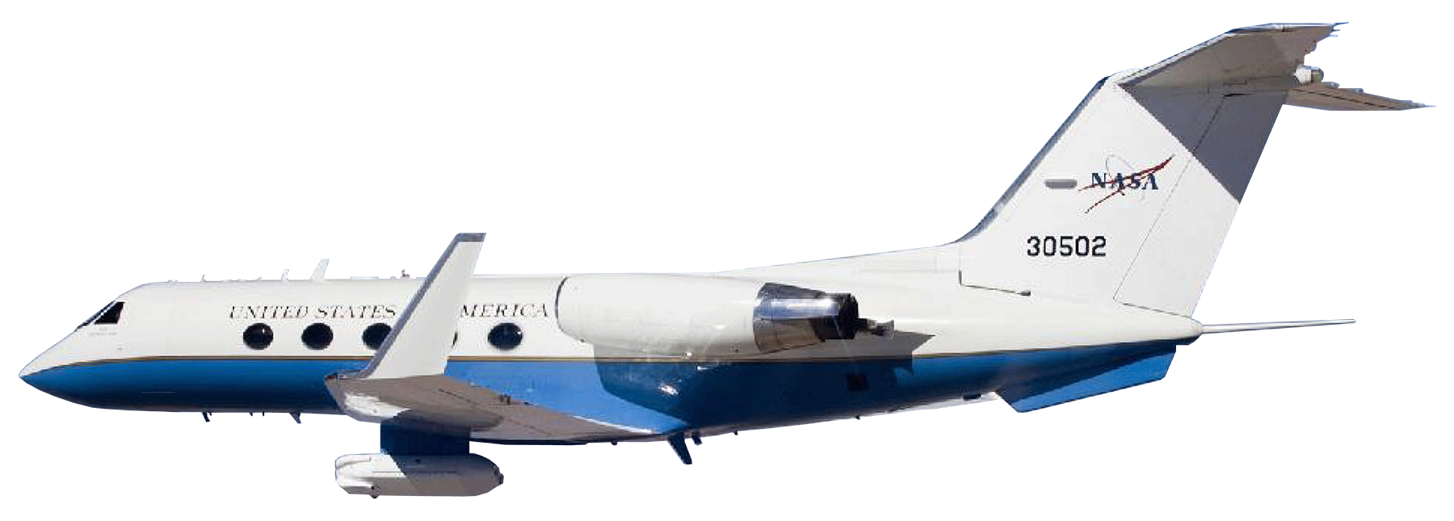
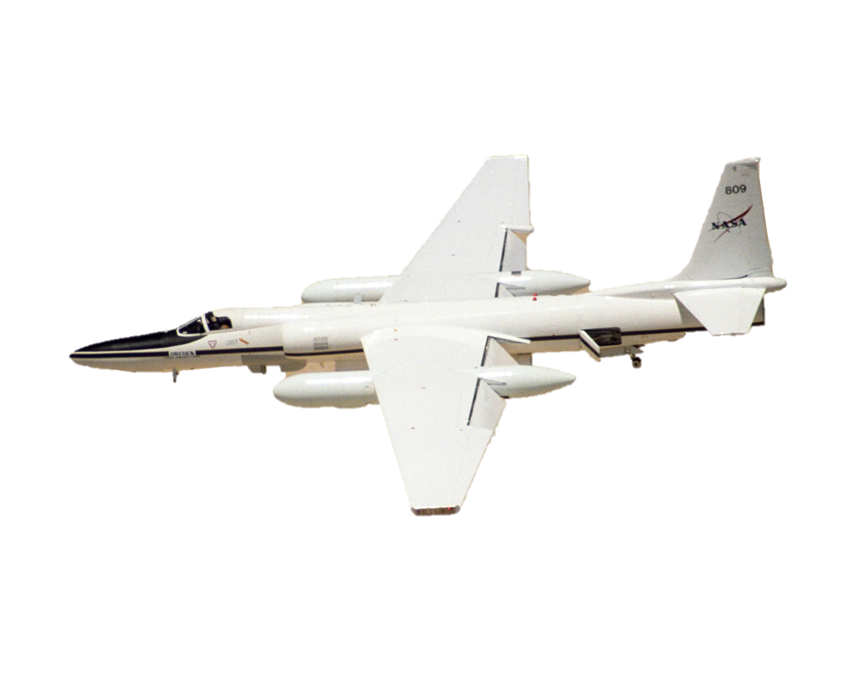
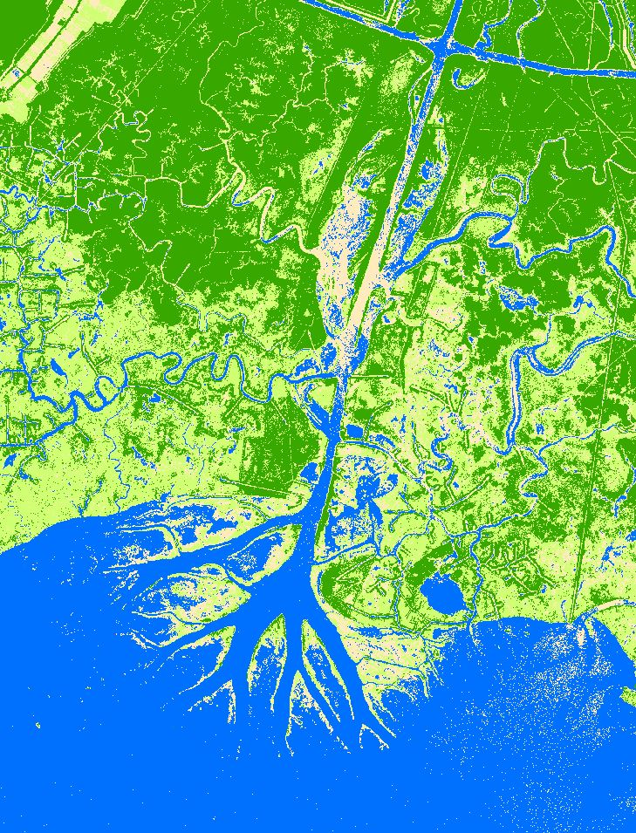
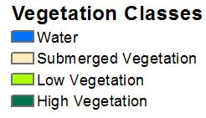
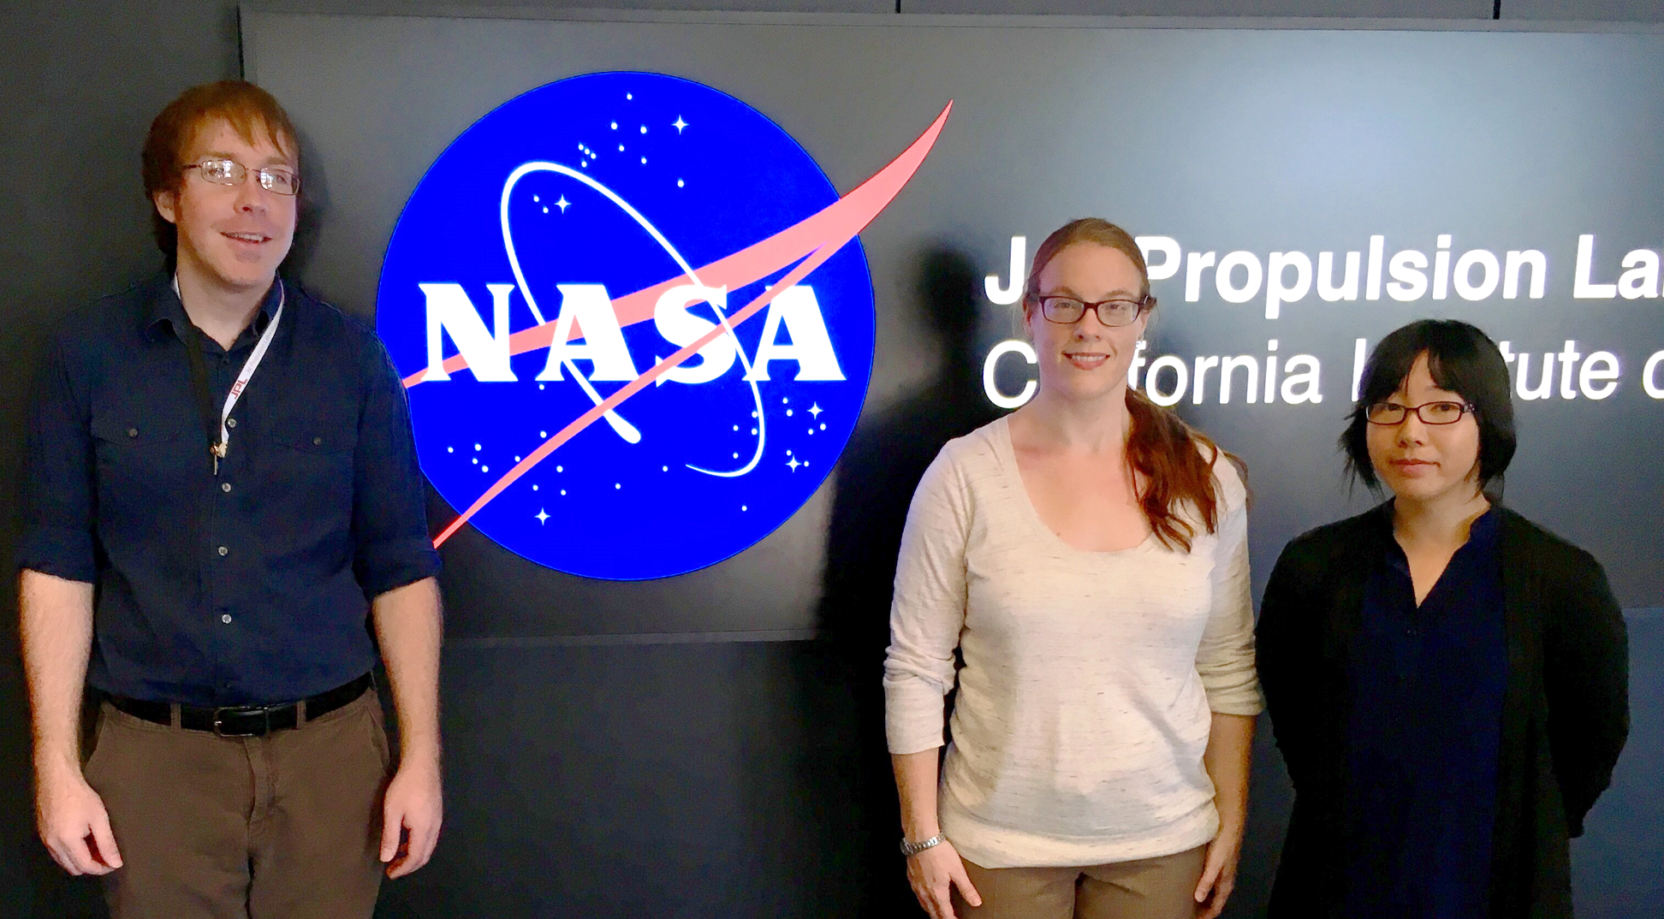
Louisiana Ecological Forecasting II
Using UAVSAR, AVIRIS, and AirSWOT to Model Coupled Water Flow and Sediment Transport in Delta Building within the Wax Lake Delta, Louisiana to Inform Coastal Restoration Efforts
Erika Higa (Project Lead), Emily Beck, Mark Barker
DEVELOP National Program at NASA Jet Propulsion Laboratory
Abstract
Objectives
Keep this blank for now.
Body text point size should be at least 24.
Caption text point size should be at least 16.
Feel free to rename, move, and resize sections as needed.
Extrapolate delta vegetation elevations using UAVSAR
Model water flow and sediment transport using Deltares Delft3D
Calibrate resulting model with AirSWOT
Examine delta formation processes to gain a better understanding of why the Wax Lake Delta is aggregating
Study Area
Methodology
Raster Datasets of Bathymetry
(ArcGIS)
Vegetation Species Classification from AVIRIS
(Exelis ENVI)
Delft3D Hydrological Model
Calibrate Model using AirSWOT Data
Modeled Sediment Transport
In Situ Data: Vegetation Species, Water Level, Flow Rate
Louisiana Wax Lake Delta
Modeled Water Flow
Study Period:
January 1985 – October 2015
Vegetation Elevation Mask from UAVSAR
(Python)
Earth Observations
AirSWOT
UAVSAR
Results
[Still in Progress]
Insert bathymetry image
Insert Delft3D model output image
AVIRIS-NG
Project Partners
US Naval Research Laboratory
Louisiana Universities Marine Consortium
Acknowledgements
Science Advisor Dr. Cathleen Jones, NASA Jet Propulsion Laboratory
Science Advisor Dr. Marc Simard, NASA Jet Propulsion Laboratory
Doug Edmonds, Delft3D
Past DEVELOPers Brittany Zajic and Raul Garcia
UAVSAR data classified into vegetation classes
Caption here
Caption here
Team Members
Conclusions
Use bullets.
Use complete sentences with periods.
[Still in Progress]
From left to right: Mark Barker, Emily Beck, Erika Higa
NASA Jet Propulsion Laboratory

