Slide 1
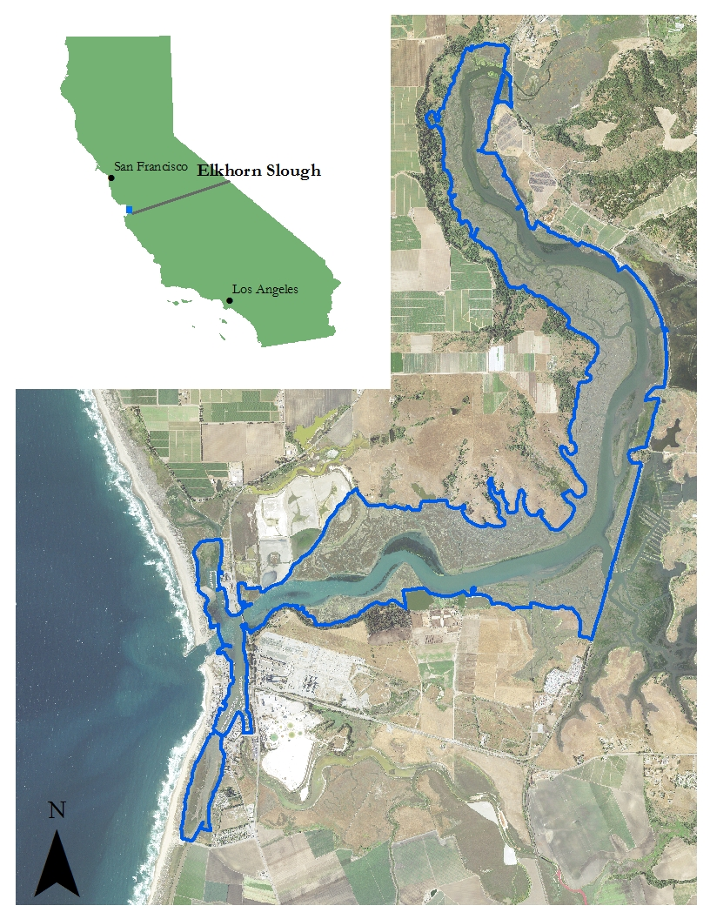
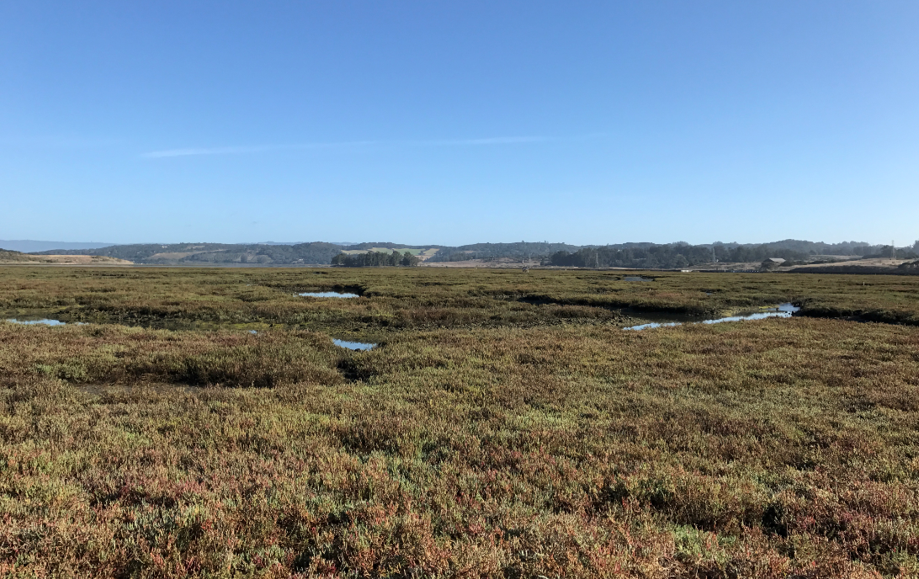
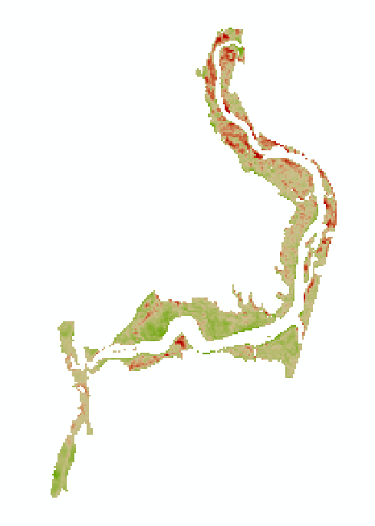
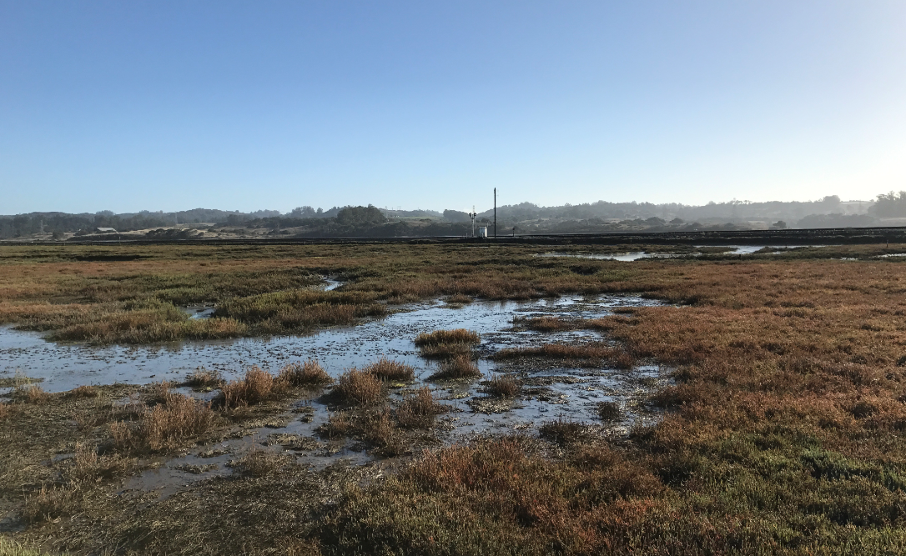
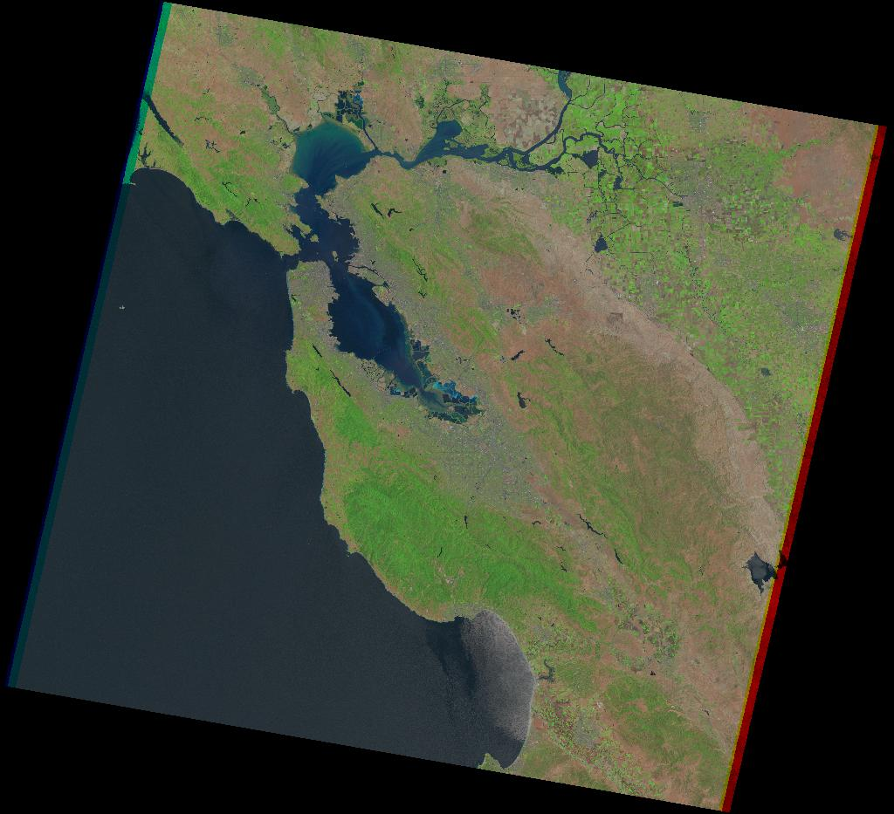
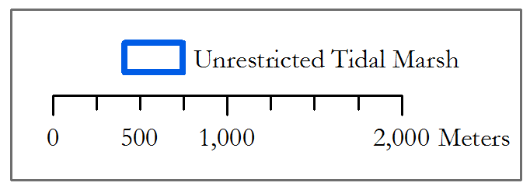
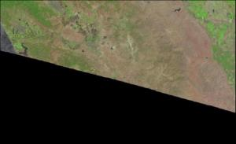
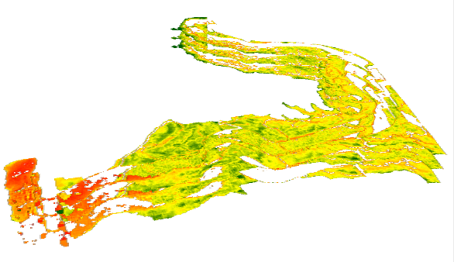
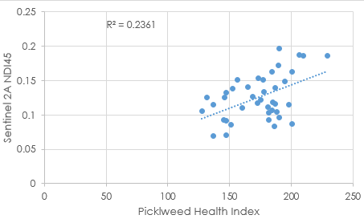
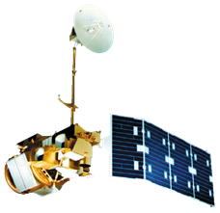
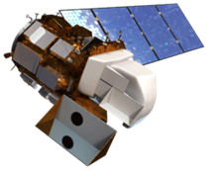
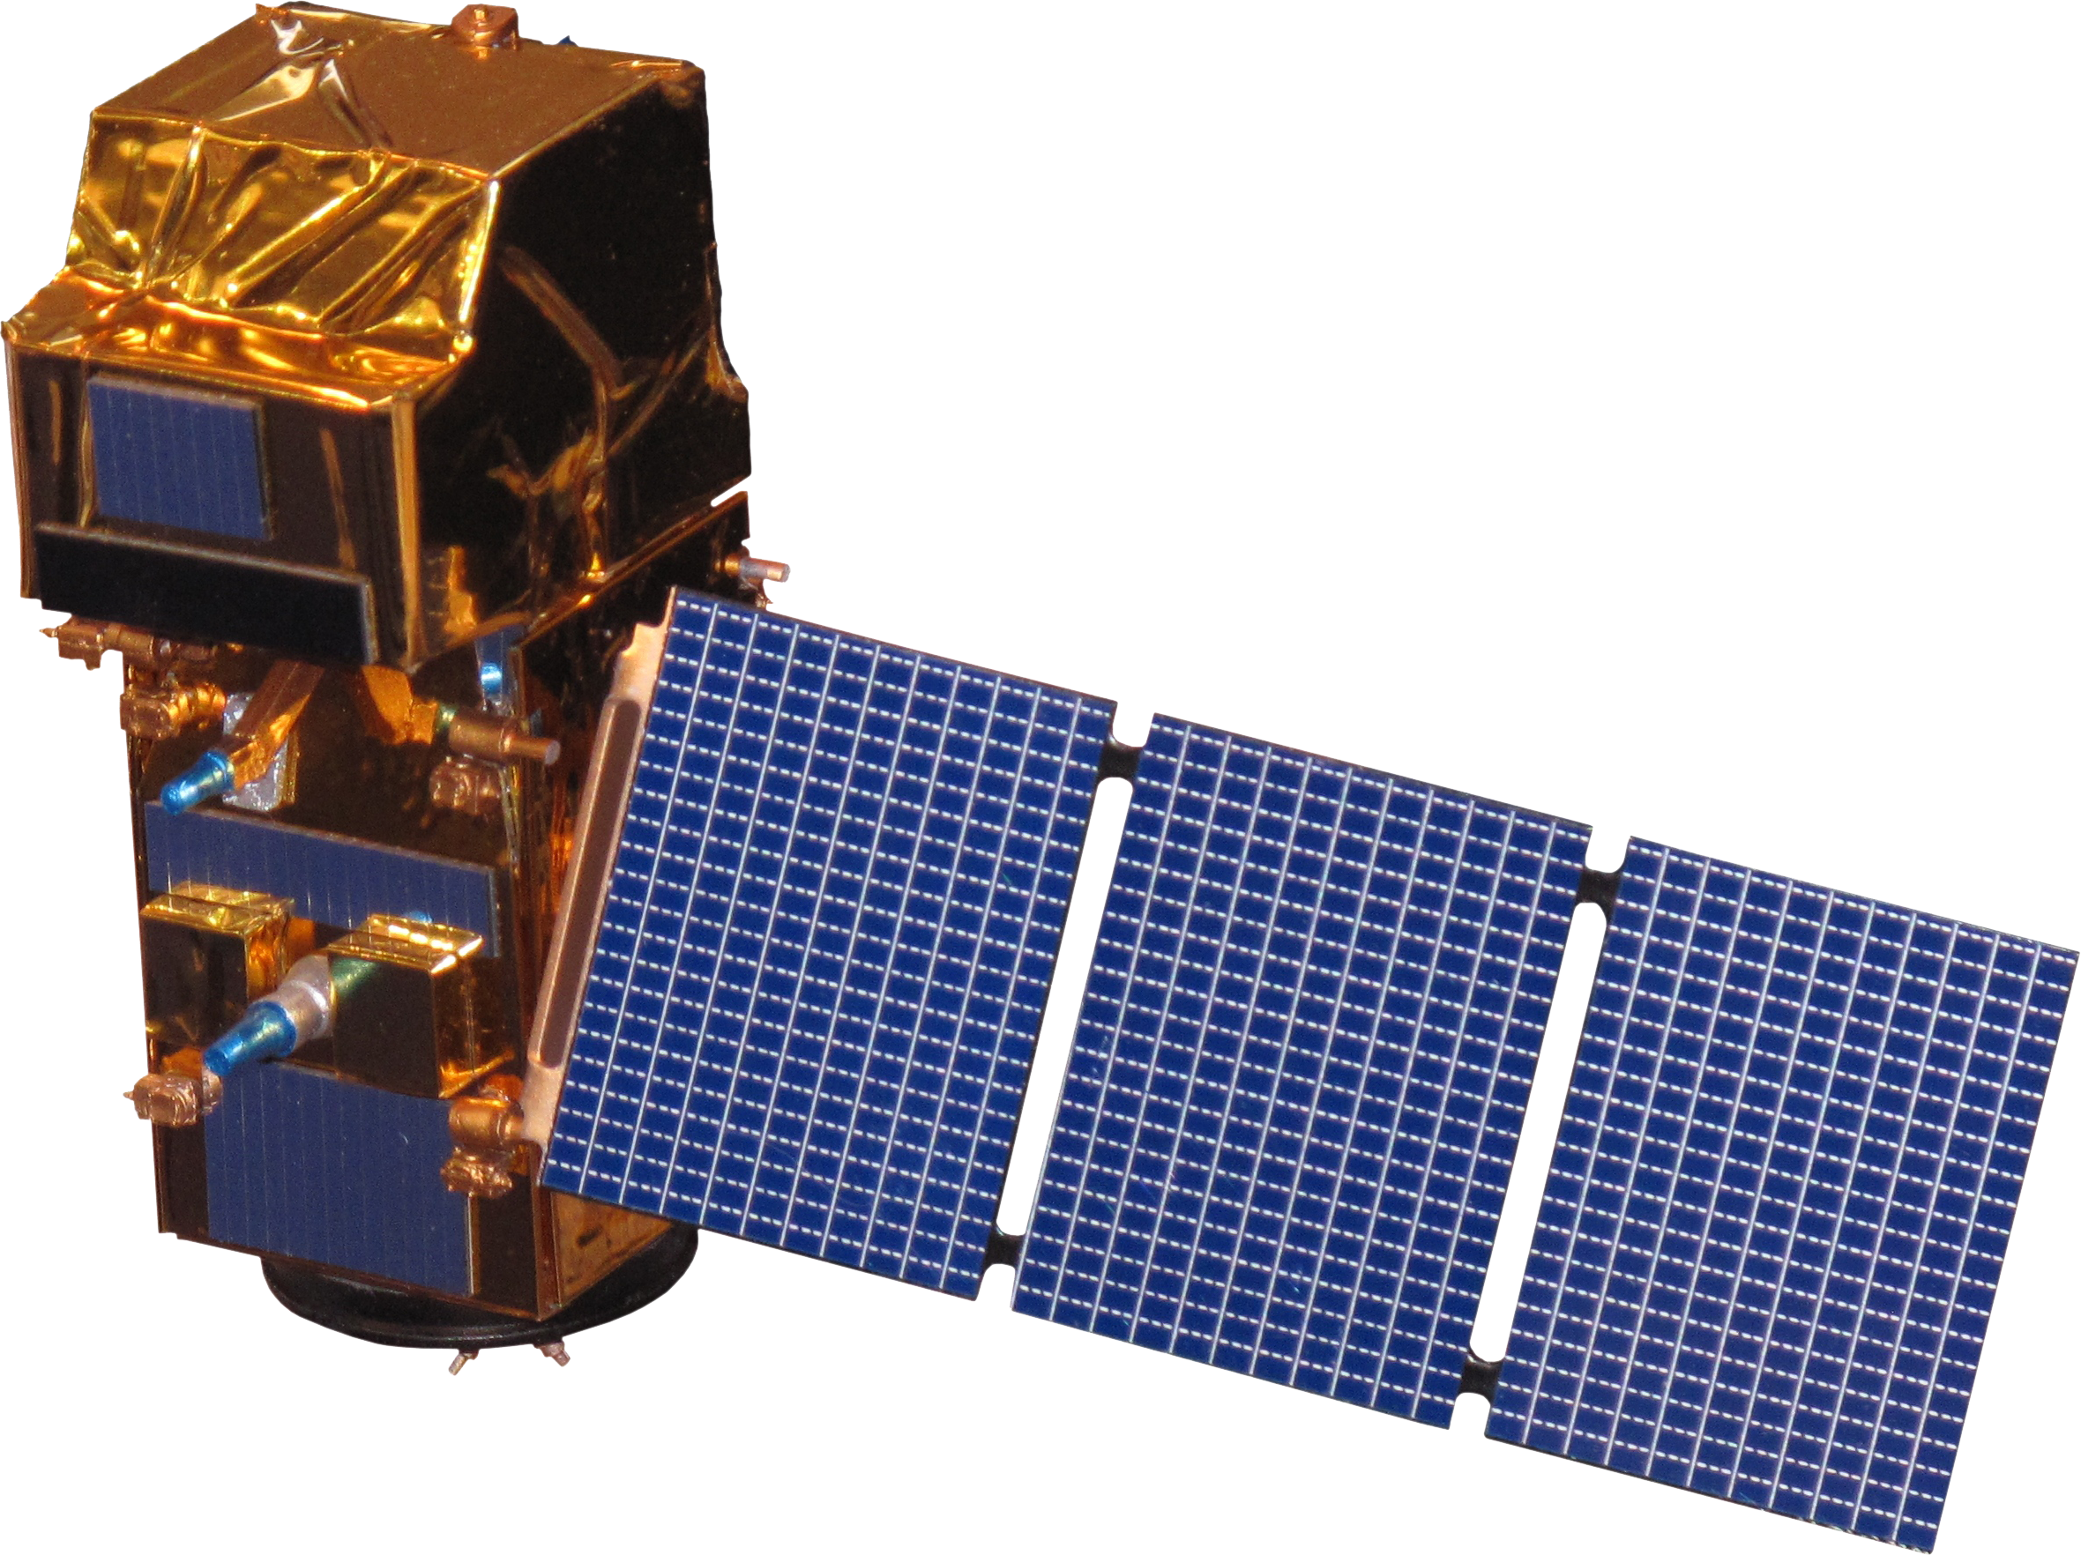
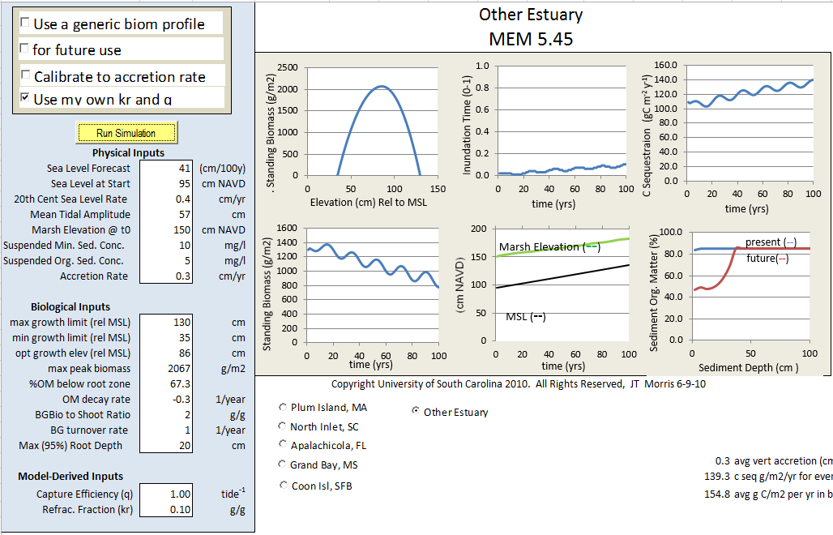
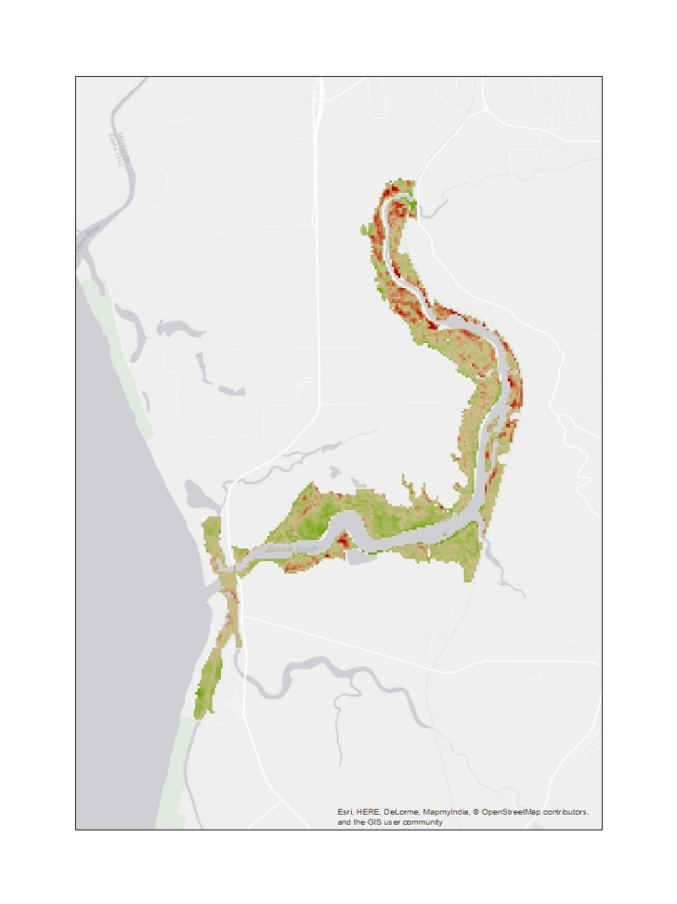
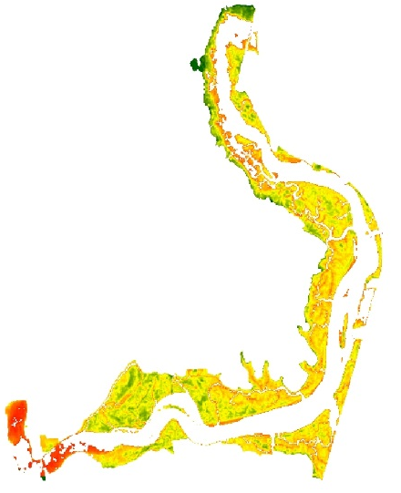
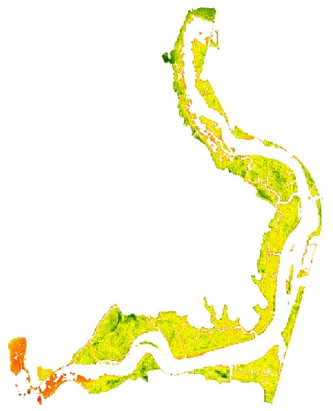
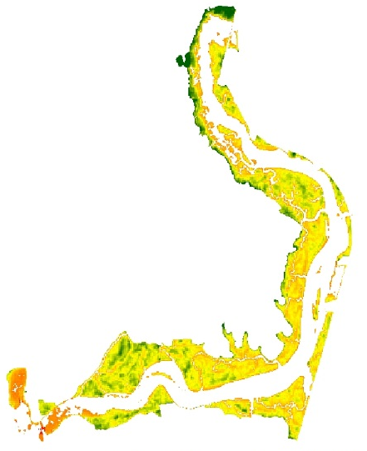
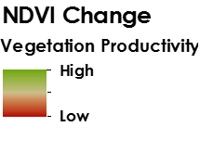
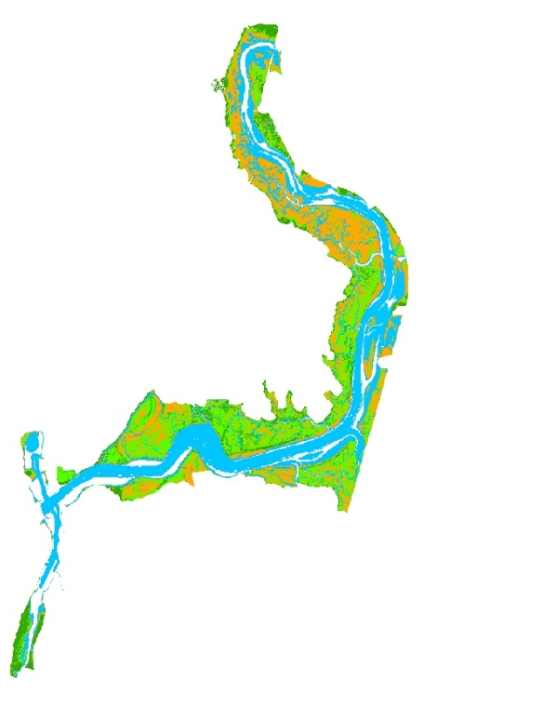
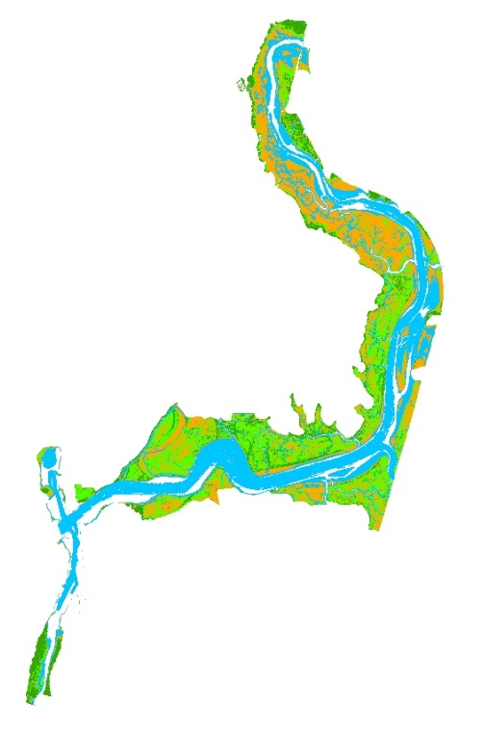
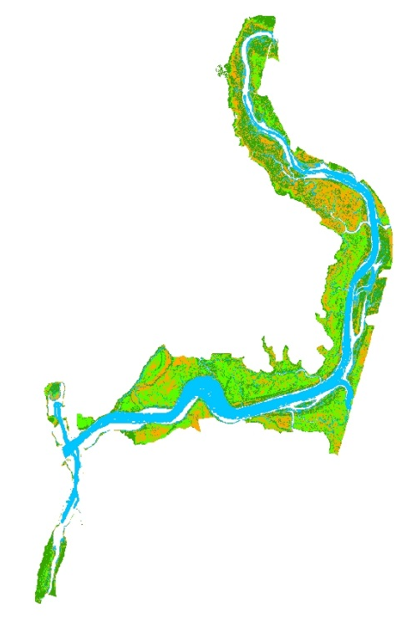
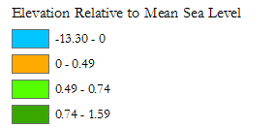
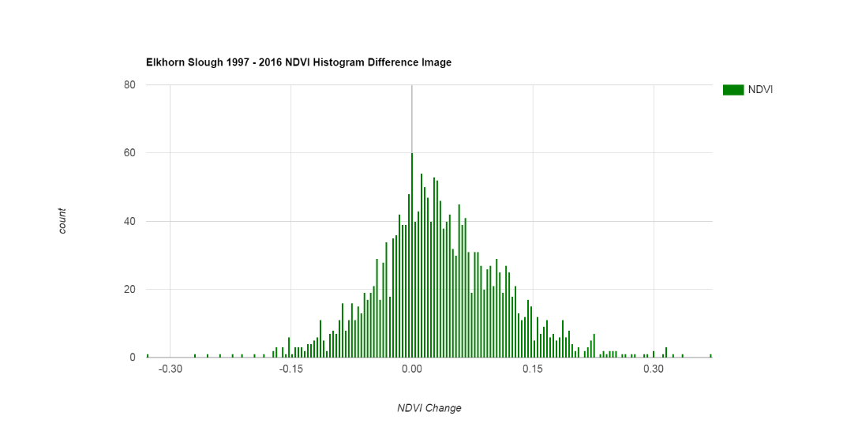
Analyzing the Historical, Current, and Future Trends in California’s Elkhorn Slough to Understand the Effects of Climatic Variation and Sea Level Rise
Abstract
Objectives
Elkhorn Slough is an ecosystem of high biodiversity found in Monterey Bay, California that protects coastline erosion, naturally filters water, provides critical habitat for unique species, and sequesters carbon. However, Elkhorn Slough is experiencing tremendous loss of its marshland extent and stress to vegetation due to threats of rising sea levels and climatic variation. These changes present an opportunity to identify spatial changes and patterns utilizing remotely sensed imagery and forecast the resilience of the slough under different climatic scenarios. This study uses Landsat imagery to detect growth and loss within the slough from 1997 to present, and map the slough’s evolution across time and space following large El Niño Southern Oscillation (ENSO) years. In addition, this study integrates Sentinel-2/Airborne Visible and Infrared Imaging Spectrometer (AVIRIS) to compare current day marsh extent and health with in situ data provided by Elkhorn Slough National Estuarine Research Reserve (ESNERR). The Marsh Equilibrium Model (MEM) also incorporates inputs from in situ data to predict the Elkhorn Slough’s resilience and adaptation to suspended sediment variations and sea level rise scenarios. These comprehensive historical analyses, in conjunction with the present-day assessment of marsh resilience from the model, offer spatial and temporal insights into Elkhorn Slough’s ecological feedbacks. The results from this study will inform ESNERR of Elkhorn Slough’s condition to help future management of this important ecosystem.
Identify spatial and temporal trends in vegetation health from 1997 to 2016 by applying Normalized Difference Vegetation Index (NDVI) in Google Earth Engine.
Assess current vegetation health within the Elkhorn Slough by comparing current satellite imagery with in situ vegetation data.
Forecast marsh resilience to sea level rise using the Marsh Equilibrium Model (MEM).
Study Area
Methodology
Landsat Historical Analysis:
Map NDVI change between El Niño years
Figure 2A. An image of healthy marsh located in Yampah Marsh, Elkhorn Slough.
Download Landsat image
Apply NDVI to each Landsat image in GEE to assess vegetation density during El Niño years
Current Day Imagery/In Situ Data Comparison
Plot data and run regression to detect trends between imagery and in situ data
Acquire Sentinel 2A Image
(August 13, 2016)
Apply Vegetation Indices (GEE)
Extract Vegetation Index Values to in situ points
Figure 1. A map of Elkhorn Slough’s unrestricted tidal marsh, located in Monterey County, CA.
Figure 2B. An image of unhealthy marsh located in Yampah Marsh, Elkhorn Slough.
Elkhorn Slough Ecological Forecasting II
Earth Observations
Model Forecasting:
Combine data from ESNERR, Schile et al. (2014) and NOAA mean sea level trends to run the Marsh Equilibrium Model (Morris et al., 2002)
Correct 2013 NOAA Coastal California TopoBathy Merge Project DEM (Buffington et al., 2016)
Airborne Visible and Infrared Imaging Spectrometer (AVIRIS)
Landsat 5 TM
Landsat 8 OLI
Sentinel-2 MSI
Apply MEM output onto the corrected DEM using the model builder developed by Schile et al. (2014) in ArcMap.
MEM (Morris et al., 2002)
Conclusions
Results
An NDVI change average of 0.55 indicates increased vegetation productivity for pickleweed coverage during El Niño years between 1997 to 2016, and that vegetation productivity generally decreased during years without the presence of El Niño.
The Normalized Difference Index-45 (NDI45) correlated strongest (R² = 0.27) with Pickleweed Health Index, the proxy variable used to measure vegetation health from in situ data.
The Marsh Equilibrium Model (MEM) predicted that with sea level rise the marsh would improve or remain relatively constant, inconsistent with predictions based on field observations, suggesting current model simulations do not capture Elkhorn’s Slough’s dynamic and stressed state. Future tests should be conducted to assess parameters and inputs to obtain a more realistic projection of Elkhorn’s adaptations.
Figure 3. A map of NDVI change during the study period of 1997 to 2016.
Figure 5 Multiple Vegetation indices applied to Sentinel 2-MSI image from August 2016.
Normalized Difference
Vegetation Index (NDVI)
Normalized Difference
Index-45 (NDI45)
Inverted Red-Edge
Chlorophyll Index (IRECI)
Figure 6. Marsh resilience to sea level rise outputs from the MEM version 5.4.5 compared to current marsh state.
Figure 4. Corresponding histogram of 1997 to 2016 NDVI difference.
Acknowledgements
Dr. Juan Torres-Pérez and Dr. Sherry Palacios, Bay Area Environmental Research Institute, Project Advisors
Brittany Zajic and Jenna Williams, NASA DEVELOP Ames Research Center
Irma Caraballo Álvarez, Abigail Childs, Kirsten Jurich, and Martha Sayre
Team Members
14 cm 100 cm Corrected DEM
Project Partners
Elkhorn Slough National Estuarine Research Reserve (ESNERR)
US Geological Survey (USGS), Western Geographic Science Center
Melanie Feen
Point of Contact
Hannah Friedrich
Stephanie Ly
This material is based upon work supported by NASA through contract NNL11AA00B and cooperative agreement NNX14AB60A. Any mention of a commercial product, service, or activity in this material does not constitute NASA endorsement. Any opinions, findings, and conclusions or recommendations expressed in this material are those of the author(s) and do not necessarily reflect the views of the National Aeronautics and Space Administration and partner organizations.
NASA Ames Research Center – Fall 2016

