Slide 1
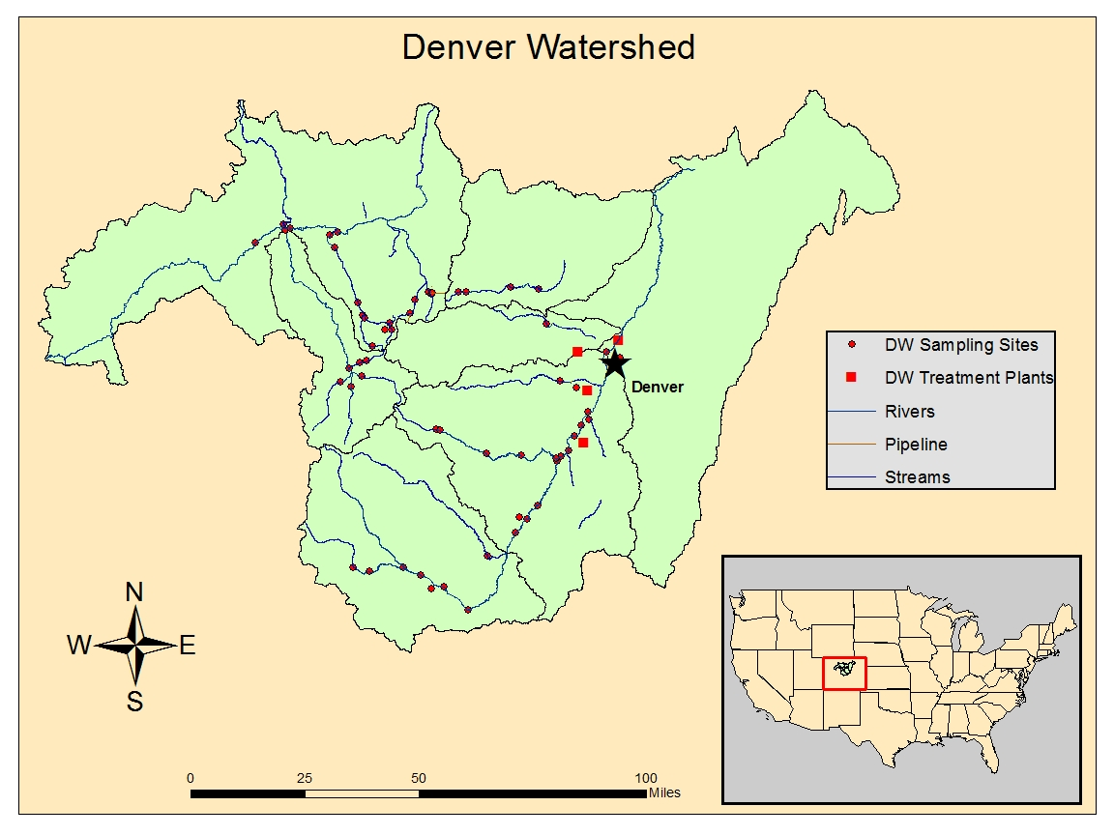
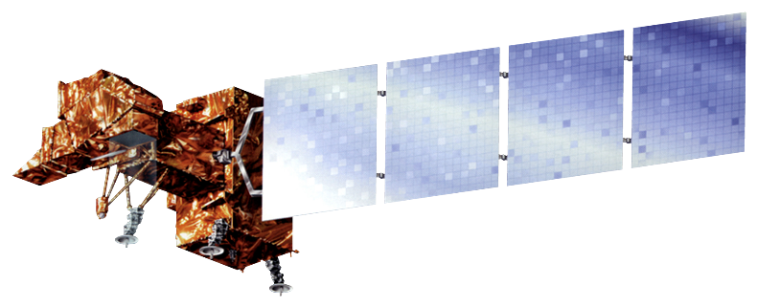
Colorado Water Resources
Utilizing NASA Earth Observations to Identify Water Quality Sampling Sites in Denver, Colorado
Geordi Alm (Project Lead), Amanda Collins, Janice M. Maldonado Jaime, Rachel Wolf
NASA Langley Research Center
Utilize NASA Earth observation land cover data from Landsat 7 Enhanced Thematic Mapper (ETM+) to identify existing infrastructure and possible pollution sources in the source waters around Denver, Colorado
Create a map identifying the optimal areas in which to place water quality sampling sites.
Data Acquisition
Data Processing
Data Analysis
Land Cover
Landsat 7 ETM+
National Land Cover Database (2011)
Converted to Top of the Atmosphere Reflectance
Fire Extent Calculation
Differenced Normalized Burn Ratio
Water Sampling Sites
Denver Water
Mosaicked Landsat Scences
Mapping potential areas for water sampling sites
Landsat 7
Soon!
We will add a nice team photo here!
Denver Water Resources
Diego Portillo
Water Resources GIS Coordinator
Sheila Pelczarski
GIS & Remote Sensing Analyst
Linda Rosales
Dr. Kenton Ross
NASA DEVELOP National Program
Science Advisor
Nathan Owen
NASA DEVELOP – Langley Center Lead

