Slide 1
Installing dnppy
A step by step Guide

Slide 2
Find NASA DEVELOP dnppy on GitHub
https://github.com/NASA-DEVELOP/dnppy

Slide 3
Click on “Download ZIP” to download dnppy-master.zip

Slide 4
Before Installing dnppy…
Eliminate redundant files in your local drive where ArcGIS is saved
C:\Python27\ArcGIS10.4\Lib\site-packages
Delete these files if found in the site-packages folder:
Numpy
Dnppy
dnppy-1.15.3b2.dist-info
Scipy
scipy-0.15.1.dist-info

Slide 5
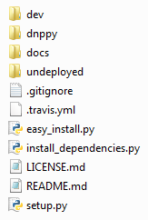
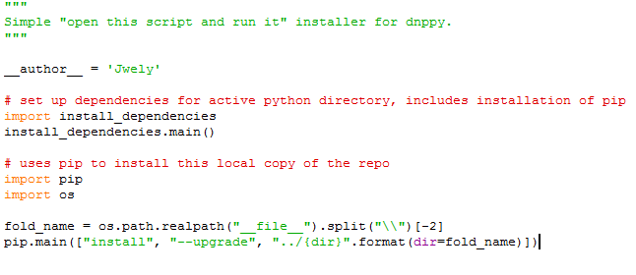
Installing dnppy
Once the contents in the zip folder are extracted, run “easy_install.py” in an IDLE environment (Python GUI)
Should look like this

Slide 6
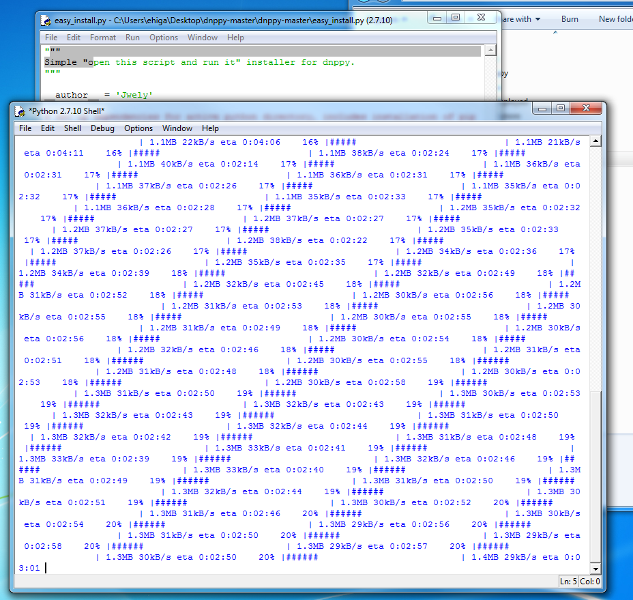
Installing dnppy
This will begin the process!
Other dependencies will be installed on your computer at this time
It may take a while based on your connection speed
It will look something similar to this

Slide 7
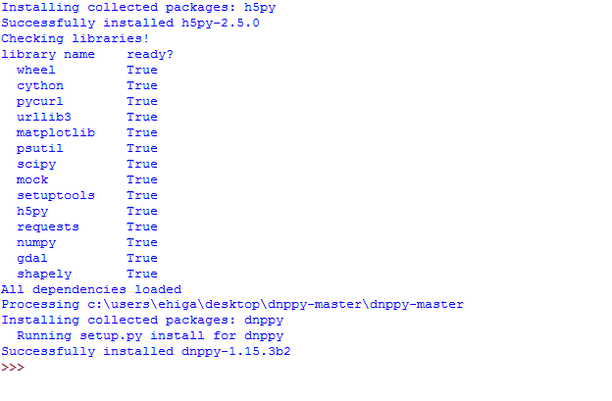
Installing dnppy
Success!
You now have access to dnppy, gdal, scipy and more
Note: if the dependencies were not successfully installed, try running “install_dependencies.py” first, then rerun “easy_install.py”

Slide 8
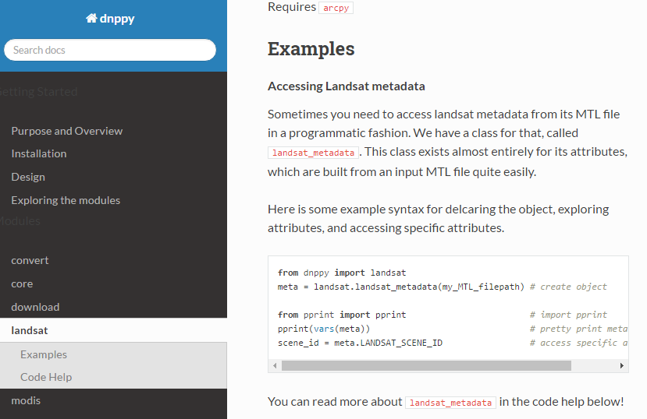
Using dnppy
Explore dnppy modules at https://nasa-develop.github.io/dnppy/
Explains parameters needed to run each module
Provides examples of code
Example code to fetch Landsat data

