Slide 1
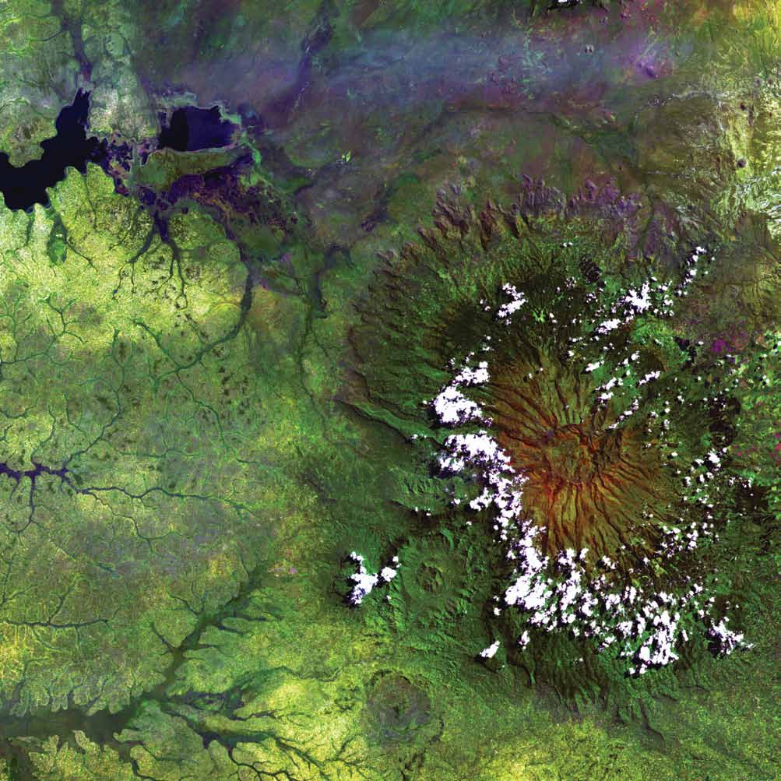
DEVELOP Orientation
Module 1. Programmatic Foundations

Slide 2
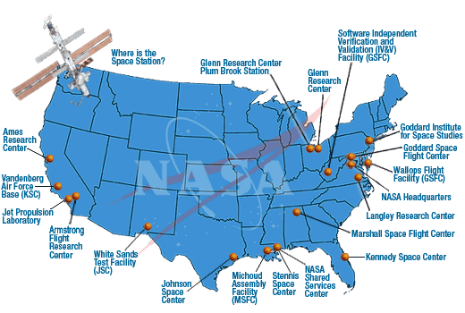
PROGRAMMATIC FOUNDATIONS
NASA History
"An Act to provide for research into the problems of flight within and outside the Earth's atmosphere, and for other purposes."
With this simple preamble, the US Congress and President Dwight D. Eisenhower established the National Aeronautics and Space Administration on July 29, 1958.
NASA began operations on October 1, 1958.
It absorbed into itself the earlier National Advisory Committee for Aeronautics (NACA).
Today, NASA has 10 Centers and multiple facilities around the country.

Slide 3
PROGRAMMATIC FOUNDATIONS
NASA Org Chart
NASA Administrator
Associate Administrator
Mission Directorates
Human Exploration and Operations
Space Technology
Science
Mission Support
Aeronautics Research
Joint Agency Satellite Div.
Heliophysics Division
Earth Science Division
Planetary Science Div.
Astrophysics Division
Applied Sciences Program
Capacity Building Program
ARSET
DEVELOP
SERVIR
You are here!

Slide 4
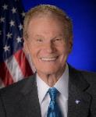
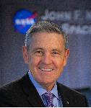
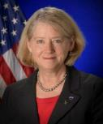
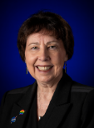
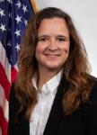
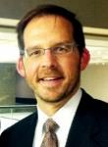
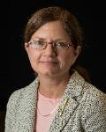
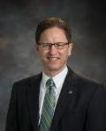
PROGRAMMATIC FOUNDATIONS
By The Way
Knowing key NASA leaders is important because you will see these people at conferences and events!
NASA Leadership
NASA Administrator
Sen. Bill Nelson
Deputy Administrator
Colonel (USAF, ret.) Pam Melroy
Bill
Nelson
Robert Cabana
Col. (USAF, ret) Pam Melroy
Associate Administrator
Robert Cabana
Science Mission Directorate
Nikki Fox, Ph.D.
Earth Science Division
Karen St. Germain, Ph.D.
Dr. Nikki Fox
Dr. Karen St. Germain
Lawrence Friedl
Applied Sciences Program
Lawrence Friedl
Capacity Building Program
Nancy Searby, Ph.D.
DEVELOP National Program
Kenton Ross, Ph.D.
Dr. Nancy Searby
Dr. Kenton
Ross
NASA Organization Chart: http://www.nasa.gov/about/org_index.html#.VBNBWvldWbM

Slide 5
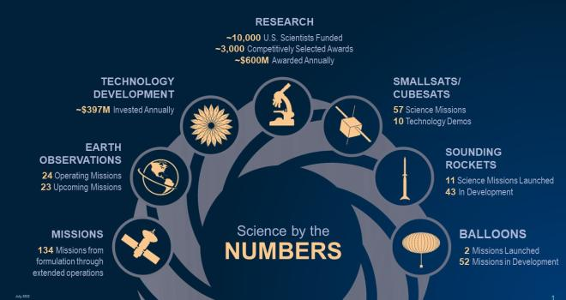
PROGRAMMATIC FOUNDATIONS
By The Way
Dr. Fox was just selected and stepped into the SMD AA position this year.
Science Mission Directorate
Science is interconnected; no important question stands alone.
The Science Mission Directorate (SMD) is an organization where discoveries in one scientific discipline have a direct route to other areas of study. This flow is something extremely valuable and is rare in the scientific world.
SMD seeks to understand the origins, evolution, and destiny of the universe and to understand the nature of the strange phenomena that shape it by…
Engaging the Nation’s science community
Sponsoring scientific research
Developing and deploying satellites and probes in collaboration with NASA’s partners around the world to answer fundamental questions requiring the view from and into space

Slide 6
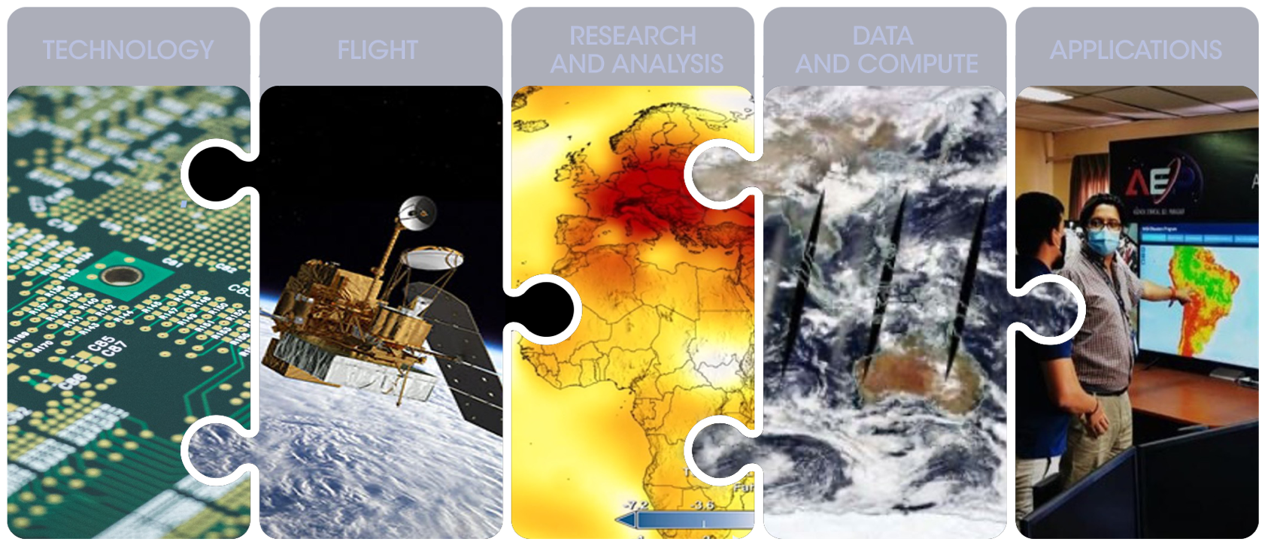
PROGRAMMATIC FOUNDATIONS
Earth Science Division
Using the global vantage point of space, ESD builds fundamental, scientific knowledge about Earth and how it is changing. ESD advances understanding of Earth as an integrated system and develops and tests applications that deliver direct societal benefit. It has five lines of business:

Slide 7
























CYGNSS (8)
NISTAR, EPIC
2015
GRACE-FO (2)
SMAP
ICESAT-2
OCO-2
2020
LIS
SAGE III
GPM
EARTH OBSERVATION (EO) FLEET
SENTINEL-6
MICHAEL FREILICH
TSIS-1
LANDSAT 8
ECOSTRESS
LANDSAT-9
SUOMI NPP
INVEST/CUBESATS
GEDI
CIRIS 2023
NACHOS 2022
CTIM 2022
NACHOS-2 2022
MURI-FD 2022
SNOOPI* 2023
HYTI* 2023
OCO-3
1995
2010
SWOT
LANDSAT 7
CALIPSO
EMIT
TERRA
TEMPO
CLOUDSAT
AQUA
AURA
JPSS INSTRUMENTS
CLARREO-PF
TROPICS (4)
2000
OMPS-LIMB 2022
LIBERA 2027
OMPS-LIMB 2027
OMPS-LIMB 2032
2005
PACE
PREFIRE (2)
ISS INSTRUMENTS
KEY
NISAR
INTERNATIONAL PARTNERS
U.S. PARTNER
ISS INSTRUMENT
JPSS INSTRUMENT
CUBESAT
LAUNCH DATE TBD
TSIS-2*
MAIA*
SENTINEL-6B
INCUS*
(PRE) FORMULATION
IMPLEMENTATION
OPERATING
EXTENDED
GLIMR*
LANDSAT NEXT*
ESO-1, 2, 3, 4*
MISSIONS
04.18.23
2025
Notes:
Outside of this room, many people think of the Moon or Mars when they think of NASA. Most people are not aware that today we have 25 missions in orbit observing our planet – with another 11 already in formulation and acquisition.

Slide 8
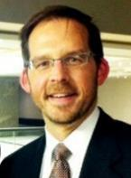
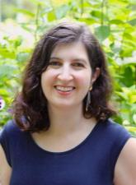







PROGRAMMATIC FOUNDATIONS
Leadership
Applied Sciences Program
NASA’s Applied Sciences (AppSci) Program helps people across the world use NASA data to solve big problems right here on Earth.
Three lines of business:
Capacity Building Program: Provides support to help institutions and individuals make better decisions about our environment, food, water, health & safety
Thematic Application Programs: Strategically invests in projects and teams that develop innovative and practical uses of Earth observations & lower the barriers to using Earth science information
Mission Planning: Enables the early and ongoing involvement of users and their priorities throughout the lifecycle of Earth science satellite and instrument missions
Lawrence Friedl,
Director
Dr. Emily Sylak-Glassman,
Deputy Director
AGRICULTURE
HEALTH &
AIR QUALITY
ECOLOGICAL CONSERVATION
DISASTERS
WATER RESOURCES
WILDLAND FIRES
CLIMATE & RESILIENCE
Notes:
Reference: https://appliedsciences.nasa.gov/

Slide 9

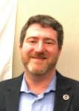
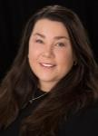
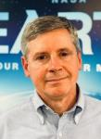
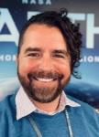

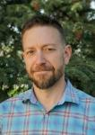
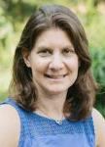
PROGRAMMATIC FOUNDATIONS
Applied Sciences Thematic Application Areas
The Applied Sciences Program is structured around thematic application areas that routinely hold solicitations and have active investment portfolios at NASA HQ:
HEALTH & AIR QUALITY
DISASTERS
ECOLOGICAL CONSERVATION
WATER RESOURCES
AGRICULTURE
WILDLAND FIRES
CLIMATE & RESILIENCE
John Haynes
Dr. Shanna McClain
Woody Turner
Dr. Keith
Gaddis
Dr. Brad Doorn
Dr. Michael Falkowski
Dr. Allison Leidner (acting)

Slide 10


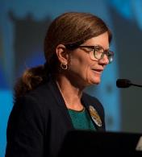
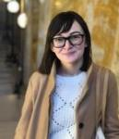
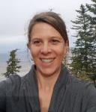
PROGRAMMATIC FOUNDATIONS
CAPACITY BUILDING
Capacity Building Program
CBP provides individuals and institutions with workforce development, training activities, and collaborative projects to strengthen understanding of Earth observations and expand their use around the world.
Through our ARSET, DEVELOP and SERVIR programs and Community Action effort that includes our Indigenous Peoples Initiative, Equity & Environmental Justice, and Prizes & Challenges elements, we work with everyone at every level — from first-time users to long-time professional users of Earth observation data.
We work through global networks like CEOS and GEO, and professional societies like AGU, to promote open data access and coordinate capacity building activities focused on users needs.
Dr. Nancy Searby
CBP Program Manager
Sydney Neugebauer
CBP Coordination & Analysis Lead
Christine Mataya
CBP Program Support Specialist

Slide 11
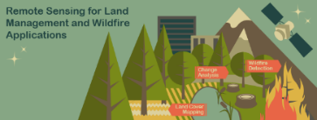

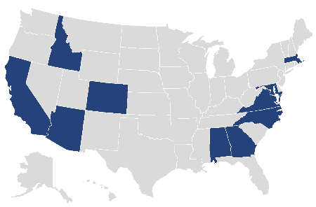
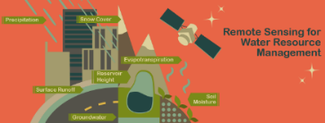

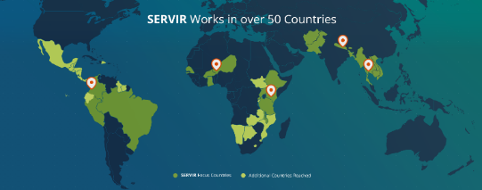
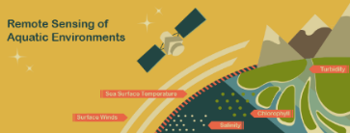

PROGRAMMATIC FOUNDATIONS
ARSET
DEVELOP
SERVIR
ARSET offers satellite remote sensing training that builds the skills to integrate NASA Earth Science data into decision-making activities. Through its decade of trainings, ARSET has reached over 100,000 participants from 180 countries and more than 10,000 organizations worldwide.
DEVELOP addresses decision-makers’ needs through interdisciplinary feasibility studies that apply the lens of NASA Earth observations to environmental issues around the globe.
Projects build capacity to use Earth observations in participants and partner organizations through eight thematic areas during three terms a year.
SERVIR connects space to village by helping developing countries use satellite data to address critical challenges in food security, water resources, weather and climate, land use, natural disasters, and air quality.
A partnership of NASA, USAID, and leading technical organizations around the world, SERVIR develops innovative solutions to improve livelihoods and foster self-reliance in Asia, Africa, and the Americas.
https://appliedsciences.nasa.gov/arset
https://appliedsciences.nasa.gov/nasadevelop
https://servirglobal.net

Slide 12
PROGRAMMATIC FOUNDATIONS
CBP Community Action Elements
Indigenous Peoples
Equity & Environmental Justice
Prizes & Challenges
The Indigenous Peoples Initiative engages with indigenous communities to foster ethical and culturally relevant space for the use of Earth observations in monitoring, mapping, and managing natural and cultural resources.
The pillars of this work include community engagement and the co-production of place-based remote sensing trainings specific to Indigenous lands and territories.
NASA has a long history with open innovation, inviting the public to participate in the agency’s scientific and technical explorations.
Within the Applied Sciences Program, we crowdsource ideas, technologies, scientific advances, and other “solutions” from people around the world through incentivized competitions called prizes and challenges.
NASA’s ESD is committed to ensuring that the investment the nation has made in NASA satellites and science benefits people across the U.S. and helps them make informed decisions about the very real challenges they face in their communities.
The EEJ program connects communities with EO to advance equity and address environmental injustices. The program manages 39 ROSES projects focused on a variety of topics impacting EJ communities.
https://appliedsciences.nasa.gov/indigenous-peoples-pilot
https://appliedsciences.nasa.gov/what-we-do/capacity-building/environmental-justice
https://appliedsciences.nasa.gov/what-we-do/prizes-and-challenges

Slide 13
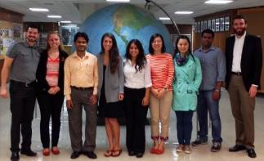
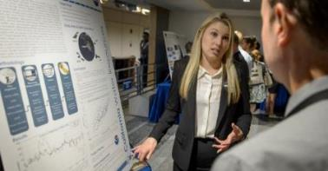
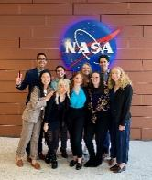
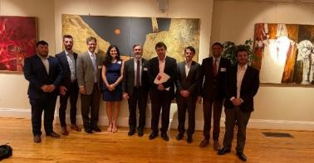
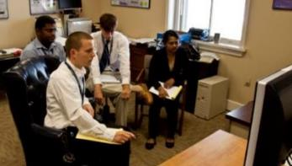
DEVELOP bridges the gap between NASA Earth Science and society by building skills to use satellite data in participants and partners.
Dual capacity building program that empowers participants and partner organizations to use Earth observation data to inform environmental decision-making
Workforce development program for individuals 18+, open to students and non-students, all majors and backgrounds
Conduct 10-week feasibility studies centered on partners’ decision-making interests
Interdisciplinary project teams access and apply satellite data under the guidance of NASA and partner science advisors

Slide 14
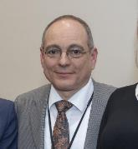
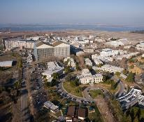
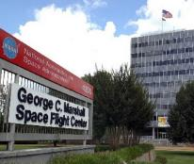
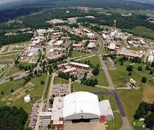
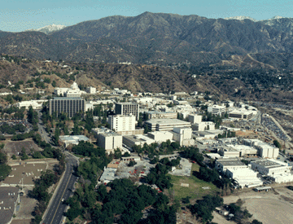
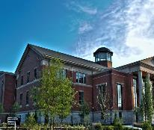
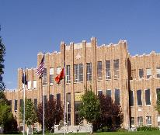
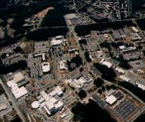
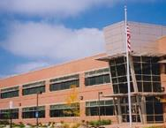
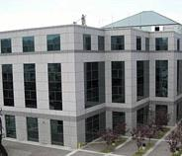
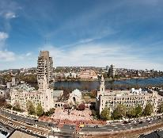
PROGRAMMATIC FOUNDATIONS
By The Way
Mike Ruiz, DEVELOP’s Program Manager for 24 years retired in December 2022!
DEVELOP History
In 1998, three interns at NASA Langley Research Center co-authored the white paper “Practical Applications of Remote Sensing.”
A proposal combining NASA’s Digital Earth Initiative and the students’ paper advocated the formation of a program, and in 1999 DEVELOP was officially formed.
Expansion beyond Langley began in 2001 and continues today.
Ames
2003
JPL
2008
Marshall
2008
Pocatello, ID
2015
Athens, GA
2013
Boston, MA
2018
Langley
1998
2004
Goddard
2012
Fort Collins, CO
2014
Asheville, NC

Slide 15


PROGRAMMATIC FOUNDATIONS
By The Way
NASA’s core values are:
Safety
Excellence
Teamwork
Integrity
Inclusion
DEVELOP shares these as well!
DEVELOP’s Mission & Vision
Mission:
Vision:
DEVELOP’s Core Values:
Integrating NASA Earth observations with society to foster future innovation and cultivate the professionals of tomorrow by addressing diverse environmental issues today.
Elevator Speech:
DEVELOP, part of NASA’s Applied Sciences’ Capacity Building Program, addresses environmental and public policy issues by conducting interdisciplinary feasibility projects that apply the lens of NASA Earth observations to community concerns around the globe. Bridging the gap between NASA Earth Science and society, DEVELOP builds capacity in both participants and partner organizations to better prepare them to address the challenges that face our society and future generations.
Shaping the future by integrating Earth observations into global decision making
  Collaboration
  Discovery
  Service
  Passion

Slide 16
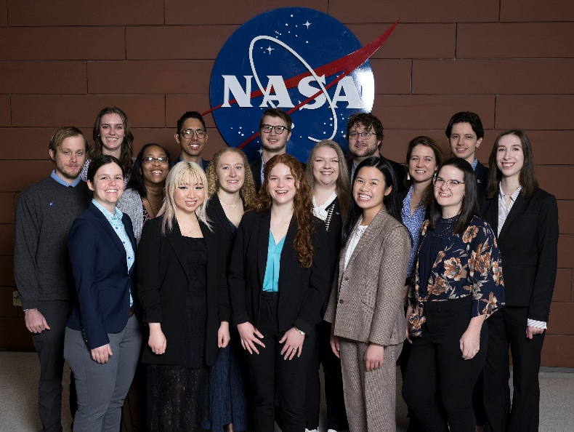
PROGRAMMATIC FOUNDATIONS
DEVELOP’s Culture
Collaborative
Inclusive
Innovative
Our approach to teamwork is based on a philosophy that each team member brings unique experience and knowledge to tasks at hand. We encourage vigorous, open flows of communication on all issues, in all directions.
We are committed to creating an inclusive environment that fosters teamwork that supports continuous learning, innovation, and an openness to new ideas.
We are adaptable, quick to respond, and go where others don’t, providing more service than is expected.
We pursue all endeavors with energy, excitement, and enthusiasm and are committed to maintaining an environment of trust, built upon honesty, ethical behavior, respect, and candor.
DEVELOP nurtures an organizational culture in which individuals make full use of their time, talent, and opportunities to pursue excellence in both the ordinary and the extraordinary.
Dynamic
Professional
Passionate
Service-Oriented
Excellent

Slide 17
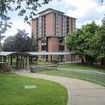

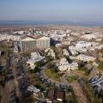
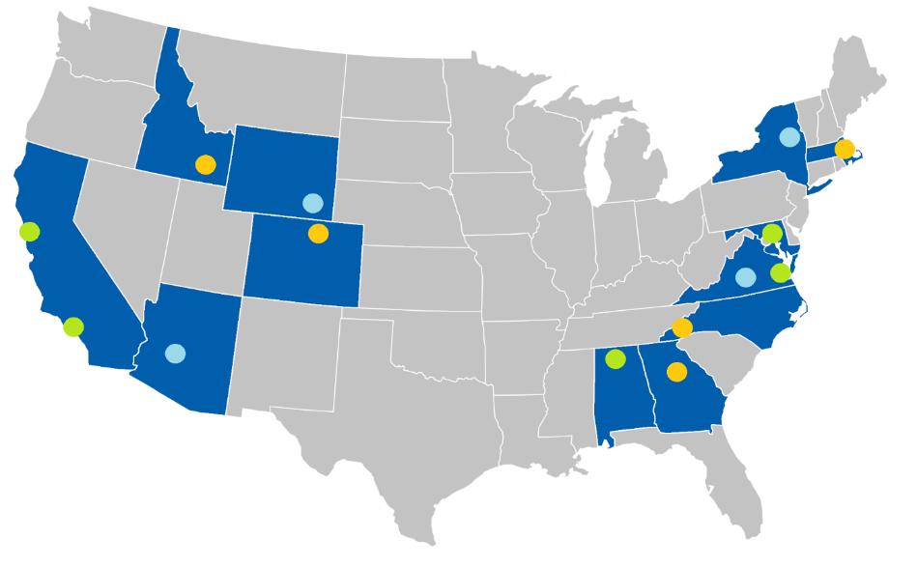
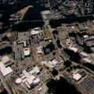
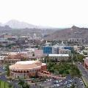









PROGRAMMATIC FOUNDATIONS
Pop-Up: Skidmore College
Est. 2023
Northeast
DEVELOP Locations
West Coast & Southwest
Massachusetts – Boston
Est. 2018
California – Ames
Est. 2003
Mid-Atlantic
California – JPL
Est. 2008
Maryland – Goddard
Est. 2004
Pop-Up: Arizona State
Est. 2016
Virginia – Langley
National Program Office, Est. 1998
Central Plains
NASA Centers
Regional Offices
Pop-Up Host Locations
Pop-Up: University of Virginia
Est. 2022
Idaho – Pocatello
Est. 2015
Southeast
Colorado – Fort Collins
Est. 2012
Georgia – Athens
Est. 2013
North Carolina – NCEI
Est. 2014
Virtual
Pop-Up: University of Wyoming
Est. 2022
Alabama – Marshall
Est. 2008
Environmental Justice
Est. 2022
Notes:
DEVELOP locations are housed in various NASA centers and institutions across the country. Our National Program Office is located here at the NASA Langley Research Center.

Slide 18
PROGRAMMATIC FOUNDATIONS
DEVELOP Structure
Programmatic Leadership
Project Team
Science Advisors
Fellows
National Program Office (NPO)
NASA HQ
NPO Support Team
Senior Fellows
Chain of Command
Node
DEVELOP’s structure is flat and all doors are open, but respecting the leadership communication chain is important for success as each link in the chain fulfills specific roles and ensures we follow NASA protocols and meet programmatic requirements.

Slide 19

















PROGRAMMATIC FOUNDATIONS
Fellows & Sr Fellows
Project Coordination
Cecil (LaRC)
Laramie (LaRC and MSFC)
Olivia (LaRC)
Lisa (ARC)
Impact Analysis
Celeste (GSFC)
Sarah P. (GA)
Geoinformatics
Sarah H. (CO)
Michael (JPL)
Carli (GSFC)
Ryan (ID)
Caroline (PUP)
Communications
Tyler (MA)
Kathryn (NC)
Julianne (VEJ)
Tyler Pantle
MA & Comm
Fellow
Carli Merrick
GSFC & Geo Fellow
Ryan Healey
ID & Geo Fellow
Celeste Gambino
IA Sr Fellow
Laramie Plott
PC
Fellow
Lisa Tanh
ARC & PC Fellow
Cecil Byles
PC Sr Fellow
Michael Pazmino
JPL & Geo Fellow
Sarah Hettema
CO & Geo Fellow
Kathryn Caruso
NC & Comm Fellow
Julianne Liu
VEJ & Comm Fellow
Sarah Payne
GA & IA Fellow
Olivia Landry
LaRC & PC Fellow
Laramie Plott
MSFC Fellow (Virtual, Acting)
Caroline Williams
Pop-up Projects (PUP) & Geo Fellow

Slide 20









PROGRAMMATIC FOUNDATIONS
National Program Office (NPO)
NPO is the core leadership and support team who manage and facilitate the various aspects of the program. The team is made up of NASA civil servants and SSAI contractors who implement DEVELOP.
NASA Civil Servant Management
SSAI Contractor Management
National Program Office
Dr. Kent Ross
Program Manager
Lauren Childs-Gleason
Science Manager
Karen Allsbrook
Business Manager
Amanda Clayton
Science Lead
Stephanie Burke
Operations Lead
Space Systems
Science Systems & Applications Inc. (SSAI)
By The Way
You are welcome to reach out to them for resources, advice, networking, and more!
NPO Support Team
Jolona Davis
Space Systems Human Resources
Danny Mangosing
Web Developer, IT &
Software Release
Sean McCartney
Training Lead & Bhutan Coordinator
Shanise Hunter
Graphic Designer

Slide 21
PROGRAMMATIC FOUNDATIONS
Programmatic Elements
Communications
Geoinformatics
Impact Analysis
Project Coordination
Social Media
Project & Promotional Videos, Brochures, and Flyers
Recruitment
Ambassador Corps
Newsletter
Alumni Engagement
Graphic Design
GIS & Remote Sensing
Programming & Coding
Software Release
Code Curation
Maintenance of the DESC
Tutorial Deliverable Review
Project, Partner, & Participant Tracking
Project Strength Index
Partner Reports & Highlights
Personal Growth Assessments
Exit & Alumni Surveys
Indicator Tracking
Deliverable Review & Management
Proposal Review
DEVELOPedia Maintenance
Project Tracking
Deliverable Templates
Publications

Slide 22






PROGRAMMATIC FOUNDATIONS
Questions?
First source for answers is your Fellow. If you have additional questions, here’s who to contact:
IT & Web Support
Operational Items & Processes
Virtual Machines
DEVELOP Website
Software Release Process
Participant Application Process
SSAI Systems & Processes
Travel
Fellow & Senior Fellow Competition
Danny Mangosing
IT & Web Support
Daniel.C.Mansgosing@nasa.gov
Stephanie Burke
Operations Lead
Stephanie.L.Burke@nasa.gov
Impact Analysis
Projects Processes & Logistics
Metrics & Indicators
Personal Growth Assessment
Pre/Post Project Partner Forms
Exit Surveys
Project Creation & Planning
Publishing & Presenting DEVELOP Work
Conference & Meeting Opportunities
Fellow & Senior Fellow Competition
Partner Engagement
Celeste Gambino
Impact Analysis Sr. Fellow
celeste.gambino@ssaihq.com
Amanda Clayton
Science Lead
Amanda.L.Clayton@nasa.gov
Project
Coordination
Human Resources
Deliverables
Export Control
DEVELOPedia
Employment Verifications & Offer Letters
Human Resource Questions
Space Systems Onboarding Processes, Systems & Paperwork
Payroll Questions
Schedule Adjustments
Cecil Byles
Project Coordination Sr. Fellow
robert.byles@ssaihq.com
Jolona Davis
Space Systems HR
jolona.davis@ssaihq.com

Slide 23
PROGRAMMATIC FOUNDATIONS
Things to Note
DEVELOP IS part of NASA’s Earth Sciences Division’s Applied Sciences Program.
DEVELOP is NOT part of NASA’s Office of STEM Engagement (NASA education & internships).
DEVELOP is very different from NASA’s internship opportunities in our approach to conducting projects, focus on teamwork, the level of responsibility and authority given to participants, the opportunities we provide, and the individuals and organizations we network with. Enjoy it while you are here!
Earth observations and Earth science data are objective, transparent, and policy-neutral.
NASA Earth Science does NOT develop or prescribe policy. Other agencies and organizations use the data and scientific results in their policy analysis and development.
Travel is limited and carefully managed following Federal guidelines and contract requirements. This means any potential travel must go through the appropriate approval processes to even be considered for DEVELOP. Travel is a privilege!

Slide 24

PROGRAMMATIC FOUNDATIONS
Quiz Time
What was NASA’s predecessor?
Who is the new SMD Associate Administrator?
What are the Applied Sciences three lines of business?
How old is DEVELOP turning this year?
Who was DEVELOP’s first Program Manager?
Who should you contact if you have a project-related question?
Who should you contact if you have a payroll-related question?

Slide 25

Thank You.
Joining the DEVELOP family means being part of NASA’s Legacy.
Learn it. Know it. Live it.

