Slide 1
MIAMI BEACH WATER RESOURCES
Assessing the Feasibility of Using NASA Earth Observations to Monitor Trends in Runoff and Storm Water Discharge of the Biscayne Bay
Pamela Kanu
Danielle Quick
Randolph Colby
NASA Langley Research Center
2017 Summer
Notes:
Your project Website Image should be placed behind the hexagon grid. An example image has been placed in this position for your reference. Delete the example image, insert your image, right click your image and select the “Send to Back” option. Position and adjust the size of your image so that it lines up with the provided margin rulers.

Slide 2
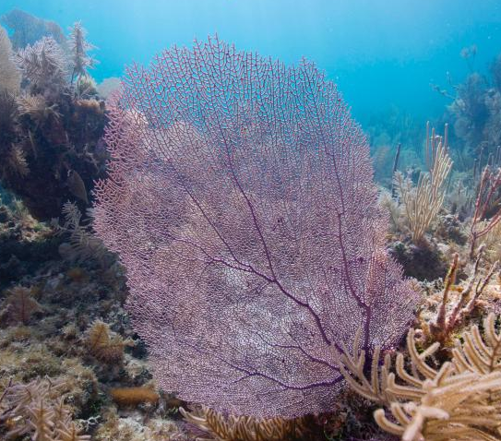
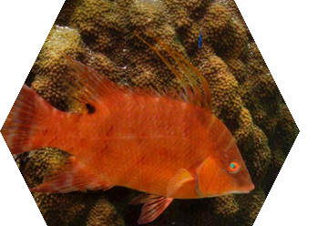
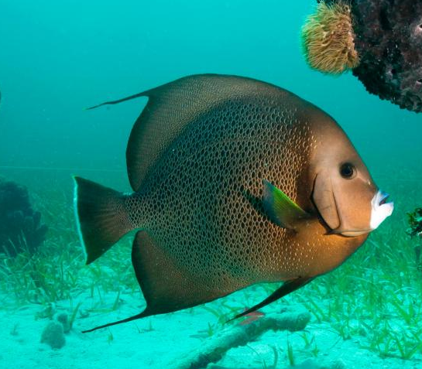
Biscayne Bay
Images: Susanna Pershern, Submerged Resources Center
Notes:
Biscayne bay is an estuary with an average depth of 1.8 meters and roughly 700 square kilometers in area (Caccia, 2005) and serves as habitat for dolphins, manatees, American crocodiles, bald eagles and a variety of fish including economically-important resources such as the pink shrimp, gray snapper, spotted seatrout, and pinfish (Lirman, 2014).
https://www.nps.gov/media/photo/view.htm?id=355EB04E-9D52-22F4-3E33B8F7B64D59A6
https://www.nps.gov/media/photo/view.htm?id=35766417-0582-48A4-16BD5011B87F0578
https://www.nps.gov/media/photo/view.htm?id=35651489-B9EE-C86D-DDBBA751E6FF8C78
https://www.nps.gov/media/photo/view.htm?id=3565F788-D1AD-257A-D77129CAE94BAEBE
https://www.nps.gov/media/photo/view.htm?id=356FA509-BEE1-43FA-8453CC7DBCB1622E

Slide 3
Miami and Miami Beach
Miami is a major metropolitan area adjacent to Miami Beach
Population of approximately 453,579 (15 mil visitors) according to the 2016 census estimate
Image Credit: Pixabay
Notes:
Located at the northern end of Biscayne bay the City of Miami and Miami Beach comprise one of the ten largest metropolitan areas in the United States, home to approximately 453,579 according to the 2016 census estimates. The area has experienced industrialization and continues to grow exponentially in population with approximately 15 million visitors to the area in 2016.
Image obtained from https://pixabay.com/en/panorama-miami-florida-water-usa-2117310/

Slide 4
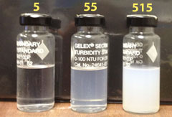
Community Concerns
Stormwater Runoff
Increased Turbidity
Ecosystem Health
Image: USGS Water Science School
Notes:
Urban development in recent years has led to increased stormwater runoff. The runoff from urban areas increases turbidity and can rapidly change salinity and water quality parameters in the Bay. Turbidity is the cloudiness of a fluid and is measured from our in situ in Nephelometric Turbidity Units (NTU) and generated as Formazin Nephelometric Units (FNU) from the Dogliotti formula through ACOLITE. NTU and FNU are comparable as one to one.
http://water.usgs.gov/edu/turbidity.html

Slide 5
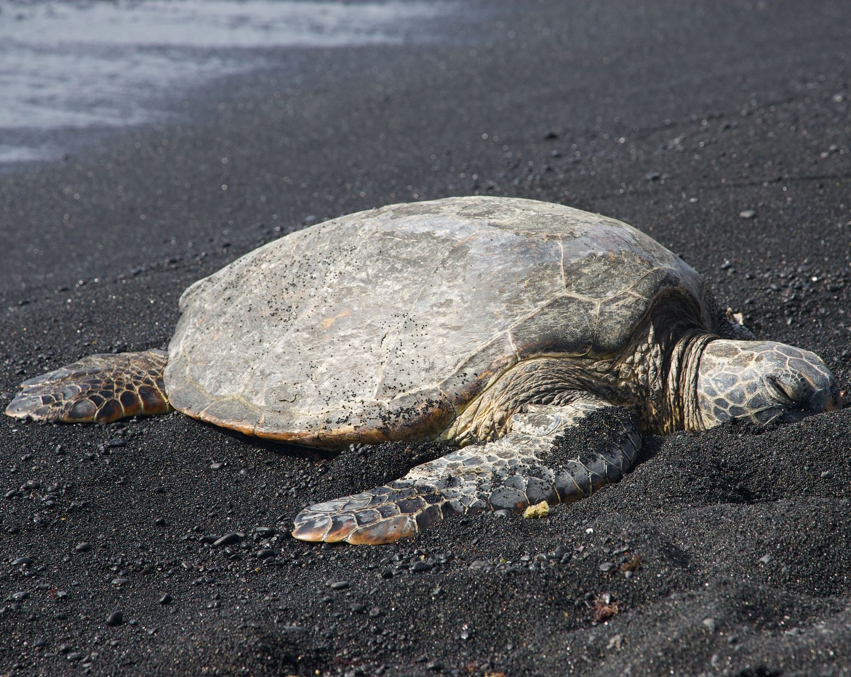
Community Concerns
Economic Importance
Wildlife
Submerged Aquatic Vegetation
Image: Amberle Keith
Notes:
In the late 1980’s through early 1990’s the nearby Florida Bay lost over 4,000 ha of seagrass due to changes in water quality. Submerged Aquatic Vegetation serve as a staple in the ecosystem providing food and habitat for many species throughout the Bay.
https://www.flickr.com/photos/nasa_develop/16394133618/in/album-72157648318032603/

Slide 6
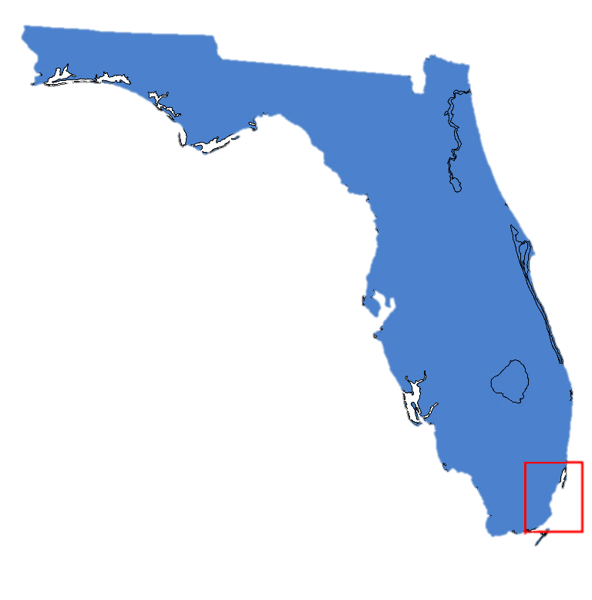
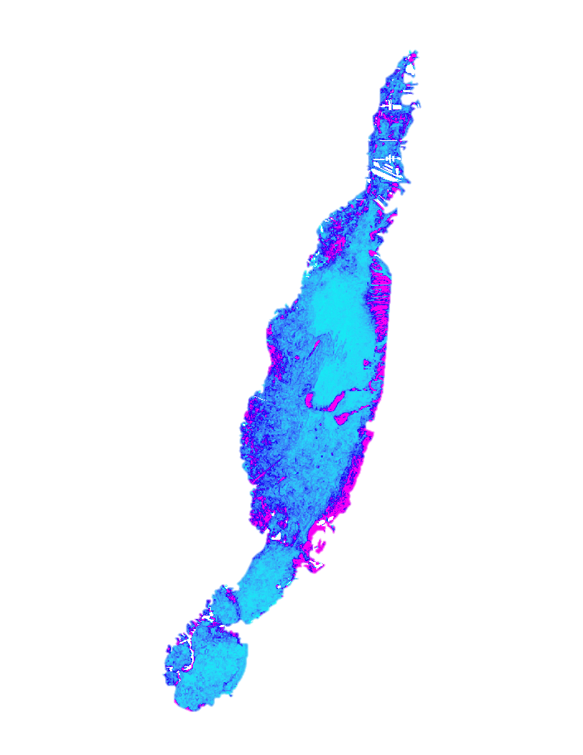
Project Objective
Evaluate the efficacy of NASA Earth observations for monitoring the Biscayne Bay, Florida.
Turbidity
Chlorophyll-a
Dogliotti Turbidity output from ACOLITE
Image: Pixabay
Notes:
This project evaluated the efficacy of NASA Earth observations for monitoring water quality parameters within Biscayne Bay with particular focus on Turbidity and Chlorophyll-A, using these metrics to develop water clarity maps and annual trend maps to generate a broad snapshot of changes in the Bay’s health.
https://cdn.pixabay.com/photo/2014/07/08/12/40/fish-386747_960_720.jpg

Slide 7
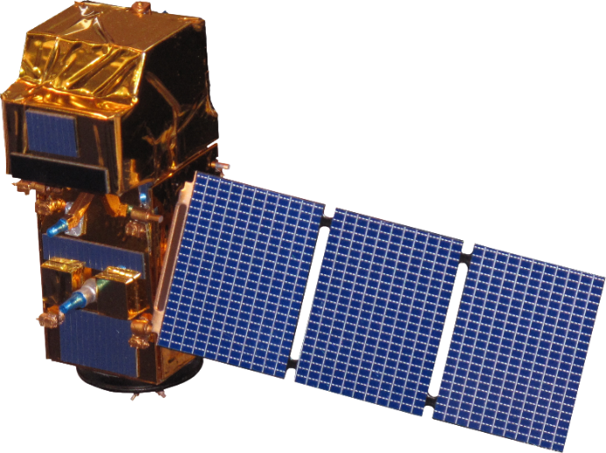
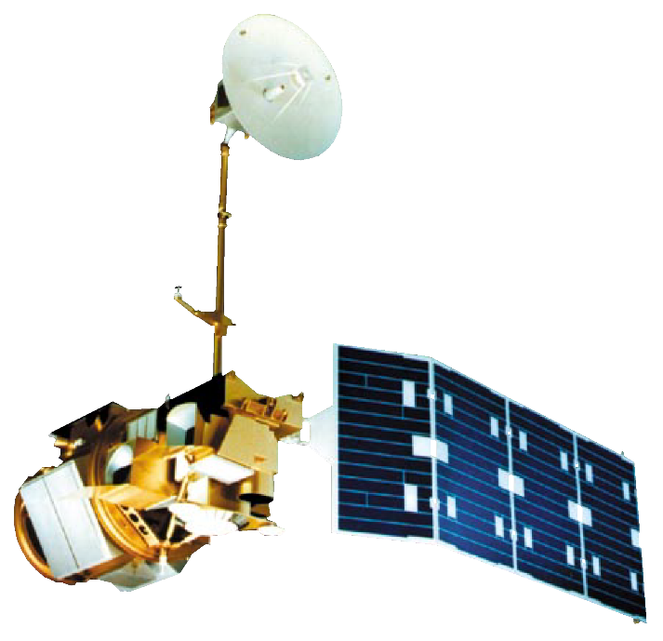
Earth Observations
Landsat 5 TM
Landsat 7 ETM+
Landsat 8 OLI
Sentinel-2 MSI
Study period:
1995-1999
Study period:
1999-2016
Study period:
2013-2016
Study period:
2016
Notes:
The NASA Earth observations used include Landsat 5 Thematic Mapper, Landsat 7 Enhanced Thematic Mapper Plus, and Landsat 8 Operational Land Imager to identify turbidity and Sentinel-2A Multispectral Instrument

Slide 8
Methodology
ACOLITE atmospheric correction for Landsat 5 TM, Landsat 7 ETM+, Landsat 8 OLI and Sentinel-2 MSI
Correlations with in situ data
Annual water clarity maps
Turbidity
Bottom Reflectance
Sand
Annual trend maps
Chlorophyll-A
Landsat 8 OLI
Notes:
Using ACOLITE, a tool developed by Royal Belgian Institute for Natural Sciences for marine remote sensing, to perform atmospheric corrections and apply formulas that fulfill the project’s goals. The team developed a toolbox to automatically batch process the Landsat 5 (TM), Landsat 7 (ETM+) Landsat 8 (OLI) and Sentinel-2 (MSI) images.
Annual mean wet season turbidity maps were generated for the full study period, and annual mean wet season chlorophyll-a concentration maps were produced for 2013 through 2016. However, the team was unable to establish confidence in the sensor data due to a lack of in situ data concurrent to remote sensing imagery.

Slide 9
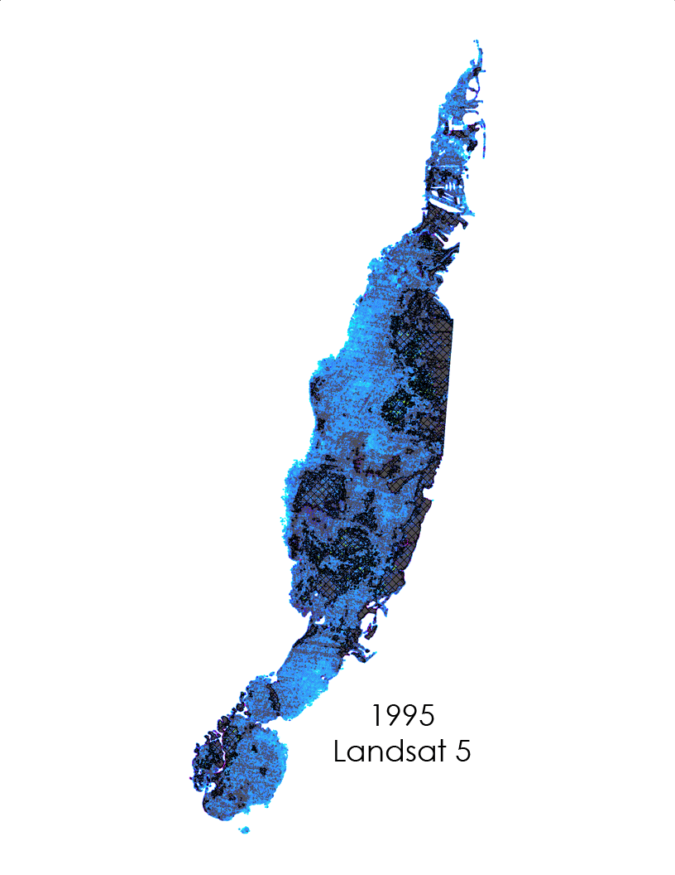
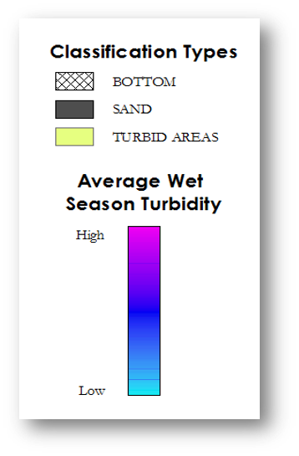
Results
Coefficient of variance and remote sensing to identify features:
Bottom Reflectance
Sand
Turbid Areas
Notes:
The team developed a tool to classify the bay.
The tool identify areas of shallow, clear waters that register as high turbidity due to bottom effects and other compounding factors.
The coefficient of variance for each wet seasoned average was used to identify Sand (Point out area of sand), a feature that is evident by the naked eye. The standard deviation of sand was compared to less discernible features and used to determine thresholds for bottom reflectance and turbid areas.

Slide 10
Results
Notes:
Turbidity products from each earth observing system fell within similar ranges, allowing for the continuance of monitoring from one satellite to the next. However, the mean wet season turbidity metric is heavily influenced by even a single highly-turbid scene, as it is typically based on five or six cloud-free scenes per year. This largely accounts for the differences in this metric between sensors for the same year. For example, most of the 1999 spike in turbidity for Landsat-5 is due to one highly turbid scene. Biscayne Bay had cleared up significantly by the time Landsat 7 imaged it, resulting in the large discrepancy shown in the graph.
wet seasonal trend
To generate correlations, further in situ data is required
No conclusive trends were generated

Slide 11
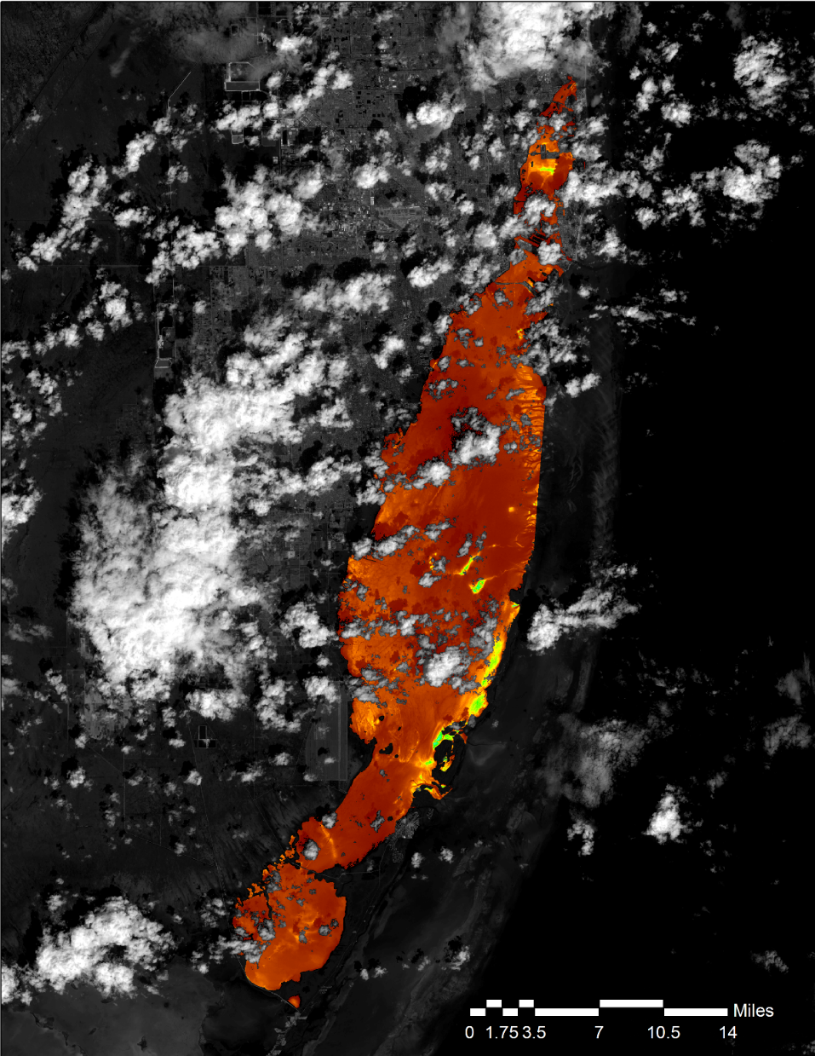
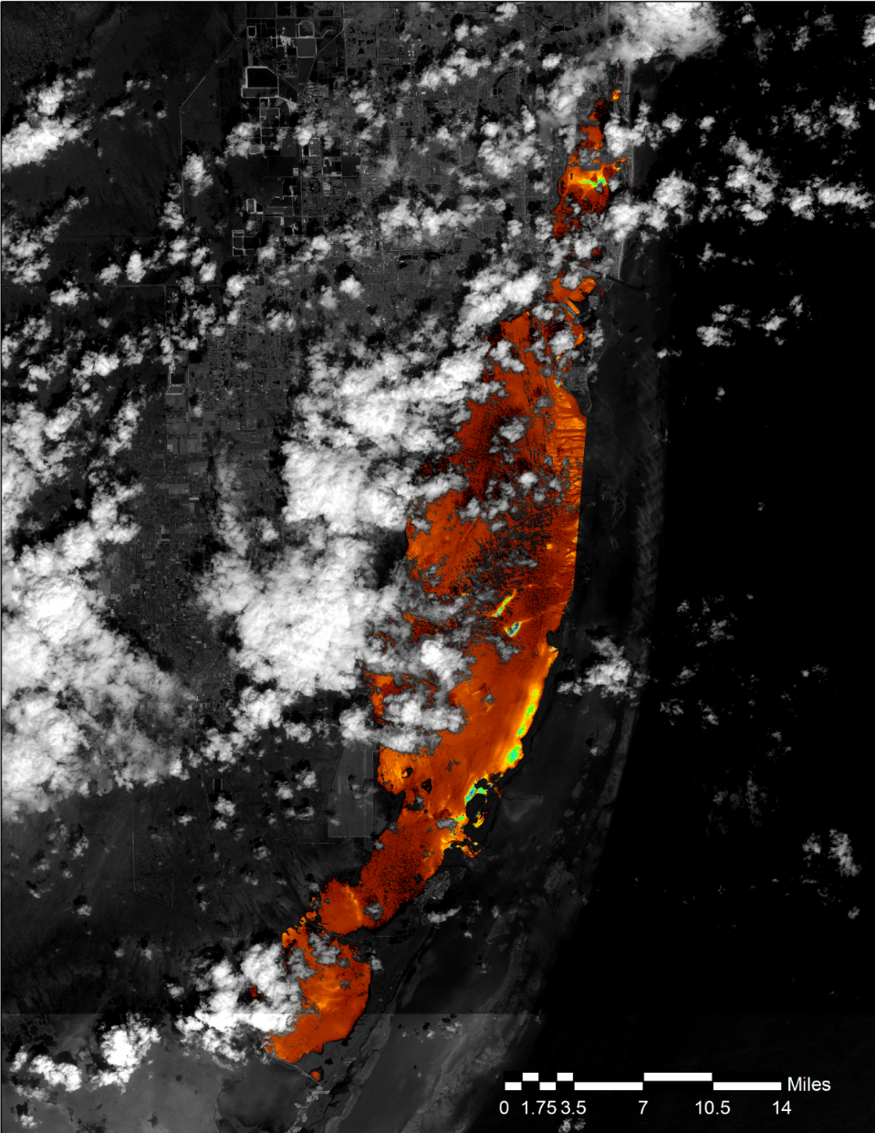
Results
October 4, 2015 gave a unique chance to compare Sentinel-2 MSI and Landsat-8 OLI
Average turbidity of Biscayne Bay was within 0.06 FNU for both sensors
N
N
Turbidity
FNU
Turbidity
FNU
High: 75
Low: 0
High: 75
Low: 0
Landsat 8 OLI
Sentinel-2 MSI
Notes:
On October 4th 2015, both Landsat-8 OLI and Sentinel-2 MSI imaged Biscayne Bay with hours of each other, allowing a fairly direct comparison of both sensors. They produced very similar results, which helped us build confidence in our ability to continue the study from one sensor to the next.

Slide 12
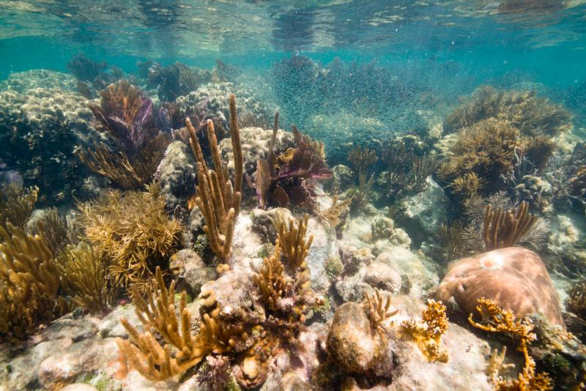
Conclusions
Annual Maps
Image: Susanna Pershern, Submerged Resources Center
Annual turbidity and chlorophyll-a concentration maps were successfully created for the partner.
Bottom Effects
A method for filtering bottom effects from results was generated and could be validated on future projects.
In situ
Due to a lack of in situ data aligned with satellite flyover correlations were not found.
Notes:
In conclusion , maps were successfully created for delivery to the Miami Beach Public Works Department. We also found a way to keep bottom effects from influencing results. We were unable to gather enough in situ data to correlate our results, but we hope that this can be accomplished in a possible second term.
https://www.nps.gov/media/photo/view.htm?id=35C0C13F-B8E3-54D7-44E26D82D0746E68

Slide 13
Future Work, Errors & Uncertainties
Future Work
Further in situ data acquisition for correlations, use of land mask for the shallowest waters in the Bay, correlations with Terra MODIS and Aqua MODIS to validate the data from Landsat and Sentinel
Errors
Changes made to ACOLITE to adjust negative water leaving radiance values and account for sun glint
Uncertainties
Bottom effects, clear water with average turbidity < 30 NTU
Notes:
Future work should also focus on comparing Aqua and Terra MODIS ocean color data to Sentinel-2 and Landsat 8 data where in situ data are unavailable to develop confidence. Errors in the work include changes made to the ACOLITE parameters to account for areas of negative water leaving radiance caused by sun glint. There are further uncertainties caused by bottom effects due to the clear water with an average turbidity of less than 30 NTU throughout the Bay, but these could be alleviated in part through the use of the tool created during our term.

Slide 14
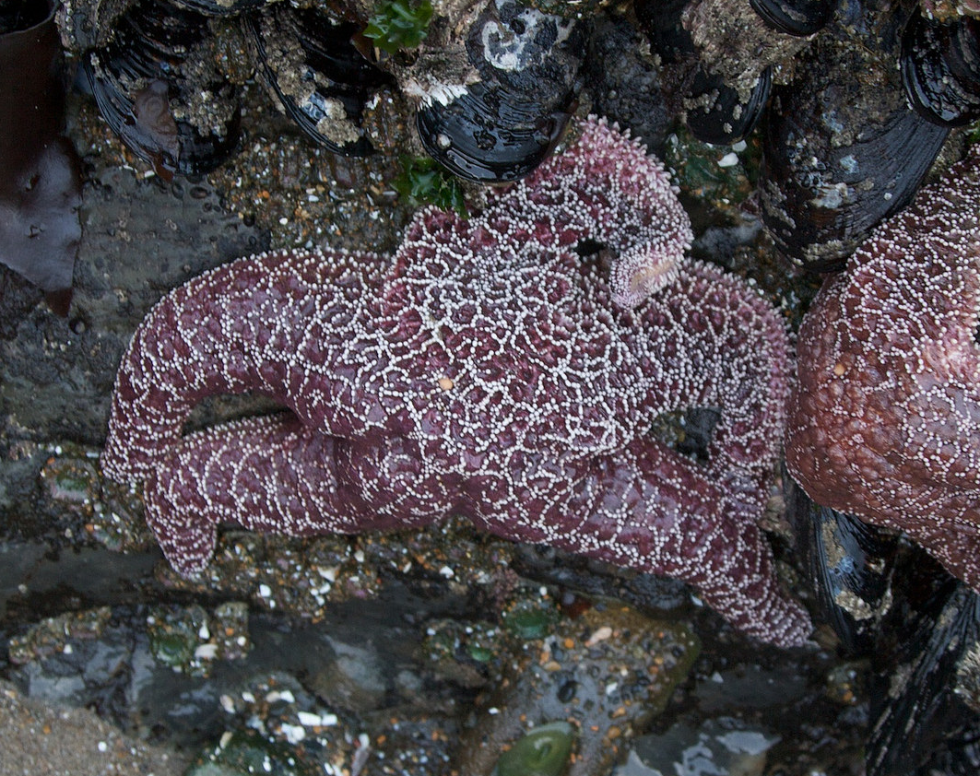
Acknowledgements
Dr. Kenton Ross,
NASA Langley Research Center
Francisco D’Elia,
City of Miami Beach Public Works Department
Emily Gotschalk,
NASA DEVELOP Center Lead
Image: Amberle Keith
Notes:
The Miami Beach Water Resources team would like to thank our Science Advisor Dr. Kenton Ross, our Partner Francisco D’Elia and our Center Lead Emily Gotschalk for all of their assistance, advice, and guidance throughout the term.
https://www.flickr.com/photos/nasa_develop/15959682774/in/album-72157648318032603/

