Slide 1
Abhishek Kumar (Project Lead)
Roger Bledsoe
Eastern India Ecological Forecasting II
Christopher Cameron
A Multi-Sensor Approach to Enhance the Prediction of Mangrove Biophysical Characteristics in Chilika Lagoon and Bhitarkanika Wildlife Sanctuary, Odisha, India
Subash Dahal
María José Rivera Araya
Caren Remillard
Austin Stone
University of Georgia
2017 Spring
Notes:
Your project VPS Image should be placed behind the top aperture shape. An example shape has been placed in this position for your reference. Delete the example VPS image, insert your image, right click your image and select the “Send to Back” option. Position and adjust the size of your image so that it lines up with the provided margin rulers.

Slide 2
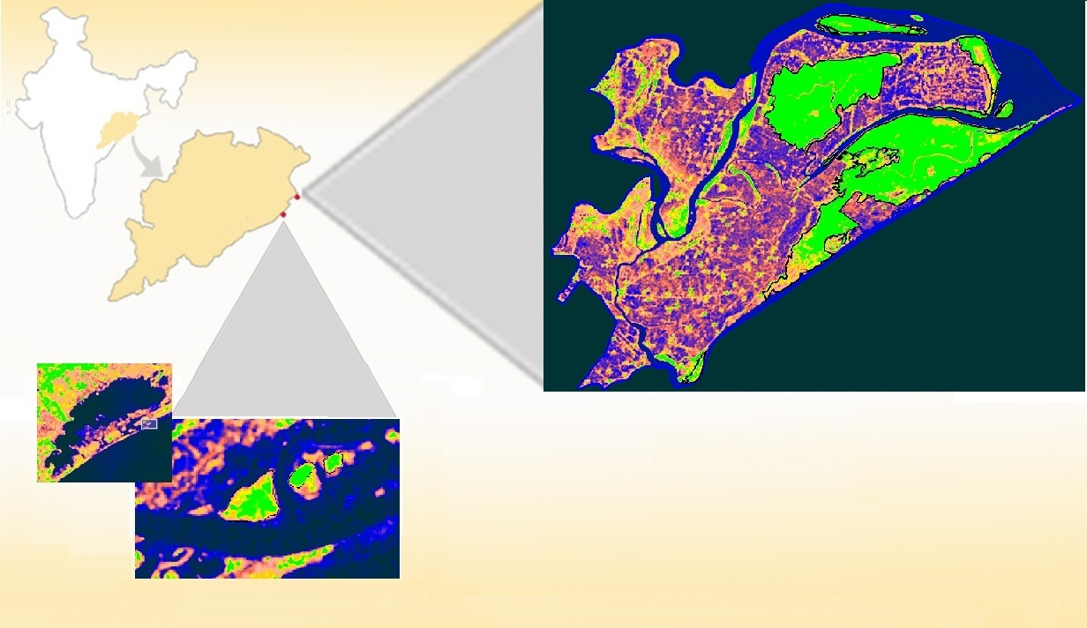
Study Area
Bhitarkanika
Latitude: 20.71ºN
Longitude: 86.86ºE
Mangrove Types: Dense, Closed & Open
Total Mangrove species: 55
Mangrove Area: 145 km²
Chilika
Latitude: 19.84º N
Longitude: 85.47º E
Mangrove Types: Open, small patches
India
Odisha
Bhitarkanika Wildlife Sanctuary
Kilometers
Chilika
0 7.5 15
Bright green polygon indicates mangrove area
Image Credit: Eastern India Eco Forecasting II Team
Notes:
Chilika Lagoon and Bhitarkanika Wildlife Sanctuary are two notable east coast wetland sites recognized by the Ramsar Convention on Wetlands and both situated in the state of Odisha. As the world’s second largest lagoon, Chilika Lagoon holds three small, but distinct mangrove patches near the opening to the Bay of Bengal. Bhitarkanika Wildlife Sanctuary lies north of Chilika Lagoon on a delta formed by Brahmani and Baitarani rivers and has several large and dense patches of mangroves.
NOTE: For every image on the slide include an image source in the speaker notes (ex. URL; Name, Affiliation, etc.)
Image Source: Esri basemap

Slide 3
Community Concerns
Residents from 36 nearby villages receive valuable ecosystem services from the mangroves.
Mangroves have been overexploited or converted to other forms of land use.
Encroachment upon forests, unauthorized aquaculture practices, and discharge of effluent place even more pressure on mangrove forests and biodiversity.
Source: Wildlife Institute of India (2003)
Notes:
Residents from 36 nearby villages receive valuable resources and services from the mangroves, including food, raw materials, medicinal and ornamental products and vacation/leisure sites.
Mangroves have been overexploited or converted to various other forms of land use, including agriculture, aquaculture, salt ponds, terrestrial forestry, and urban and industrial developments.
Bhitarkanika Wildlife Sanctuary and Chilika Lagoon supports several populations of crocodiles, lizards, migratory birds, and several rare and endangered mammals.
Image Source: http://irade.org/eerc/pdf/WB_FR_RuchiBadola.pdf

Slide 4
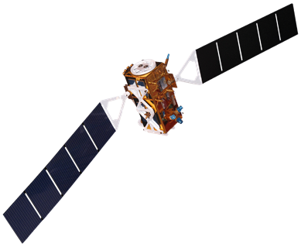
Objectives
Derive a long term phenology of biophysical parameters in order to enhance management and restoration efforts
Produce land use/land cover time series maps to observe changes in mangrove cover over the past 20 years
Integrate high resolution radar data to enhance future seasonal analyses of mangrove characteristics
Landsat 5 TM
Landsat 8 OLI
Sentinel-1 C-SAR
Terra MODIS
Image Credit: NASA
Source: NASA DEVELOPedia
Image Credit: NASA
Notes:
The primary objective of the study is to integrate multiple satellites including Terra, Landsat 5 and 8, and Sentinel-1 to estimate biophysical characteristics of mangroves. The secondary objective is to produce land use/land cover time series maps to observe changes in mangrove cover over the past 20 years. Lastly, this project aims to integrate high resolution radar data to enhance future seasonal analyses of mangrove characteristics.
The end-products and results will be used by the Ministry of Environment and Forests, Odisha and Chilika Development Authority to improve conservation efforts.
Satellite Image Source: NASA’s Developedia

Slide 5
Methodology
Satellite Data
NASA Giovanni
Landsat 5 & 8
Surface Reflectance
MODIS/Terra
Surface Reflectance
Sentinel 1A GRD/IW C-SAR
MODIS Biophysical Products
ET, PTC, LAI, GPP
Precipitation
NDVI, EVI, R_{rs}
Correlation
Backscattering coefficient
Biophysical Data Extraction
Surface Temperature
Surface Runoff
Classification
(Supervised)
Biophysical Models
LAI, GPP, CHL
Monthly & Annual Composites
Change Detection
Spatio-Temporal
Maps
Seasonal & Annual Variability
Correlation
Long-Term
Time Series and Analysis
Image Credit: NASA
Notes:
The overall process and data involved in different stages of this study is shown in this flowchart. Satellite data from multiple sensors were downloaded from April 1995 to February 2017. Additionally, we incorporated meteorological products from the NASA Giovanni web-based application tool. Radar data (Sentinel 1) were downloaded from the European Space Agency (ESA) Scientific Data Hub website. We used ERDAS for LULC, SNAP for radar data processing, ArcMap and ENVI for MODIS datasets. Finally, a long term analysis was carried out to examine changes in biophysical characteristics as well as LULC change.

Slide 6
Results: Calibrating Radar Data
CHL=127*NDVI - 46.61 (1)
LAI=17.15*EVI2 – 2.57 (2)
GPP=0.098*EVI2 + 0.016 (3)
$$NDVI=\frac{Rrs \left(B2\right) − Rrs(B1)}{Rrs \left(B2\right) + Rrs(B1)}$$
$$EVI2=2.5∗\frac{Rrs \left(B2\right) − Rrs(B1)}{1+Rrs \left(B2\right) +2.4∗Rrs(B1)}$$
Notes:
Integration of Sentinel 1A radar data with MODIS showed significant correlation between calibrated backscattering coefficients (VV, VH) and MODIS based vegetation indices. VV polarized signal showed better relationship than VH backscatter and further used to create biophysical products (LAI, CHL, and GPP) using the Eastern India biophysical models from Sentinel 1A data.

Slide 7
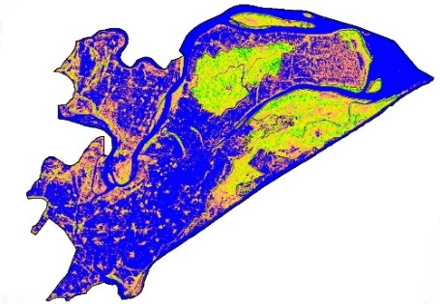
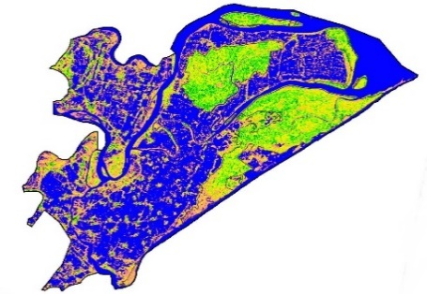
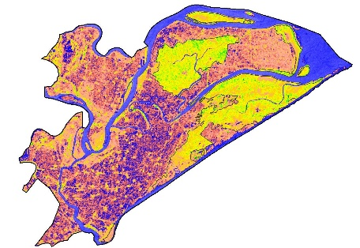
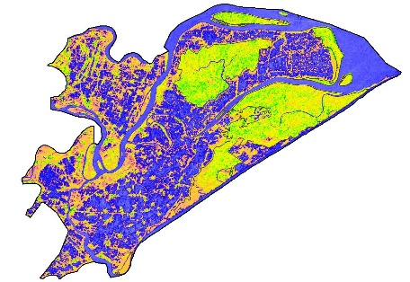
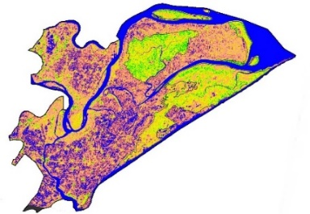
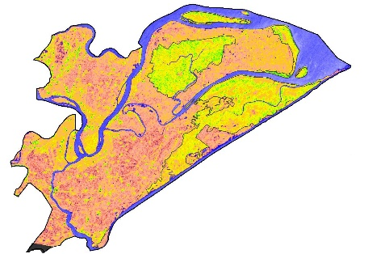
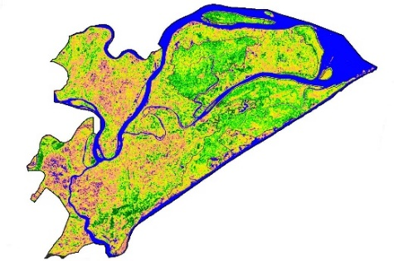
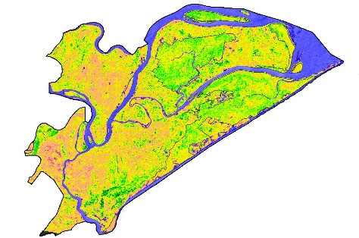
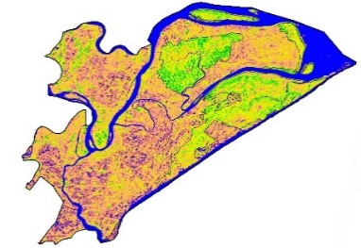
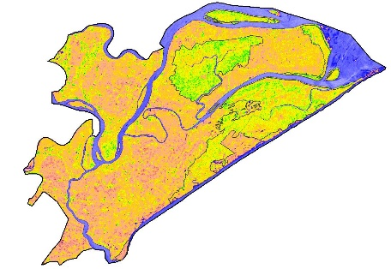
Results: Biophysical Parameters
Chlorophyll
Leaf Area Index
Summer
Summer
Monsoon
Monsoon
Spring
Spring
Fall
Fall
Winter
Winter
0
CHL(µg/cm²)
60
0
LAI
6
Source: Sentinel 1A, 2016-17
Source: Sentinel 1A, 2016-17
Notes:
Both Chlorophyll and LAI showed similar seasonal variability such as peaked during Fall, moderate during Winter and Spring, and lowest during summer season. This is consistent with our previous term results and additional improvement with radar data is to capture monsoon season as well which was not possible because of cloud cover using optical sensors. The seasonal variability in agriculture surrounding the mangroves can also be noticed easily in these spatial maps.

Slide 8
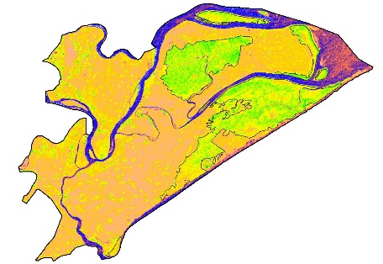
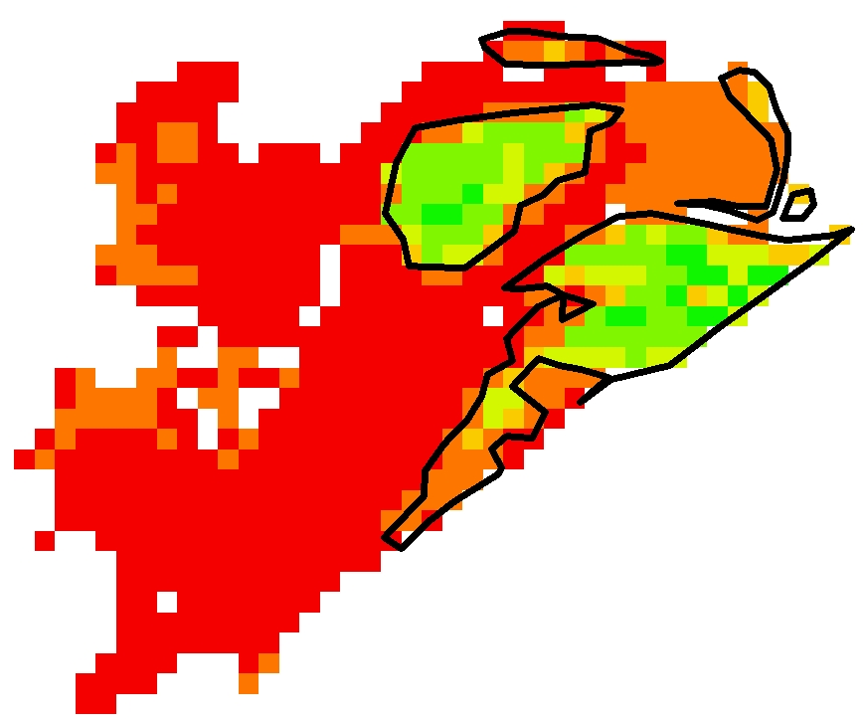
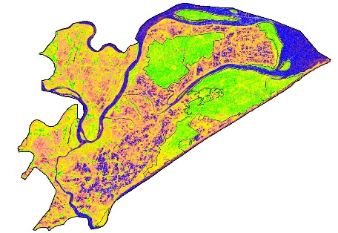
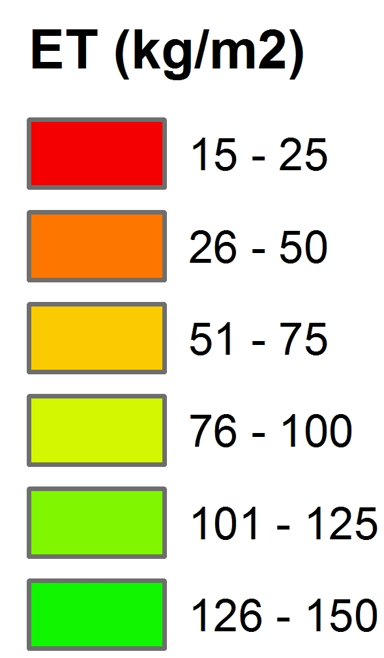
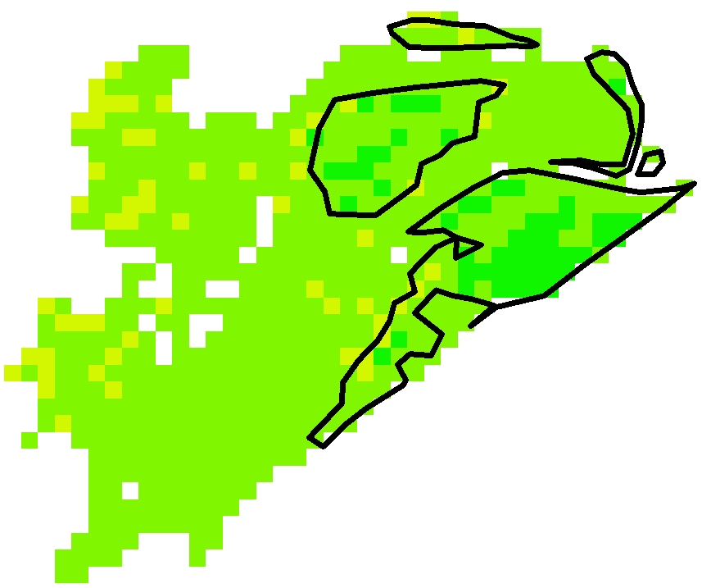
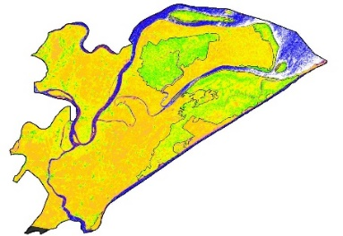
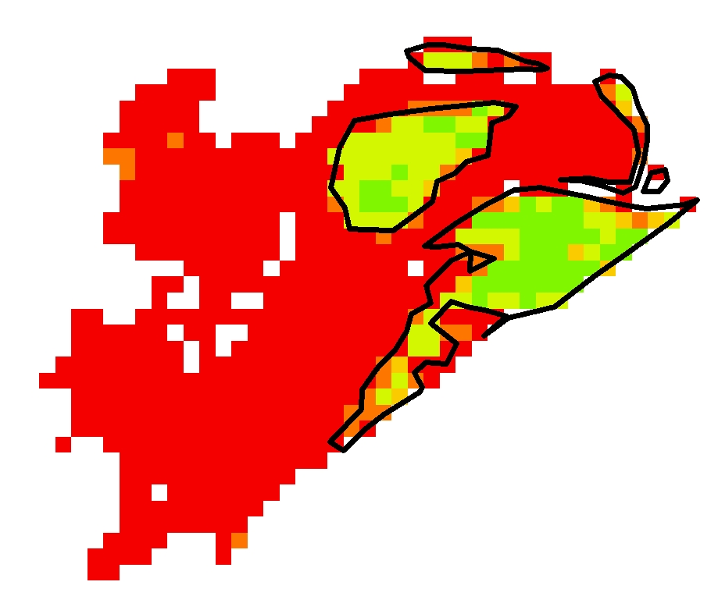
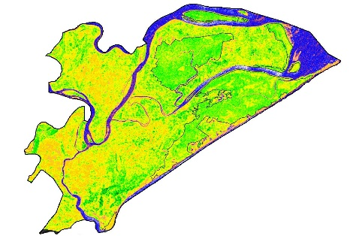
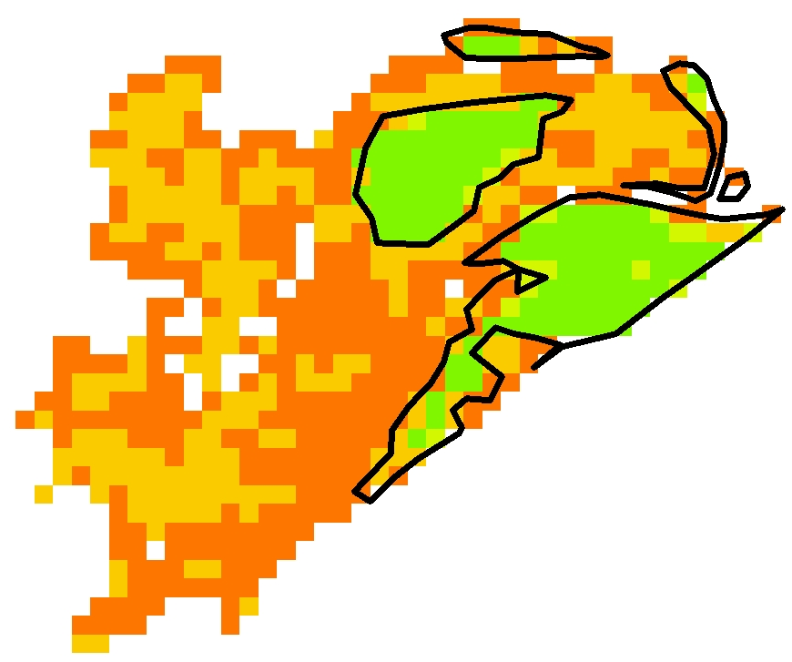
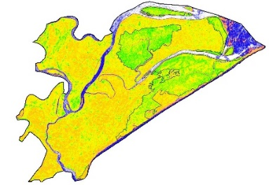
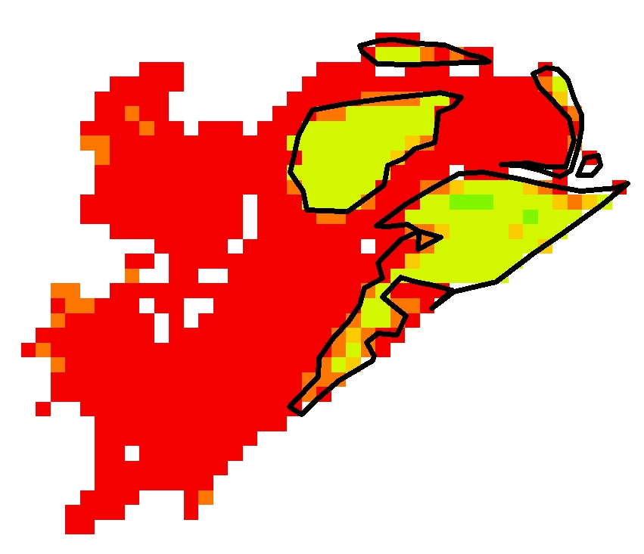
Results: Biophysical Parameters
Gross Primary Productivity
Evapotranspiration
Summer
Summer
Monsoon
Monsoon
Spring
Spring
Fall
Fall
Winter
Winter
0
GPP (gC/m²)
0.07
Source: Sentinel 1A, 2016-17
Source: Terra MODIS, 2000-14
Notes:
Gross primary productivity and MODIS derived evapotranspiration (ET) maps also showed similar seasonal patterns. Variability in ET was most consistent with rainfall, such as highest ET was observed during monsoon season and lowest during Winter and Summer season.

Slide 9
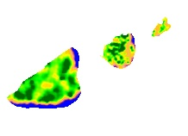
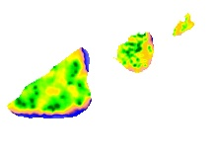
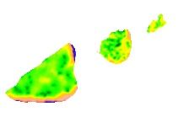
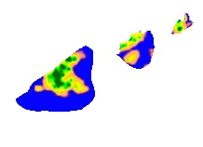
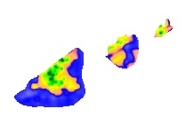
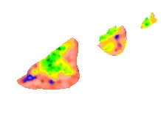
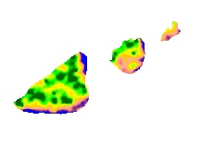
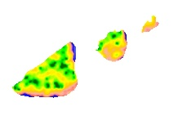
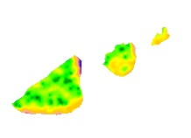
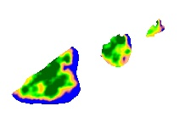
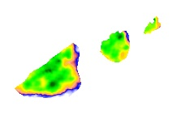
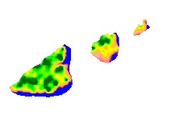
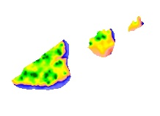
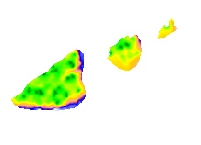
Results: Biophysical Products
Chlorophyll
Leaf Area Index
Gross Primary Productivity
Summer
Summer
Summer
Monsoon
Monsoon
Monsoon
Spring
Spring
Spring
Winter
Fall
Winter
Fall
Fall
Winter
0
CHL(µg/cm²)
60
0
LAI
6
0
GPP (gC/m²)
0.07
Source: Sentinel 1A, 2016-17
Source: Sentinel 1A, 2016-17
Source: Sentinel 1A, 2016-17
Notes:
The similar seasonal variability in all the biophysical parameters (CHL, LAI, and GPP) was observed for small mangrove patches of Chilika. Additionally, during monsoon season, increase in water level submersed the outer swamps and change in areal coverage is visible in spatial biophysical product maps.

Slide 10
Results: MODIS Composites
MODIS Biophysical Product (LAI)
MODIS Biophysical Product (GPP)
Summer
Summer
Spring
Fall
Spring
Fall
Winter
Winter
2001-16
2001-16
Notes:
Long-term biophysical products derived after creating composites of these MODIS products (2000 -2016) also showed similar seasonal patterns which verified the seasonality shown by radar data. There are many bad pixels encountered for all years in MODIS GPP product for the study area (red color inside mangrove patches) and excluded from quantitative analysis.

Slide 11
Results: Inter-Annual & Seasonal Trends
GPP (gC/m²)
LAI
ET (kg/m²)
Notes:
The long-term quantitative data (2000 – 2016) for all the biophysical parameters did not show much annual variability but seasonal variability was clearly observed. The monsoon months (June, July, August, September) were excluded from analysis because of heavy cloud cover and lack of quality data.

Slide 12
Results: Inter-Annual & Seasonal Trends
Notes:
The long term analysis of meteorological and physical parameters derived from NASA’s Giovanni web based interactive tool showed that seasonal variability was dominant compared to inter-annual variability.

Slide 13
Results: Correlation
Notes:
The correlation analysis between biophysical parameters and meteorological variables revealed that surface temperature is highly correlated with most of the parameters. However, precipitation only showed good correlation with ET. Surface runoff did not show good correlation with any parameters.

Slide 14
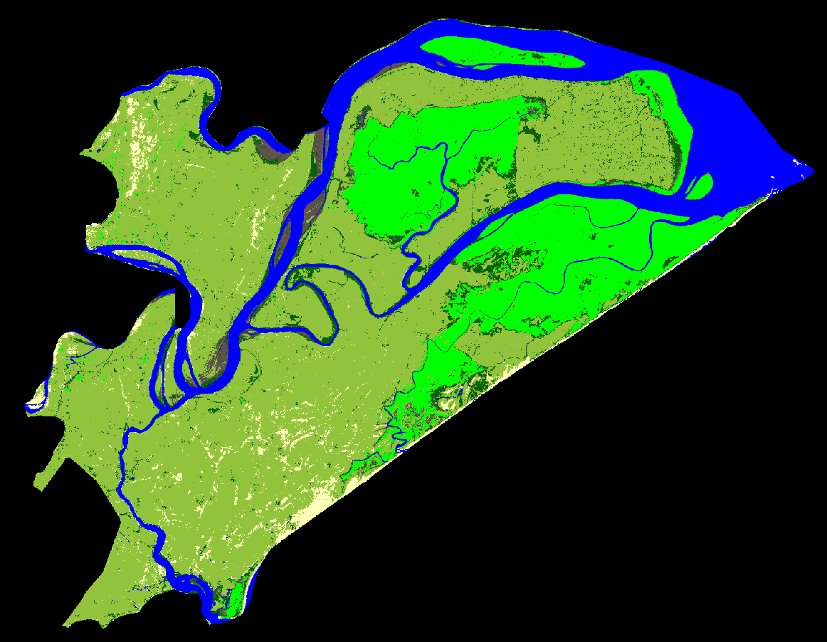
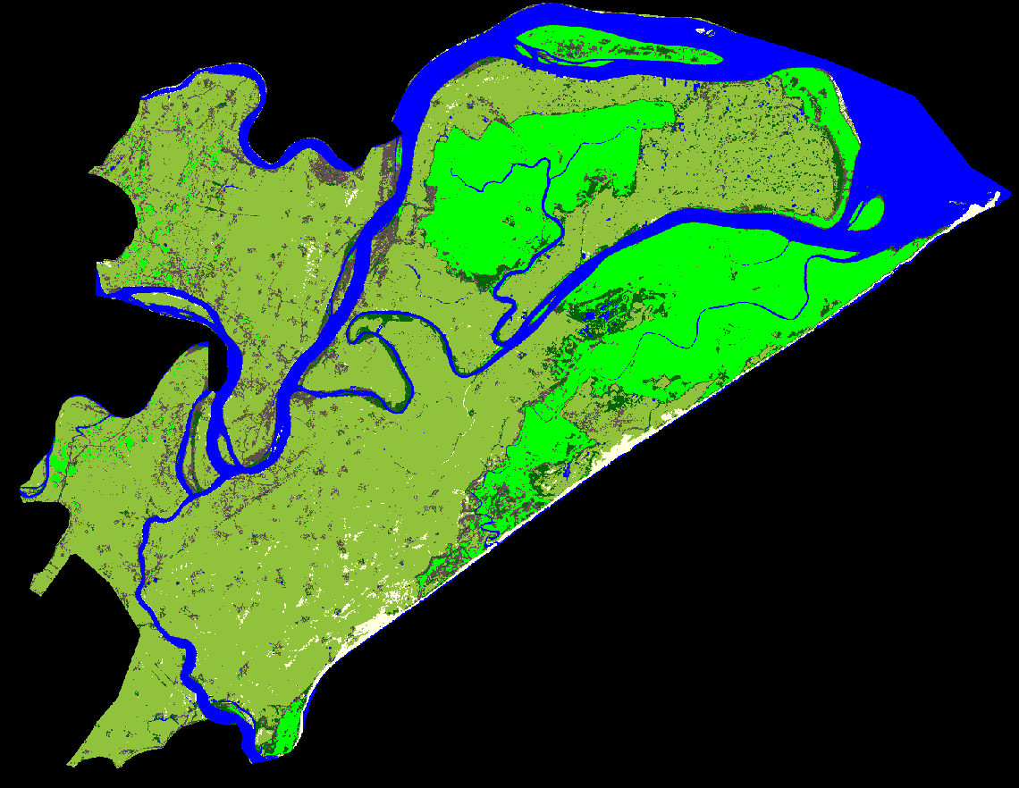
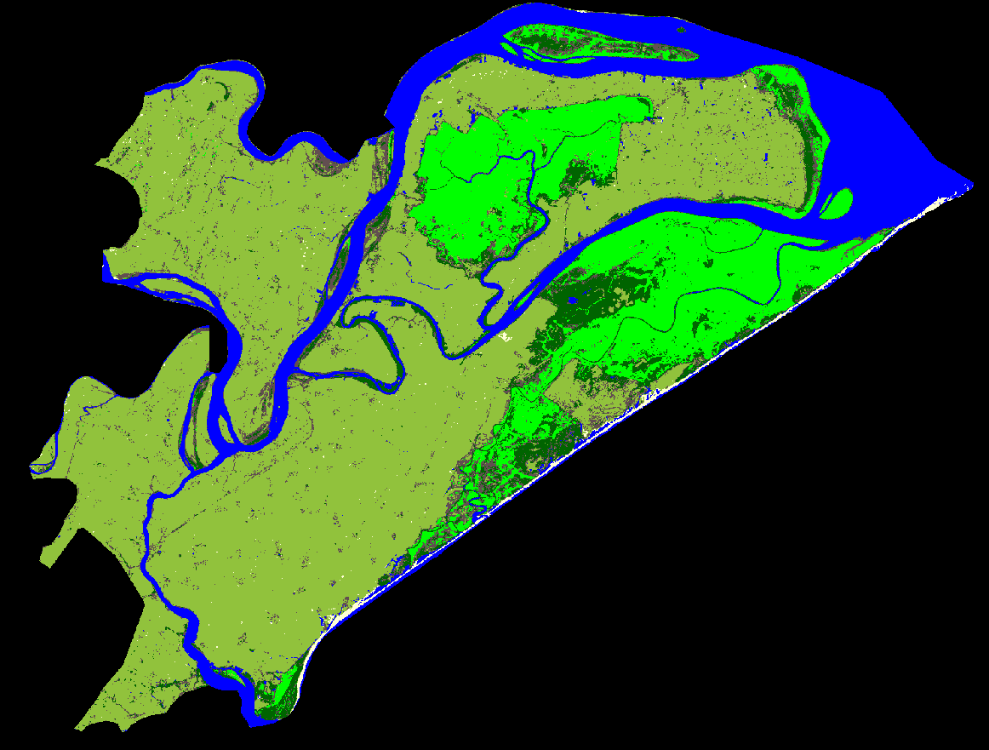
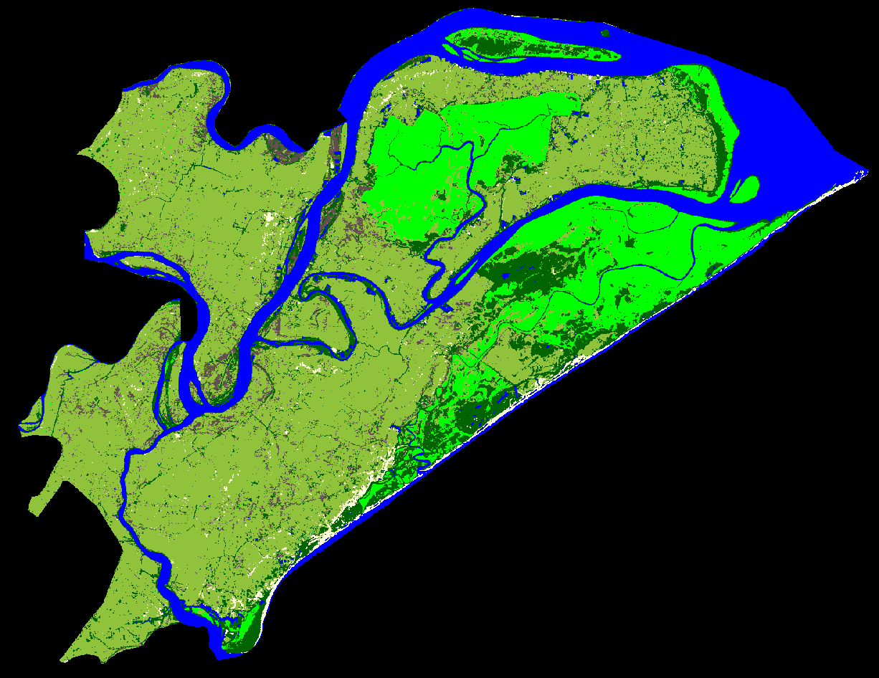
Results: Land Use Land Cover Trends
April 1995
April 2000
April 2005
April 2010
Dense Mangrove
Open Mangrove
Agriculture
Mudflat
Water
Sand
Area (Km ² )
Ag. Area (Km ² )
April 2014
Source: Landsat 5 & 8
Notes:
Landsat based supervised classification revealed a decreasing trend in dense mangrove area and increasing trend in open mangrove area. Cloud free images from same months were selected to avoid any seasonal bias in classification. However, change in sensor specification between Landsat 5 and Landsat 8 could induce some error in transferring one classification to other. The area estimates of each classes were found to be consistent with previous studies.

Slide 15
Results: LULC Accuracy Assessment
Classification Strength
Year | Overall Accuracy | Kappa Coefficient
1995 | 78% | 0.66
2000 | 80% | 0.66
2005 | 78% | 0.66
2010 | 75% | 0.67
2014 | 75% | 0.67
Notes:
A trend line for dense and open mangroves extending back to past with previous study data (included as diamond marker) showed consistentdecrease in dense mangrove area and increase in open mangrove area. The accuracy result produced from confusion matrix also showed consistent result for the period of data analysed (1995 – 2014).

Slide 16
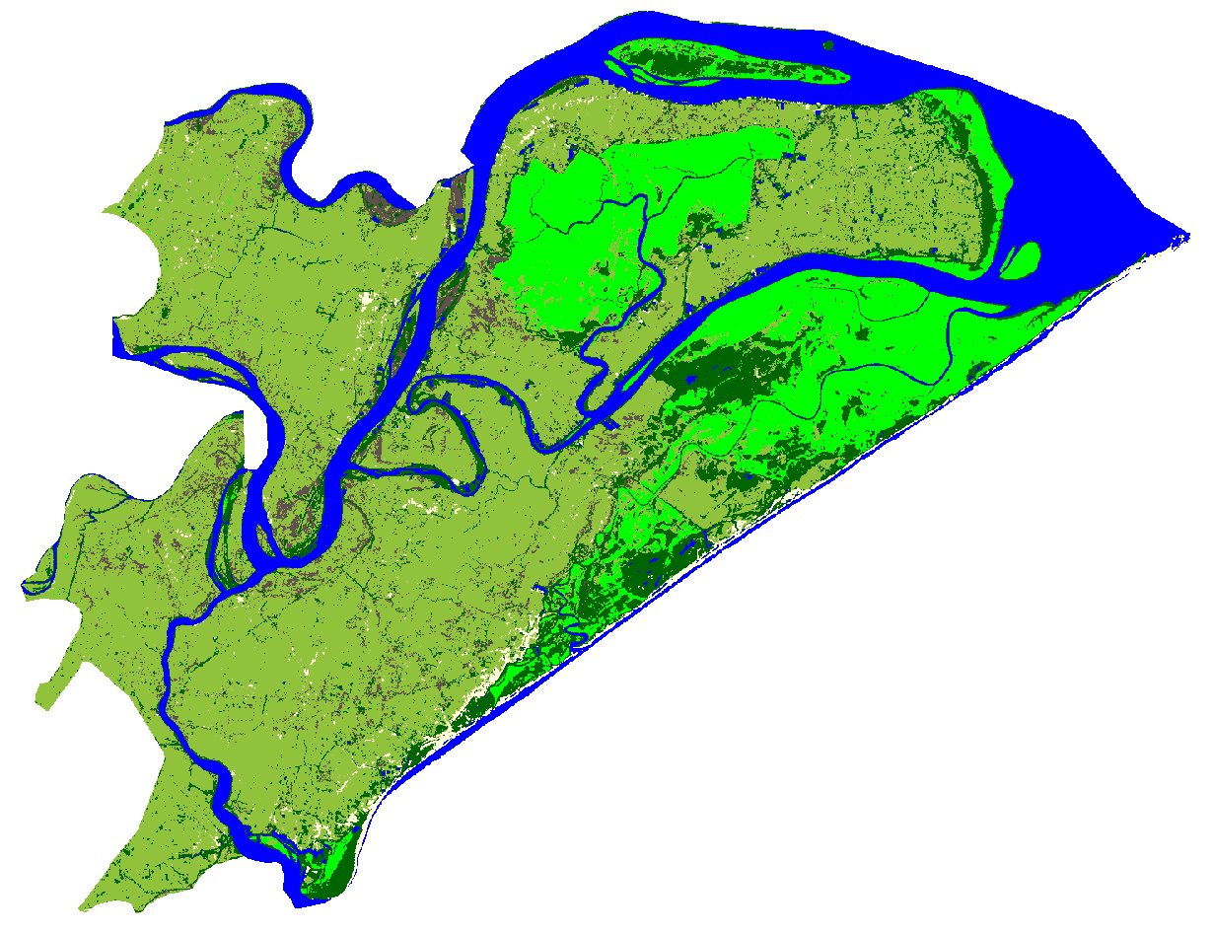
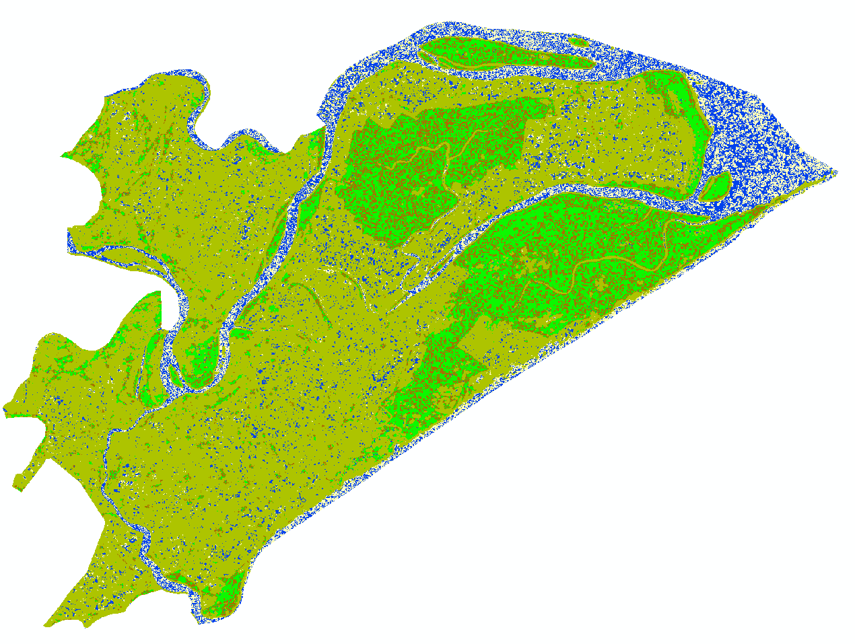
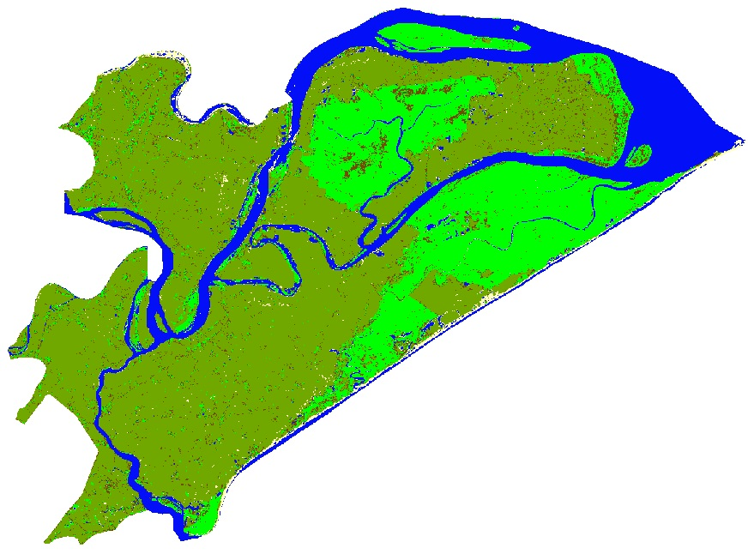
Results: Comparing Sentinel & Landsat
Landsat 8 (Apr 2014)
Sen 1A
(Apr 2016)
Landsat 8 + Sen 1A
Dense Mangrove
Open Mangrove
Agriculture
Mudflat
Water
Sand
Notes:
We also experimented to classify radar data separately as well as in combination with Landsat 8 to improve the classification accuracy. However, classification result from individual radar data showed poor result and also limited classes. Also, combining radar data after resampling to Landsat data showed improvement compared to separate radar data. More combinations need to be investigated in future to utilize advantage of radar data in classification.

Slide 17
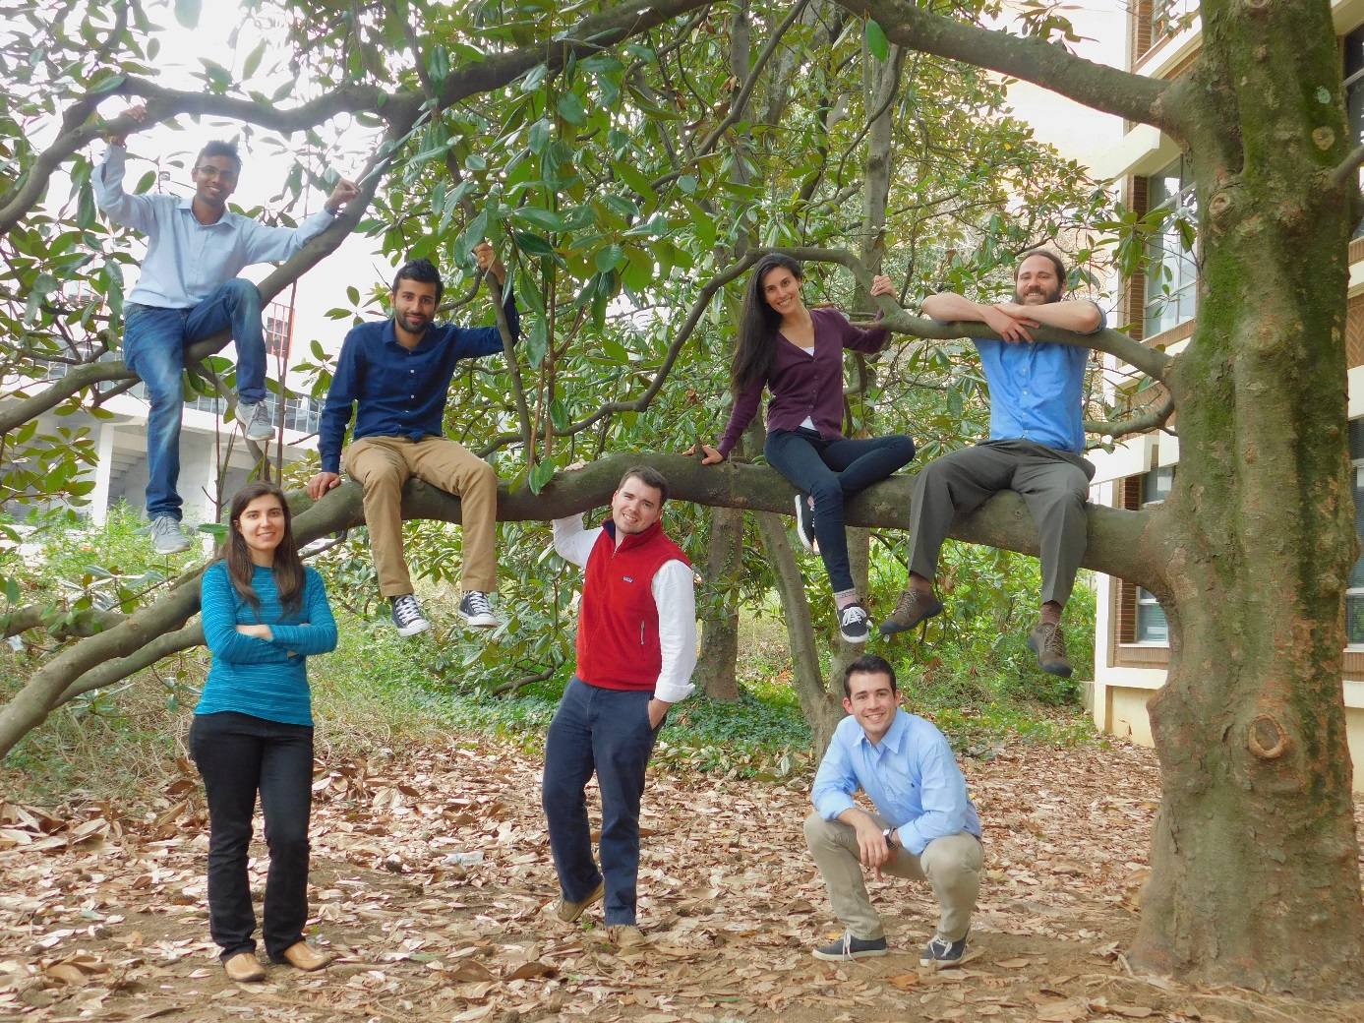
Conclusion
Multi-sensor remote sensing tools can be effectively utilized to capture seasonal and inter-annual variability of mangrove biophysical parameters.
All biophysical parameters followed a similar seasonal pattern.
Integration of radar data with optical sensor showed promising results.
Decrease in dense mangrove and increase in open mangrove area indicated need for enhanced management practices.
The accuracy of biophysical models can be further improved by incorporating field data.
Notes:
Multi-sensor remote sensing tools can be effectively utilized to capture seasonal and inter-annual variability of mangroves biophysical parameters. All biophysical parameters followed a similar seasonal pattern reaching peak values in the fall season, moderate values in the winter and spring seasons, and low values in the summer season. Integration of radar data with optical sensor showed promising results and can be utilized for monitoring the mangroves health in future even during cloud cover. Decrease in dense mangrove and increase in open mangrove area indicated need for proper management practices. The accuracy of biophysical models can be further improved by incorporating field data.

Slide 18
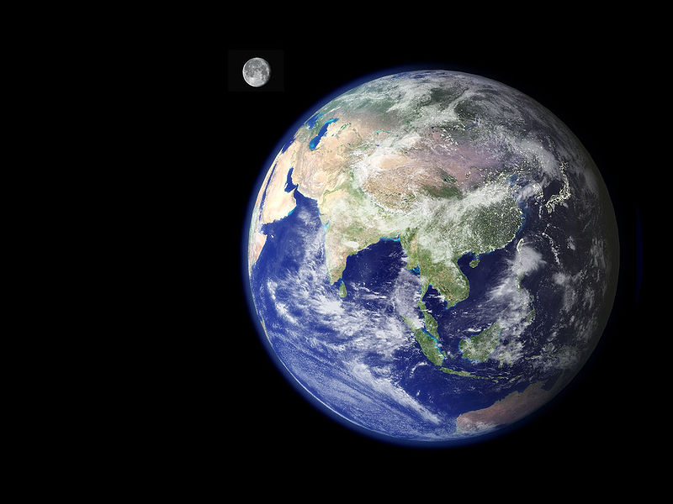
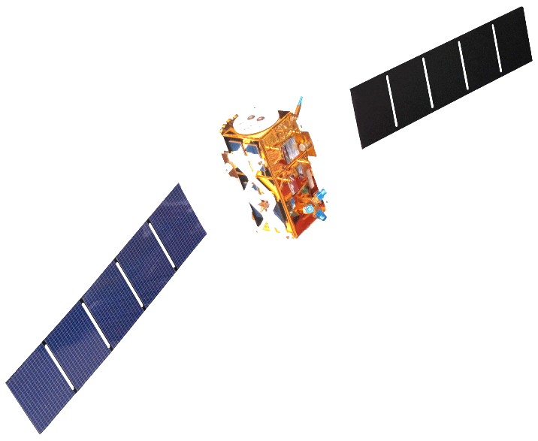
Future Work
Incorporate field data.
Analyze additional radar data.
Improve integration of radar and optical sensor for land use land cover classification.
Classify different types of mangrove in the study area using hyperspectral data.
Forecast mangrove biophysical parameters.
Explore the biophysical parameters of similar mangrove forest in other parts of India and around the world.
Source: NASA
Notes:
Incorporate field data to improve predictive accuracy of biophysical models. Analyze more radar data from past (apart from Sentinel 1A) and future. Improve integration of radar and optical sensor for land use land cover classification by experimenting various combinations. Classify different types of mangrove in the study area using hyperspectral data. Forecast mangroves biophysical parameters based on phenological pattern and meteorological variables such as surface temperature. Explore the biophysical parameters of similar mangrove forest in other part of India and around the world to implement and improve the tools developed in this project.

Slide 19
Advisors
Dr. Deepak Mishra, University of Georgia Department of Geography
Partners
Dr. Gurdeep Rastogi, Senior Scientist, Wetland Research and Training Center
Others
Patricia Stupp
Dr. Marguerite Madden, UGA Lead Science Advisor

