Slide 1
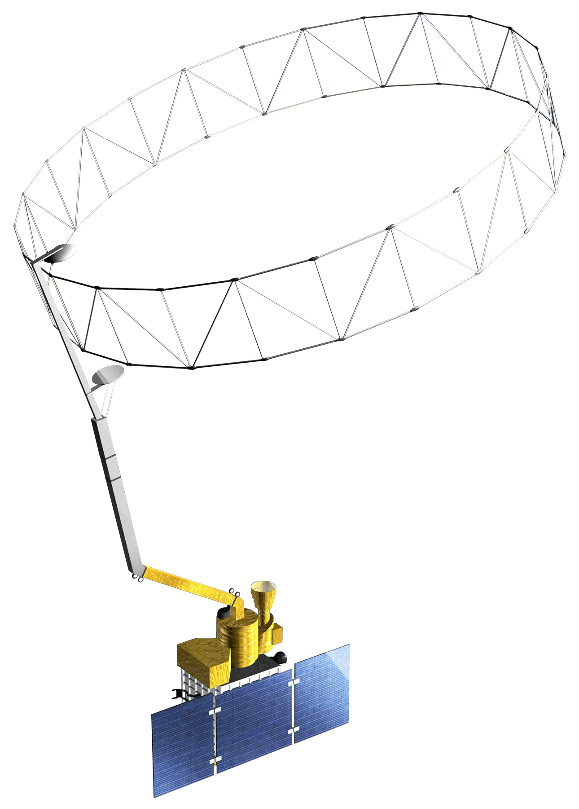
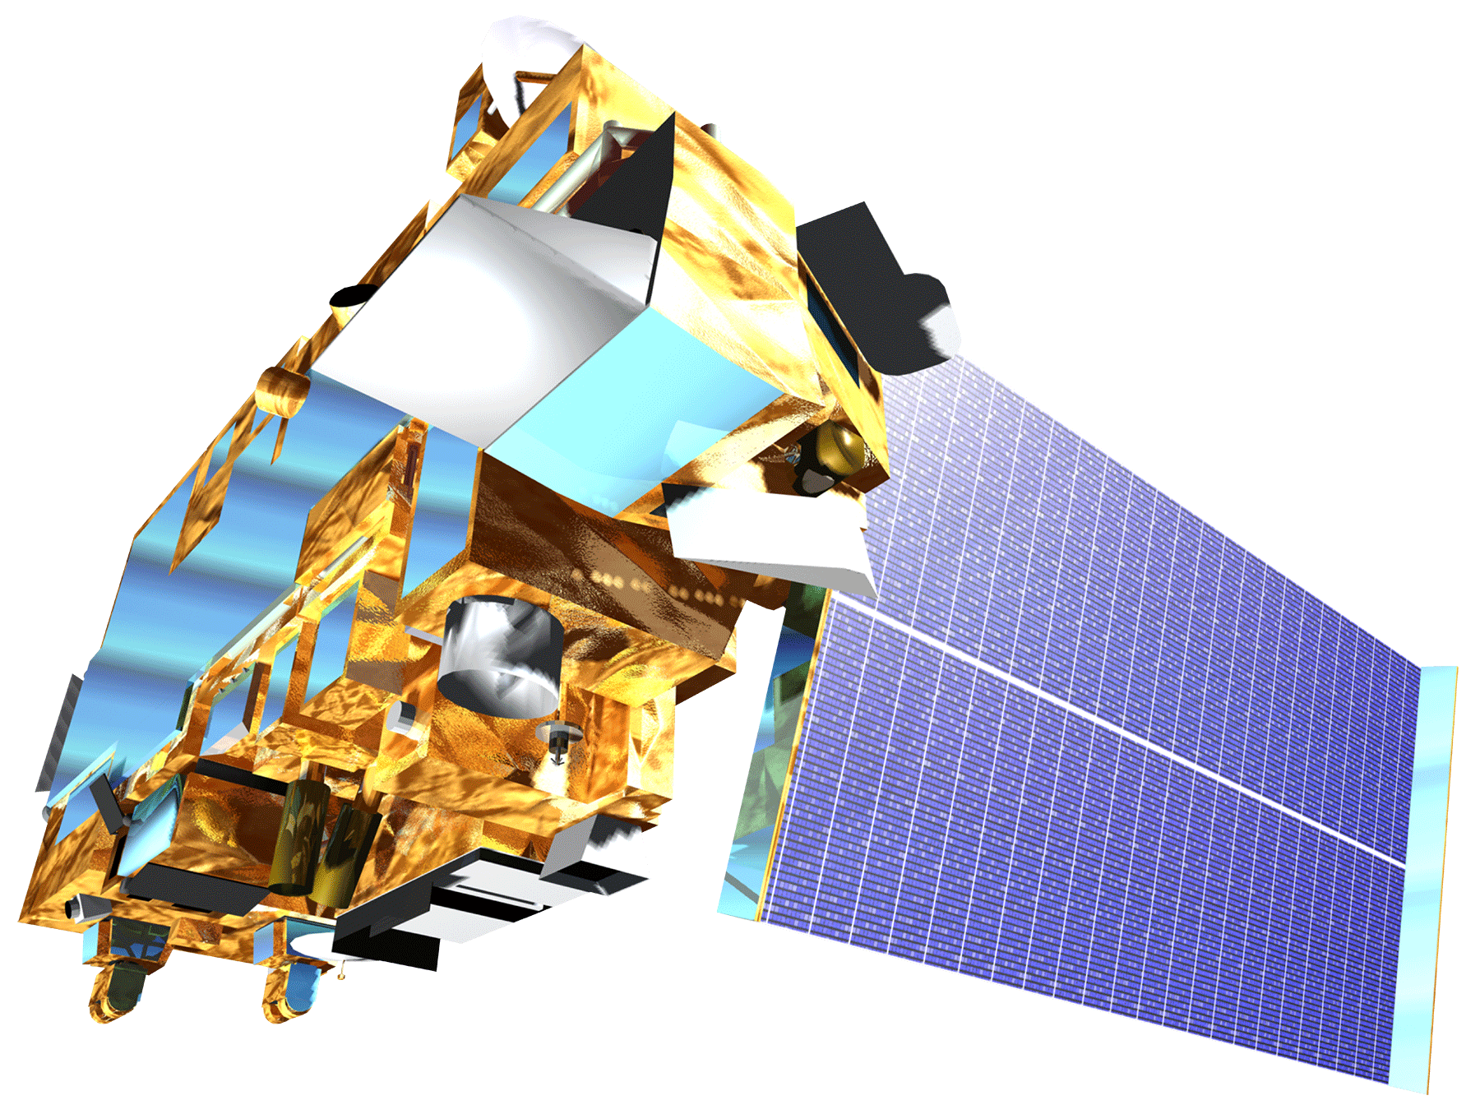
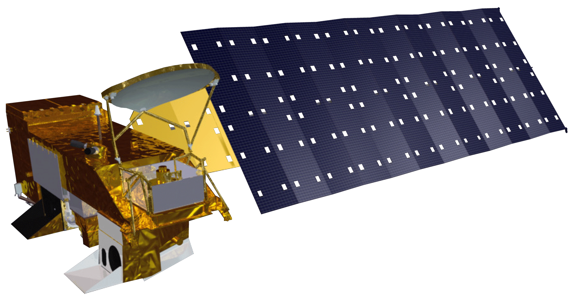
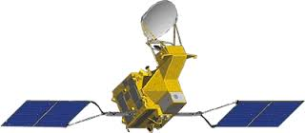
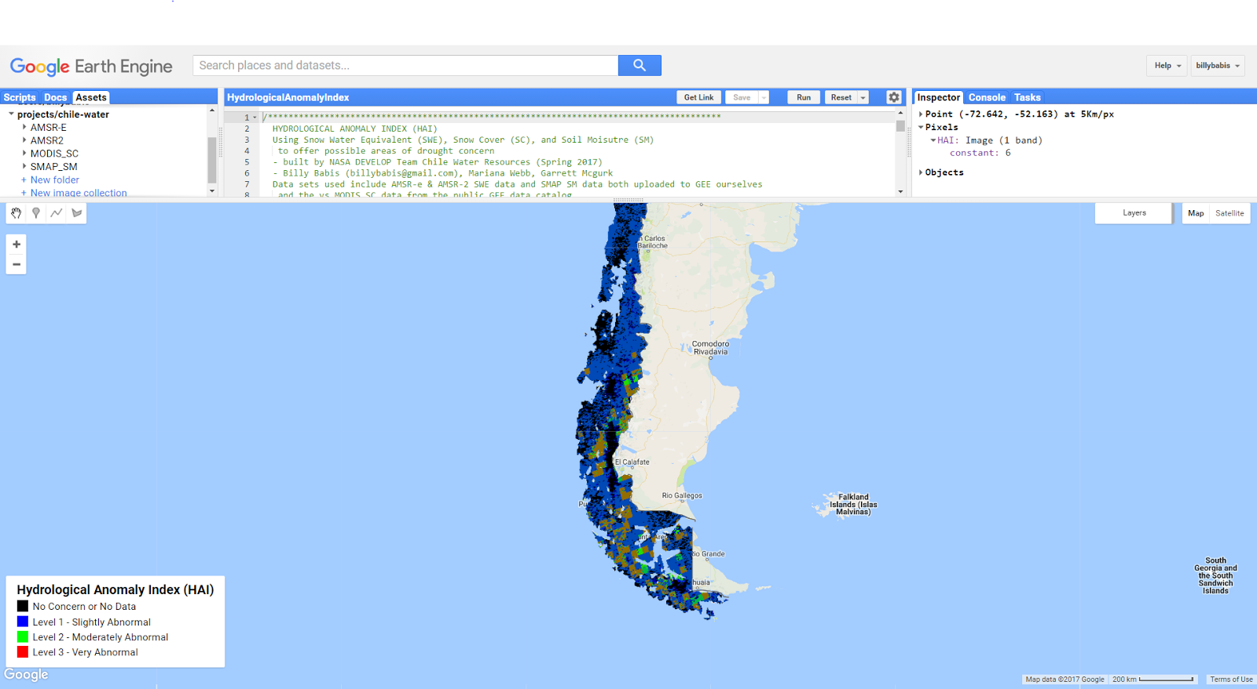
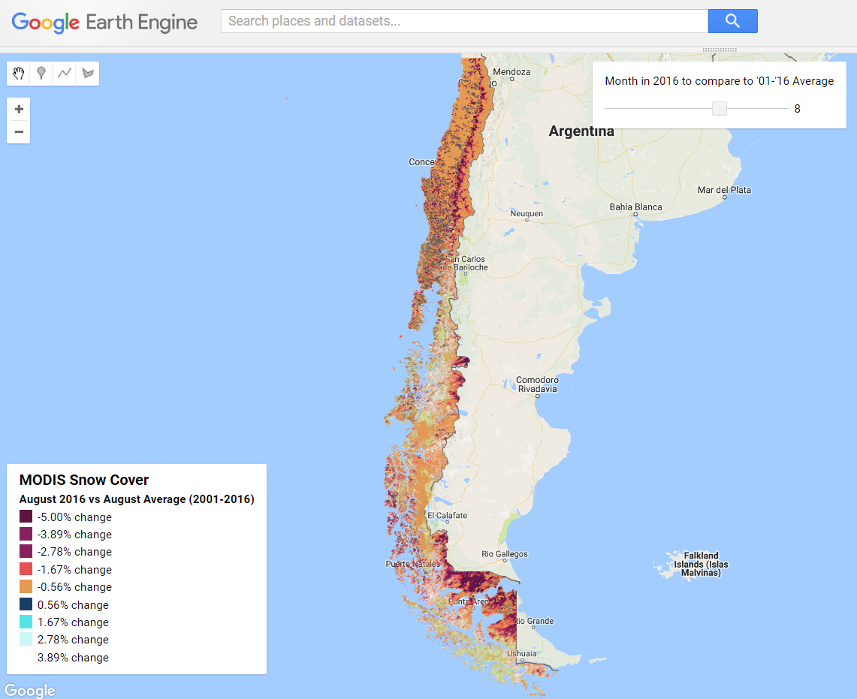
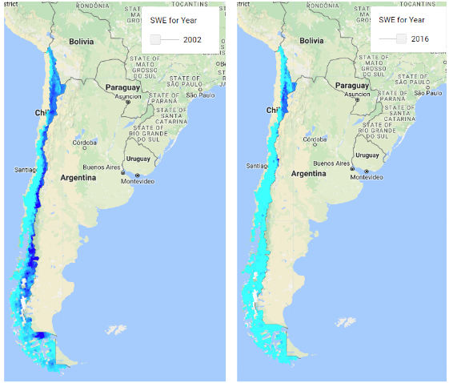
Integrating NASA Earth Observations into the Google Earth Engine Platform to Enhance Drought Monitoring in Chile
Abstract
Objectives
Chile is characterized by extreme climate variability ranging from the arid Atacama Desert, one of the driest places on earth, to the extremely wet Lake District that averages 2,535 mm of annual rainfall. In recent years, Chile has experienced abnormal climate conditions as record droughts and rapidly receding glaciers place an added strain on a historically limited water supply. With stakeholders from the water resources and agricultural communities relying on this limited reserve, the management of water in Chile has become increasingly important as the Ministry of Agriculture prepares for future climate variability. This project provided the Chilean Ministry of Agriculture with a case study evaluating the effectiveness of incorporating new Earth observation datasets into the Google Earth Engine (GEE) platform to enhance drought monitoring capabilities in Chile. To highlight the potential benefits of utilizing GEE to aid in drought monitoring and decision-making, the team developed a tool within the GEE platform that aggregates data from the Soil Moisture Active Passive (SMAP) radiometer, the Moderate Resolution Imaging Spectroradiometer (MODIS), and the AMSR-E and AMSR2 radiometers. Parameters derived from the remotely-sensed data include soil moisture (SM), snow cover (SC), and snow water equivalent (SWE). The advantage of hosting this data in the GEE platform is that it is a collaborative cloud-based analysis tool, which allows users to share, store, and perform analysis on large volumes of data. GEE has the potential to transform the way in which geospatial information is studied and disseminated, improving upon the accessibility and breadth of the data currently available.
Integrate NASA Earth observations of soil moisture, snow cover, and snow water equivalent into the Chilean Ministry of Agriculture’s toolbox for drought monitoring and early warning
Analyze the feasibility of utilizing the Google Earth Engine platform as a climate data repository and visualization tool
Improve drought monitoring capabilities in Chile by advancing the accessibility, assimilation, and interpretation of relevant climate datasets
Study Area
Earth Observations
SMAP Radiometer
Terra MODIS
Methodology
Aqua AMSR-E
Action
Data Product
GCOM-W1 AMSR2
Satellite Data
GeoTIFF
Download from DAAC
GeoTIFF
Upload to Google Cloud
Conclusions
The GEE Platform is a powerful tool for organizing and hosting large datasets, processing large-scale server-side computations, and visualizing remotely-sensed data. The GEE interface is equipped with a JavaScript code editor, documentation, dataset library, and an interactive map that allows for effective data visualization; creating and modifying a shared repository for data assets and javascript files on the GEE platform is organized and version controlled.
Using satellite datasets from the GEE data catalog for computation is quick and seamless. Uploading and analyzing local datasets is a fairly tedious process that illuminates some of the warts that the GEE team is consistently working to flush out. The data pipeline for hosting satellite datasets on the GEE is oblique but following the Hydrological Anomaly Engine (HAE) tutorial for data ingestion simplifies this process. Once the data is available for use in the GEE code editor, the processing and visualization capabilities are unparalleled.
GEE Python API
Chile Water Resources
Google Earth Engine Asset
GEE Code Editor
Visualization in GEE
While MODIS SC version 5 & 6 data are available on the GEE public data catalog, the SMAP SM and AMSR-E and AMSR2 SWE data need to be preprocessed before ingestion to GEE. These L3 datasets were downloaded as GeoTIFFs via NASA’s Earthdata Search Tool and HEG tool processing. These datasets can then be uploaded to Google Cloud Storage where the GEE Python API and Command-Line Interface (CLI) API can batch upload to GEE assets with metadata. Each uploaded dataset is stored as an ee.ImageCollection object in GEE in a shared assets folder for easy analysis and visualization.
Acknowledgements
Results
Javier Chuad
U.S. Embassy of Chile, Agricultural Specialist
Dr. Juan Torres-Perez
Bay Area Environmental Research Institute, DEVELOP Science Advisor
Dr. Eduardo Bendek
NASA Ames Research Center, Science Advisor
Nicholas Clinton
Google Earth Engine, Developer Advocate.
Brittany Zajic
NASA DEVELOP National Program
Jenna Williams
NASA DEVELOP National Program
No Concern or No Data
Level 1 - Slightly Abnormal
Level 2 - Moderately Abnormal
Level 3 - Very Abnormal
Project Partners
Hydrological Anomaly Index Tool
Chile Ministry of Agriculture
Agricultural Office- Embassy of Chile
Team Members
August 2016 vs August Average (2001-2016)
-5.00% change
-3.89% change
-2.78% change
-1.67% change
-0.56% change
0.56% change
1.67% change
2.78% change
3.89% change
MODIS Snow Cover Visualization
Snow Water Equivalent 2002 vs 2016
Garrett McGurk
POC
Mariana Webb
Billy Babis
NASA Ames Research Center – Spring 2017

