Slide 1
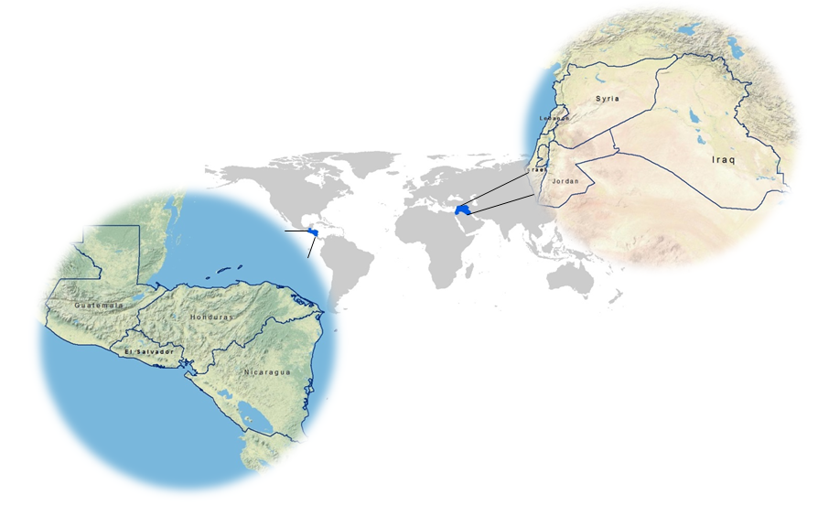
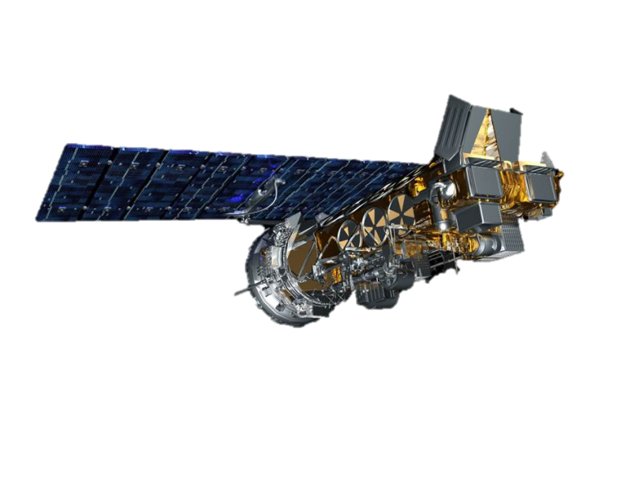
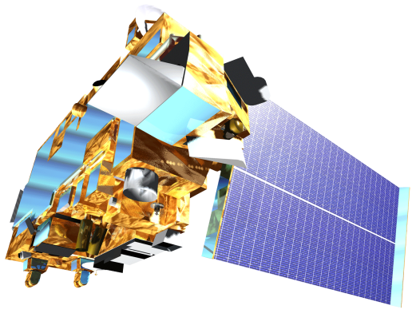
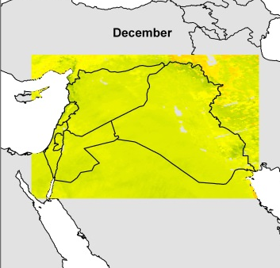
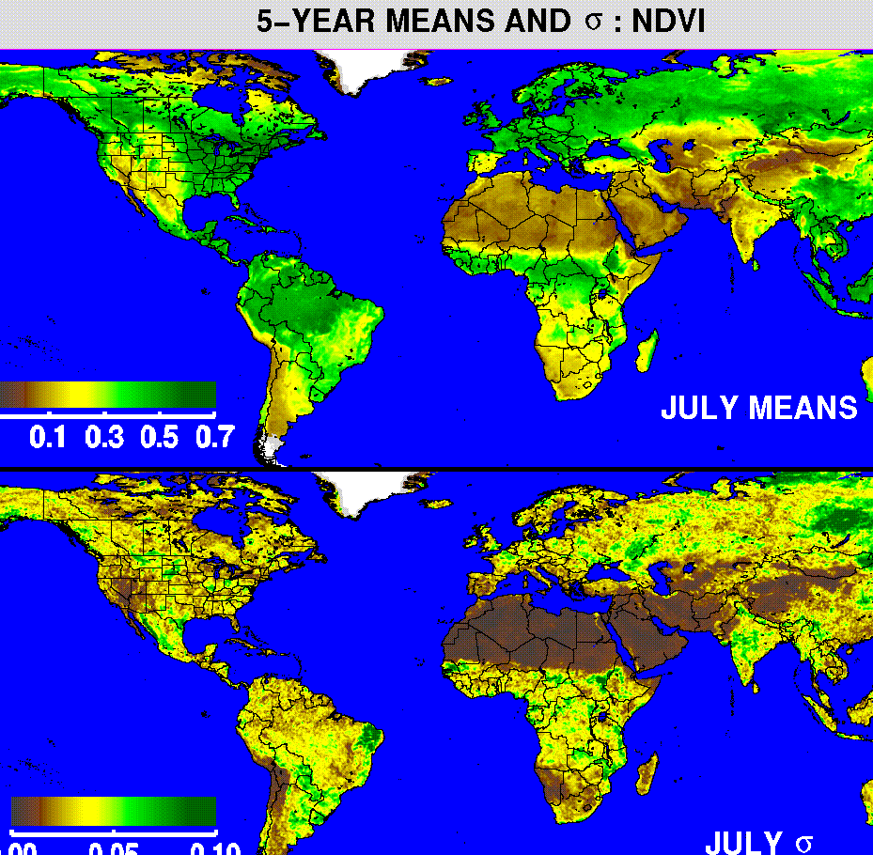
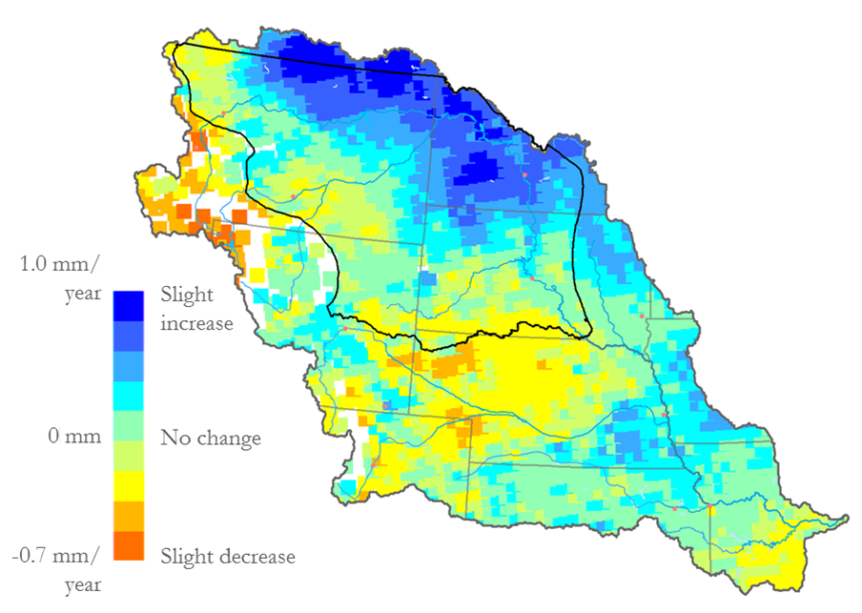
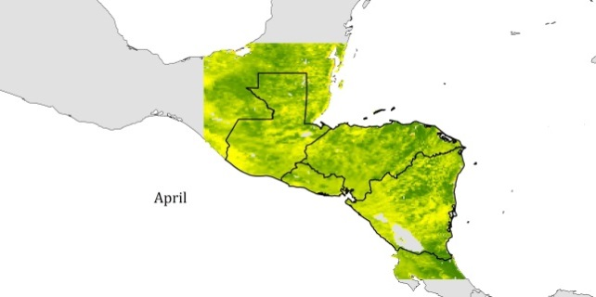
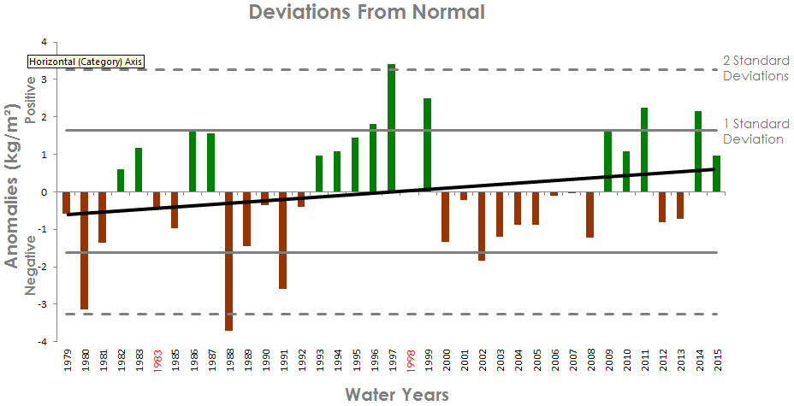
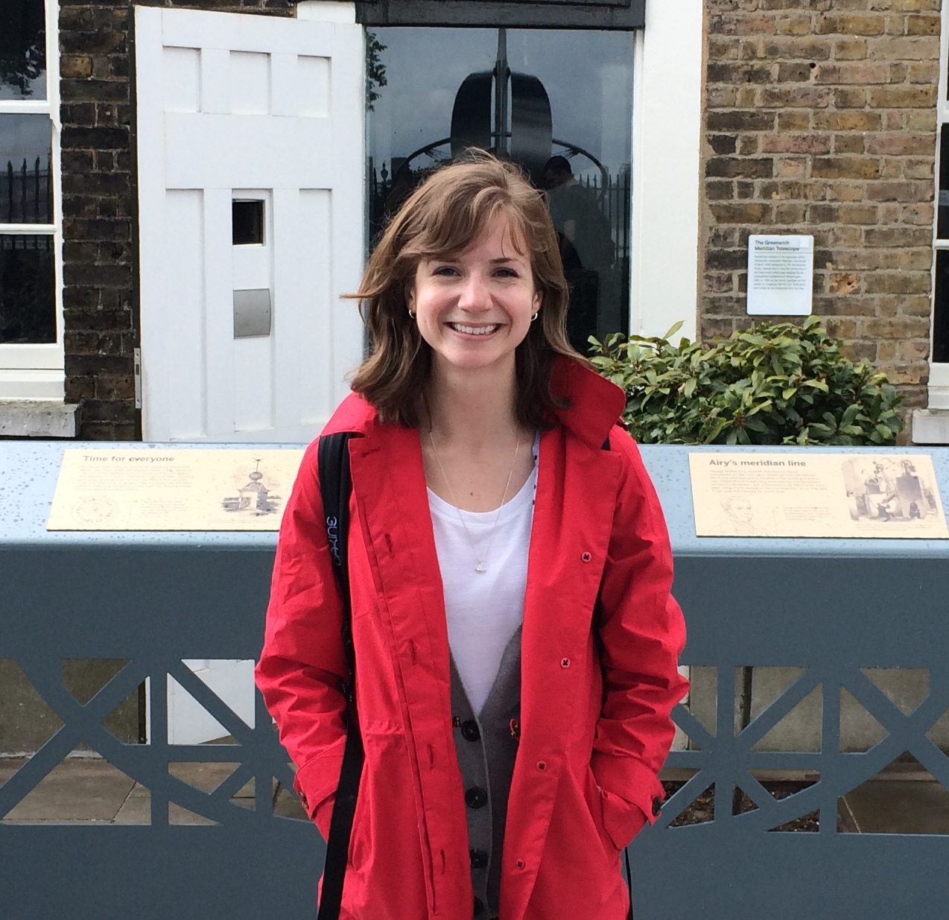
Levant and Central American Climate
Monitoring precipitation and drought to enhance U.S. Air Force predictions and decision-making in the Levant and Central America
Alec Courtright (Project Lead), Christie Stevens, Hayley Hajic
DEVELOP National Program at NOAA National Centers for Environmental Information
Abstract
Objectives
Keep this blank for now.
Body text point size should be at least 24.
Caption text point size should be at least 16.
Feel free to rename, move, and resize sections as needed.
Create comprehensive climatologies of Central America and the Levant to enhance the 14th Weather Squadron’s decision-making capabilities.
Compare NOAA AVHRR and NASA MODIS NDVI data sets to assess data reliability.
Examine neutral and anomalous years to discover trends and determine effects of extreme weather-related events, such as El Niño and La Niña.
Study land-cover maps and compare land-use change with NDVI in both regions.
Study Area
Earth Observations
NOAA AVHRR
0.5 degrees resolution daily
NASA MODIS
1km resolution every 16 days
Figure 1 Central America including Guatemala, El Salvador, Honduras and Nicaragua (left); The Levant study area including Lebanon, Israel, Jordan, Iraq and Syria (right)
Methodology
Data Acquisition
El Niño
and
La Niña
Results
Land Cover Change Maps
End Products
Data Processed Using R Programming
NASA MODIS
Anomalous Years
Figure 2 shows NDVI trends over 30 years by pixel.
NOAA
AVHRR
Normal
Difference Vegetation Index (NDVI)
Data Analysis
Enhance monitoring of drought and precipitation to alleviate conflict due to climatic events
Figure 2 (Placeholder) Example land use change trend map
Figure 3 shows the general NDVI trend and the deviation from the normal trend each year.
Conclusions
Figure 3 (Placeholder) Example of anomalous year graph highlighting ENSO events
Use bullets.
Use complete sentences with periods.
Team Members
Project Partners
Alec Courtright
Team Lead
Hayley Hajic
Christie Stevens
Acknowledgements
Dr. DeWayne Cecil, Science Advisor, National Centers for Environmental Information
Jessica Sutton, Center Lead at NOAA NCEI
Emma Baghel, Assistant Center Lead at NOAA NCEI
U.S. Air Force 14 Weather Squadron, End users
U.S. Air Force 14th Weather Squadron
National Oceanic and Atmospheric Association
NOAA National Centers for Environmental Information

