Slide 1
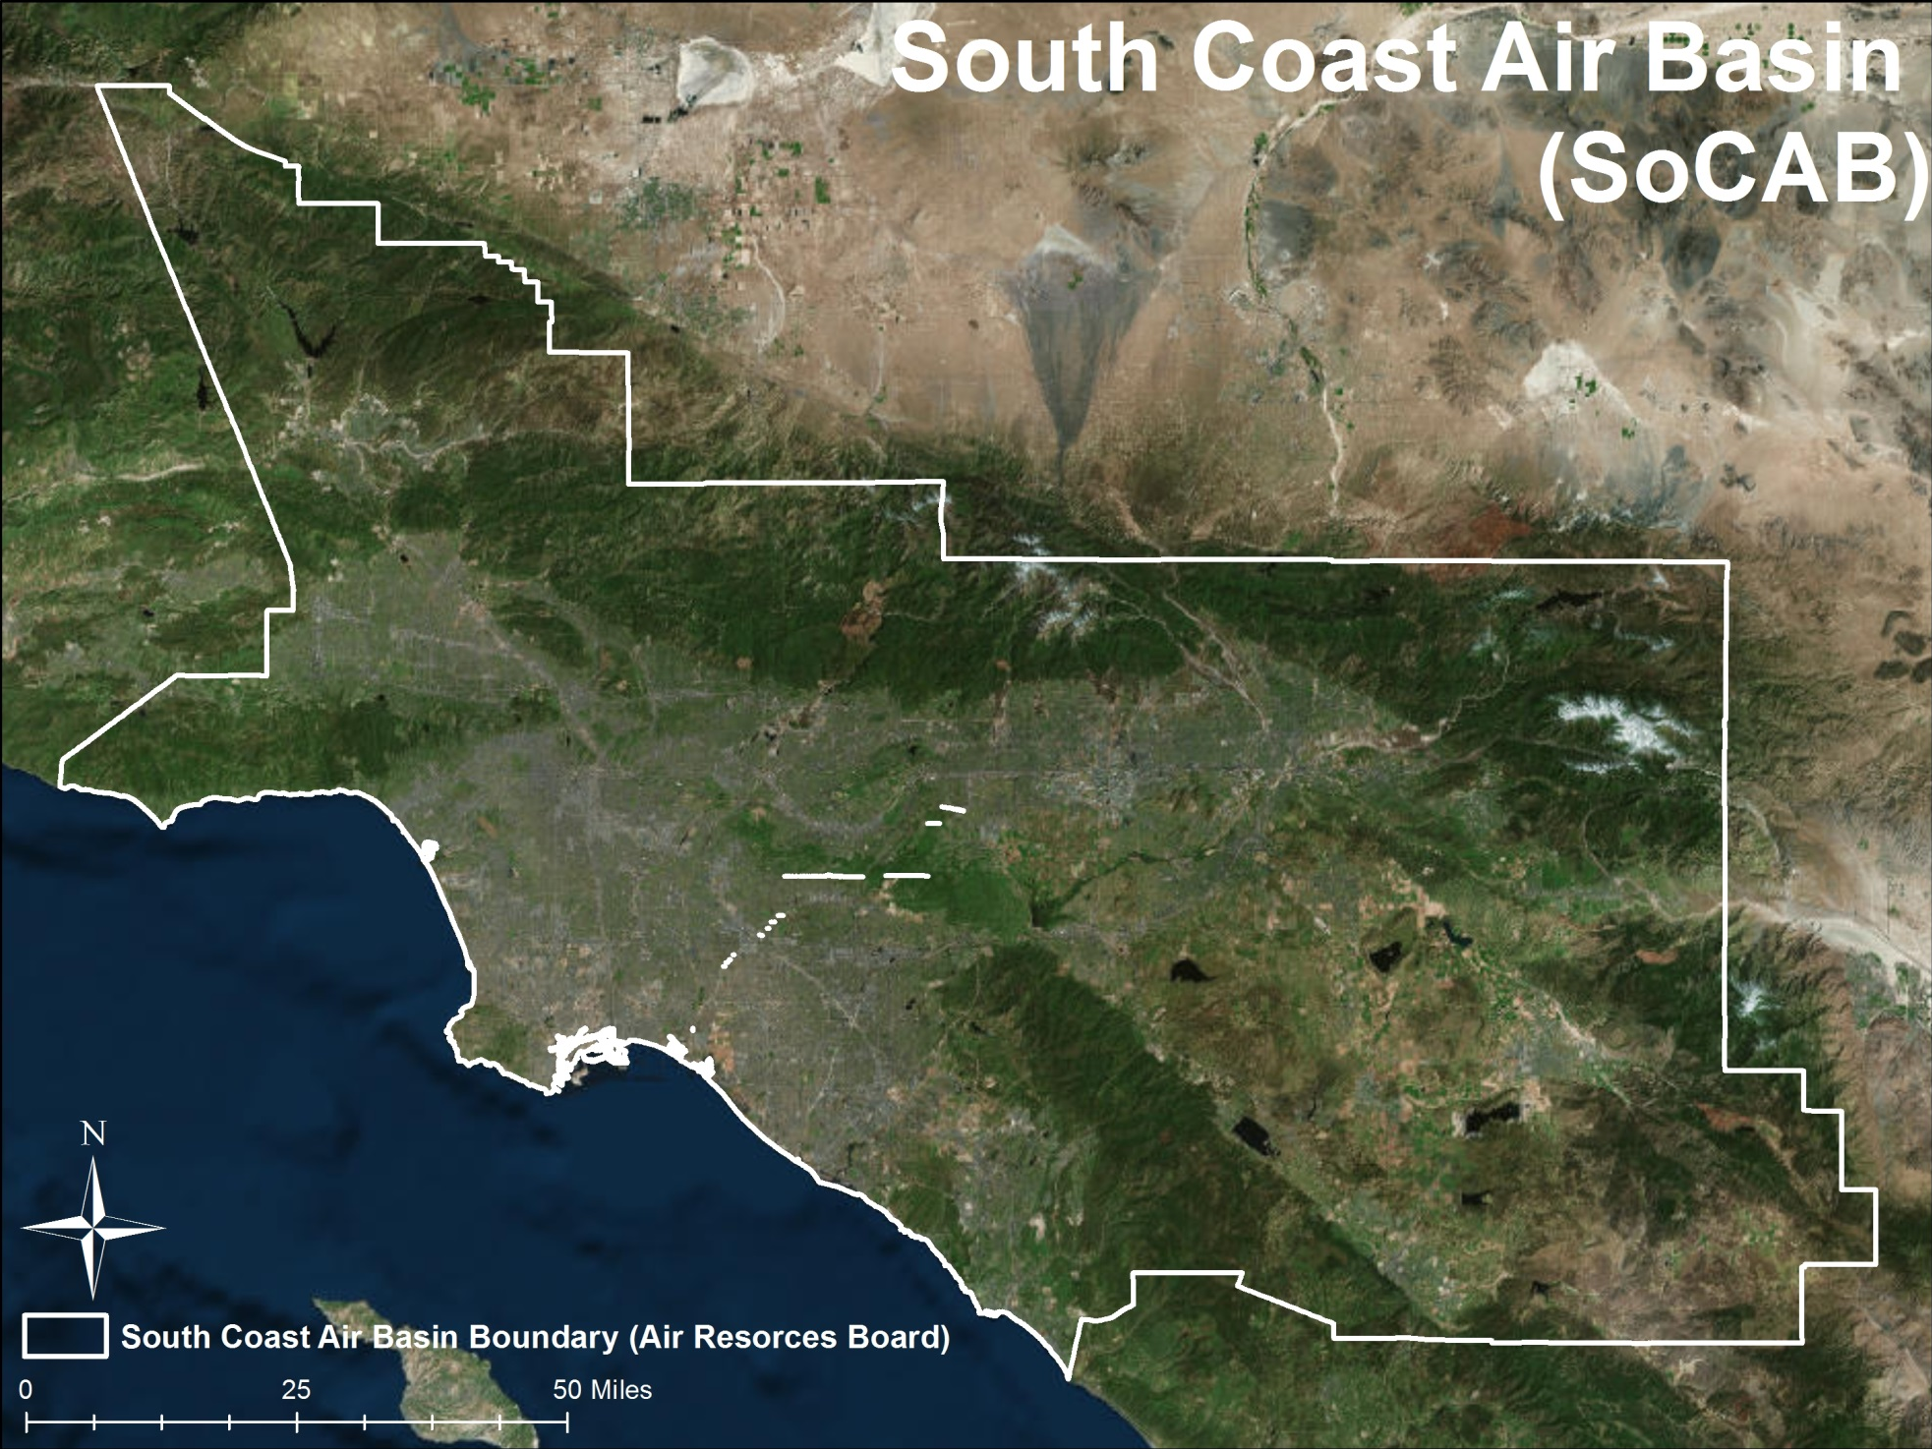
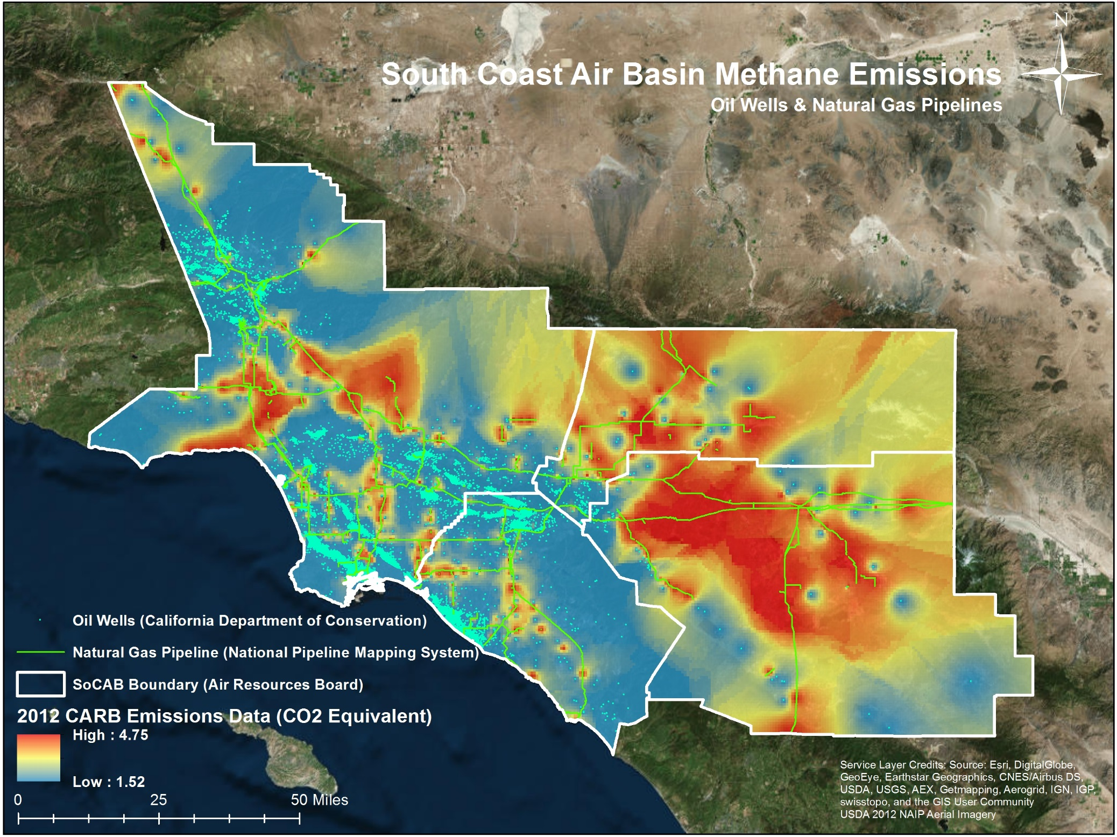
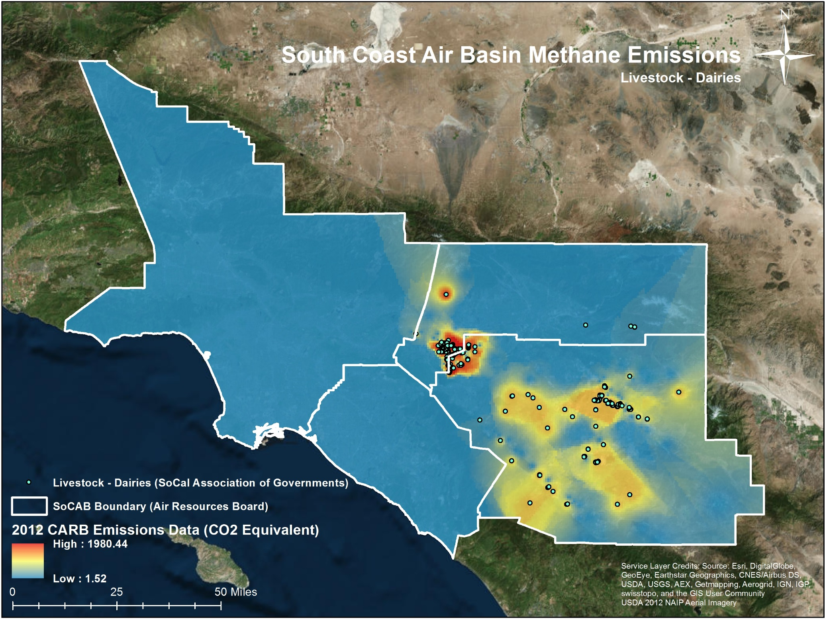
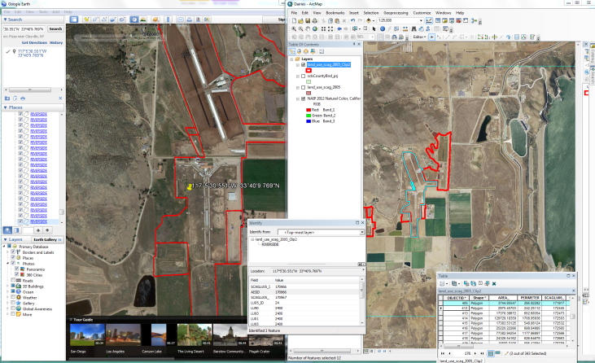
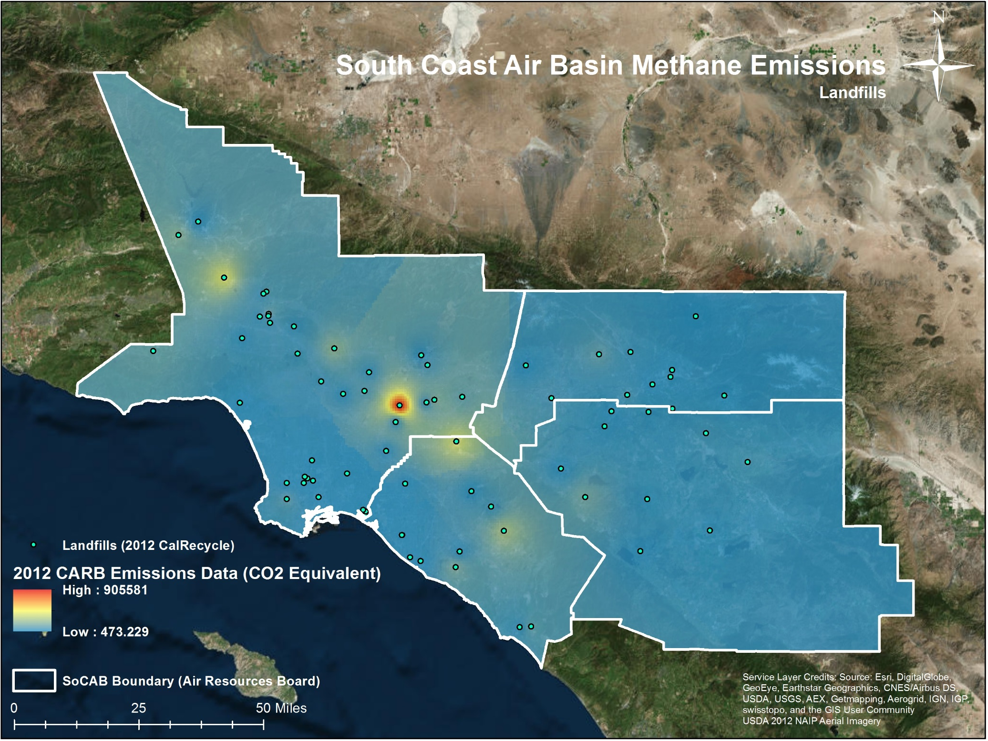
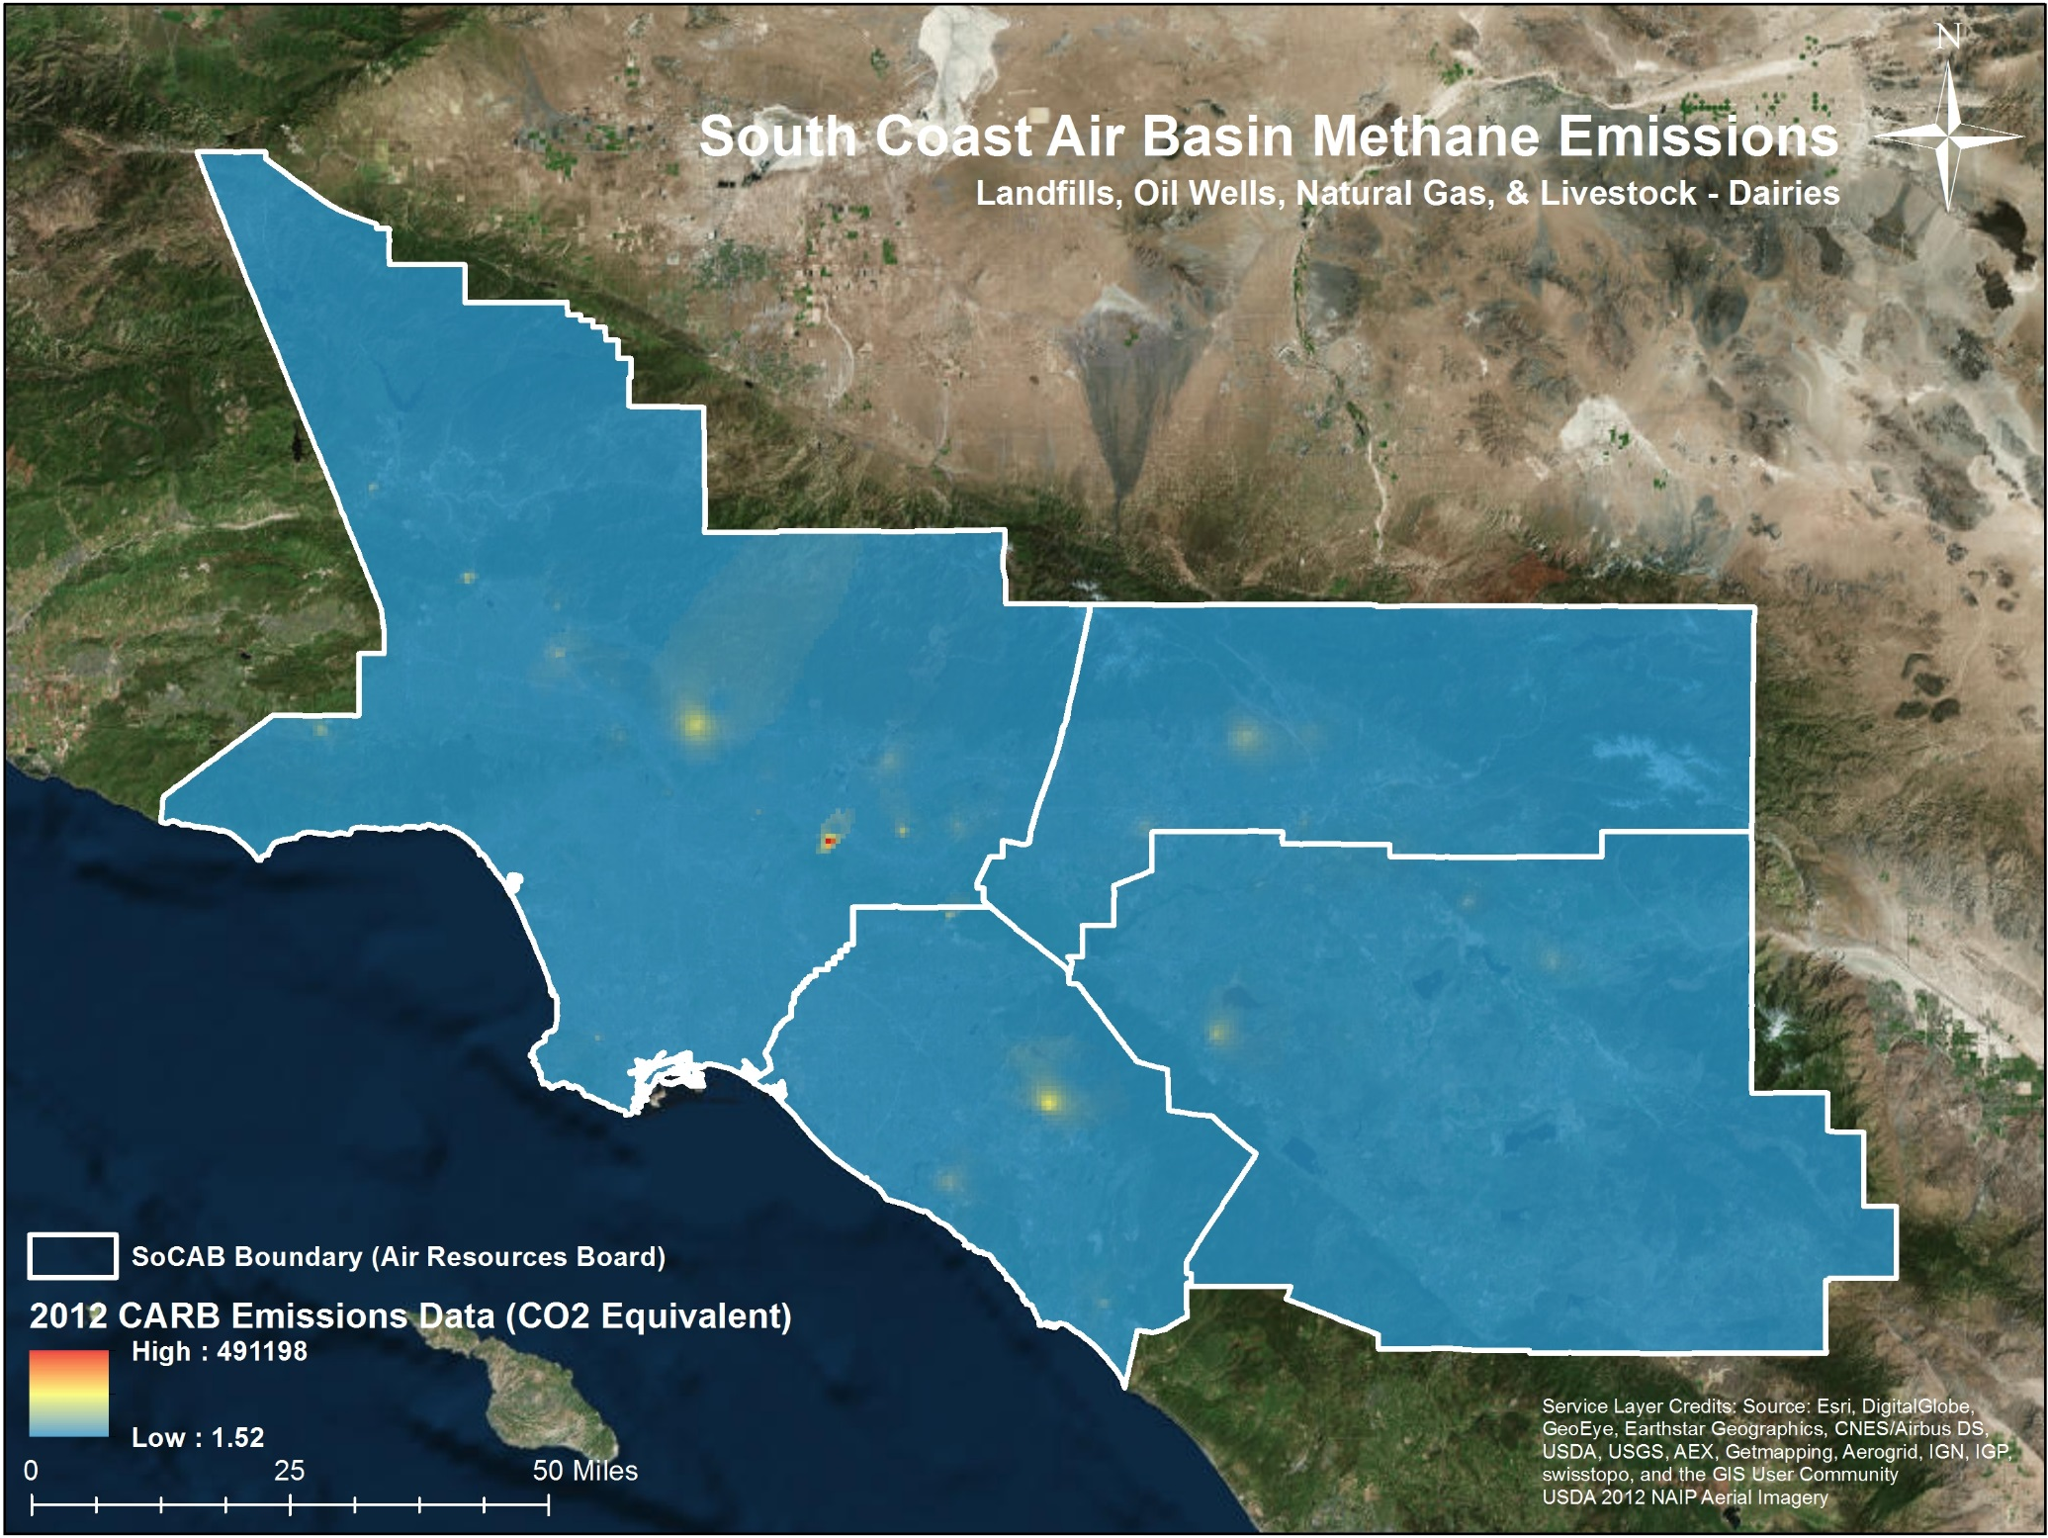
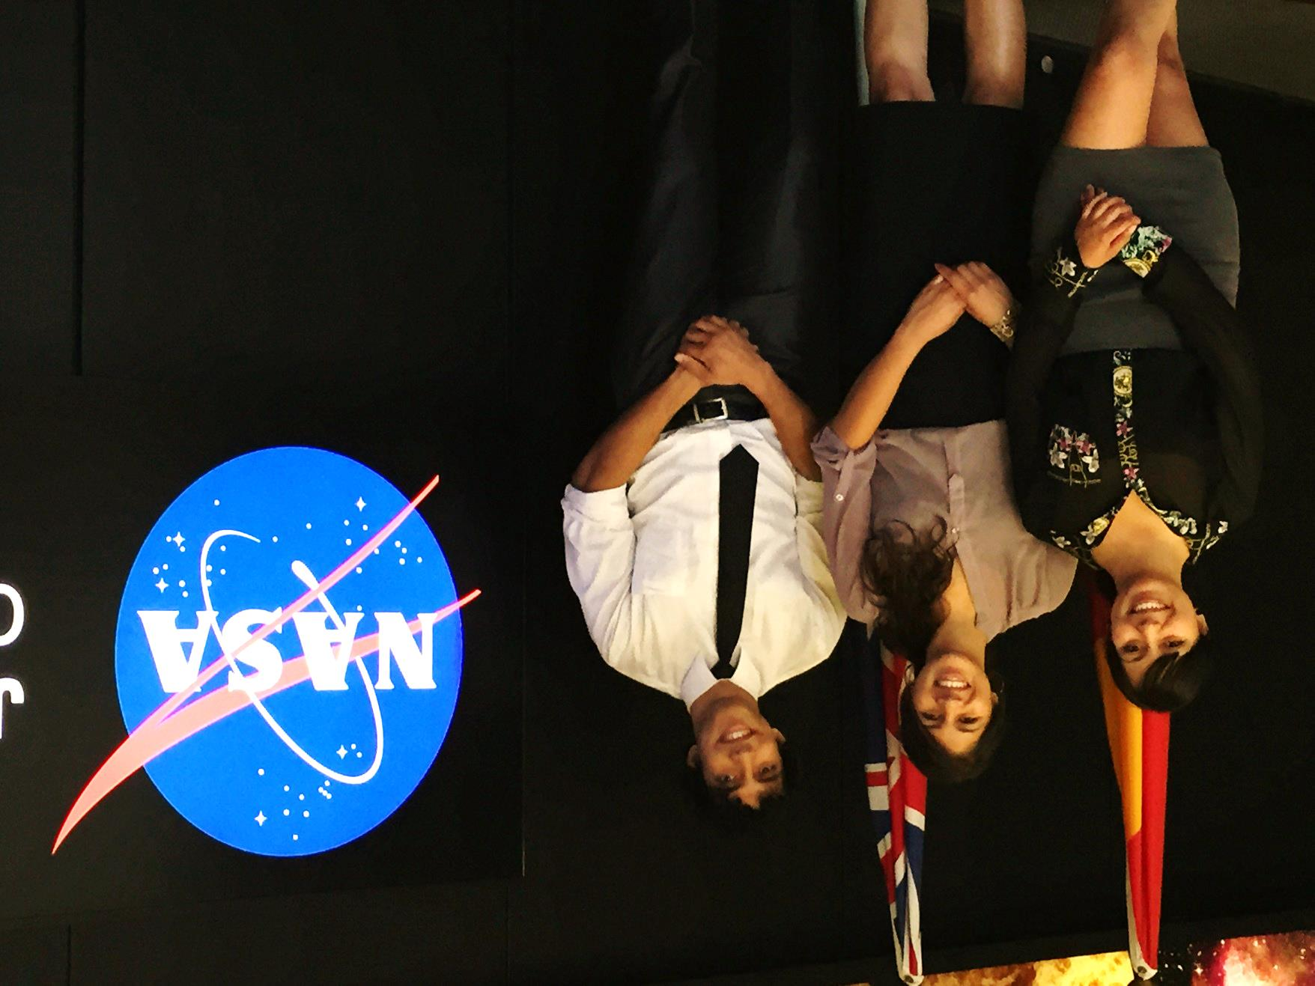
Los Angeles Health & Air Quality
Identifying urban emission patterns in the Los Angeles megacity
Talha Rafiq (Project Lead), Isis Frausto-Vicencio, Valerie Carranza
NASA DEVELOP National Program at NASA Jet Propulsion Laboratory
Abstract
Study Area
Objectives
Combining greenhouse gas (GHG) datasets with GIS spatial modeling is a viable method for analyzing the distribution of GHG emissions. Understanding the spatial dynamics of GHG emissions is important for global climate modeling and forecasting, especially as it relates to predicting the effects of global warming and the development of state and federal policies.
This research provided spatial models of methane (CH₄) emissions in the Southern California Air Basin (SoCAB). Point sources of CH₄ emissions are established through the development of a geospatial database. CH₄ emission factors were obtained using a combination of the GHG inventory developed by the California Air Resources Board (CARB) and other statistical methods derived from previous GHG studies. These emission factors were tabulated to the spatial datasets in order to create raster-based visualizations of CH₄ emissions for 2012.
The spatial maps of CH₄ emissions illustrated the potential of spatial modeling for accurately depicting GHG emissions in a megacity, such as greater Los Angeles. This data provided a baseline against which measurements collected by NASA Jet Propulsion Laboratory’s Earth Science Department, chiefly the Megacities Carbon Project, can be evaluated.
Collected, processed, standardized, and validated different sources of GIS spatial layers that symbolized CH₄ emission sectors
Researched and ranked various sectors in SoCAB to determine their significance in producing CH₄ emissions
Used the expertise from the NASA JPL Earth Science advisors and CARB partners to obtain estimated emission factors for the top CH₄ producing sectors
Developed raster-based spatial representations of CH₄ emissions in the SoCAB region of
Evaluated results with CLARS and HyTES CH₄ spatial measurements
Earth Observations
Methodology
NASA JPL Hyperspectral Thermal Emissions Spectrometer (HyTES)
NASA JPL Mt. Wilson Observatory – California Laboratory for Atmospheric Remote Sensing (CLARS)
1
GIS data collection of CH₄ Emission Sectors
Results
2
Data Processing & Validation of GIS Layers
3
Rank Top Sectors by CH₄ Emission Output
CARB 2012 | Statewide
CARB 2012 | SoCAB
(projected)
CALGEM 2012 | SoCAB
Rank | Source | Statewide Total (Gg CH₄/year)
1 | Livestock-Dairy | 73,175
2 | Landfills | 7,973
3 | Natural Gas | 2,354
4 | Wastewater Treatment Plants | 1,665
5 | Oil | 1,037
Rank | Source
1 | Landfills
2 | Natural Gas
3 | Oil
4 | Livestock-Dairy
5 | Wastewater Treatment Plants
Rank | Source | SoCAB Total (Gg CH₄/year)
1 | Landfills | 171.3
2 | Oil & Natural Gas | 87.4
3 | Livestock-Dairy | 77.3
4 | Wastewater Treatment Plants | 56.3
Team Members
Conclusion
This research helped evaluate previous local and regional scale emissions estimates and atmospheric observations as conducted by CARB and NASA JPL. This study improved bottom-up emissions estimates for methane and validated NASA HyTES and CLARS CH₄ spatial measurements. Future research will entail utilizing other NASA top-down datasets to measure methane emissions in the South Coast Air Basin. These datasets include measurements collected by the in-situ network in the Los Angeles Basin, the OCO-2 satellite dataset, the TCCON network, and the GOSAT satellite dataset.
4
Develop Emission Maps of Top 3 Sectors
Acknowledgements
Project Partners
We want to thank our NASA JPL Climate & Science Advisors Francesca Hopkins, Kristal Verhulst, & Preeti Rao, Clare Wong, Sha Feng, and Riley Duren for their time and support. We also want to thank the DEVELOP National Program especially Benjamin Holt and Gwen Miller for giving us this valuable opportunity to learn and research at NASA JPL.
LA Health & Air Quality Team (from left): Valerie Carranza, Isis Frausto-Vicencio, and Talha Rafiq (Project Lead)
California Air Resources Board (CARB)
NASA JPL Megacities Carbon Project
NASA Jet Propulsion Laboratory

