Slide 1
Argentina
Agriculture & Food Security
Crop Monitoring and Forecasting for Argentina Using NASA Satellite Observations
Brooke Egley, Ryan Lam, Tyler Pantle, Sienna Templeman, & Caroline Williams
Maryland – Goddard
Notes:
Speaker:
This project was conducted by Brooke Egley, Ryan Lam (team lead), Tyler Pantle (data manager), Sienna Templeman (software point of contact), and Caroline Williams.
The project, conducted remotely out of the NASA Goddard Space Flight Center (GSFC) node, focused on Argentinian agriculture and food security, partnering with a Argentina nonprofit organization to develop climate services of direct use to decision-makers.

Slide 2
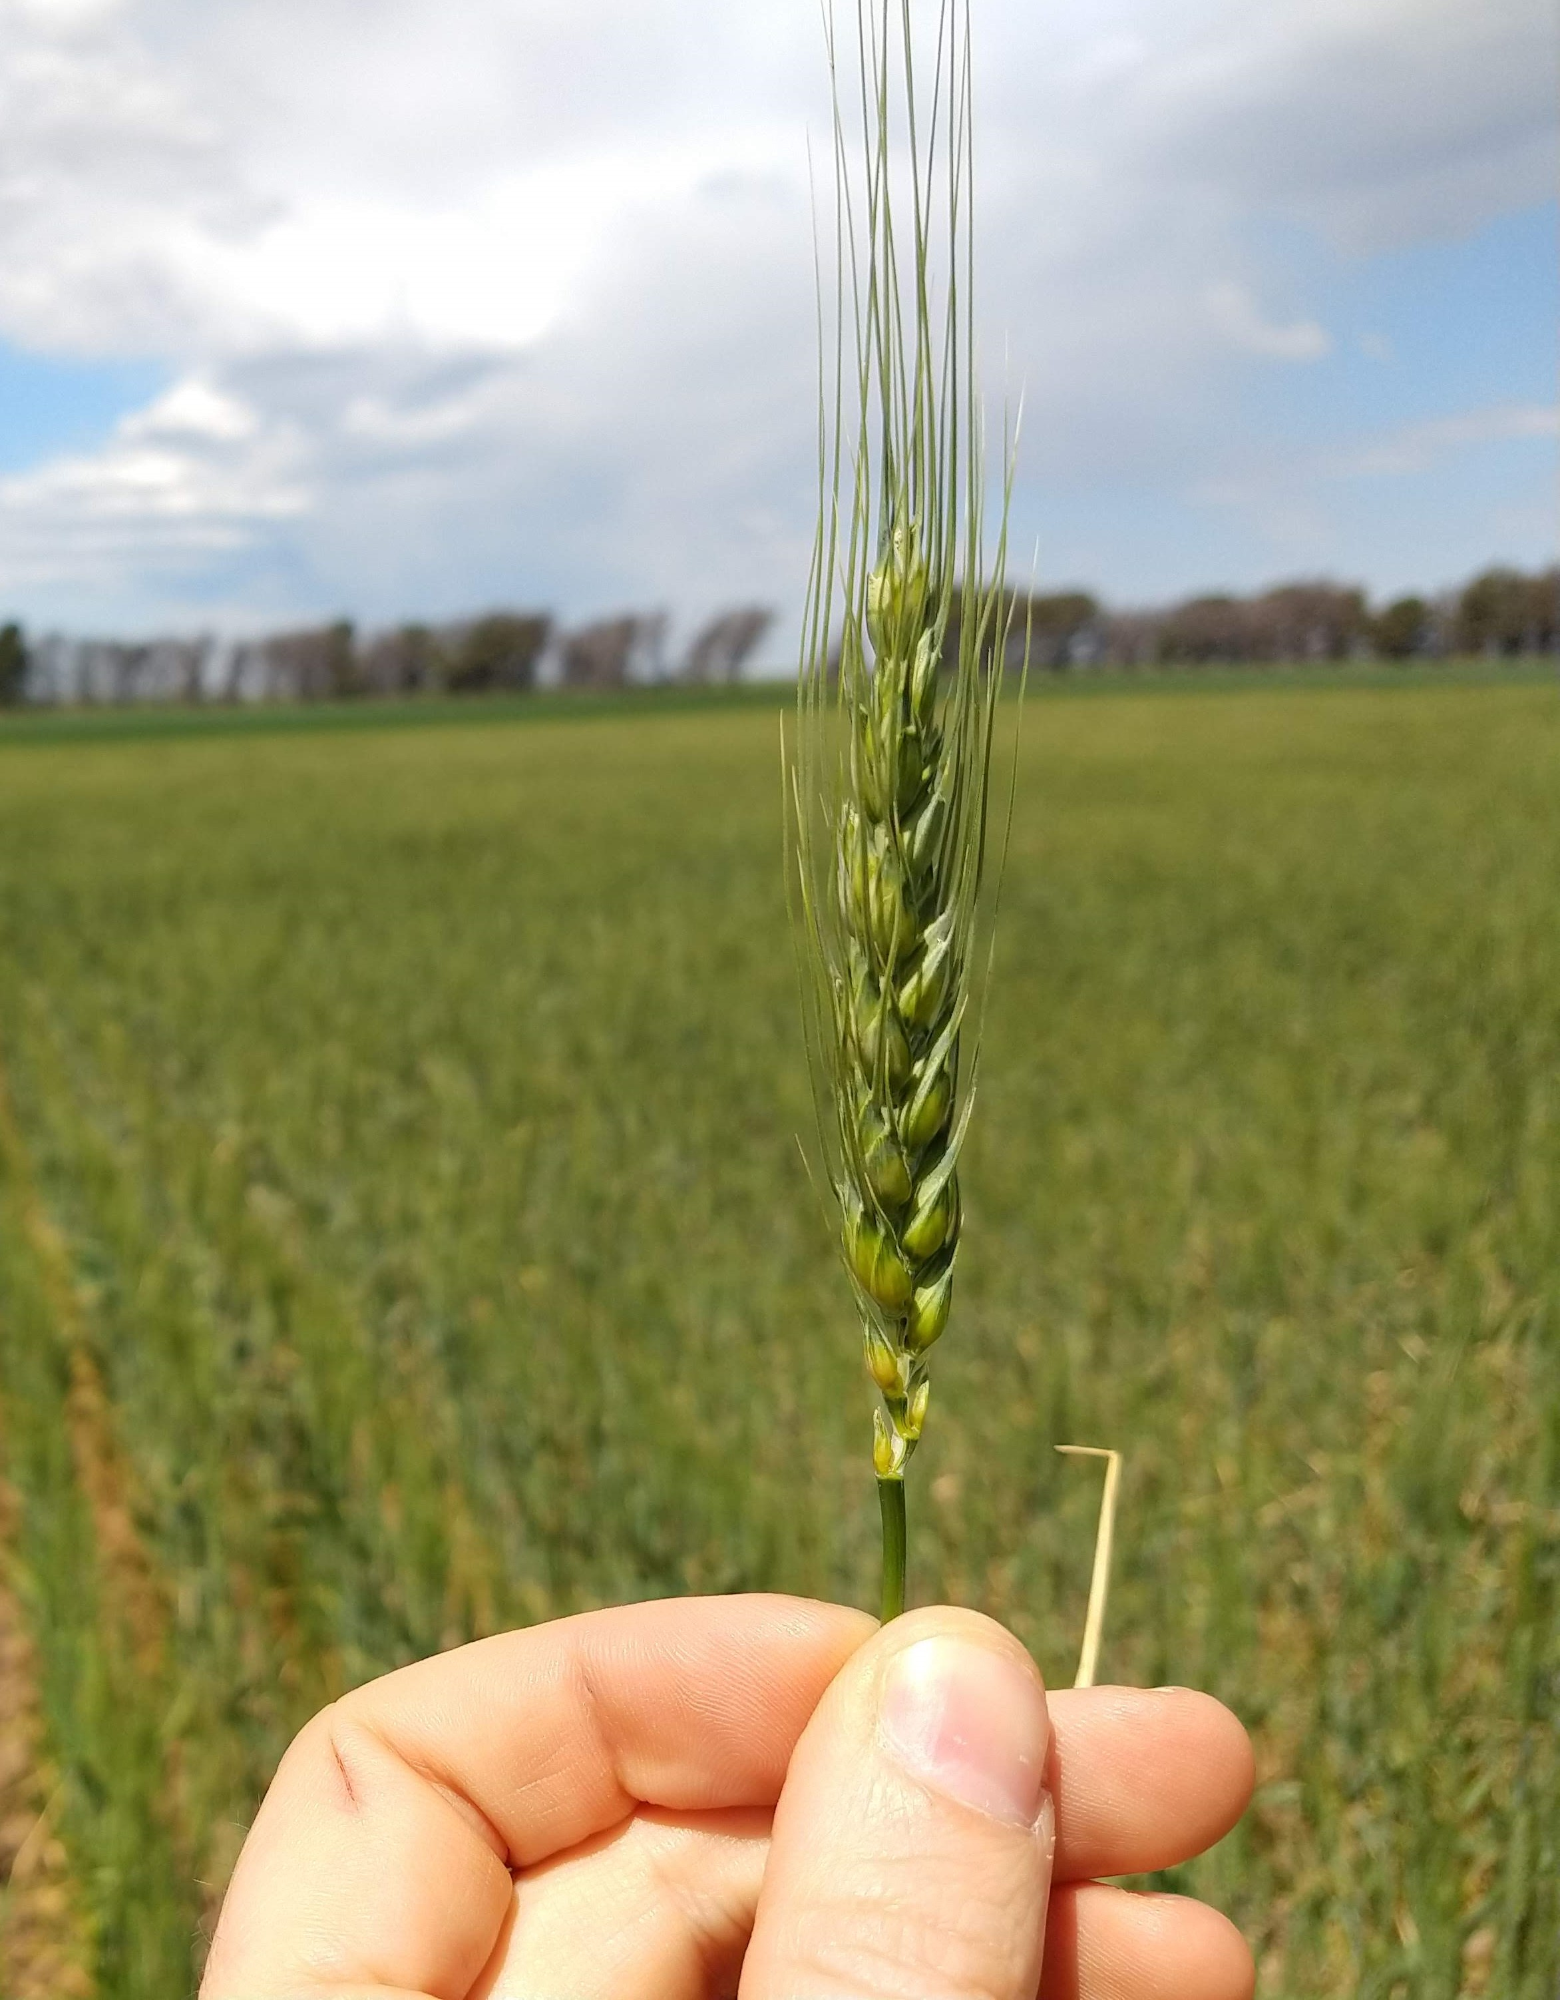
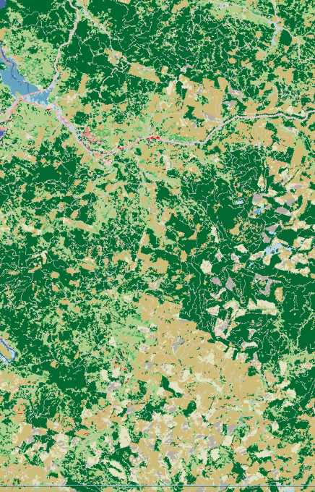
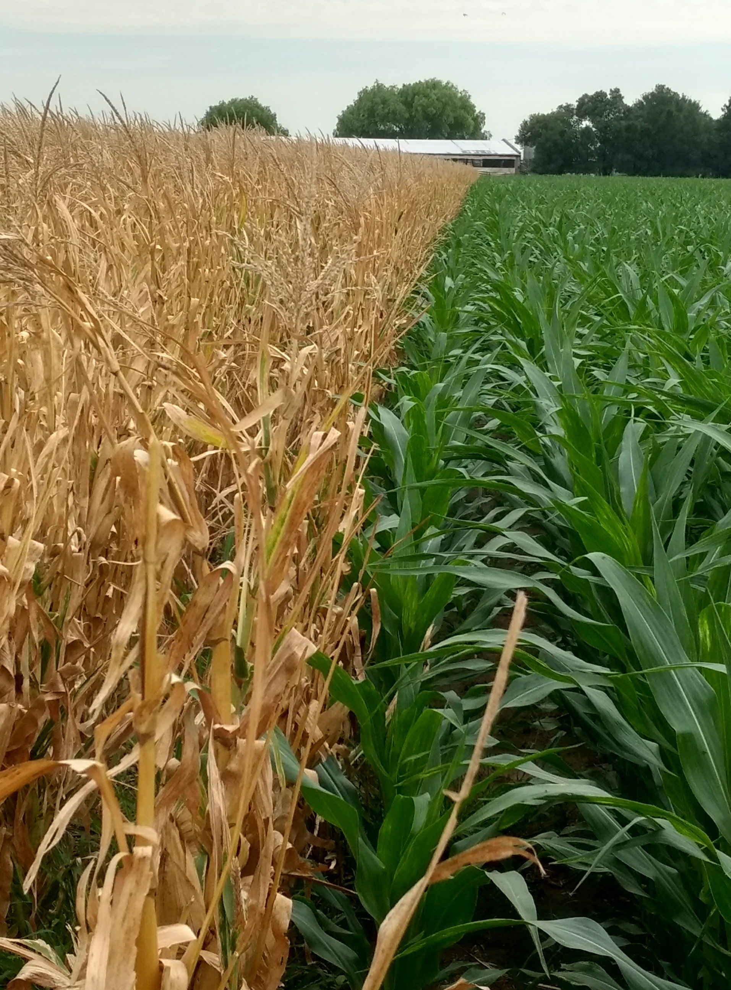

Community Concerns
Crop Yield Forecasting
Abundance of Data
Climatology and Environmental Factors
Data Processing Limitations
I
L
S
A
km
Image Credit: Buenos Aires Grain Exchange, Brooke Egley, Connie Zhou
Notes:
Speaker:
Short lead times and lack of tailored data for forecasts: The economy of Argentina is dependent on its crop production. Therefore, crop yield forecasting is essential for farmers, consumers, and policymakers. Current forecasting models rely mainly on in situ measurements to evaluate growing conditions. These include vegetation health, soil moisture, temperature, and precipitation. Longer lead times and tailored climate service data products will cause the forecasts to be more useful, accurate, and applicable. By bringing in satellite data, we are able to provide support through crop yield forecasting.
Abundance of data for processing capabilities: Larger datasets require wide scale data gathering, processing, cleaning, maintaining, and analyzing to be the most useful. This can pose significant limitations surrounding funding, technical capacity, and team size.
Impact of climatological oscillations and weather events on harvest: Temperature, soil moisture, and precipitation affect the growing conditions for major crops. Fluctuations in these environmental factors affect crop yield and can result in food insecurities in Argentina and global market insecurities economically. Large scale climate oscillations in the oceanic and atmospheric systems cause significant and longer-scale temporal effects. Argentina is heavily impacted by the status of the El Nino Southern Oscillation (ENSO). Understanding of the climatological and weather event impacts on the crop growing season and agricultural practice necessities is crucial to a successful harvest year.
Lack of processing infrastructure: Data processing limitations can create a good, applicable, and useful dataset to be unusable. Google Earth Engine, the main web-based data processing tool used in this project, can resolve the technical needs for data processing and make the data outputs of the GEE tool much more widely accessible.
------------------------------Image Information Below ------------------------------
Images from left to right:
•Image Credit: Buenos Aires Grain Exchange
•Source: Buenos Aires Grain Exchange (provided by the partner with permission to use)
•Image Credit: Brooke Egley
•Source: Brooke Egley, NASA DEVELOP
•Image Credit: Buenos Aires Grain Exchange
•Source: Buenos Aires Grain Exchange (provided by the partner with permission to use)
•Image Credit: Connie Zhou
•Source: https://www.behance.net/gallery/15584671/Google-Data-Center

Slide 3
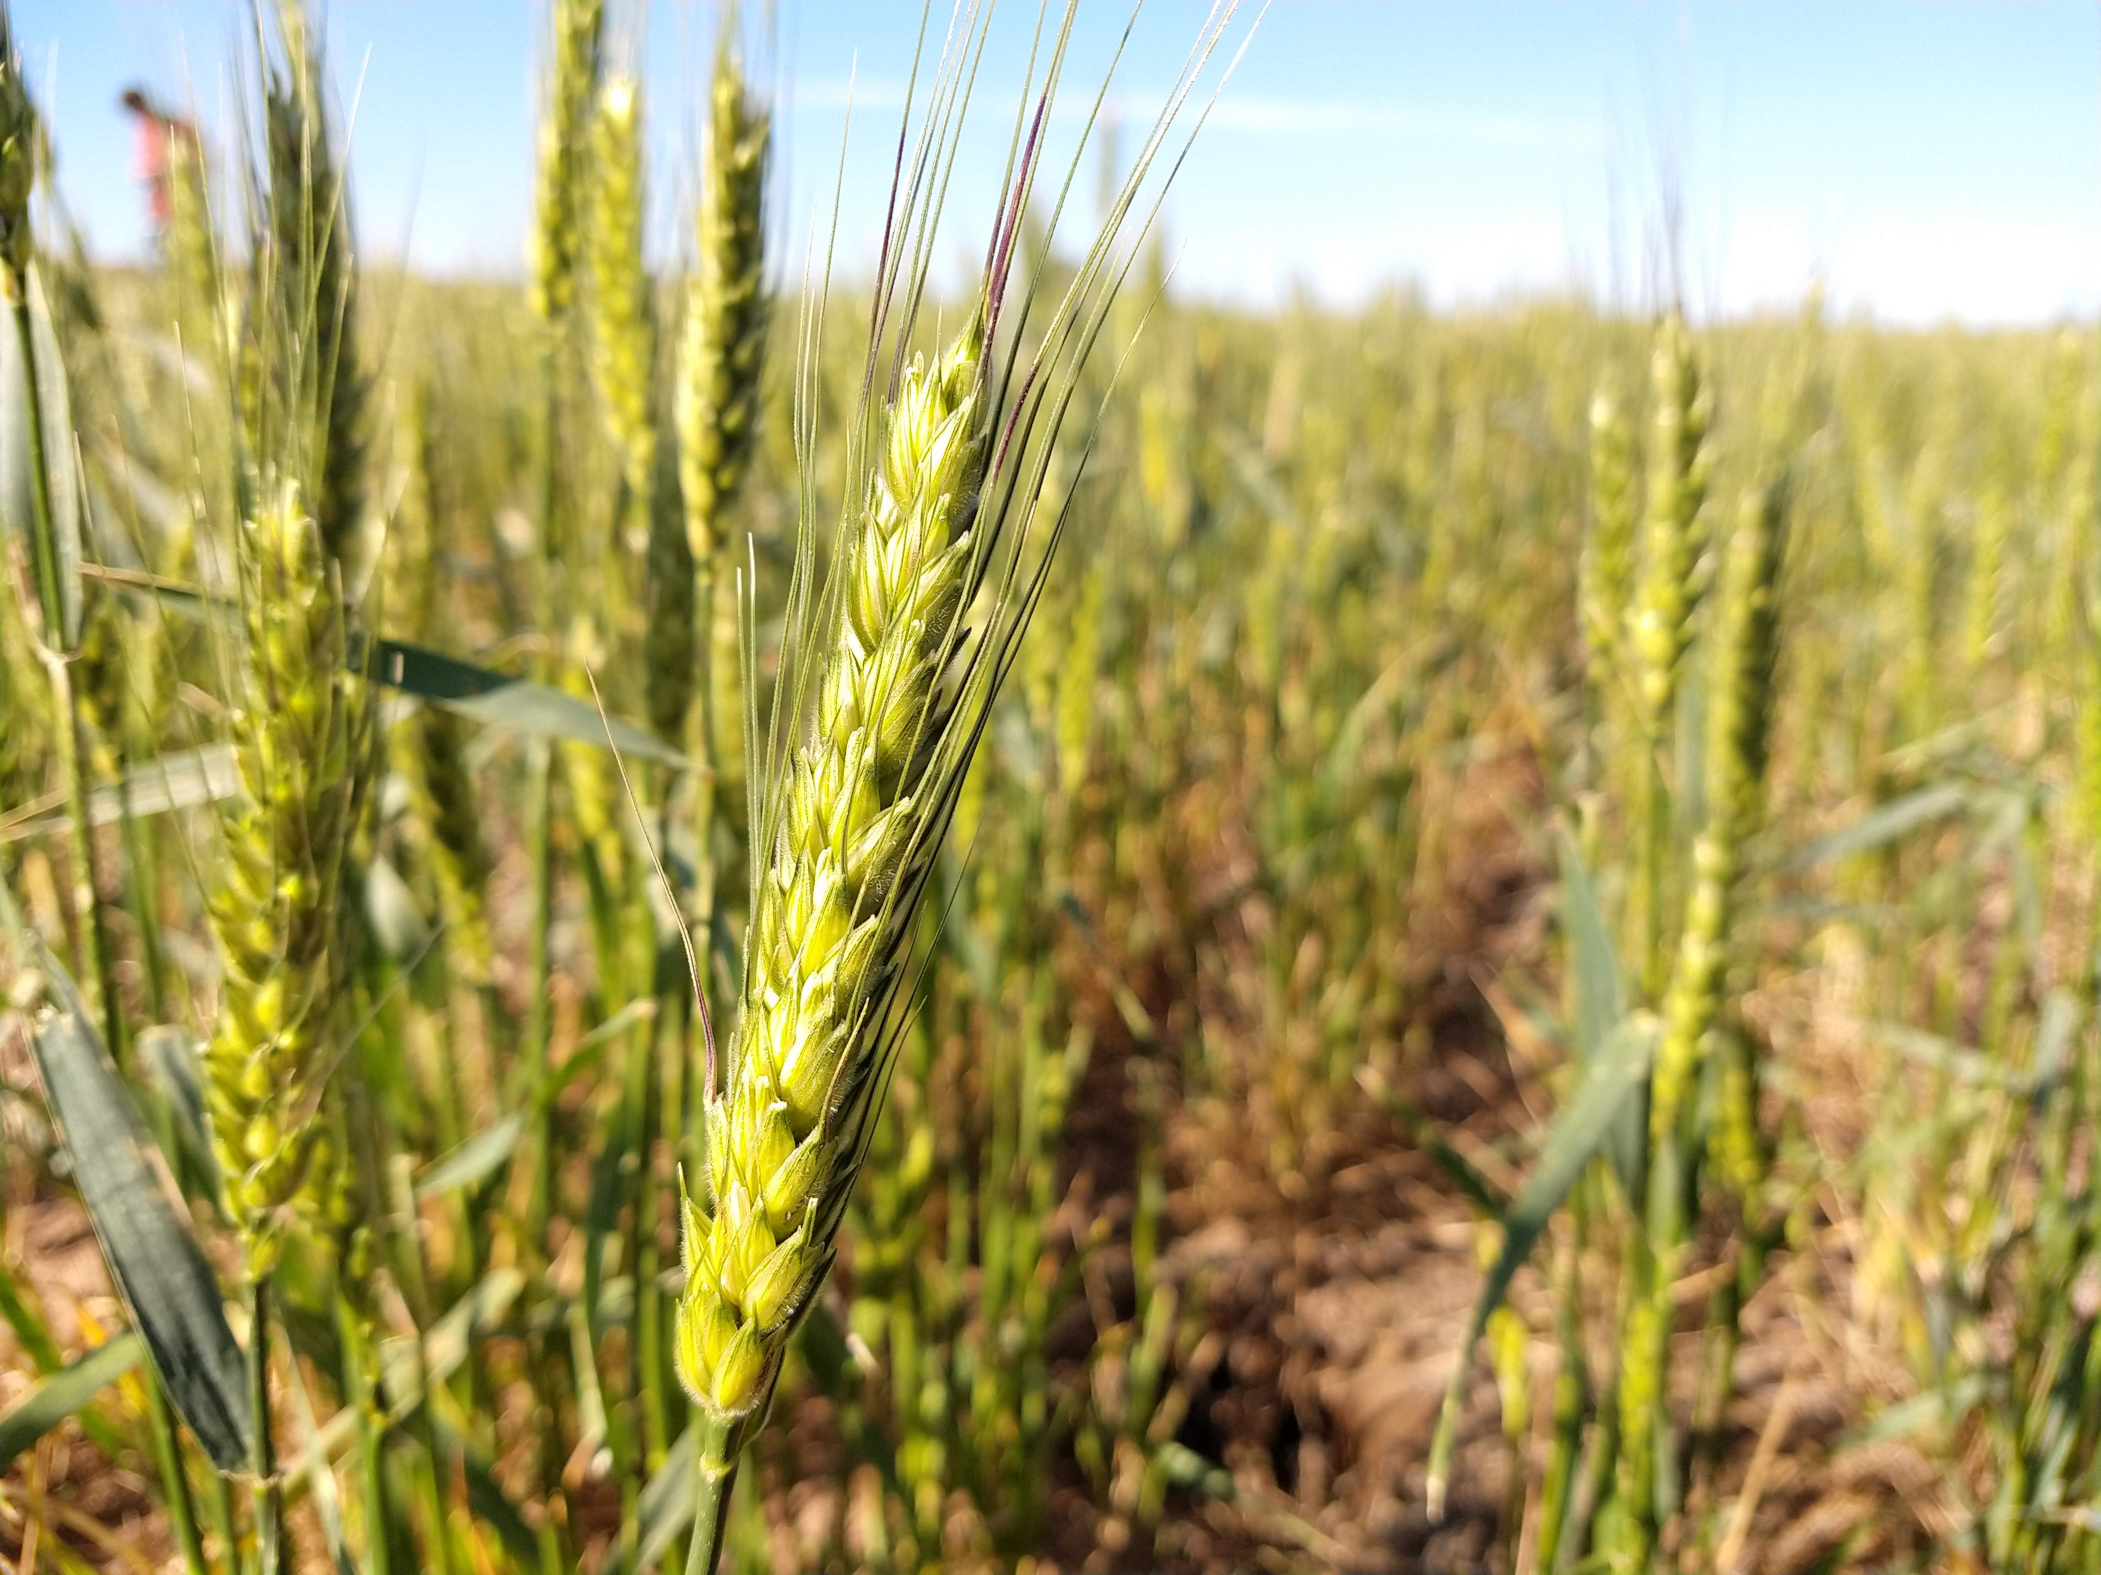
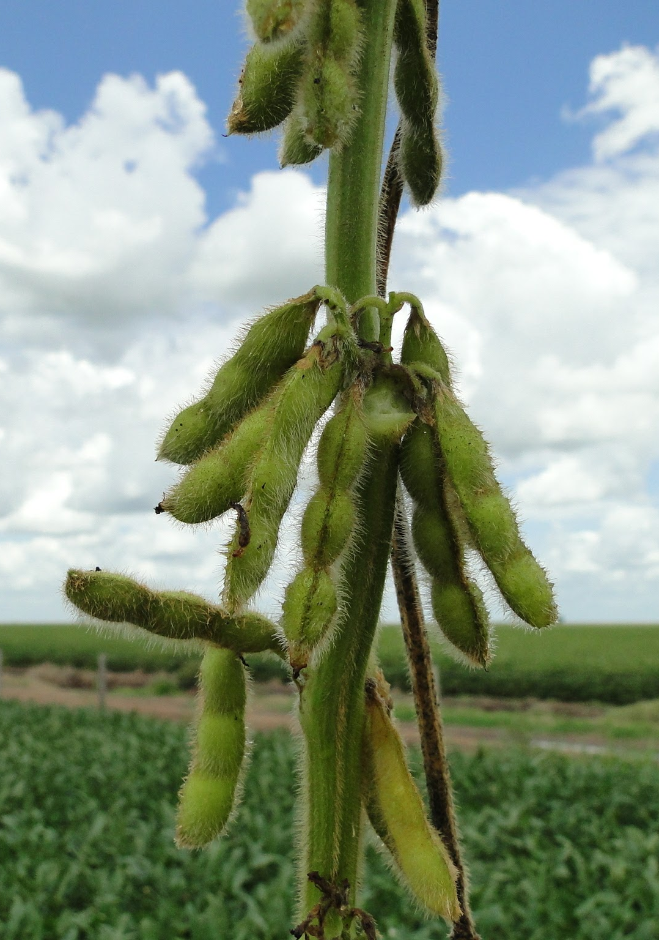
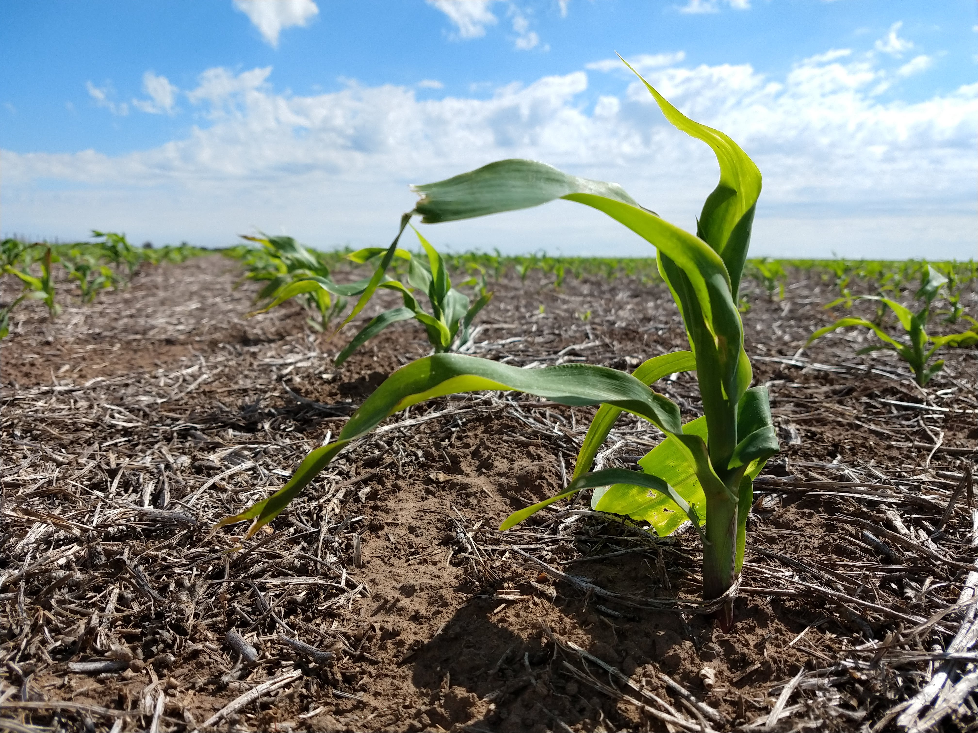
Partners
Buenos Aires Grain Exchange
  Boundary organization
  Weekly yield reports
  End of season estimates
Image Credit: Buenos Aires Grain Exchange
Notes:
Speaker:
Our partner for this project is the Buenos Aires Grain Exchange. The Grain Exchange is a unique partner because they're a boundary organization which means that they will share our project's results with their partners. The Grain Exchange produces weekly crop yield reports for the 15 agricultural zones across northeastern Argentina. These yield reports help inform grain prices and, since crops are an important export for Argentina, this impacts both regional and international markets. The weekly reports also influence the end-of-season estimates generated by the Grain Exchange.
------------------------------Image Information Below ------------------------------
•Image Credit: Buenos Aires Grain Exchange
•Source: Buenos Aires Grain Exchange (provided by the partner with permission to use)
•Image Credit: Buenos Aires Grain Exchange
•Source: Buenos Aires Grain Exchange (provided by the partner with permission to use)
•Image Credit: Buenos Aires Grain Exchange
•Source: Buenos Aires Grain Exchange (provided by the partner with permission to use)

Slide 4
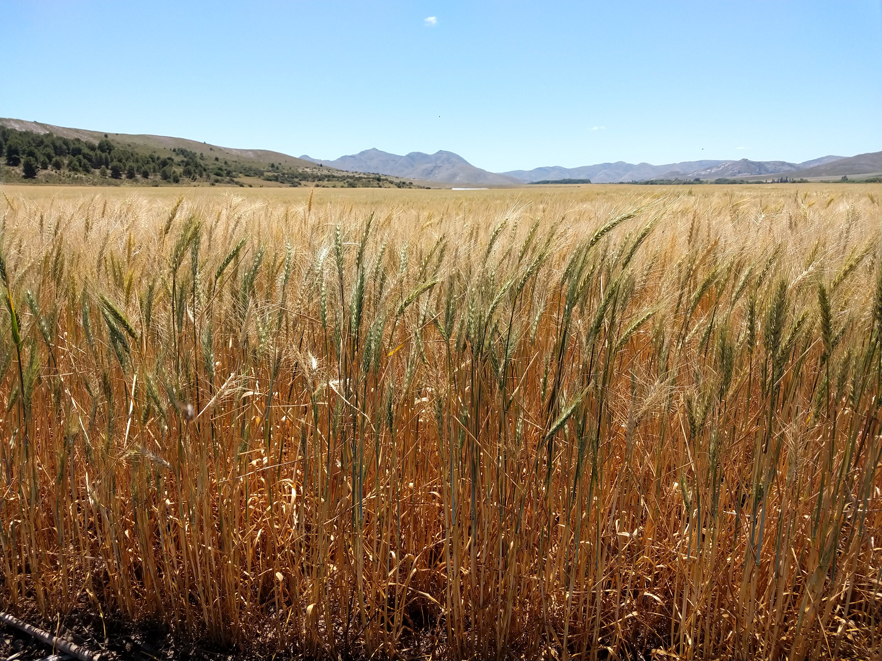
Objectives
Generate spatial and temporal maps and figures of temperature, precipitation, soil moisture, and vegetation indices
Develop GEE tools to monitor and forecast crop growth one month before the harvest period
Image Credit: Buenos Aires Grain Exchange
Notes:
Speaker:
There are two main goals of the project:
The first is to generate maps and figures based on the climatological variables – namely, temperature, precipitation, soil moisture, and vegetation indices (NDVI).
The second is to develop tools in Google Earth Engine that will be able to accurately forecast NDVI and provide estimations for crop yield with a lead time of one month for the initial harvest period date.
------------------------------Image Information Below ------------------------------
•Image Credit: Buenos Aires Grain Exchange
•Source: Buenos Aires Grain Exchange (provided by the partner with permission to use)

Slide 5
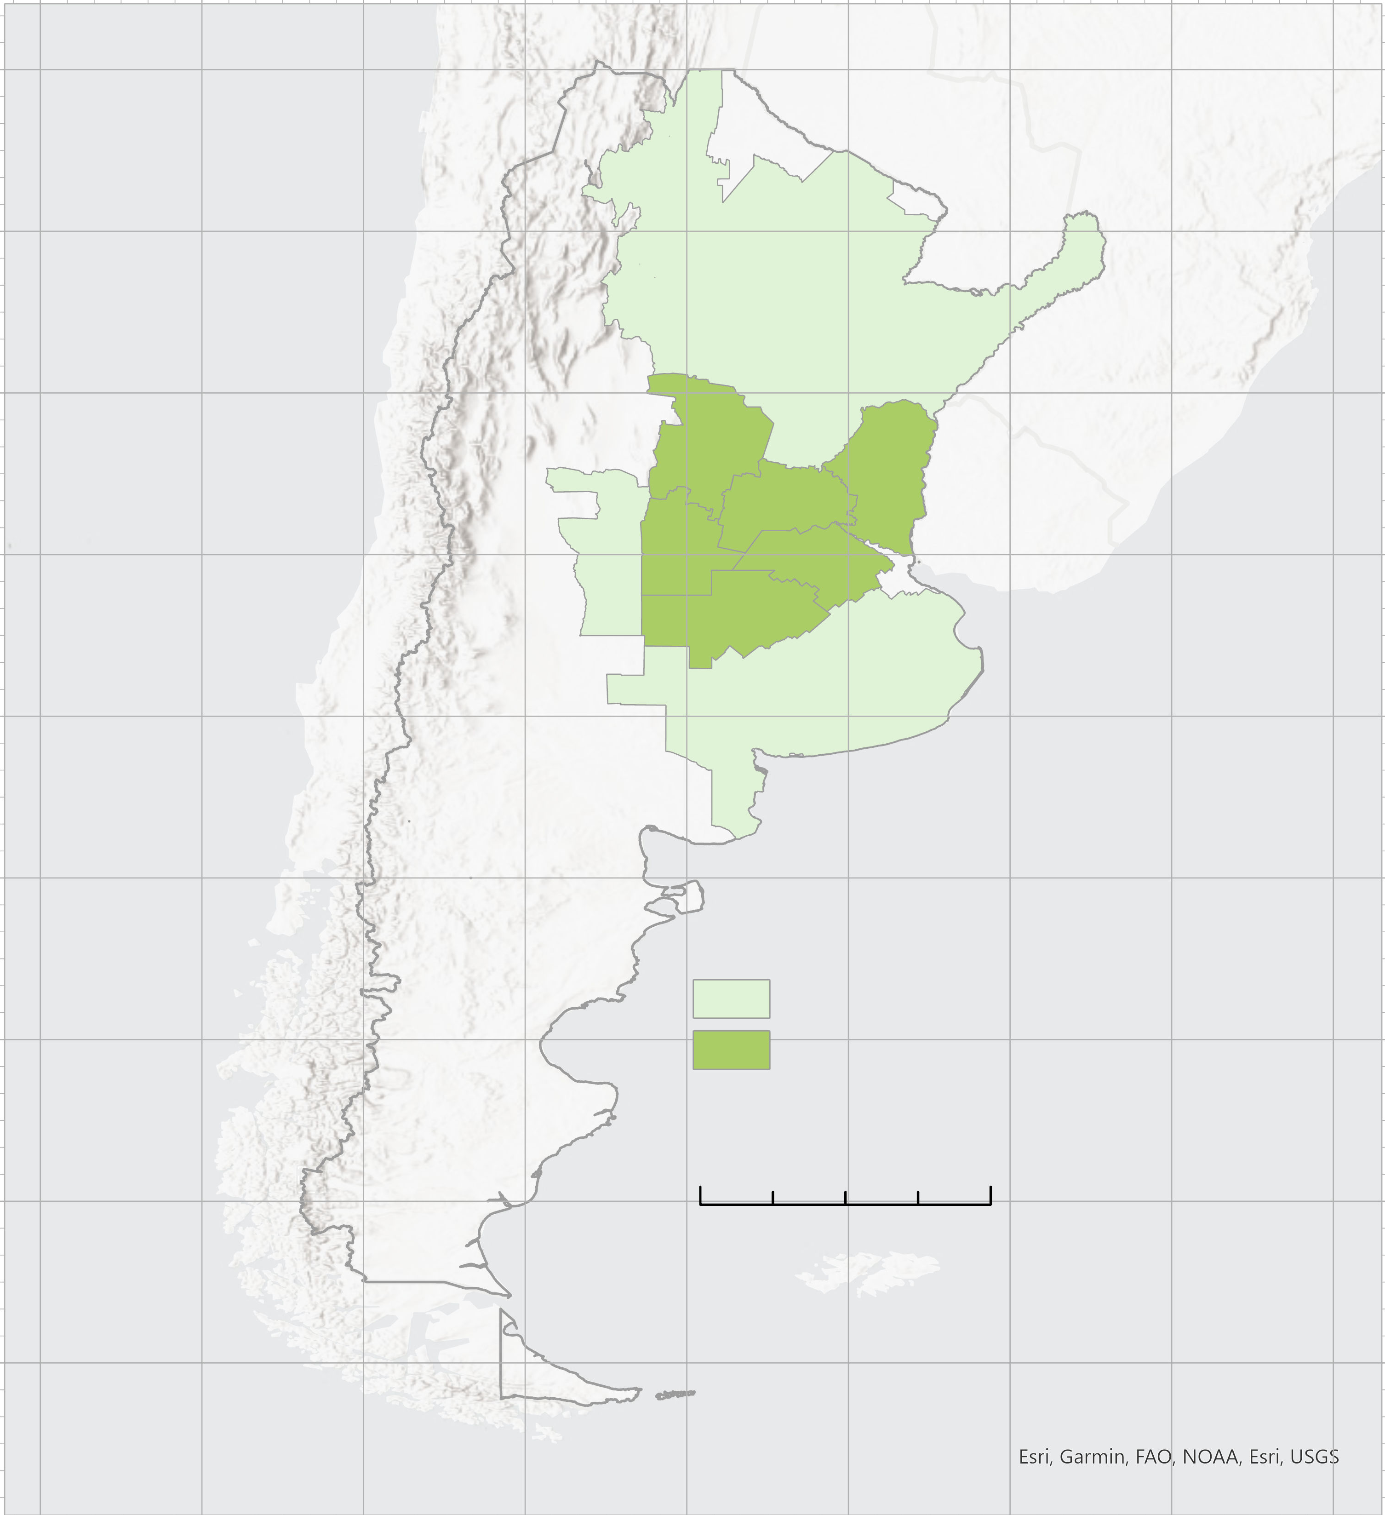
Study Area and
Period
80°W 72°W 68°W 60°W 52°W
N
➣
Study period: November 2012 – July 2021
6 main Agricultural Zones
360,389 km²
Wheat, corn and soybeans
3
6
8
4
7
9
36°S 44°S 38°S 30°S 22°S
Agricultural Zones
Core Growing Zones
0 400 800 km
Notes:
Speaker:
Our study period begins in November 2012 to coincide with the first date of available crop yield data and continues until July of 2021, the date of the last NDVI imaging available at the conclusion of this study. However, once the partners have access to the model, they will be able to update the script with near real-time data to predict beyond 2021. Our study area included 15 agricultural zones monitored by our project partners. Of these 15 zones, they recommended that we focus on the 6 core zones highlighted here on the map, 3-4 and 6-9, because these zones provide the majority of the crop harvest and provide the most useful data for our partners. The zones cover over 360,000 square kilometers and the main crops produced in the study area are wheat, corn, and soybeans.
------------------------------Image Information Below ------------------------------
•Basemap Credit: ArcGIS Pro
•Basemap Sources: Esri, Garmin, FAO, NOAA, USGS (Creative Commons BY 4.0)

Slide 6


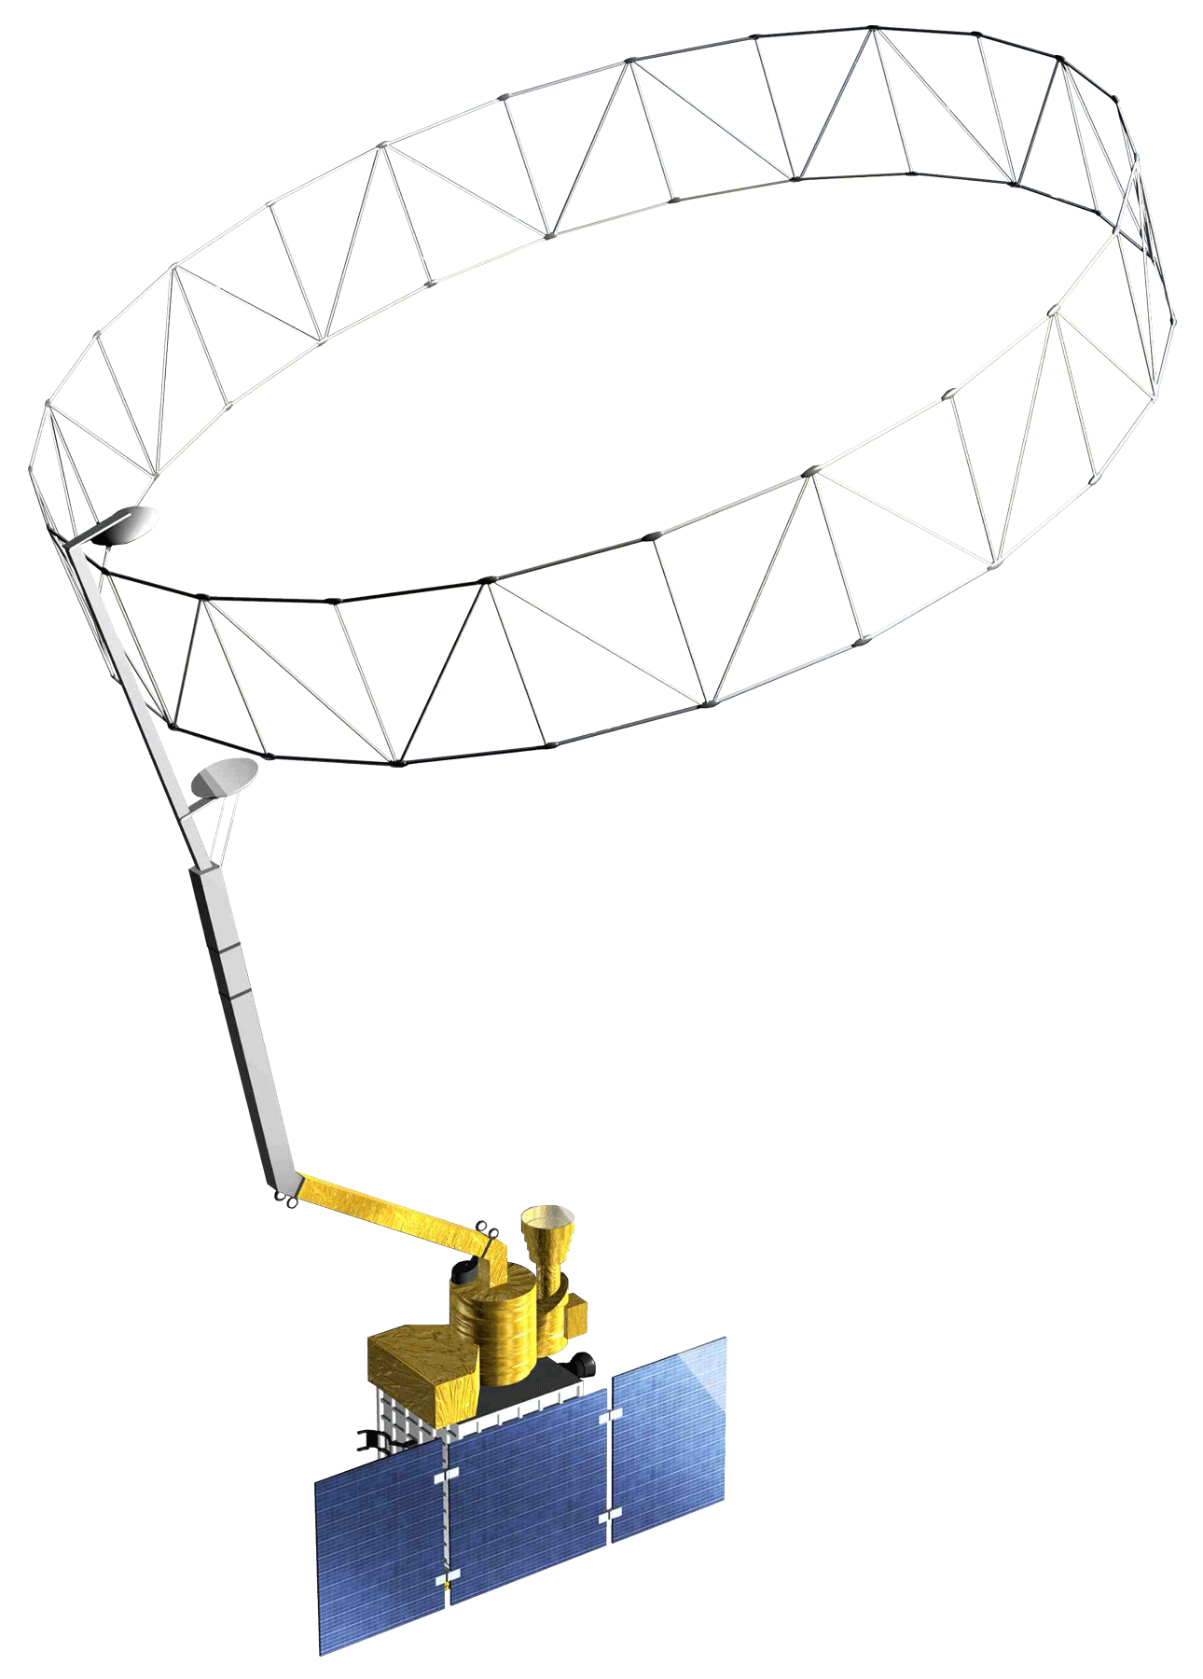
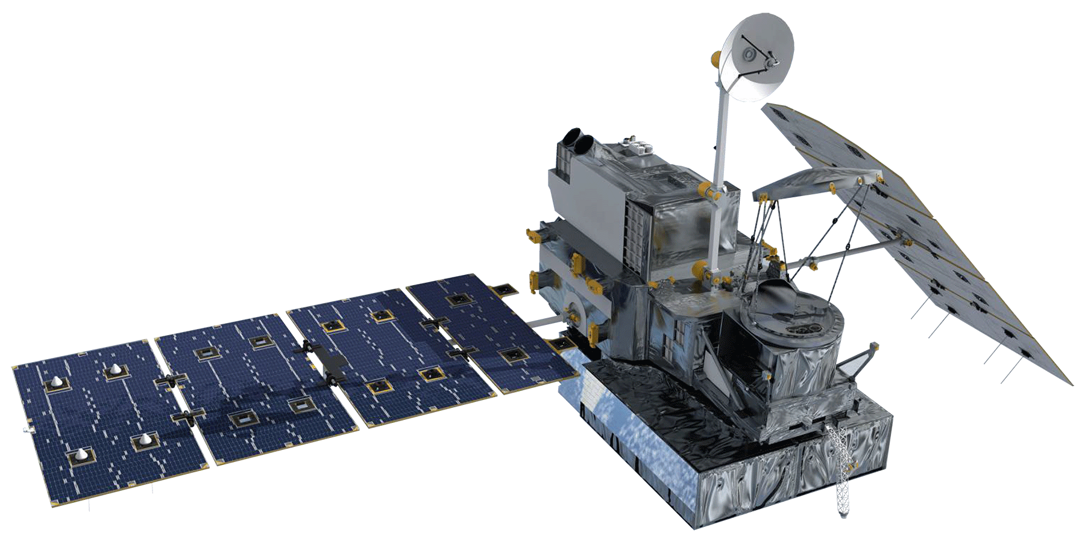
Earth Observations
Terra Moderate Resolution Imaging Spectroradiometer (MODIS)
Soil Moisture Active Passive (SMAP)
Global Precipitation Measurement (GPM)
Integrated Multi-satellitE Retrievals for GPM (IMERG)
Image Credit: NASA, Wikimedia
Notes:
Speaker:
To monitor trends in vegetation, soil moisture, and climate, we utilized the Terra Moderate Resolution Imaging Spectroradiometer (MODIS), Soil Moisture Active Passive (SMAP), and Global Precipitation Measurement Integrated Multi-satellitE Retrievals for GPM (GPM IMERG) satellites and sensors. Terra MODIS was used to measure vegetation by examining the Normalized Difference Vegetation Index. Meanwhile, SMAP allowed for close monitoring of soil moisture. Lastly, with GPM IMERG, precipitation trends were observed.
------------------------------Image Information Below ------------------------------
•Image Credit: NASA
•Source: https://www.devpedia.developexchange.com/dp/index.php?title=List_of_Satellite_Pictures (Image License: Public Domain)
•Image Credit: NASA
•Source: https://www.devpedia.developexchange.com/dp/index.php?title=List_of_Satellite_Pictures (Image License: Public Domain)
•Image Credit: NASA
•Source: https://www.devpedia.developexchange.com/dp/index.php?title=List_of_Satellite_Pictures (Image License: Public Domain)
•Image Credit: Jcpag2012
•Source: https://commons.wikimedia.org/wiki/File:Earth_Western_Hemisphere_transparent_background.png (Image License: Public Domain)

Slide 7
Methodology
Inputs
Data Processing & Analysis
Outputs
Crop Yield Data
NDVI & Crop Yield model selection and development
Max NDVI-crop yield prediction model
Future Crop Yield prediction
Ancillary Data
Study Area Shapefiles
NDVI model
selection and development
NDVI Prediction model
Future NDVI prediction
Terra MODIS:
NDVI
Terra MODIS: Temperature
NASA Earth Observations
Filter data based on user inputs
Timeseries Plots & Maps
Timeseries results
GPM IMERG: Precipitation
SMAP: Soil Moisture
Notes:
Speaker:
Using Google Earth Engine, we brought together data from the previously mentioned satellites and data from the Grain Exchange. Satellite data included NDVI, precipitation, soil moisture, and temperature. We had two parts of our project running simultaneously – one that focused on NDVI and crop yield forecasting and another that focused on timeseries plotting of climate variables. The NDVI forecasting model used autoregression to predict future NDVI values based on the recent values. The predicted NDVI output is then inputted into a linear model forecasting NDVI and crop yield in order to generate a crop yield output. The other aspect of our GEE tool creates timeseries plots and maps of precipitation, soil moisture, NDVI, and temperature. The user inputs coordinates and selects an agricultural zone, and the relevant plots and maps are output to supplement. These plots and maps allow the partners to analyze climate variables alongside the predicted NDVI and crop yield values.

Slide 8
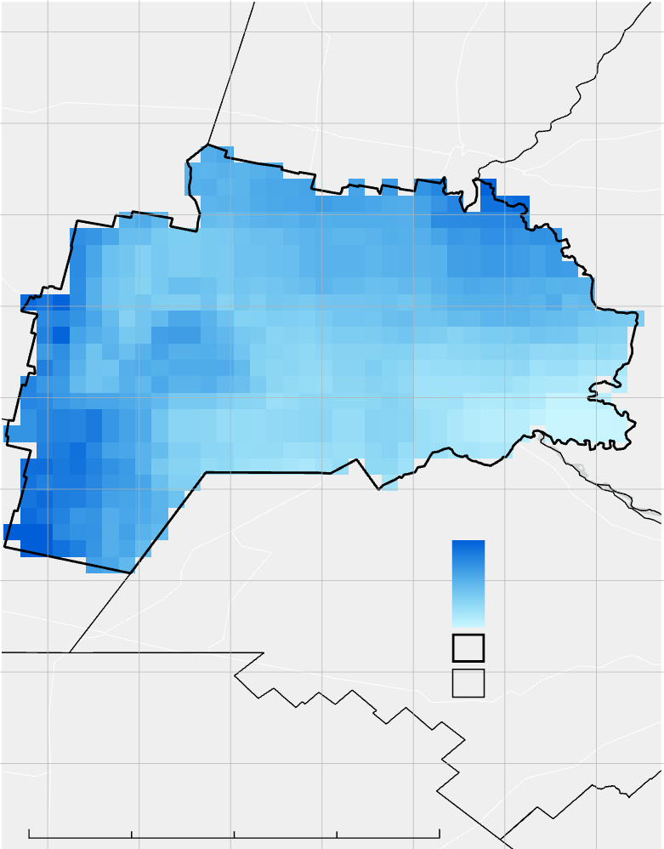
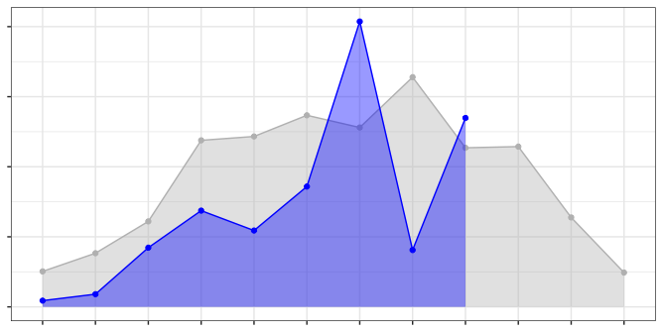
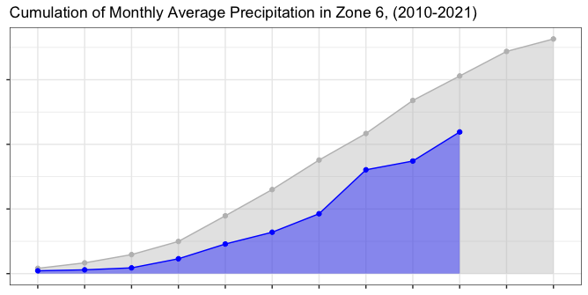
63°W
62°W
61°W
60°W
Results: Precipitation - Zone 6
N
31°S
➣
Monthly Average Precipitation
200
150
32°S
100
50
0
33°S
Jul
Sept
Nov
Jan
Mar
May
'20-'21
Precipitation (mm)
10-yr Avg.
Cumulation of Monthly Average Precipitation
Precip (mm)
122
900
34°S
57
600
Zone 6
Ag. Zones
300
35°S
0
0
125
250 Kilometers
Jul
Sept
Nov
Jan
Mar
May
Month
Notes:
Speaker:
Our tool allows users to produce hundreds of different results over the course of the study period, so we selected Agricultural Zone 6—one of the main agricultural zones in Argentina—and the most recent growing season as a case study to present an example of these results. The results from the climate variables, gathered through Google Earth Engine, plotted using R, and mapped using ArcGIS Pro, depict four different variables: precipitation, temperature, vegetation indices, and soil moisture.
This slide shows a sampling of results from the precipitation variable from the GPM IMERG satellite constellation measured in zone 6.
Monthly mean precipitation is depicted in the top graph and cumulative precipitation is depicted in the bottom graph. The blue section is from the 2020-2021 season, and the gray is a ten year average of mean precipitation on the top graph and cumulative precipitation on the bottom graph. The map on the right shows averaged cumulative precipitation over the recent growing season from July 2020 to June 2021.

Slide 9
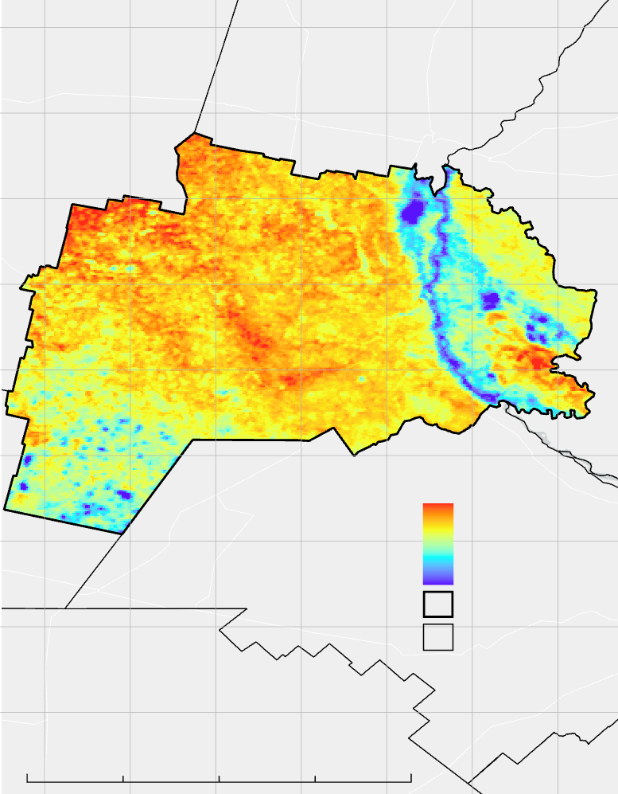
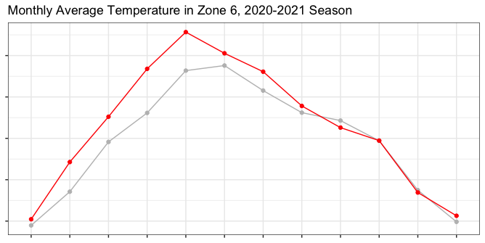
Results: Temperature - Zone 6
62°W
61°W
60°W
63°W
N
31°S
➣
'20-'21
32°S
Monthly Average Temperature
10-yr Avg.
35
33°S
30
Temperature (°C)
25
Temp (°C)
20
32
34°S
15
18
Zone 6
Jul
Aug
Sept
Oct
Nov
Dec
Jan
Feb
Mar
Apr
May
Jun
Ag. Zones
Month
35°S
0
125
250 Kilometers
Notes:
Speaker:
This slide shows a sampling of results from the temperature variable from the Terra MODIS satellite in zone 6.
Monthly mean temperature is depicted in Celsius in the graph with the red line showing the 2020-2021 season, and the gray is a ten year average of mean temperature in zone 6. The map on the right shows averaged temperatures over the recent growing season from July 2020 to June 2021.

Slide 10
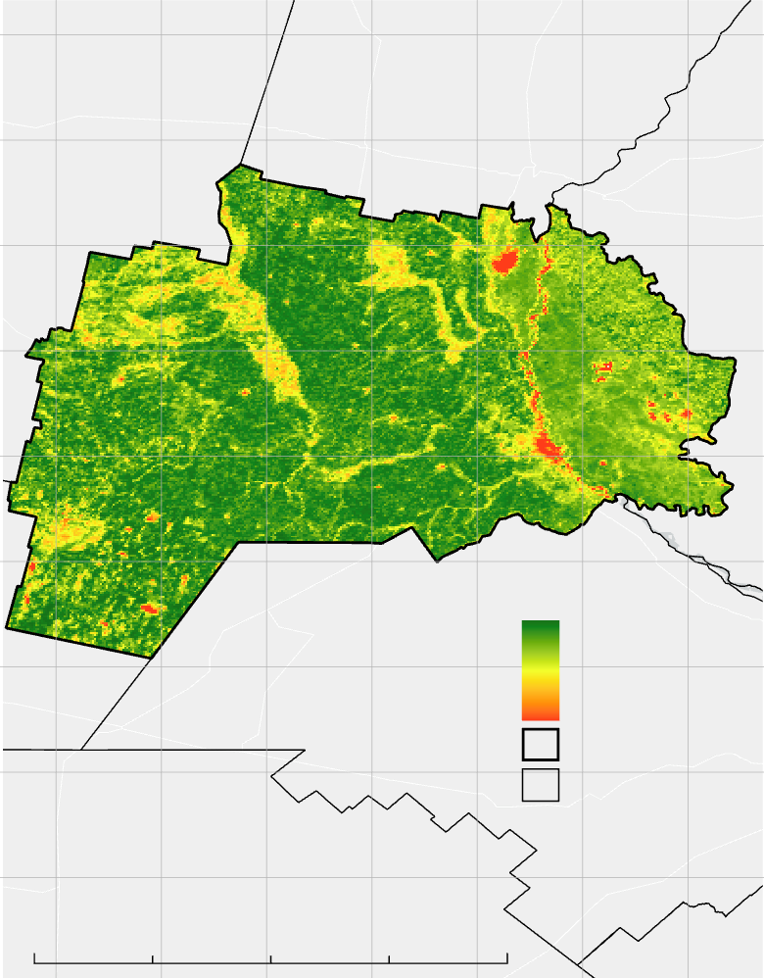
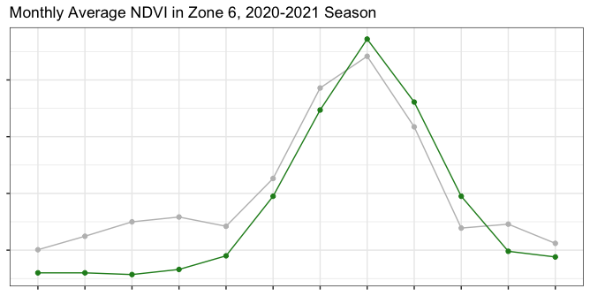
63°W
62°W
61°W
60°W
Results: Vegetation - Zone 6
N
31°S
➣
'20-'21
32°S
Monthly Average NDVI
10-yr Avg.
0.7
33°S
0.6
NDVI
0.5
NDVI
1
0.4
34°S
-0.2
Zone 6
Jul
Aug
Sept
Oct
Nov
Dec
Jan
Feb
Mar
Apr
May
Jun
Ag. Zones
Month
35°S
0
125
250 Kilometers
Notes:
Speaker:
This slide shows a sampling of results from the NDVI/vegetation index variable from the MODIS satellite in agricultural zone 6.
From July 2020 to June 2021, monthly mean NDVI, measured from –1 to 1 with 1 being the 'healthiest' vegetation and 0 being the 'least healthy' vegetation, is depicted here. The green line on the plot shows the averages for the 2020-2021 season and the gray is a ten year average of mean NDVI values throughout zone 6. The map on the right shows maximum NDVI values from July 2020 to June 2021. This is shown as a maximum value rather than an averaged value to provide a visual for the most active growing regions of zone 6, and what regions do not reach a positive NDVI value throughout the year and therefore do not have significant crop growth.

Slide 11
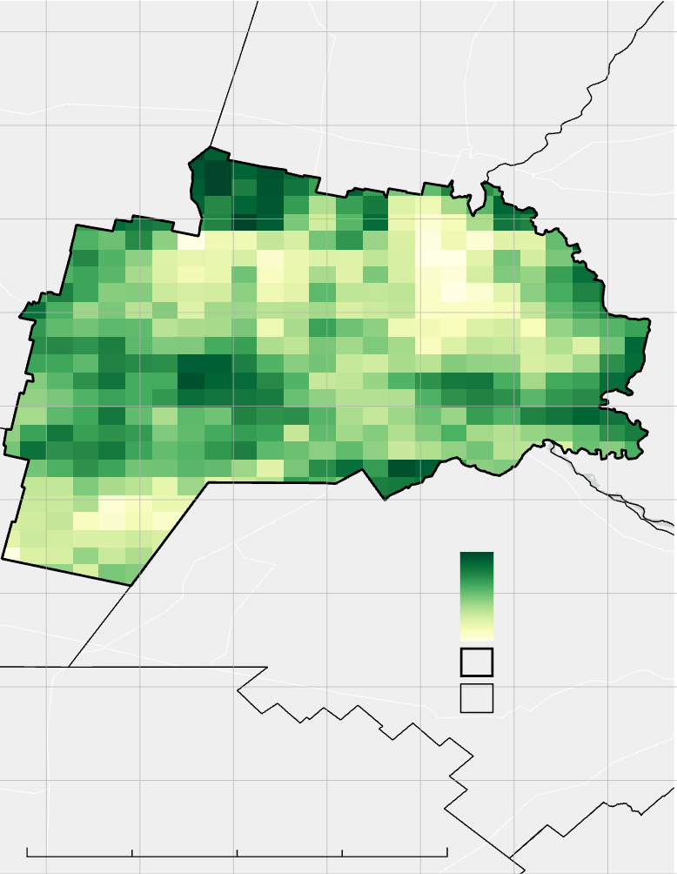
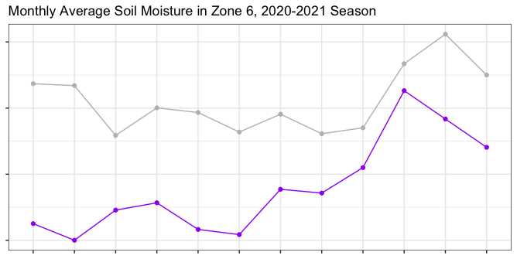
Results: Soil Moisture - Zone 6
63°W
62°W
61°W
60°W
N
31°S
➣
'20-'21
32°S
Monthly Average Soil Moisture
5-yr Avg.
16
33°S
12
Soil Moisture (mm)
8
SMAP (mm)
15
34°S
4
3.6
Feb
Zone 6
Jul
Aug
Sept
Oct
Nov
Dec
Jan
Mar
Apr
May
Jun
Ag. Zones
Month
35°S
0
125
250 Kilometers
Notes:
Speaker:
This slide shows a sampling of results from the soil moisture variable from the SMAP satellite in agricultural zone 6.
From July 2020 to June 2021, monthly mean soil moisture is depicted in the graph. The purple line is from the 2020-2021 season, and the gray is a five-year average of mean soil moisture in agricultural zone 6 since the beginning of the SMAP mission in 2015. The map on the right shows averaged soil moisture values from July 2020 to June 2021.

Slide 12
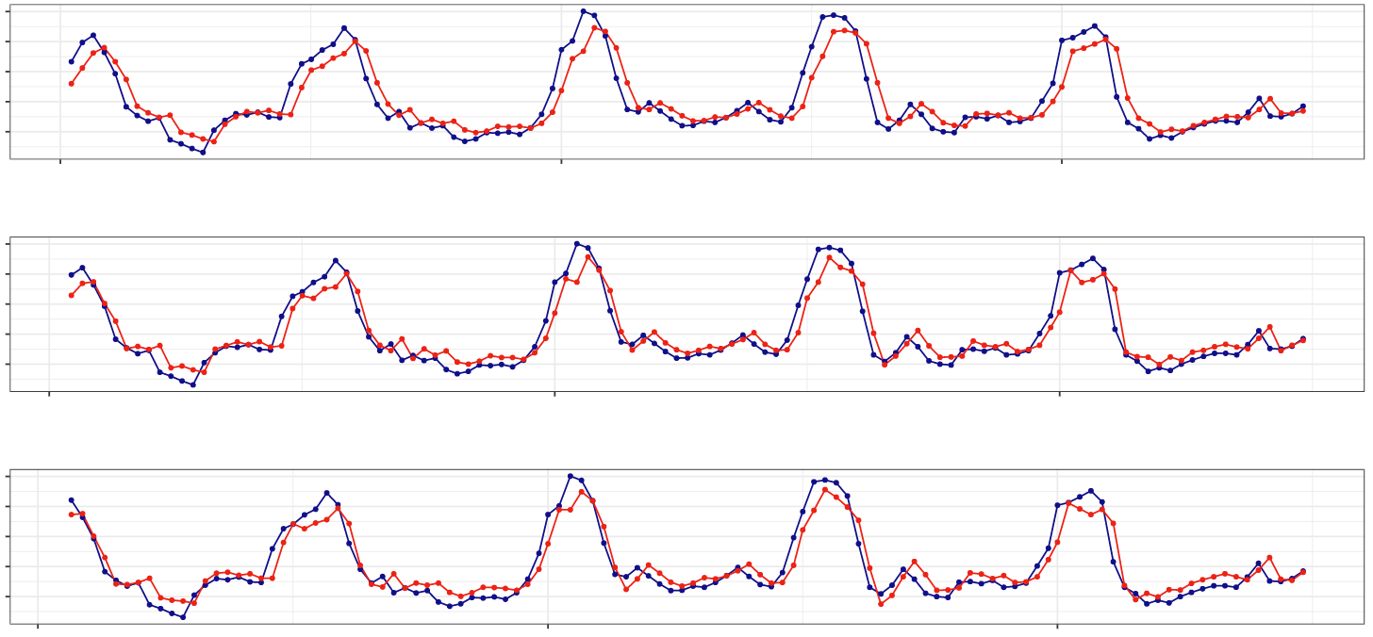
Results: NDVI Forecast Model Development
Autoregression Model 1 (AR1) Lag t-1
RMSE = 0.081
0.8
0.7
0.6
0.5
0.4
2012
2014
2016
Autoregression Model 2 (AR2) Lag t-1 & t-2
RMSE = 0.076
0.8
0.7
0.6
NDVI
0.5
0.4
2012
2014
2016
Autoregression Model 3 (AR3) Lag t-1, t-2, & t-3
RMSE = 0.074
0.8
0.7
0.6
0.5
0.4
2012
2014
2016
NDVI
Fitted
Time
Notes:
Speaker:
The NDVI forecasting model development consists of three auto-regression models, AR1, AR2, and AR3. AR1 indicates a linear regression model that incorporates a lag of t-1. The second model includes a lag of t-1 and t-2. The third model then includes a lag of t-1, t-2, and t-3. The Model Development for the forecasting model includes the years 2012 to the end of 2016. These figures show the observed MODIS NDVI values in blue with the model or fitted values in red. Additionally, these plots represent the mean NDVI values at Zone 6. These plots can also be generated for other zones of interest. As you can see the second and third models are more closely fitted to the observed NDVI values in zone 6. To measure the accuracy we examined the root mean square error (RMSE). Model 1 performed with an RMSE of 0.0814. Models 2 and 3 show an RMSE of 0.0765 and 0.0738 respectively. The lower values indicate higher accuracy, therefore the AR3 model was selected for the forecasting model.

Slide 13
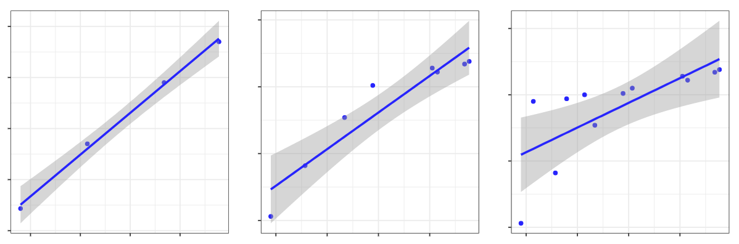
Results: NDVI Forecast Regressions
Observed Versus Forecasted Normalized Difference Vegetation Index (NDVI) Zone 6
2-Month Forecast
Nov. 16, 2020 - Jan. 1, 2021
4-Month Forecast
Nov. 16, 2020 - March 6, 2021
6-Month Forecast
Nov. 16, 2020 - May 9, 2021
0.51
y = 0.4903x + 0.214
R² = 0.9967
0.55
y = 0.2739x + 0.3164
R² = 0.8913
y = 0.1865x + 0.382
R² = 0.5361
0.55
0.48
0.50
0.50
Predicted NDVI
0.45
0.45
0.45
0.42
0.40
0.40
0.39
0.40
0.45
0.50
0.55
0.40
0.50
0.60
0.70
0.40
0.50
0.60
0.70
Actual NDVI
Notes:
Speaker:
The NDVI forecasting model accurately produces anticipated values several months out. These plots show regressions between the observed NDVI values and predicted values from the forecasting model for the last growing season. A 2-month forecast predicts values up to January from November while a 4 and 6-months forecast shows values March and May 2021 from November 2020. The accuracy of these models is shown with the R-squared values. Forecasting 2 months out shows and r-squared value of 0.9967 meanwhile forecasting 6 months out features an r-squared of 0.5361.

Slide 14
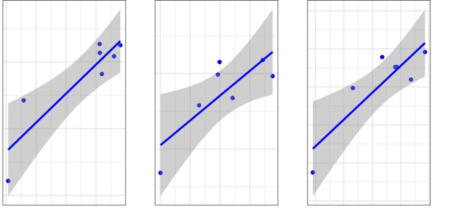
Results: NDVI & Crop Yield Regressions
Zone 3
Zone 6
Zone 7
y = 3.78x - 0.048
R² = 0.804
y = 3.58x - 0.212
R² = 0.647
7.0 -
y = 3.83x - 0.183
R² = 0.761
6.75 -
6.0 -
6.0 -
Log of Soy Crop Yields (kg/ha)
6.5 -
5.5 -
6.25 -
5.5 -
6.0 -
5.0 -
5.75 -
0.625 0.650 0.675 0.700
0.73 0.75 0.77 0.79
0.74 0.76 0.78 0.80 0.82
Average Maximum NDVI
Notes:
Speaker:
Here we have graphs of soybean yields compared to the calculated average maximum NDVI. Taking the log of crop yield helps make a more 1:1 ratio of NDVI to crop yield. The three zones are distributed from the inland mountains to the coast, which give us an idea of how vegetation and crop yield change across regions. Overall, there is a moderately strong positive correlation between the log of crop yields and the average maximum NDVI. The r-squared values range from 0.64 to 0.8.
Additional information, if a question is asked regarding other crop types:
Soybean is shown here because it exhibits the strongest correlation between NDVI and crop yield. Wheat has a strong negative correlation (approximately 0.8), and corn has a very weak positive correlation (approximately 0.07).

Slide 15
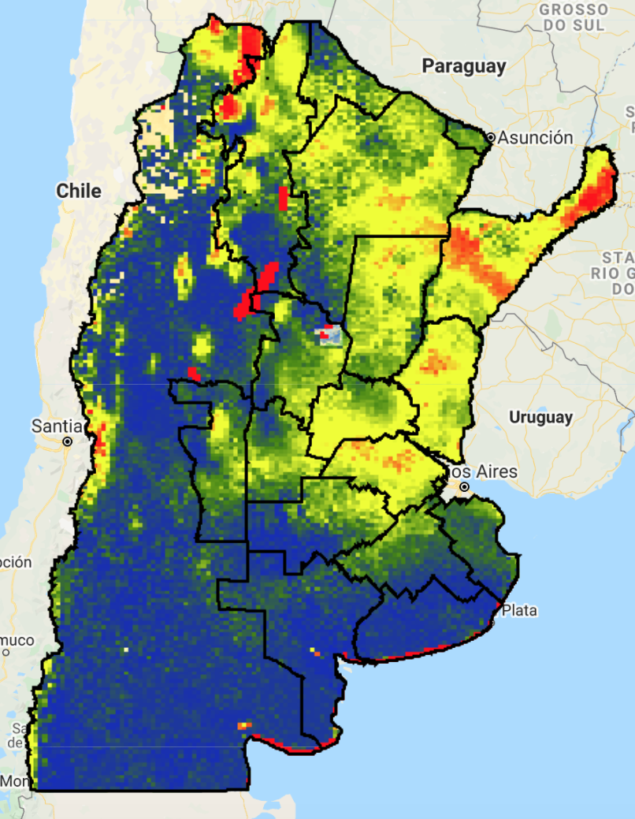
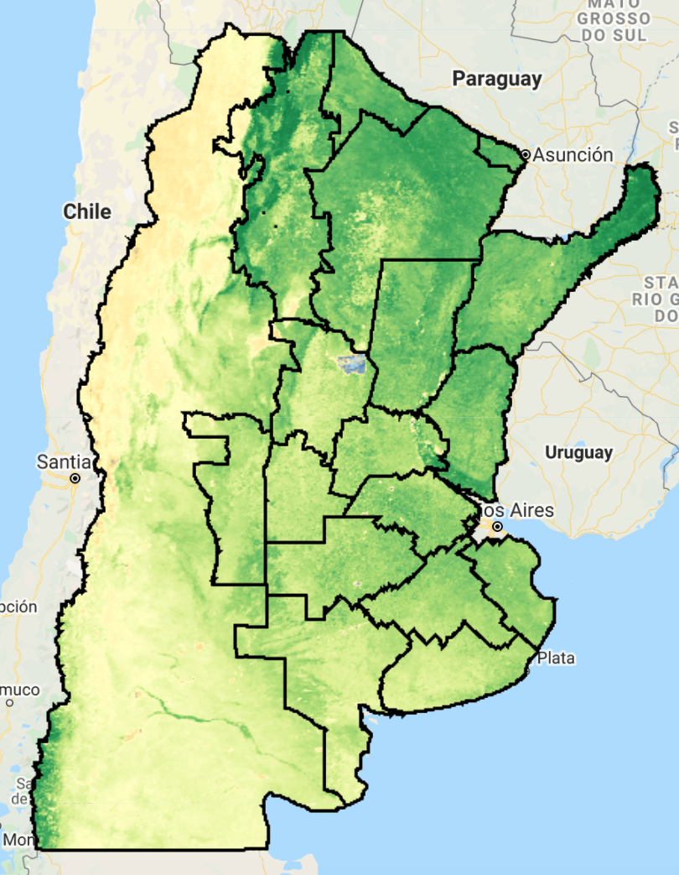
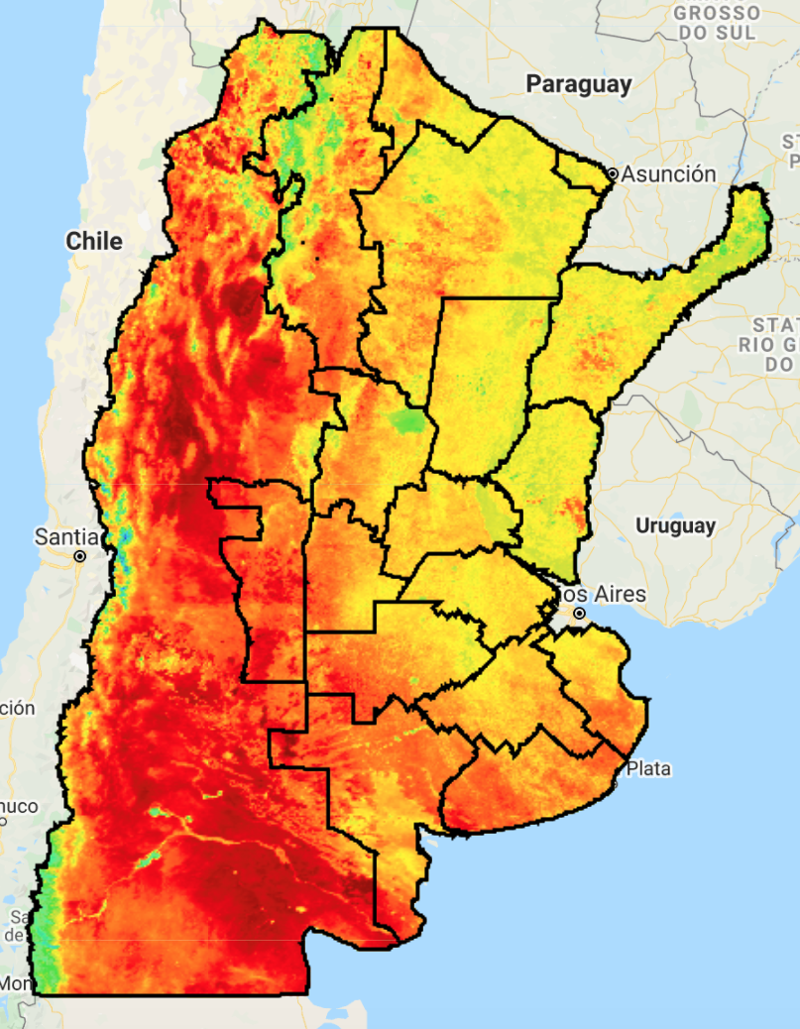
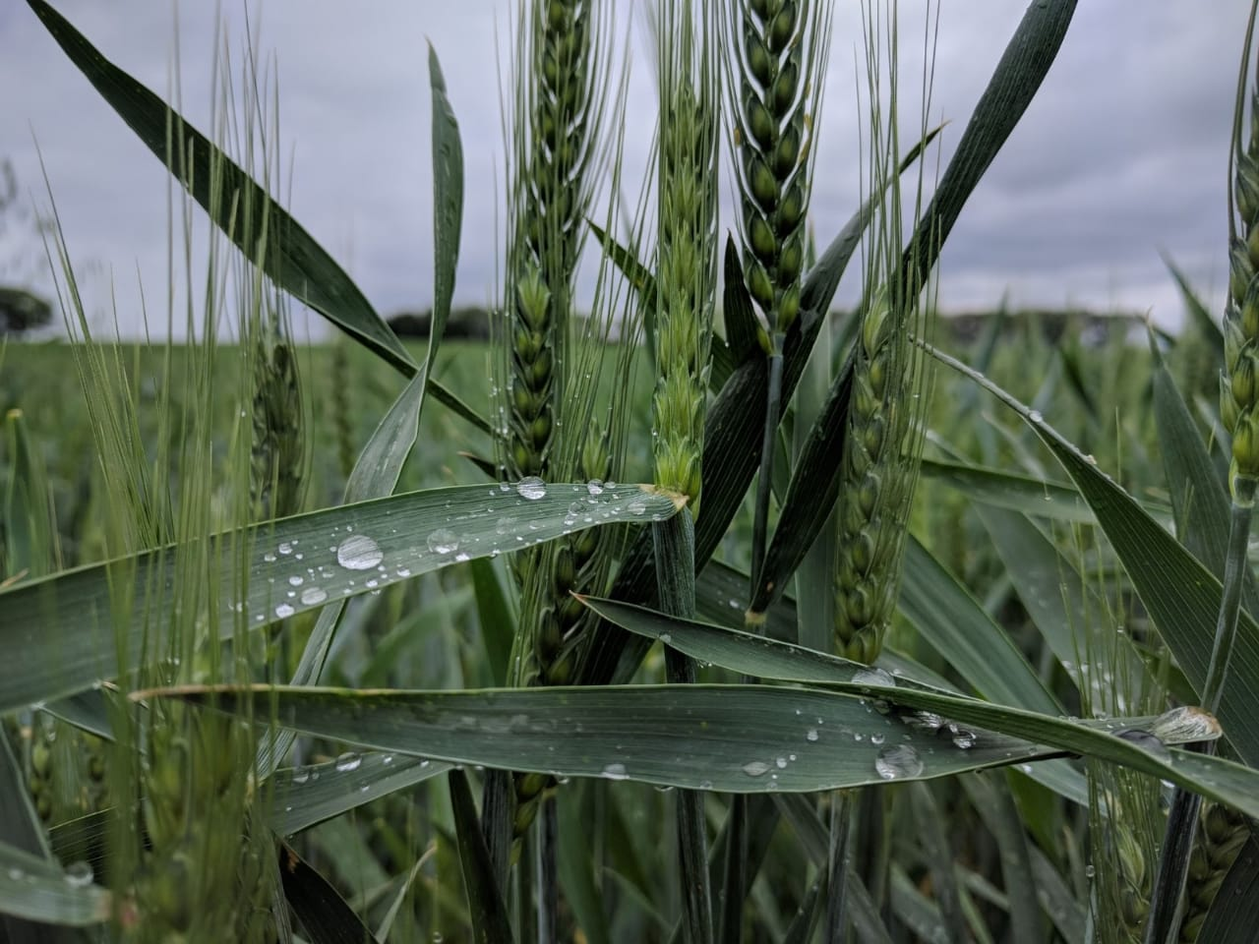
Errors & Uncertainties
Crop yield influenced by other variables
Influence of extreme weather events, climatological anomalies, and diseases after model prediction
N
➣
400 km
Image Credit: Buenos Aires Grain Exchange
Notes:
Speaker:
We briefly want to address points of uncertainty with our model analysis. First, crop yields can be influenced by other variables besides NDVI, such as temperature and soil moisture. While we were not able to incorporate these variables directly into the model in the 10-week timeline of the model, we incorporated capabilities into the model to output climate variable data to allow our partners to view that data alongside the NDVI and crop yield forecasts. Additionally, certain weather and crop events such as unexpected cold snaps, climate anomalies, or destructive crop diseases cannot be accounted for in the model and could occur between the forecasting time and the end of the season, potentially affecting forecasting accuracy.
------------------------------Image Information Below ------------------------------
•Image Credit: Buenos Aires Grain Exchange
•Source: Buenos Aires Grain Exchange (provided by the partner with permission to use)
•Basemap Credit: Google – Google Earth Engine
•Basemap Sources: Google – Google Earth Engine (Creative Commons BY 4.0)

Slide 16
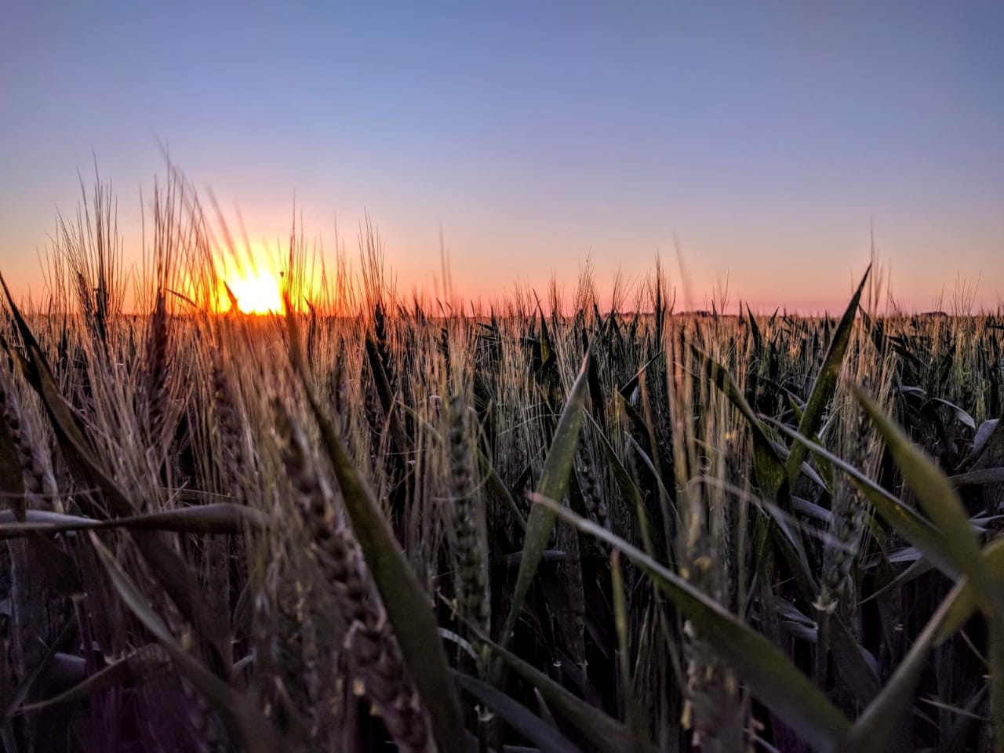
Conclusions
Temperature, precipitation, soil moisture, and NDVI exhibit different patterns throughout the growing season
The NDVI forecasting model is capable of forecasting NDVI two to four months in advance for the growing season with R² values ranging from 0.89 to 0.99
Relationship between NDVI and crop yield vary for growing zone and crop type. R² values exhibit moderately strong correlation.
Our scripts contribute to a better understanding of the relationship between climate, NDVI, and crop yield
Image Credit: Buenos Aires Grain Exchange
Notes:
Speaker:
In examining the temperature, precipitation, soil moisture, and vegetation trends in Argentina, we found that soil moisture is highest at the end of the growing season, temperatures peak at the onset of the growing season and steadily decline, and NDVI peaks around February in the middle of the growing season, and follows a normalized trend line.
The NDVI forecasting model is able to forecast NDVI values for the upcoming growing season with high accuracy – the R^2 values range between 0.86 to 0.99
The crop yield model contributes to the study of the relationship between NDVI and crop yield – helping us to make more informed estimations of crop yield. Soy shows moderately strong correlations between NDVI and crop yield that vary for each growing zone.
Overall, our work has contributed to a better understanding of the spatial and temporal patterns of these variables.
------------------------------Image Information Below ------------------------------
•Image Credit: Buenos Aires Grain Exchange
•Source: Buenos Aires Grain Exchange (provided by the partner with permission to use)

Slide 17
Future Work
Development of a Graphical User Interface (GUI)
A GUI would provide an increase in user friendliness for the code and software products
Increased lead time & accuracy
Longer lead times for forecasting and greater accuracy means more useful predictions
Downscaled model
Paired with other variables, a downscaled model would provide the partner with more meaningful end products
Improved crop yield forecast
With a greater amount of input variables, the outputs would be more widely applicable
Notes:
Speaker:
For someone unfamiliar with code and software, or Google Earth Engine (GEE) specifically, having to read through hundreds of lines of code, making changes without producing any errors, and getting the specific output you want can be very difficult. Development of a Graphical User Interface (GUI) bypasses the need for the end users to interact with the code at all.
Increasing the forecasting lead times (the amount of time between when a forecast is produced and the date of the event forecasted) will provide more advance notice, and a greater level of forecasting accuracy will allow for more certainty in market and agribusiness changes made as a result of the modeling.
Downscaling the model, for example – 10 km (the current spatial resolution) to 1 km - would provide a significant benefit. Inclusion of econometric, statistical, or market data could improve the usefulness of the forecasts and climate model when coupled with a downscaled product, as there would be small enough regional data to have meaningful impacts on the Argentine and the global economy.
The inclusion of hindcasting practices in the model could also greatly improve the usefulness of the outputs. With a combination of more variables, and potentially a combination of the climatology variables into the forecasting information to include the effects of climate and weather phenomena like the El Nino Southern Oscillation (ENSO) or tropical storms/cyclones, the crop yield forecast could be increasingly useful for farmers and Argentinians as well as the global economy and agribusiness market. Including existing forecasting models for oscillations like ENSO could greatly improve the usefulness of the products as well.

Slide 18
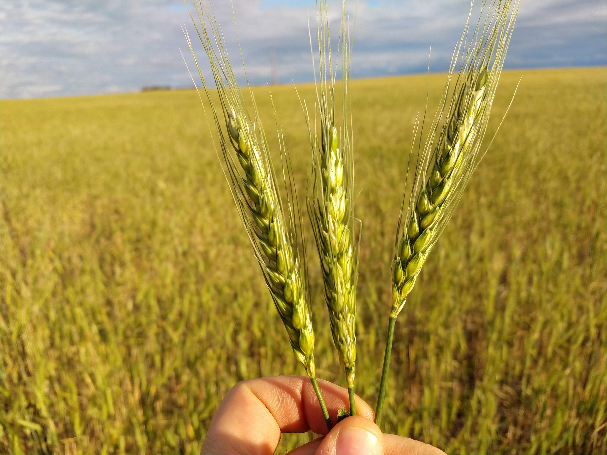
Partners
Esteban J. Copati, Buenos Aires Grain Exchange
Martín López, Buenos Aires Grain Exchange
Juan Pablo Gianatiempo, Buenos Aires Grain Exchange
NASA DEVELOP
Dr. Nicole Ramberg-Pihl, NASA DEVELOP Fellow/Center Lead
Science Advisors
Dr. John Bolten, NASA Goddard Space Flight Center
Dr. Nazmus Sazib, NASA Goddard Space Flight Center
Image Credit: Buenos Aires Grain Exchange
Notes:
Speaker:
Special thanks to our science advisors Dr. John Bolton and Dr. Nazmus Sazib, as well as our fellow Dr. Nicole Ramberg-Pihl, for their guidance throughout the project term. We would also like to thank our partners Esteban J. Copati, Martín López, and Juan Pablo Gianatiempo from the Buenos Aires Grain Exchange for their continued support. And thank you to everyone at NASA DEVELOP for supporting the project and helping the team be the best they could be.
------------------------------Image Information Below ------------------------------
•Image Credit: Buenos Aires Grain Exchange
•Source: Buenos Aires Grain Exchange (provided by the partner with permission to use)

