Slide 1
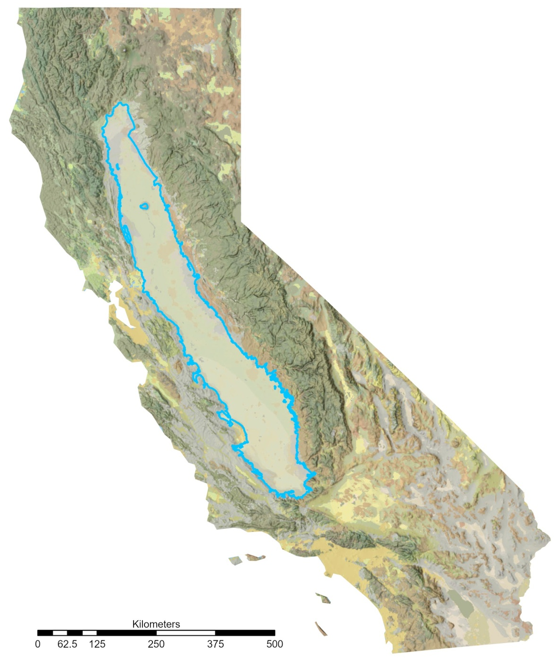
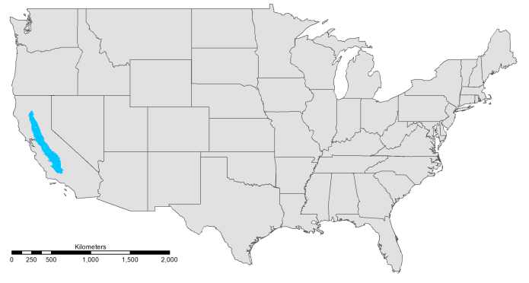
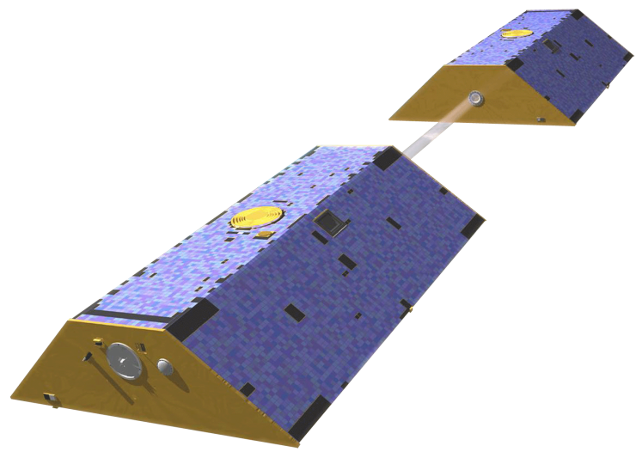
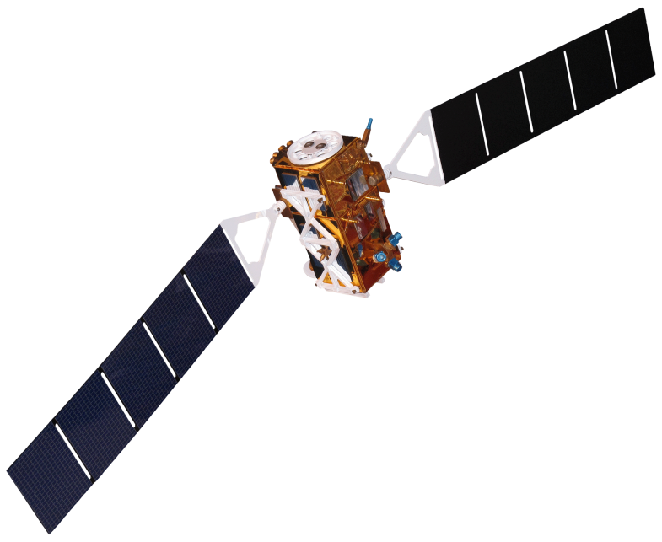
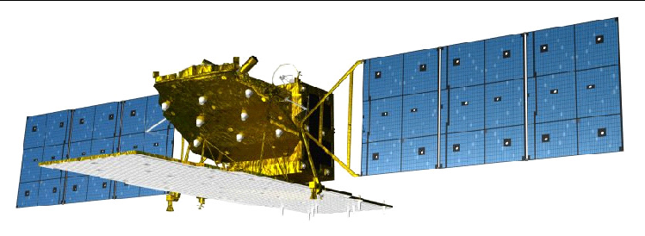
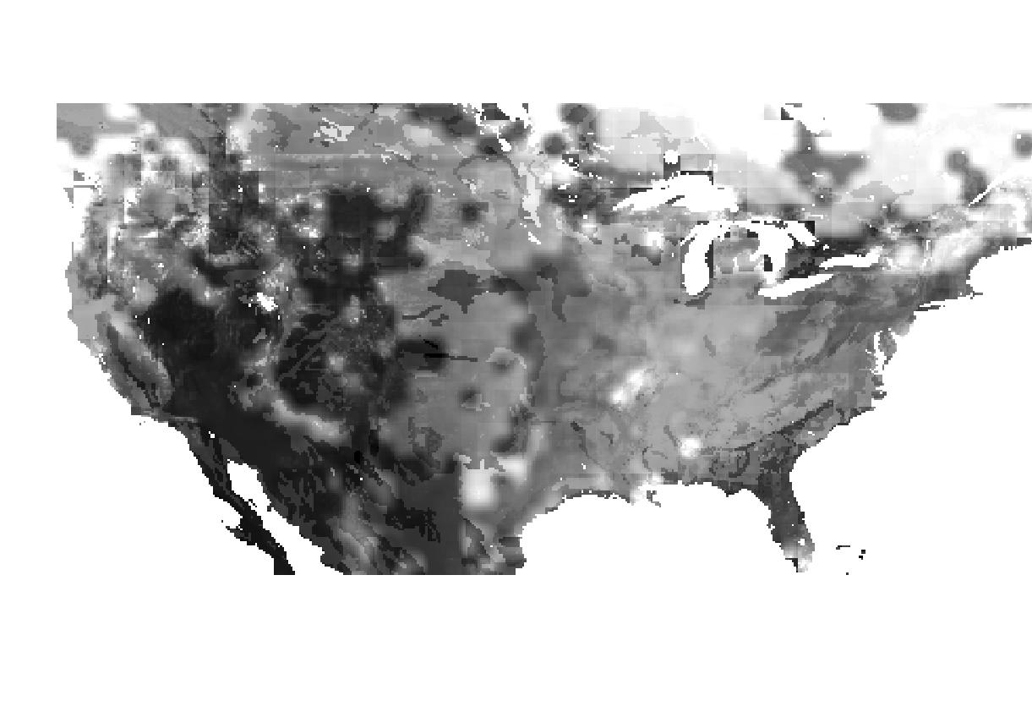
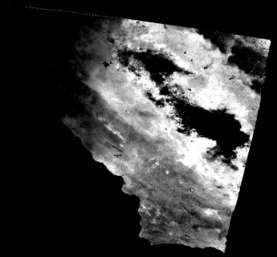
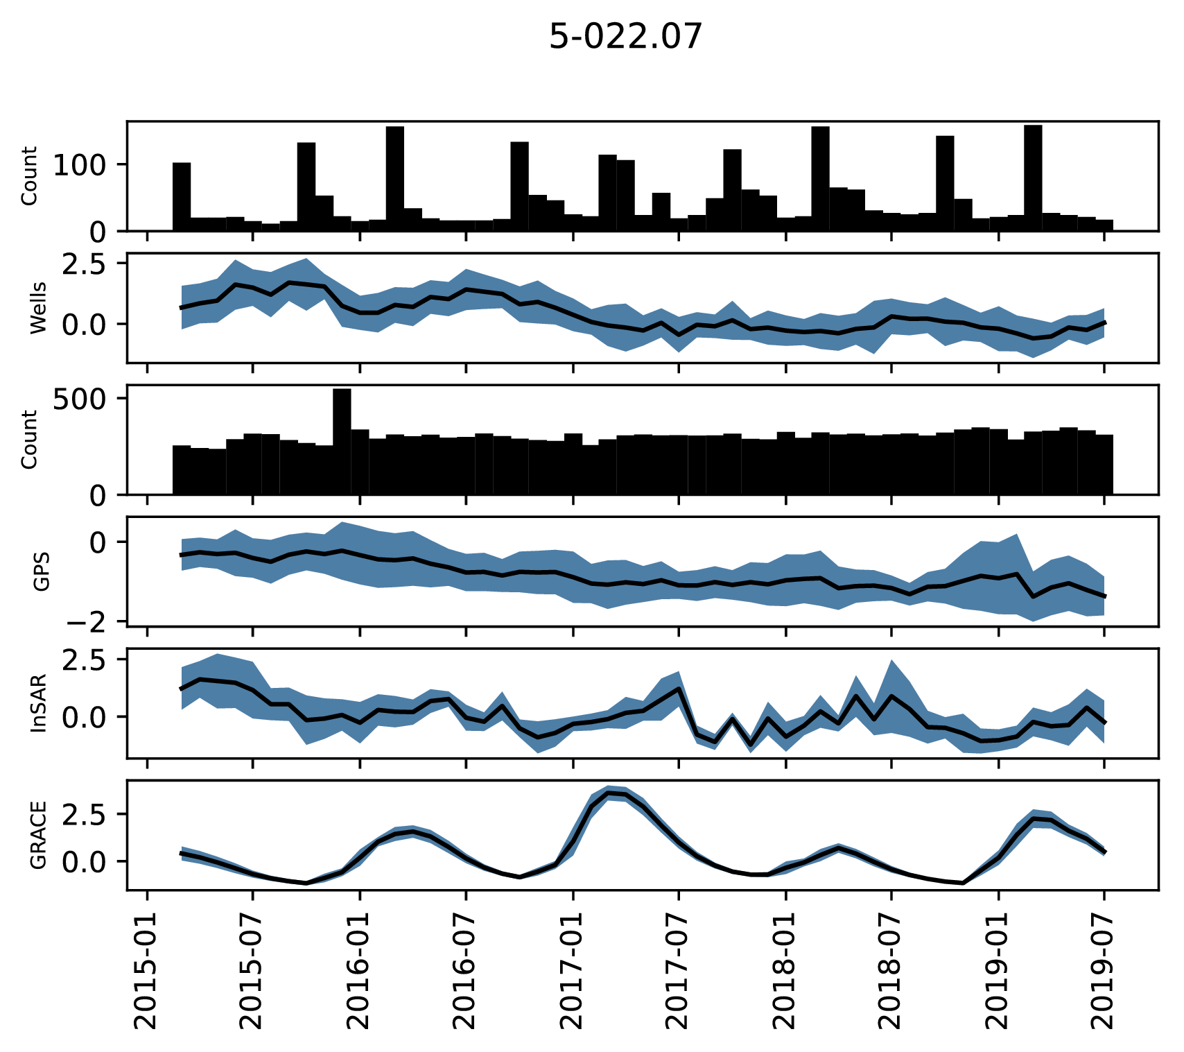
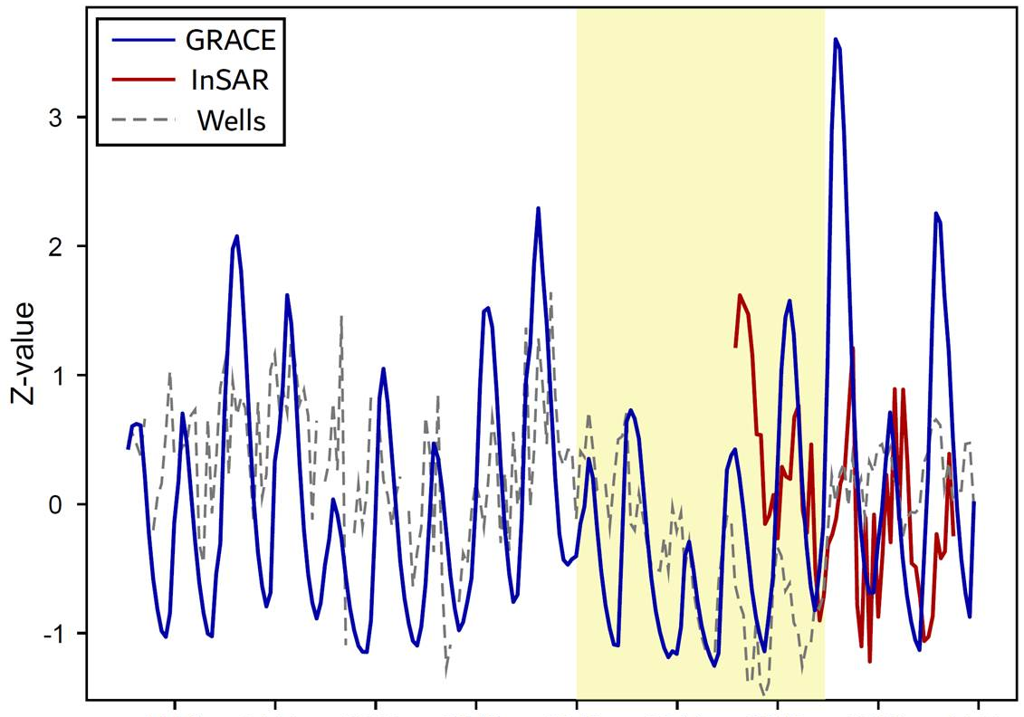
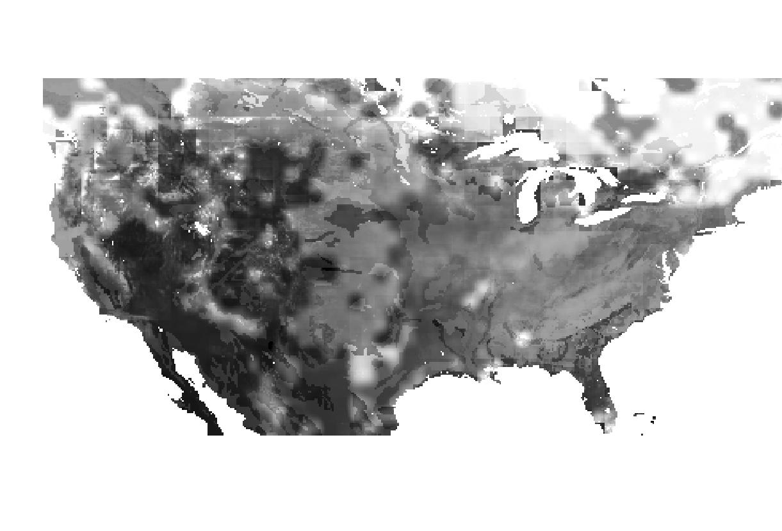
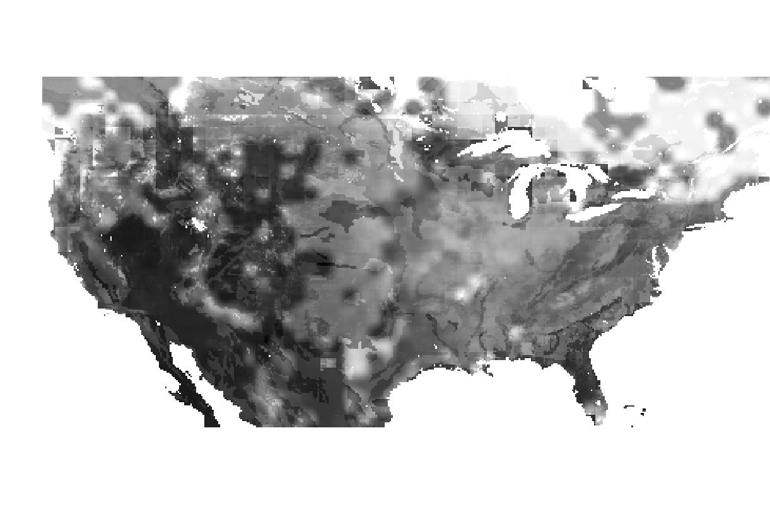
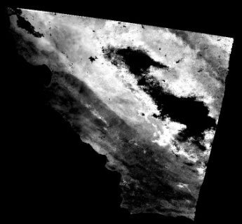
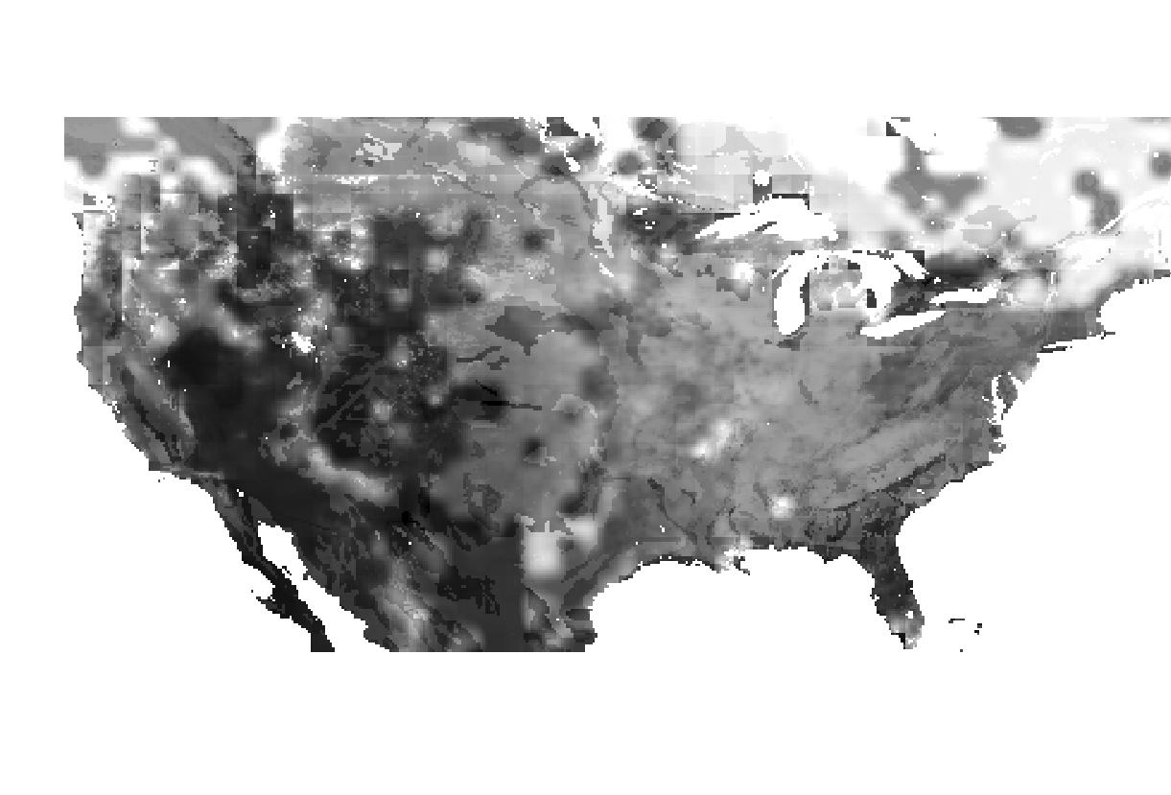
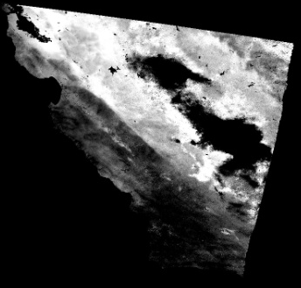
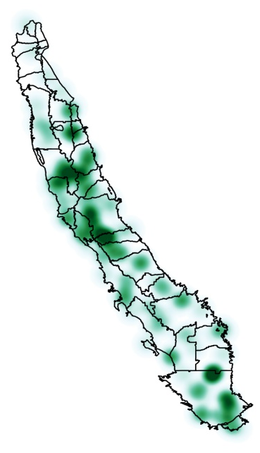
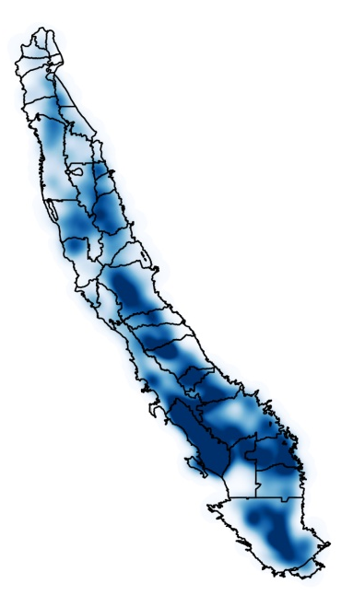
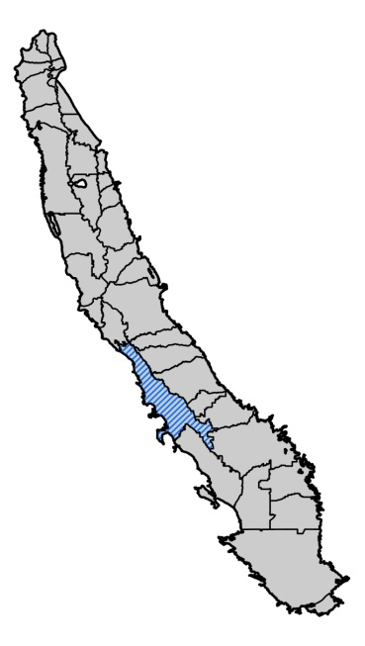
Improving California Groundwater Assessments using
GRACE and InSAR Datasets for Water Resource Management
Abstract
Study Area
Central Valley Water Resources
California’s Central Valley is one of the most productive agricultural areas in the world, producing approximately $20 billion in crops annually. The recent California droughts of 2007-2010 and 2012-2019 resulted in increased groundwater pumping in the Central Valley to adequately irrigate farmland. Overdrafting of the Central Valley aquifer results in groundwater depletion, land subsidence, and permanent loss of groundwater storage. In 2014, depletion of groundwater led the state of California to enact the Sustainable Groundwater Management Act (SGMA), requiring critically overdrafted, high, and medium priority sub-basins to reach sustainable levels of groundwater pumping and recharge by 2042. SGMA allows local Groundwater Sustainability Agencies (GSAs) the authority to create Groundwater Sustainability Plans (GSPs) at the sub-basin level. To assist California’s Department of Water Resources (DWR), this project quantified groundwater change and land subsidence in Central Valley sub-basins with sparse or unreliable well and Geographic Positioning Systems (GPS) data. This was done using NASA’s Gravity Recovery and Climate Experiment (GRACE), GRACE Follow On (GRACE-FO), and interferograms derived from Sentinel-1 C-band Synthetic Aperture Radar (C-SAR) and Advanced Land Observing Satellite 2 (ALOS-2) Phased Array L-band Synthetic Aperture Radar 2 (PALSAR-2). Time series of the GRACE and InSAR data were compared with well and GPS data in data-dense sub-basins to determine the feasibility of these datasets for groundwater storage and subsidence monitoring. We found that GRACE and InSAR data are effective tools for determining groundwater change and land subsidence and can be used on their own to monitor sub-basins in the absence of well and GPS data.
Central Valley, California, USA
Area: 20,000 square miles
Population: 6.5 million (2018)
California: 11% of the state’s total land area, supplies 60-75% of the state’s water
Agriculture: Produces ~50% of United State’s nuts, fruits, and vegetables within 17% of total U.S. irrigated land
Concerns: Currently the rate of groundwater pumping is unknown, and in some areas land is sinking at a rate of more than 18 inches a year
N
Coast
Sierra Nevada
Mountains
San
Francisco
Central Valley
CALIFORNIA
Ranges
Objectives
Los Angeles
0
Kilometers
500
250
Evaluate groundwater storage
Evaluate surface elevation subsidence
Characterize temporal relationship of groundwater & subsidence
Characterize spatial relationship of groundwater & subsidence
Assess groundwater & subsidence change within each sub-basin
Earth Observations
Methodology
Acquire study area in-situ & remotely sensed data
In-Situ: Well & GPS
EOs: GRACE/InSAR
Process raw data
Quality control, normalize data
GRACE &
GRACE-FO
Sentinel-1
(C-SAR)
ALOS-2
(PALSAR-2)
Aggregate in-situ and remote sensing data
Spatially and temporally
Evaluate surface subsidence and groundwater storage change spatially and temporally at the sub-basin scale
Maps, time-series, rate of change charts
Results
In-Situ and Remote Sensing:
GPS, Wells, GRACE, InSar
Zonal Trends:
Delta-Mendota Sub-basin
Temporal Trends:
Delta-Mendota Sub-basin
N
2003
N
2015
Count of Well Observations (#)
GRACE
Drought
2012 - 2016
3
InSAR
2020
San
Francisco
2019
Well Water Surface Elevation
(Z-Score)
WSE
San
Francisco
GRACE
Groundwater Storage
Count of GPS Observations (#)
2
InSAR Surface Subsidence
Z-Score
Delta-
Mendota
Sub-basin
GPS Ground Surface Elevation (Z-Score)
1
N
Very High
Sparse
Sparse
InSAR Ground Surface Elevation
(Z-Score)
0
High
Dense
Dense
Medium
GRACE Groundwater Thickness (Z-Score)
Sub-basin
Sustainability
Priority
Very Low
GPS
Station
Density
-1
Well
Station
Density
2015 July
2016 July
2017 July
2018 July
2019 Jan.
2004
2006
2008
2010
2012
2014
2016
2018
2020
2015 Jan.
2016 Jan.
2017 Jan.
2018 Jan.
2019 July
Temporal Analysis: Evaluation of temporal trends from 2003-2019 in the Delta Mendota Sub-basin indicate a distinct decline in groundwater storage during the drought of 2012-2016 as evidenced in InSAR, GRACE, and groundwater well trends. This trend is consistently observed across most sub-basins within the Central Valley.
In-Situ and Remote Sensing: Sub-basin Scale Analysis: Data sources were aggregated and evaluated at a sub-basin scale to balance the need for high-resolution interpretations while maintaining broader perspective for land managers. While broad trends exist across the Central Valley, the specific response of each sub-basin to drought conditions and rebound are unique.
Groundwater Analysis: The Delta-Mendota sub-basin was selected as a test case to verify the efficacy of this study’s methodology. Zonally averaged time series allow for the comparison of trends in each sub-basin. Delta-Mendota demonstrates a general decreasing trend in well water surface elevation (WSE), that is confirmed by GPS, InSAR, and GRACE observations.
Conclusions
Project Partners
Seasonal minima and maxima, in addition to periods of drought, can be detected and readily correlated across in-situ (well and GPS) and remotely sensed (InSAR and GRACE) analysis methods.
Sub-basin scale snapshots provide locally-relevant information as a basis for decision-making for land managers.
GRACE and InSAR data can be relied on to provide groundwater storage and subsidence data in regions with sparse in-situ well and GPS data.
California Department of Water Resources, North Central Region, South Central, & Southern Region Offices
California State University, Los Angeles
Team Members
Acknowledgements
We would like thank our science advisors at the NASA Jet Propulsion Laboratory (JPL) for their guidance during this term and for providing the Earth observation data required for this study: Dr. Zhen Liu, Dr. Kyra Kim, and Dr. John T. Reager. We also thank JPL’s Benjamin Holt and NASA DEVELOP Fellow Cecil Byles for their support throughout this study.
This material contains modified Copernicus Sentinel data (2015-2020), processed by ESA.
Forrest Corcoran
Project Lead
Marissa Dudek
James Kitchens
Patrick Saylor
California - JPL

