Slide 1
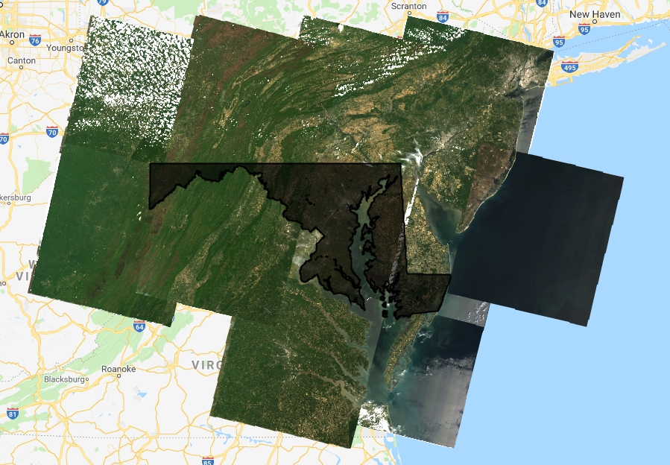
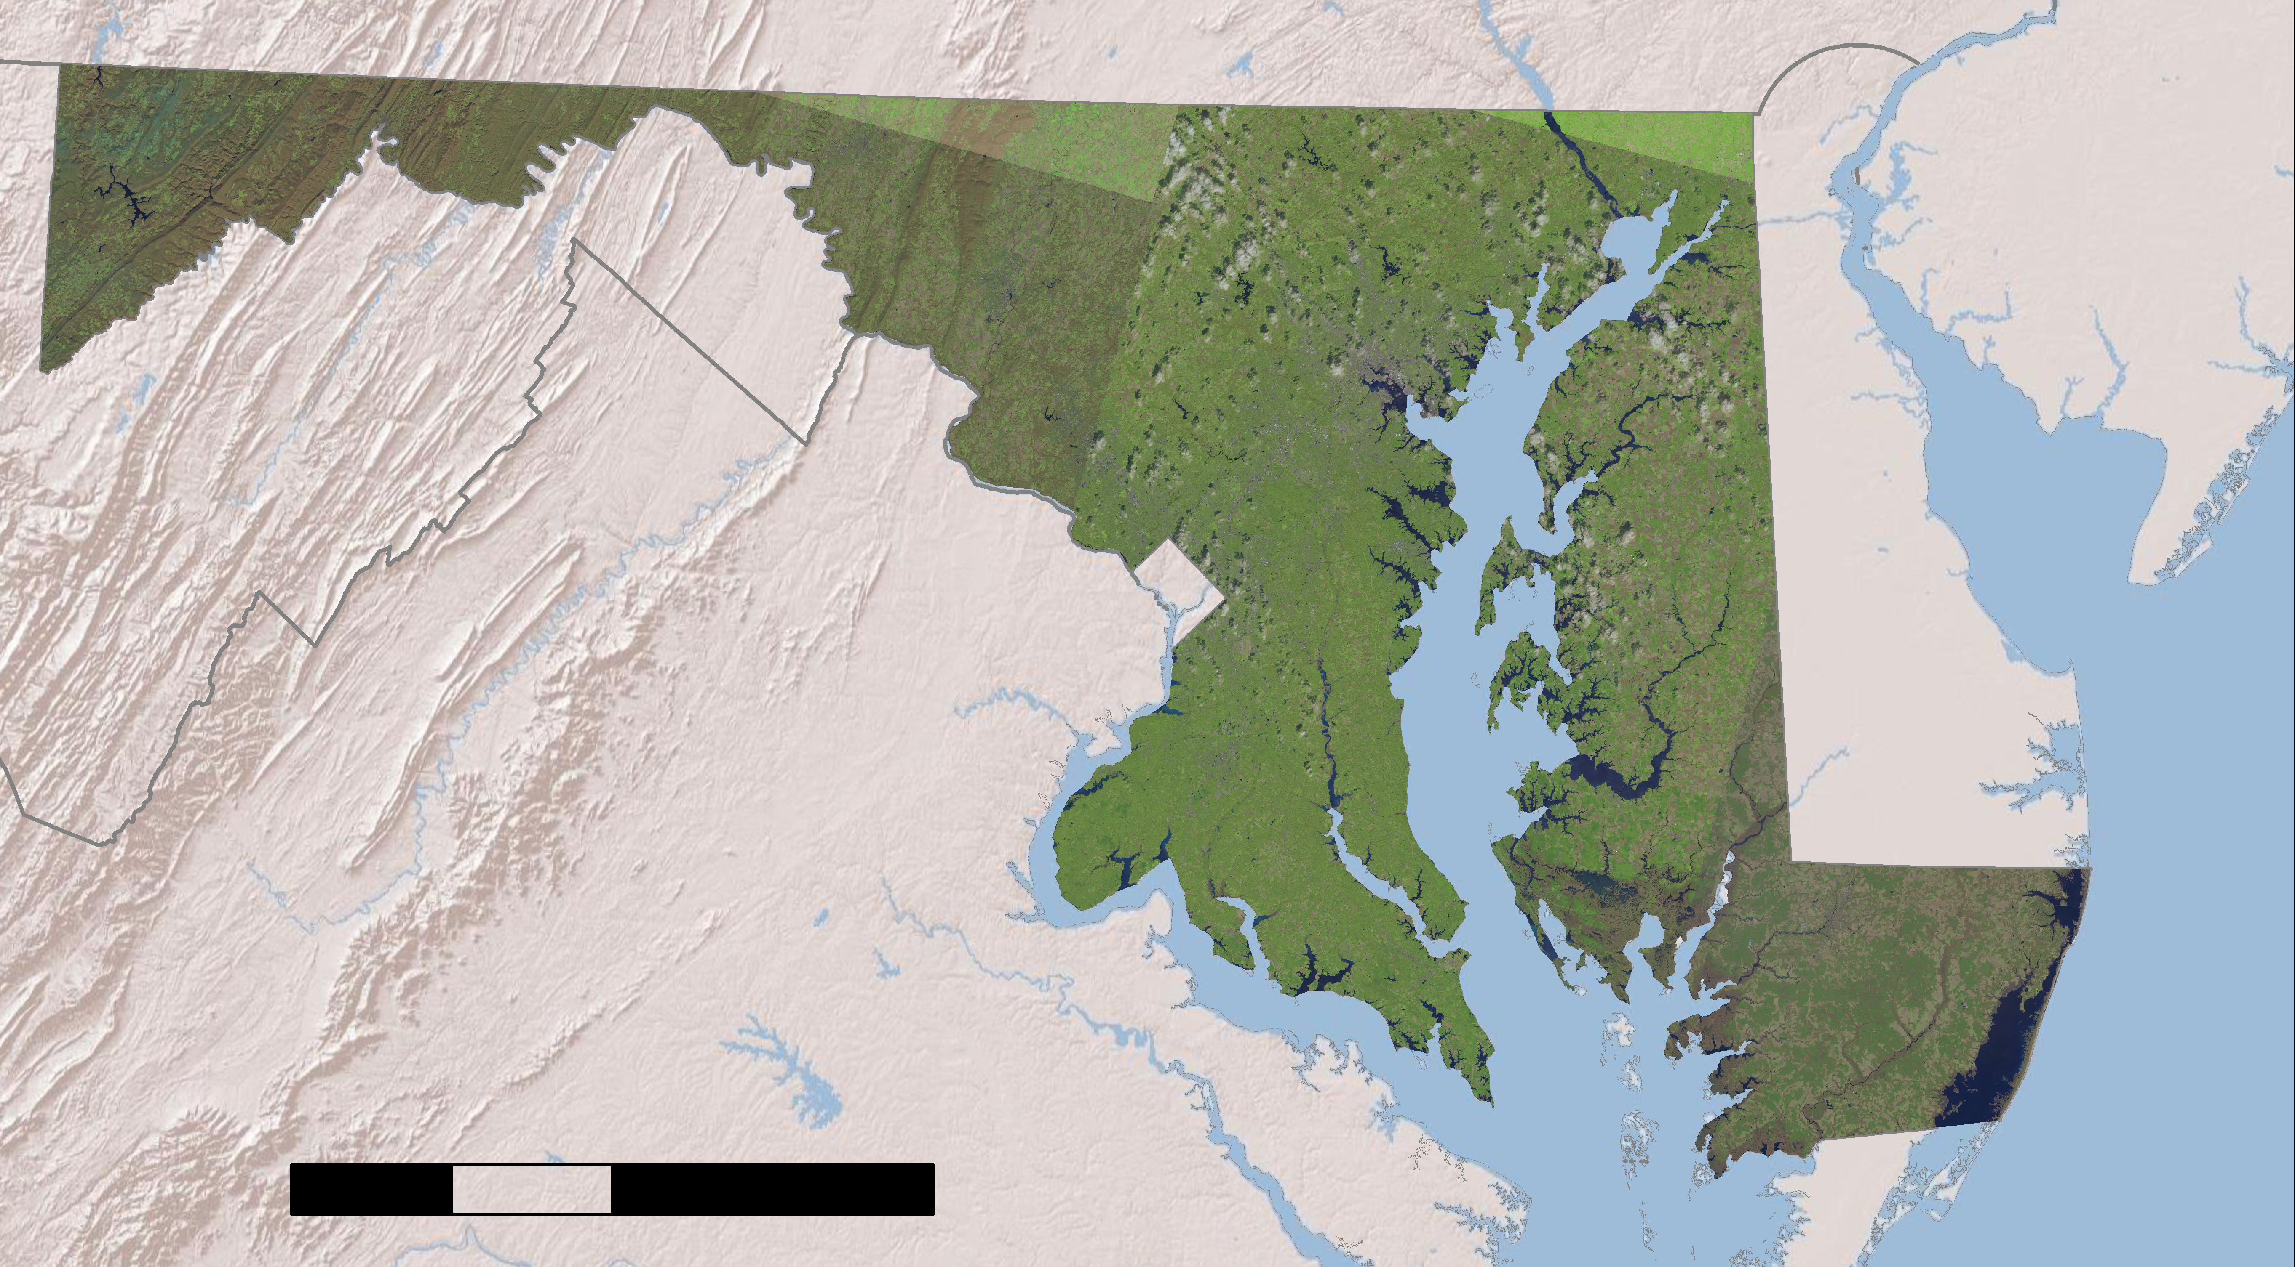
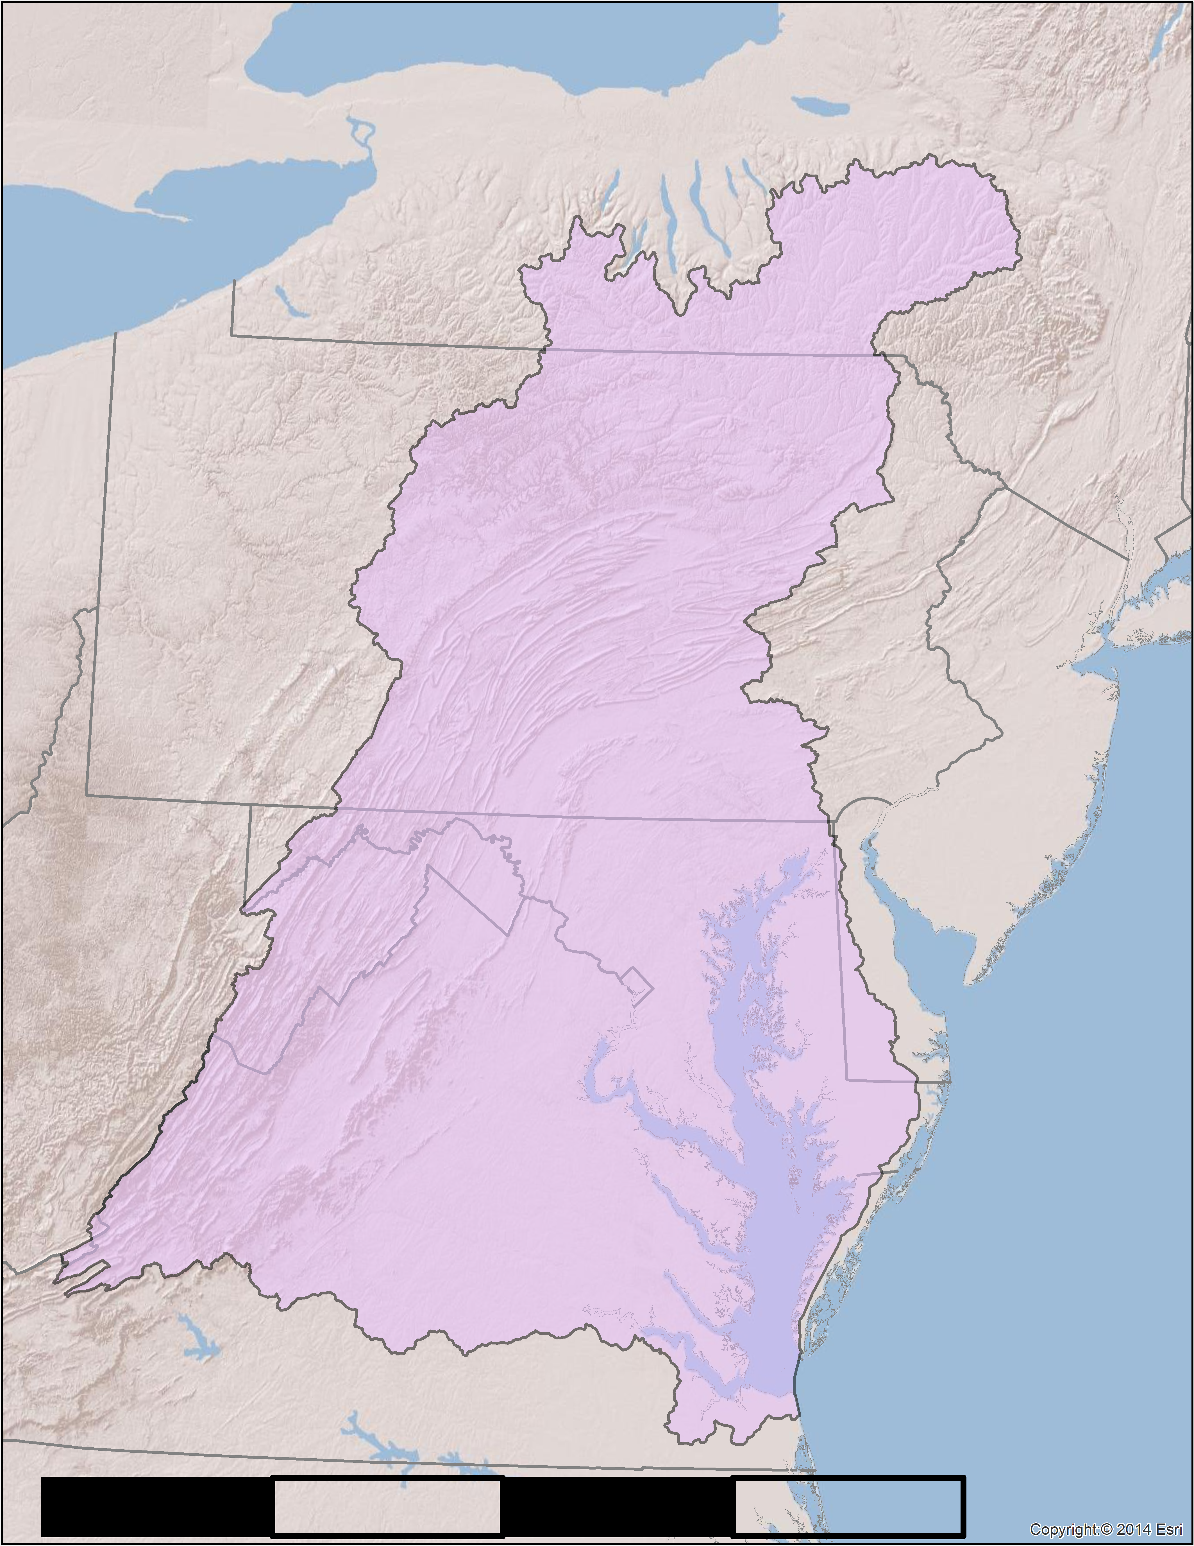
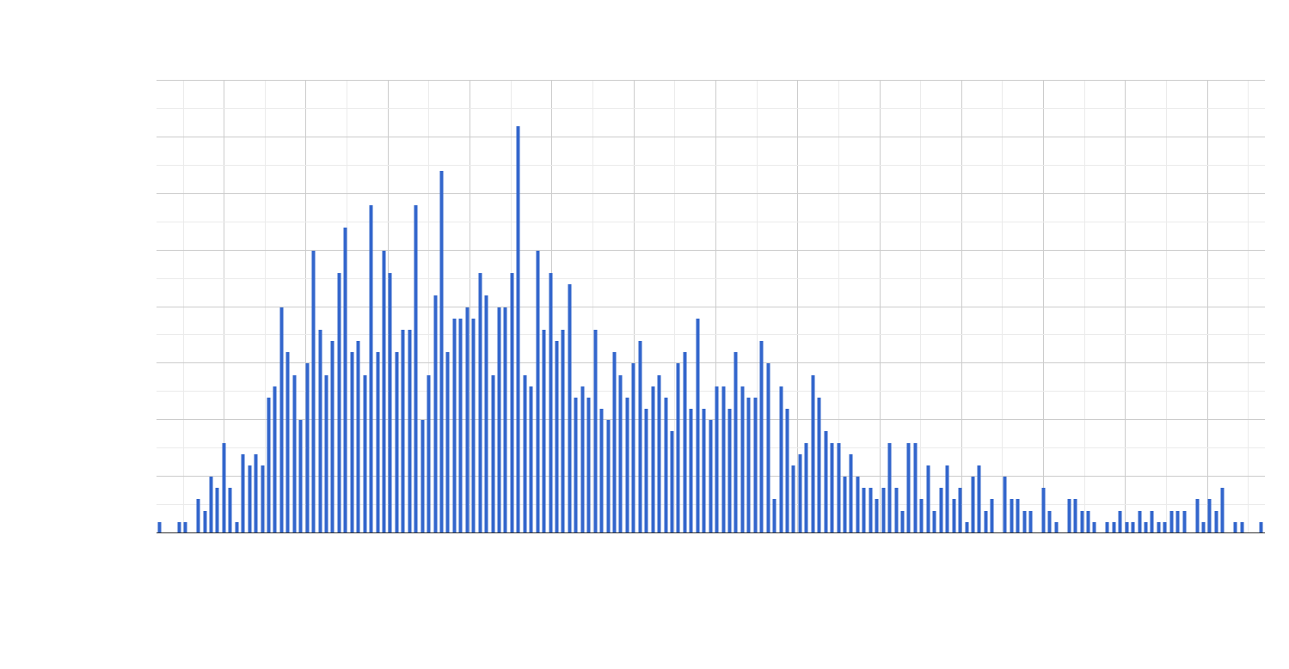
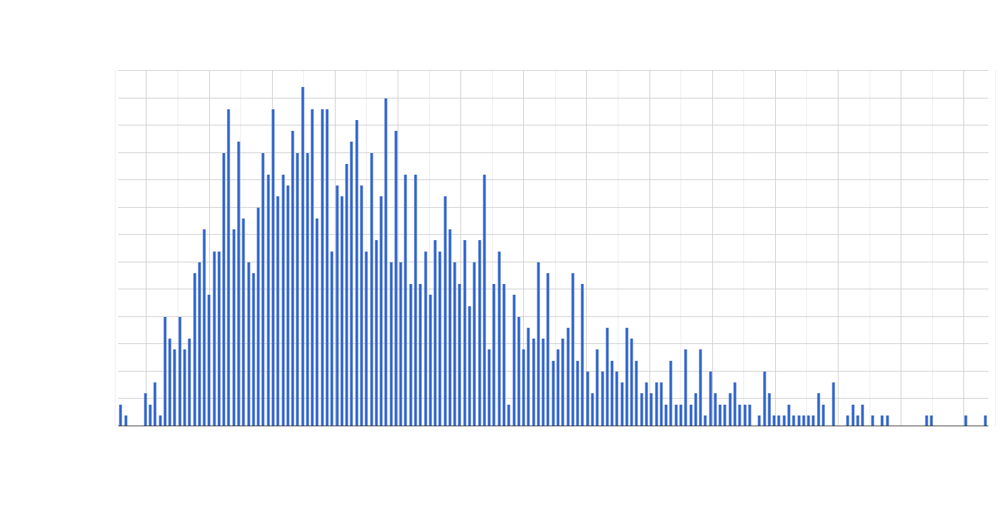
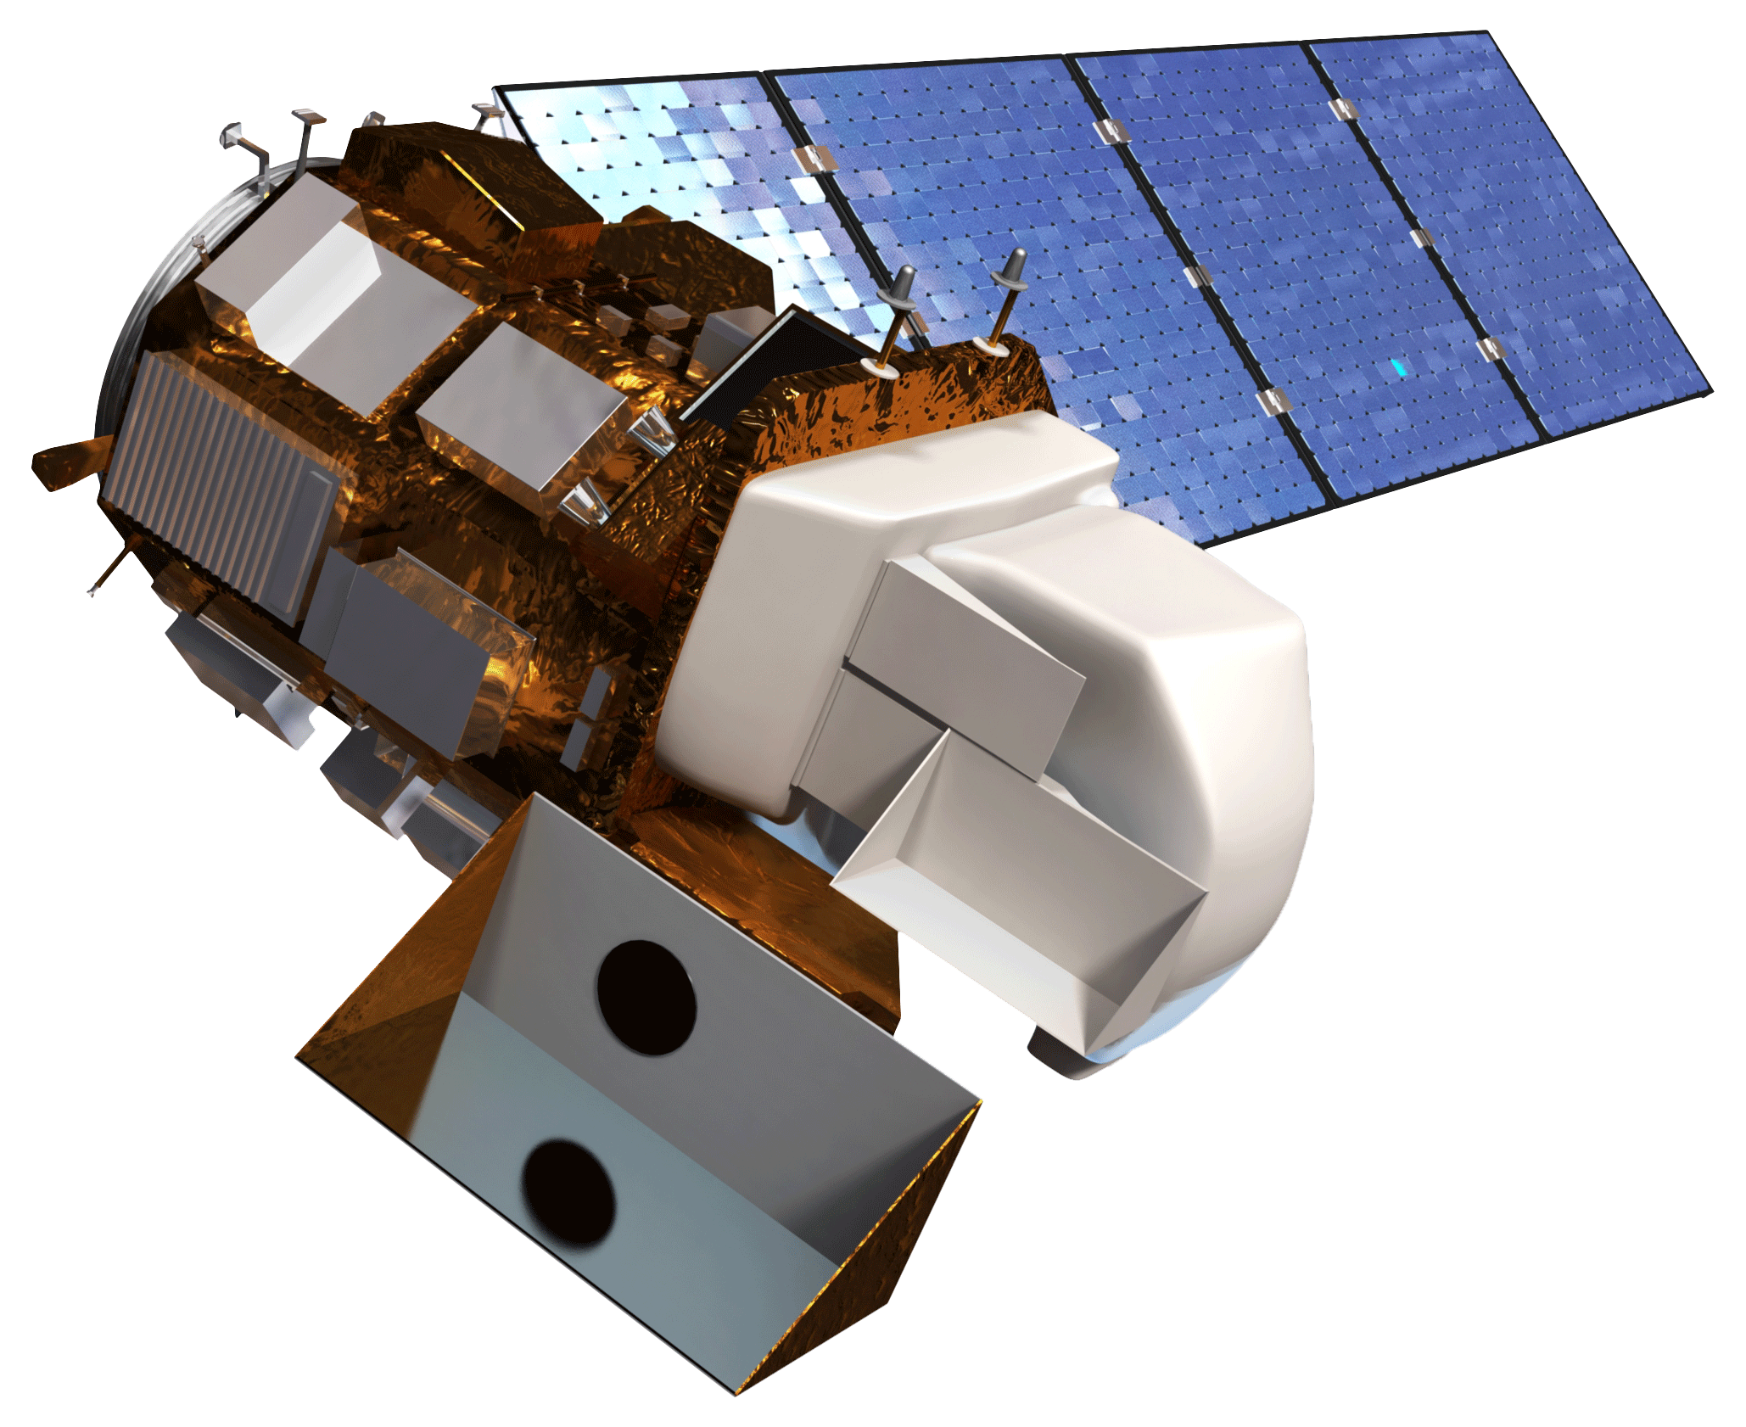
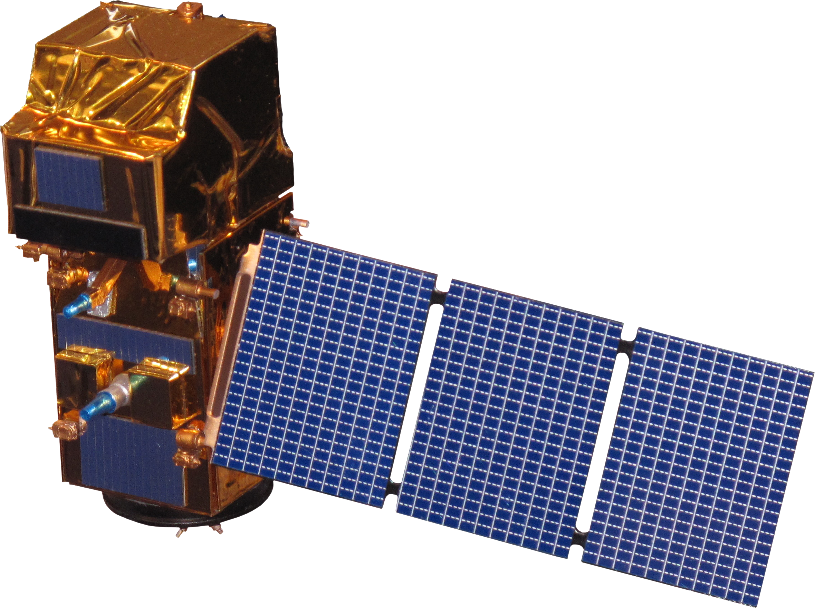
Quantifying Wintertime Agricultural Land Use and Springtime Management of Winter Cover Crops using Landsat and Sentinel to Support Environmental Conservation in Maryland
Abstract
Methodology
Cover crops enrich soils, limit erosion, and reduce nutrient runoff from agricultural land. To promote their usage, the Maryland Department of Agriculture (MDA) subsidizes farmers who plant winter cover crops. In order to maximize environmental benefits, cover crops must be terminated in the spring, rather than harvested. Previous DEVELOP collaborations with the MDA used imagery from Landsat 5 Thematic Mapper (TM), Landsat 8 Operational Land Imager (OLI), and Sentinel-2 MultiSpectral Instrument (MSI) to analyze various agronomic parameters which affect cover crop effectiveness. The Spring 2019 DEVELOP team continued to work with this imagery through Google Earth Engine and created a new application to remotely sense the presence of cover crops during the spring season. This tool, Cover Crop Remotely Observed Performance (CCROP3), aims to confirm that cover crops have been planted and verify the dates on which they were terminated, thereby reducing the need for the MDA to manually spot-check fields. The resulting graphical user interface (GUI) will also be used by the MDA to analyze parameters that influence cover crop effectiveness, such as cover crop type, planting date, and fertilizer usage. This GUI has the potential to promote more informed decision making and more effective conservation efforts for the Chesapeake Bay.
N
N
N
0
1
km
NASA & ESA Satellite Imagery
MDA Shapefiles & Agronomic Data
Google Earth Engine Graphical User Interface
Objectives
Analyze cover crop vegetation density in enrolled fields across Maryland
Finalize a GUI by adding a time series analysis to visualize Normalized Difference Vegetation Index (NDVI) values of fields at planting and termination dates set by the MDA
Provide an interactive tool, CCROP3, which allows the MDA to analyze cover crop performance through a set of filtering parameters, ultimately bolstering conservation efforts for the Chesapeake Bay via remote sensing technology
Results
1
NDVI
0
Study Area
0
1
km
N
Subset of NDVI Values, Dec. 21, 2017
Chesapeake Bay Agriculture & Food Security III
30
NDVI Distribution for Kent County, 12/21/17
NDVI Distribution for Kent County, 03/18/18
25
30
20
25
20
Number of Fields
Number of Fields
15
15
10
10
5
5
0
250
500
0
0.2
0.3
0.4
0.5
0.6
0.7
0.8
0
0.2
0.3
0.4
0.5
0.6
0.7
0.8
km
NDVI Value
NDVI Value
Conclusions
N
CCROP3 visualizes vegetation density for all enrolled cover crop fields across the state of Maryland throughout winter and spring.
NDVI values calculated throughout the cover crop growing season can be used to analyze crop lifecycles and help verify termination dates.
The MDA can use tabular outputs and other GUI features to support agronomic analysis and identify areas of improvement for their cover crop program.
0
30
60
120
KM
Earth Observations
Project Partners
 Maryland Department of Agriculture, Office of Resource Conservation
 USDA, Agricultural Research Service, Hydrology and Remote Sensing Laboratory
 USGS, Eastern Geographic Science Center
 US EPA, Chesapeake Bay Program
Landsat 8 OLI
Landsat 5 TM
Sentinel-2 MSI
Team Members
Acknowledgements
Thanks to Dr. Sunita Yadav, John Fitz, Sean McCartney, Perry Oddo, Alison Thieme, Diane Portillo, and Logan Kline of DEVELOP for laying the groundwork for this project. Additional thanks to Dr. John Bolten (NASA Goddard Space Flight Center), Dr. W. Dean Hively (USGS Eastern Geographic Science Center), Dr. Greg McCarty (USDA Agricultural Research Service), and Jason Keppler (Maryland Department of Agriculture) for scientific advising and additional support throughout the project. Special thanks to our mentor and Center Lead, Victor Lenske, for his guidance.
This material contains modified Copernicus Sentinel data (2006-2019), processed by ESA.
Benjamin Whong
Project Lead
Bryan Eder
Julio Peredo
Callum Wayman
Maryland – Goddard | Spring 2019
This material contains modified Copernicus Sentinel data (2017—2019), processed by ESA.

