Slide 1
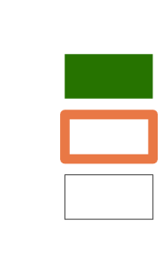
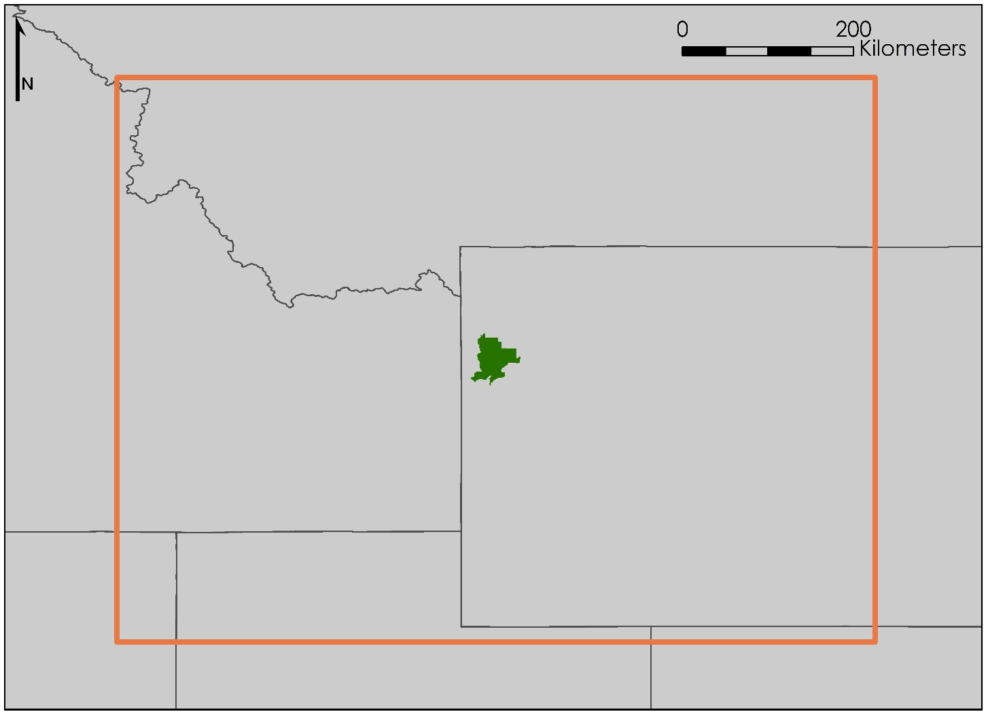
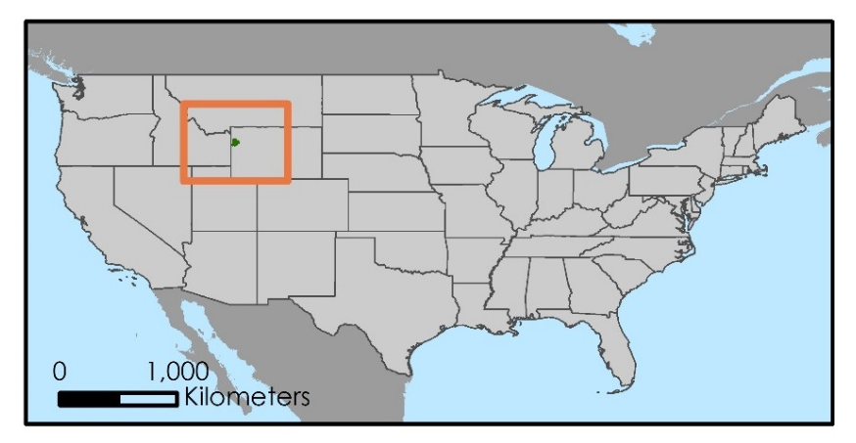
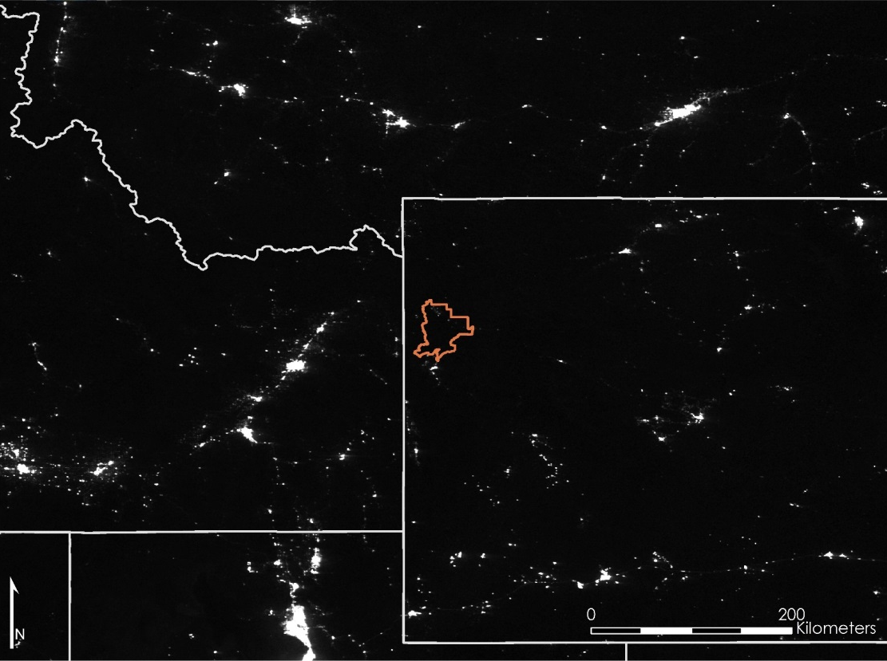
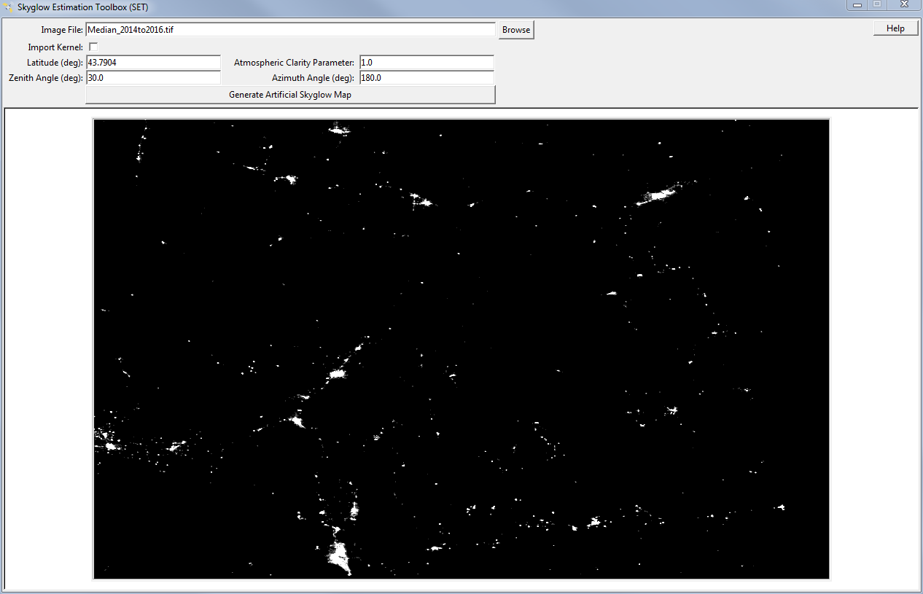
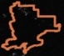
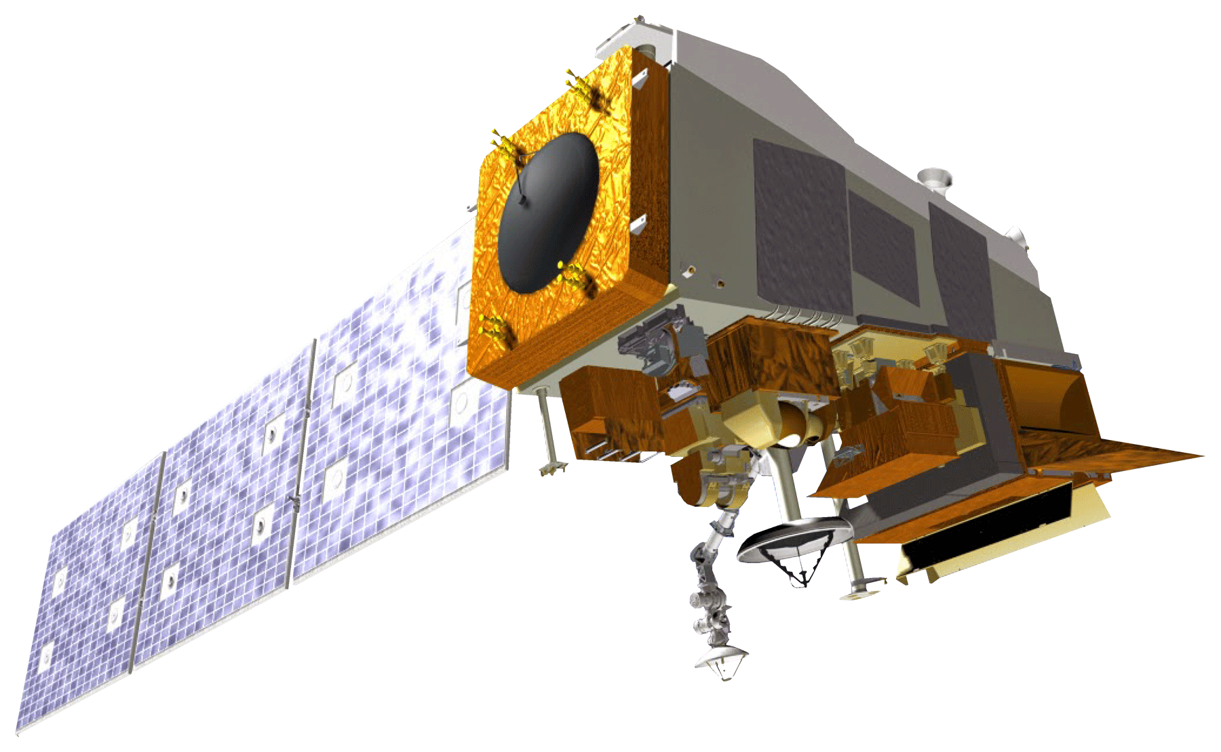

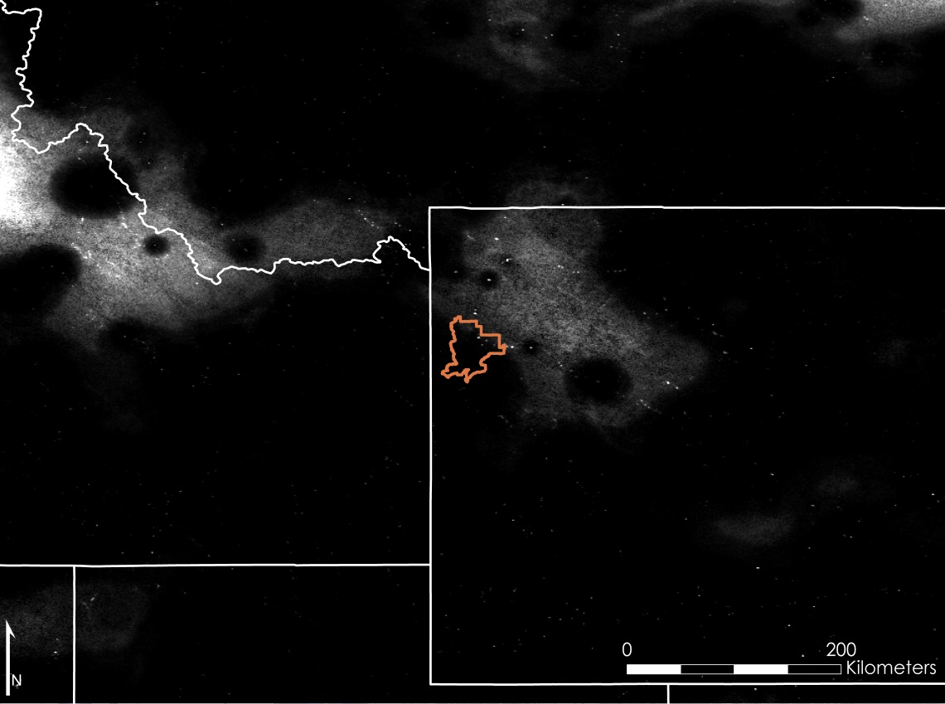
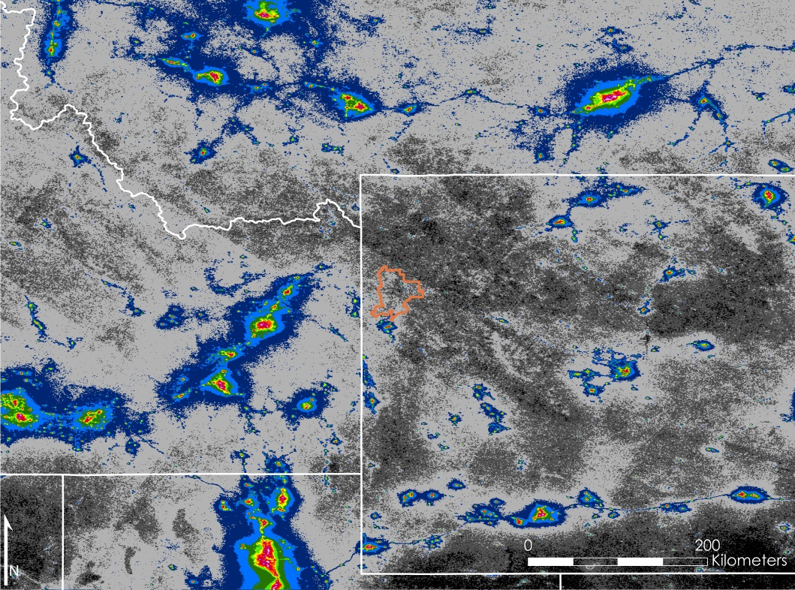

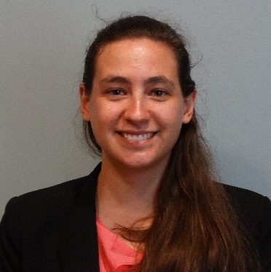

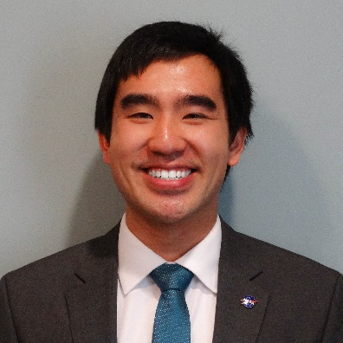

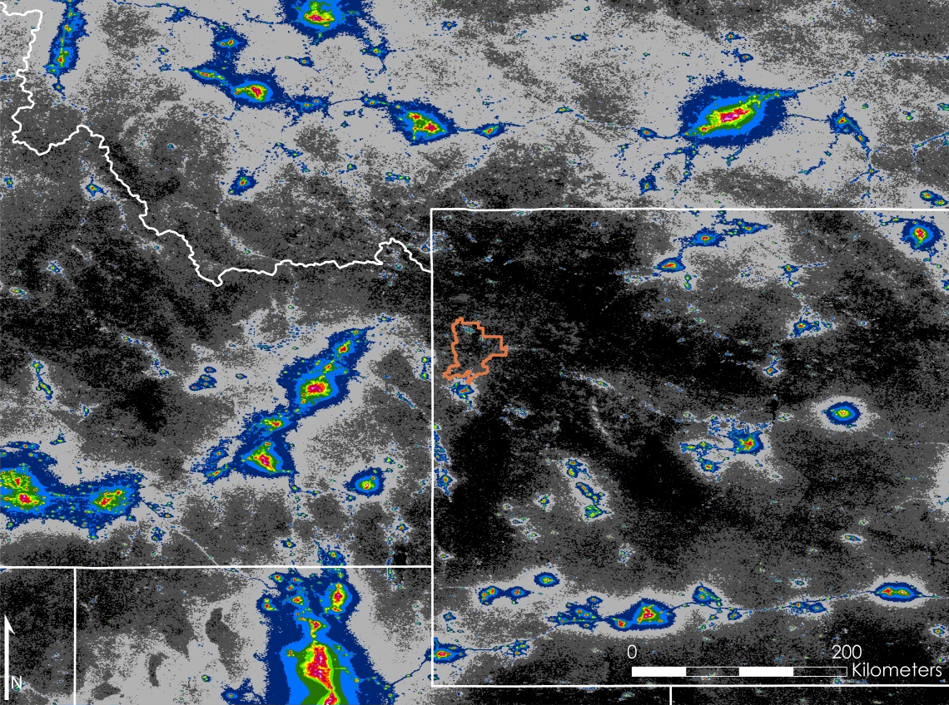
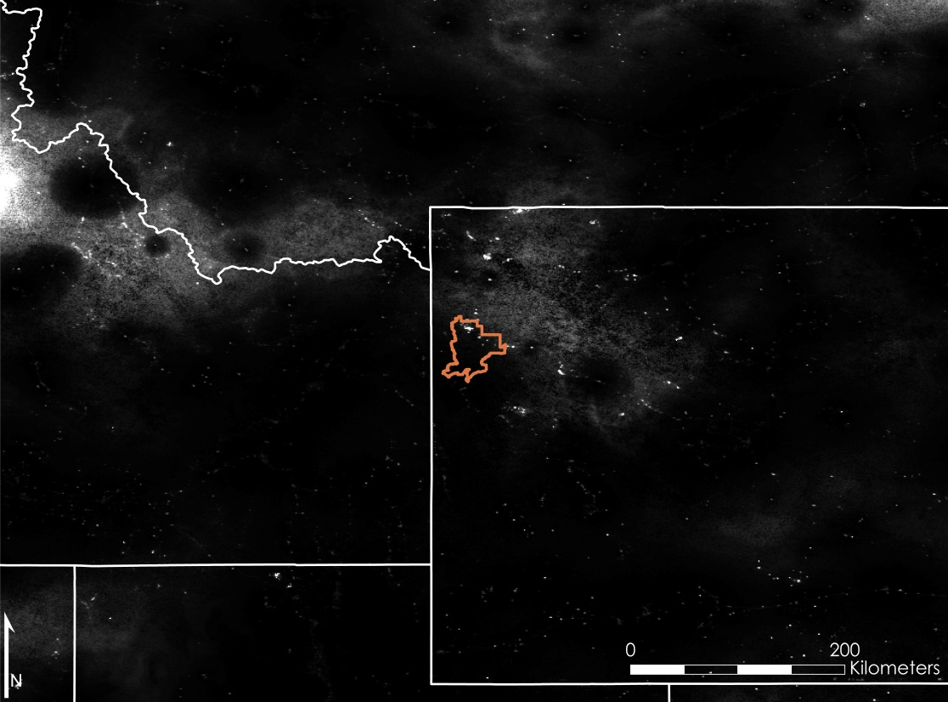

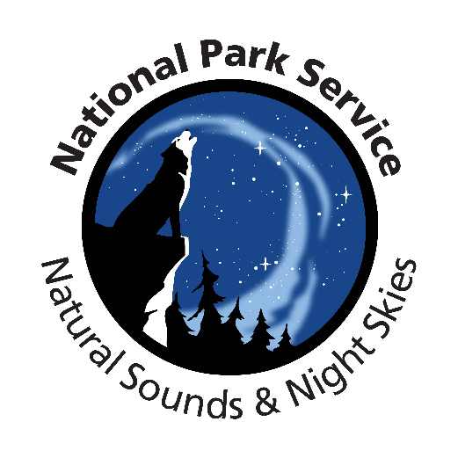
Detecting Changes in Nighttime Sky
Brightness over Grand Teton National Park
with NASA’s VIIRS Sensor
Abstract
As more outdoor lighting is installed for safety and development, light pollution has become a growing problem that threatens the quality of life for humans and wildlife. The onset of light pollution in cities and dark sky areas not only hinders humans from seeing the stars and the Milky Way but also has been linked to health disorders in humans and behavioral changes in flora and fauna. Grand Teton National Park is concerned about the scattering of light pollution and its associated impacts on visitor experience and the environment. Thus, in collaboration with the National Park Service and Wyoming Stargazing, the NASA DEVELOP Wyoming Cross-Cutting II team created the Skyglow Estimation Toolbox that utilizes data collected by the Suomi National Polar-orbiting Partnership Visible Infrared Imaging Radiometer Suite Day/Night Band. This software used images of the park and a 300 km square buffer collected by the sensor from the summer months (July, August, and September) of 2014, 2015, and 2016 to calculate the effect of light scattering. By processing the pixel values in this image through convolution, the Toolbox applies Cinzano (2001) and Garstang’s (1989) model of light propagation to create Artificial Skyglow Maps in Esri’s ArcGIS that measure skyglow at various viewing angles and lines of sight in the park, helping park officials determine current sky quality and identify sources of light pollution that are diminishing its quality. Moreover, the data produced by the Toolbox will help government officials make informed decisions regarding lighting ordinances in Teton County.
Study Area
Grand Teton National Park
Study Area (300 km buffer)
State Boundary
Montana
Idaho
Wyoming
Nevada
Utah
Colorado
Objectives
Assess ramifications of artificial skyglow over time
Design a model of light propagation in the atmosphere from different viewing angels and latitudes
Visualize sources of anthropogenic light pollution
Publish an open-source Python program with supporting documentation for local communities to derive information about night sky quality
Test Python program against previous work in the New World Atlas of Artificial Night Sky Brightness (New World Atlas) by Falchi et al. (2016)
Methodology & Results
Earth Observations
The Skyglow Estimation Toolbox (SET) produces an Artificial Skyglow Map from user-defined inputs: a regional VIIRS image, viewing angle, and atmospheric clarity parameter. This image shows the software interface and median VIIRS image.
Suomi National Polar-orbiting Partnership (NPP)Visible Infrared Imaging Radiometer Suite (VIIRS) Day/Night Band (DNB)
Low Radiance
High Radiance
Suomi NPP VIIRS monthly composite images from NOAA EOG over July-September of 2014-2016 were compiled into a median image.
Conclusions
The Skyglow Estimation Toolbox (SET) and Suomi NPP VIIRS imagery combined can model light pollution as viewed from the ground.
Skyglow Artificial Maps identify sources of light pollution and shows patterns of light scatter and propagation.
SET offers broader, more dynamic capabilities and applications than handheld light meters, allowing park officials to expand the geographic scope of current measurement practices.
Both the Median and Mean Skyglow Artificial Maps closely resemble the New World Atlas, but the Mean is a slightly better representation than the Median.
Model validation will increase precision and accuracy of SET.
Wyoming Cross-Cutting II
High Similarity
Low Similarity
| | | | | | | | | | | | |
1.74 3.48 6.96 13.9 27.8 55.7 111 223 445 890 1780 3560 7130
Team Members
Comparison between Median Artificial Skyglow Map and New World Atlas
An Artificial Skyglow Map is produced using SET and the median VIIRS image.
Veronica Warda
Team Lead
Ryan Avery
Steven Chao
Stanley Yu
Acknowledgements
Dan Greenblatt, National Park Service, Grand Teton National Park
Randy Stanley, National Park Service, Intermountain Region
Sharolyn Anderson, PhD, National Park Service, Natural Sounds and Night Skies Division
Li-Wei Hung, PhD, National Park Service, Natural Sounds and Night Skies Division
Samuel Singer, PhD, Wyoming Stargazing
Dr. Kenton Ross, NASA Langley Research Center
Dr. L. DeWayne Cecil, NOAA NCEI & Global Science and Technology, Inc.
Bob VanGundy, The University of Virginia’s College at Wise
Benjamin Marcovitz, NASA DEVELOP National Program
Aubrey Hilte, NASA DEVELOP National Program
Christine Stevens, NASA DEVELOP National Program
Eric White, NASA DEVELOP National Program
J. Michael Brooke, NASA DEVELOP National Program
| | | | | | | | | | | | |
1.74 3.48 6.96 13.9 27.8 55.7 111 223 445 890 1780 3560 7130
High Similarity
Low Similarity
An Artificial Skyglow Map is produced using SET and the mean VIIRS image.
Comparison between Mean Artificial Skyglow Map and New World Atlas
Project Partners
Wyoming Stargazing
Wise County Clerk of Circuit Court’s Office – Summer 2017

