Slide 1
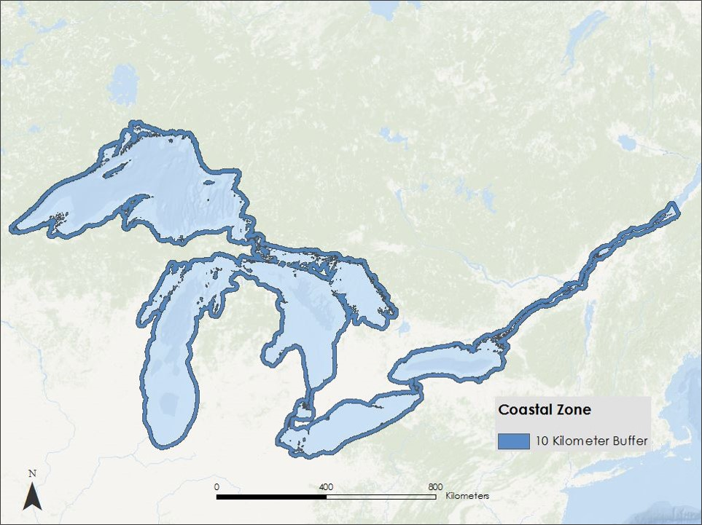
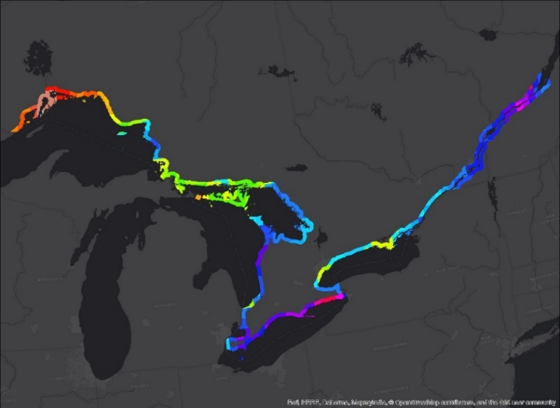
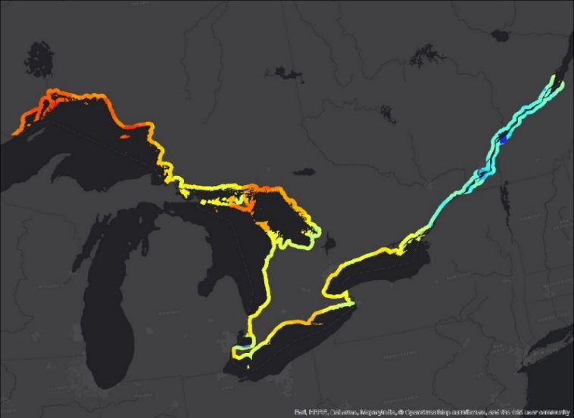
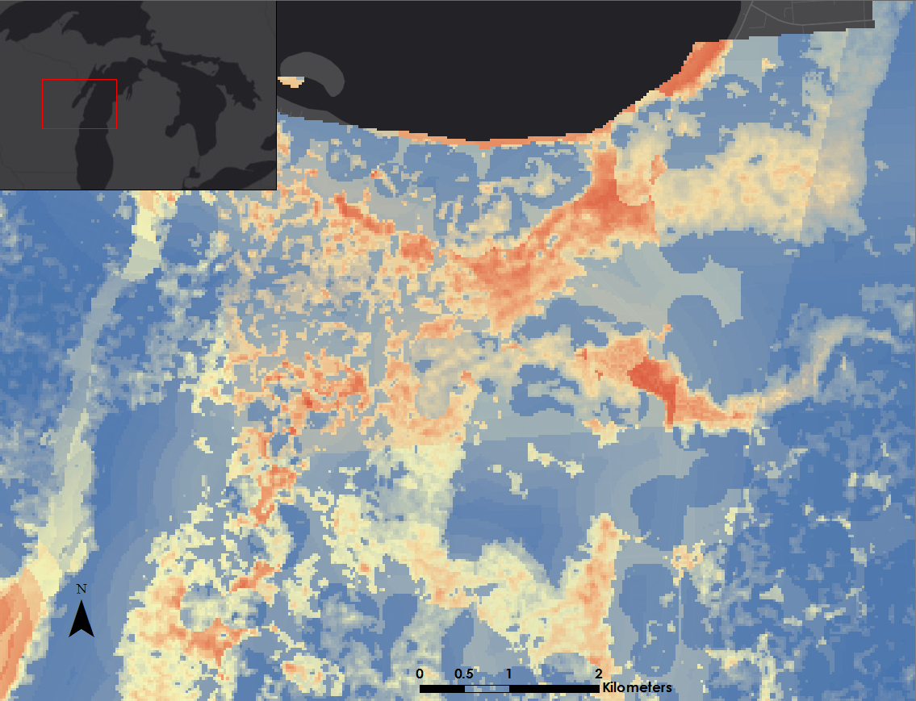
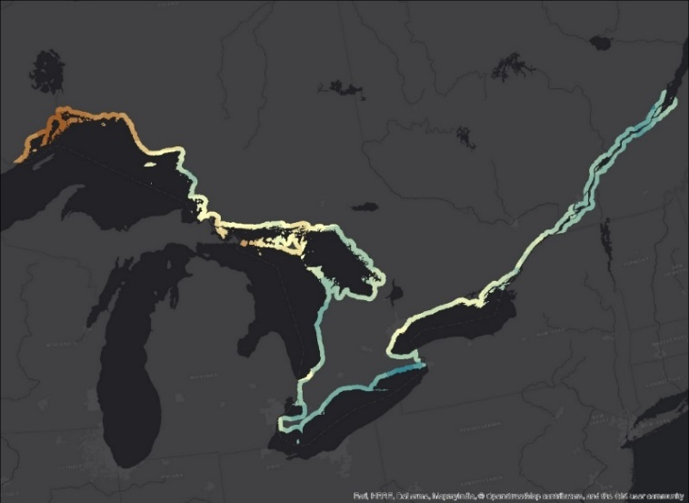
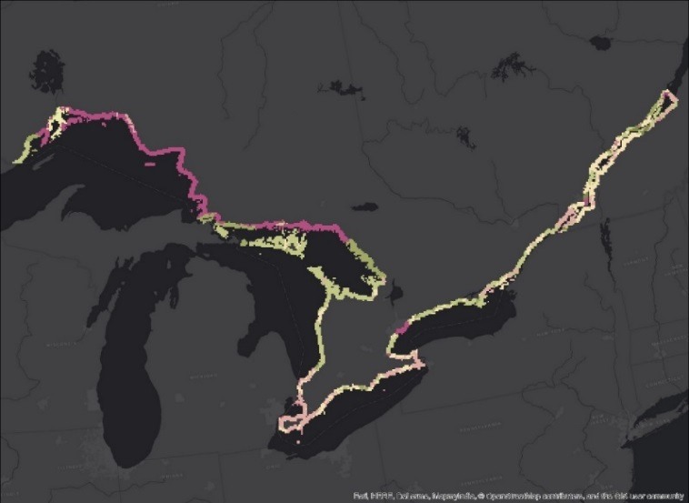
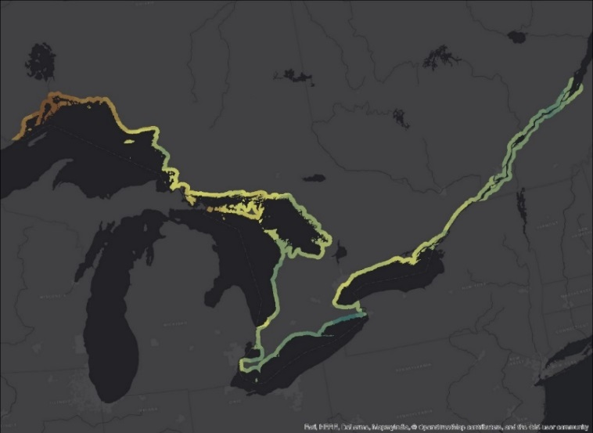
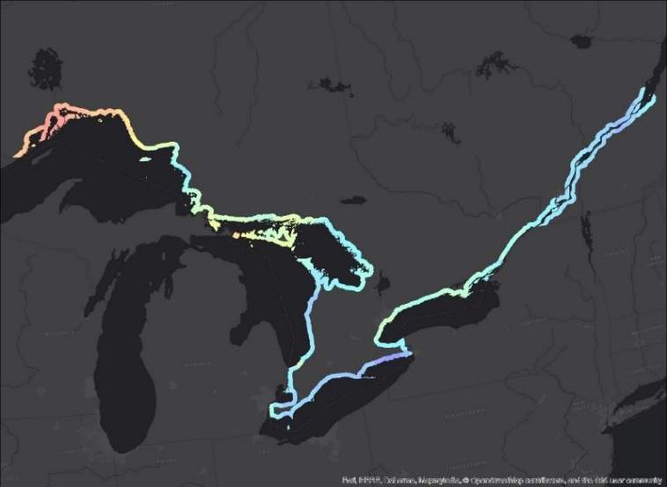
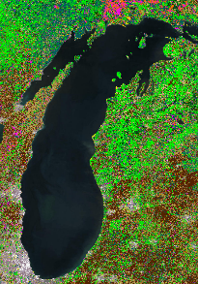
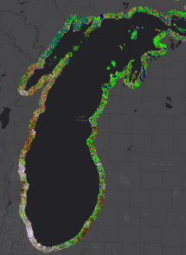
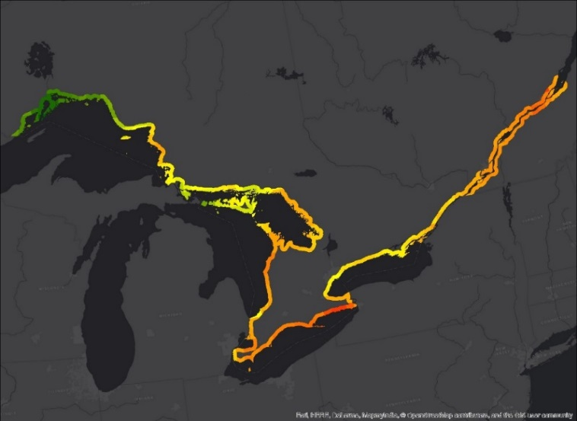
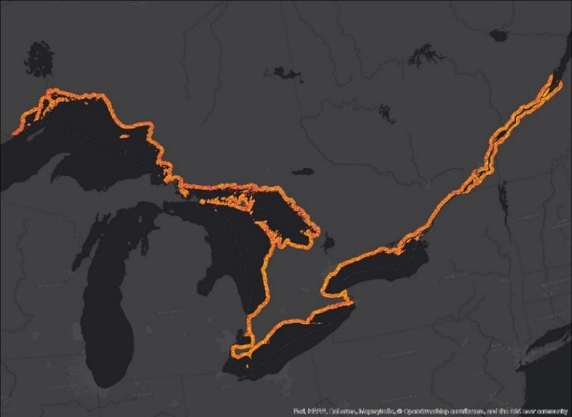
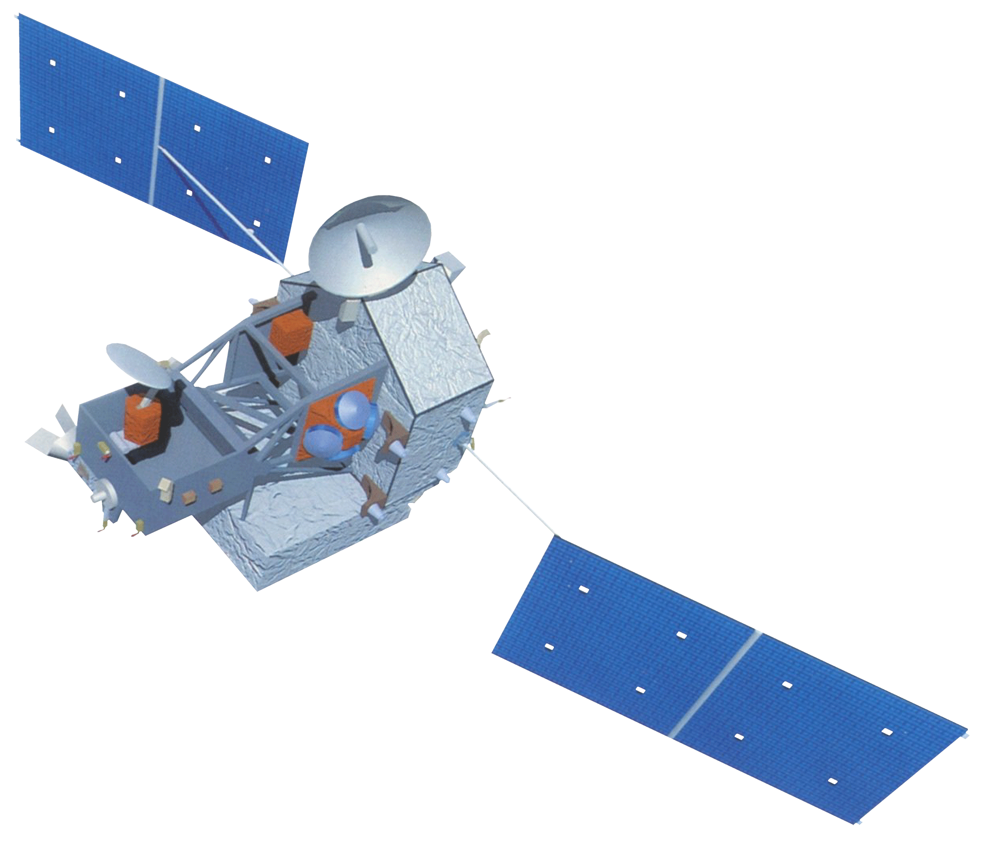
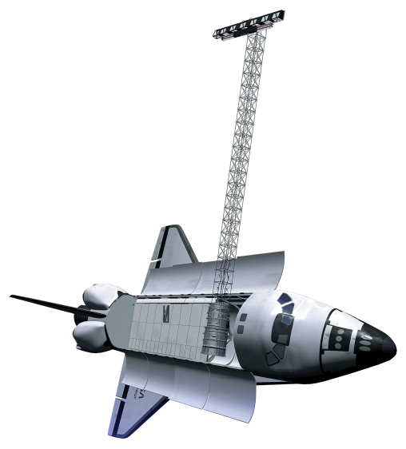
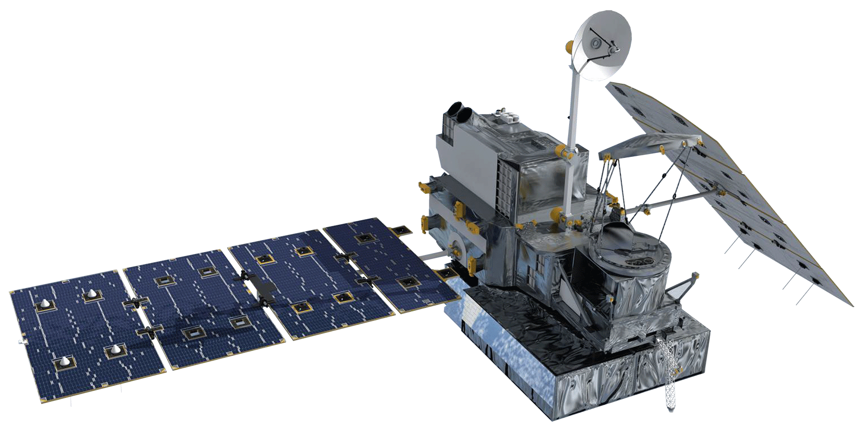
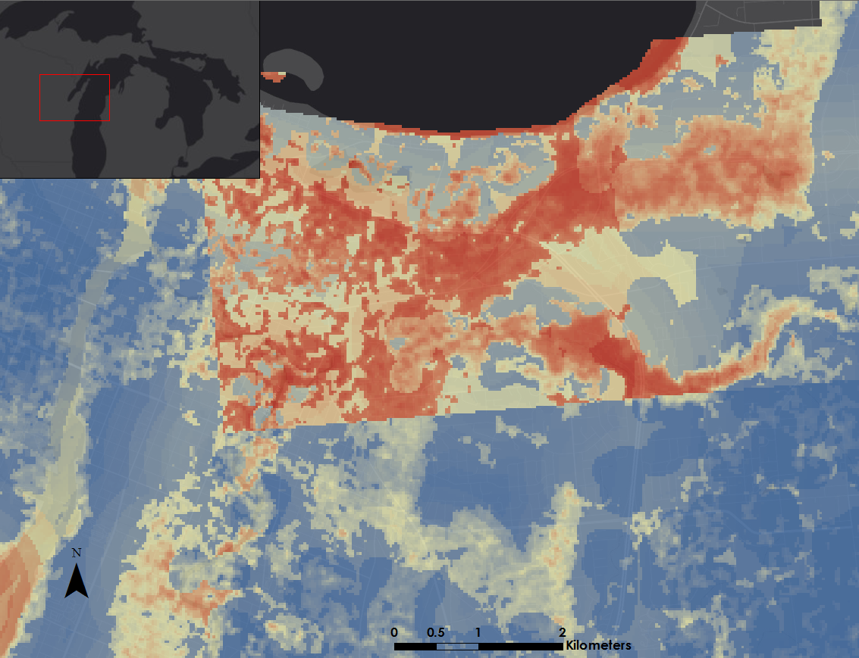
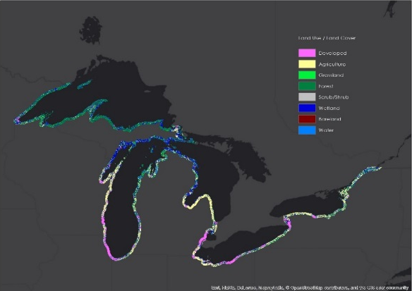
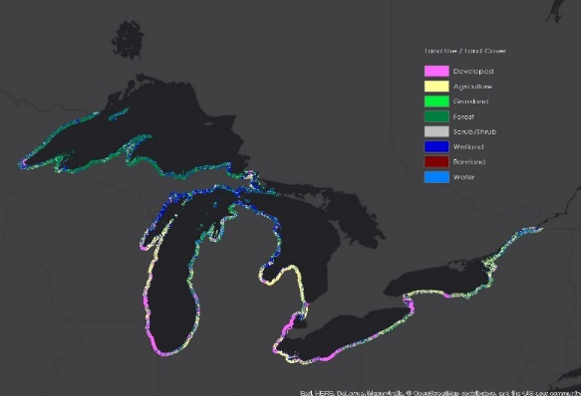

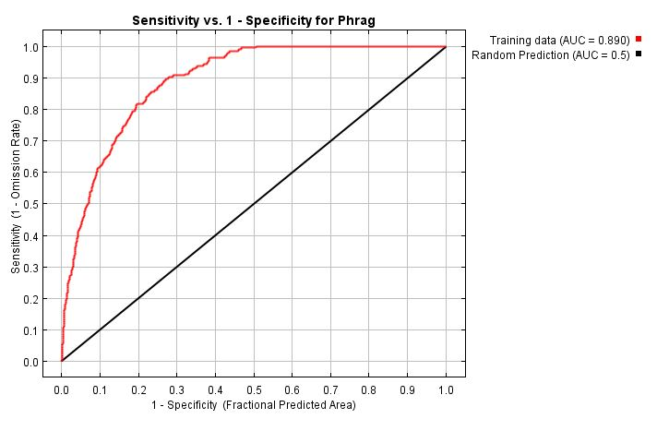
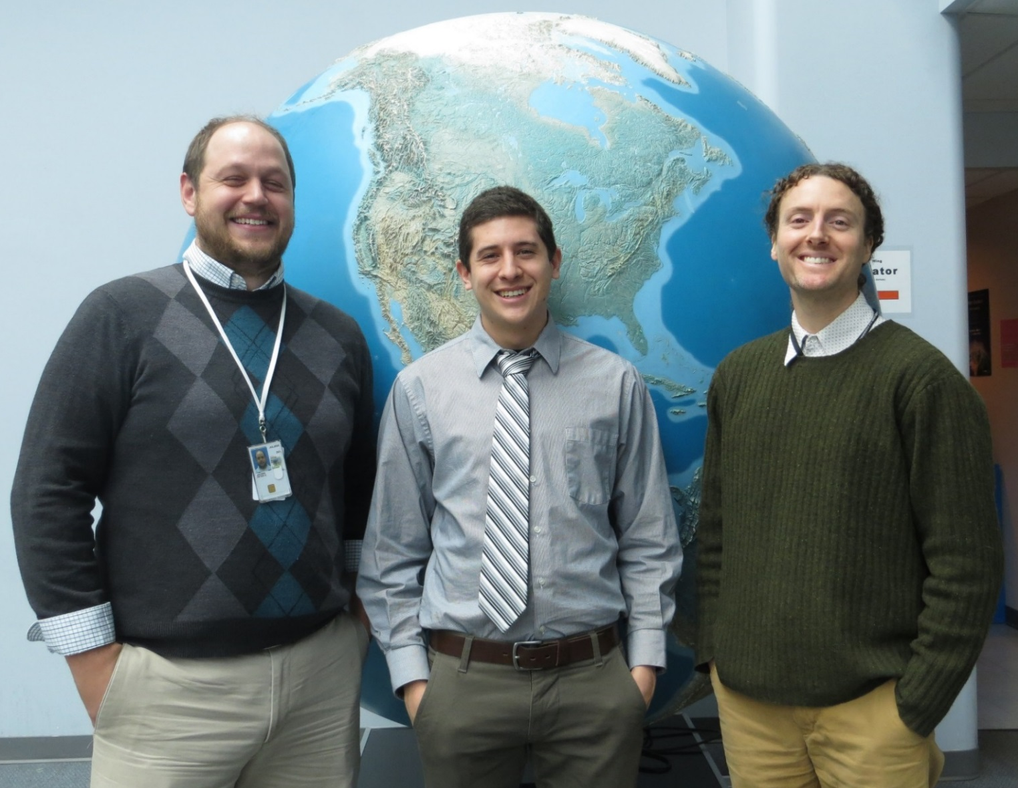
Great Lakes Ecological Forecasting
Utilizing NASA Earth observations to monitor and forecast the spread of Phragmites australis in the Great Lakes Basin
Issac Kinton (Project Lead), Sean McCartney, Peter Jacobs
DEVELOP National Program at NASA Goddard Space Flight Center
Abstract
Objectives
Phragmites australis is an invasive species that threatens wetland habitats in the Great Lakes and St. Lawrence River basin. Governments in both Canada and the United States recognize that Phragmites detection is the first line of defense in limiting the spread of this species. Left untreated, Phragmites australis outcompetes native regional wetland species, resulting in monotypic stands of invasive Phragmites. As a result, habitat for native fish and wildlife becomes unsuitable, fire risk grows, and elevation of the landscape increases due to an expansion of below-ground biomass, depriving wetlands of nutrients needed by native flora and fauna. Project goals included identifying relevant drivers of the extent of Phragmites and forecasting near-term Phragmites extent throughout the Great Lakes Basin. Research from this project will help the Great Lakes and St. Lawrence Cities Initiative in its goal to distribute Phragmites information to local policymakers in both the U.S and Canada. Earth observations (EO) utilized included Shuttle Radar Topography Mission (SRTM), Tropical Rainfall Measuring Mission (TRMM), and Global Precipitation Measurement (GPM). Ancillary datasets known to correlate with Phragmites were also used as model variables. Land use/land cover (LULC) maps were created using TerrSet Land Change Modeler. MaxEnt habitat suitability modeling used environmental variables and LULC classifications to forecast Phragmites habitat suitability extent through the year 2020. Forecasting results will help local governments to enact policies that plan for and mitigate the spread of Phragmites australis. Challenges and limitations included finding an alternative to mapping Phragmites using radar data, and acquiring current LULC maps of the study area.
Assess the value of Earth observations, and ancillary data, in creating environmental variables as inputs for habitat modeling
Model a current risk map of Phragmites australis for the 10 kilometer coastal zone within the Great Lakes and St. Lawrence River Basin
Model land change in the study area and use as driver variables for ecological forecasting
Forecast a risk map of Phragmites australis for 2020 for the 10 kilometer coastal zone within the Great Lakes and St. Lawrence River Basin
Methodology
Study Area
Datasets
Processing
MaxEnt
Coastal Area
Great lakes and St. Lawrence
Presence locations of Phragmites australis
Distance from Agriculture
Soil Drainage Class
Project
Distance from Developed
Topographical Roughness
Clip
Reclassify
Risk Modeling
Driest Period Temperature
Distance from Roads
Warmest Quarter Precipitation
Coldest Quarter Precipitation
Mosaic
Resample
Forecasting
Current Risk Map (MaxEnt 2010)
Land Change Modeler (TerrSet)
Future Risk Map (MaxEnt 2020)
Earth Observations
TRMM
SRTM
GPM
Results
MaxEnt 2010
MaxEnt 2020
Land Change Modeler
Project Partners
1985
2010
Great Lakes and St. Lawrence Cities Initiative
Michigan Tech Research Institute
Acknowledgements
2020
Laura Bretheim (Great Lakes and St, Lawrence Cities Initiative)
Simon Belisle (Great Lakes and St. Lawrence Cities Initiative)
David Ullrich (Great Lakes and St. Lawrence Cities Initiative)
Dr. Laura Bourgeau-Chavez (Michigan Tech Research Institute)
Dr. Kurt P. Kowalski (United States Geological Survey)
Emily Adams (DEVELOP)
Variable contributing most to model | Percent contribution
Topographic roughness | 28
Driest season temperature | 17.7
Coldest season temperature | 17.1
Soil drainage | 13
Distance from agriculture | 12.5
Team Members
Conclusions
Phragmites risk areas are increasing as time goes on due to forecasted land classification changes and favorable bioclimatic trends.
Phragmites presence is more heavily observed in areas closest to human activity.
Land change classifications such as agriculture or development will positively influence Phragmites expansion; therefore, policy makers should keep in mind that expansion of these lands will further increase Phragmites potential in their communities.
Left to Right: Peter Jacobs, Issac Kinton, Sean McCartney
NASA Goddard Space Flight Center

