Slide 1
Yellowstone
Ecological Forecasting II
Assessing Change in Aspen Extent
in Northern Yellowstone National Park
Vanessa Bailey
Ryan Brinton
Samantha Snowden
Aliza White
Georgia – Athens| Fall 2022
Notes:
Speaker:
Hello. Our project, Yellowstone Ecological Forecasting II, assessed change in aspen extent in northern Yellowstone National Park.
Everyone says hi/introduces themselves.

Slide 2
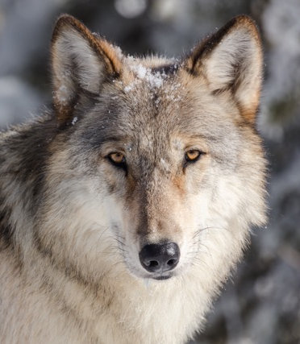
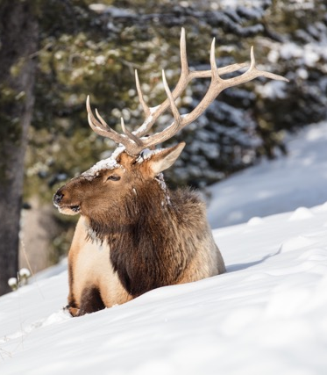
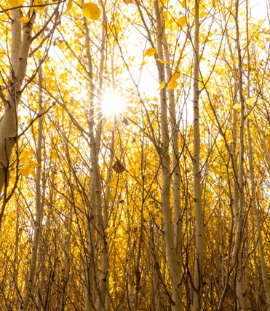
Trophic Cascade | Then
Image Credit: Jacob W. Frank, NPS
Notes:
Speaker:
For this project, the team was interested in seeing how aspen has changed from the 1950s to present. Yellowstone National Park has become a textbook example of the effects of a trophic cascade. In the 1900s, wolves were removed from Yellowstone National Park. Removal of wolves led to an increase in the elk population and therefore, increased browsing on aspen. Increased browsing on aspen led to a decrease in aspen extent, as new shoots were not able to reach maturity.
Image credit: NPS, Jacob W. Frank, flickr.com/yellowstonenps
Left: https://www.flickr.com/photos/yellowstonenps/38346221956/in/photolist-qKbSAp-eBRPo7-21vot86-2jj3uyw-21qwpPS-2jjGjFx-2i1K3f7-2i1HUZm-2jj3usE-qJXGgP-2jMSM2s-qsyQ4J-qK8evZ-pAWpv8-21voxUk-qsFgr4-2aAtHhk-qKbGgg-2i1Ft1D-2i1FJdT-2i1Fy13-2ifVeWV-e519ea-26W6C6E-pNmjzt-2i1Fwrw-X2kCgB-JrLJWM-qsGGwR-CXwoxi-pNaCnq-2ifVf29-qK3hXp-GbJLcw-qsy9zb-2hhM676-26W6ABN-26W6KgS-XywdZC-2ifVf3w-GbJxTd-RmbxRh-KW3vSv-qsybYE-TqZC81-2hhN4cP-2ifVf31-qK4jZi-GbJzaS-2i1K5oq
Middle: https://www.flickr.com/photos/yellowstonenps/32120313492/in/photolist-QWn19u-PVW674-2nWG2WZ-2nWH19p-jbJdHR-2nK3cmJ-jEGmWx-FVEuAi-Sd8m4A-cuL9iQ-EnQ3vP-jbK6jG-Gu66ZL-2hkV7A9-26LHXgg-Um1EqG-PVUUje-pa9KXX-pagSjJ-paKTB1-2myFDkq-zHc9gE-2nK2dJU-pvz9f8-WNjCM6-pmVdjp-oMiVR4-zJ8REf-289j4ZR-PHTZoD-oMi4XQ-cuKUJJ-2dLgS3L-p4KXGW-2jcBGPi-VSp2CE-q7ckDm-cuL9as-e16ZuM-dC2wn4-FL1Djb-FL1EkQ-2j6ySPR-2cqST2A-2j6uPx4-RHh5EN-PHTZzF-NdAXdV-CcrVbL-oMhWrr
Right: https://www.flickr.com/photos/yellowstonenps/48800394783/in/photolist-2mvowfg-28HeKut-pdZ6Py-2mwcTQn-2mCrP7G-2jPUaMi-2mCsXRk-2mwcXmq-2jJWu9K-2jPUaz4-2jJVDZC-TkciGa-2eDUehw-pymANX-2mvoxqY-2hmnini-ptrfwW-2hmmx9x-2hmjMbX-2mCsXMH-2jJWtvL

Slide 3
Trophic Cascade | Now
Image Credit: Jacob W. Frank, NPS
Notes:
Speaker:
Beginning in 1995, wolves were reintroduced to Yellowstone National Park. Wolves predated on elk, reducing their population, and changed their browsing patterns as well. Aspen could have the potential to regenerate following this change. Aspen regeneration resulting from this trophic cascade has been a question of interest from many, and this project seeks to contribute to that discussion by determining how aspen stands have changed between 1954 and 2021.
Image credit: NPS, Jacob W. Frank, flickr.com/yellowstonenps
Image credit: NPS, Jacob W. Frank, flickr.com/yellowstonenps
Left: https://www.flickr.com/photos/yellowstonenps/38346221956/in/photolist-qKbSAp-eBRPo7-21vot86-2jj3uyw-21qwpPS-2jjGjFx-2i1K3f7-2i1HUZm-2jj3usE-qJXGgP-2jMSM2s-qsyQ4J-qK8evZ-pAWpv8-21voxUk-qsFgr4-2aAtHhk-qKbGgg-2i1Ft1D-2i1FJdT-2i1Fy13-2ifVeWV-e519ea-26W6C6E-pNmjzt-2i1Fwrw-X2kCgB-JrLJWM-qsGGwR-CXwoxi-pNaCnq-2ifVf29-qK3hXp-GbJLcw-qsy9zb-2hhM676-26W6ABN-26W6KgS-XywdZC-2ifVf3w-GbJxTd-RmbxRh-KW3vSv-qsybYE-TqZC81-2hhN4cP-2ifVf31-qK4jZi-GbJzaS-2i1K5oq
Middle: https://www.flickr.com/photos/yellowstonenps/32120313492/in/photolist-QWn19u-PVW674-2nWG2WZ-2nWH19p-jbJdHR-2nK3cmJ-jEGmWx-FVEuAi-Sd8m4A-cuL9iQ-EnQ3vP-jbK6jG-Gu66ZL-2hkV7A9-26LHXgg-Um1EqG-PVUUje-pa9KXX-pagSjJ-paKTB1-2myFDkq-zHc9gE-2nK2dJU-pvz9f8-WNjCM6-pmVdjp-oMiVR4-zJ8REf-289j4ZR-PHTZoD-oMi4XQ-cuKUJJ-2dLgS3L-p4KXGW-2jcBGPi-VSp2CE-q7ckDm-cuL9as-e16ZuM-dC2wn4-FL1Djb-FL1EkQ-2j6ySPR-2cqST2A-2j6uPx4-RHh5EN-PHTZzF-NdAXdV-CcrVbL-oMhWrr
Right: https://www.flickr.com/photos/yellowstonenps/48800394783/in/photolist-2mvowfg-28HeKut-pdZ6Py-2mwcTQn-2mCrP7G-2jPUaMi-2mCsXRk-2mwcXmq-2jJWu9K-2jPUaz4-2jJVDZC-TkciGa-2eDUehw-pymANX-2mvoxqY-2hmnini-ptrfwW-2hmmx9x-2hmjMbX-2mCsXMH-2jJWtvL

Slide 4
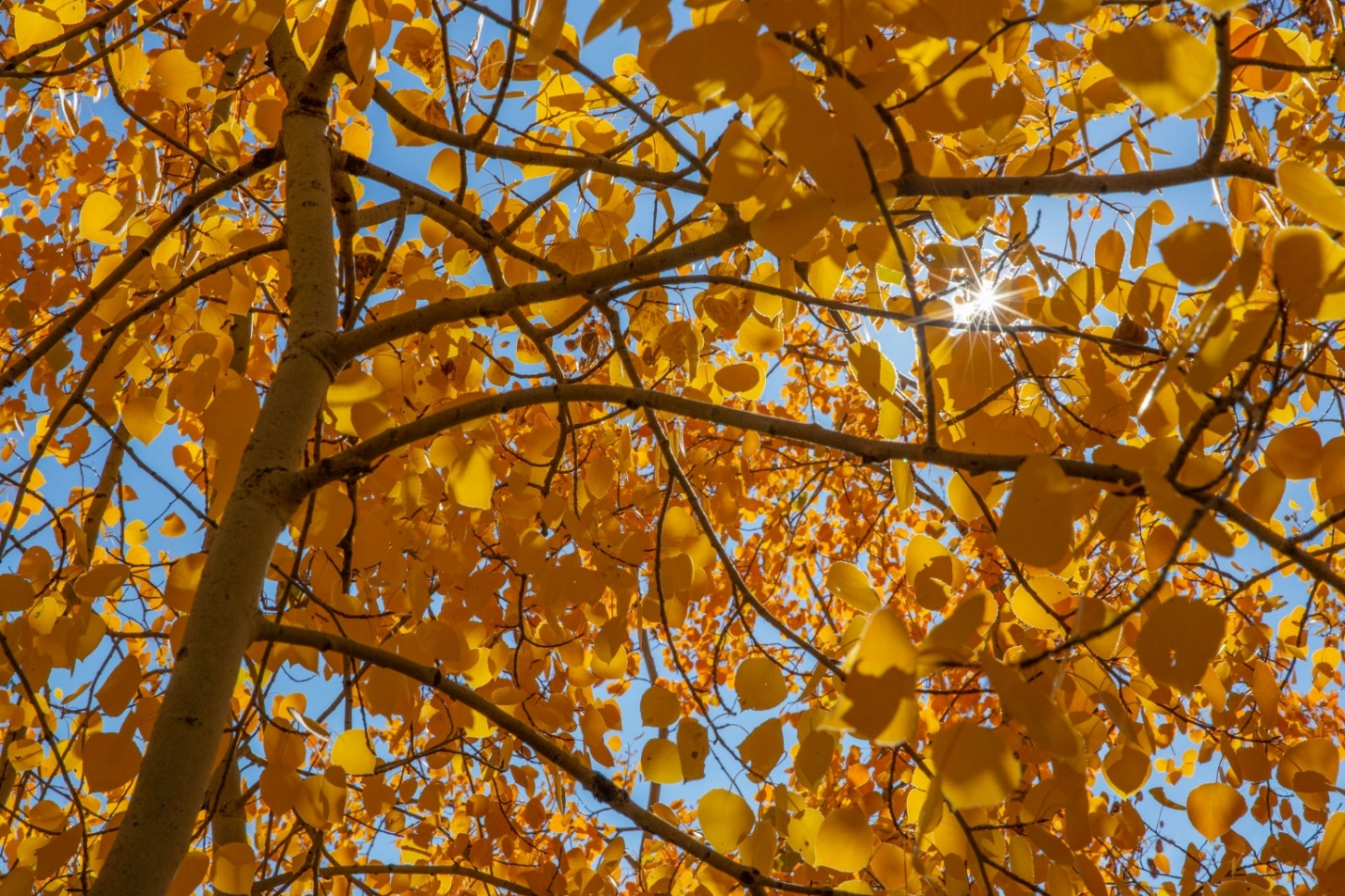
Community Concerns
Aspen supports
Biodiversity
Ecosystem health
Wilderness character
Tourism
Image Credit: Diane Renkin, NPS
Notes:
Speaker:
It is important to understand if aspen are recovering following wolf reintroduction because they play a valuable role in the ecosystems of Yellowstone National Park. Aspen promotes greater biodiversity, ecosystem health, wilderness character, and tourism, especially in terms of leaf color change. It is important to understand if aspen regeneration is occurring because if not, the decline could negatively affect Yellowstone's ecosystems.
Image credit: NPS, Diane Renkin, flickr.com/yellowstonenps
https://www.flickr.com/photos/yellowstonenps/51608258056/in/photolist-2mvowfg-28HeKut-pdZ6Py-2mwcTQn-2mCrP7G-2jPUaMi-2mCsXRk-2mwcXmq-2jJWu9K-2jPUaz4-2jJVDZC-TkciGa-2eDUehw-pymANX-2mvoxqY-2hmnini-ptrfwW-2hmmx9x-2hmjMbX-2mCsXMH-2jJWtvL

Slide 5
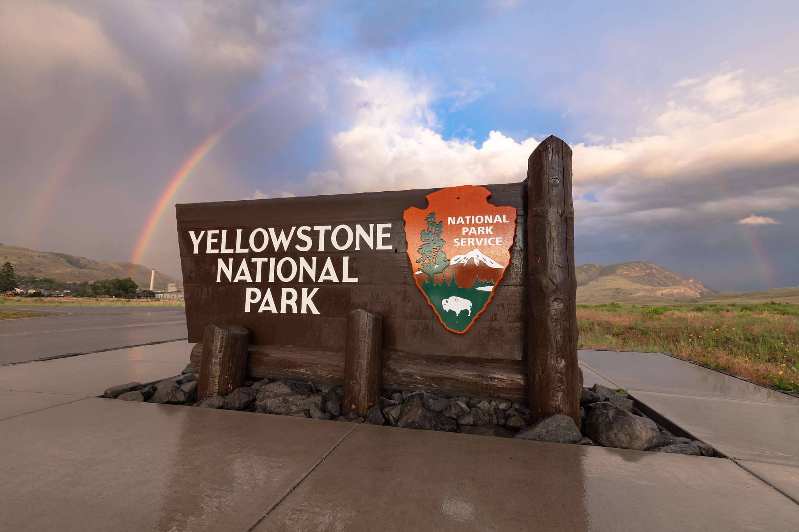
Partner Organizations
End User
Yellowstone National Park
Dr. Daniel Stahler, Wildlife Biologist
Collaborators
Utah State University
Dr. Daniel MacNulty, Professor
Nicholas Bergeron, Researcher
University of Wisconsin – Stevens Point
Dr. Eric Larsen, Professor
Image Credit: Jacob W. Frank, NPS
Notes:
Speaker:
The partners that are interested in the results of this work are the following:
The end user for this project is Yellowstone National Park, where we’ve been working with Dr. Daniel Stahler, a wildlife biologist. Our other collaborators are Dr. Daniel MacNulty and his student, Nicholas Bergeron at Utah State University, as well as Dr. Eric Larsen at the University of Wisconsin – Stevens Point. All have been interested in the trophic cascades driven by wolf dynamics and how they affect aspen in the park.
Image credit: NPS, Jacob W. Frank, flickr.com/yellowstonenps
https://www.flickr.com/photos/yellowstonenps/48266789916/in/photolist-2gxaV43-e511rp-2h6X4R6-r9Q4tM-2nuMMsZ-2iHAJ8m-qw9i7S-2mby9Yf-2jgJFbM-XuRW3f-2mbH6RU-2mbBWPM-2mbya7r-2jgNUyE-2h6X34y-2mbBVCy-2hyVpkk-2mbH6JQ-21T1wK1-2hyZbNY-2hh3Htb-XuRV4S-2meikPc-n16aSn-2m8RWu9-2jMRXBG-MXPj3h-2jgMyKH-rqkdKy-2aCcr68-2mePAww-2baBnja-25L1eF7-2meYBnp-2iHDsL1-2mKJcwi-2irHLny-2mKNhVW-2haA9a5-2irLqh5-NNa894-22Xx2Jt-2myaAiz-2irHJgE-M1xqUV-Dj4Uai-L8sQhq-TqW4Fy-2irLqE9-2jcBHMf

Slide 6
Project Objectives
Evaluate 1954 aspen extent from historical imagery
Refine analysis of aspen extent in 2021
Generate maps and comparison tables to quantify and visualize changes in aspen extent over time
Notes:
Speaker:
There were 3 primary objectives for this project. First, building off the summer 2022 term’s analysis, we evaluated aspen extent in 2021 in order to refine their analysis and take the most recent changes into consideration. We also evaluated 1954 aspen extent using historical aerial imagery. Finally, we used these analyses to create maps and comparison tables to visualize and quantify these changes.
Image credit: Office 365/Powerpoint Icons

Slide 7
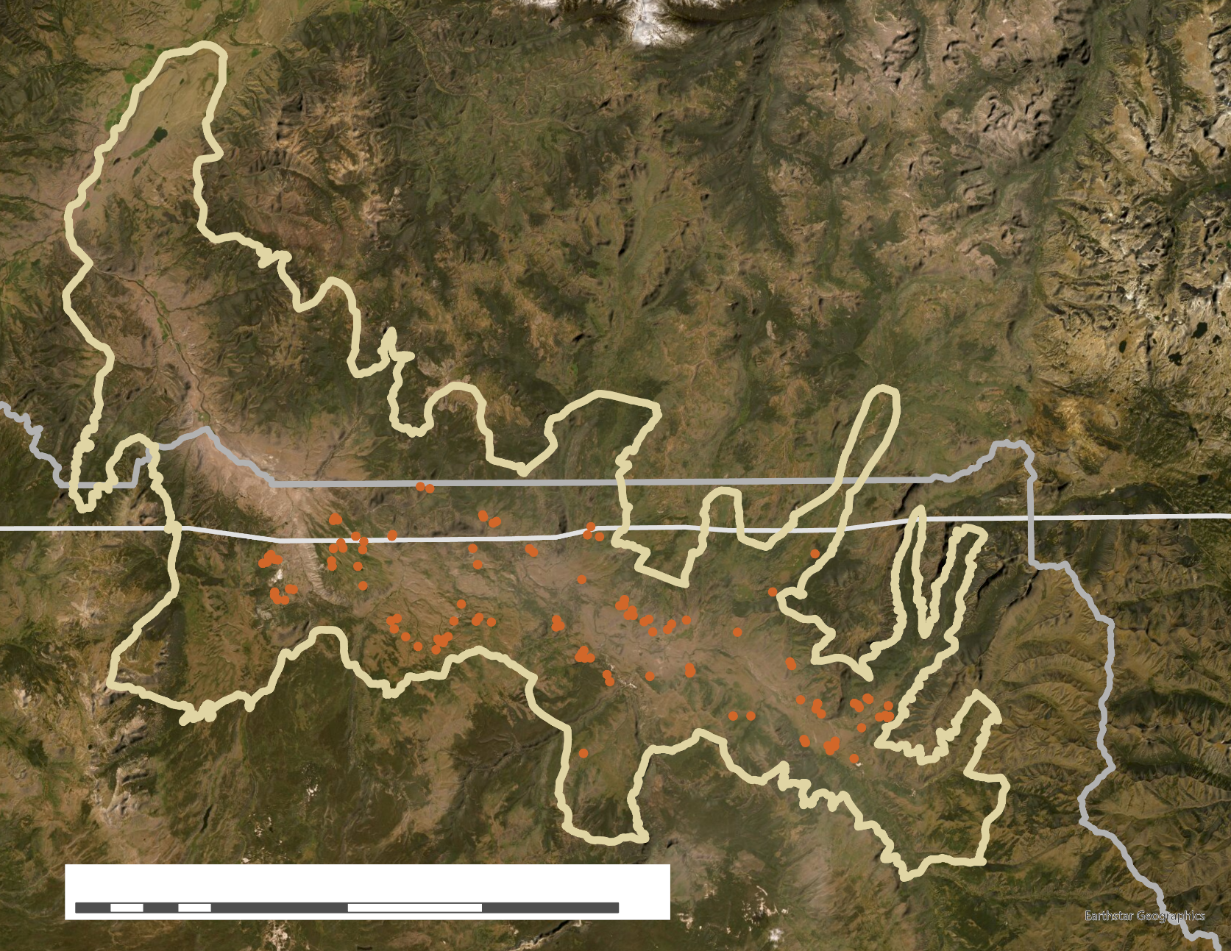
Study Area
N
Belt Transect
Elk Wintering Range
Yellowstone National Park
Montana
Wyoming
0 5 10 20 30 40
km
Notes:
Speaker:
Our analyses were focused on the study area shown here. This is a map of the northern elk wintering range that extends beyond northern Yellowstone National Park into southern Montana. Belt transects, shown in orange, have been monitored for aspen presence and health since 1999 and became the areas of focus within the range. Our focus for the 1954 imagery was on the 113 belt transects, while the 2021 analysis focused on the entire elk wintering range.
Image credit: Esri basemap – Earthstar geographics

Slide 8
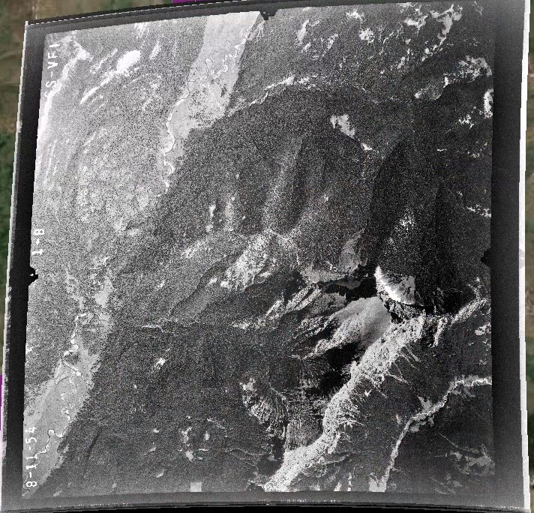
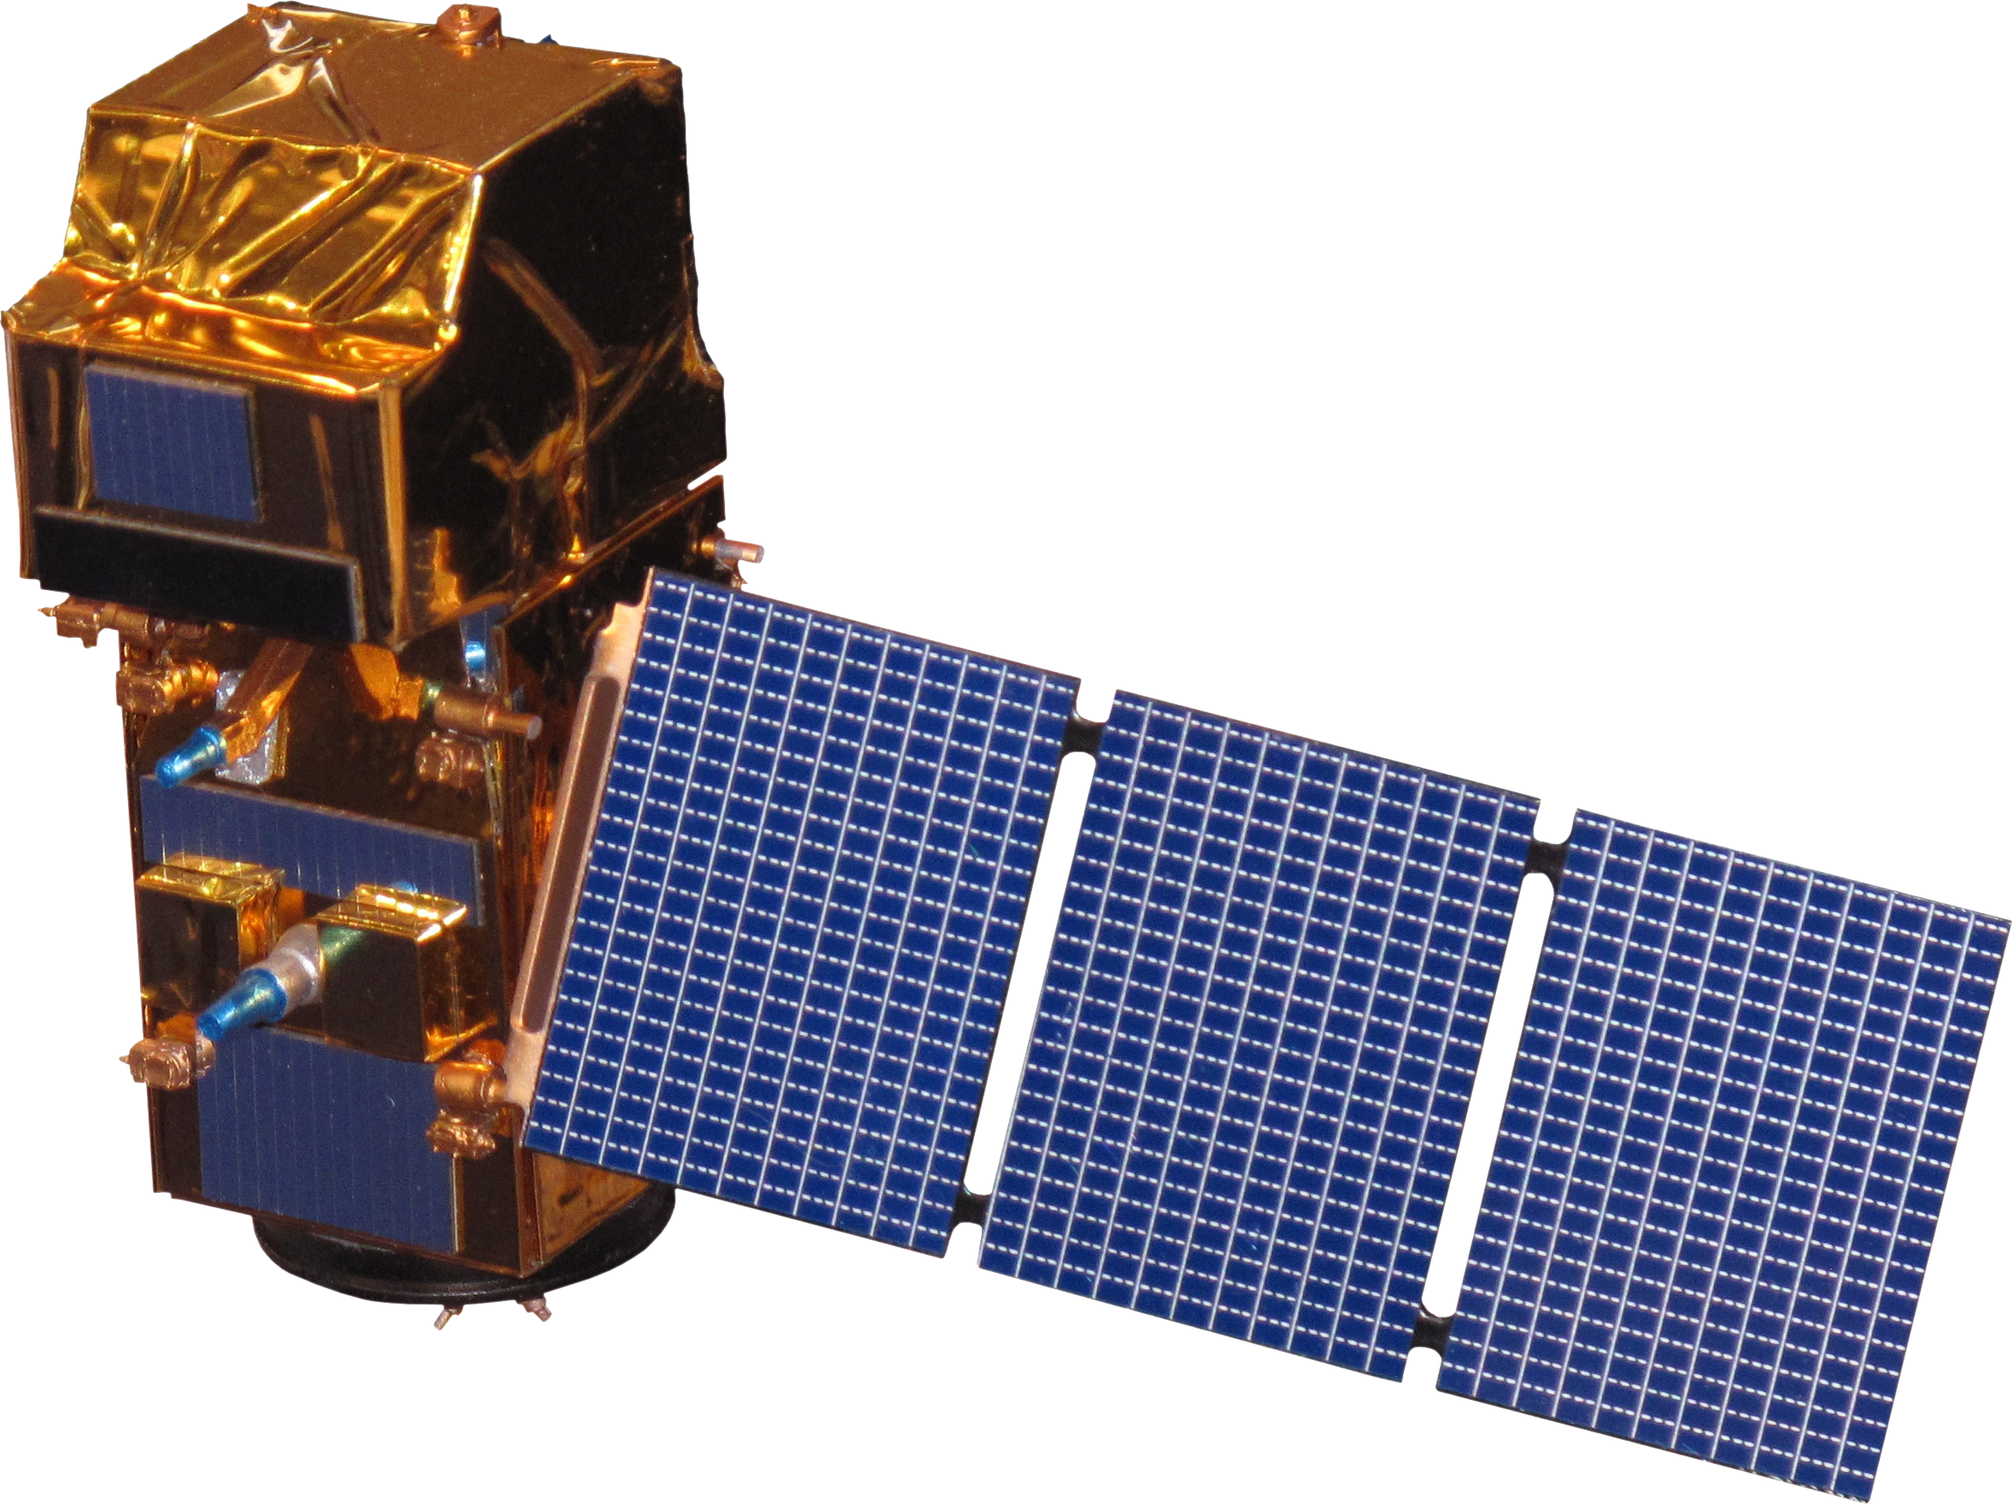
Data
Aerial Image
1954:
Aerial photography single frames
2021:
Landsat 8 OLI
Sentinel-2 MSI
Other:
PlanetScope
Land cover point data
Landsat 8 OLI
Sentinel-2 MSI
Image Credit: USGS, NASA
Notes:
Speaker:
For our 1954 analysis, we used historical aerial imagery at a scale of 37400:1 taken on September 24, 1954, downloaded from USGS EarthExplorer. For 2021, we obtained both Landsat 8 OLI and Sentinel-2 MSI data in Google Earth Engine and compared differences in spatial resolution. High-resolution 2021 PlanetScope imagery was used to identify landcover point data for several different classes, including aspen and conifer. The landcover point data was used in our random forest classification as well as to inform NDVI change in the phenological approach.
Image credit: USGS, https://earthexplorer.usgs.gov/
NASA, https://www.devpedia.developexchange.com/

Slide 9
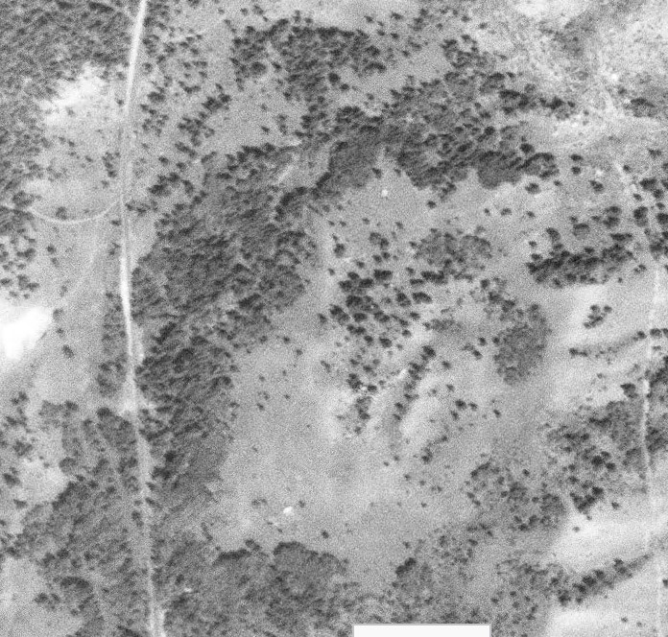
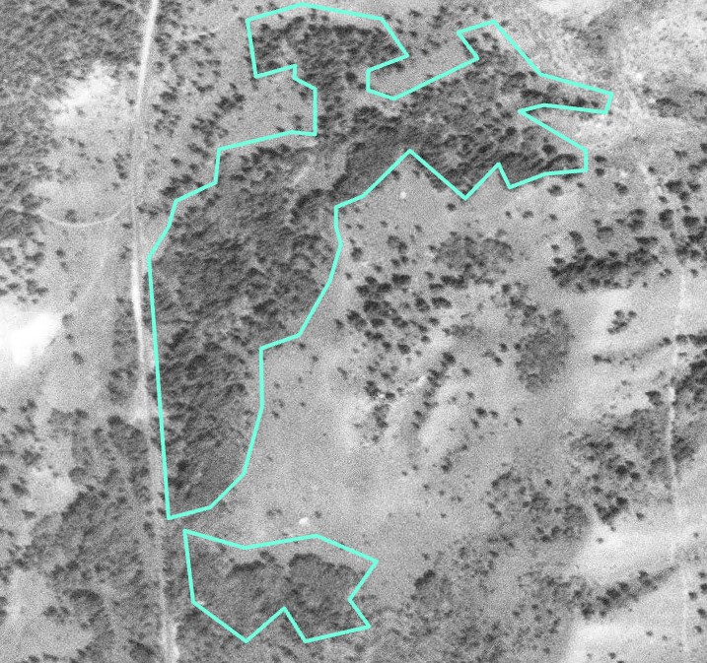
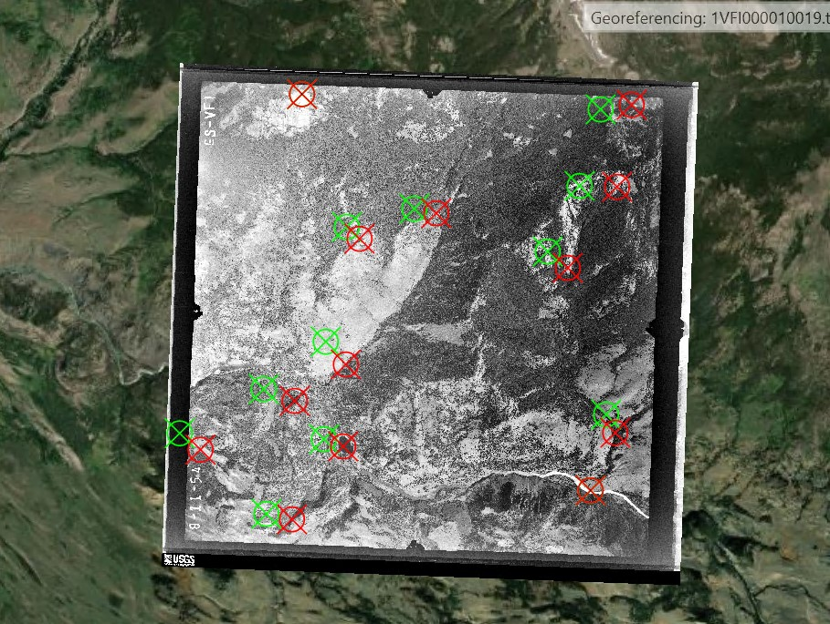
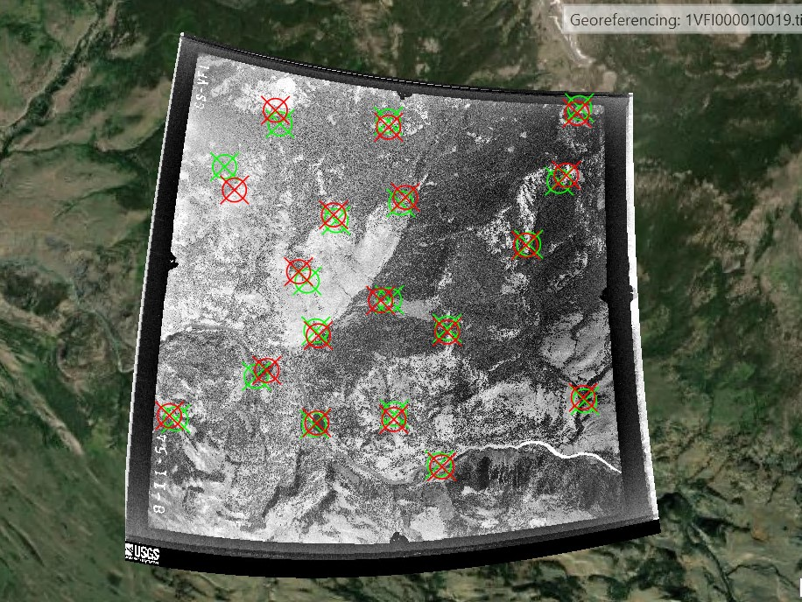
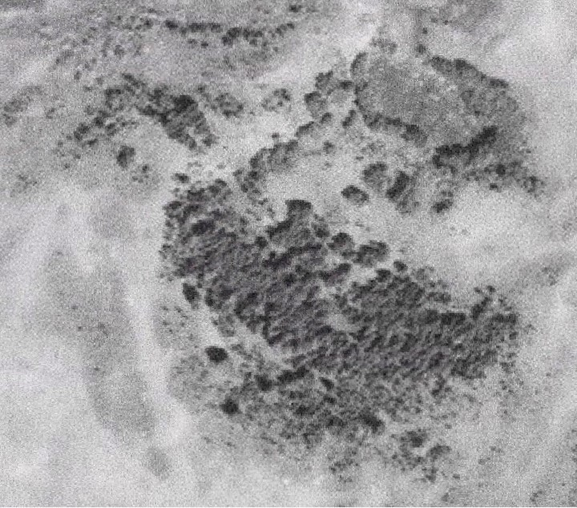
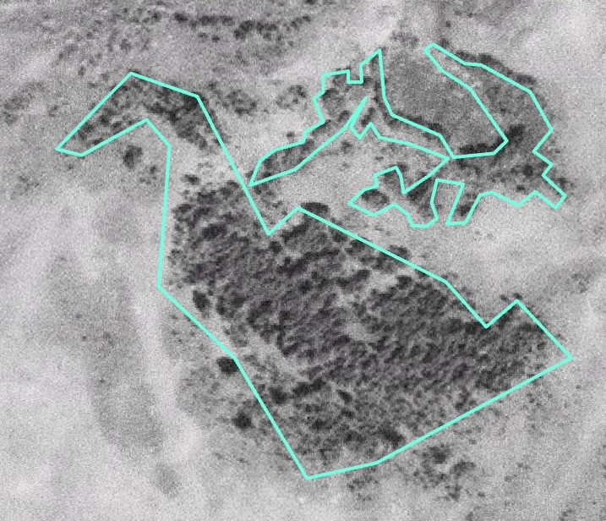
Methodology | 1954
Georeferencing
Digitization
Notes:
Speaker:
For the 1954 analysis, we downloaded aerial photography taken on September 24, 1954, from USGS EarthExplorer. Then, using ArcGIS 3.0.2, we georeferenced the imagery with control points of static land features (e.g., ridges), using 2019 NAIP imagery as the reference layer. Following that process, we digitized stands around the 113 belt transects provided by the partners. These images show examples of how the imagery looked pre- and post- georeferencing as well as pre- and post- digitization.

Slide 10
Methodology | 2021 Random Forest
Predictors
Classes
Predictors
Training Data
Red, green, and blue bands
Shortwave infrared
Near infrared
Normalized Difference Vegetation Index (NDVI)
Enhanced Vegetation Index (EVI)
Tasseled Cap Brightness (TCB)
Tasseled Cap Greenness (TCG)
Tasseled Cap Wetness (TCW)
Elevation, slope, and aspect
Aspen
Bare ground
Conifer
Cottonwood
Grass
Shrub
Water
Willow
Classification
Validation
Notes:
Speaker:
Our next goal was to classify aspen stands in recent satellite imagery to compare to historical aspen extent. The two approaches we utilized for analysis of 2021 imagery were based on a random forest model and changes in phenology. For the random forest approach, we used predictors of different satellite bands and derived indices, such as NDVI, as well as partner provided landcover points to train the model. On the left, we have all our predictor variables listed. Training data was provided by partners, who have thorough knowledge of the landscape and marked points representative of landcover type using satellite imagery in ArcGIS Pro. A complete list of classes they provided is listed on the right. The resulting classification was then validated against the landcover points not used in the original model.

Slide 11
Methodology | 2021 Phenology
NDVI Equation
NDVI Thresholds
Summer NDVI
Fall NDVI
NIR – RED
NIR + RED
Landsat 8
Deciduous = 0.2
Sentinel-2
Deciduous = 0.35
Difference
Validation
Notes:
Speaker:
For the phenology approach, we calculated the normalized difference vegetation index (NDVI) for both the summer and fall 2021 imagery. On the left is the NDVI equation, which is a ratio of red to near infrared reflectance that serves as an index for healthy vegetation. Deciduous species, like aspen, show a much greater change in NDVI with their leaf color change in the fall compared to evergreen species, which have a relatively stable NDVI. These images were subtracted, and areas were classified as deciduous or not based on the amount of change in NDVI from summer to fall. On the right are the thresholds that we used to distinguish deciduous vegetation from other land cover types, which was validated against the landcover points provided by the partners.
Then, we looked at where the classification overlapped from both approaches in order to have greater confidence in the results.

Slide 12
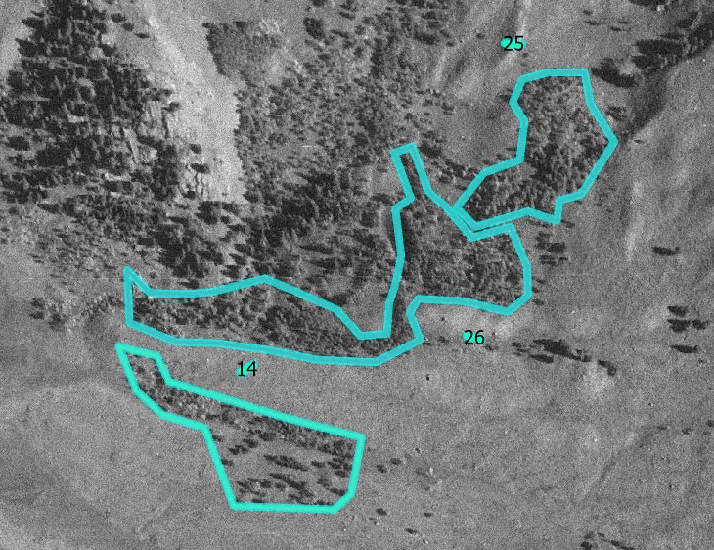
Results | Example Stand
Aerial Imagery
1954
Notes:
Speaker:
This image shows an example of digitization results for 1954 aerial imagery. Three stands of various shape and size are shown that correspond with different monitored belt transects within the greater study area. The 1954 analysis focused on 113 specific stands.

Slide 13
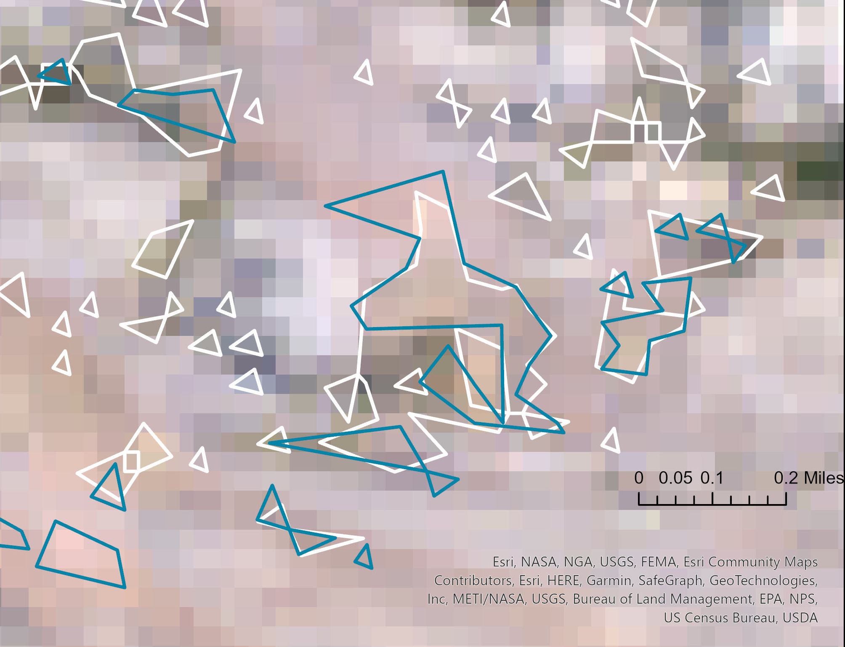
Results | Example Stand
Landsat 8
2021
Phenology
Random Forest
Notes:
Speaker:
Those same stands are shown using a 2021 fall Landsat 8 true color image. The blue outline indicates the delineation from the phenological method while the white indicates the random forest results. Landsat 8 has a 30 m resolution which strongly influences these outputs. For 2021, we looked at the entire elk wintering range.

Slide 14
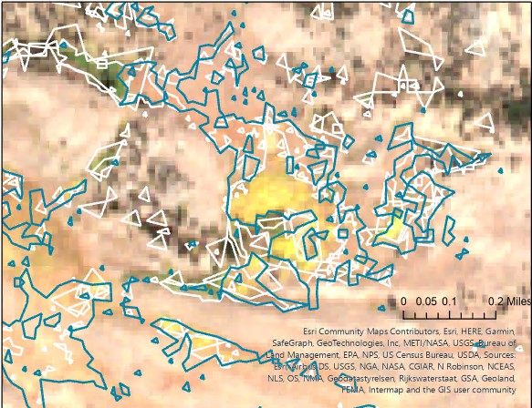
Results | Example Stand
Sentinel-2
2021
Phenology
Random Forest
Notes:
Speaker:
Again, this image shows 2021 outputs for random forest and phenology but using Sentinel-2 data to produce results. Sentinel-2 bands have 10 or 20 m resolution; a qualitative assessment shows improved results as compared to Landsat 8 . Area with overlap has even greater confidence in aspen likelihood since both suggest aspen presence there.
Due to georeferencing limitations of the 1954 imagery, it was difficult to compare 1954 to 2021, especially at the different scales that were being examined. Random forest is advantageous for classifying land cover with accurate training points, while the phenological approach does not require them. However, random forest can target aspen more specifically, while phenology is more at the level of deciduous species. Used in combination, the two approaches can build confidence in areas that are likely aspen. Sentinel 2 helps improve results since the finer resolution is closer to the size of aspen stands resulting in finer detail that is lost with Landsat 8 (i.e., other landcover types influencing aspen areas when the scale is coarser).

Slide 15
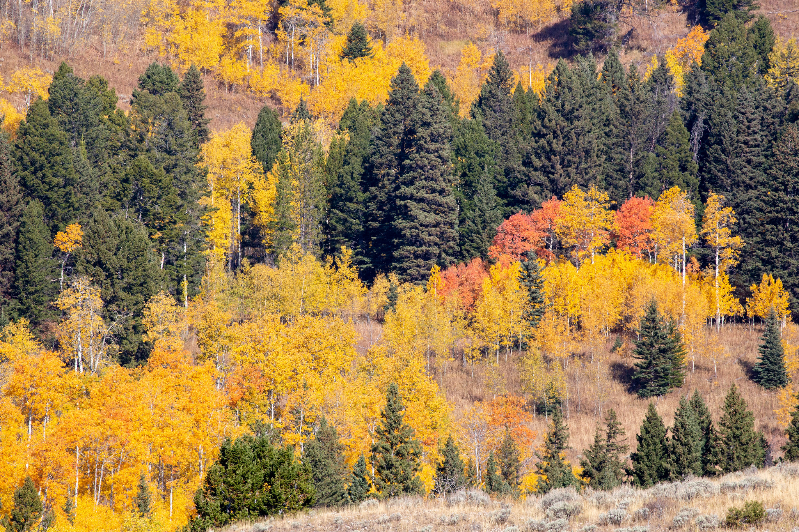
Limitations
Imprecise georeferencing
Subjective georeferencing and digitization
Coarse imagery resolution compared to aspen stand size
Availability of imagery
NDVI calculation and classification
Image credit: Diane Renkin, NPS
Notes:
Speaker:
There were a few limitations in our analysis. To do the georeferencing, we relied on features that remained unchanged over the large time gap between the historical imagery and the reference imagery, but inherent changes in other areas of the terrain limited the accuracy of georeferencing. Also, the outputs of the random forest and phenological approach can be sparse/scattered as seen in the images, which again makes it difficult to determine stand extent for comparison between 1954 and 2021.
In addition, the 30-meter spatial resolution of Landsat 8 imagery can potentially result in over- or underestimations of aspen extent since the pixels are influenced by other landcover types.
Regarding NDVI, our calculation is based on available imagery, which may not reflect the ideal times of peak greenness and senescence due to revisit time and cloud cover issues. Additionally, using one threshold for NDVI change could misclassify deciduous plants since aspen stands can be found in different microclimates.
Image credit: Diane Renkin, NPS flickr.com/yellowstonenps
https://www.flickr.com/photos/yellowstonenps/50425001591/in/photolist-2jPTjca-2kyDrXf-2jPUapj-2jJWu9K-2mnEdCH-2hXHiY2-2k5ggY1-2kgXbWB-VzPotw-2mw892j-2kmvkRT-2k5gg5H-2kmzLV6-2kh2oSB-2jPUaEp-2jPUaz4-2mnEg18-2mw9qi7-2mCrP7G-2kmZvtM-GEXzYa-2mMMvKv-2is8Z6K-2kyE7GW-2jJVDZC-HTDvxC-2kh1Xma-VUN773-2h73Esw-2mCsXMH-2hkM1zd-2mMMvXe-2jPUaMi-2kh2o1X-2kh2nTT-2mvpFiF-2mw89kf-2hXHiWd-2kgXc8i-2mwcT3f-2gEz2Q1-2jJVEqs-2kyDrsC-2is98bY-Ka6DVv-25JaUVL-2kh1XYH-2jjDm9f-2mMQCrx-CHNmbU

Slide 16
Future Work
Other factors affecting aspen stands
Location of die-off or regeneration
Specific bands to identify aspen stands
Other deciduous species trends
Notes:
Speaker:
Several other research questions could be analyzed with the methodology used in this project. For example, another team could investigate if aspen in Yellowstone are affected not only by elk browsing, but by changes in temperature, moisture, and fire regimes as well as other biotic controls. The locations of die-off and regeneration could also be explored further to see if south- and west-facing slopes are more vulnerable as has been found elsewhere. In terms of identification of aspen, specific bands and indices could be utilized to see if the aspen signature within hyperspectral imagery is distinguishable from other landcover types. Finally, further analyses could focus on other deciduous species in the region, like cottonwood and willow, to see if the trend applies to all deciduous species or aspen alone.
Image credit: Office 365/Powerpoint Icons

Slide 17
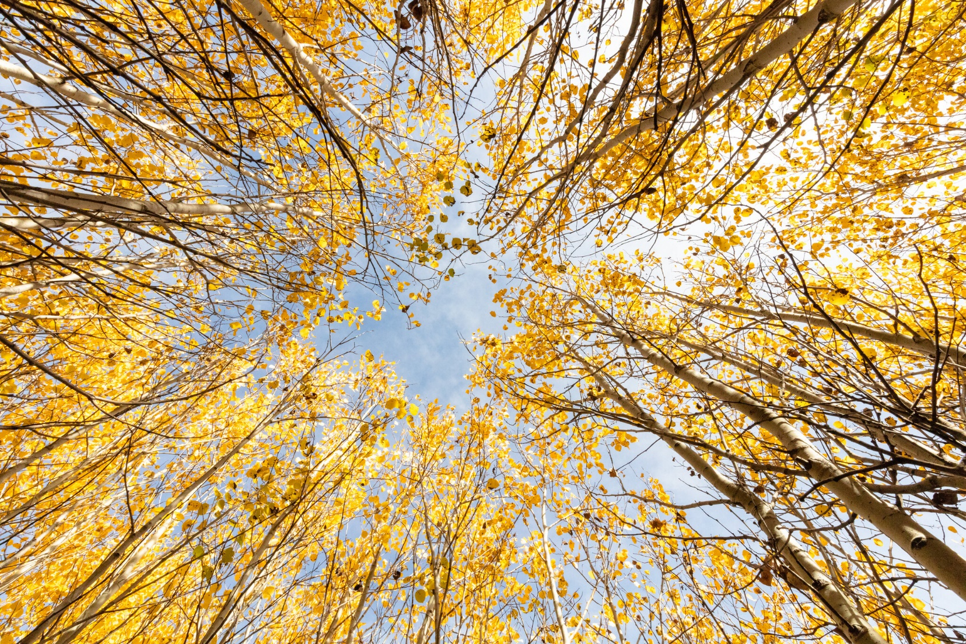
Conclusions
Remote sensing provides new insights into wolf-elk-aspen dynamics
Aspen within the 113 stands generally decreased between 1954 and 2021
Potential to inform rewilding decisions
Image Credit: Jacob W. Frank, NPS
Notes:
Speaker:
This project has provided our partners with numerous opportunities to explore how remote sensing can be used to study aspen in the context of trophic cascades in Yellowstone National Park. Our results indicate a general INCREASE/DECREASE in aspen extent across the area we analyzed. These results provide context on the role of wolves in aspen regeneration, and more broadly demonstrate how rewilding decisions may drive ecological change at the landscape scale.
Image credit: NPS, Jacob W. Frank, flickr.com/yellowstonenps
https://www.flickr.com/photos/yellowstonenps/48800886527/in/photolist-2mvowfg-28HeKut-pdZ6Py-2mwcTQn-2mCrP7G-2jPUaMi-2mCsXRk-2mwcXmq-2jJWu9K-2jPUaz4-2jJVDZC-TkciGa-2eDUehw-pymANX-2mvoxqY-2hmnini-ptrfwW-2hmmx9x-2hmjMbX-2mCsXMH-2jJWtvL

Slide 18
Partners
Dr. Daniel Stahler, Wildlife Biologist
Yellowstone National Park
Dr. Eric Larsen, Professor
University of Wisconsin – Stevens Point
Dr. Daniel MacNulty, Professor
Utah State University
Nicholas Bergeron, Researcher
Utah State University
Science Advisors
Dr. Marguerite Madden
University of Georgia, Center for Geospatial Research
Joseph Spruce
Science Systems and Applications, Inc.
Special Mention
NASA DEVELOP National Program
Sarah Payne, Fellow
Kyle Steen, Gabriella Boodhoo, & Barry McLaughlin, Summer 2022 Participants
Dr. Kunwar Singh, Summer 2022 Science Advisor
William & Mary, AidData & Global Research Institute
Yellowstone National Park
Jake Frank, Addy Falgoust, & Ashton Hooker, Social Media Team
This material contains modified Copernicus Sentinel data (2021), processed by ESA. ​
Notes:
Speaker:
We would like to thank our wonderful partners, science advisors, fellow, and past contributors who helped make this project what it is today.

