Slide 1
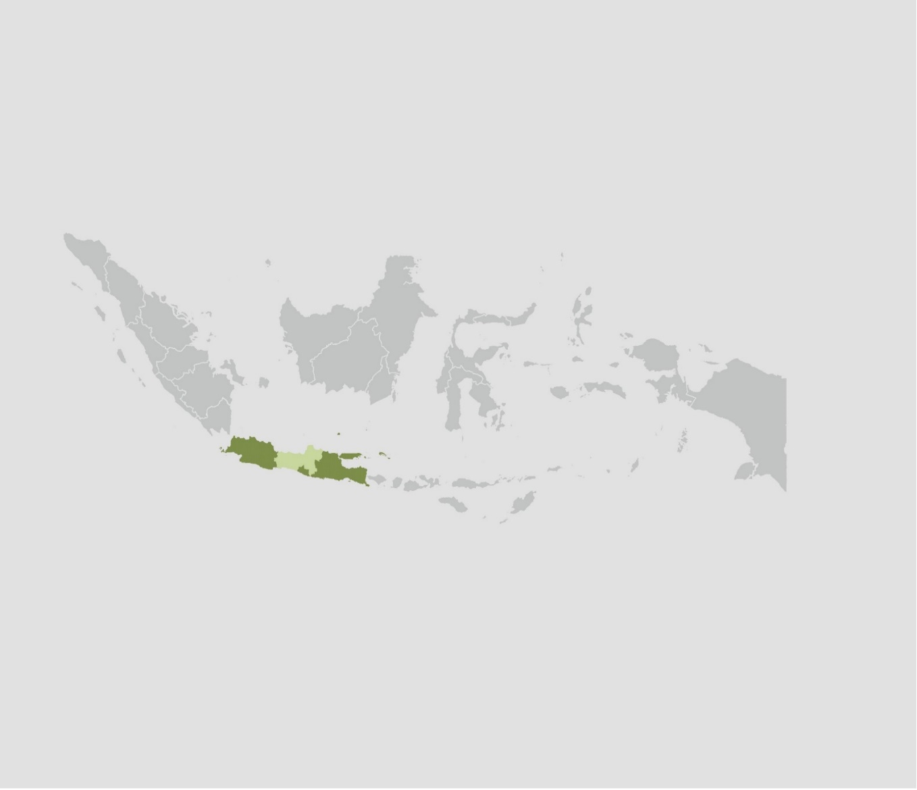
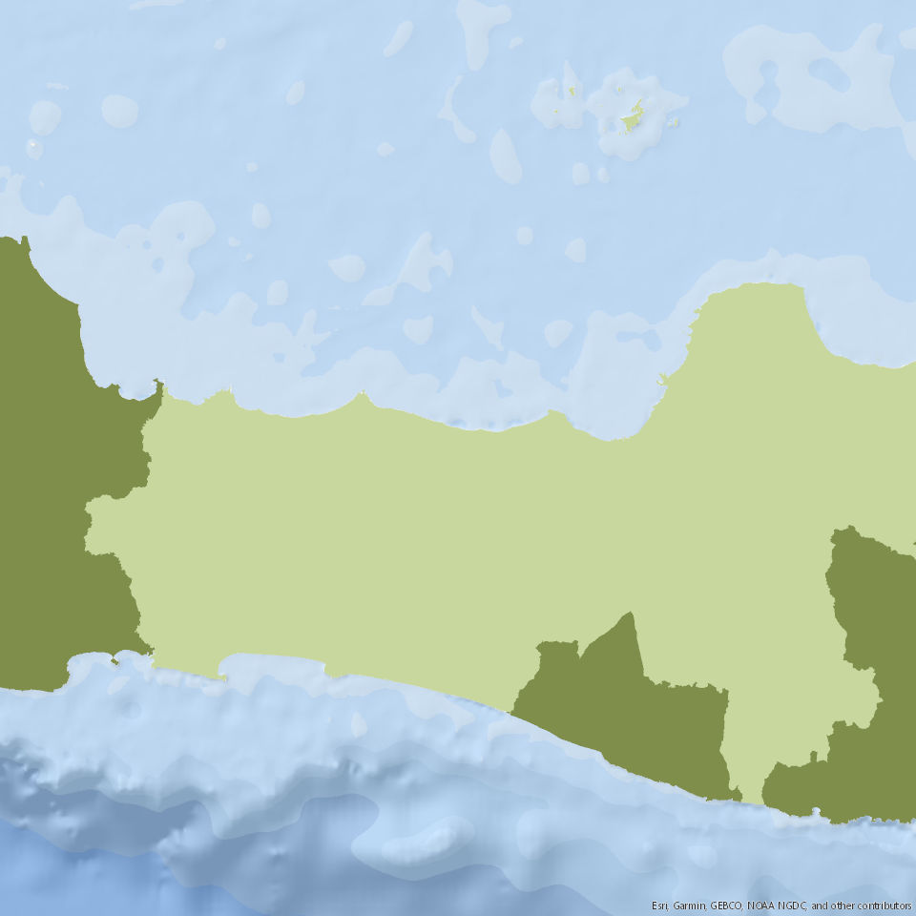
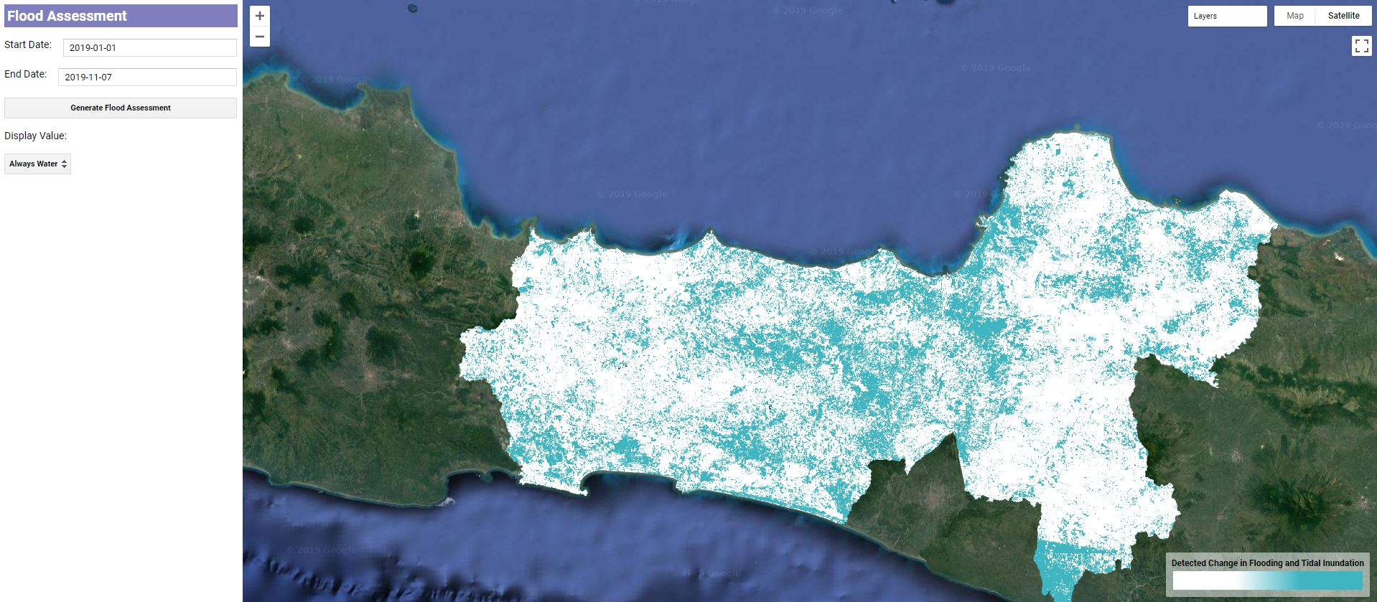
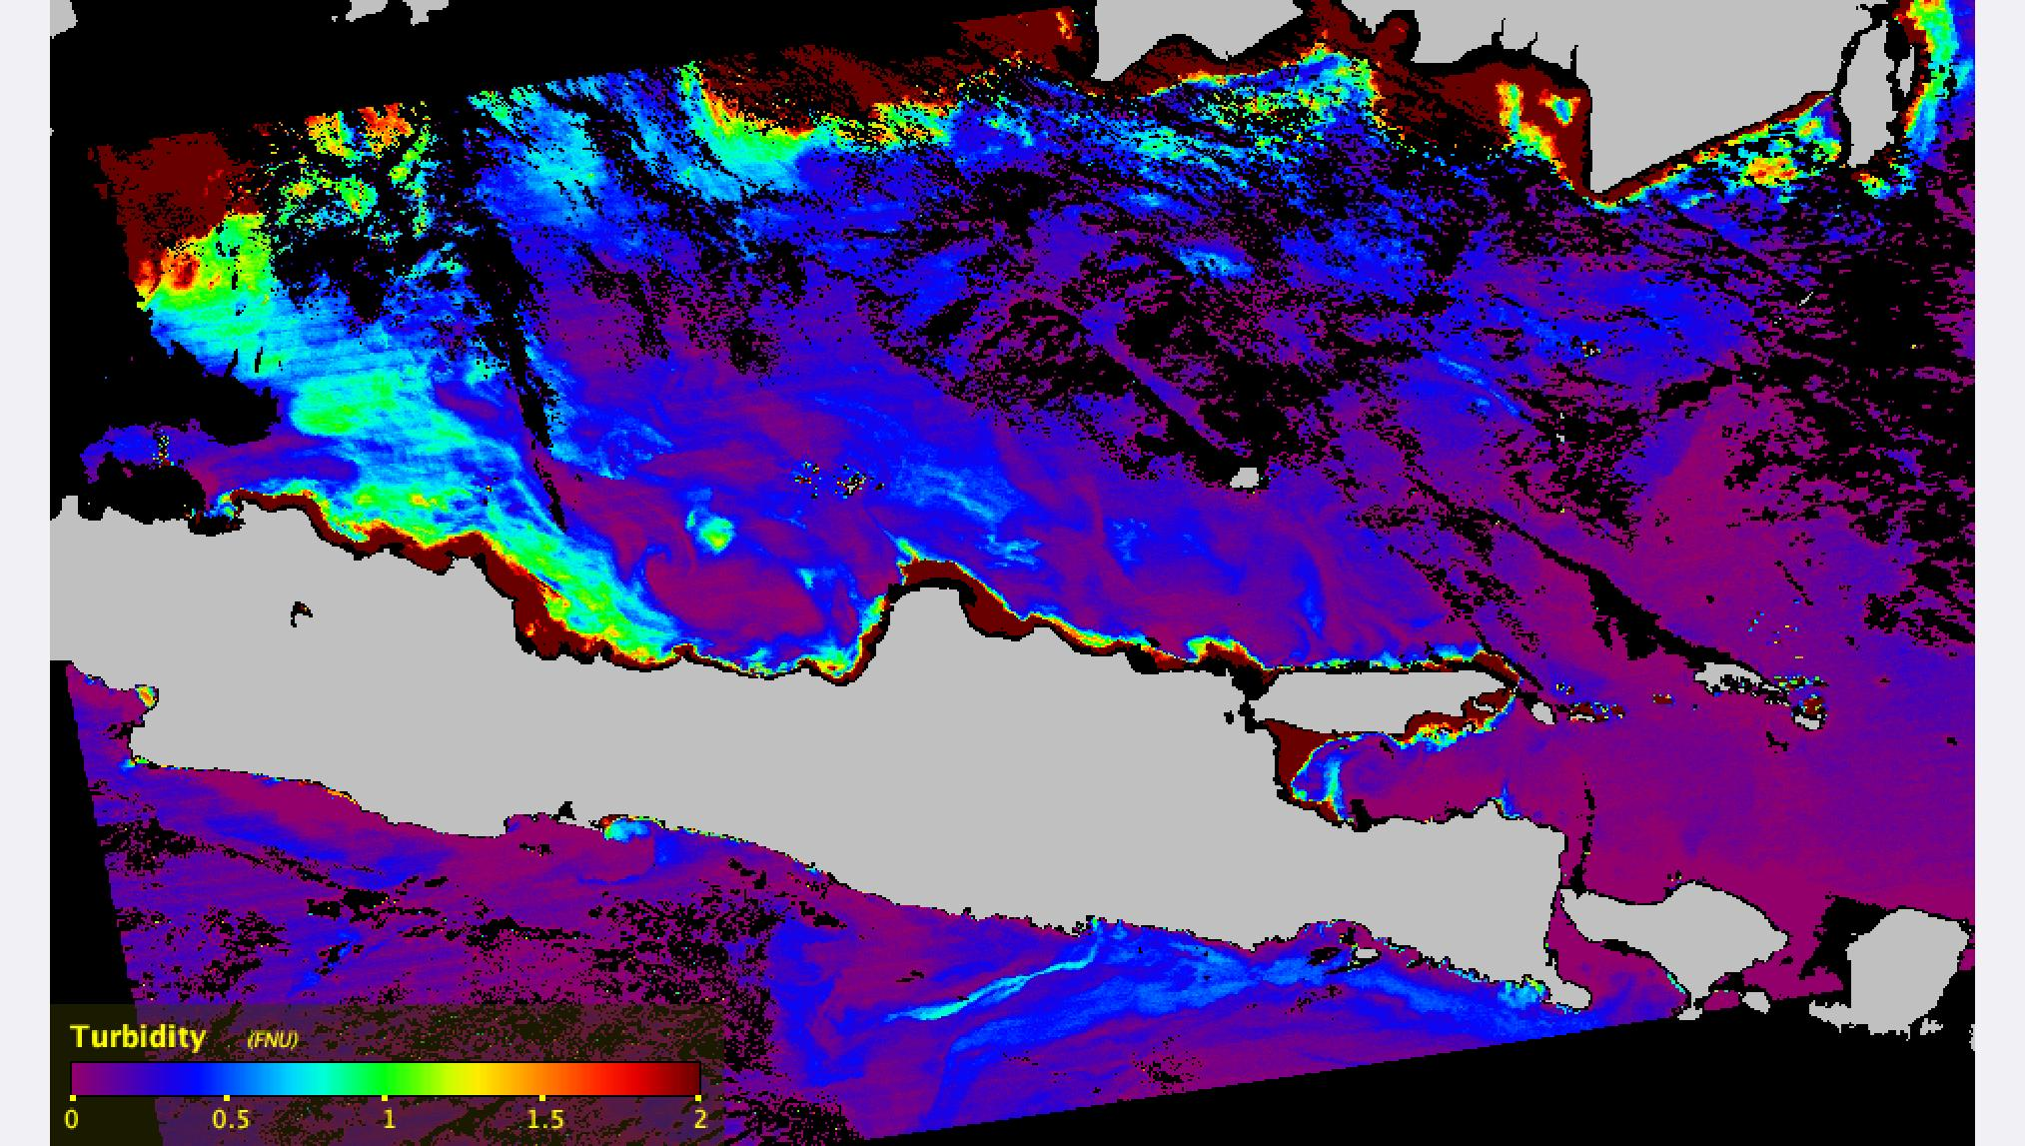
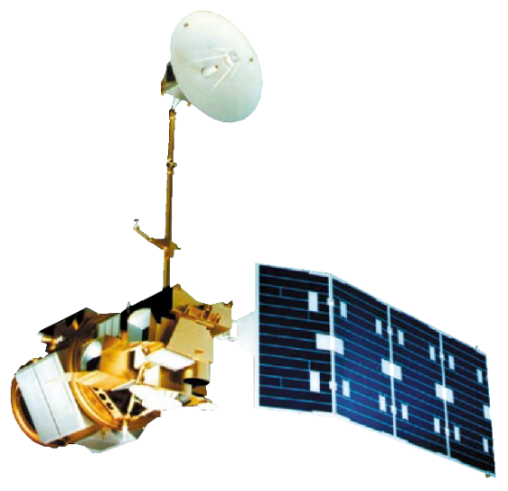
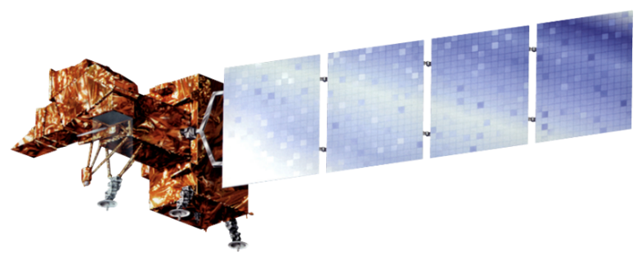
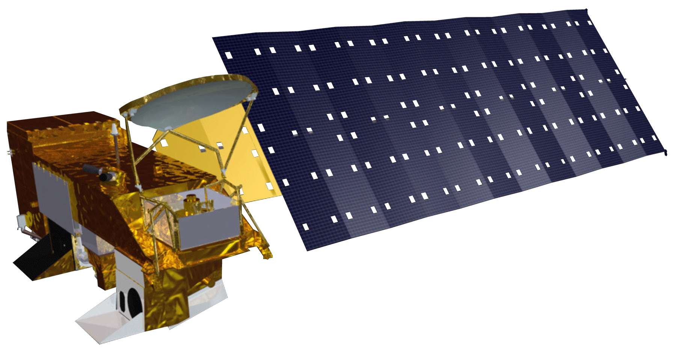
Evaluating Coastal Flooding and Related Marine Turbidity Variations Caused by Extreme Tidal Inundation Events in Central Java, Indonesia
Abstract
Objectives
Central Java Disasters
Extreme tidal inundation events resulted in wide-ranging damage to the densely populated coastline of Central Java, Indonesia. Central Java Province is vulnerable to extreme tidal inundation and severe fluxes in marine turbidity due to a combination of factors, including storm surges, sea level rise, and land subsidence resulting from groundwater extraction. In Central Java, 368 flood events occurred between 2011 and 2015, with 1,000 ha in Semarang City and 2,116 ha in Demak reported as inundated in 2015 alone. Torrential rain caused flash floods and landslides in Central Java during 2018 and 2019, claiming thousands of lives and causing extensive damage to urban areas. Continual flooding and associated fluxes in marine turbidity threaten the livelihoods of coastal communities, mangrove restoration efforts, and marine ecosystems. This project supports the flood management and mitigation efforts of the Center for Coastal Rehabilitation and Disaster Mitigation Studies at Diponegoro University and the Water Resources and Spatial Planning Office of Central Java Province. The Boston NASA DEVELOP team utilized Landsat 8 Operational Land Imager (OLI) and Aqua Moderate Resolution Imaging Spectroradiometer (MODIS) to assess inundation extent and water quality. To aid partner organizations in water resource management decisions, the team created a tidal land cover analysis tool that maps coastal flooding. Marine turbidity estimation maps were created to assess variations in turbidity and sediment availability through time. DEVELOP’s end products will aid partners in ongoing mitigation efforts, inform marine ecosystem restoration initiatives, and monitor threats to human safety.
Create a tidal land cover analysis tool in Google Earth Engine (GEE) with a user-friendly interface that allows end users to obtain more frequent and wide-scale assessments of tidal inundation
Produce marine turbidity estimation maps that allow end users to assess variations in marine turbidity and sedimentation availability over a ten-year period
Provide a tutorial to end users containing instructions for utilizing the GEE tool interface
Methodology
Created an unsupervised land classification to determine where flooding and tidal inundations were occurring
Generated a flood and tidal threshold map to mask permanent water, seasonal surface water, and intertidal zones
Ran a harmonic regression with baseline imagery, monitoring imagery, and Normalized Difference Moisture Index
Exported results to user interface
Tidal Land Cover Analysis Tool (TiLCAT)
Data Acquired in GEE
Landsat 5 , Landsat 7, Landsat 8
JRC’s Global Surface Water Mapping Layers
Murray Global Intertidal Change Classification
Marine Turbidity Estimation Maps
Calculated water reflectance using the remote sensing reflectance 645 nm band
Derived turbidity using the Dogliotti algorithm
Visualized data using cartographic techniques
Data Imported into SeaDAS
Aqua Modis
Study Area
PACIFIC OCEAN
Results
Sumatra
Detected change in flooding and tidal inundation
Figure 2: The detected change in flooding and tidal inundation across Central Java, with baseline imagery from 1985 to 1990 and a monitoring period of January 1st to November 7th 2019. Blue regions represent areas within this monitoring time period where significant change in water occurred, likely due to tidal inundation or flooding.
Kalimantan
Maluku Islands
Pekalongan
Java
Sulawesi
New Guinea
Semarang
0
68
136
INDIAN OCEAN
Kilometers
0
68
136
Kilometers
Figure 1: The picture above highlights the study region of our project; Central Java, Indonesia
Figure 3: Marine turbidity estimation map for July 31st 2019. Higher turbidity areas are shown in red and lower turbidity areas are shown in purple and blue. The highest turbidity values occurred near the mouths of Javanese rivers.
Project Partners
Water Resources and Spatial Planning Office (WRSPO) of Central Java Province
Diponegoro University, Center for Coastal Rehabilitation and Disaster Mitigation Studies (CoREM)
Earth Observations
Turbidity (FNU)
0
0.5
1
1.5
2
0
136
Kilometers
Conclusions
TiLCAT was able to detect flooding in the city and surrounding areas of Pekalongan. Furthermore, TiLCAT detected flooding in aquaculture ponds and agricultural areas near Semarang and Demak.
Marine turbidity estimation maps indicated highest turbidity values along the coastline of Central Java and where rivers flow into the Java Sea.
Over the last decade, turbidity values in the Java Sea were highly variable in relation to the location on the coastline of Central Java and the season.
Landsat 5 TM
Landsat 7 ETM+
Landsat 8 OLI
Aqua MODIS
Team Members
Acknowledgements
Dr. Sakti Kania Army, WRSPO
Dr. Hari Dhamayanti, WRSPO
Dr. Aswar Annas Kunaefi, WRSPO
Dr. Anindya Wirasatriya, CoREM
Dr. Rudhi Pribadi, CoREM
Dr. Muhammed Helmi, CoRem
Dr. Cedric Fichot, Boston University
Dr. Valerie Pasquarella, Boston University
Dr. Magaly Koch, Boston University
Juliette Bateman, Boston University
Celeste Gambino, DEVELOP Massachusetts – Boston
Nicole Ramberg-Pihl
Project Lead
Ahmed Baqai
Erica Issenberg
Dianna Farrell
Massachusetts – Boston| Fall 2019

