Slide 1
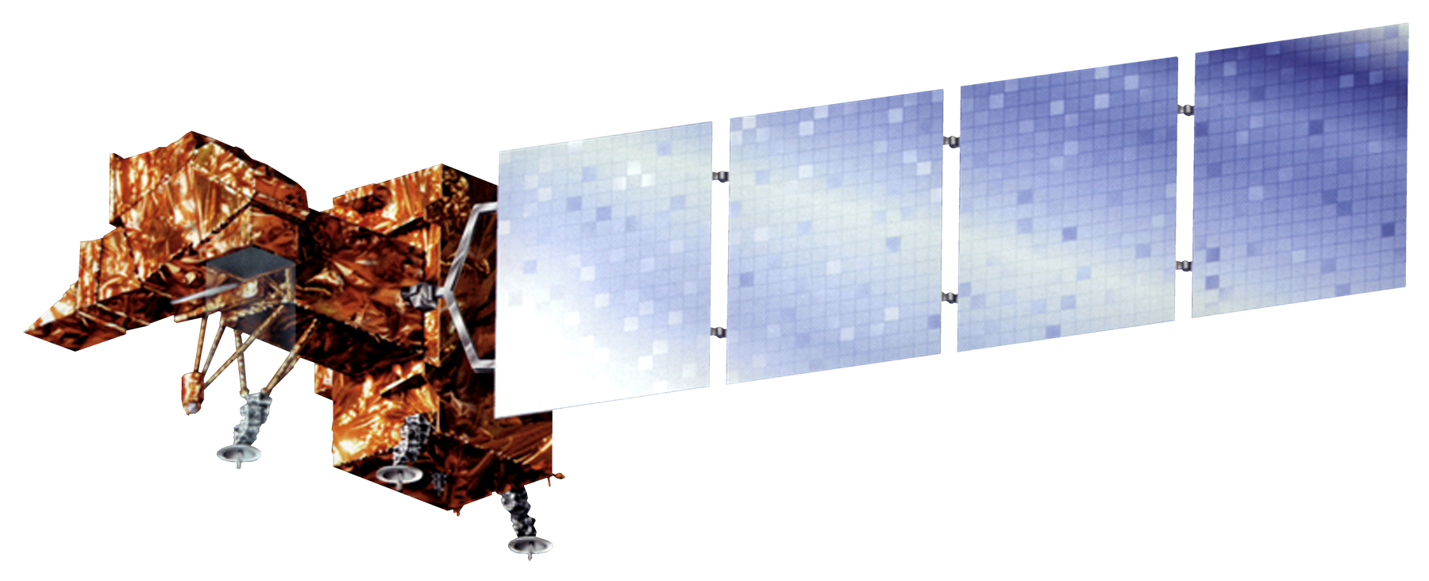
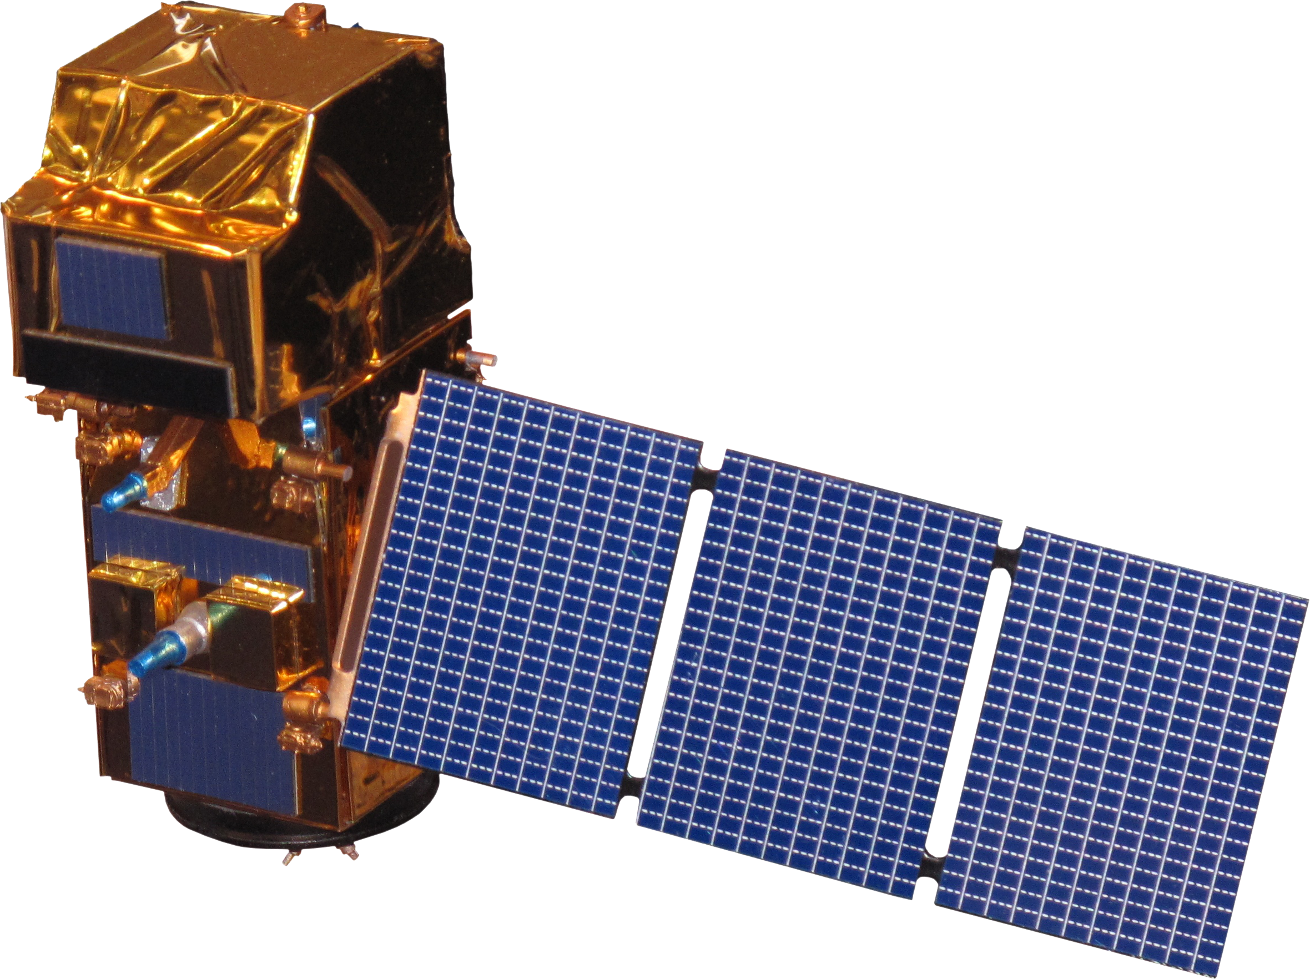
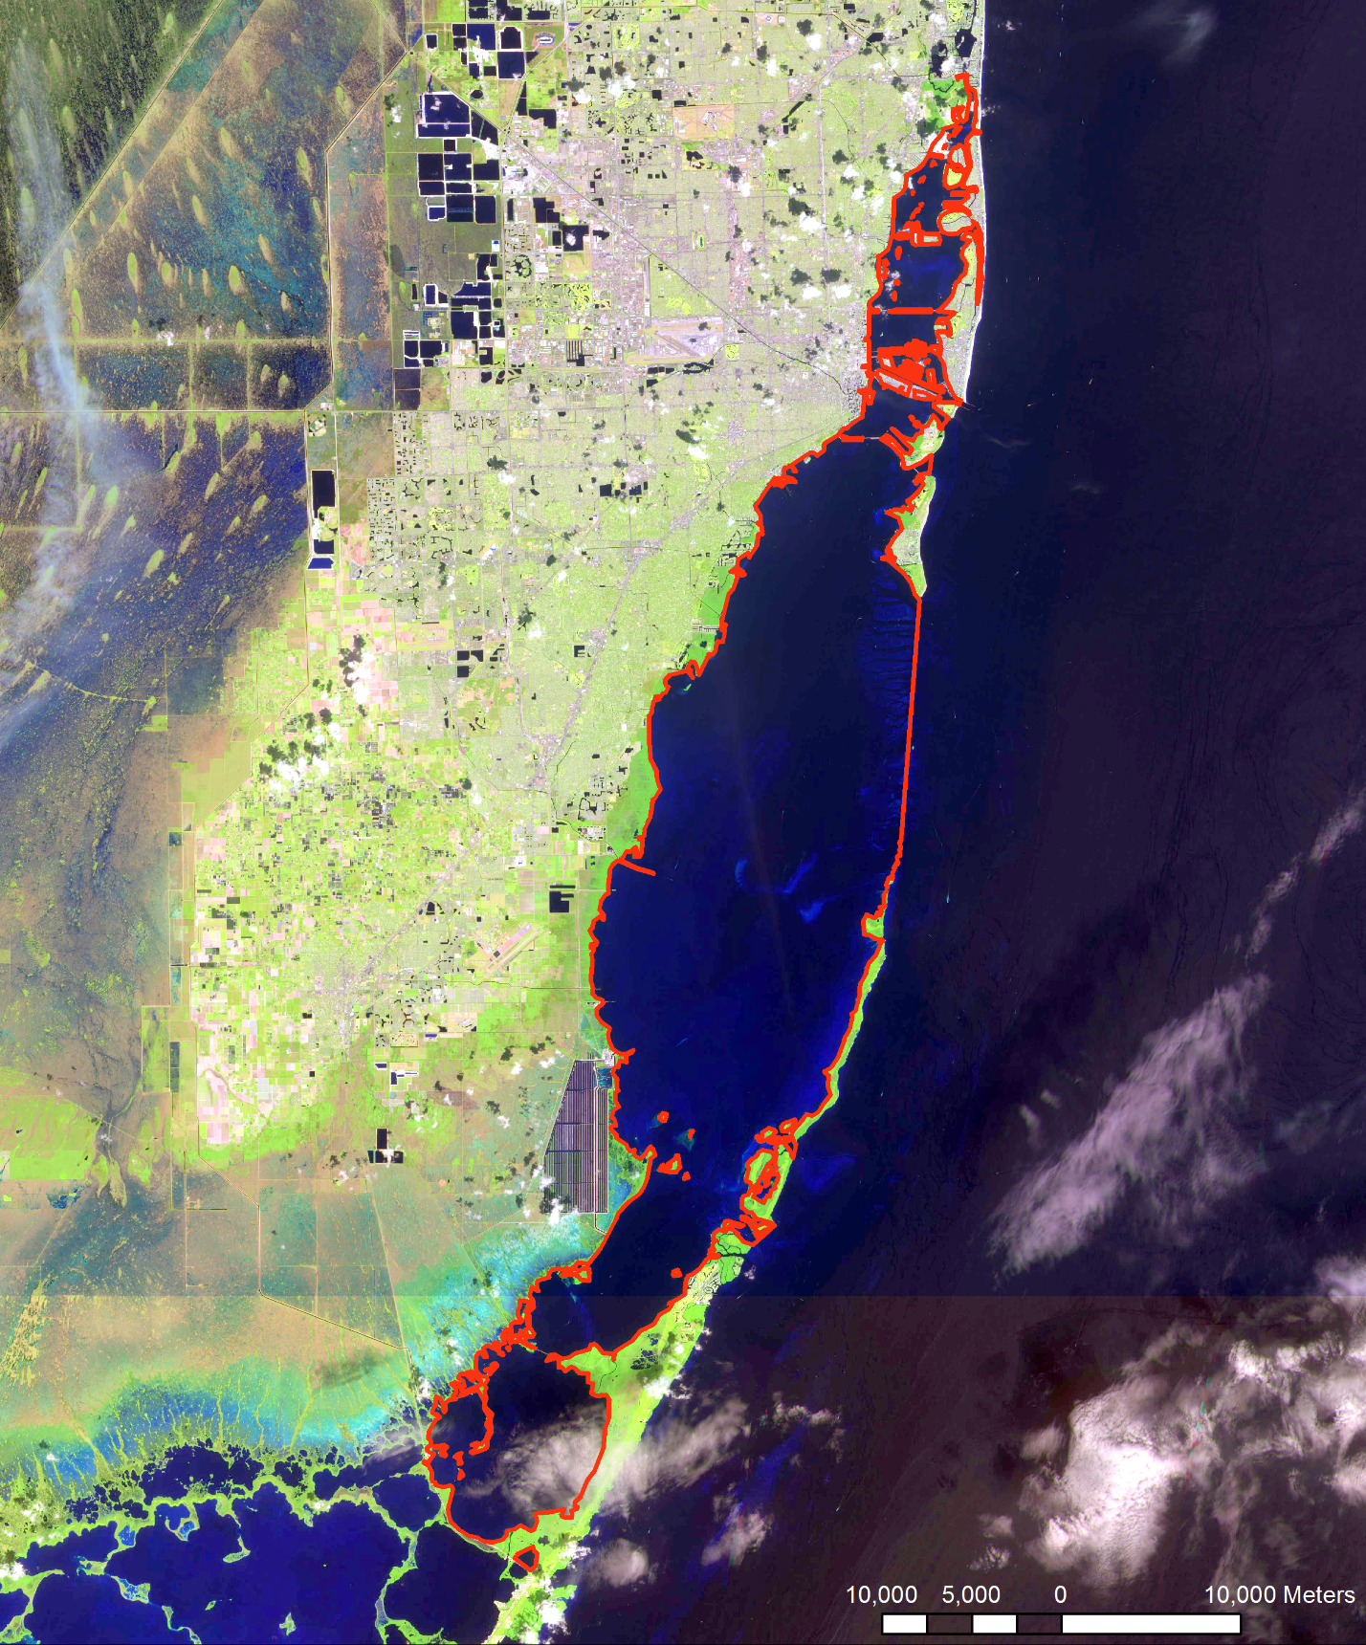
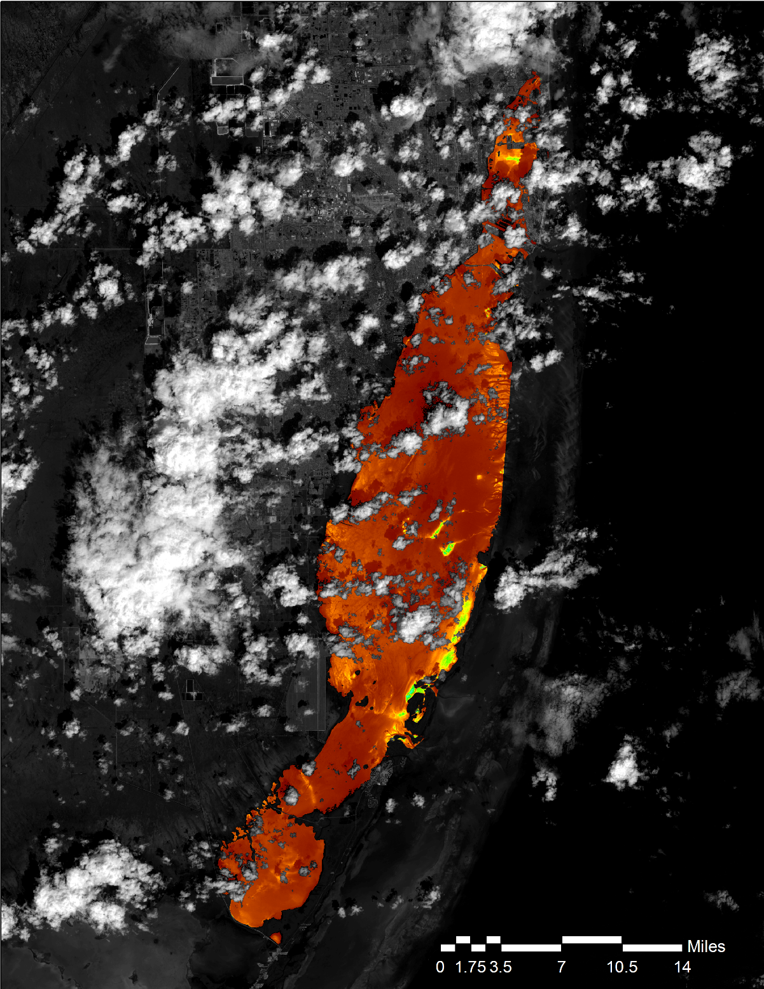
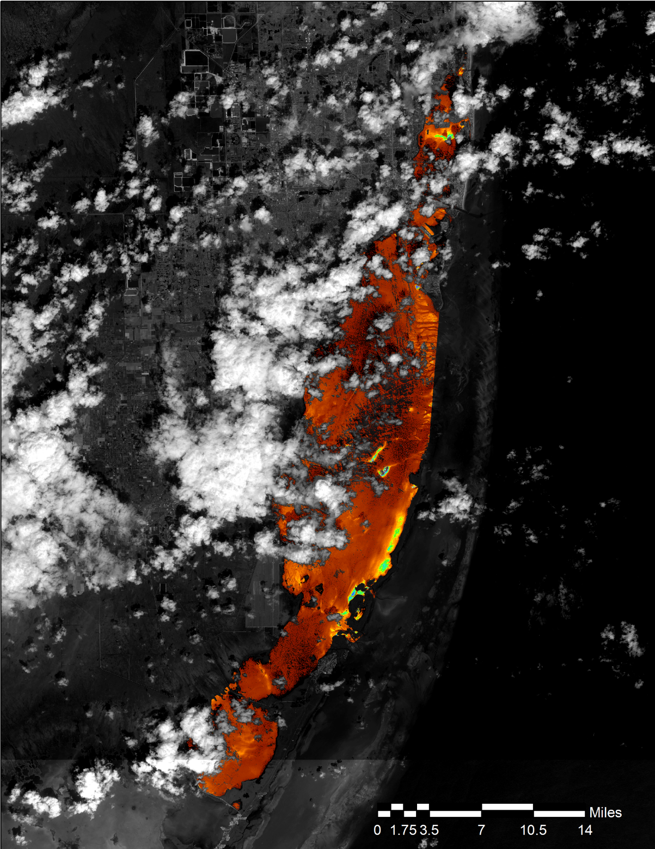
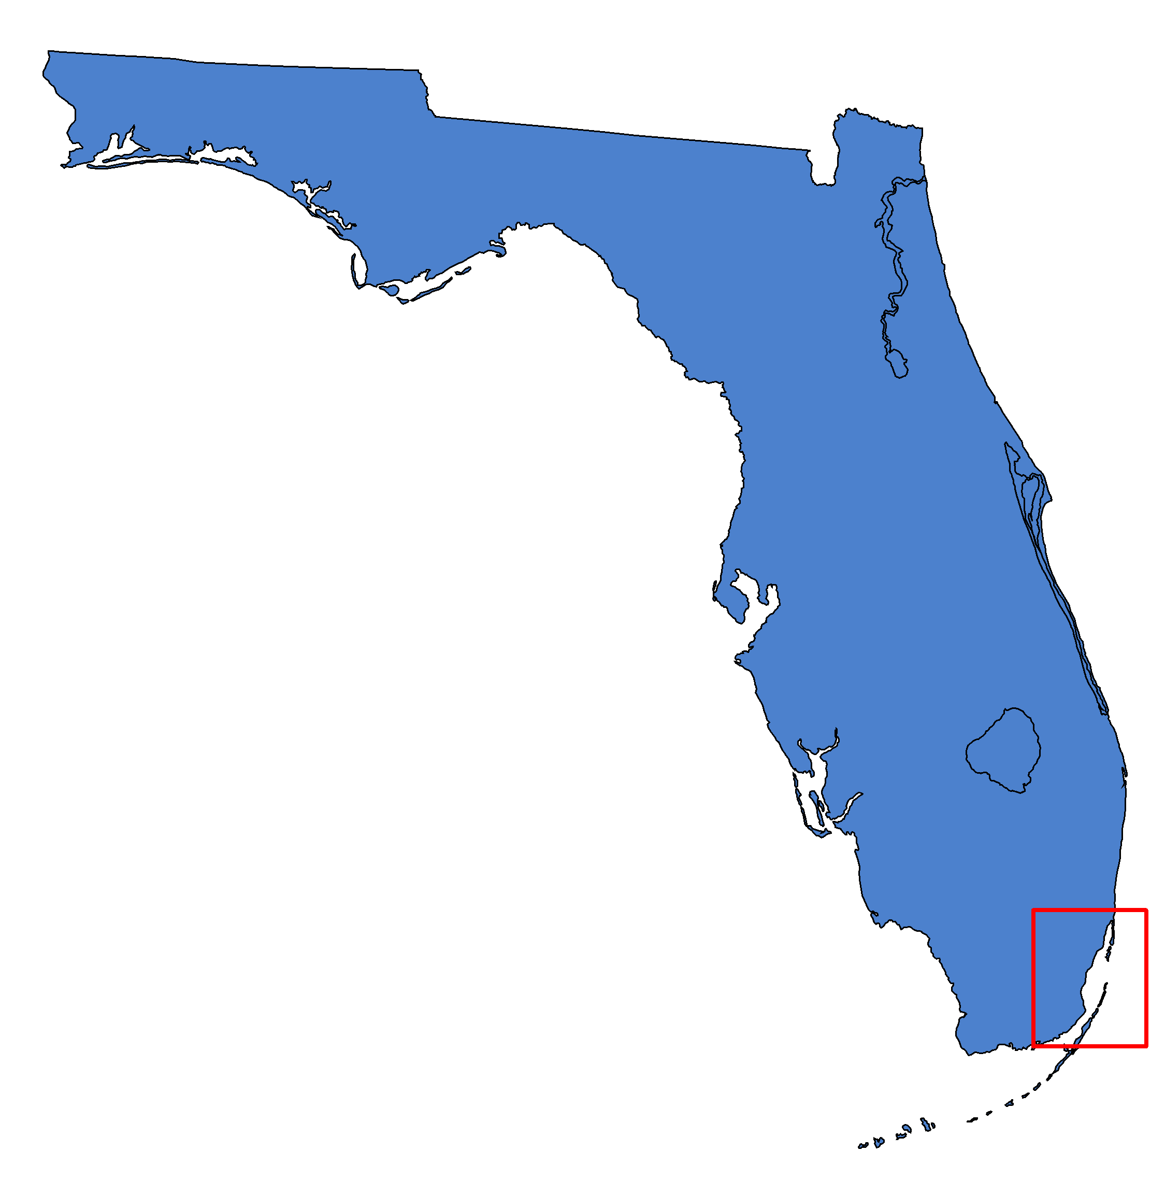
Assessing the Feasibility of Using NASA Earth Observations to Monitor Trends
in Runoff and Stormwater
Discharge of the Biscayne Bay
Abstract
Earth Observations
Submerged Aquatic Vegetation (SAV) is an important component of coastal ecosystems, and is vulnerable to increased turbidity in the water column. It provides stability and protection to sediment deposits, and offers food and shelter to economically valuable species of marine life. Recent urban development and population growth in the Miami area have resulted in an increase in stormwater discharge connected to changing water quality in Biscayne Bay. The project used Earth observation data from a suite of sensors including Landsat 8 OLI, Landsat 7 ETM+, Landsat 5 TM, and Sentinel-2 MSI in conjunction with in situ water quality monitoring data. Turbidity, chlorophyll-a concentration, Normalized Difference Turbidity Index (NDTI), absorbance due to dissolved and non-algal detrital material (A_{DG}), and Total Suspended Matter (TSM) data were used to develop a tool to view both historic and current water quality parameters in Biscayne Bay. The results of this project will assist the City of Miami Beach Public Works Department in decision making and predicting future water quality trends in Biscayne Bay and the surrounding area.
Landsat 5 TM
Landsat 7 ETM+
Landsat 8 OLI
Sentinel-2 MSI
Results
Objectives
Assess feasibility of using NASA Earth observations for water quality monitoring in Biscayne Bay
Develop correlations between in situ and remotely sensed data
Produce annual water clarity maps
Generate trend maps of chlorophyll-a concentration and turbidity
Study Area
N
N
N
Miami Beach Water Resources
Turbidity
FNU
Turbidity
FNU
High: 75
Low: 0
High: 75
Low: 0
Outlined area enlarged
ACOLITE derived turbidity from Landsat 8 OLI (left) and Sentinel-2 MSI (right) on 10/04/2015. Turbidity from Landsat 8 was on average 0.06 FNU higher than that from Sentinel, with a standard deviation of 2.69.
Biscayne Bay outlined in red
Methodology
Year | 2013 | 2014 | 2015 | 2016
Landsat 8 OLI Mean Chlorophyll-a Concentration (mg/m^3) | 3.20 | 4.73 | 4.11 | 5.50
Download Satellite Imagery
Analyze Data
(Chlorophyll-A)
Correlate Data with In Situ Data
Conclusions
Project Data into NAD 1983
Analyze Data (Turbidity)
Produce Trend & Water Clarity Maps
Strong correlations between in situ data and remotely sensed data were not found for turbidity metrics.
In situ data sampling dates did not coincide with flyover dates for Sentinel-2, so correlations could not be established for Sentinel-2 MSI.
ACOLITE turbidity products from Landsat 8 OLI and Sentinel-2 MSI are statistically close enough to be used interchangeably.
Annual mean wet season turbidity and chlorophyll-a concentration are heavily influenced by the dates of flyover, leading to differences in values between satellites. Therefore it is likely not a reliable estimate of actual mean wet season turbidity.
Due to the shallow, clear water of the bay, bottom effects influenced the calculation of both chlorophyll-a and turbidity, leading to higher estimates.
Atmospherically Correct Data in ACOLITE
Process Data using Custom Tools
Display Results in Web App
Project Partners
City of Miami Beach, Public Works Department
Team Members
Acknowledgements
Science Advisor – Dr. Kenton Ross, NASA Langley Research Center
Partner – Francisco D’Elia, City of Miami Beach, Public Works Department
Others – Emily Gotschalk, NASA DEVELOP National Program, Center Lead at NASA Langley Research Center
Pamela Kanu
Team Lead
Danielle Quick
Randolph Colby
NASA Langley Research Center – Summer 2017

