Slide 1
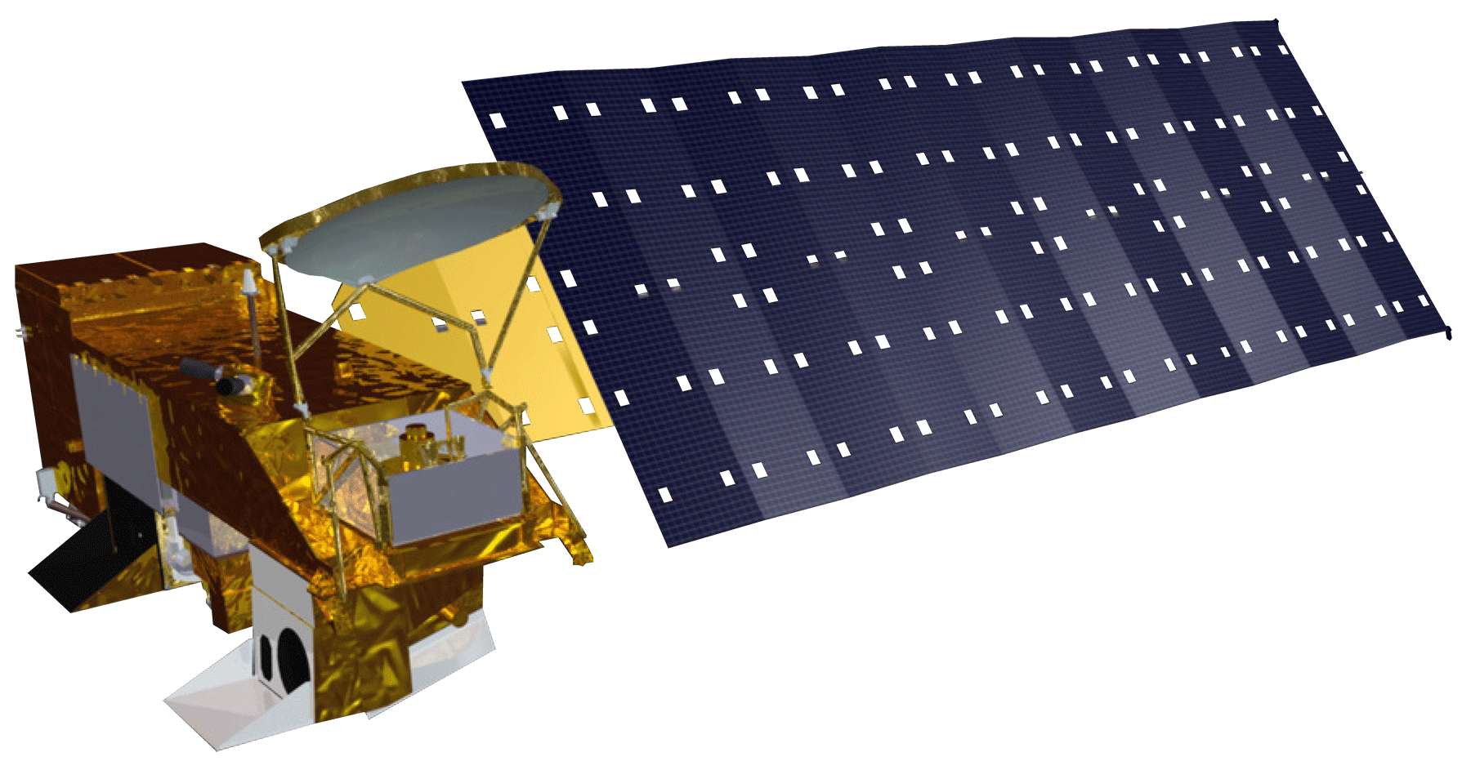
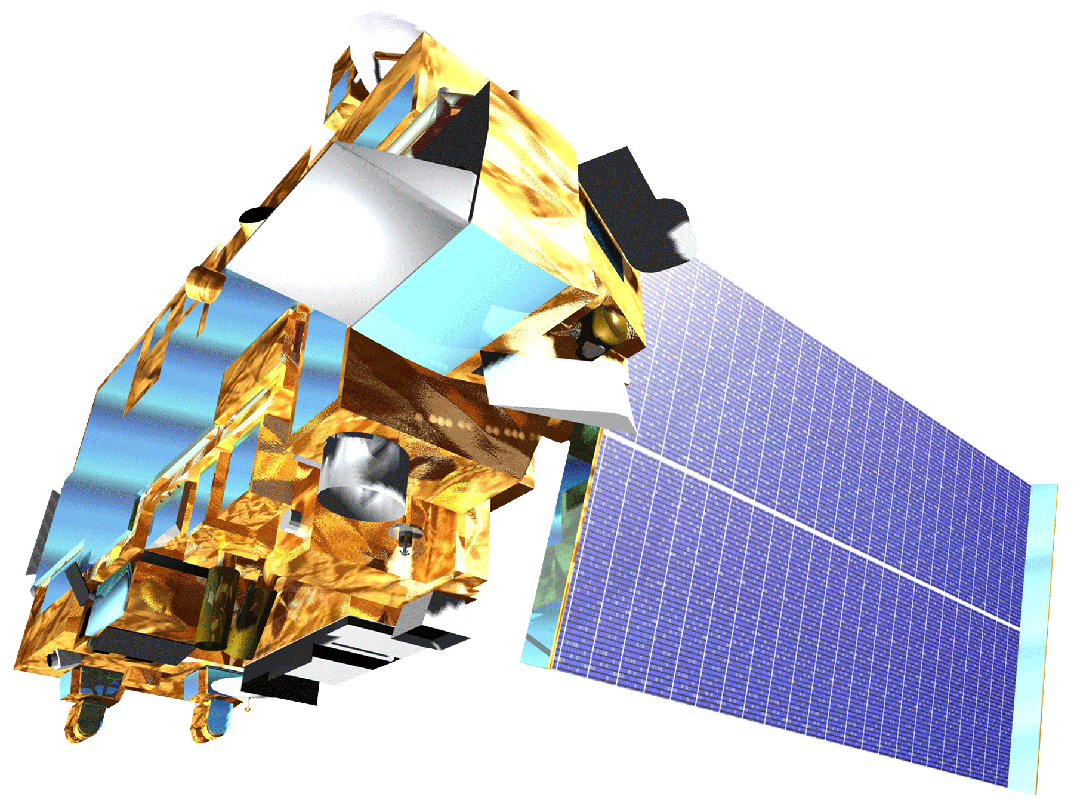
Megan Buzanowicz
Laura Lykens
Zacary Richards
Jeff Close (USAF)
Dr. Kenton Ross
Dr. Venkat Lakshmi
MODIS Aqua
MODIS
Terra

Slide 2
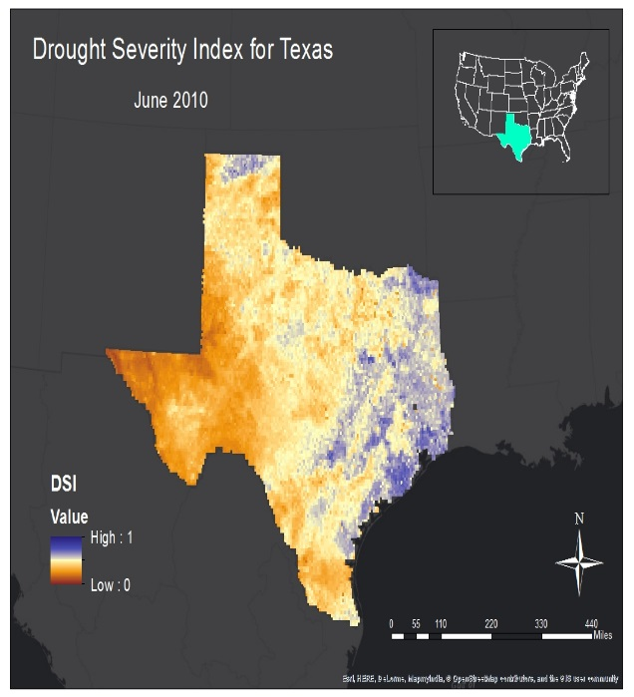
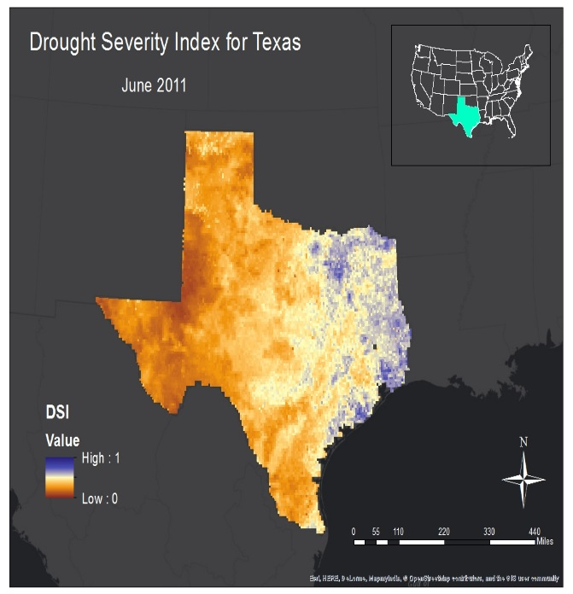
Utilizing NASA Earth Observations to Monitor Drought Severity in Texas for Wildfire Mitigation Support
Texas Forest Service
Texas, United States 2010-2011, 2014-2015
Wildfires pose a constant risk for many regions across the state; for example, in 2013 there were 7,598 fires reported which burned 45,963 acres. The ability to accurately monitor drought conditions is vital to forecasting wildfire risk, in particular in grassland regions, where fires often spread rapidly. More information about the spatial coverage of drought conditions will allow the TFS to better allocate resources to mitigate the spread of wildfires.
The main products that will help TFS decision makers are the drought severity index maps. These maps provide an estimation of water stress to vegetation and impacts where the TFS will allocate resources in preparation for wildfires. A correlation of the DSI with measurements of live fuel moisture will help to validate the DSI.
In a cooperative effort with the John C. Stennis Space Center (SSC), our team at NASA Langley assisted the Texas Forest Service (TFS) in preparing for future wildfires by expanding upon a drought severity index created during the summer 2013 Great Plains Agriculture project, which will allow the TFS to identify what geographical locations within the state are the most prone to wildfire disasters. The accuracy of the DSI was correlated to live fuel moisture as measured by the National Fuel Moisture Database.

