Slide 1
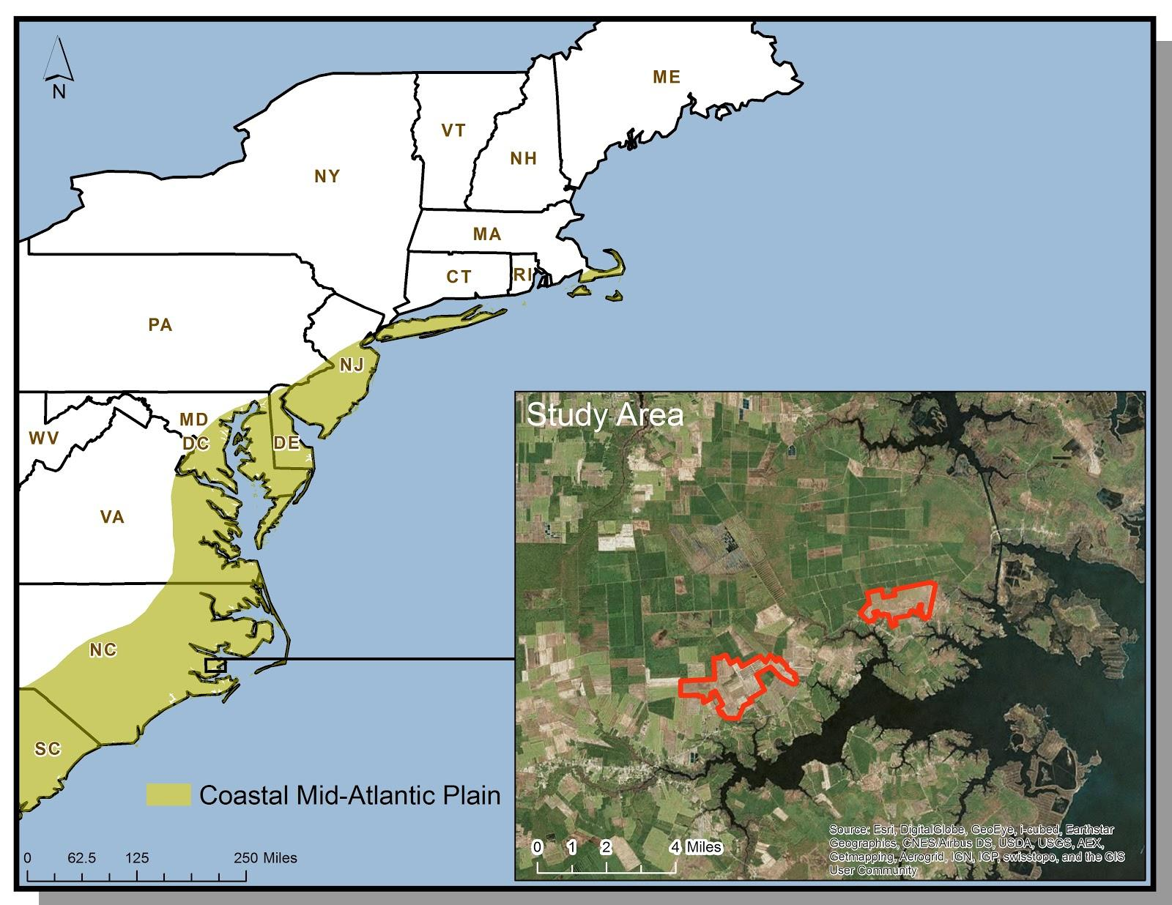
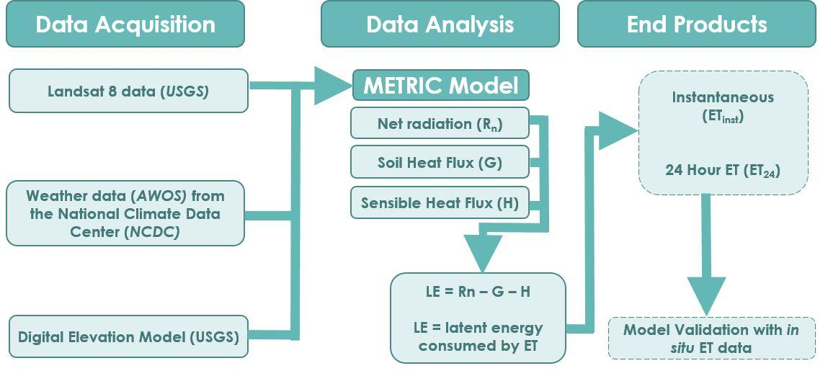
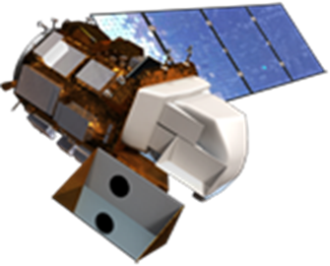
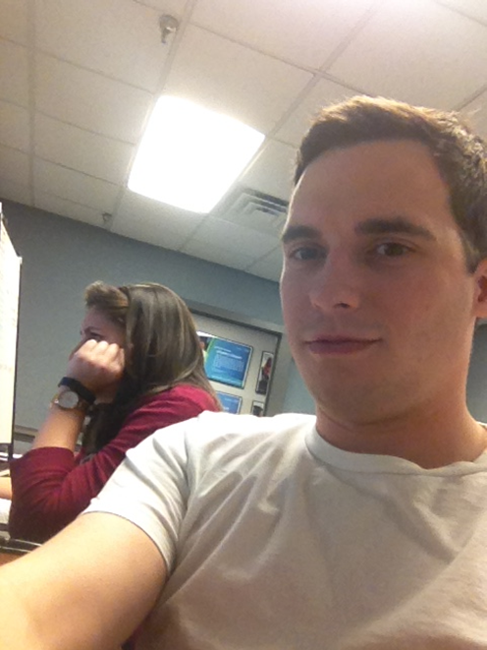
Coastal Mid-Atlantic Water Resources III
Using the METRIC Model to Estimate Evapotranspiration for Coastal Mid-Atlantic Region
Kent Sparrow
Jamie VanderHeiden
NASA Langley Research Center
To develop an operational, user-friendly, METRIC model for calculating ET₂₄ rates in the Mid-Atlantic coastal plain.
To provide end users with a handoff model, executable from Python Toolbox, to assist in efficient irrigation planning
Landsat 8 OLI/TIRS
The Python script written to run the METRIC model successfully calculated ET₂₄ using Landsat 8 imagery, AWOS weather data, and a DEM.
The validated METRIC model was packaged into a tool, available in ArcToolbox, through a software release process.
METRIC is now a useful tool for calculating ET₂₄ to improve irrigation planning and drought monitoring for the agriculture industry.
The use of the METRIC model will be beneficial to government officials and private industries involved in the agriculture industry.
Future work will need to focus on incorporating weather model data into the methods of Allen et al. (2007) to create a predictive scheme for ET₂₄ values.
24-hour ET
Imagery
Jamie Vanderheiden
Kent Sparrow
Digital Harvest
Young Kim, General Manager
Virginia Secretary of Natural Resources
Molly Ward, Secretary
Travis Hill, Deputy Secretary
Virginia Secretary of Technology
Karen Jackson, Secretary
Virginia Secretary of Agriculture & Forestry
Todd Haymore, Secretary
Virginia Department of Environmental Quality
David Paylor, State Water Commission
DEVELOP Program National Science Advisor
Dr. Kenton Ross
DEVELOP Program International Lead
Jamie Favors
Summer 2014 Coastal Mid-Atlantic Water Resource DEVELOP Team
Fall 2014 Coastal Mid-Atlantic Water Resources Team

