Slide 1
El Salvador Ecological Forecasting
Utilizing NASA Earth Observations to Develop
a Historically Based Trajectory of Deforestation
and Degradation in El Salvador
Jordan Ped (Team Lead)
Susannah Miller
Stephen Zimmerman
Clarence Kimbrell
Courtney Duquette
Notes:
Hello everyone my name is Stephen
Everyone one else introduces themselves briefly

Slide 2
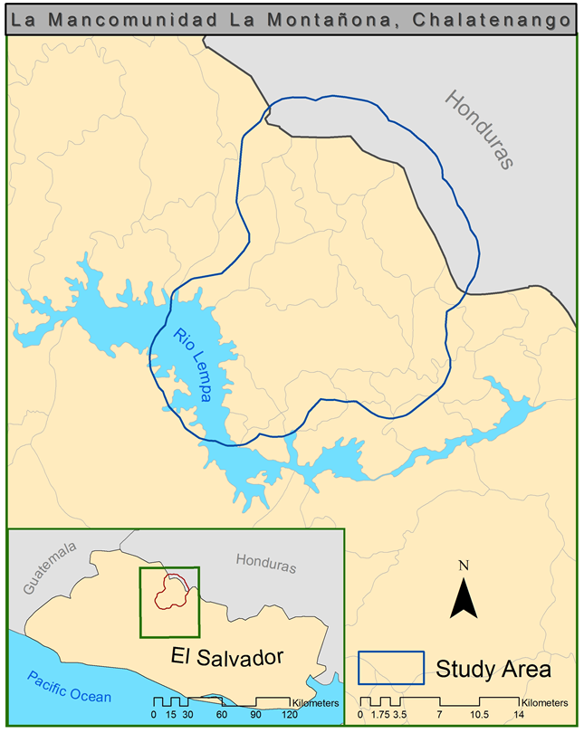
Study Area and Period
Study Area:
La Mancomunidad
La Montañona, Chalatenango, El Salvador
Study Period: 1986-2015
Notes:
Notes:
The study area
based on DEVELOP’s collaboration with the Earth Institute at Columbia University, Agroforestry for Biodiversity and Ecosystem Services (ABES) project.
Ministerio de Medio Ambiente y Recursos Naturales (MARN), El Salvador’s agricultrual minstry is concerned about deforestation and forest degradation in their densely populated country (300 people/km2) given the prevelance of slash and burn agriculture and the limited forest cover (121,000 hectares the lowest in Central America).
MARN, ABES, and DEVELOP are working on this scale to develop a methodology which can be applied nationally.
The study period
The earliest landsat data for the region
Creating a historical trajectory from all the avaialble information
Forecasting future change

Slide 3
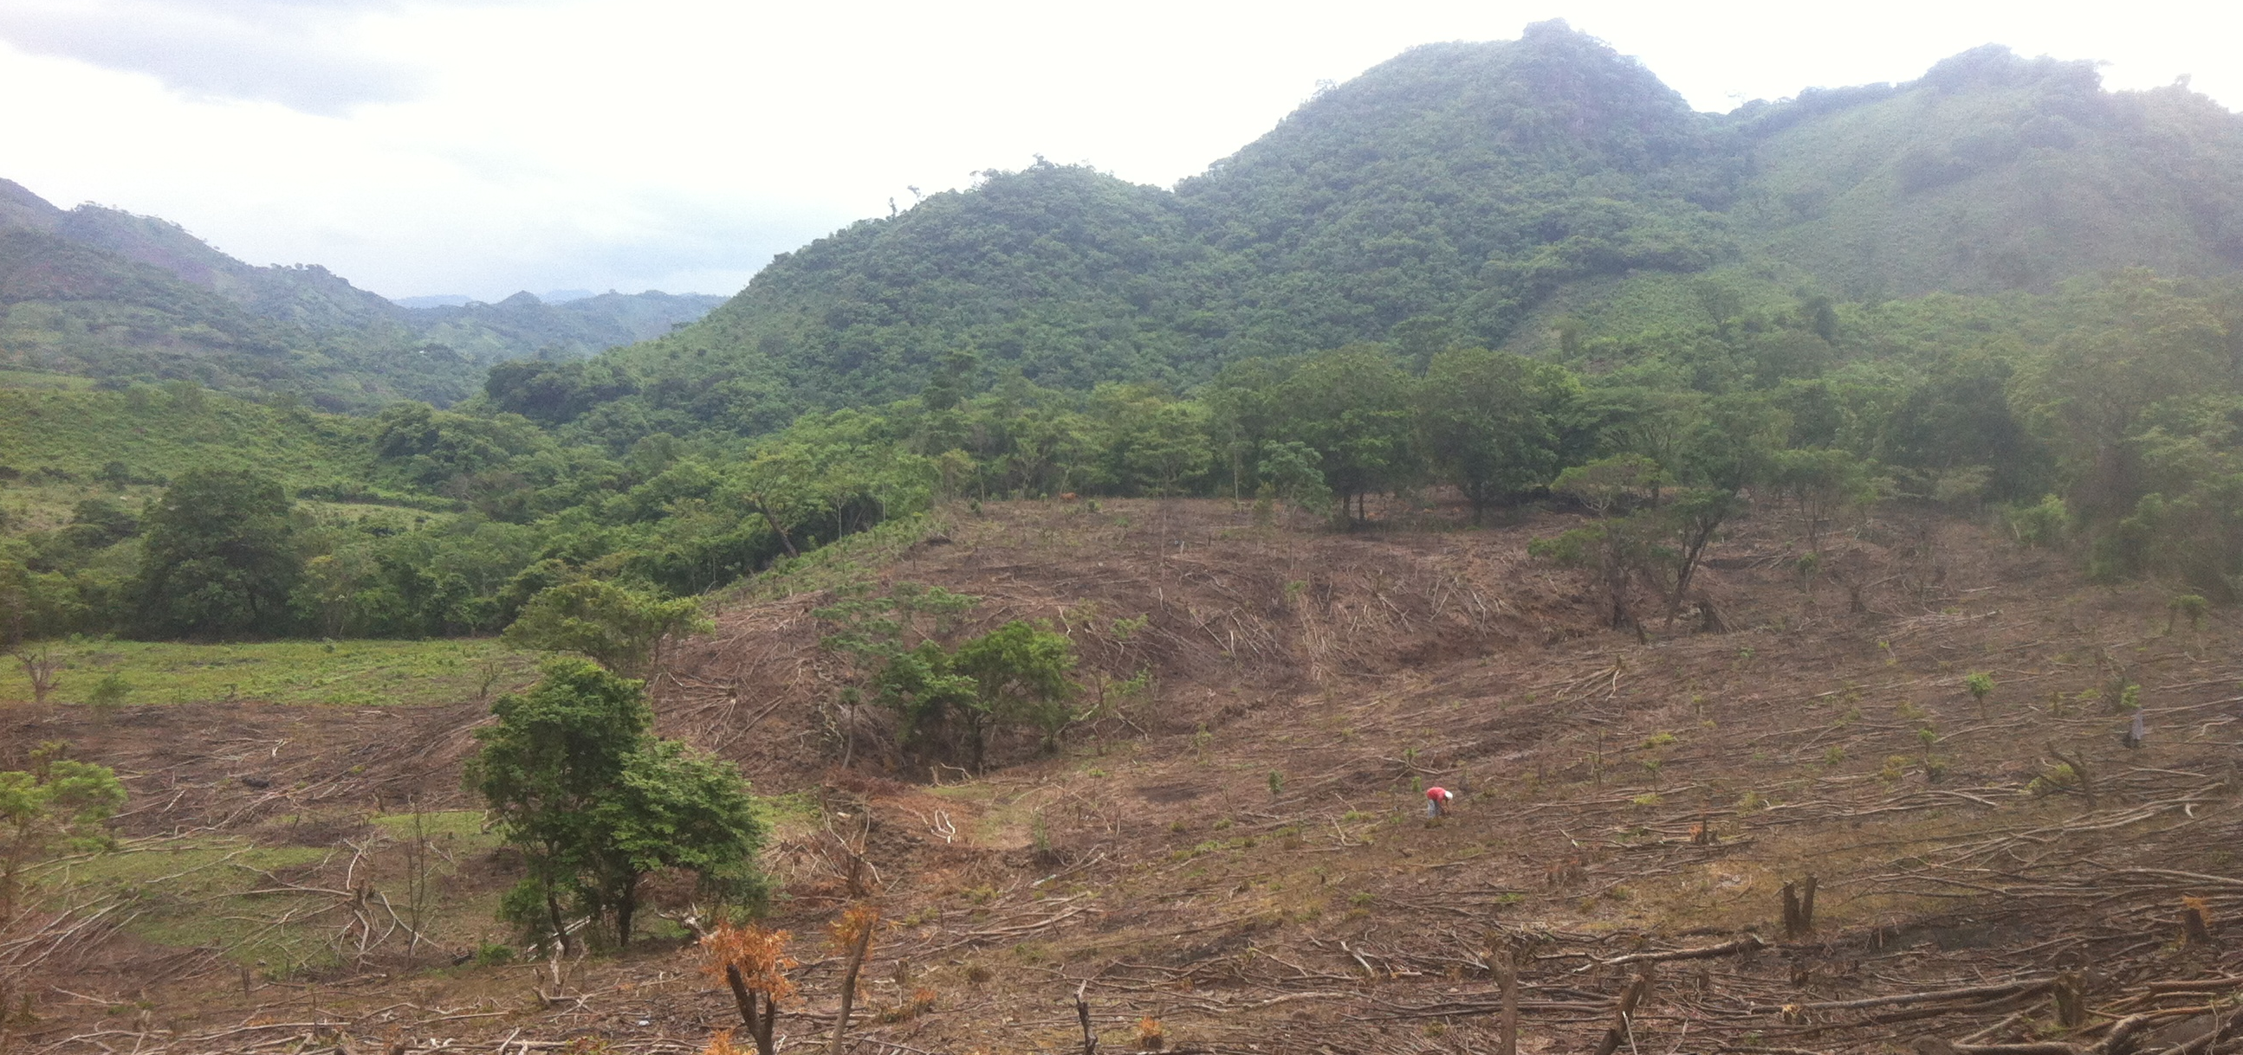
Sean Kearney, USAID, ABES Project
Community Concerns
High population density in El Salvador and low forest canopy cover
Forests provide soil stability
Critical to maintaining healthy springs and rivers
Forests remove carbon dioxide from the atmosphere
Notes:
Notes:
1) The pine oak forests are an important part of the ecosystem in La Mancomunidad La Montañona, surrounding regions, and are relevant to maintaining the global carbon budget.
3) Forests can remove carbon dioxide from the atmosphere which is emitted by human activity. The forests in El Salvador, and especially in this region specifically are being destroyed at an alarming rate through “slash and burn” agriculture. This agricultural method is unsustainable with large populations or for intensive farming in tropical regions. El Salvador has one of the highest population density in Central America with one of the lowest forest canopy covers.
2) Locals are reliant on healthy forests to maintain the water quality for a major national watershed and provide soil stability to prevent landslides and add nutrients for more agriculture.

Slide 4
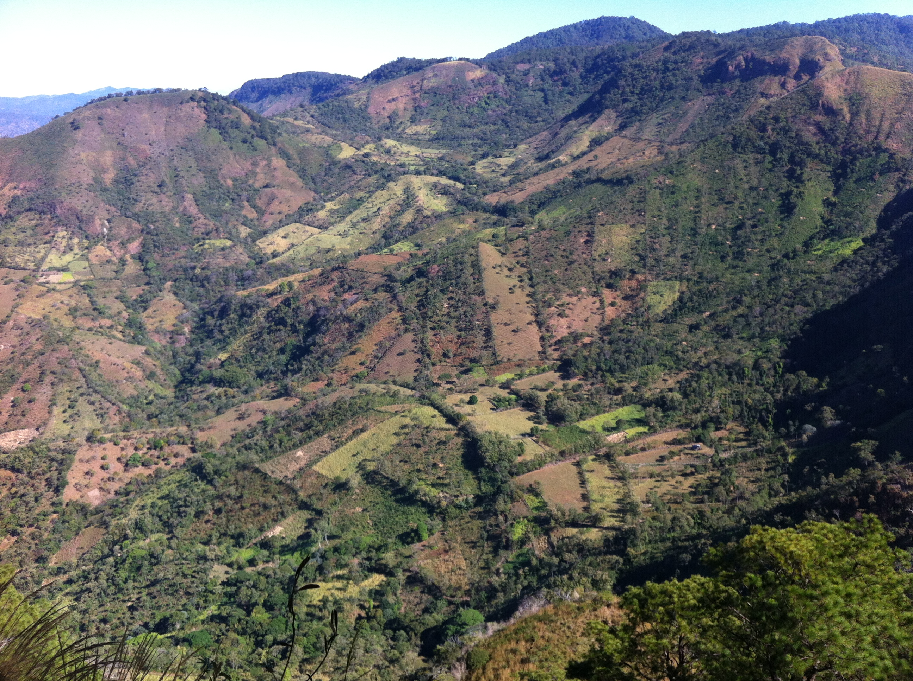
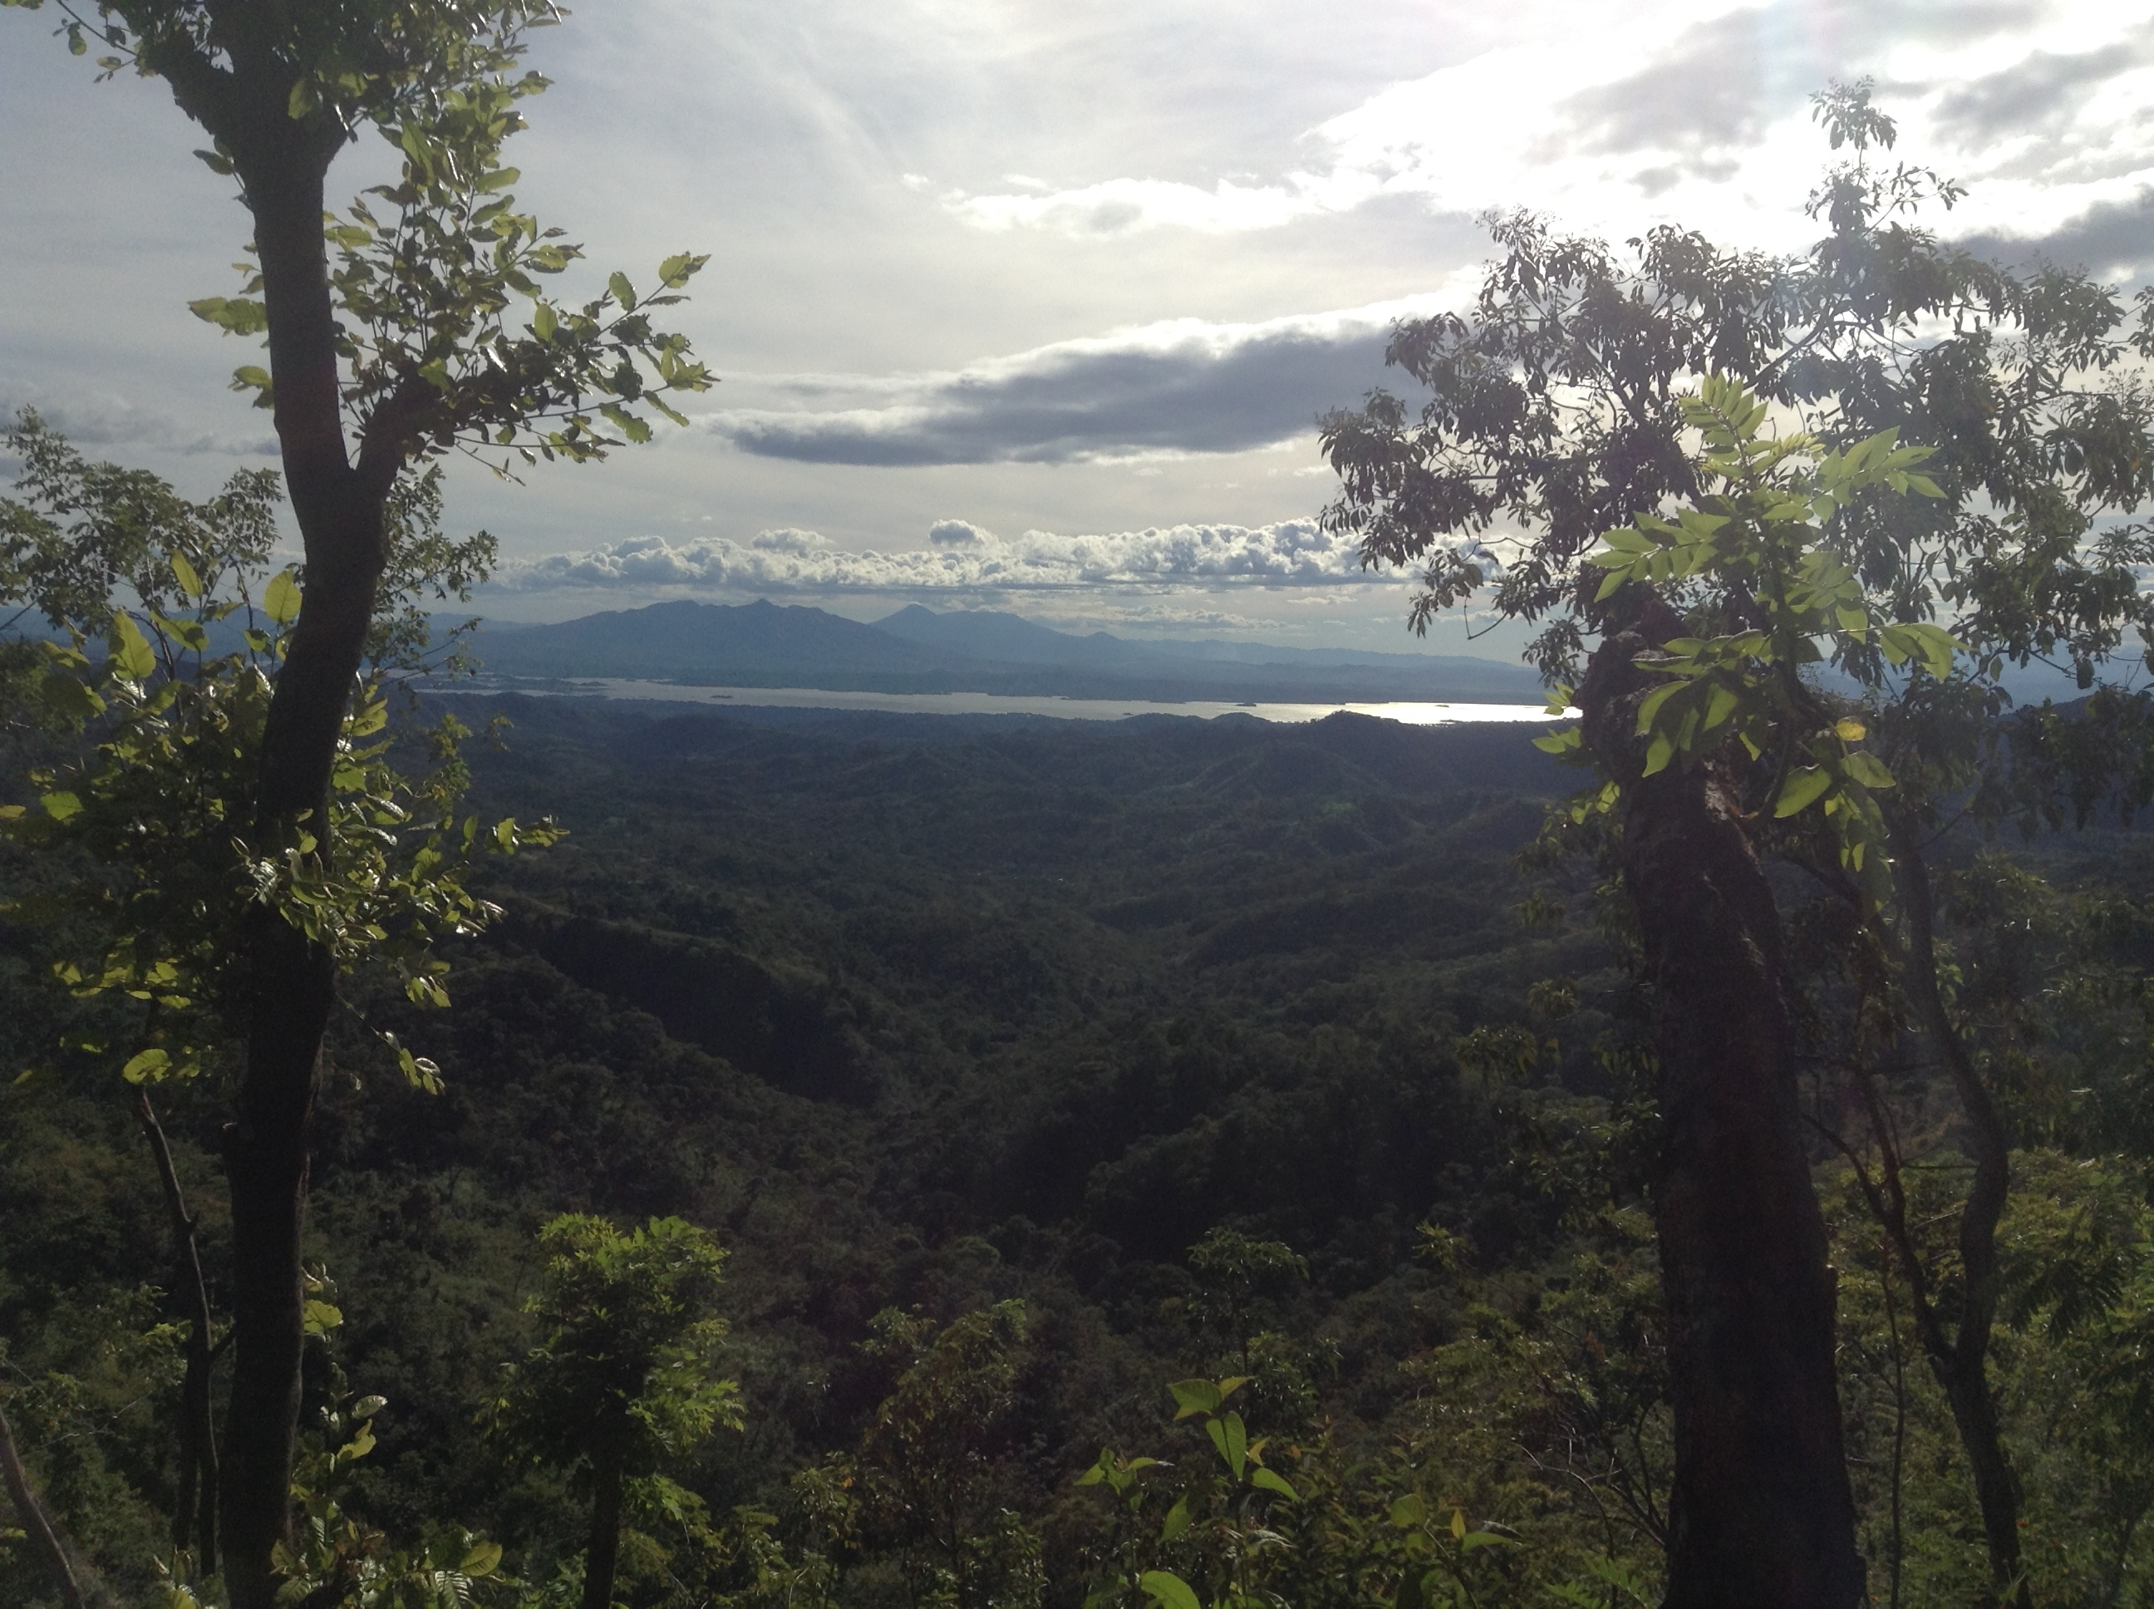
Sean Kearney, USAID, ABES Project
Objectives
Land Use/Land Cover
Forecasting Model
Notes:
Land use Land Cover (LULC)
The first objective is to use the information gathered by ABES to create a LULC map with the available Landsat imagery and ground truth from high resolution data (Quickbird and Rapideye) that can serve as a baseline for the Regional Forest Inventory and the Forecasting Model
Forecasting Model
The historical trajectory of forest cover change was used to forecast deforestation
The model will allow MARN to assess areas that are at a high risk of degradation and deforestation

Slide 5
NASA Satellites & Sensors
Landsat 4/5 TM
Landsat 8 OLI
Notes:
Notes:
Using Landsat 4, 5, and 8 scenes from path 19, row 50, historical data was collected for analysis between 1986 to 2015.
USGS Earth Explorer was used to download the climate data record, which accounts for top of atmosphere reflectance and radiometric variation, for a more accurate and standardized analysis.
Landsat 7 was not used because the study region is relatively small and the outcome would be affected by the data gaps.
The ABES Project were able to provide RapidEye and QuickBird imagery from 2012, which proved useful in developing ground truth and satellite calibration data.

Slide 6
Methodology
DATA ACQUISITION
SRTM, Open Street Map
Landsat & RapidEye clipped using Python
Landsat CDR 4, 5, & 8
Supervised LULC for 1986, 1996, 2000, & 2014
*
QuickBird & RapidEye
Resampled
Forecasting Model to 2030
*
ABES Project Data
Validation of GFC at Regional Scale
GFC clipped to QuickBird extent.
Global Forest Cover (GFC)
Notes:
-In addition to EOS we used SRTM, Open Street Map, ABES Project Data, GFC from Matt Hansen which measures percent tree cover world wide

Slide 7
Methodology
DATA ACQUISITION
DATA PROCESSING
SRTM, Open Street Map
Landsat & RapidEye clipped using Python
Landsat CDR 4, 5, & 8
Supervised LULC for 1986, 1996, 2000, & 2014
*
QuickBird & RapidEye
Resampled
Forecasting Model to 2030
*
ABES Project Data
Validation of GFC at Regional Scale
GFC clipped to QuickBird extent.
Global Forest Cover (GFC)
Notes:
-Data was standardized using ArcGIS and python so that it could be processed and analyzed at the same extent

Slide 8
Methodology
DATA ACQUISITION
DATA PROCESSING
DATA ANALYSIS
SRTM, Open Street Map
Landsat & RapidEye clipped using Python
Landsat CDR 4, 5, & 8
Supervised LULC for 1986, 1996, 2000 & 2014
*
QuickBird & RapidEye
Resampled
Forecasting Model to 2030
*
ABES Project Data
Validation of GFC at Regional Scale
GFC clipped to QuickBird extent.
Global Forest Cover (GFC)
*End Product
Notes:
-Training sites were drawn for four evenly space epochs
-The 2014 training sites were refined using the available ground truth data and statistical analysis
-Several classification methods were tested in ArcGIS and using Google Earth Engine
-The GFC data set was also analyzed as a source of additional ground truth. We compared the high resolution imagery from ABES to the dataset to determine the percent of tree cover that most accurately represents the regions forest extent
-Finally the 1986 and 2014 LULC classifications were combined using Terrset Land Change Modeler to Forecast LULC in 2030

Slide 9
Results
Percent Similar – Landsat based LULC to RapidEye based LULC
Software | Method | Forest | Water | Urban | Crop | Pasture
Earth Engine | Maximum Entropy | 81.7 | 98.5 | 95.7 | 73.6 | 73.1
 | Random Forest | 81.7 | 98.5 | 95.7 | 73.6 | 73.1
ArcGIS | Maximum Likelihood | 82.0 | 99.5 | 96.0 | 68.2 | 69.7
 | Unsupervised | 69.4 | 99.5 | 86.8 | 70.4 | 66.9
Notes:
-This table is showing the statistics calculated between our classifications and the classifications from higher resolution data, giving a basis for comparing the various methods
-The best performing classification was random forests using google earth engine
-but the changes in land cover most aligned with the predicted or theoretical changes i.e. decreased forest cover and growing urban areas was maximum likelihood in ArcGIS

Slide 10
Results
Percent Similar – Landsat based LULC to RapidEye based LULC
 | Method | Forest | Water | Urban | Crop | Pasture
Earth Engine | Maximum Entropy | 81.7 | 98.5 | 95.7 | 73.6 | 73.1
 | Random Forest | 81.7 | 98.5 | 95.7 | 73.6 | 73.1
ArcGIS | Maximum Likelihood | 82.0 | 99.5 | 96.0 | 68.2 | 69.7
 | Unsupervised | 69.4 | 99.5 | 86.8 | 70.4 | 66.9
Notes:
-This table is showing the statistics calculated between our classifications and the classifications from higher resolution data, giving a basis for comparing the various methods
-The best performing classification was random forests using google earth engine
-but the changes in land cover most aligned with the predicted or theoretical changes i.e. Decreased forest cover and growing urban areas was maximum likelihood in ArcGIS

Slide 11
Results
Maximum Likelihood Classification
2014 Accuracy: 60.1%
Notes:
-This shows the classification results from the 4 different epochs
-The ABES plot data was used to calculate the percent accuracy for the 2014 image, which is a more robust statistic than % similar and indicates that the map in 2014 is classifying %60.1 of its pixels correctly

Slide 12
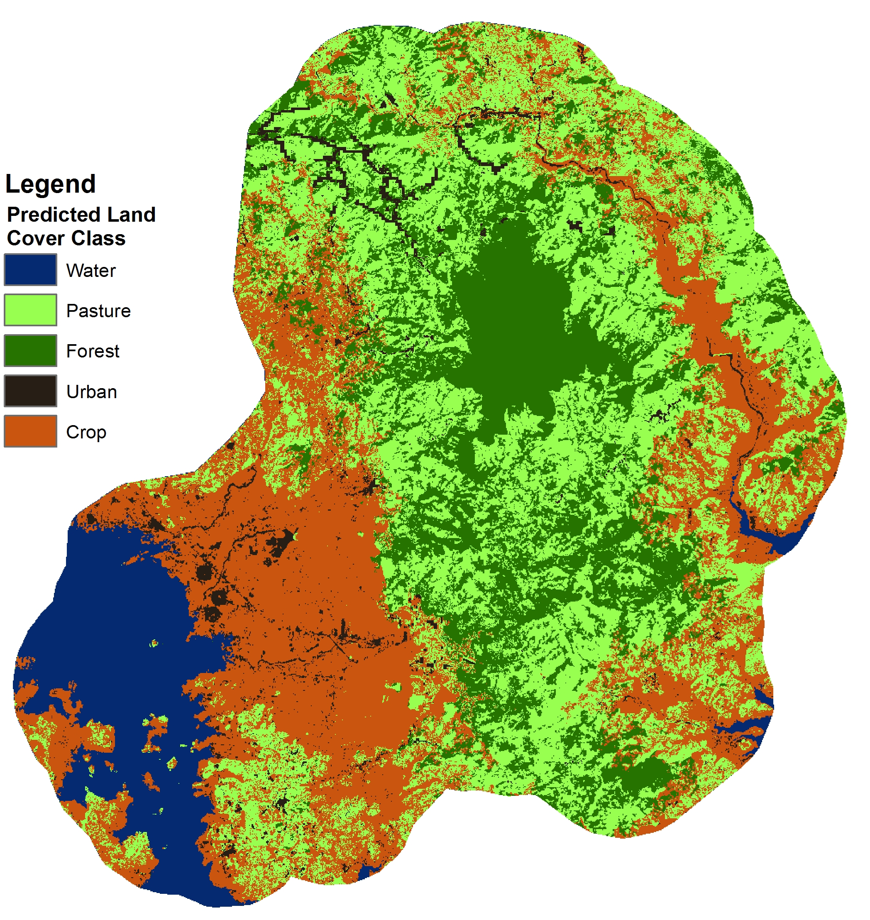
End Product
Forecast 2030
Produced in TerrSet Land Change Modeler
Notes:
-Using these results, other variables, and TerrSet’s land change modeler we were able to forecast to the year 2030
-However the model is not deemed to be very accurate as it contradicts expectations and shows increasing forest cover and the retreat of urban areas

Slide 13
Sean Kearney, USAID, ABES Project
Conclusions
Created an easily replicable methodology for LULC
Refinement of training sites will increase accuracy of the LULC classifications and the forecast model
MARN will be able to apply these methods on the national scale
Notes:
This project is being continued in the Spring 2016 term. For this reason we wanted to focus much of our effort in creating a strong backbone methodology that can be passed on to the next DEVELOP team so they can refine the results to better suit our partners in El Salvador.
We created an easily replicable methodology for LULC classifications, including one or two scripts that can streamline some of the batch data processing.
We began validating a GFC dataset at the regional scale. A successful validation of this dataset means we can use it as “ground truth”, this is particularly useful for regions that do not have available plot survey data or high resolution satellite imagery for an accuracy assessment of the LULC classification. MARN would be able to apply our methods on a national scale without having to buy high-res satellite imagery or hiring people to conduct field surveys.

Slide 14
Sean Kearney, USAID, ABES Project
Future Work
Improve accuracy using updated ABES plots gathered in January 2016
Expand the timeline of LULC classifications to include additional years
Develop a regional forest inventory to improve El Salvador’s capability for REDD+ monitoring
Notes:
For the DEVELOP team continuing this project we recommend working to improve the accuracy of the LULC classifications by refining training sites and incorporate the updated plot data from ABES taken in January 2016.
We would like to see additional years of LULC classifications created, by refining training sites and improving the accuracy of the LULC we can look further into the past with more confidence.
One thing we wanted to do was created a regional forest inventory, simply highlighting the forest class in the LULC and breaking that class into subclasses (ie. Broadleaf forest, mixed pine forest, etc…) giving our partners a tool for monitoring forest dynamics in El Salvador.

Slide 15
Advisors
Dr. Kenton Ross, NASA DEVELOP National Program
Collaborator:
The Earth Institute, Columbia University (ABES Project)
POC: Dr. Sean Smukler & Sean Kearney
End Users:
La Mancomunidad La Montañona, Chalatenango
POC: Arnulfo Alberto
Ministerio de Medio Ambiente y Recursos Naturales (MARN)
POC: Giovanni Molina

