Slide 1



2019 Fall
NATIONAL
ORIENTATION
MODULE 4. Projects

Slide 2


Project Characteristics
50-60 projects take place each year – at their core they share these characteristics:
Highlight the applications and capabilities of NASA Earth observations
Address community concerns relating to decision-making for real-world environmental issues
Partner with organizations who can benefit from using NASA Earth observations to enhance decision making by providing decision support tools
Align with at least one of the eight NASA Applied Sciences Program’s National Application Areas
Create a consistent set of deliverables
Research is conducted by teams with diverse backgrounds under the scientific guidance of Science Advisors and mentors from NASA and partner organizations

Slide 3

Project Ideas Sources
National
Science
Objectives
Environmental
Decision
Makers
NASA
Program
Managers
End-User Needs
State & Local
Policy
Makers
DEVELOP
Science
Advisors
DEVELOP
Fellows & Participants
NSF
Decadal
Survey
Local
Communities &
Tribal Entities
New
NASA
Missions
Federal
Agencies &
Organizations
By The Way
Ideas can come from anywhere as long as they connect to a decision-making end user! Have an idea? Tell your Fellow!

Slide 4
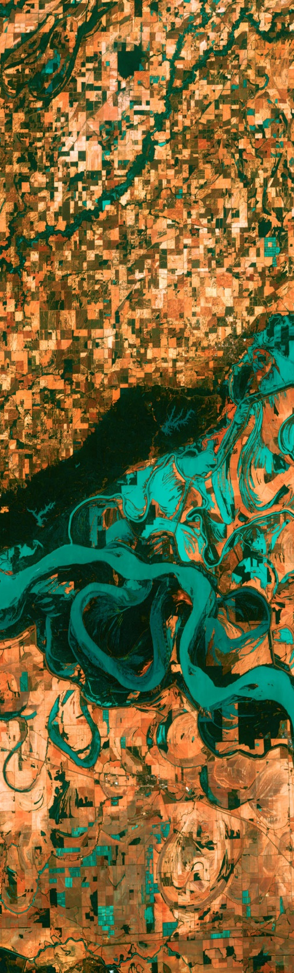
Project Lifecycle
Conversations w/ Potential Partners to Identify Needs Surrounding Their Decision-Making Process
Project Idea Collection
- Submission to NPO
- NPO Reviews & Discusses w/ Node
Proposal Process
- Fellows Draft Proposals
- NPO Reviews
- NASA HQ Reviews
Project Execution
- Literature Review
- Data Acquisition & Processing
- Results
- Discussion & Conclusions
- Deliverables Created
Hand Off to Partners & Video Release & Conference Presentations
All DEVELOP projects center around a decision.
DEVELOP identifies the information that would be helpful to the partner when making this decision. This is the partner’s need.
Project end products are designed to fit into the partner’s decision-making process.
The end deliverable package is handed off for partners to explore further and assess integration into their decision-making process.

Slide 5
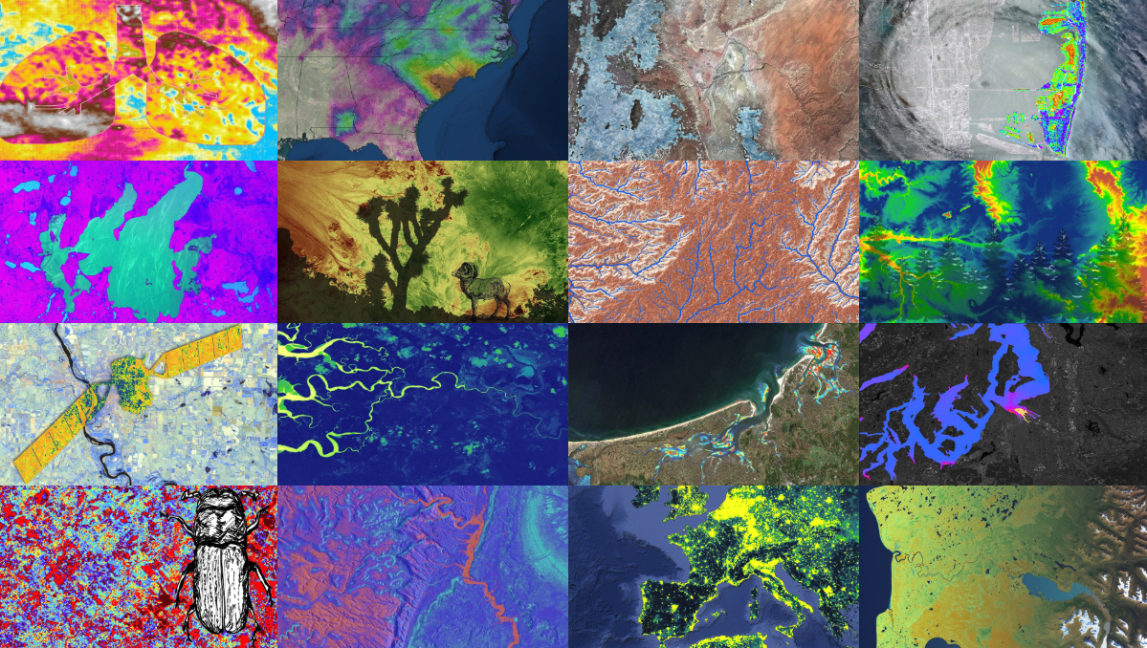
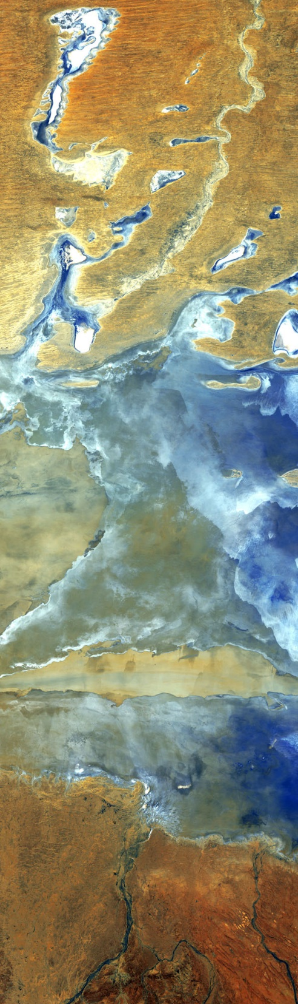
Deliverables
All projects create:
Project Summary
Study Area Shapefile
Poster
Presentation
Tech Paper
DEVELOPedia Page
Website Image
Feedback Form
Some projects create:
Video & Transcript
Code
Software Release Forms (required if team plans to share code w/partner)
Tutorial (optional)
Brochure (optional)

Slide 6
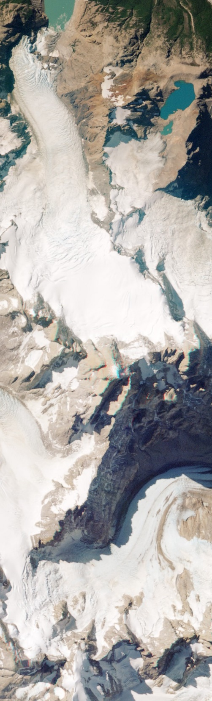
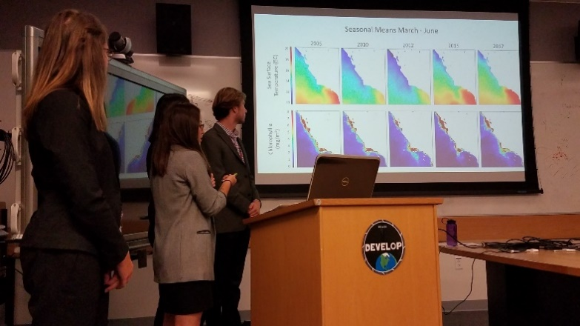
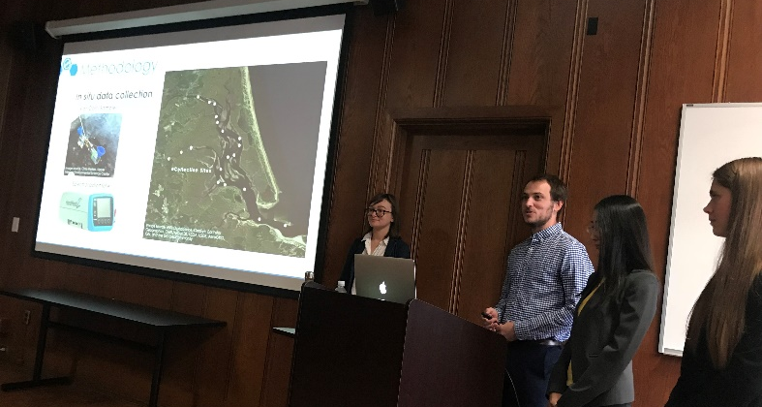
Project Handoff
Handoffs are an important step in transitioning results and methodologies to end users and working towards the goal of the end users integrating NASA Earth observations into their decision-making processes.
Depending on what you are handing off, be cognizant that you must get materials approved by NASA prior to handoff.
Commonly Used Handoff Styles
Email deliverables (Tech Paper, Tutorials, Presentation, etc.)
Teleconference or videoconference presenting the results and methodologies
In-person presentation of results and methodologies
By The Way
Get creative in how and what you hand off. Interesting idea? Speak to your Fellow about it!

Slide 7
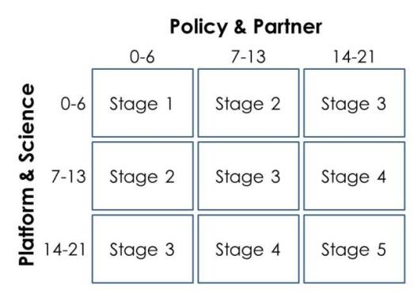
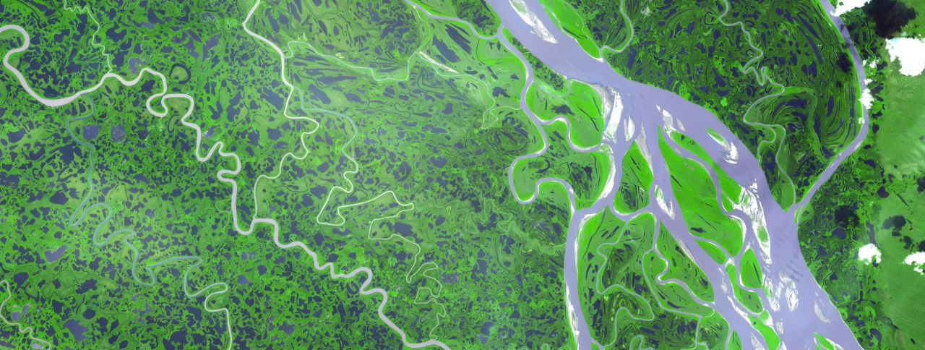
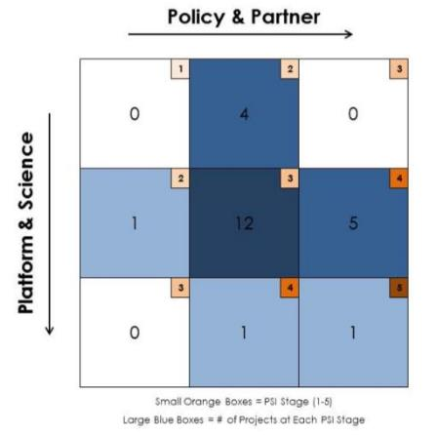
Project Assessment
DEVELOP Project Strength Index (PSI)
DEVELOP projects have consistently improved and matured over the Program’s last 15+ years. The PSI provides DEVELOP a means of objectively evaluating projects and tracking progress in two steps. The PSI Part 1 is completed after each term of a project, creating a preliminary score. The PSI Part 2 is completed ~4-6 months after the final term of the project to assess additional project characteristics such as publishing, conference presentations, and partner use of end products.
A series of questions are answered earning a total of 21 points in two sections: 1. Policy & Partner and 2. Platform & Science. The score for each category is then placed on the Index to determine the project’s current stage (1 to 5).
Stage 1: Basic Research
Stage 2: Application Concept Complete
Stage 3: Application Demonstration Successful
Stage 4: Application Verified / End User Engaged
Stage 5: Transition to End User / Decision Enhanced

Slide 8

Project Assessment – Partner Inputs
A Pre-Project Partner Form was sent out before the term to gather information about partner needs and expectations. A Post-Project Partner Form will follow the completion of the term to collect information regarding the perceptions of success of collaborating with DEVELOP.
  Were the project results and methodologies useful?
  Was the experience a good one?
  Is the partner using the results or methodologies in their decision-making process?
Timeline: Fellows sent out the Pre-Project survey link a couple weeks before the beginning of the term. The Post-Project survey link will be sent to partners at the end of the term. In case of a project that has multiple terms, the survey does not go out until after the project’s final term.
Please communicate to your partners that DEVELOP will stay in touch and send a brief survey at the end of the project’s final term.

Slide 9

Feasibility Considerations
DEVELOP projects are 10-week feasibility studies.
In 10 weeks, validation efforts are limited at best.
Be mindful in how you communicate with partners – do not overpromise or oversell your products and results.
NASA does not develop or prescribe policy, thus DEVELOP projects do not either.
DEVELOP projects simply demonstrate the feasibility of integrating NASA Earth observations into decision-making processes.
Other agencies and organizations may use the data and scientific results in their policy analysis and development.
NASA funds DEVELOP, thus DEVELOP projects are focused on the application of freely-available NASA Earth observations.
The North Carolina node receives NOAA funds, so they have an additional directive to highlight NOAA CDRs.

Slide 10

2019 Fall Portfolio
Hawaii Water Resources - ARC
Louisville Urban Development - AZ
Apostle Islands Water Resources - CO
Medicine Bow Disasters - CO
Northern Forest Food Security & Agriculture II - GA
Costa Rica & Panama Ecological Forecasting - GA
Visayan Islands Ecological Forecasting - GA
Gila Water Resources - GSFC
Great Basin Ecological Forecasting - ID
Belize & Honduras Water Resources II - JPL
Panama Water Resources - JPL
New York City Urban Development - LaRC
Central America Health & Air Quality – LaRC
Central Java Disasters - MA
Delaware Urban Development - MSFC
Tennessee Valley Energy - MSFC
Honduras & Nicaragua Ecological Forecasting - NC
Asheville Food Security & Agriculture - NC
By The Way
Feel free to reach out to other teams! They may be using similar EO, working with similar partners, or working in a similar geographic area!

Slide 11
Quiz Time!
How many projects does DEVELOP conduct a year?
What do all DEVELOP projects center around?
What is the last step in the DEVELOP project lifecycle?
What is DEVELOP’s project assessment called?
Does NASA prescribe policy?
Can teams pursuing similar projects reach out to other nodes?

Slide 12



THANK YOU!
“A place for everything and everything in its place.”
-- Benjamin Franklin --

