Slide 1
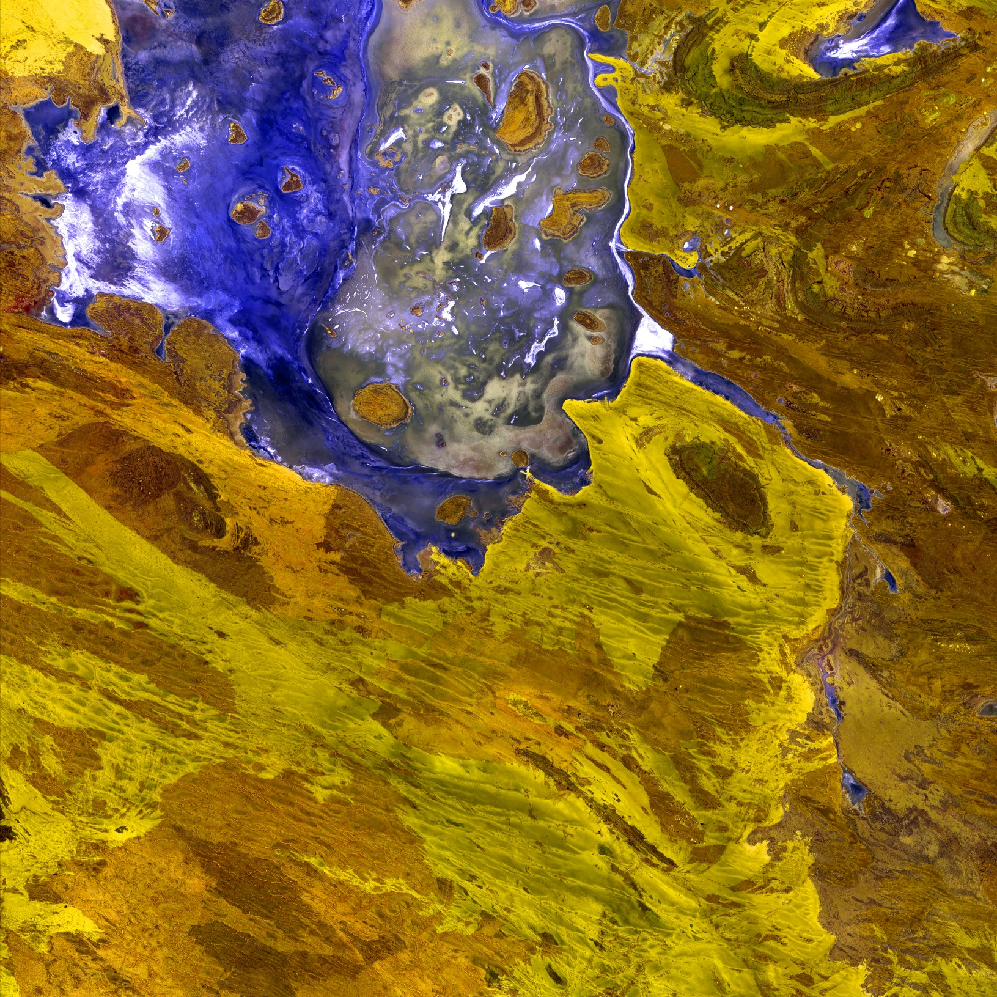
2018 Fall Term
DEVELOP
Proposal Bootcamp
Day 2
Notes:
Your project Website Image should be placed behind the hexagon grid. An example image has been placed in this position for your reference. Delete the example image, insert your image, right click your image and select the “Send to Back” option. Position and adjust the size of your image so that it lines up with the provided margin rulers.

Slide 2
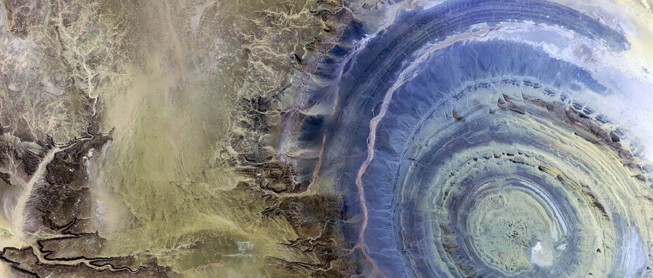
Project Development
Needs Assessment
Idea Generation
Project Idea Form
Feedback Forms
Summer Feedback
Scoping
Metrics & Targets
Underutilized Sensors
SDGs & Socioeconomic Data

Slide 3
Partner Needs Assessment
Prepare for your first communication with a potential partner by compiling questions relating to the following areas. This typically happens ahead of or during the proposal writing process.
Community Concern or Policy
Background, current policies, and upcoming/ongoing decisions relating to the issue at hand
Economic impact (ex. cost of fighting a wildfire or drought impacts to crops in a region)
Technology
Do they currently use GIS and/or remote sensing?
What data types are they familiar with?
Do they have access to ArcGIS/ENVI/MATLAB/etc. or whatever software you will use? (this can guide the team’s use of open source software)
Partnership and Transition
Clarify expected level of involvement – how much can the partner interact with the team?
What organizations do they partner with?
What tutorials would be of use? What format should end-products be in to be useful?
What is the best transition approach? Email, telecon, videocon, in-person (consider distance for this one – if you’re 3000 miles apart choose a different option)

Slide 4
Project Idea Collection
When: 1-6 months ahead of proposal deadline
What:
Short Title
Subtitle
Primary Application Area
Study Area
Partners
Why: Helps NPO coordinate the portfolio, ensure balance, and strengthen project ideas
Tips:
Feel free to ‘over-propose’ ideas and let NPO help you refine
List them in your prioritized order so we understand your preferences
International projects require a checklist which is crucial to a project being approved by NPO --- no international checklist, no go
Communication with partners should have begun prior to idea submission
When communicating with partners about collaborating with DEVELOP, be fuzzy with the term planning at the beginning – always talk about the upcoming opportunity as potentially taking place between two future terms in the case something needs to be delayed. Share details & timelines for both and give clarity to the proposal process.
EO
Decision Description
Potential End-Products
International Checklist (if applicable)

Slide 5
Project Idea Form
Collects:
Submitter’s Info: Name, Title, Organization, Contact Info, preferred method of communication
Questions:
What is the issue and/or environmental concern at hand, and where is it occurring?
What decision is being made relative to the above mentioned issue, that you think could be improved through the incorporation of NASA Earth observations?
What tools/end-products would be of use to the decision-making described above?
Description of project: (optional - only if any idea is formulated yet)
Any additional information/links that may be useful to DEVELOP as they review this request: (optional)
Available on the website on the project page
Submitted to the DEVELOP DL email
Collects a small amount of information to facilitate conversations
NPO works to find a home for each project that seems feasible

Slide 6
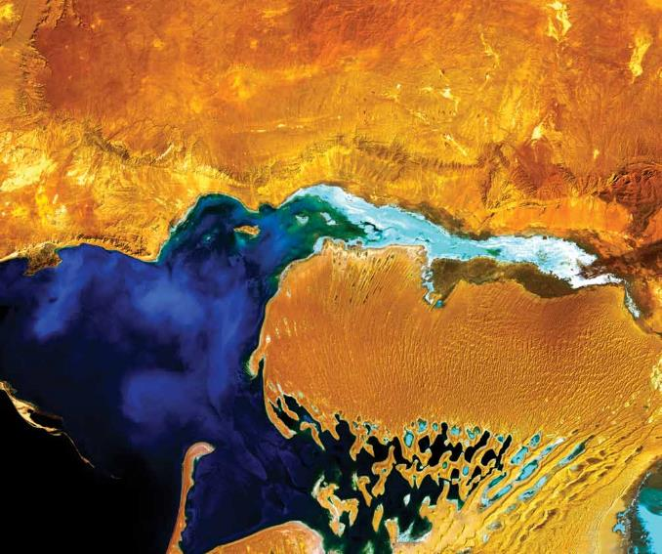
Feedback Form
Does the team consider this project to be successful?
If you had the opportunity to do this project again, what would you do differently?
Is this project planned to continue into another term? If so, please reflect on why you think it should or should not.
Recommendations to future teams pursuing a similar project?
NASA Earth Observation Data
Source
General Overview
Partner Engagement
Involvement
Responsiveness
Culminating Research Questions Generated
Team-Identified Future Work
Partner-Identified Follow-On Research Questions
Acquisition
Processing/Analysis
Capacity Built
Further Collaboration

Slide 7
Summer Feedback
Partner interaction
Pay attention to field seasons and partner availability
In the beginning of the term, contact partners to define a list of research questions and/or expectations
Make sure objectives are clear from the beginning
Ensure partners are aware of the limitations of a 10-week term
“We never had any communication with this partner”
End user: 2
Collaborator: 1
“Lost communication with this partner”
End user: 1
Collaborator: 2

Slide 8
Summer Feedback
First steps
Spend more time researching the issue and proposed methods to inform questions for science advisors and contact them often
Research the issue beforehand and understand the community/partner concerns first
Use DEVELOPedia to refer to previous projects
For multiterm projects, contact the previous term; establish communication to figure out what needs to be done
Lay out a strategic plan to keep on track

Slide 9
Summer Feedback
Data
Get in situ data ASAP
Evaluate potential datasets early and make decisions!
You aren’t limited to satellites/datasets from the proposal
Start thinking about sensors early; become familiar with how each sensor processes and visualizes data
Learn more about satellites and sensors
Even if you get helpful data, it might be too late in the term to use it
Higher spatial resolution data would be helpful
Make sure you have enough data for statistical analysis
Resources
Start science advising meetings earlier
Take advantage of science advisors earlier
Leverage online communities for code/GEE
Contact authors of papers that were used for methods

Slide 10
Effectively Scoping Projects
Assume 4 participants @ 29 hours each for each project team
Project scope considerations:
Study area extent
Study period
Satellite/sensors and data type
Feedback
Limit your study scope
“In the end, this decision strengthened our project because we were able to investigate spatial and temporal relationships with the saved time.”
Begin with a more narrow scope and more information from the partners
Narrow the scope so that initial data exploration doesn’t take away time from analysis
Analyze EO availability before submitting the project to check feasibility
Overwhelming number of sensors originally suggested
Use previous code and improve methods or efficiency

Slide 11
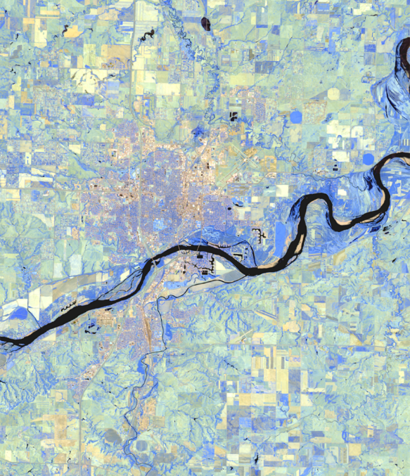
DEVELOP Metrics
35 states impacted per year (both FY and CY)
50 states impacted on a rolling 3-year basis
Work in all application areas annually
3 Latin America-focused projects per year in alignment with AmeriGEOSS
Cap of 25% international (HQ told us we can work internationally after 35 states annually have been impacted)

Slide 12
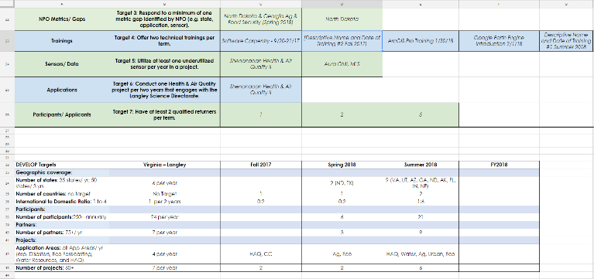
Node Targets
Node targets provide a means of each node contributing to the DEVELOP portfolio
Management tool designed to help the program to meet metrics and ensure balance
Will be assessed on a term by term basis
Each Fellow should be prepared to present at the retreat in the node overview
Note: Metrics that are reliant on the number of projects being conducted at a node may shift due to funding available

Slide 13
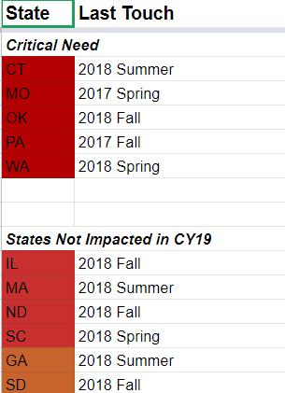
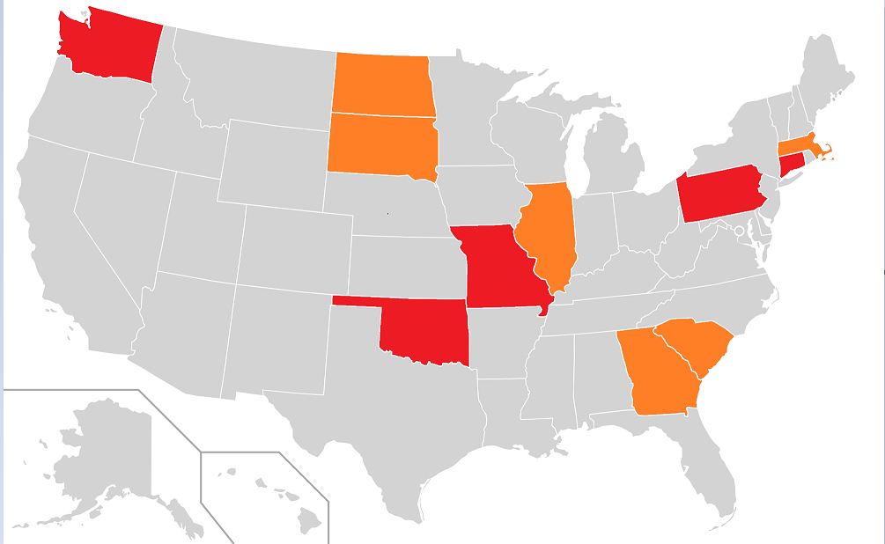
States Impacted
Gaps:
Critical Gaps:
Critical Need: CT, MO, OK, PA, WA
States Not Impacted in CY19: IL, MA, ND, SC, GA, SD

Slide 14
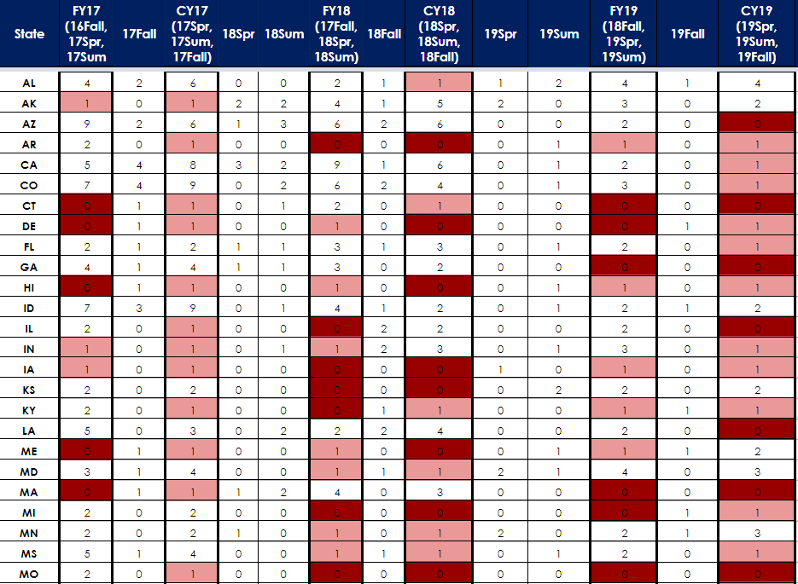

Slide 15
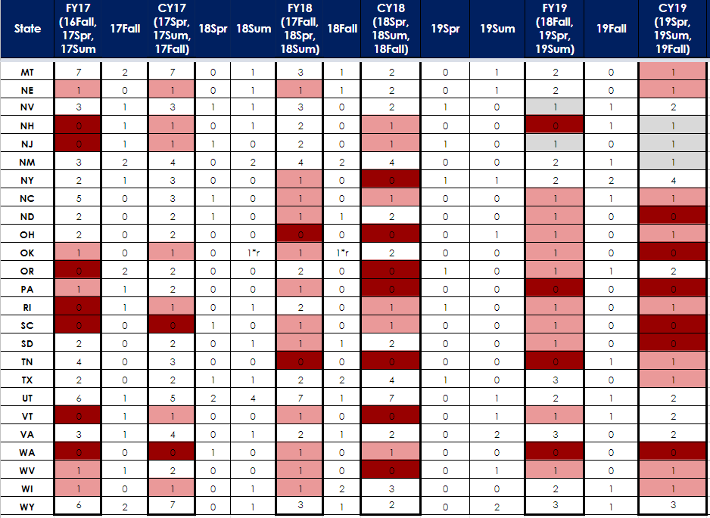

Slide 16
Application Areas
App Area | 17Spr | 17Sum | 17Fall | 18Spr | 18Sum | 18Fall | 19Spr | 19Sum | 19Fall | 20Spr
FS & Ag | 3 | 0 | 0 | 2 | 3 | 2 | 2 | 3 | 2 | 3
Disasters | 3 | 4 | 3 | 3 | 4 | 2 | 4 | 2 | 2 | 3
Eco | 3 | 5 | 4 | 2 | 5 | 2 | 2 | 5 | 2 | 2
Energy | 1 | 1 | 1 | 0 | 1 | 0 | 1 | 2 | 1 | 0
Health & AQ | 1 | 4 | 3 | 2 | 2 | 2 | 1 | 1 | 1 | 0
Transportation |  |  | 0 | 0 | 0 | 2 | 0 | 2 | 0 | 0
Urban |  |  | 2 | 5 | 3 | 2 | 1 | 3 | 4 | 0
Water | 7 | 7 | 3 | 7 | 10 | 4 | 5 | 4 | 6 | 11
App Gaps:
CY/FY19: All Addressed
FY20: TI
CY20: Energy, HAQ, TI, Urban
Application Areas
Each DEVELOP project is classified by one of the Applied Sciences Program’s eight thematic application areas of importance:
Disasters
Health &
Air Quality
Energy
Food Security & Agriculture
Ecological Forecasting
Urban Development
Water
Resources
Transportation & Infrastructure

Slide 17
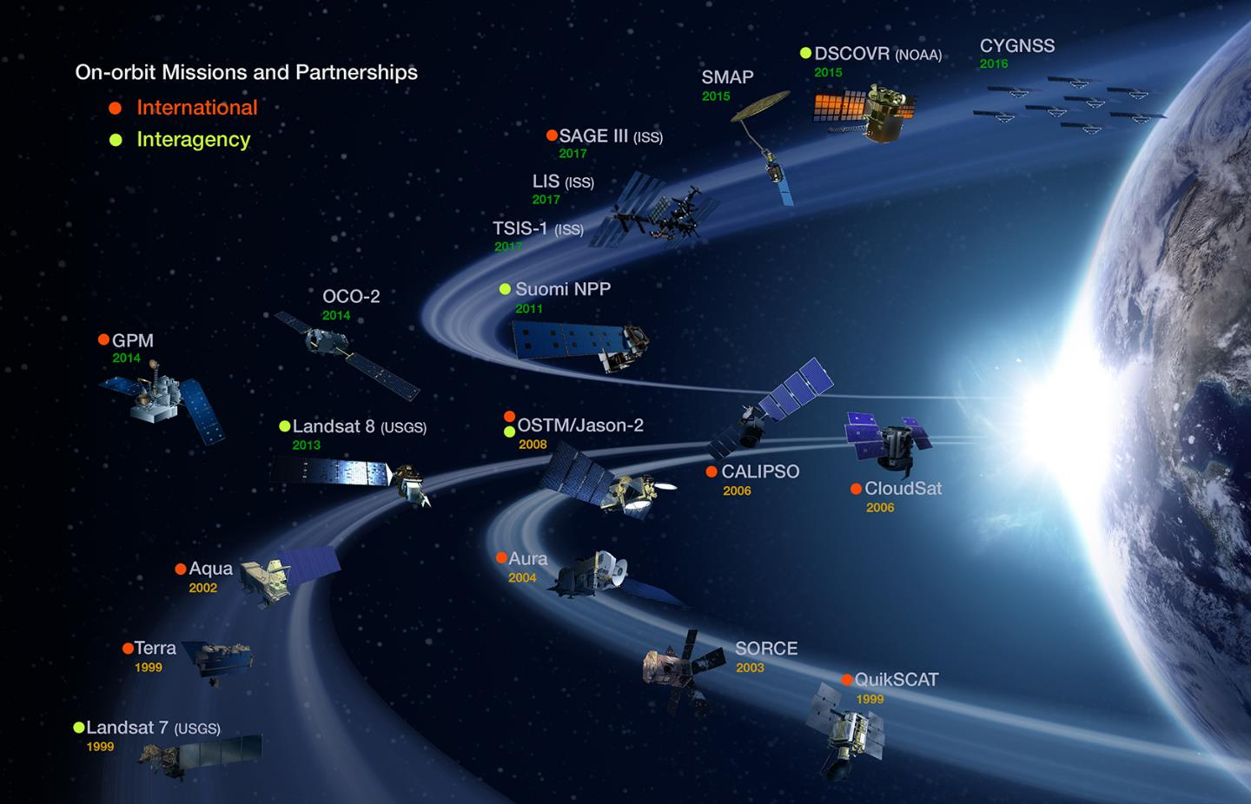
Underutilized Sensors
Under Utilized
Never Used
AIRS
AMSR-E
CERES
Over Utilized:
Landsats
MODIS
ASTER
Sentinel-2 (not NASA, but worth mentioning)
CERES
MOPPITT MISR

Slide 18
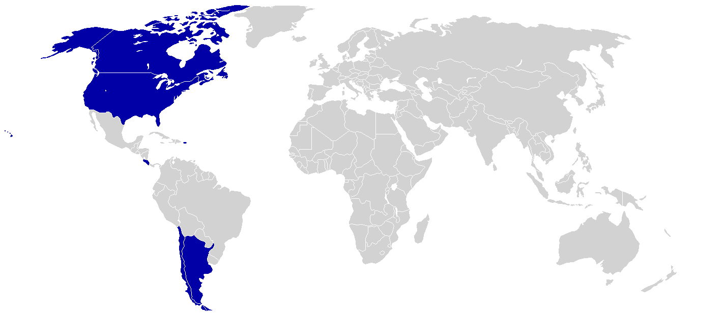
Countries Impacted
FY19:
Argentina
Canada
Chile
Costa Rica
CY19:
Argentina
Canada
Chile
Not Impacted
Impacted
Americas:
CY19: Argentina, Canada, Chile
CY18: Canada, Costa Rica, Colombia, Honduras, Guatemala, Chile
CY17: Canada, Chile, Costa Rica

Slide 19
Designated Countries
Designated Countries
Available at: https://oiir.hq.nasa.gov/nasaecp/docs/DCList_02-15-2017.pdf
NASA’s list of “Designated Countries” is a compilation of countries with which the U.S. has no diplomatic relations, countries determined by Department of State to support terrorism, countries under Sanction or Embargo by the United States, and countries of Missile Technology Concern.
Do not knowingly communicate with individuals in these countries.
Impacts to Project Creation
NASA has strict guidelines relating to doing work in designated countries. Before any communications take place with an individual/institution in a designated country, contact Lauren to discuss. We have open communication lines with NASA’s Office of Interagency and International Relations (OIIR) and they can counsel us on what is and isn’t ok.
Domestic Partners Working in Designated Countries
Discuss with NPO. There are some opportunities where this is acceptable if we talk to OIIR and get their approval first. Ex. Middle East Water project in 2016 Summer
Congressional legislation prohibits NASA from working unilaterally with China or doing any work with Cuba. These countries are entirely off limits to DEVELOP for project study areas.

Slide 20
SDGs
What?
September 2015, UN adopted the 2030 Agenda for Sustainable Development
Outlines 17 Sustainable Development Goals (SDGs) which lay out the overarching objectives for all countries to meet by 2030 in such global concerns as ending poverty and hunger, ensuring gender equality, access to clean water, and environmental sustainability
Why?
Support GEO & NASA Applied Sciences Program efforts to identify SDG indicators that could integrate Earth observations (EO) into their monitoring.
How?
Identify DEVELOP projects that align with SDGs and create case studies that provide an example of how EO can be integrated into SDG monitoring
Partner with organizations that are already working in support of SDGs

Slide 21
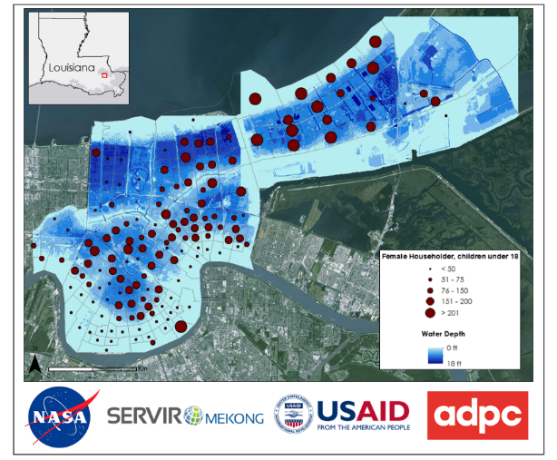
Socioeconomic & Demographics Data Usage
NASA’s Socioeconomic Data and Applications Center (SEDAC): Focusing on human interactions in the environment, SEDAC has as its mission to develop and operate applications that support the integration of socioeconomic and earth science data and to serve as an ‘Information Gateway’ between Earth sciences and social sciences.” (http://sedac.ciesin.columbia.edu/)
Support Capacity Building Program’s efforts to support SEDAC data usage and incorporate socioeconomic analyses into CBP work
Ideas: Include demographic data relating to gender in population in risk/ vulnerability map products
Well-suited for Disasters, HAQ, and Agriculture
Resources:
ARSET Trainings: https://arset.gsfc.nasa.gov/sdgs
SERVIR GIS & Gender Guidance Notes: https://servir.adpc.net/publications/gender-and-gis-guidance-notes

