Slide 1
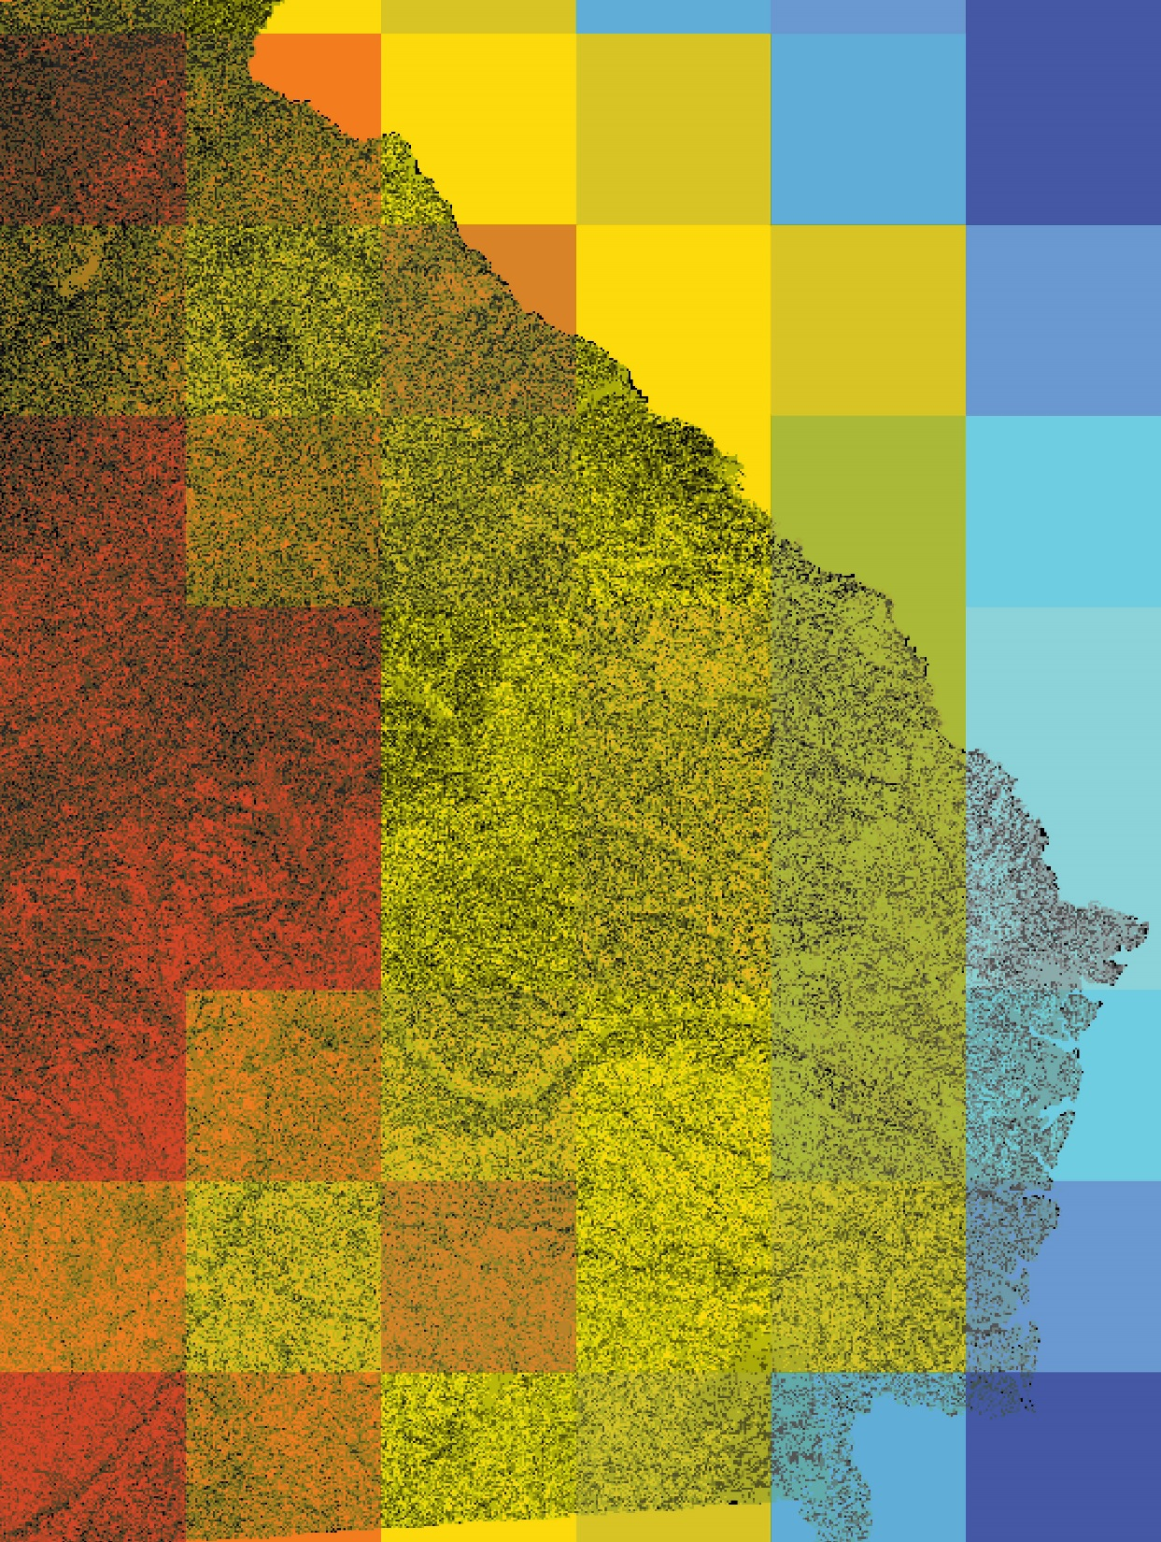
GEORGIA ENERGY
Identifying Suitable Areas for Solar Power Generating Facilities while Reducing Conflicts with Sensitive Habitats and Wildlife Populations
Lynn Abdouni
Roger Bledsoe
Emad Ahmed
Christopher Cameron
Natalia Bhattacharjee
Suravi Shrestha
Austin Stone
University of Georgia
2017 Summer
Notes:
This project will examine the rapid growth of solar energy in Georgia, and provide a planning support tool for solar farm developement to minimize impacts to environmentally sensitive areas.

Slide 2
Notes:
Solar energy is a rapidly growing industry and demand for alternative energy sources is increasing in the state of Georgia. This is encouraging for decision makers and developers interested in alternative, sustainable energy sources for utility planning; however, the construction and siting of solar farms could pose threats to environmentally sensitive habits and associated species.

Slide 3
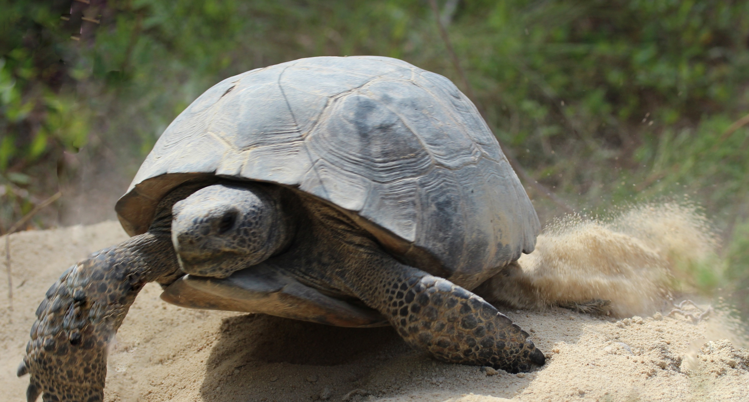
Community Concerns
Notes:
Impacts from solar farm development to protected species habitat and other environmentally sensitive areas
Need for a land use planning tool that incorporates solar farm development and environmental protection criteria

Slide 4
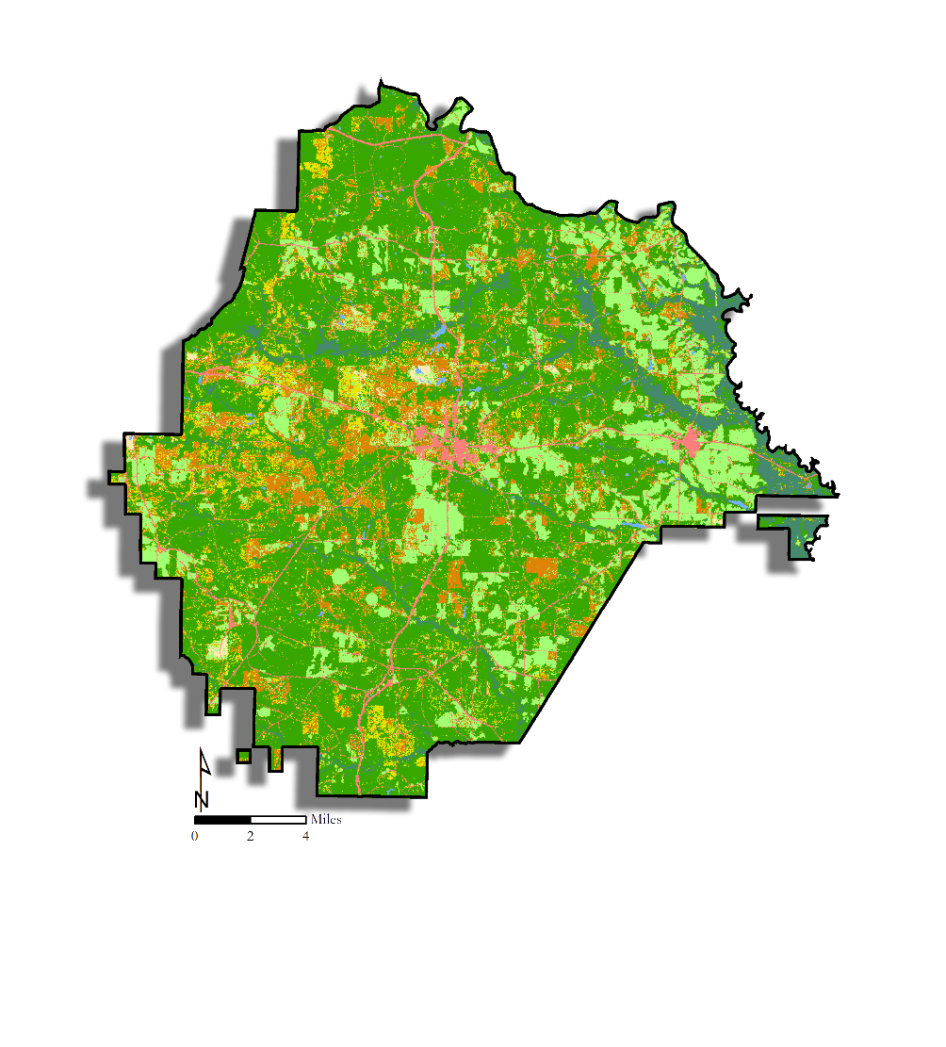
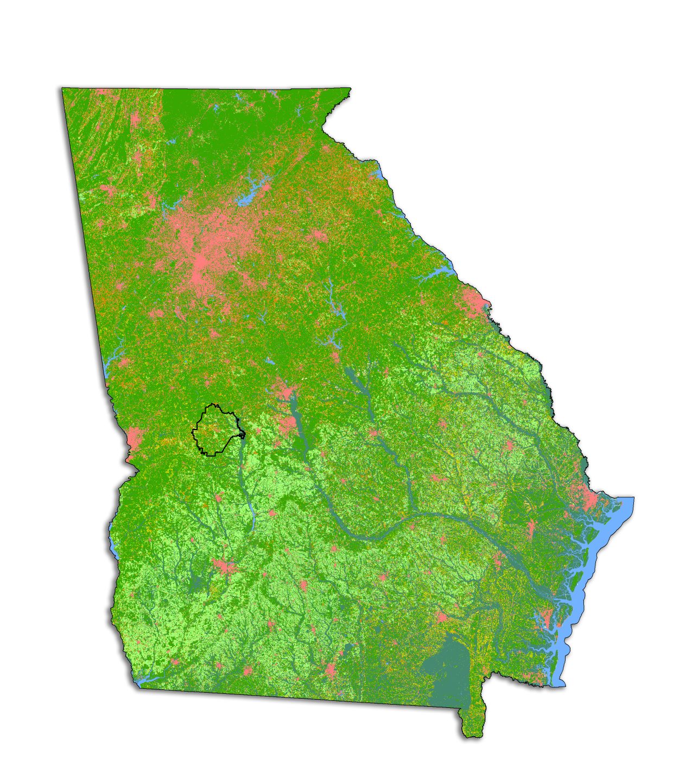
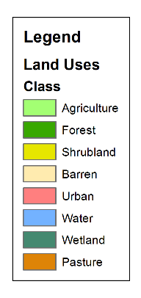
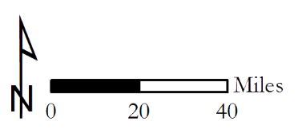
Study Area and Period
Study Area:
State of Georgia
Taylor County
Study Period:
Jan 2016 – Dec 2016
Data: USDA CropScape
Notes:
Solar energy is a rapidly growing industry in the state of Georgia. The expansion of solar energy production opportunities in Georgia is encouraging for decision makers and developers interested in sustainable energy sources for utility planning.

Slide 5
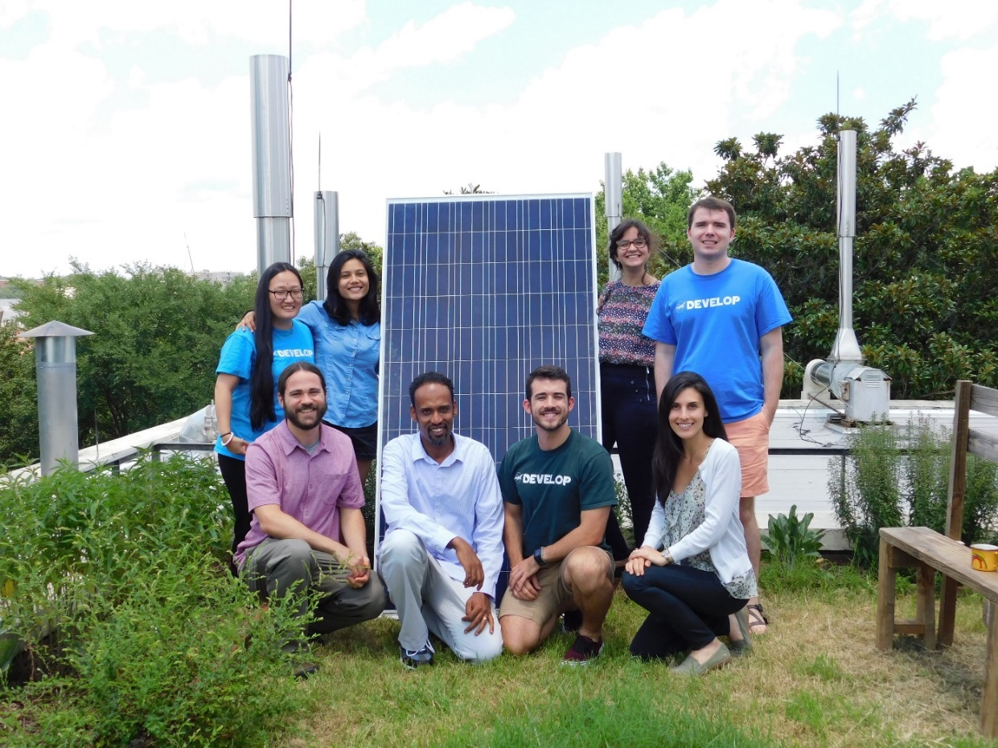
Partners
The Nature Conservancy
Georgia Department of Natural Resources
United States Fish and Wildlife Service
Notes:
This NASA DEVELOP project partnered with The Nature Conservancy and the Georgia Department of Natural Resources to provide a comprehensive model of solar farm development that accounts for the protection of environmentally sensitive areas. The model will facilitate communication with solar site developers to include an environmental protection lens in the development process and provide a framework for the tool to be updated with new information to continually improve the planning process.

Slide 6
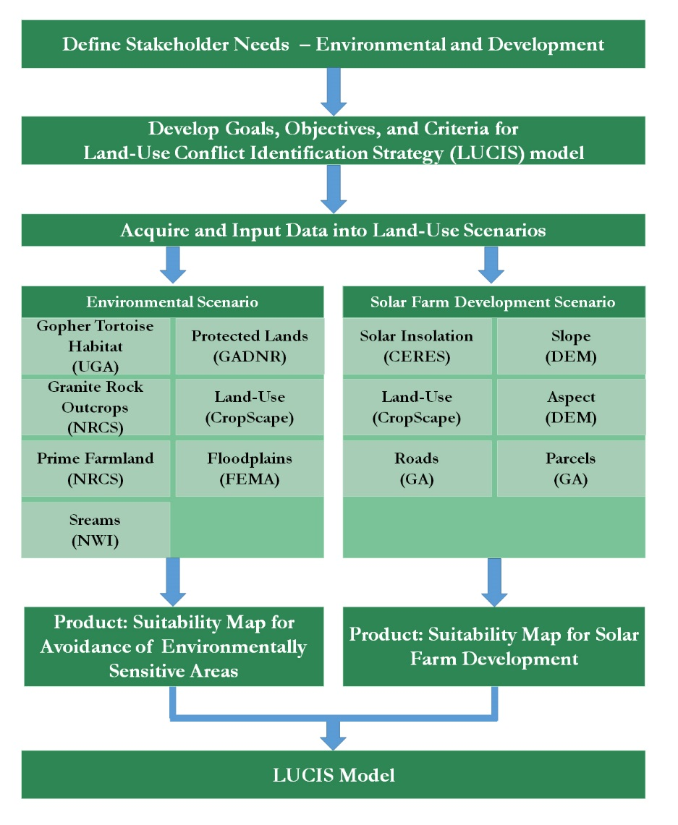
Methodology
Notes:
The team analyzed solar insolation datasets from Terra CERES. These Earth observations were combined with other datasets such as the 2016 USDA CropScape land-use map and a UGA Gopher Tortoise habitat model to classify and extract data layers for a solar site suitability and identify conflicts with sensitive environmental areas.

Slide 7
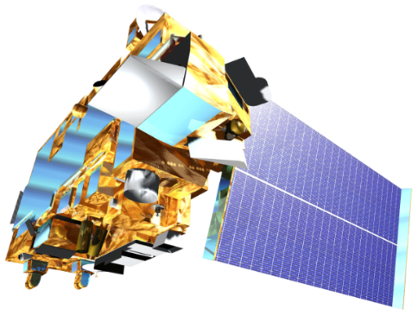
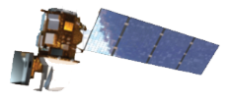
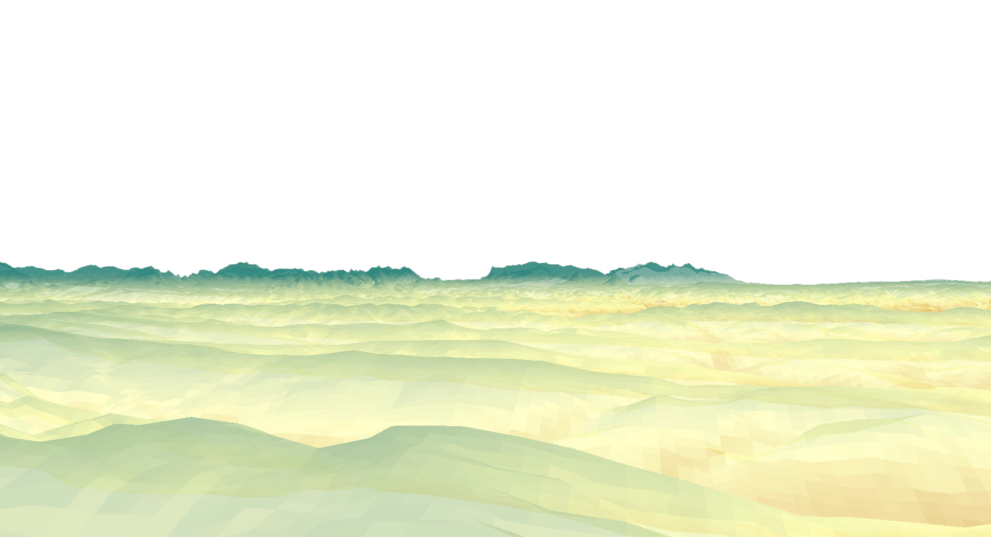
NASA satellites and sensors
Terra CERES
Landsat 8 OLI
Aqua CERES
Notes:
The team analyzed solar insolation datasets from Terra CERES. These Earth observations were combined with other datasets such as the 2016 USDA CropScape land-use map and a UGA Gopher Tortoise habitat model to classify and extract data layers for a solar site suitability and identify conflicts with sensitive environmental areas.

Slide 8
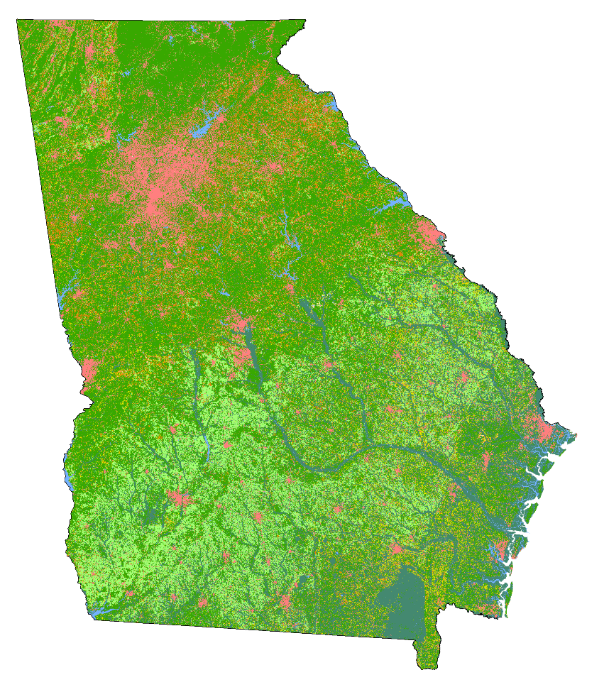
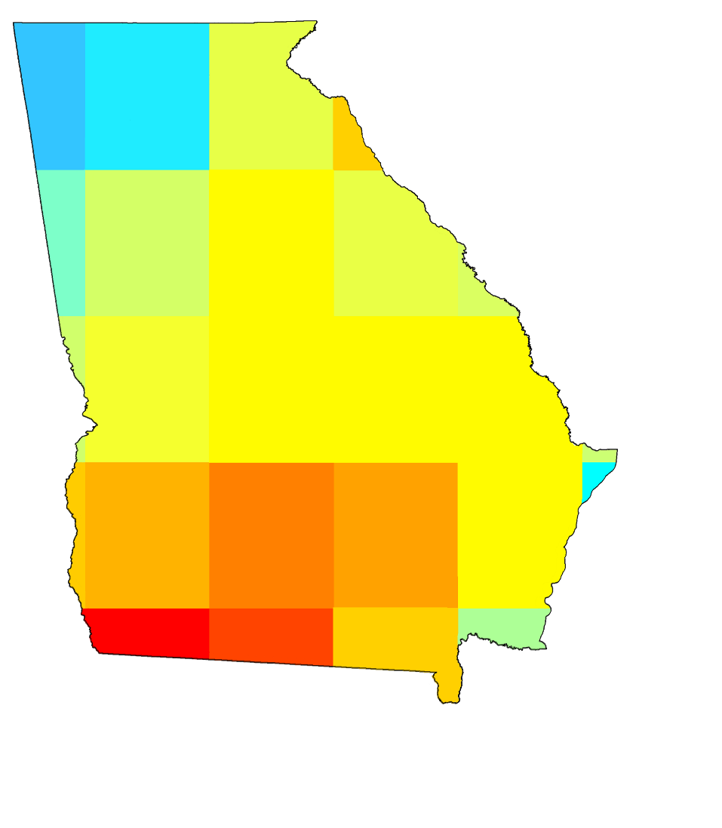
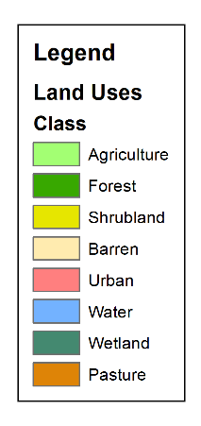
NASA satellites and sensors
Land Use
Solar Insolation
Landsat 8 OLI –
USDA CropScape
Terra and Aqua CERES
Notes:
The team analyzed solar insolation datasets from Terra CERES. These Earth observations were combined with other datasets such as the 2016 USDA CropScape land-use map and a UGA Gopher Tortoise habitat model to classify and extract data layers for a solar site suitability and identify conflicts with sensitive environmental areas.

Slide 9
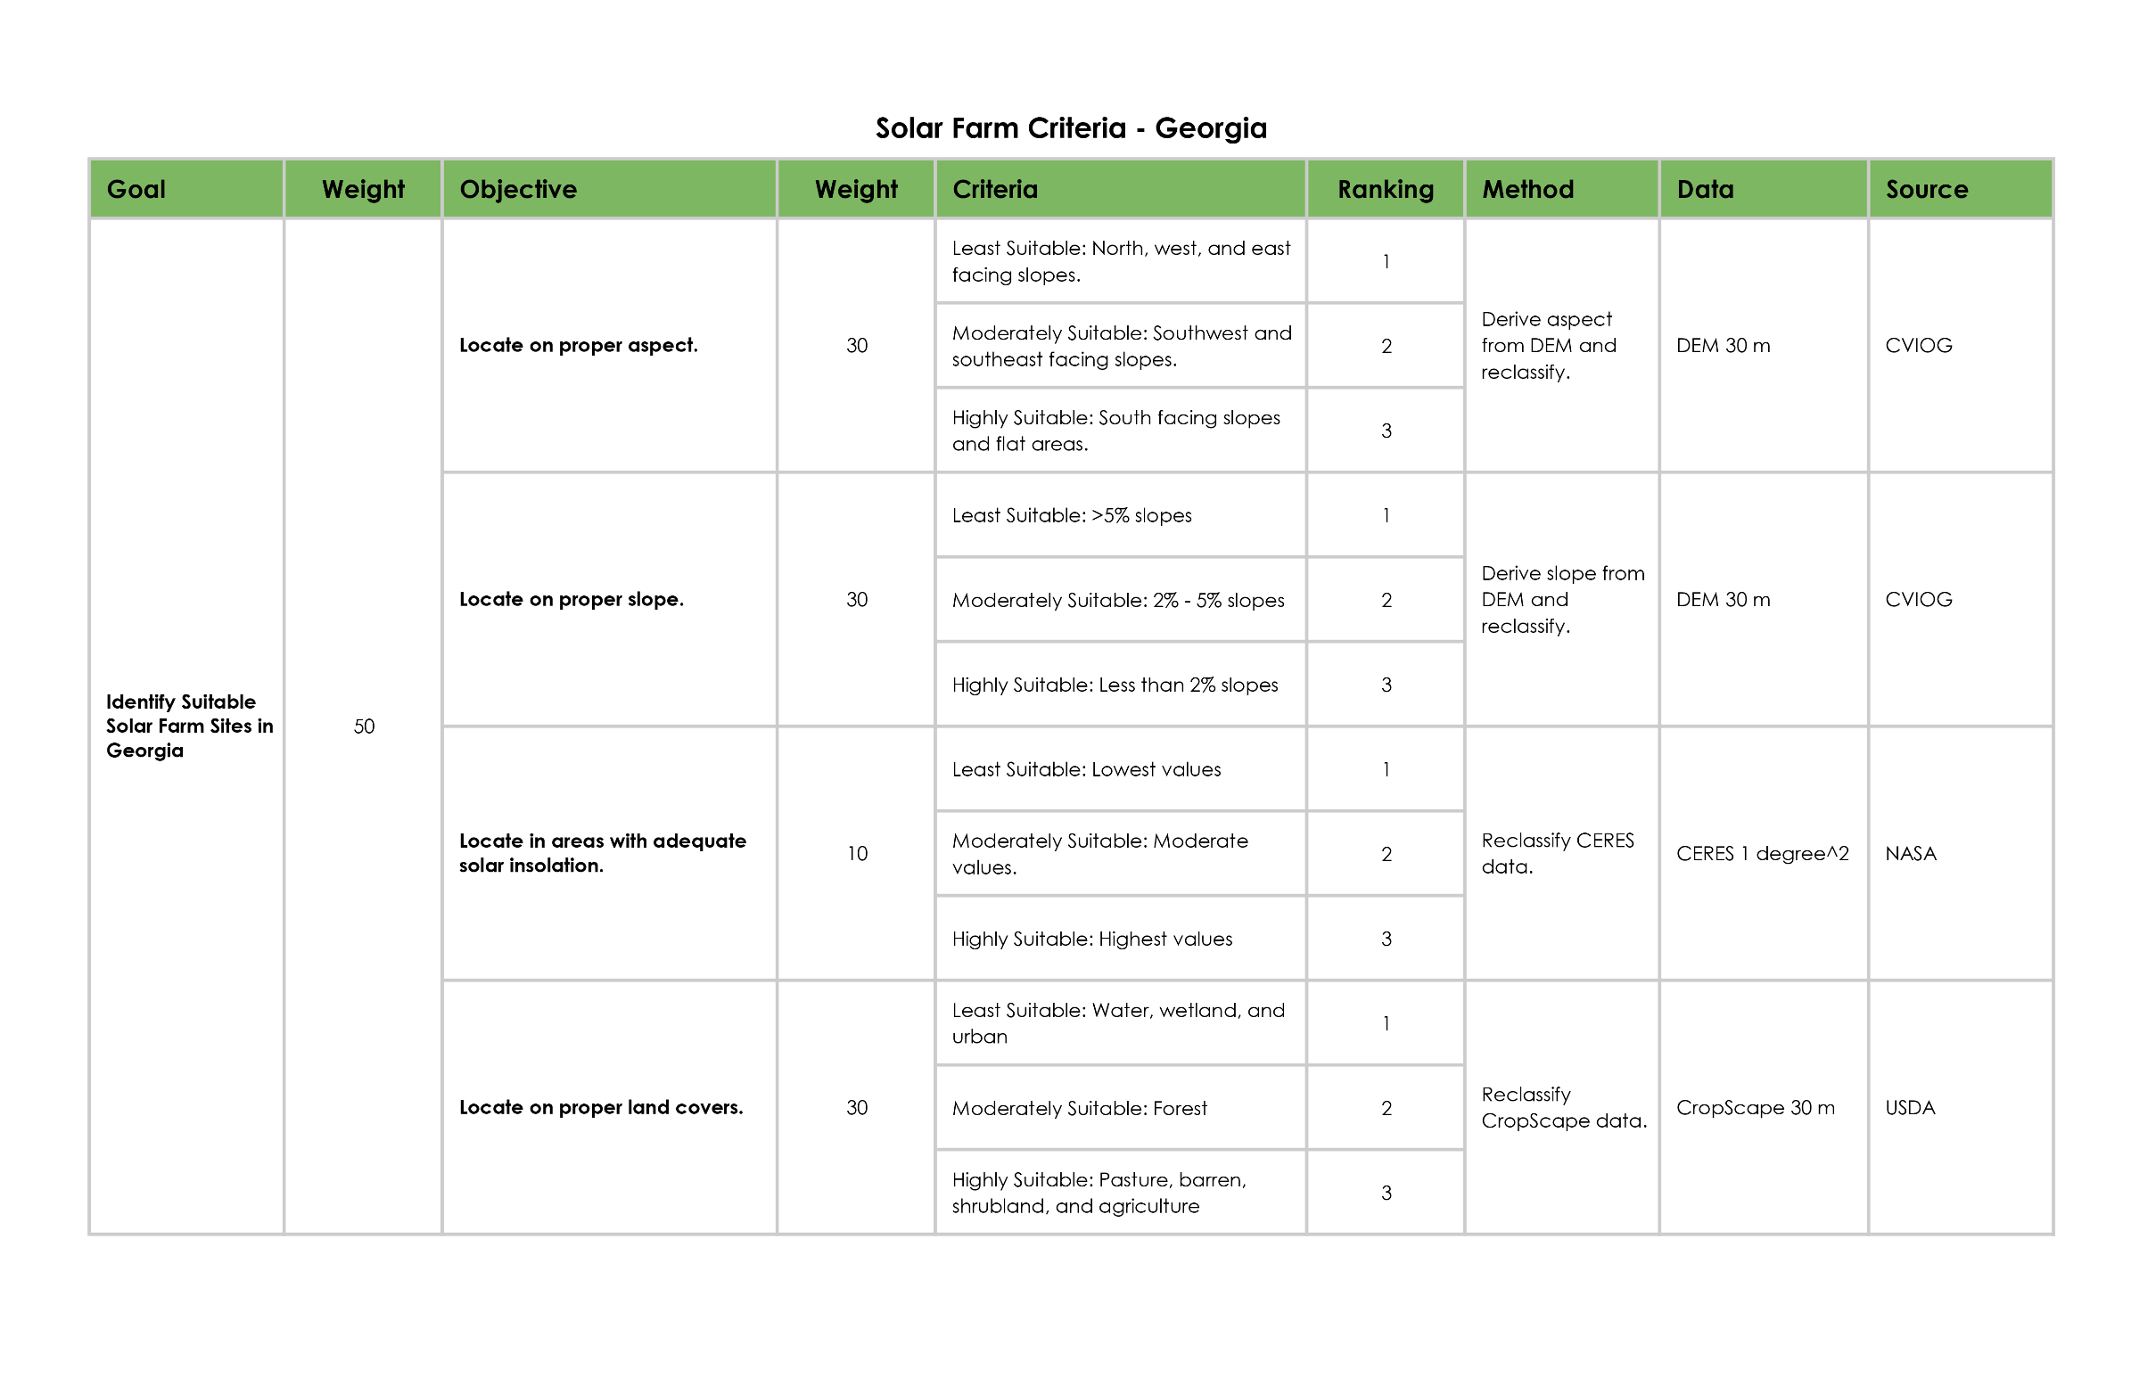
Methodology
Notes:
The team analyzed solar insolation datasets from Terra CERES. These Earth observations were combined with other datasets such as the 2016 USDA CropScape land-use map and a UGA Gopher Tortoise habitat model to classify and extract data layers for a solar site suitability and identify conflicts with sensitive environmental areas.

Slide 10
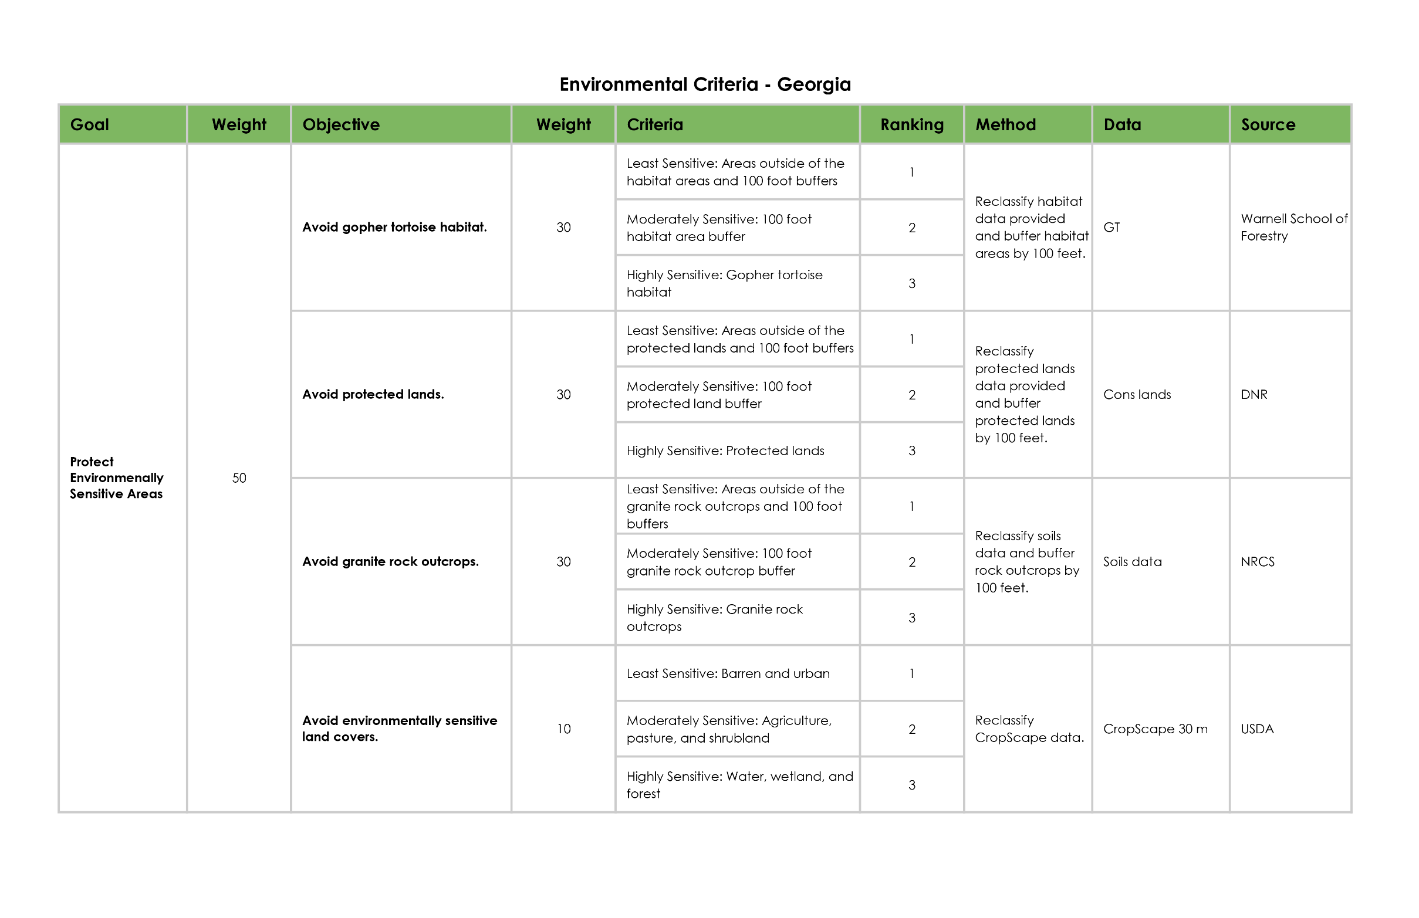
Methodology
Notes:
The team analyzed solar insolation datasets from Terra CERES. These Earth observations were combined with other datasets such as the 2016 USDA CropScape land-use map and a UGA Gopher Tortoise habitat model to classify and extract data layers for a solar site suitability and identify conflicts with sensitive environmental areas.

Slide 11
Results
LUCIS Model – State of Georgia
Solar Farm Development Suitability Map
Environmental Sensitivity Map
Conflict Map
Suitability Map
LUCIS Model - Taylor County*
Solar Farm Development Suitability Map
Environmental Sensitivity Map
Conflict Map
Suitability Map
* Taylor County included more datasets due to its smaller geographic area

Slide 12
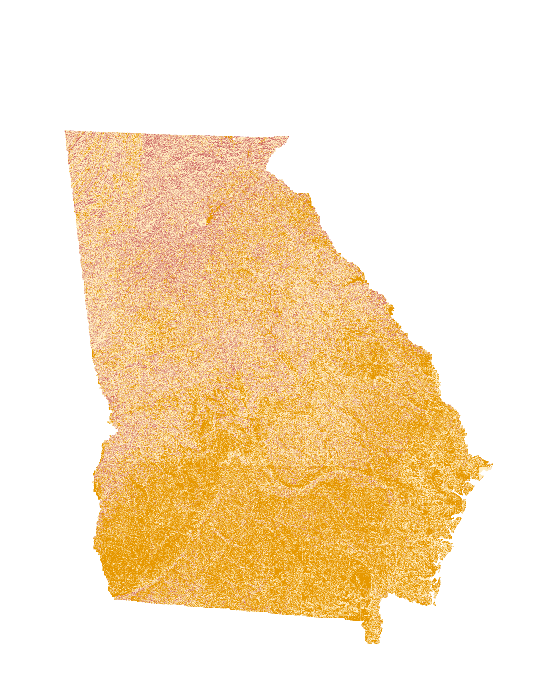
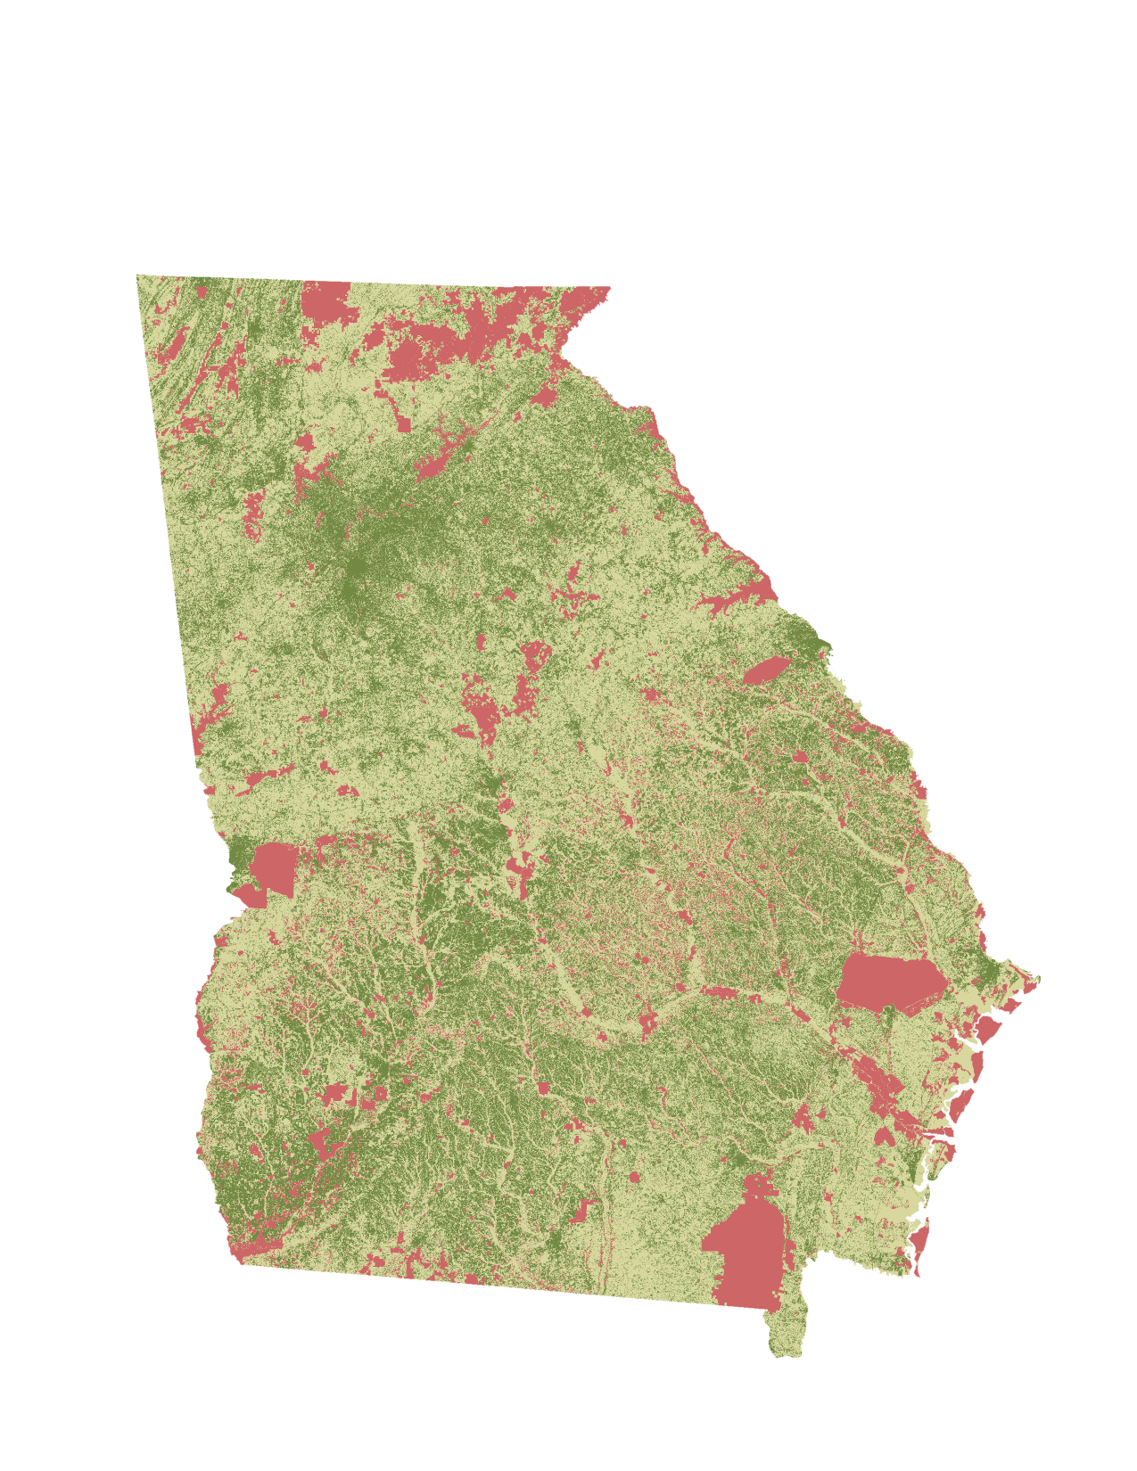
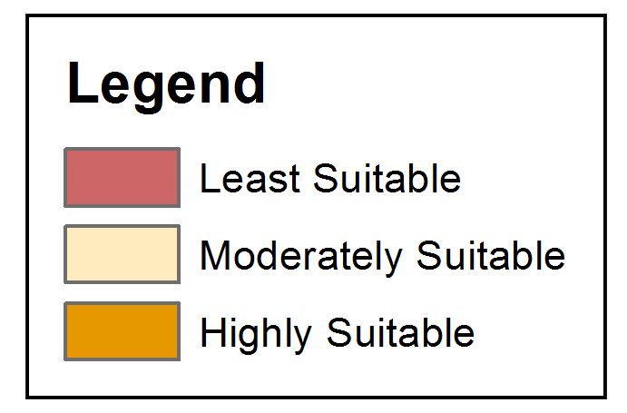
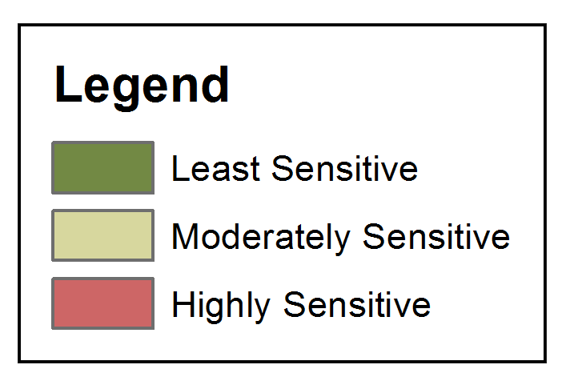
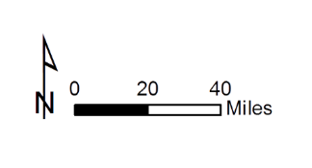
LUCIS Model : Layers in use
Solar Farm Development Suitability Map
Environmental Sensitivity Map
Notes:
Additionally, the DEVELOP team used DEM, CropScape land cover, Georgia roads, and Taylor County parcel data to assist in the suitability mapping for solar farm development.

Slide 13
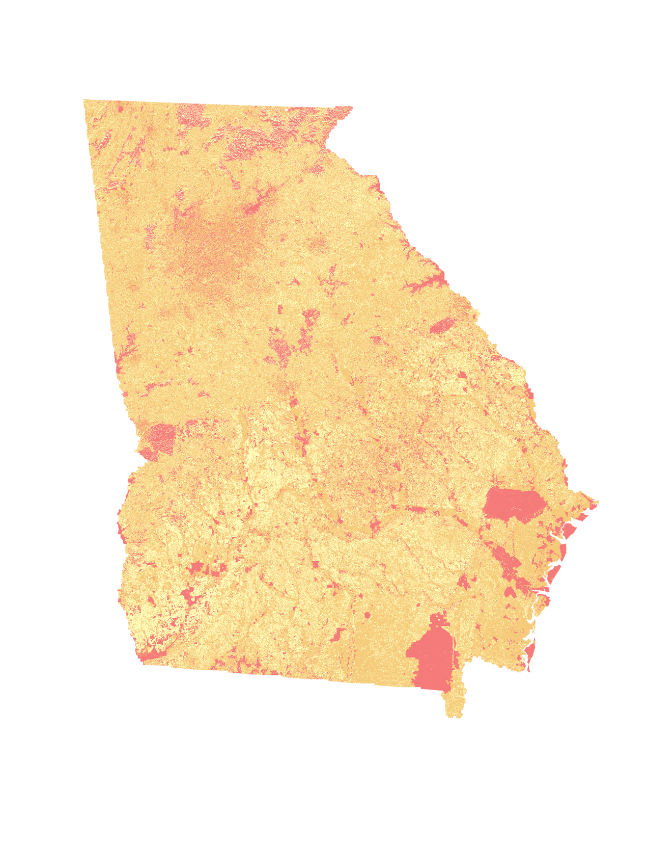
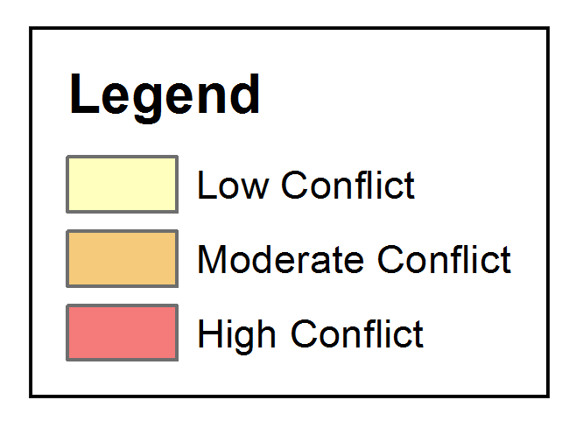
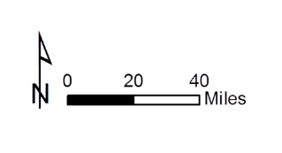
LUCIS Model: Conflict Map
Conflict mapping between the Environmental and Solar Maps:
Least Sensitive Areas – Optimal for solar farm development
Moderately Sensitive – Suitable for solar farm development, but also involves moderate environmental impacts
Highly Sensitive – Conflict Areas
Conflict Areas – Areas both suitable for solar farm development and environmental protection; therefore, they are not suitable for solar farm development
Georgia Environmental and Solar Farm Development Conflict Map
Notes:
Additionally, the DEVELOP team utilized protected species habitat layers and other environmentally sensitive sites such as streams and floodplains to frame the avoidance of environmentally sensitive areas. These data were used to create end products that map and depict potential conflicts between ideal solar energy sites and endangered species habitats. The results of this project will be used by partners at The Nature Conservancy and Georgia Department of Natural Resources to recommend suitable sites for solar farm development that minimize environmental impacts.

Slide 14
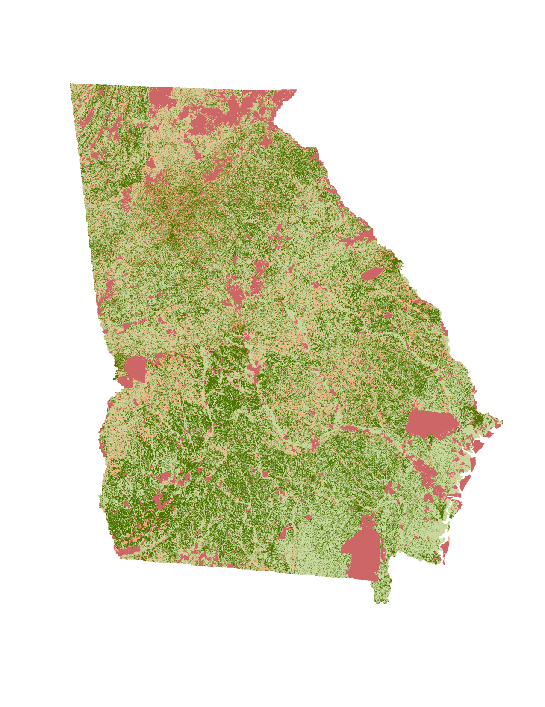
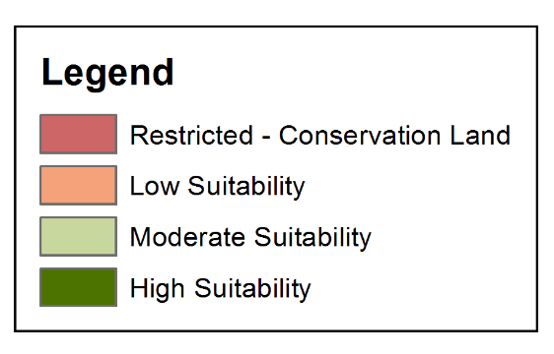
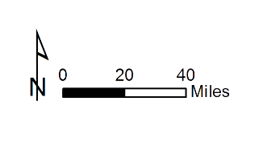
LUCIS Model: Suitability Map
Derived from the LUCIS Model
Combines environmental and solar data
Reclassified the protected lands as restricted areas in the suitability classifications
Georgia Solar Farm Development Suitability Map
Notes:
Additionally, the DEVELOP team utilized protected species habitat layers and other environmentally sensitive sites such as streams and floodplains to frame the avoidance of environmentally sensitive areas. These data were used to create end products that map and depict potential conflicts between ideal solar energy sites and endangered species habitats. The results of this project will be used by partners at The Nature Conservancy and Georgia Department of Natural Resources to recommend suitable sites for solar farm development that minimize environmental impacts.

Slide 15
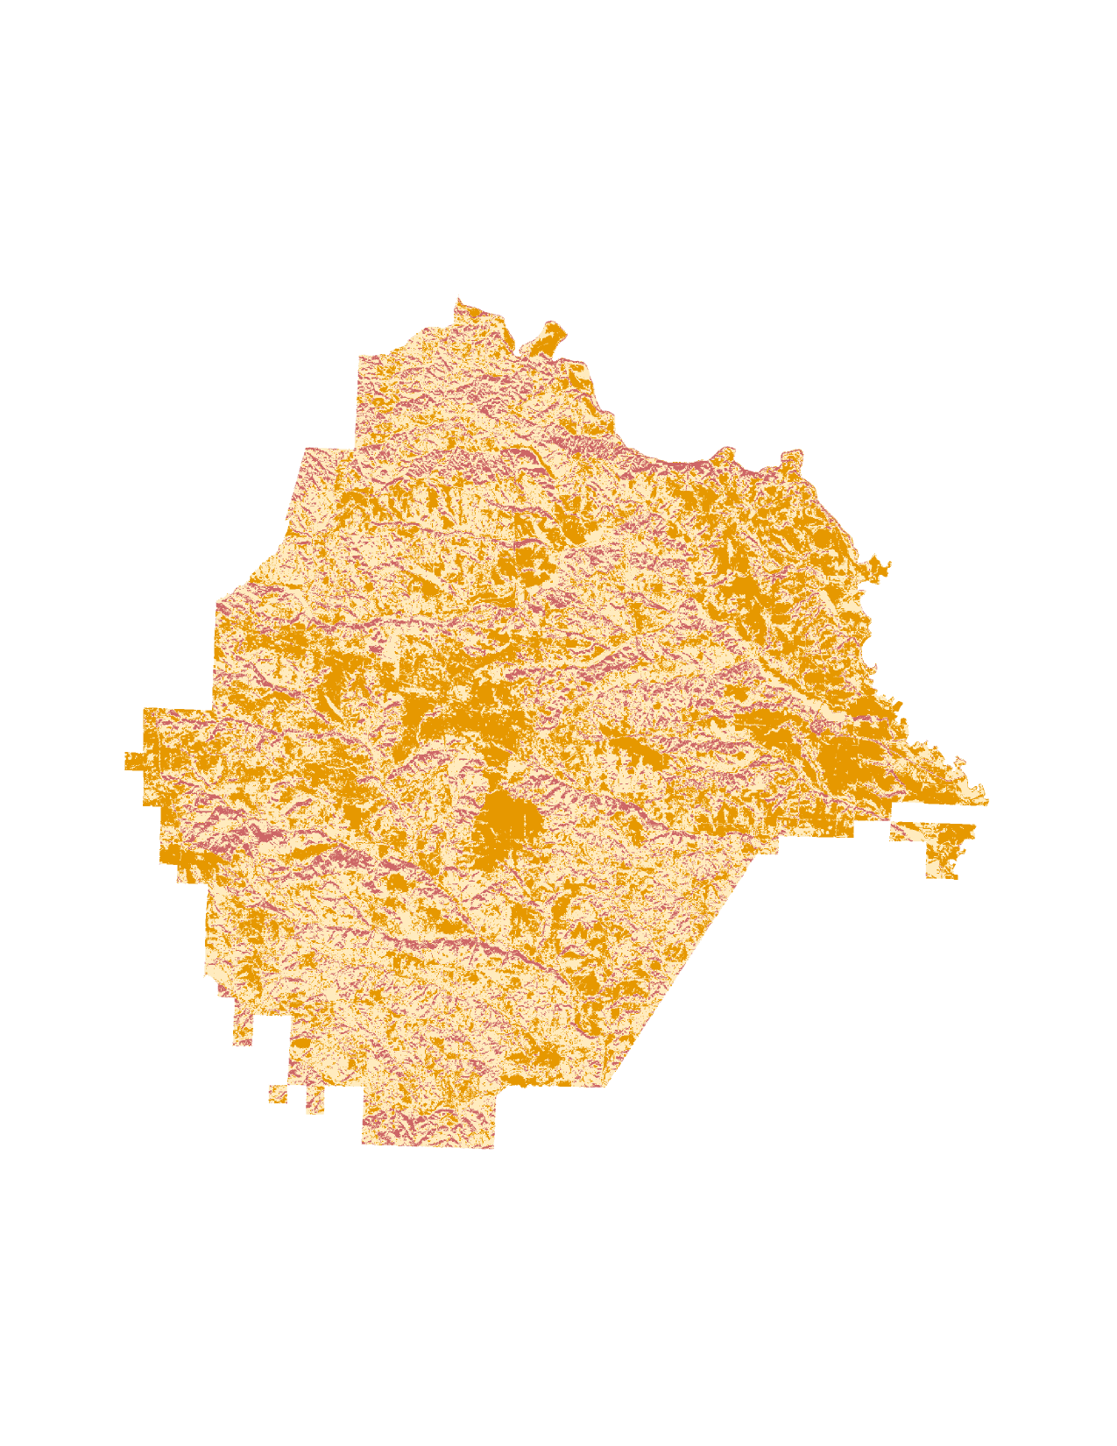
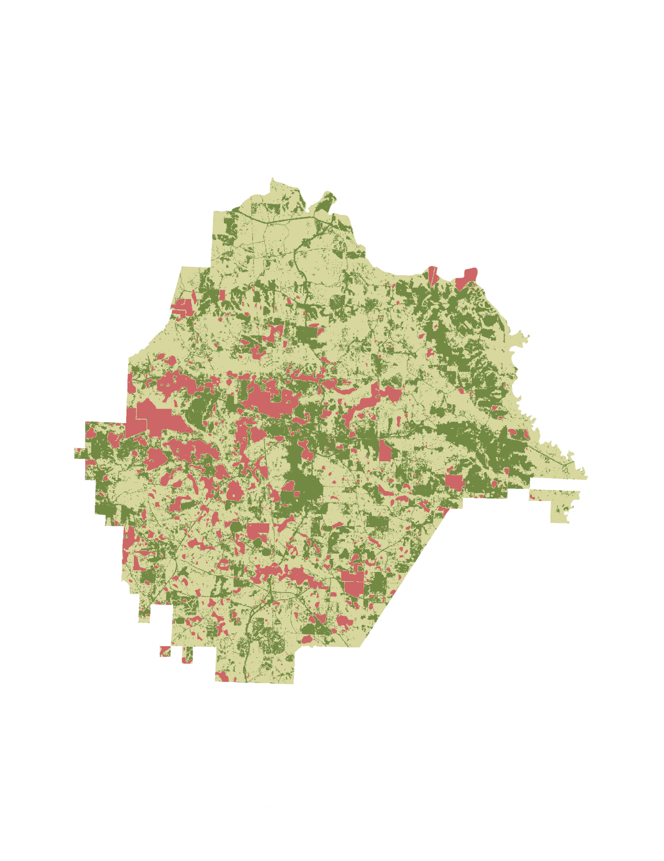
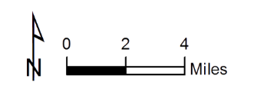
LUCIS Model: Layers in use
Solar Farm Development Suitability Map
Environmental Sensitivity Map
Notes:
Additionally, the DEVELOP team used DEM, CropScape land cover, Georgia roads, and Taylor County parcel data to assist in the suitability mapping for solar farm development.

Slide 16
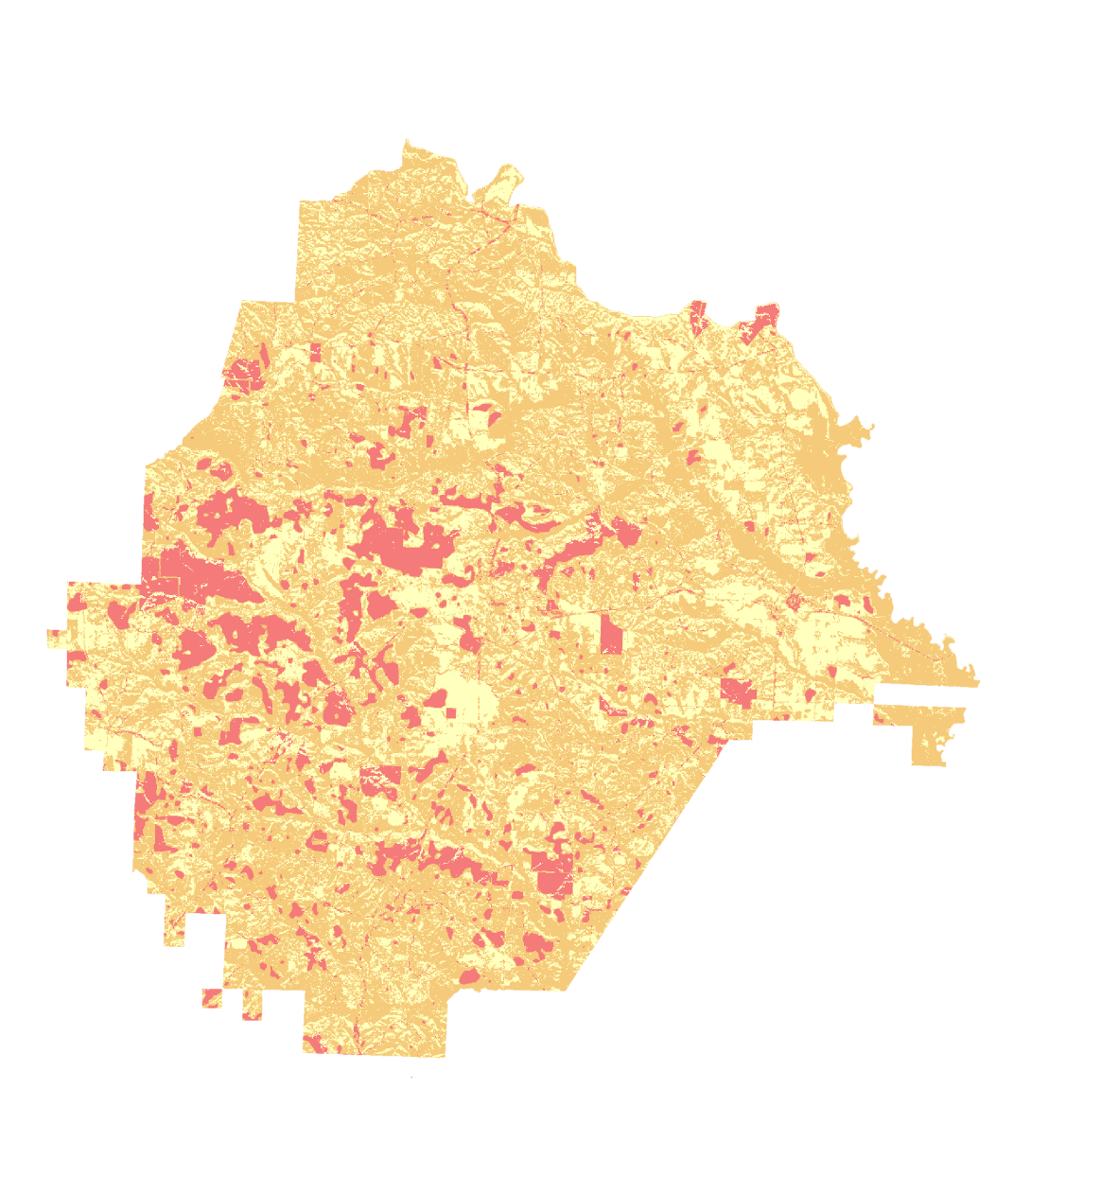
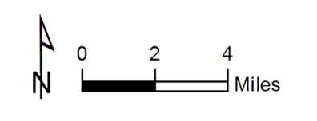
LUCIS Model: Conflict Map
Conflict mapping between the Environmental and Solar Maps:
Least Sensitive Areas – Optimal for solar farm development
Moderately Sensitive – Suitable for solar farm development, but also involves moderate environmental impacts
Highly Sensitive – Conflict Areas
Conflict Areas – Areas both suitable for solar farm development and environmental protection; therefore, they are not suitable for solar farm development
Taylor County Environmental and Solar Farm Development Conflict Map
Notes:
Additionally, the DEVELOP team utilized protected species habitat layers and other environmentally sensitive sites such as streams and floodplains to frame the avoidance of environmentally sensitive areas. These data were used to create end products that map and depict potential conflicts between ideal solar energy sites and endangered species habitats. The results of this project will be used by partners at The Nature Conservancy and Georgia Department of Natural Resources to recommend suitable sites for solar farm development that minimize environmental impacts.

Slide 17
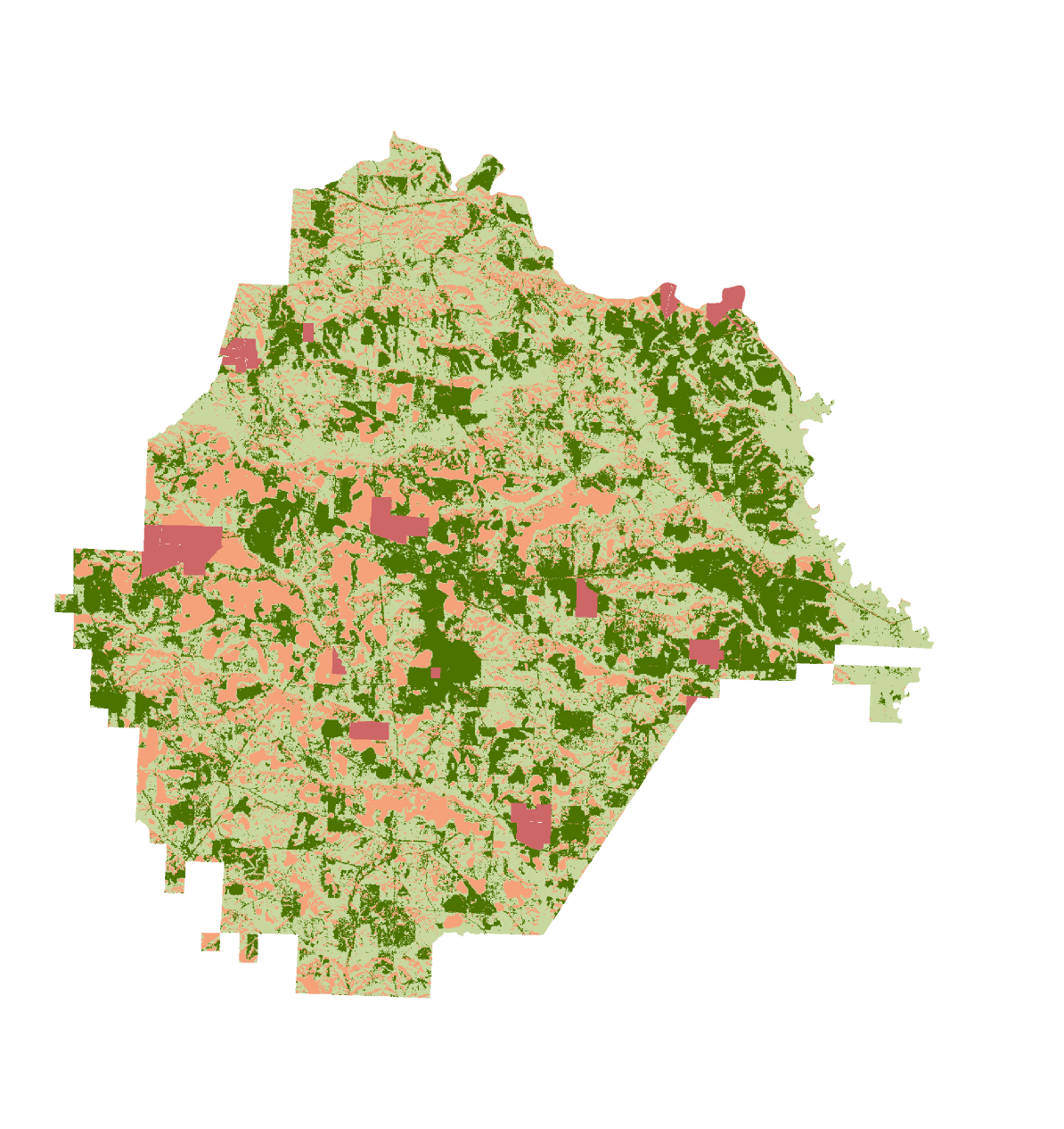
LUCIS Model: Suitability Map
Derived from the LUCIS Model
Combines environmental and solar data
Reclassified the protected lands as restricted areas in the suitability classifications
Taylor County Solar Farm Development Suitability Map
Notes:
Additionally, the DEVELOP team utilized protected species habitat layers and other environmentally sensitive sites such as streams and floodplains to frame the avoidance of environmentally sensitive areas. These data were used to create end products that map and depict potential conflicts between ideal solar energy sites and endangered species habitats. The results of this project will be used by partners at The Nature Conservancy and Georgia Department of Natural Resources to recommend suitable sites for solar farm development that minimize environmental impacts.

Slide 18
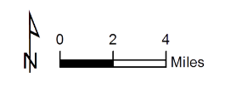
Suitability Map
Derived from the LUCIS Model
Combines environmental and solar data
Reclassified the protected lands as restricted areas in the suitability classifications
Georgia Solar Farm Development Suitability Map
Taylor County Solar Farm Development Suitability Map
Notes:
Additionally, the DEVELOP team utilized protected species habitat layers and other environmentally sensitive sites such as streams and floodplains to frame the avoidance of environmentally sensitive areas. These data were used to create end products that map and depict potential conflicts between ideal solar energy sites and endangered species habitats. The results of this project will be used by partners at The Nature Conservancy and Georgia Department of Natural Resources to recommend suitable sites for solar farm development that minimize environmental impacts.

Slide 19
Products
The Conflict Map shows where different land use priorities (solar and environmental) overlap and yields land use conflicts.
The Suitability Map derives from the conflict map areas most suitable for solar development while accounting for environmental concerns.
The Solar Siting Suitability Model can be utilized to minimize environmental impacts and the model can be updated to reflect changing priorities.
Notes:
These notes should be thorough enough for someone not familiar with the project to clearly present the material.
NOTE: For every image on the slide include an image source in the speaker notes (ex. URL; Name, Affiliation, etc.)
Image Source: http://commons.wikimedia.org/wiki/File:Claude_Monet_-_The_Magpie_-_Google_Art_Project.jpg

Slide 20
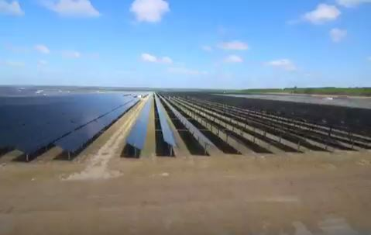
Errors and uncertainties
Model Refinement: Additional discussions with stakeholders (both environmental and developer) should be undertaken to continue to tailor the model to reflect the stakeholders’ needs and improve its accuracy on a county level.
Notes:
These notes should be thorough enough for someone not familiar with the project to clearly present the material.
NOTE: For every image on the slide include an image source in the speaker notes (ex. URL; Name, Affiliation, etc.)
Image Source: http://commons.wikimedia.org/wiki/File:Claude_Monet_-_The_Magpie_-_Google_Art_Project.jpg

Slide 21
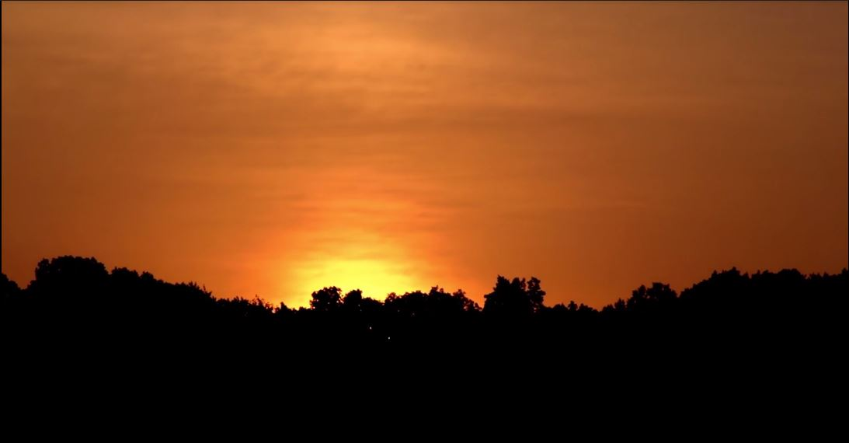
Future work
Refine the model as previously discussed
Evaluate the potential for solar farm development with other land use classifications such as urban areas
Notes:
These notes should be thorough enough for someone not familiar with the project to clearly present the material.
NOTE: For every image on the slide include an image source in the speaker notes (ex. URL; Name, Affiliation, etc.)
Image Source: http://commons.wikimedia.org/wiki/File:Claude_Monet_-_The_Magpie_-_Google_Art_Project.jpg

Slide 22
Acknowledgements
Advisors
Dr. Marguerite Madden, UGA Center for Geospatial Research
Partners
Cassidy Jordan, The Nature Conservancy
Matt Elliott, Georgia Department of Natural Resources

Slide 23
Questions?

