Slide 1
GEORGIA ENERGY II
Identifying Suitable Areas for Solar Power Generating Facilities while Reducing Conflicts with Sensitive Habitats and Wildlife Populations
Suravi Shrestha
Peter Hawman
Emad Ahmed
Nick Morgan
Amanda Aragón
Caren Remillard
Marie Bouffard
Austin Stone
Fabiola Clermont
Georgia – Athens
Fall 2017
Notes:
Introduction to the team and team members

Slide 2
Study Area
Study Area:
Georgia
Taylor County
Decatur County
Study Period:
Jan 2015 – Aug 2017
Taylor
County
Decatur County
Notes:
This study looked at solar development suitability on the state level in Georgia as well as in fine detail at the county level. After consulting with our project partners, we chose Taylor and Decatur counties for an in-depth analysis because of their rapid growth of large-scale solar installations.

Slide 3
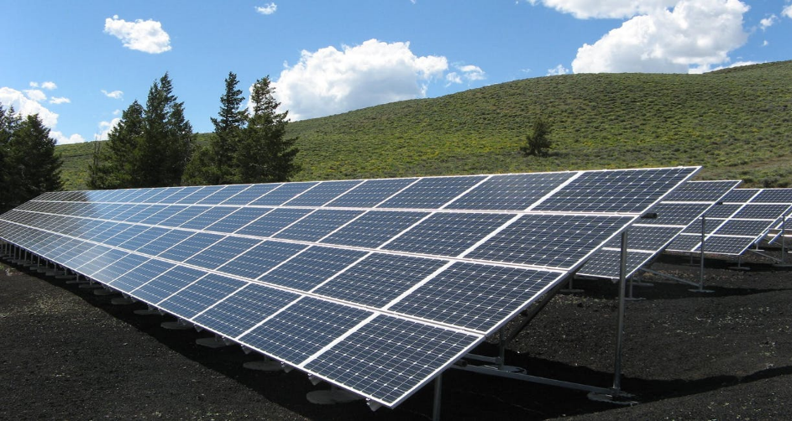
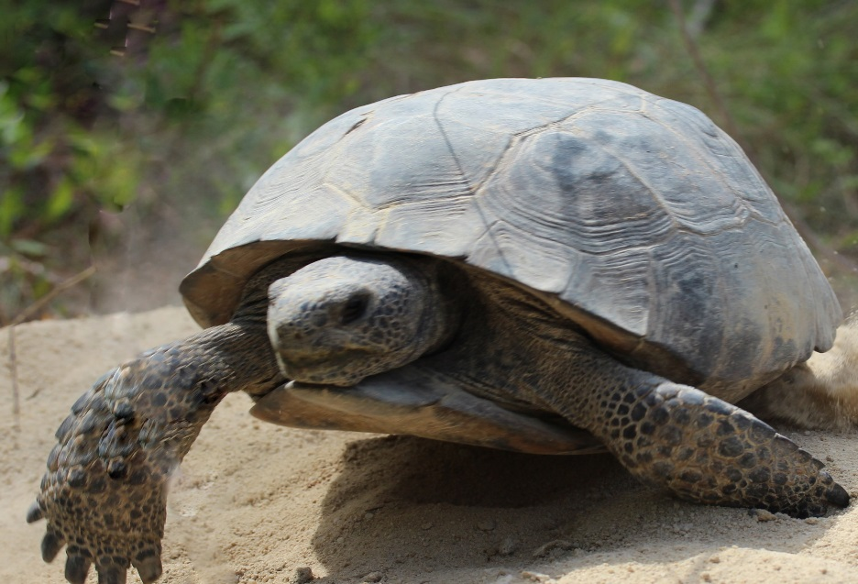
Community Concerns
Georgia is one of the top ten states in the nation for solar energy production potential
Since 2013, solar energy production has increased by 30-45% annually in the state
Construction may impact environmental sensitive habitats
Image Credit: Pexel
Image Credit: DNR
Notes:
While solar energy development has many benefits, decision makers must consider the environmental impact of solar farm construction. The construction of large scale installations can significantly alter the site environment causing habitat loss.
Developers can reduce their environmental impact by carefully selecting solar installation sites to avoid developing on vulnerable habitat areas.
This is particularly important to consider in areas that serve as habitat for sensitive species such as the Gopher Tortoise, which is already at risk of being placed on the endangered species list. Gopher tortoises play the role of a keystone species their ecosystem because over 300 other species of birds, reptiles, and amphibians rely on their burrows for protection.
Image Source: https://www.pexels.com/photo/black-and-silver-solar-panels-159397/

Slide 4
Objectives
Conduct solar site suitability analysis
Analyze land cover change associated with solar development
Integrate environmental and infrastructural data for site suitability to map ideal locations for utility-scale solar development
Provide decision-makers with data tools to assist in selecting solar development sites
Notes:
The objectives for this project were to create an analysis that integrates stakeholder concerns for solar development and habitat preservation into a data toolset that will assist developers in making informed decisions about siting solar farms installations.

Slide 5
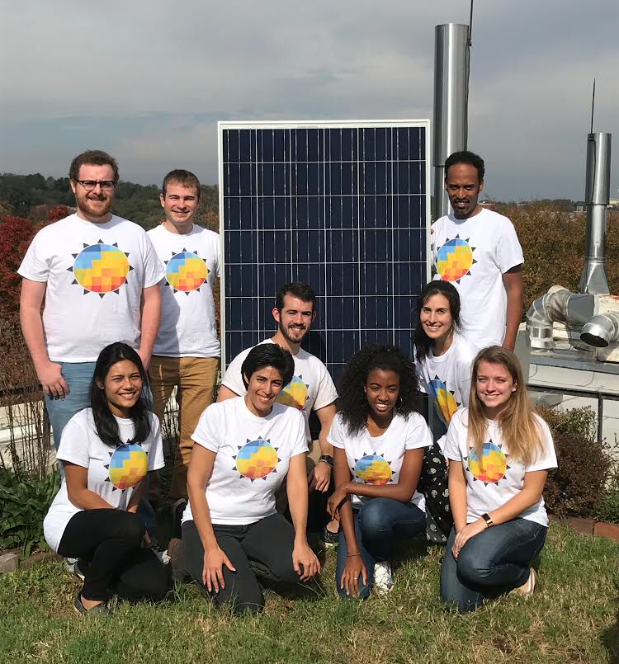
Partners
Georgia Energy II Team
The Nature Conservancy
Georgia Department of Natural Resources
Notes:
Our partners, The Nature Conservancy and the Georgia Department of Natural Resources, will use the maps and data products this project provides to work with solar developers to select installation sites that maximize solar potential while minimizing negative impact on sensitive environments.

Slide 6
Satellites
Platform | Instrument
Terra (1999) | Clouds and the Earth’s Radiant Energy System (CERES)
Landsat 8 (2013) | Operational Land Imager/Thermal Infrared Sensor (OLI/TRIS)
Notes:
This project analyzed land cover trends from Landsat 8 Operational Land Imager (OLI), in addition to solar insolation data sets from Terra’s Clouds and the Earth’s Radiant Energy Systems (CERES) sensor.
These Earth observations were combined to classify and extract data layers for a solar site suitability and conflict identification model following the Land Use Conflict Identification Strategy (LUCIS).

Slide 7
Methodology
Stakeholder Needs: Environmental and Solar Developer
Develop Goals, Objectives, and Criteria for Land-Use Conflict Identification Strategy (LUCIS) Model
Acquire and Input Data into Land-Use Scenarios
Environmental Sensitivity
Solar Development Potential
Environmental Sensitivity
Solar Insolation (CERES)
Slope
(DEM)
Gopher Tortoise Habitat (UGA)
Protected Lands (GADNR)
Land-Use (CropScape)
Aspect
(DEM)
Granite Rock Outcrops (NRCS)
Land-Use (CropScape)
Roads
(GA)
Parcels
(GA)
Prime Farmland
(NRCS)
Streams
(NWI)
Transmission Lines (TNC)
Floodplains
(FEMA)
Product: Map Indicating Environmentally Sensitive Areas
Product: Suitability Map for Solar Development Potential
Product: Bivariate Map
Product: Suitability Map
Notes:
Our analysis classified objectives into environmental sensitivity and development potential. We identified factors for each objective, conducted an analysis for each, and then combined them. We synthesized this data through our Land Use Conflict Identification model by weighting each factor according to importance to calculate overall suitability for each location.

Slide 8
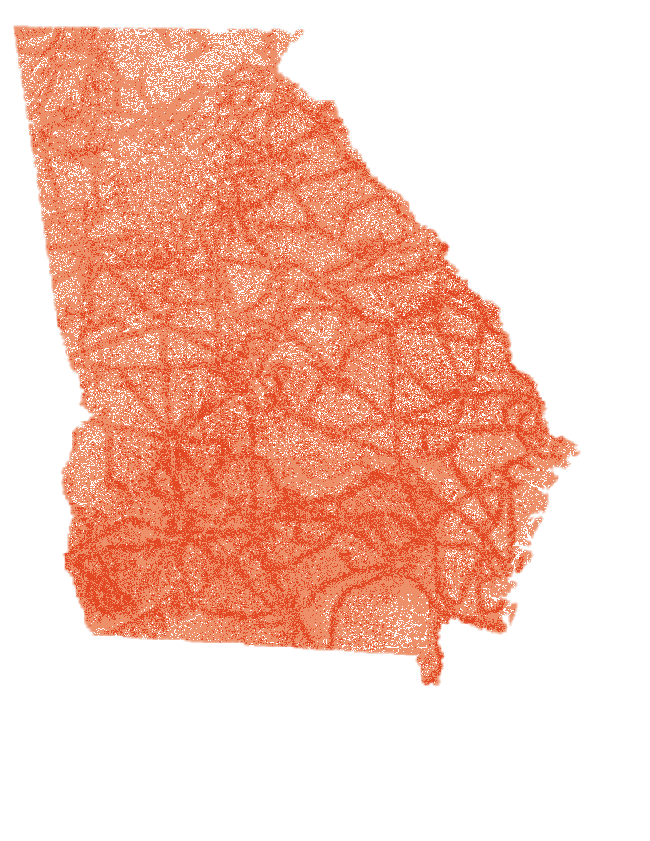
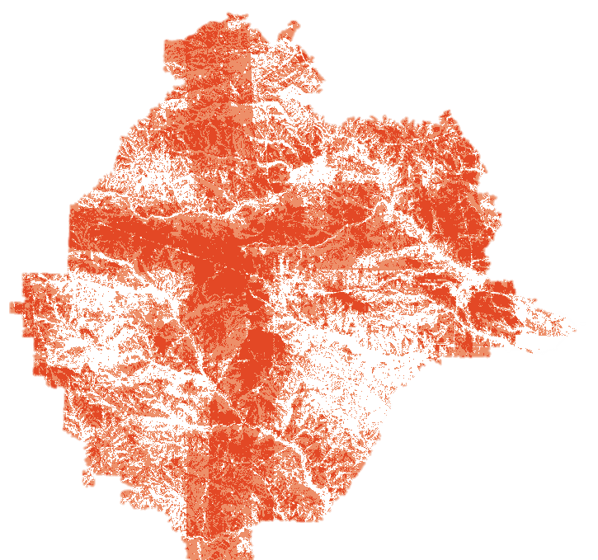
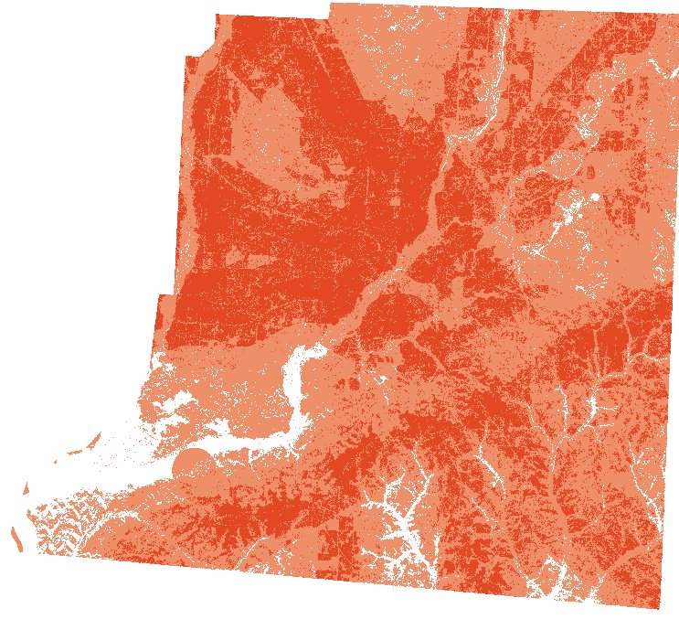
Solar Development Potential
Decatur County
Taylor County
Less Suitability
Moderate Suitability
High Suitability
Notes:
The Solar farm Development map depicts a suitability analysis for solar farm siting according to the perspective of developers. This map incorporates factors important to the development of solar farms including solar insolation, land cover, slope, aspect, and proximity to transmission lines. Floodplains and proximity to roads were added as factors for the higher resolution analysis on the county level and Taylor county also included parcel data as an additional factor.

Slide 9
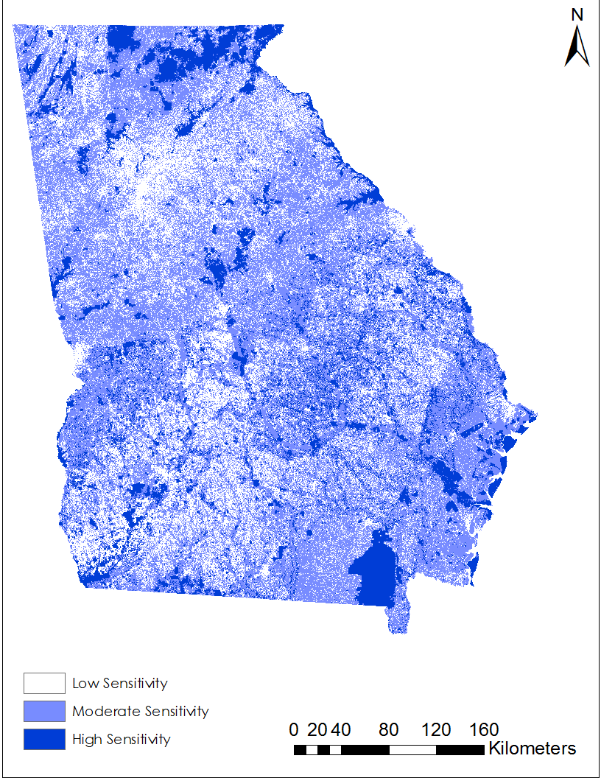
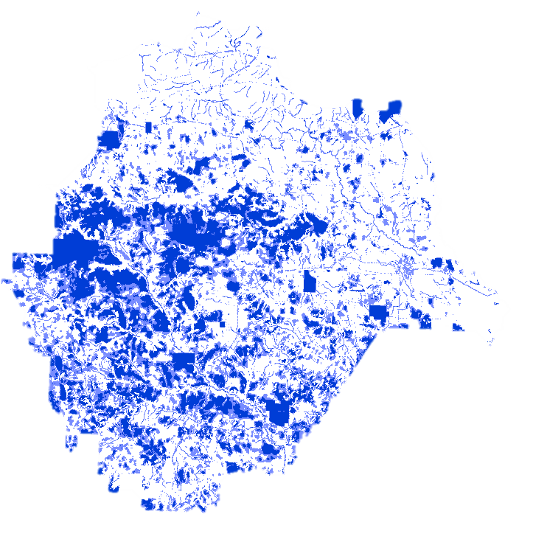
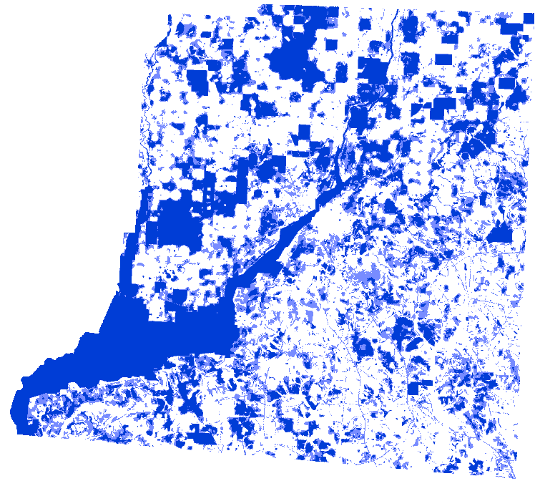
Environmental Sensitivity
Decatur County
Taylor County
Less Sensitive Moderate Sensitive Highly Sensitive
Notes:
The Environment Map depicts environmental sensitivity at the state level using spatial data on land cover, tortoise habitat, protected land, and rock outcrops. Our county level analysis also included prime farmland and streams as additional factors.

Slide 10
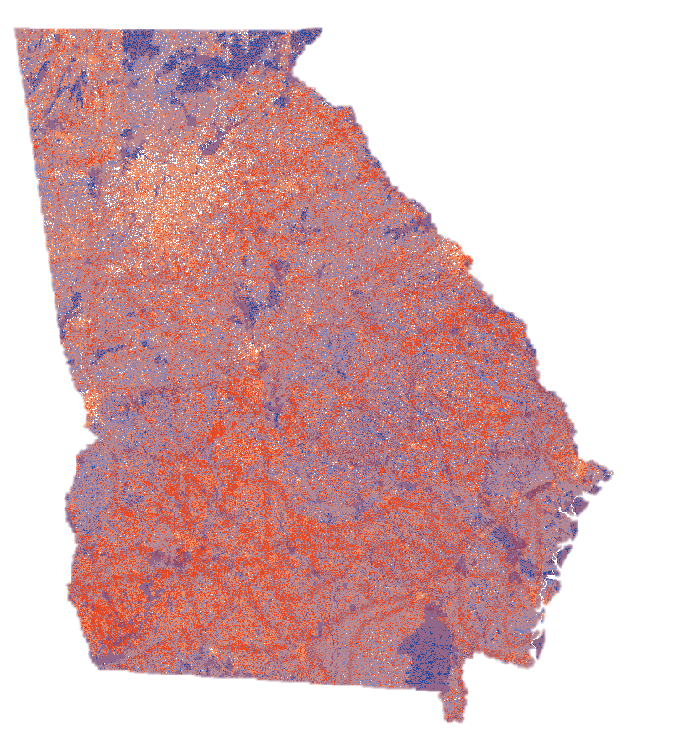
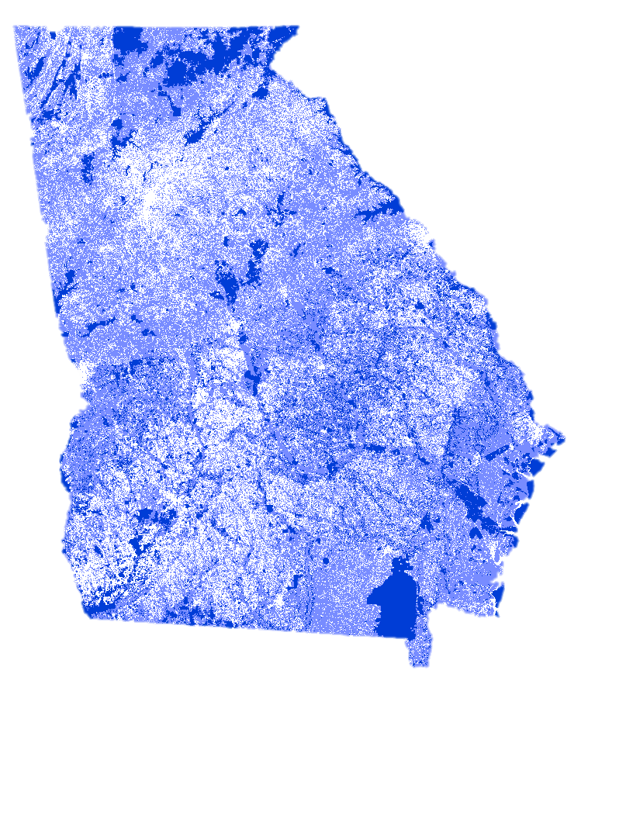
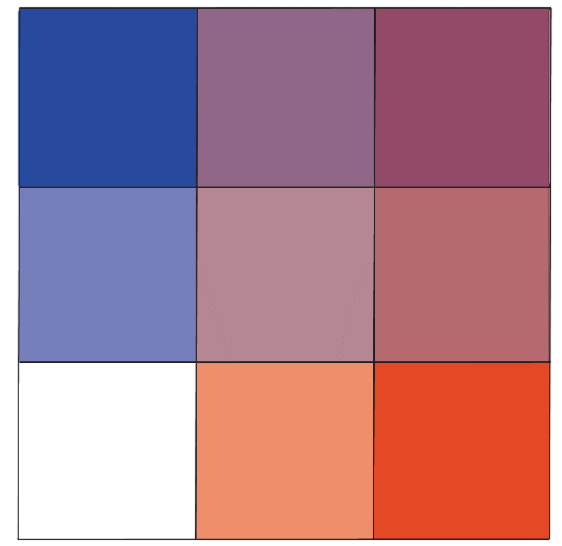
Bivariate Map
Solar Farm
Development Potential
Environmental
Sensitivity
High Potential but High Sensitivity
High Sensitivity
Environmental Sensitivity
High Potential
Bivariate Analysis
Solar Farm Development Potential
Notes:
We chose a bivariate map to display how environmental and development concerns overlap. Each of the nine color classes represents how the combination of environmental and development concerns impact overall suitability for solar installations.
Orange areas represent low environmental concern but high potential for solar farms and are regarded most suitable for development.
Blue shows areas that contain highly sensitive habitat but are also not desirable for development indicating least suitable locations for solar farms.
The highest conflict between environmental and development perspectives occurs in purple areas where locations are environmentally sensitive but also prime locations for construction.

Slide 11
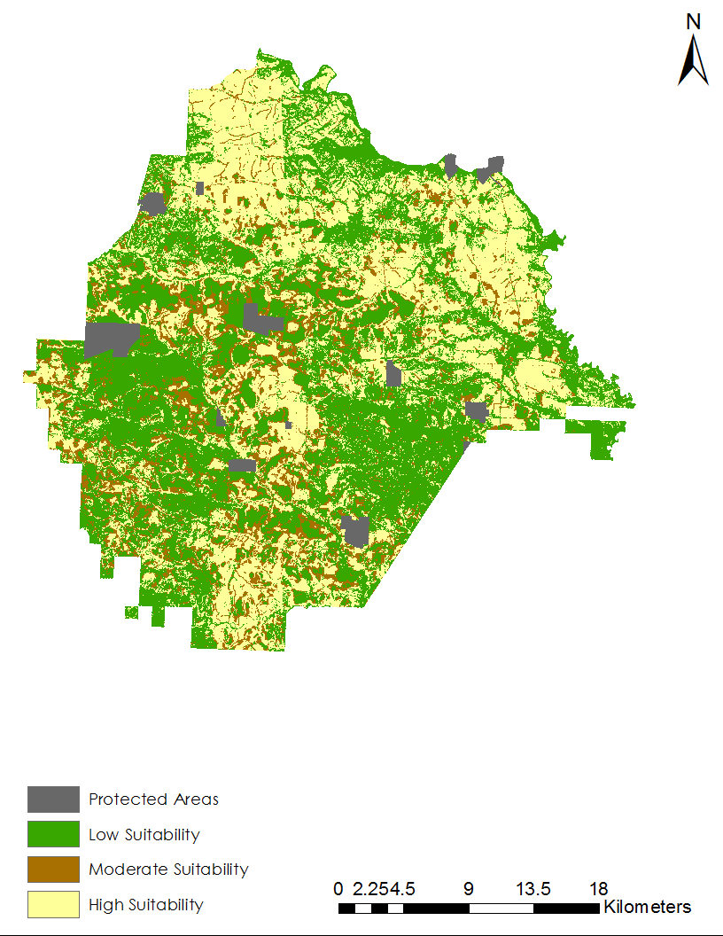
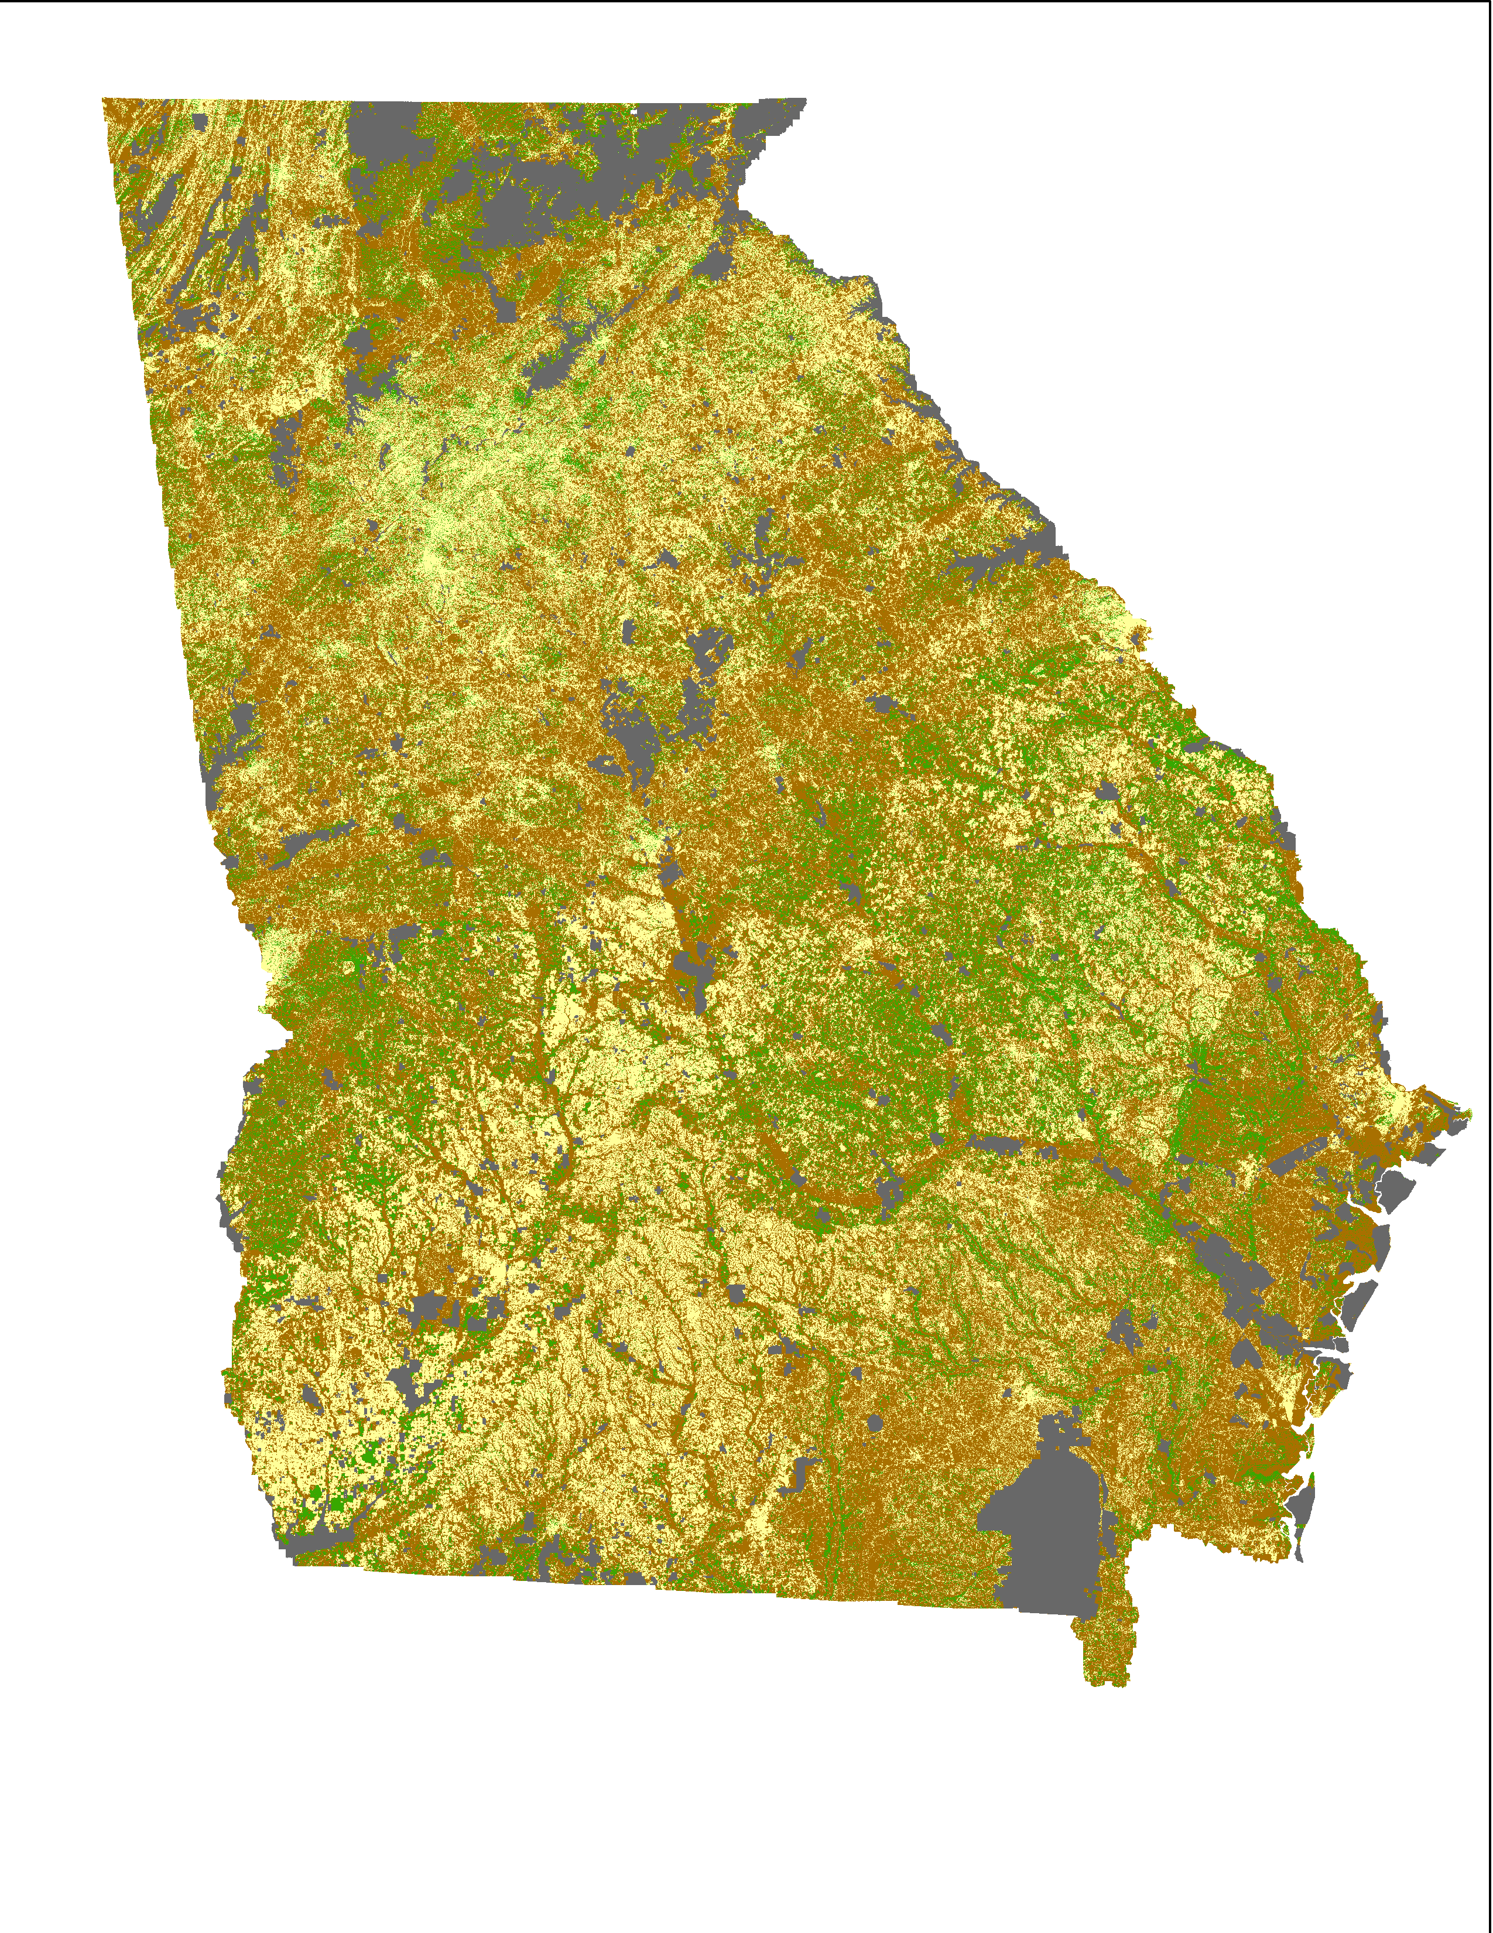
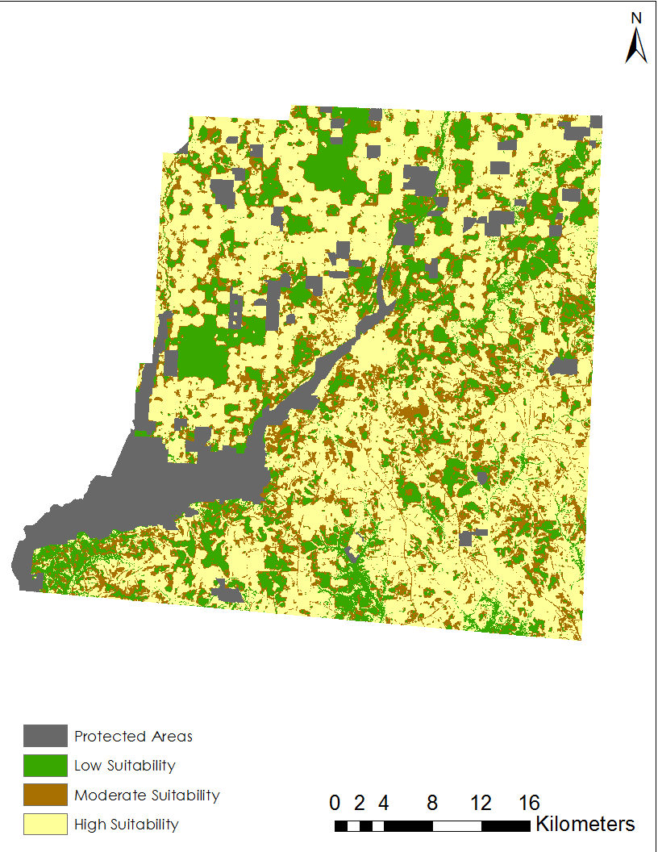
Suitability Map
Protected Areas
Low Suitability
Moderate Suitability
High Suitability
Notes:
This is the final suitability map that shows low, moderate and high suitability for solar farm development. We also masked out protected areas to avoid any development in these areas.

Slide 12
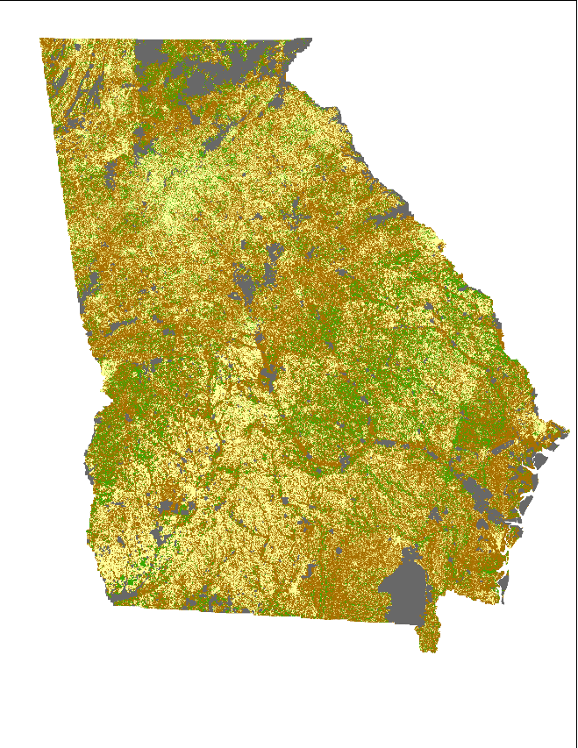
Results Overview
Protected Areas
Low Suitability
Moderate Suitability
High Suitability
Less Suitability
Moderate Suitability
High Suitability
Less Sensitive Moderately Sensitive Highly Sensitive
Environmental
Sensitivity
Solar Farm
Development Potential
Solar Farm
Development Potential
Environmental
Sensitivity
Bivariate Analysis
Suitability Analysis
Notes:
This is an overview of our results where we show solar development and environmental sensitivity maps combined form the bivariate map. We then reclassified our maps to produce the final suitability map.

Slide 13
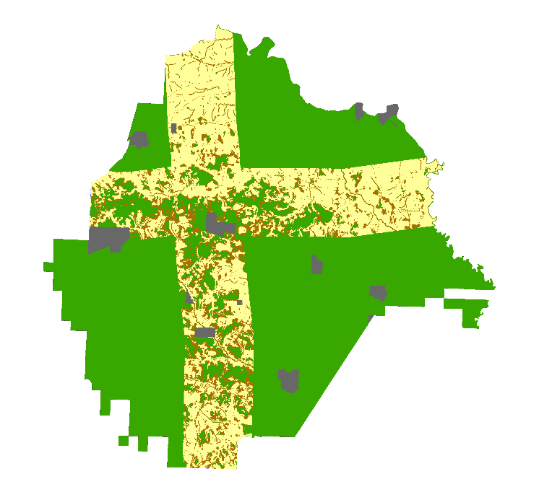
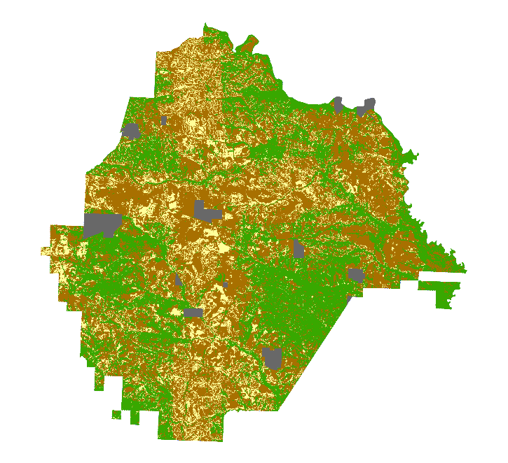
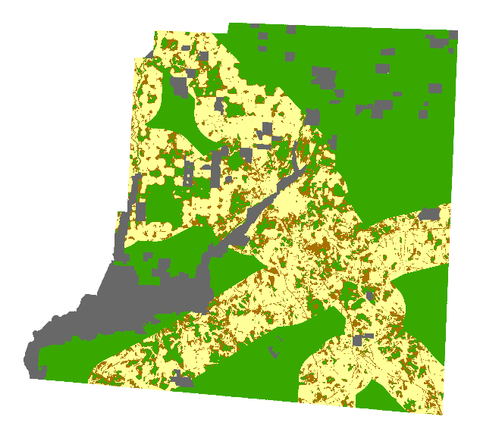
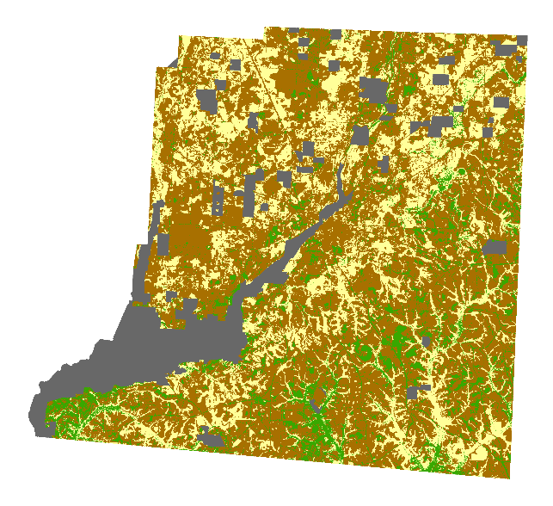
Solar Suitability Scenarios
Taylor County
Decatur County
Protected Areas
Low Suitability
Moderate Suitability
High Suitability
Environmental Sensitivity:
Same as current analysis
Solar Development Potential:
Only Transmission Lines
Environmental Sensitivity:
Equal weights on factors
Solar Development Potential:
Same as current analysis
Current analysis
Notes:
We will be providing the LUCIS model to our project partners so that they can consult with solar developers and environmental stakeholders to produce a suitability map geared towards their preferences.
Here we show how maps from our model can produce different suitability maps. This is a demonstration of how different factors play a role in solar site suitability. In the second column, we only considered transmission lines as our solar development factor and we can clearly see that the suitable areas are concentrated within the buffer zones of these transmission lines.
Another is where we keep the solar development factors constant and consider equal weights on each of the environmental factors on the current analysis. Current analysis has higher weightage on gopher tortoise habitat, protected lands and streams.

Slide 14
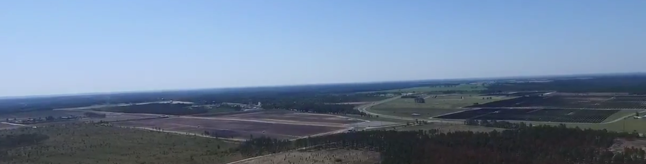
Limitations
Unavailability of parcel data for Decatur county
Solar developer input
Image Credit: Monet
Image Credit: Conservation Matters LLC.
Notes:
As with any project, the team faced limitations to our analysis. Data on a parcel and block group data was unavailable for Decatur County as the data is still being collected.

Slide 15
Conclusion
Higher suitability for solar development was found in southern regions of the state and areas in proximity to transmission lines
Decatur county has more suitable sites for solar farm development than Taylor county
Majority of the existing solar farms in Taylor and Decatur county show that they are under areas of high potential for solar development and low environmental sensitivity
Notes:
We aimed to answer the following questions in our analysis:
The following are our conclusions (note to speaker: questions here serve as guidelines):
Which parts of the state had the greatest amount of high suitability?
Higher suitability of solar development was found in southern regions of the state and areas in proximity to transmission lines.
Did Taylor Co. or Decatur Co. have more suitable sites?
According to our analysis, Decatur county has more suitable sites for solar farm development.
Did your results reveal the potential in developing solar farms in areas that don't conflict with sensitive habitat or is it a lost cause?
Existing solar farms in Taylor and Decatur county show that they are under areas of high potential for solar development. Many of the existing farms lie under the highly suitable areas that have low environmental sensitivity, according to our analysis. There is still great potential for solar farm development in these counties with minimal environmental impact.
How will the project partners benefit from your results?
Project partners can use these maps to bring environmental stakeholders and solar developers together to promote sustainable solar farm development.
.

Slide 16
End Products
Suitability Map
Solar Siting Suitability Model
Outreach materials: ArcGIS Story map, brochures and flyers
Image Source: https://storymaps.arcgis.com/en/
Notes:
Our end-products include materials and tools that our partners can use to work in collaboration with solar developers as the industry continues to grow in Georgia.
The Bivariate Analysis Map shows where different land use priorities (solar and environmental) overlap, which is useful for identifying potential land use conflicts.
Our Suitability Map derived from the Bivariate map identifies areas that are most suitable for solar development while accounting for environmental concerns.
In addition, the updated Solar Siting Suitability Model can be used to minimize environmental impacts and the model can be adapted to best fit each scenario.
Finally, we also have provided our partners with outreach materials, flyers, a Story map, and brochures that they can implement as part of their communications with stakeholders and developers in order to best inform them.

Slide 17
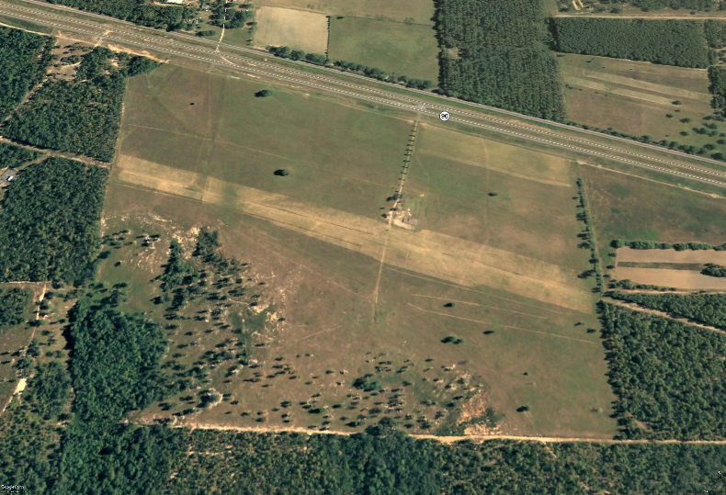
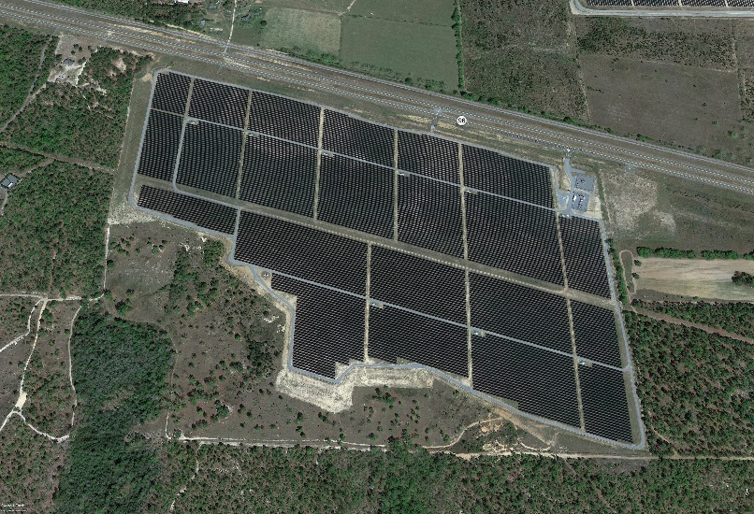
Future Work
Input from solar developers
Emphasis on additional counties growing in solar development (e.g. Mitchell county)
Camilla Solar Farm – Taylor County
?
2009
2017
Future
Image Source: Google Maps
Notes:
Future expansions of this project could include adding in-depth focus counties based on locations deemed important by partners, expanding the suitability analysis to include economic and social factors in addition to physical ones, or by integrating more data into specific tools and outreach materials that developers and stakeholders can apply in their decision making processes.
Future terms could also include input from developers and more layers into the model to add additional insights to the analysis.

Slide 18
Acknowledgements
Advisors
Dr. Marguerite Madden, UGA Center for Geospatial Research
Partners
Cassidy Jordan, The Nature Conservancy
Matt Elliott, Georgia Department of Natural Resources
Past Contributors
Lynn Abdouni
Natalia Bhattacharjee
Christopher Cameron
Roger Bledsoe
Notes:
The Georgia Energy II Team would like to acknowledge their science advisor Dr. Marguerite Madden at UGA. We would also like to thank our partners, Cassidy Jordan at The Nature Conservancy, and Matt Elliot at the Georgia Department of Natural Resources, for their continuous involvement with the project and communication during the summer project term. Additionally, we would like to thank Caren Remillard, (UGA Center Lead) and Lynn Abdouni (Team Lead for Term I) for their timely support and feedback.

Slide 19
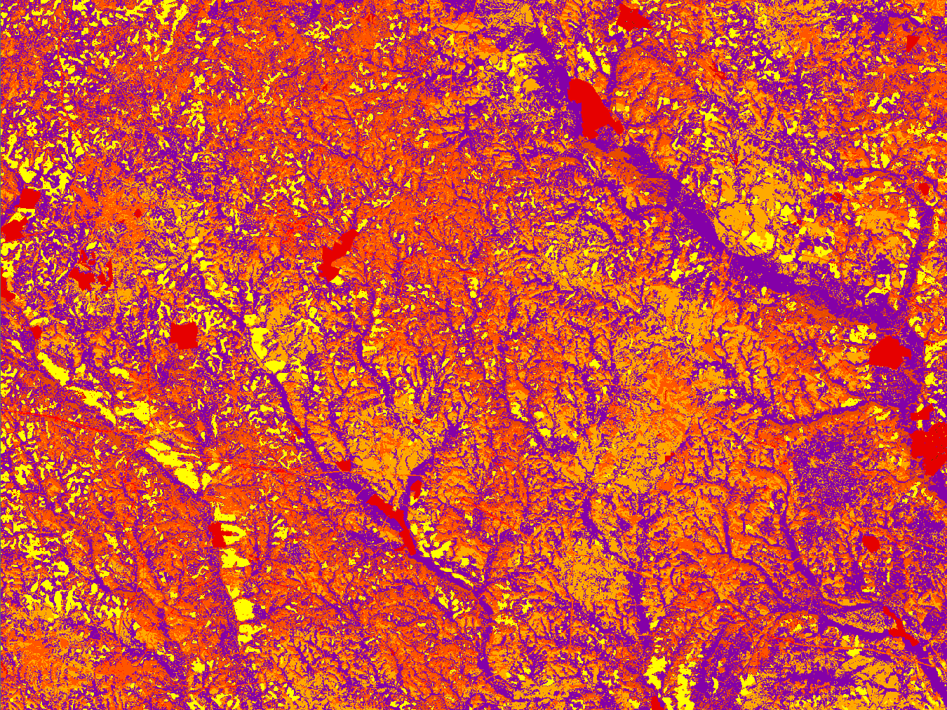
Questions?
Notes:
Any Questions?

