Slide 1
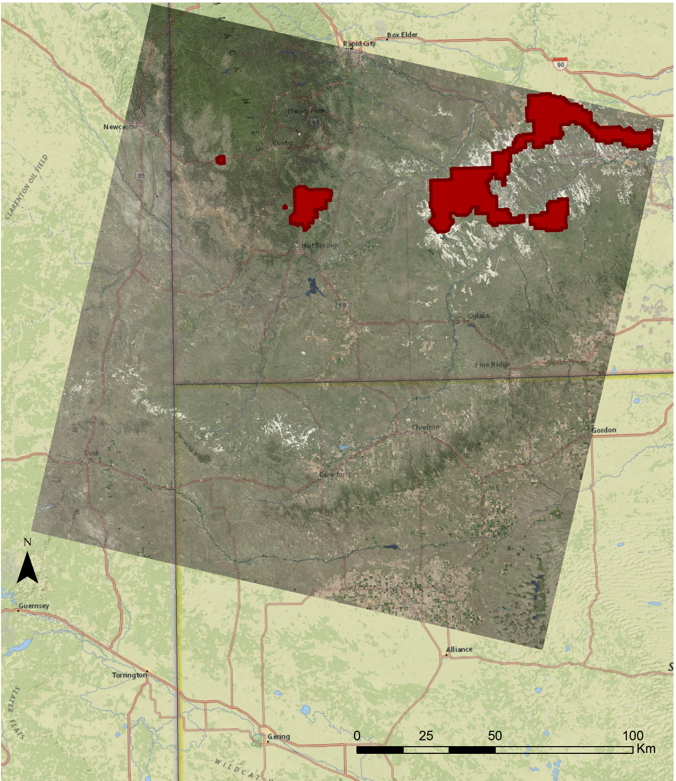
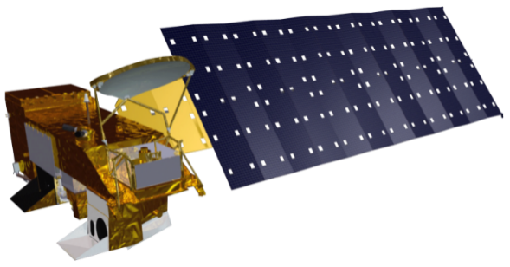
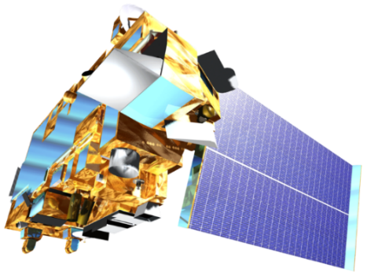
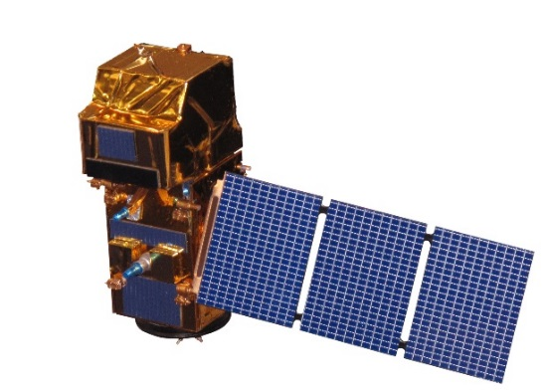
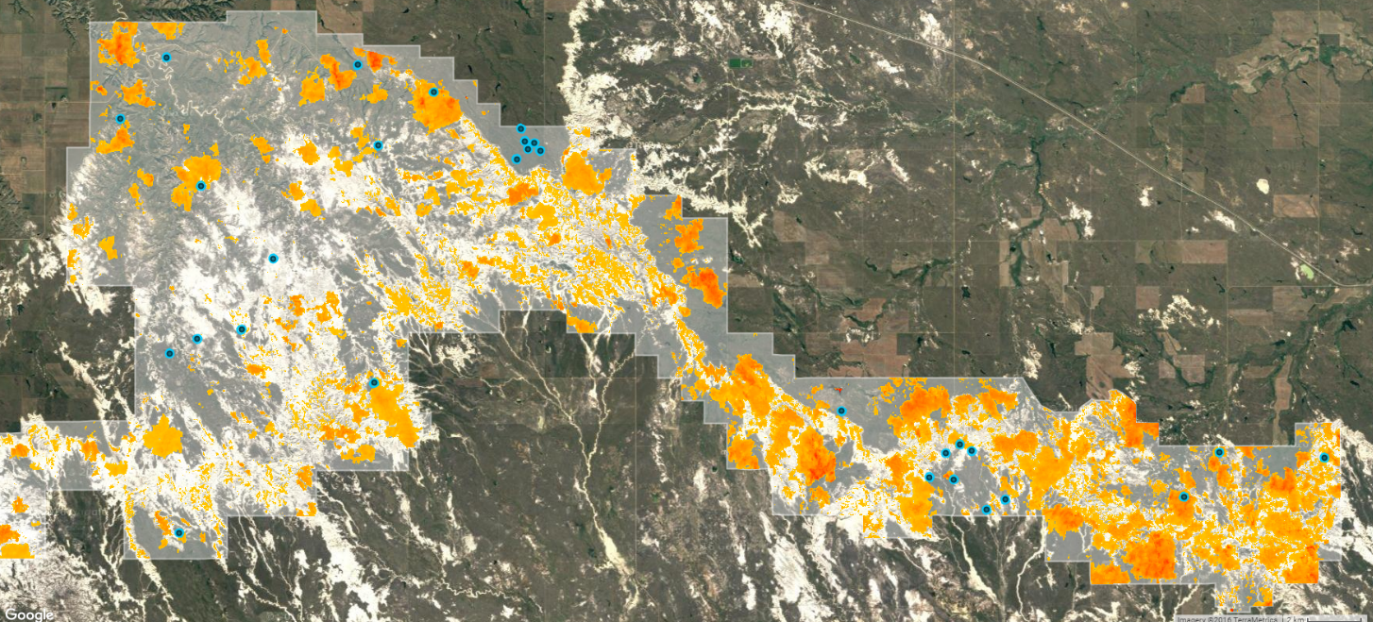
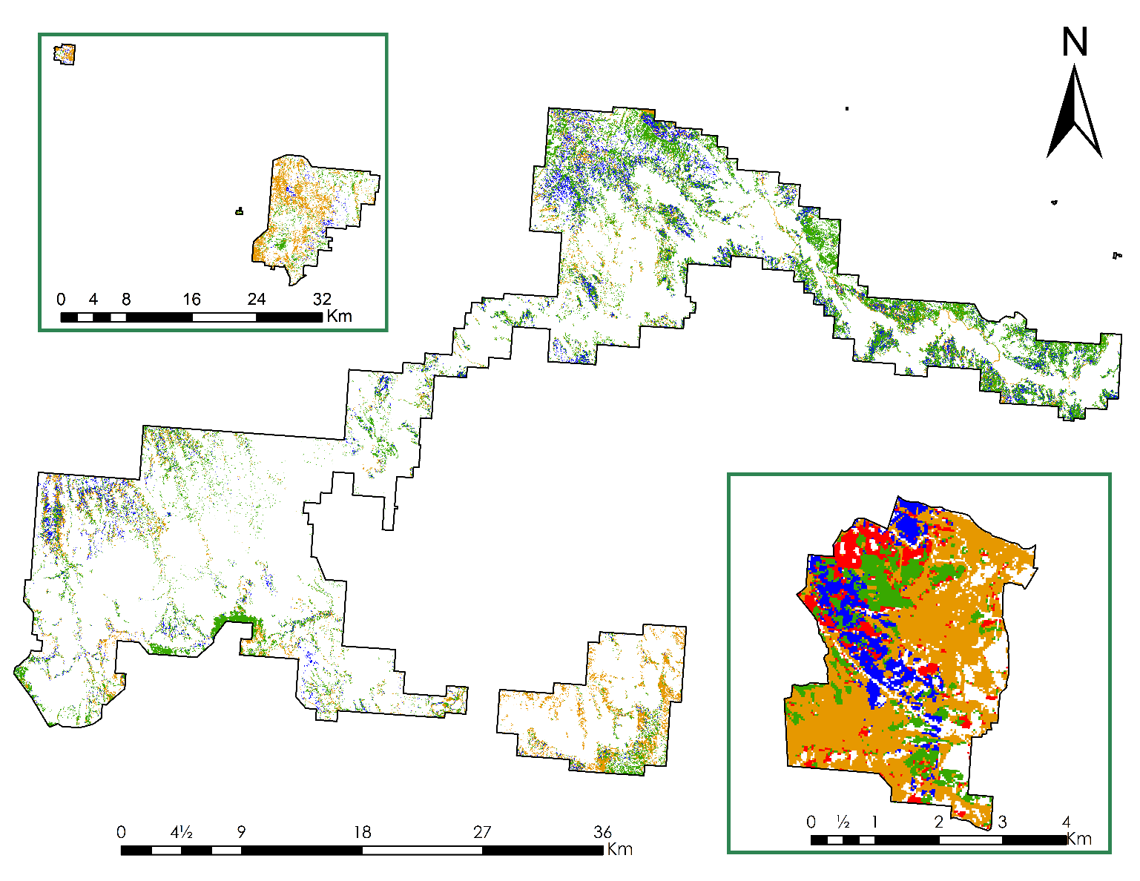
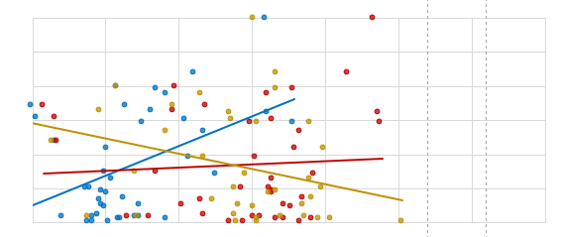
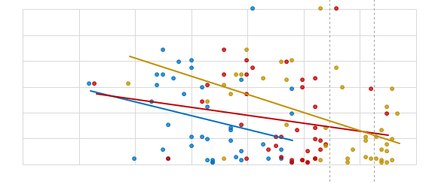
Utilizing NASA Earth Observations to Map Temporal and Spatial Patterns of Annual Bromes and Develop a Management Plan for Invasive Species Control in the Northern Great Plains
Abstract
Objectives
Cheatgrass (Bromus tectorum) and Japanese brome (Bromus japonicus) are widespread invasive annual brome grasses that are distributed throughout the western United States. In the Northern Great Plains (NGP), the presence of these invasive brome species has led to a decrease in native plant diversity, reduced soil water content, and altered fire regimes leading to more frequent fires of higher intensity. The National Park Service Northern Great Plains Network (NGPN) Inventory & Monitoring Program conducts vegetation monitoring throughout national park units to develop management practices for habitat restoration and invasive species control. Incorporating remotely sensed NASA Earth observation data enables the NGPN to efficiently monitor the regional extent of brome abundance over time. The spatial and temporal resolution of Aqua/Terra Moderate Resolution Imaging Spectroradiometer (MODIS), Landsat 8 Operational Land Imager (OLI), Landsat 5 Thematic Mapper (TM), and Sentinel-2 Multispectral Instrument (MSI) were leveraged to capture the vegetation phenology of these invasive brome species across the NGP. The satellite-derived Normalized Difference Vegetation Index (NDVI) was used to determine the distinct and early green up and senescence patterns of brome. Using unsupervised classification methods, the invasive bromes were identified from the surrounding native grassland species and associations were made between brome abundance and NDVI phenology metrics. Understanding the behavior of these invasive species through space and time will aid managers in developing a successful annual brome management strategy for NGP park units and identify areas for targeted management efforts.
Utilize NASA Earth observations to remotely sense spatial and temporal trends in annual brome grass abundance in the Northern Great Plains national park units and surrounding areas.
Produce maps depicting areas of historic, current, and future brome invasion which will aid the National Park Service (NPS) in the development of a comprehensive management plan for the control of these invasive grasses.
Study Area
Earth Observations
WY
SD
NE
Landsat 5 Landsat 8 Aqua Terra Sentinel-2
Methodology & Results
Aqua & Terra MODIS
ForWarn NDVI
Landsat 5 & 8
NDVI Difference
National Park Service Ground Survey
Landsat 5 & 8
NDVI
Sentinel-2
NDVI
Landsat 8
NPS
Land Cover
Phenology Estimation
Northern Great Plains Ecological Forecasting
NDVI Time Series
Supervised Classification
Phenology Time Series
NDVI Difference
July 2016 – April 2016
Estimated Brome Cover Percentage
June 2016
60
50
40
30
20
10
NDVI Differencing
Jewel Cave NM
NDVI Differencing
Wind Cave NP
Relative Abundance (%)
Landsat 8
Badlands NP
60
50
40
30
20
10
1
0
Test Site – Scotts Bluff NM
Aqua / Terra MODIS
Above: The difference between Landsat derived NDVI values between April 2016 and July 2016 within Badlands National Park; positive differences, shown in orange, represent areas with earlier vegetation phenology.
Left: High resolution Landsat captures expected brome phenology, where early season NDVI values are high in areas with high abundance and low during peak season; this is not seen at the MODIS scale.
Right: In situ data from the National Park Service was used to create training data to derive brome abundance estimation maps using the Interactive Supervised Classification tool in ArcMap.
Estimated Percent Brome
25 - 50
00 - 04
04 - 12
0 0.1 0.2 0.3 0.4 0.5 0.6 0.7
More than 50
12 - 25
Normalized Difference Vegetation Index
Conclusions
Project Partners
Vegetation phenology, captured by NASA Earth observations, was used to distinguish cheatgrass and Japanese brome from surrounding native vegetation using supervised classification techniques.
Brome abundance is increasing and exhibits temporal and spatial variability; future abundance can be influenced by environmental conditions including precipitation and temperature.
The National Park Service can incorporate remote sensing into current protocols for the inventory and monitoring of invasive annual bromes in the Northern Great Plains region.
Team Members
Acknowledgements
Dr. Kenton Ross (NASA DEVELOP National Program)
Dr. Isabel Ashton (National Park Service)
Dr. Amy Symstad (United States Geological Survey)
Bill Christie (USDA Forest Service)
Any opinions, findings, and conclusions or recommendations expressed in this material are those of the author(s) and do not necessarily reflect the views of the National Aeronautics and Space Administration. This material is based upon work supported by NASA through contract NNL11AA00B and cooperative agreement NNX14AB60A.
Amanda Clayton
Project Lead
Jessica Fayne
Carl Green
Jared Tomlin
NASA Goddard Space Flight Center – Summer 2016

