Slide 1
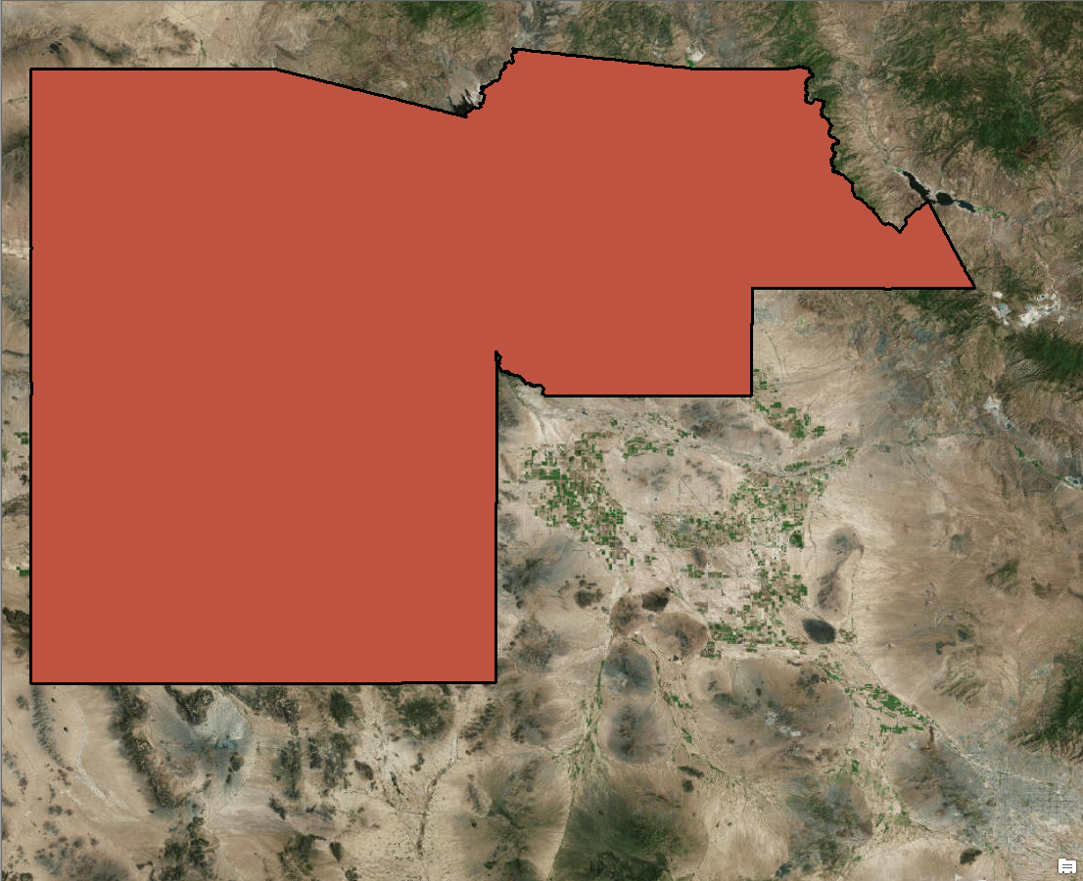
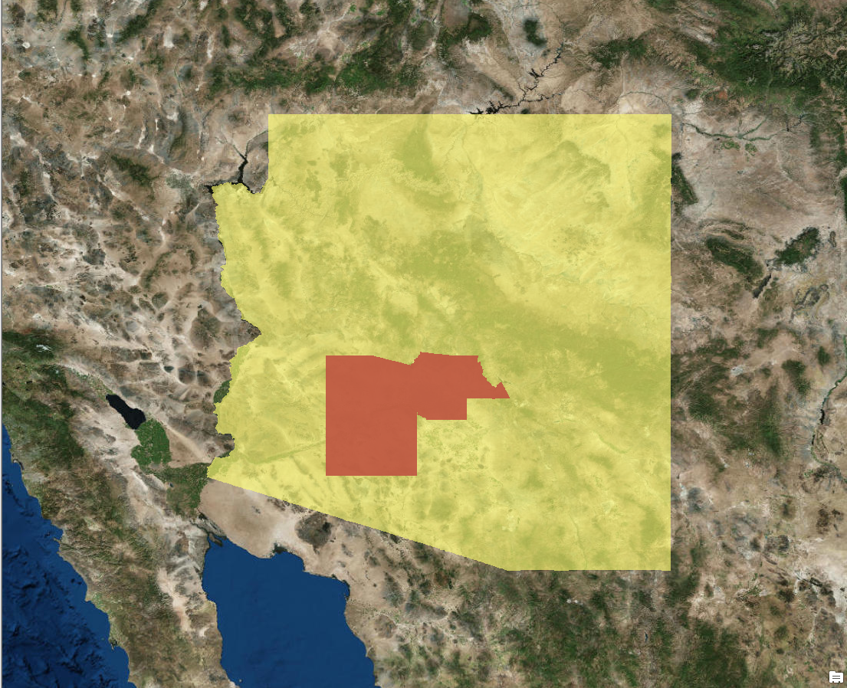
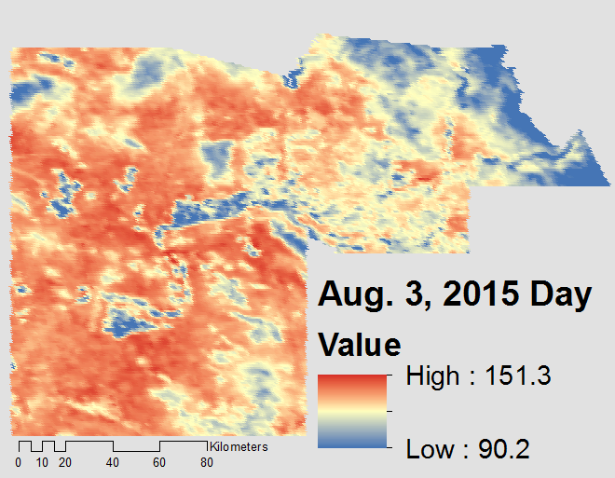
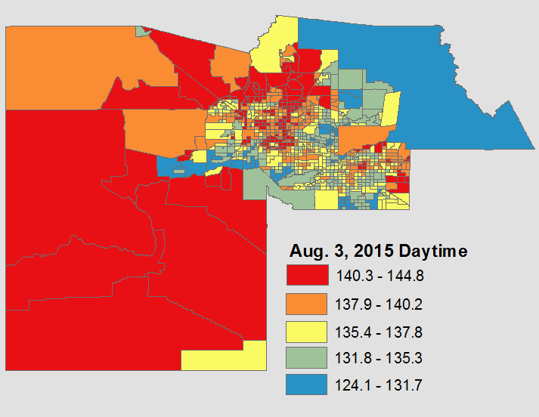
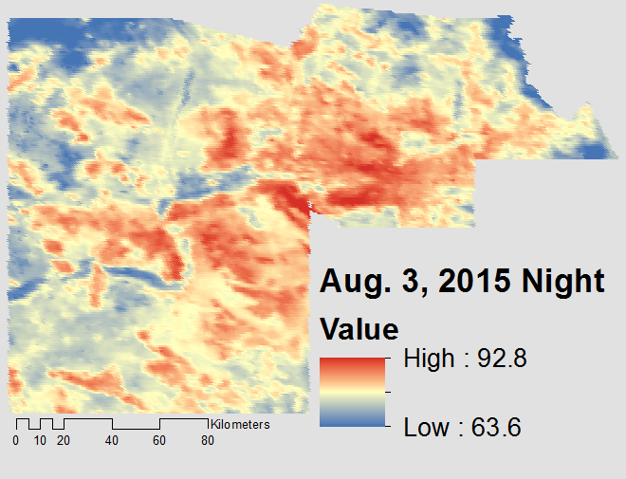
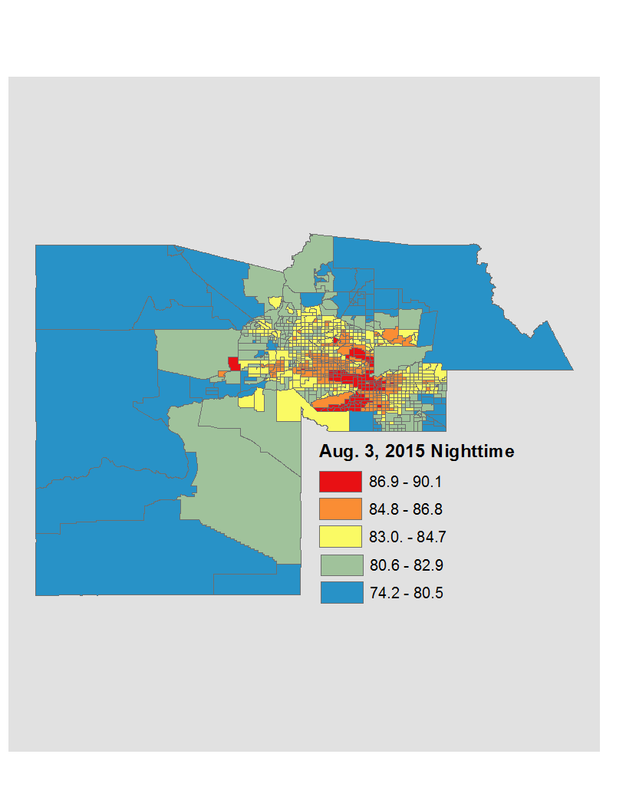
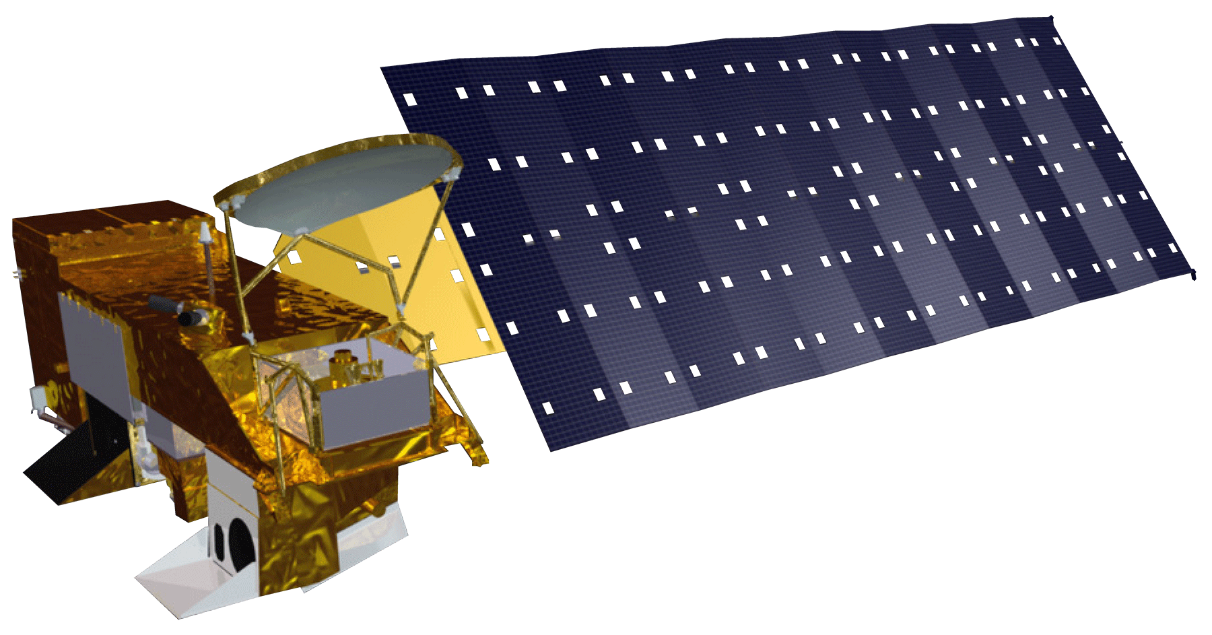

Arizona Health and Air Quality II
Enhancing extreme heat intervention and preparedness activities in Maricopa, Co. Arizona with NASA Earth observations
Daniel Finnell (Project Lead), Teresa Fenn, Richard Muench, Ashley Brodie
DEVELOP National Program at NASA Langley Research Center
Objectives
Abstract
Automate the creation of heat vulnerability maps for Maricopa County
Create a tool to monitor heat severity
Extreme heat causes and exacerbates a number of health problems, leading to hospitalization and death in some cases. The problem of severe heat is notably felt in Maricopa County, Arizona, where the socially disadvantaged and physically vulnerable are especially susceptible to the effects of extreme heat. Within the Maricopa County limits is the city of Phoenix, a dense urban area surrounded by 300-2,000 m ridge lines above the valley floor. The volume of impervious surfaces, lack of shade and vegetation, and the high ridge lines surrounding the city exacerbate the heat stress by a phenomenon known as the urban heat island effect (UHI). After the sun sets, heat retained by impervious building materials is released at a decreased rate compared to natural vegetation and soil coverage. Ambient air temperatures in urban areas tend to be higher than the surrounding rural areas. Several organizations, including the Arizona Department of Health Services and the Phoenix Heat Relief Network, are working to create more effectively placed cooling centers and heat warning systems to aid those with the highest risk of exposure. This project created a Python tool using Aqua Moderate Resolution Imaging Spectroradiometer (MODIS) land surface temperature parameters to generate heat maps that reference demographics data on extreme heat days. In addition to this, using the resources available at the Atmospheric Science Data Center (ASDC) will allow for access to near real-time data acquisition, which will aid the partners in providing spatially distributed relief during extreme heat events.
Study Area
Phoenix
Maricopa County
Arizona
Results
Methodology
Data Sources
Data Products
Processing
End-User Manipulation
Figure 1: The Left side depicts MODIS imagery collected on August 3, 2015. The right side is the translation of those images to census tracts in degrees Fahrenheit. It is visible to see in the more dense census tracts (Phoenix Metropolitan area) that there are pockets of retained heat during the night due to the Urban Heat Island (UHI) effect.
Earth Observations
Conclusions
Aqua MODIS
Automation was successfully completed for MODIS data organization, the collection of weather station data from MesoWest API, and attaching the average temperature values to census tract shapefiles
Due to time constraints we were unable to automate statistical analysis of county wide AC use and demographics of vulnerable populations
Team Members
Project Partners
Acknowledgements
From left :to right: Ashley Brodie, Daniel Finnell, Richard Muench, Teresa Fenn
Arizona Department of Health Services (ADHS)
Phoenix Heat Relief Network
Arizona State University, Center for Policy Informatics (CPI),
National Weather Service, Phoenix Forecast Office
We would like to thank the Arizona Health & Air Quality Term 1 team: including Amy Stuyvesant, Geordi Alm, Rocky Garcia, Emma Baghel, April Rascon, Bernardo Gracia.
We would also like to thank Brian and Matt Tisdale from the ASDC for assisting us with OPeNDAP.
NASA Langley Research Center
Notes:
Data Sources: Mesowest & Synoptic Labs ; Earthdata Search manual data collection ; Connection to OPeNDAP servers ; Survey Results, CASPER
Data Products: Weather Station: Daily High, Daily Low, Pressure, Humidity ; Aqua MODIS: Land Surface Temperature ; Terra ASTER: elevation ; Suomi NPP VIIRS: Population ; Landsat 8 OLI: Land Surface Temperature
Processing: Python Scripts from Term 1 ; Compiling and automation of scripts

