Slide 1
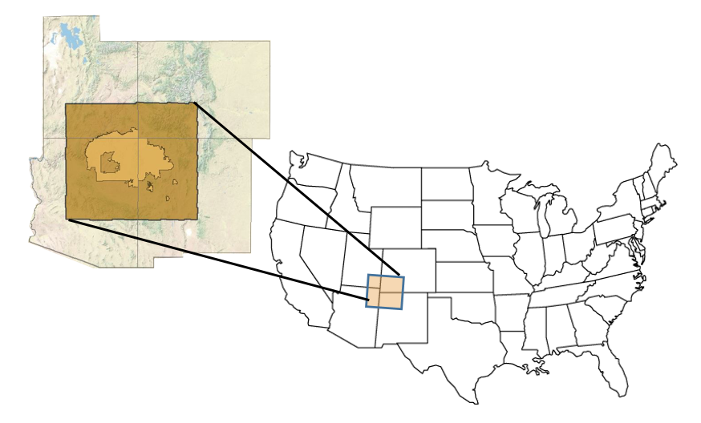


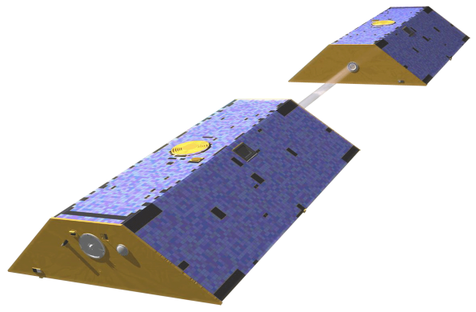
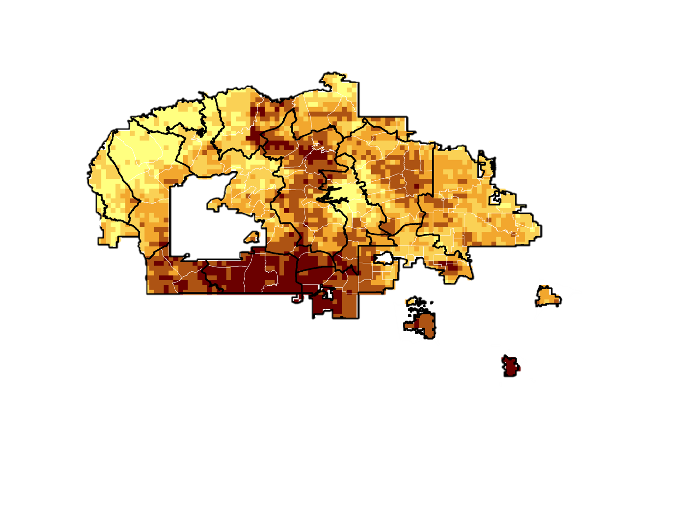
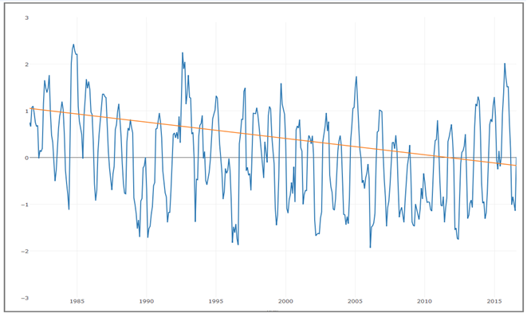




Validating the Drought Severity Assessment Tool and Analyzing Drivers of Drought in the Navajo Nation
Abstract
Objectives
The Navajo Nation (NN) is a 65,700 km² Native American territory located in the southwestern US that has been experiencing increasing seasonal dust storms, declining in rangeland, and shifting of plant ranges caused by severe drought. Drought exacerbates water resource availability, where one-third live without potable water in homes and resort to hauling water.
Currently, monthly drought monitoring status report summaries issued by the Navajo Nation Water Management Branch (NNWMB) are published by piecing together regional and national hydroclimatic variables such as Standardized Precipitation Index (SPI) to drought classifications. The DEVELOP Ames Navajo Nation Climate I and II teams created a decision support tool called the Drought Severity Assessment Tool 2.0 (DSAT 2.0) to improve visualization of user-specified zonal SPI statistics using the Climate Hazards Group InfraRed Precipitation with Station data (CHIRPS). High annual and seasonal variation make it difficult to assess whether increasing drought trends are significant. This term, the Navajo Nation Climate III team aims to determine whether there are significant temporal and spatial trends of SPI from DSAT2.0, in addition to other drought indicators such as snow water equivalent (SWE) from NOAA's Snow Data Assimilation System (SNODAS), land surface temperature (LST) from Terra MODIS, and root zone soil moisture (RZSM) from Assimilated GRACE. Precipitation, SWE, RZSM, LST were analyzed for statistical anomalies, as well as spatial and temporal trends, to enable enhanced decision-making capacity regarding imminent economic and agricultural impacts from water resources in the NN.
Validate DSAT2.0 CHIRPS data with rain gauge data
Determine what historical trends reveal ongoing drought conditions
Analyze statistical trends and relationships within and across:
  CHIRPS Standard Precipitation Index (SPI) data
  Terra MODIS Land Surface Temperature
  SNODAS Snow water equivalent (SWE)
  GRACE Assimilated Surface Soil Moisture
Study Area
Methodology
Data Acquisition
Snow Water Equivalent (SWE)
Processing (Python, R Studio, ArcMap, Excel)
Create “climate zones” to break up the Navajo Nation
Analysis
Trend Analysis
Results
Overall, drought is getting worse over time in the Navajo Nation
DSAT 2.0 is a validated, useful tool for tracking drought
Other drought drivers such as RZSM and LST show strong seasonal variability
Assimilated Gravity Recovery and Climate Experiment, Root Zone Soil Moisture (RZSM)
DSAT 2.0 Tool
Land Surface Temperature (LST)
Clip/ Mask all data to created climate zones
Sample daily data to monthly averages
Time Series Plots
Multivariate Analysis
Earth Observations
Terra MODerate Resolution Imaging Spectroradiometer (MODIS)
Navajo Nation Climate III
Tropical Rainfall Measuring Mission (TRMM)
Gravity Recovery and Climate Experiment (GRACE)
Results
Conclusions
The Navajo Nation split up by climate zone, showing the range of frequency of moderate SPI values. The graph below is a time series plot for the Hopi Buttes climate zone, showing a decrease in SPI over time, indicating drier conditions.
DSAT 2.0 was validated with weather station precipitation, is a useful tool for monitoring drought
Every climate zone is experiencing a significant decline in monthly and annual precipitation
The largest SPI declines occur in the Hopi Buttes and Chuska Mountains climate zones
March and April show the steepest SPI declines for nearly all climate zones
LST and RZSM show high seasonal variability, with no significance
Plateaus outside of the Chuska Mountains have been experiencing a rapid winter decline in SWE since 2010
All investigated parameters show drier conditions in the Navajo Nation
 | SPI | RZSM | LST
Arid Canyonlands | -0.0128 | -0.0427 | -0.0155
Chaco Tablelands | -0.0093 | -0.0797 | -0.0251
Chinle Valley | -0.0260 | -0.0162 | -0.0529
Chuska Mountains | -0.0305 | 0.0363 | -0.0072
Hopi Butte/Grasslands | -0.0350 | -0.0076 | -0.0720
Marble Platform | -0.0223 | 0.1431 | -0.0479
Mesa Highlands | -0.0281 | -0.2049 | -0.0332
Monument Valley | -0.0180 | -0.1373 | -0.0574
Painted Desert | -0.0230 | 0.2898 | -0.0081
San Juan Badlands | -0.0223 | 0.1274 | -0.0214
Sandy Plateaus | -0.0203 | -0.0536 | -0.0272
Semiarid Tablelands | -0.0243 | -0.0918 | 0.0241
SPI Time Series for Hopi Buttes / Grasslands
6-month SPI
Project Partners
Robert Kirk, Principal Hydrologist, Navajo Nation Department of Water Resources
Carlee McClellan, Senior Hydrologist, Navajo Nation Department of Water Resources
Mariah Ashley, Intern, Navajo Nation Department of Water Resources
Maurice Upshaw, GIS Supervisor, Navajo Nation Department of Water Resources
Table 1: Annual Sen’s Slopes. The significant slopes are shown bolded and colored. Significant negative slope indicates increasing dryness.
Year
Team Members
Acknowledgements
Victoria Ly, former NASA DEVELOP Navajo Nation Climate participant
Brittany Zajic, NASA DEVELOP National Program
Jenna Williams, NASA DEVELOP National Program
This material is based upon work supported by NASA through contract NNL11AA00B and cooperative agreement NNX14AB60A. Any mention of a commercial product, service, or activity in this material does not constitute NASA endorsement. Any opinions, findings, and conclusions or recommendations expressed in this material are those of the author(s) and do not necessarily reflect the views of the National Aeronautics and Space Administration and partner organizations.
Lauryn Gutowski
POC
Madison Davis
Christina Zapata
NASA Ames Research Center – 2016 Fall

