Slide 1
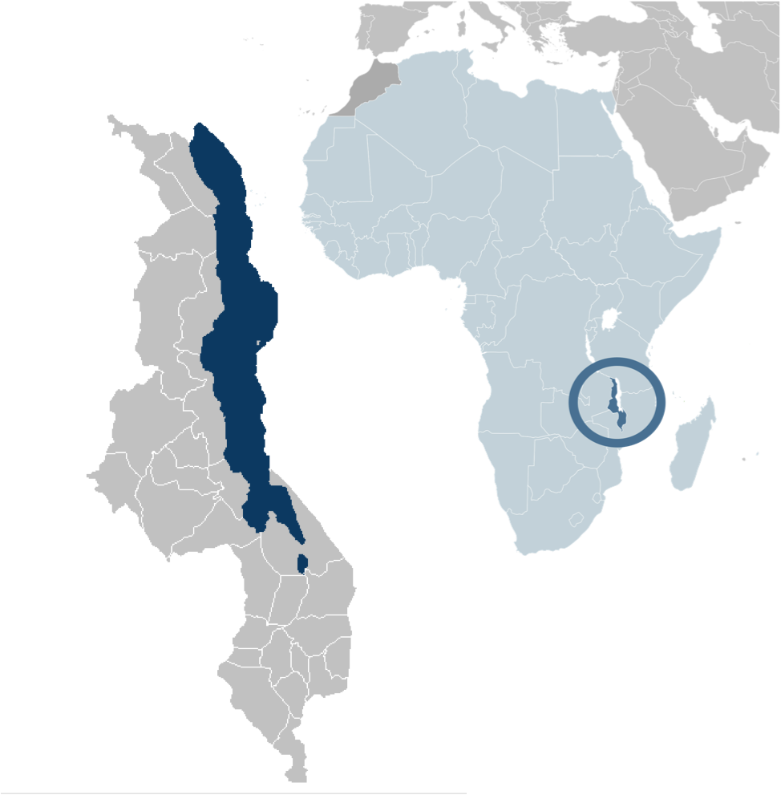
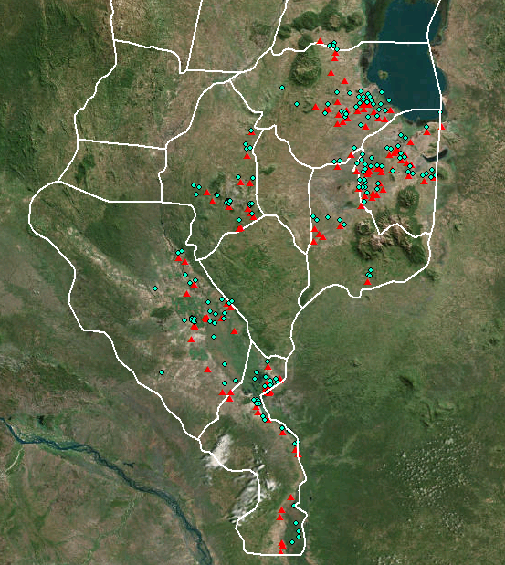
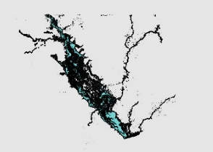


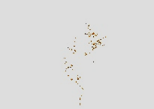
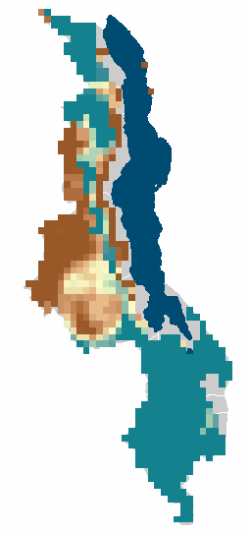
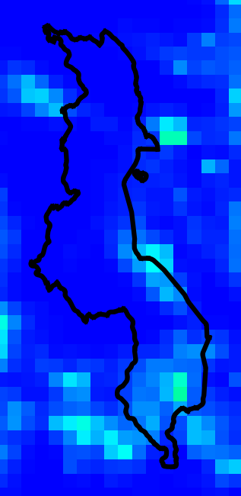
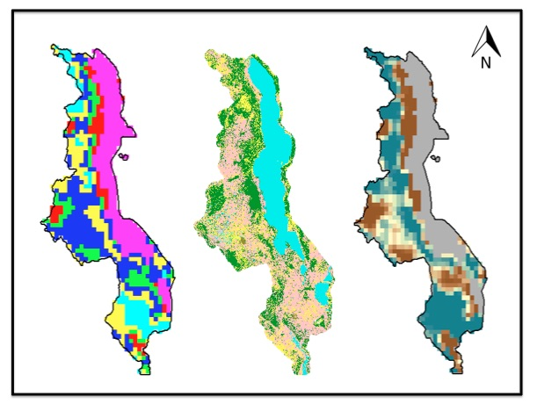
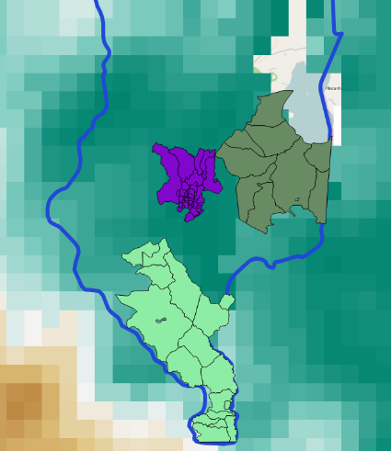
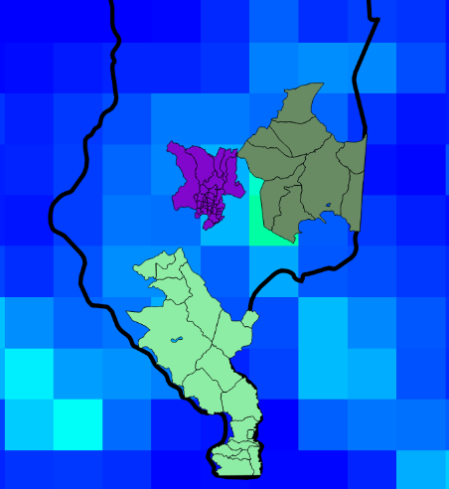
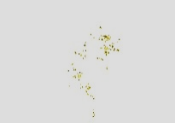
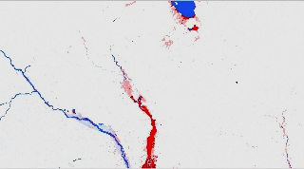
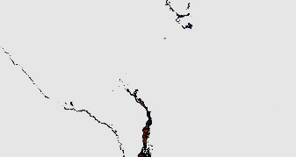

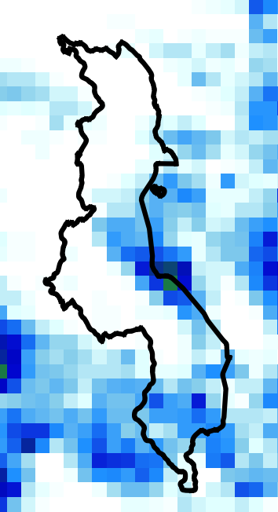
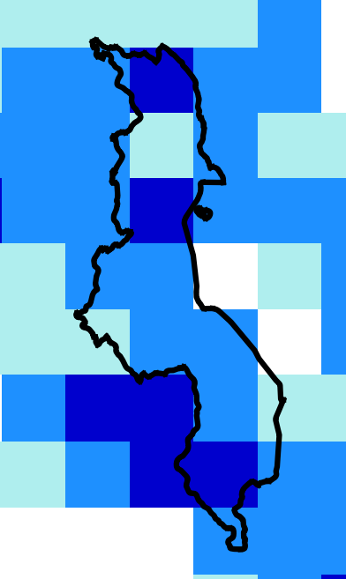
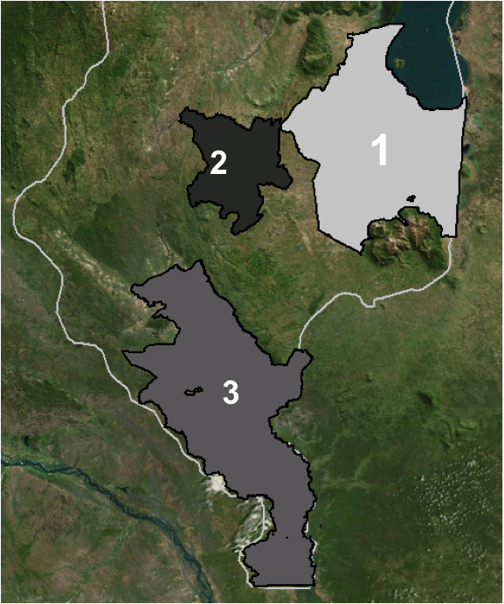
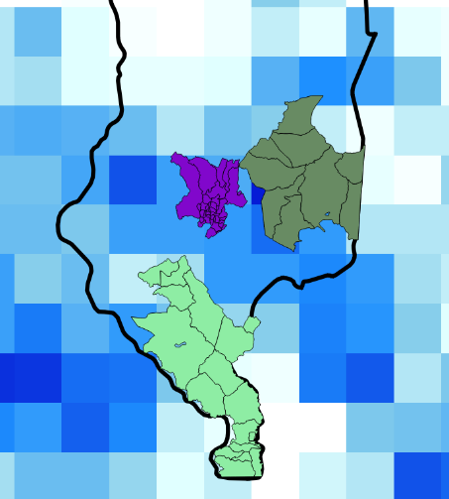
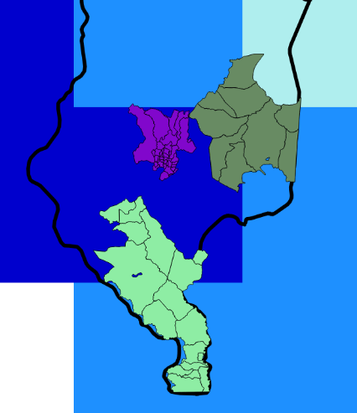
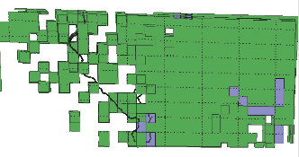
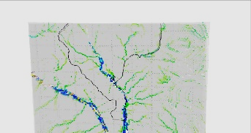
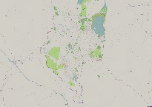

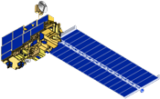
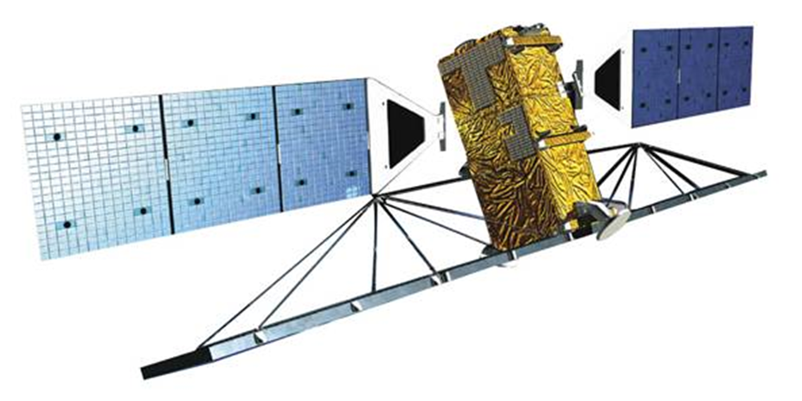
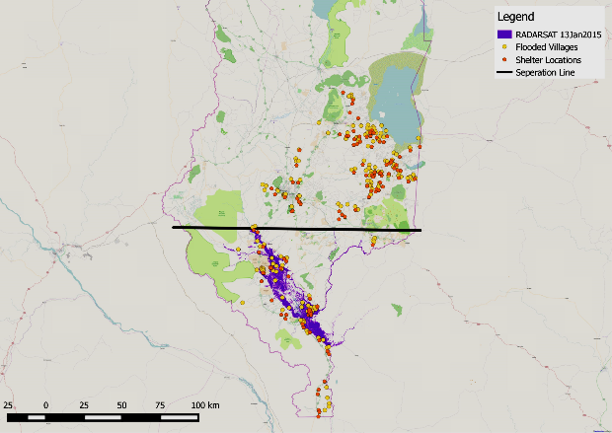
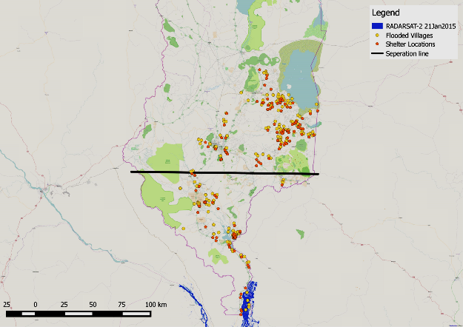
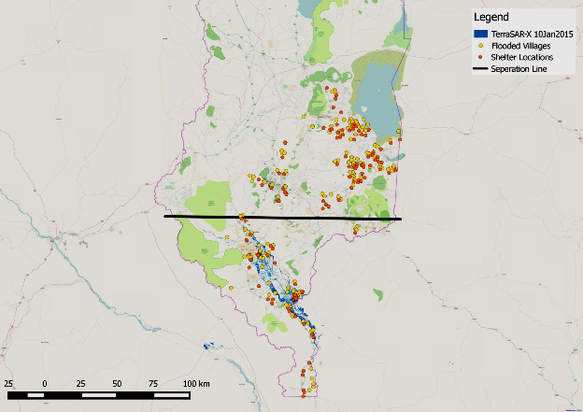
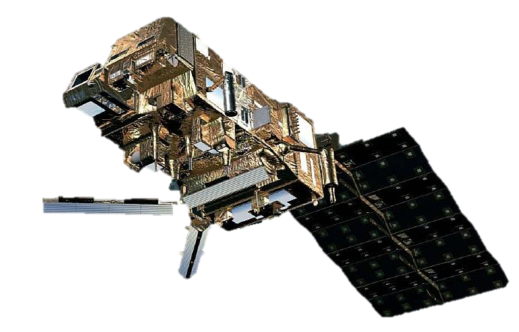
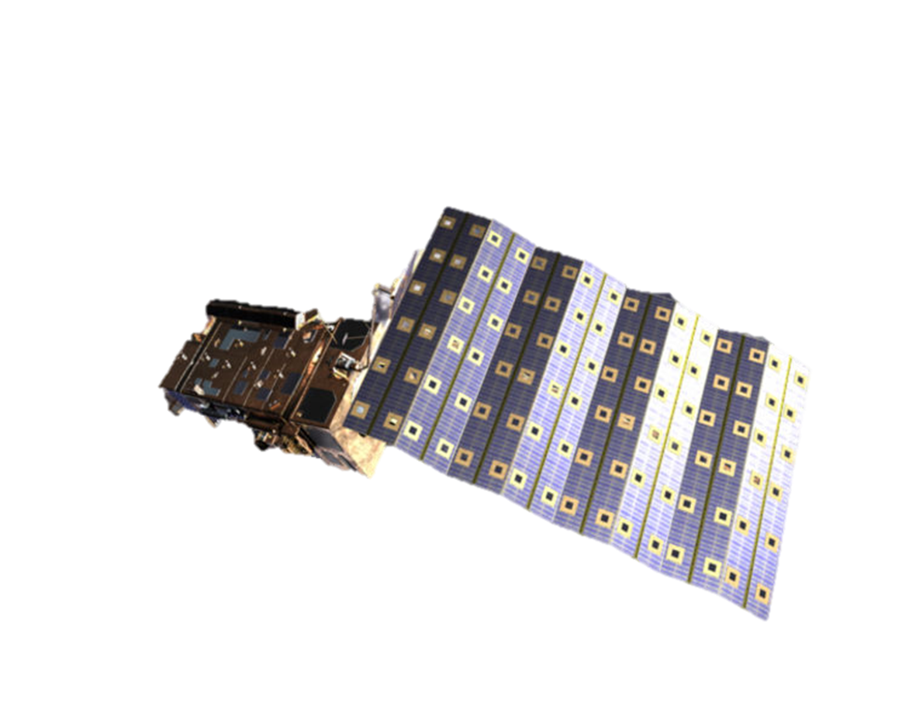
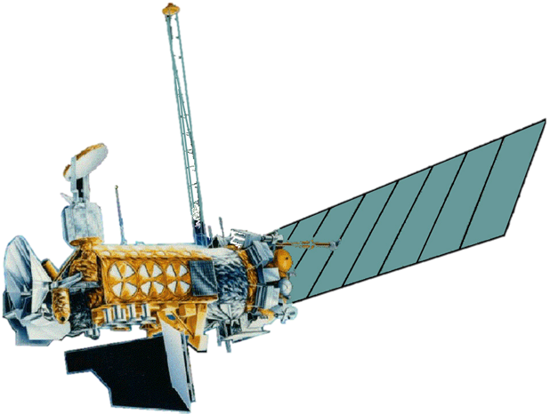
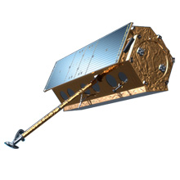

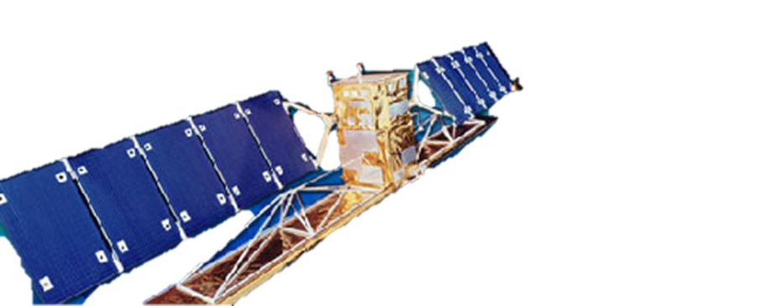
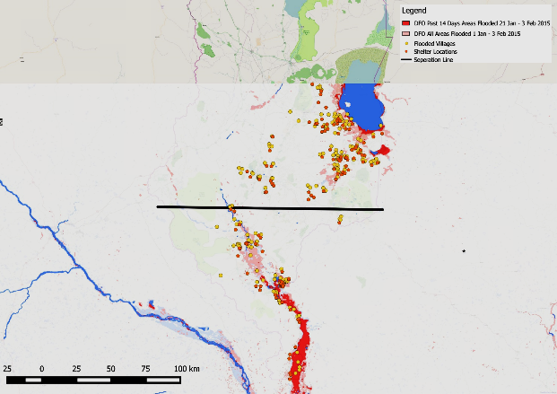
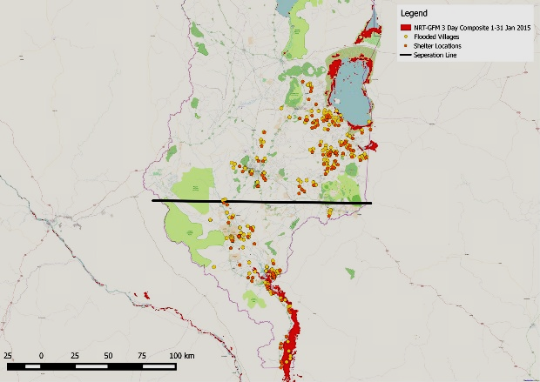
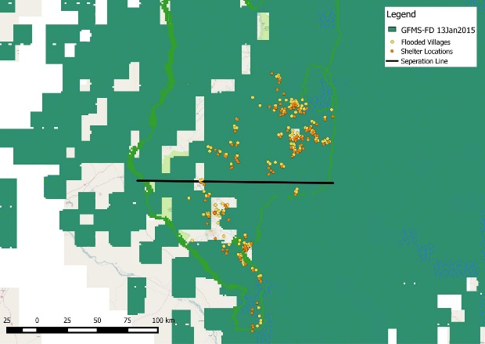
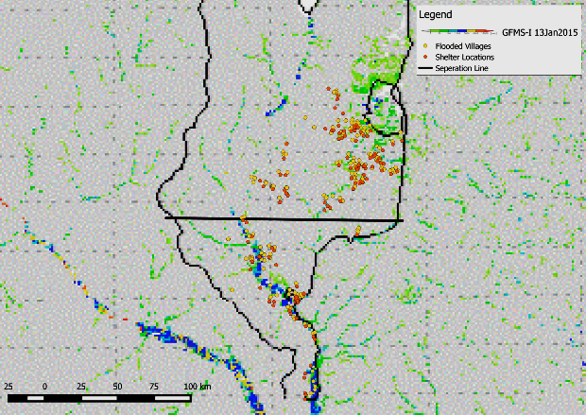

Malawi Disasters II
Applications of flood definitions and NASA Earth Observations to create a flood forecasting methodology
Andrew Kruczkiewicz (Project Lead), Helen Cen, Brigitte Moneymaker
NASA DEVELOP National Program at International Research Institute for Climate and Society
Abstract
Objectives
The African country of Malawi experiences a strong seasonal rainy season stretching from October to April, which provides about 95% of its annual precipitation. In addition to this high seasonality, about 20% of Malawi’s land cover is comprised of surface water from Lake Malawi, one of the Great African Lakes. These unique features contribute to the country’s increased vulnerability to riverine floods and flash floods. In January 2015, extended periods of extreme rainfall caused a series of flood events throughout Malawi, which resulted in the displacement of over 230,000 residents and caused 276 fatalities. In order for local authorities and humanitarian agencies to provide post-disaster relief, these organizations often rely on remotely-sensed satellite data to evaluate initial disaster impact and design response programs. In partnership with the Malawi Red Cross, this project aimed to expand on the findings from previous research in Spring 2015 by first comparing ground-truth data (locations of shelter site of internally displaced people (IDPs) and origins of IDPs) with previous term data and second, by integrating European Space Agency (ESA) remotely sensed data to explore the potential predictive capabilities of soil moisture for flash flood detection. In addition to data from NASA sensors (MODIS, TRMM, SSM-I and AMSU-A data), this project incorporated ASCAT data from ESA. The results of this study will increase the ability to forecast and monitor flood events, benefiting organizations involved with disaster relief efforts in Malawi and potentially allowing for more efficient response and allocation of emergency flood relief efforts.
Use the January 2015 floods in Malawi to compare various inundation detection tools
Validate flood maps with ground truth data provided by the Malawi Red Cross
Explore the predictive capacity of soil moisture for specific types of floods
Study Area
Malawi
Study Period
Methodology
December 2014 & January 2015
Flood Product
Soil Moisture Product
Acquire & Process Ground Truth Data
Group Flood Products
Comparison & Validation
Acquire Data
Selecting Areas of Interest
Zonal Statistical Analysis
  Group 1: SAR Products (Zoomed-in)
Flooded Villages Layer
Flood Detection Products
Shelter Sites Layer
Base Layer (Open Street Map)
Iso Cluster Unsupervised Classification
RADARSAT
RADARSAT-2
TerraSAR-X
Selected areas with similar soil moisture behavior
  Group 2: Near Real Time Products
Soil Water Index
CMORPH
Soil Water Index
CMORPH
DFO
NRT-GFM
Phalombe Region
Blantyre Region
Shire Region
Shelter Sites
Flooded Villages
  Group 3: University of Maryland Global Monitoring System Products
GFMS-FD
GFMS-I
TRMM
IFRC 6 Day Heavy Rainfall Forecast
TRMM
IFRC 6 Day Heavy Rainfall Forecast
Results
Earth Observations
Flood Product Spatial Analysis
Soil Moisture Product Analysis
  Group 1
Aqua
Terra
RADARSAT-2
RADARSAT
RADARSAT-2
TerraSAR-X
MetOp-A
MetOp-B
DMSP
  Group 2
TerraSAR-X
TRMM
RADARSAT
Conclusions
DFO
NRT-GFM
TerraSAR-X and RADARSAT in Group 1, NRT-GFM in Group 2, are relatively better at detecting riverine floods.
The soil moisture iso cluster analysis showed that the zones with different flood types also had different soil moisture behaviors
All selected areas between the dates January 10th and 13th, 2015 showed average rainfall and average soil moisture to be positively correlated, therefore no distinction could be made between flash flood and riverine flood using the two types of data.
In Blantyre, soil moisture was elevated earlier, indicating a longer period of time being at or near saturation- this could be used as a precursor for flash flood risk.
  Group 3
GFMS-FD
GFMS-I
Team Members
Project Partners
Acknowledgements
Andrew Kruczkiewicz, Helen Cen & Brigitte Moneymaker
Red Cross/Red Crescent Climate Centre:
Erin Coughlan
Malawi Red Cross Society:
Hastings Kandaya
Dr. Pietro Ceccato
Lead Environmental Monitoring Program, IRI
(Science Advisor)
International Research Institute for Climate and Society

