Slide 1
New Jersey Health & Air Quality
Modeling Near Surface Air Temperature Profiles of Complex Urban Systems Based on Land Surface Properties by Correlating on-Site and Satellite Data to Better Understand Temperature Profiles in Urban Microclimates
Maryam Karimi (Project Lead, NOAA Crest Institute of CUNY)
Jerrod Lessel (Center Lead, IRI)

Slide 2
Introduction
Urbanization and the impact of urban heat island (UHI) effect
UHI can create numerous health risks including respiratory difficulties, heat cramps, heat stroke, and heat-related mortality
Image Credit: NASA
Can a better understanding of microclimates help us understand and resolve urban heat island effects?
Notes:
Our land surface are changing. More UHI effect leads to more heat related mortalities in urban environment
Image Source: http://earthobservatory.nasa.gov/Features/GreenRoof/

Slide 3
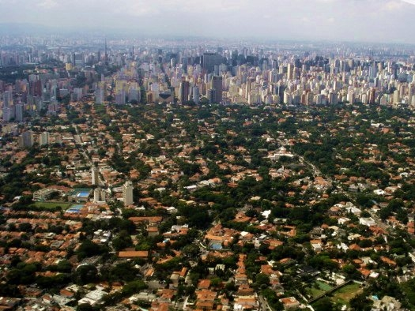
Image Credit: Flickr CC – Chris Combe
Image Credit: Wikipedia - FlaviaC
Introduction
Increases in UHI are primarily due to the changing of landscapes from permeable/moist surfaces to more impermeable/dry surfaces.
Notes:
UHI is seen more due to modification in our land surfaces. We are developing due to population growth. These impervious surfaces increase UHI effect due to trapping of heat and lack of evatraporation
Image Source: https://www.flickr.com/photos/cosmicherb70/14277229595/in/photolist-nKCwWX-ixYaN8-eM3tzH-neidTW-qcpwjE-tBsr1o-uvrzYy-nBJEh5-p3QURT-zJUdhV-kBGiG6-hNq3da-xbu8eE-zkqDSy-zmF9Hb-efCmN4-nuyHMd-oc26V8-j68uYX-n8y8nA-naERaK-nCKJbu-uztDJy-xAM1CT-oZGihU-oyCv3w-nzTSVU-qUEr62-o7VGBZ-r5THxg-kU9RfX-oWbtbi-3tEnf-nAhtGc-8LGEM1-m8EcGT-nCJQ4S-pojdyJ-rCyRsS-nAtfWu-oLsxjT-uLh49P-zF7gtr-6Ku6yz-j2HjqE-pe5ZQ3-8hHzYW-inhgJA-sAVyXm-mxyQmT
https://pt.wikipedia.org/wiki/Jardins#/media/File:S%C3%A3o_Paulo_City_03197.jpg

Slide 4
Introduction
Heat Waves and Mortality
Exposure-response function for temperature related mortality in Manhattan, NY based on daily data from 1982 to 1999
Image Credit: Li, et al., 2013
Notes:
Image Source: Li, T., Horton, R. M., & Kinney, P. (2013). Future projections of seasonal patterns in temperature-related deaths for Manhattan. Nature climate change, 3, 717

Slide 5
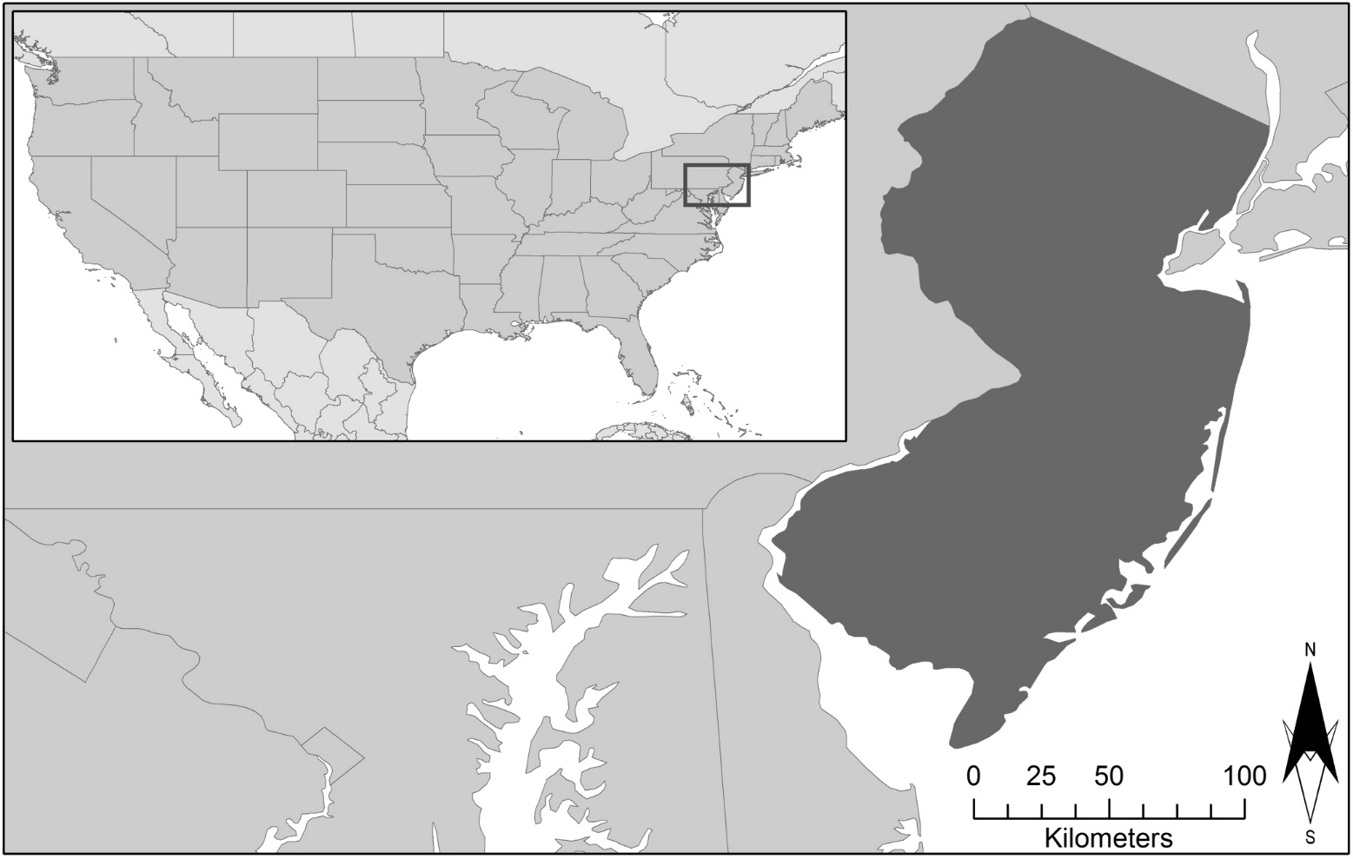
Introduction
Study Area:
Glassboro, NJ
(Rowan University Campus)
Study Period:
May – July 2015
New Jersey
Glassboro

Slide 6
Objectives
To improve understanding of the effect of the Urban Heat Island (UHI) on the near surface air temperature where humans interact
Mitigating the UHI effects in urban microclimate’s
Develop a correlation identifying the role of surface features on near surface air temperature for new perspectives in urban design for developers and city management
Image Credit: Jerrod Lessel

Slide 7
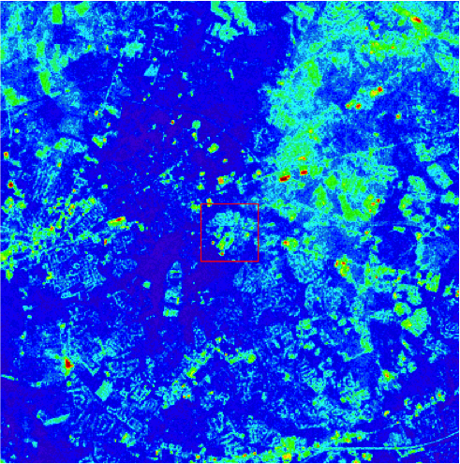
Methodology
NASA Earth Observation:
Landsat 8 – TIRS
Landsat 8

Slide 8
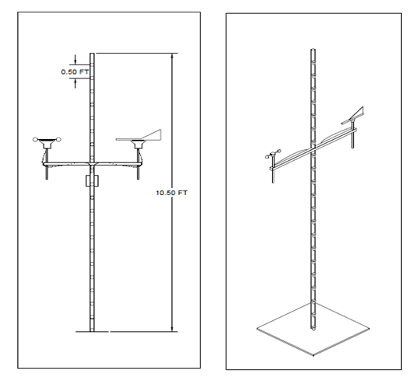
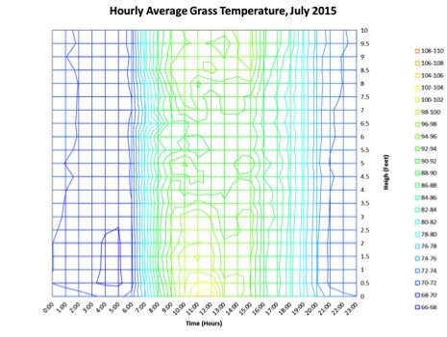
To improve understanding of the effect of the Urban Heat Island (UHI) on the near surface air temperature where humans interact
Mitigating the UHI effects in urban microclimate’s
Develop a correlation identifying the role of surface features on near surface air temperature for new perspectives in urban design for developers and city management
Methodology
Temperature Probe Setup
Probes set up on Rowan University campus
Microclimate types: Grass, Water, Concrete, and Asphalt
Notes:
Temperature Probe Setup
The sensors were spaced at half foot increments on a 10 foot pvc pole.
The temperature probe setup was then employed within varying microclimates located on the Rowan University campus.
The chosen microclimates exhibited three different surface types: mainly grass surface, area with a water surface, and a predominantly concrete surface.

Slide 9
To improve understanding of the effect of the Urban Heat Island (UHI) on the near surface air temperature where humans interact
Mitigating the UHI effects in urban microclimate’s
Develop a correlation identifying the role of surface features on near surface air temperature for new perspectives in urban design for developers and city management
Methodology
Collect raw probe data
Collect remotely sensed data
Compare remotely sensed data to probe data
Analyze probe data
Compare probe data for differing environmental factors

Slide 10
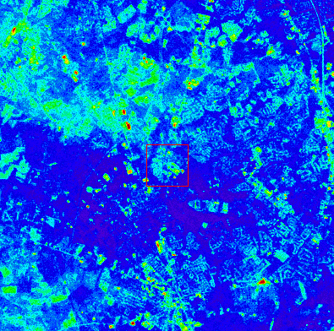
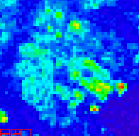
To improve understanding of the effect of the Urban Heat Island (UHI) on the near surface air temperature where humans interact
Mitigating the UHI effects in urban microclimate’s
Develop a correlation identifying the role of surface features on near surface air temperature for new perspectives in urban design for developers and city management
Methodology
Convert Landsat TIRS thermal band to temperature
Compare Landsat temperature to field measurement data
Rowan University
Campus

Slide 11
Results and Discussion
Temp. (°F) | Probe Height (ft) |  |  |  |  |  |  |  |  |  | 5/22/2015
 | Landsat | 0 | 0.5 | 1 | 1.5 | 2 | 2.5 | 3 | 3.5 | 4 |  | 4.5 | 5 | 5.5 | 6 | 6.5 | 7 | 7.5 | 8 | 8.5 | 9 | 9.5 | 10
Asphalt | 80.6 | 89.1 | 84.0 | 83.8 | 83.1 | 83.0 | 82.4 | 82.3 | 81.4 | 79.3 |  | 80.1 | 81.7 | 82.1 | 81.8 | 81.7 | 81.6 | 81.8 | 81.7 | 81.7 | 83.0 | 81.4 | 82.0
Concrete | 78.5 | 81.1 | 78.5 | 78.1 | 78.2 | 78.0 | 78.4 | 78.0 | 78.2 | 78.2 |  | 78.0 | 77.8 | 77.7 | 78.3 | 78.1 | 77.8 | 77.6 | 78.3 | 77.9 | 78.6 | 78.0 | 77.8
Grass | 76.9 | 77.9 | 78.1 | 78.2 | 78.6 | 78.5 | 78.1 | 78.9 | 78.4 | 78.0 |  | 77.0 | 77.6 | 76.7 | 77.2 | 76.1 | 77.3 | 77.5 | 77.9 | 79.0 | 80.0 | 80.4 | 80.7
Water | 75.4 | 77.0 | 77.0 | 77.9 | 77.8 | 77.2 | 77.4 | 77.4 | 77.1 | 77.1 |  | 76.9 | 76.9 | 76.6 | 76.7 | 76.6 | 76.6 | 76.6 | 76.6 | 76.4 | 76.7 | 76.6 | 77.1
Temp. (°F) | Probe Height (ft) |  |  |  |  |  |  |  |  |  |  | 7/25/2015
 | Landsat | 0 | 0.5 | 1 | 1.5 | 2 | 2.5 | 3 | 3.5 | 4 | 4.5 |  | 5 | 5.5 | 6 | 6.5 | 7 | 7.5 | 8 | 8.5 | 9 | 9.5 | 10
Asphalt | 96.9 | 105.1 | 107.5 | 106.6 | 106.3 | 106.6 | 108.0 | 104.7 | 102.3 | 98.0 | 99.7 |  | 105.5 | 110.5 | 105.2 | 109.0 | 104.6 | 108.0 | 105.1 | 105.2 | 109.5 | 104.1 | 107.2
Concrete | 93.4 | 94.1 | 91.9 | 91.7 | 91.7 | 91.6 | 91.8 | 91.4 | 91.4 | 91.4 | 91.1 |  | 90.9 | 90.7 | 90.9 | 90.8 | 90.7 | 90.7 | 91.1 | 91.2 | 91.5 | 91.5 | 91.3
Grass | 90.3 | 95.7 | 91.9 | 92.5 | 92.7 | 94.0 | 94.0 | 94.7 | 92.3 | 93.1 | 92.0 |  | 93.8 | 91.9 | 92.7 | 91.4 | 92.0 | 92.1 | 94.0 | 96.6 | 97.8 | 97.7 | 97.4
Water | 88.7 | 116.5 | 110.0 | 107.1 | 108.4 | 105.3 | 104.9 | 104.6 | 105.0 | 107.0 | 103.6 |  | 98.9 | 97.5 | 97.2 | 98.0 | 100.9 | 100.7 | 97.5 | 97.9 | 99.3 | 99.5 | 99.2
Image Credit: Jerrod Lessel
Notes:
Probe temperature at different elevation is compared to the Landsat temperature for the same latitude/longitude for each micro climate. A summary of the data and its comparison is shown in the tables.

Slide 12
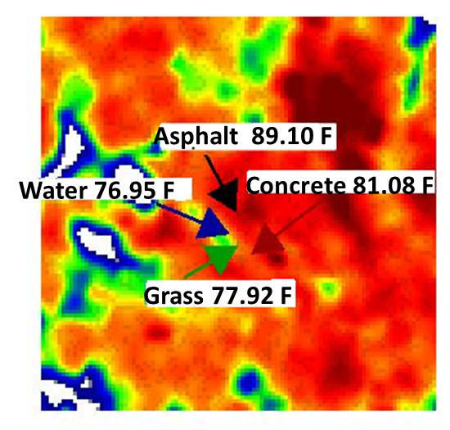
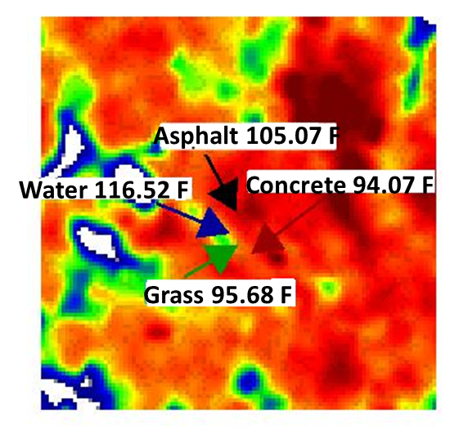
Results and Discussion
5/22/2015
Probe Height 0 ft
7/25/2015
Probe Height 0 ft
Landsat 8 Temperature maps for May and July 2015

Slide 13
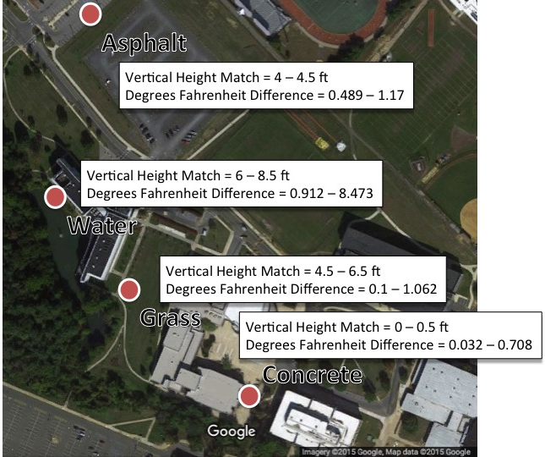
Results and Discussion

Slide 14
Conclusions
In our analysis over the study period of May 2015 through July 2015, we found that Landsat image temperatures matched the different microclimates at varying vertical heights.
For asphalt, at the vertical height of 4 to 4.5 ft, the Landsat imagery most closely matched the probe data with only 0.489 to 1.17 °F difference.
For concrete, at the vertical height of 0 to 0.5 ft, the Landsat imagery most closely matched the probe data with only 0.032 to 0.708 °F difference.
For grass microclimates, at the vertical height of 4.5 to 6.5 ft, the Landsat imagery most closely matched the probe data with only 0.1 to 1.062 °F difference.
Finally for mainly water microclimates, at a vertical height of 6 to 8.5 ft the Landsat imagery most closely matched the probe data with only 0.912 to 8.473 °F difference.
Using results from this work and future work (at additional locations), different constants could be calculated in order to complete an empirical formula.
Even after such a formula is completed though, there may still be errors due to changes in conditions from those that were used to find the formula’s constants.
As such, an offset table should be included in order to correct for weather types and surface types in different environments.

Slide 15
Advisor
Pietro Ceccato (Research Scientist, Lead Environmental Monitoring Program, The International Research Institute for Climate and Society, The Earth Institute, Columbia University)
Partners
Thomas Matte (Bureau of Environmental Surveillance and Policy, New York City Department of Health and Mental Hygiene)
Rouzbeh Nazari (Rowan University)
Aurash Khawarzad (We Act for Environmental Justice)
Patrick Kinney (Columbia University, Mailman School of Public Health)
Brian Vant-Hull (Consortium for Climate Risk in the Urban Northeast)

