Slide 1
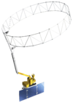
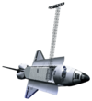
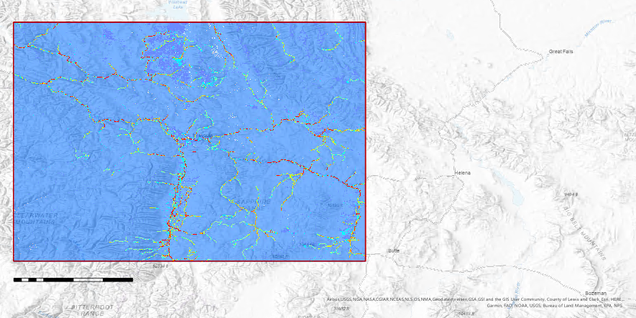
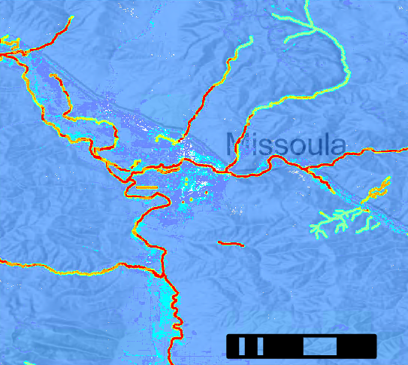
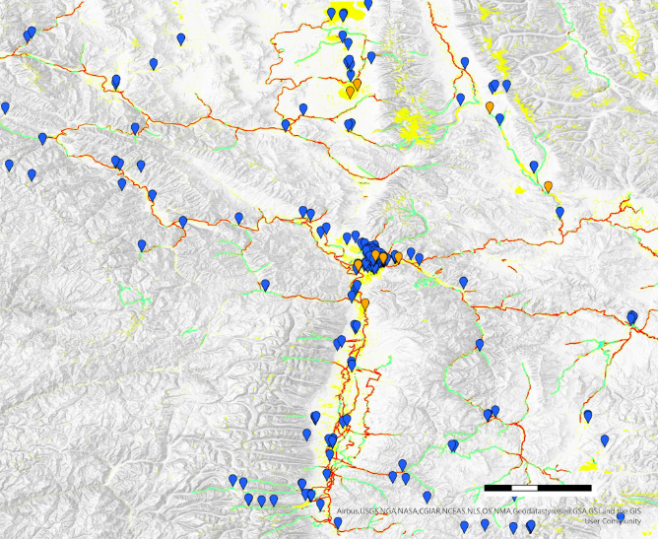
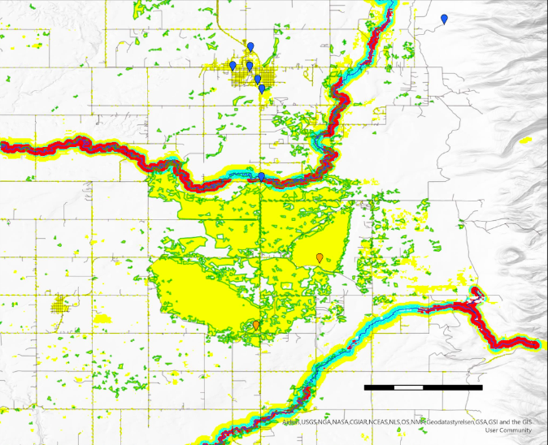
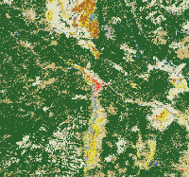
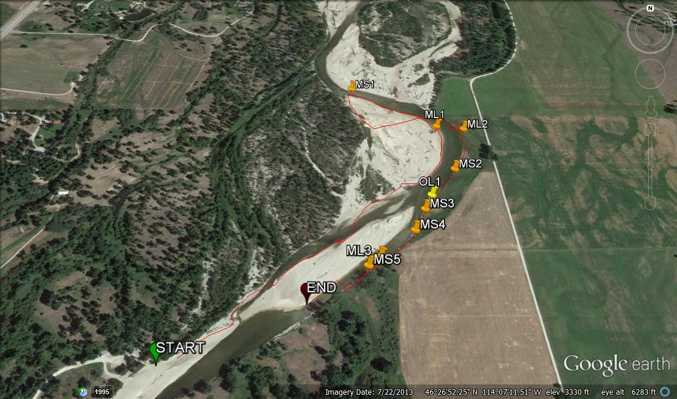
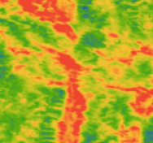
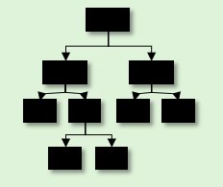
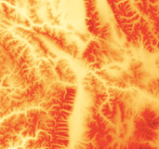
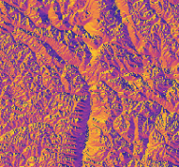
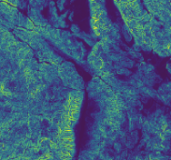
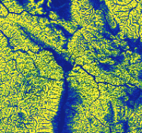
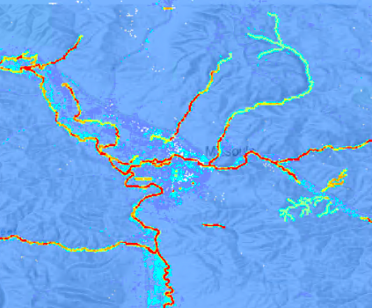
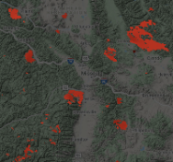
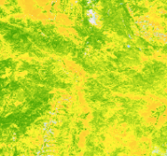
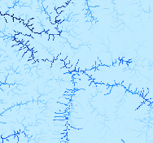
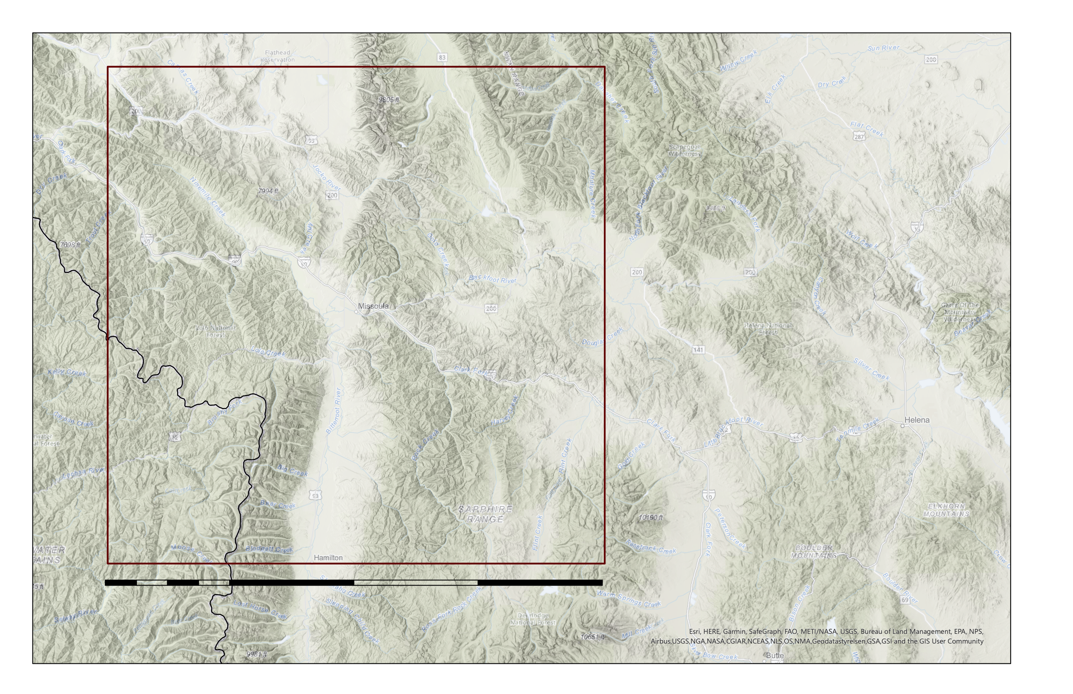
Objectives
Create habitat suitability models for American Mink (Mustela vison) and North American River Otter (Lontara canadensis) to facilitate contaminant monitoring in Western Montana
Project habitat suitability models to 2040 based on changing climate conditions
Develop tool to identify survey regions based on proximity to contaminant sources and availability of suitable mustelid habitat
Modeling Habitat Suitability of Mustelid Species to Guide Detection Dog Surveys for Contaminants Monitoring, via Collected Scats, in River Systems in Western Montana
Abstract
Earth Observations
Western Montana Ecological Forecasting
Environmental contaminants are becoming increasingly prevalent in riverine ecosystems. The status of contaminants in western Montana’s relatively pristine river systems is largely unknown. Monitoring for heavy metals, brominated flame-retardants (BFRs), and pharmaceuticals is important due to their negative effects on ecosystems. Exposure to these contaminants can have significant endocrine, neurological, and reproductive effects. Contaminants easily travel up the food chain and bioaccumulate in apex predators. As predators with a largely aquatic diet, American mink (Mustela vison) and North American river otter (Lontra canadensis) serve as reliable indicator species of environmental health and the status of contaminants. Analysis of scat from these species is a noninvasive method to measure contaminant levels, and detection dogs from Working Dogs for Conservation (WD4C) have been used to locate these scat samples. To aid in the search of these samples, habitat suitability models were created for mink and otter for the years 2013-2020 and projected to 2040 using the random forest algorithm in the Software for Assisted Habitat Modeling (SAHM). Predictor variable data were acquired from Landsat 8 Operational Land Imager (OLI), Terra Moderate Resolution Imaging Spectroradiometer (MODIS), Global Precipitation Measurement Integrated Multi-satellite Retrievals for GPM (GPM IMERG), Shuttle Radar Topography Mission (SRTM), and Soil Moisture Active Passive (SMAP). Within these models, the most important variable for mink and otter habitat was distance to river. Suitable habitat also corresponded with emergent herbaceous land cover and deeper river locations. These habitat suitability models will inform sampling site section for further contaminant analysis.
Terra MODIS
SRTM
Landsat 8 OLI
GPM IMERG
SMAP
Results
N
N
Missoula
Objectives
0
20
40 km
Create habitat suitability models for American mink and North American river otter to facilitate contaminant monitoring in Western Montana
Project habitat suitability models to 2040 based on changing climate conditions
Develop tools to determine future survey locations based on proximity to contaminant sources and availability of suitable habitat
Habitat Suitability
0.287-0.466
0
25
100 km
0.000-0.039
0.467-0.639
0.040-0.137
0.640-0.823
0.138-0.286
0.824-1.000
Methodology
Fig. 4. Habitat suitability map focused on Missoula, Montana. Habitat suitability is measured in probability of mink and otter occurrence throughout the study area. Blue indicates low probability and red indicates high probability.
Data Acquisition
Data Analysis
Mapping
N
Google Earth Engine
Current habitat suitability maps
WorldClim
Software for Assisted Habitat Modeling (SAHM)
Preprocessing
Model runs
Missoula
Partner occurrence data
Future habitat suitability maps
0
2.5
5 km
GBIF
0
20
40 km
Survey feasibility maps
Points of Interest
Habitat Suitability
Open Street Map
GBIF Otter Presence
No Habitat
Study Area
Low
Roads
Medium
Rivers
High
Figure 1. General project workflow. GBIF stands for Global Biodiversity Information Facility.
Emergent Herbaceous Wetland
Occurrence data
Predictors
Analysis
Fig. 5. Habitat suitability final model with points of interest (potential contaminant sources) and additional occurrence data. Areas of lowest probability were removed to focus on likely survey areas. The inset map highlights one suggested survey site.
NLCD
Land Cover
1. Random Forest Model
Conclusions
Mink and otter occurrence was most strongly correlated with distance to rivers, river depth, land surface temperature, and land cover, in that order of importance.
We identified multiple regions of Western Montana that WD4C should survey based on availability of habitat, proximity to contaminant sources, and proximity to other known otter sightings.
The habitat suitability maps, research site feasibility maps, and Google Earth package created in this project will help guide WD4C in future survey site selection.
ssm
ppt
Climatic
Image Credit: N. Richards
LST
Species occurrence data
elev
aspect
Topographic
2. Probability Map
slope
HAND
Acknowledgements
burn
NDVI
Other
Dr. Allison Howard – University of Georgia
Dr. John Bolten – NASA Goddard Space Flight Center
Dr. Kenton Ross – NASA Langley Research Center
Dr. Peder Engelstad – Colorado State University
Dr. Nicole Ramberg-Pihl – NASA GSFC Node Fellow
river dist
depth
Figure 2. Workflow for current habitat suitability models. Predictors defined as follows: NLCD- National Land Cover Database, LST- Land Surface Temperature, NDVI- Normalized Difference Vegetation Index , SSM- Surface Soil Moisture
Study Area
N
Study Area Boundary
Project Partners
Dr. Ngaio Richards – Working Dogs for Conservation
Dr. Mark LaGuardia – The Virginia Institute of Marine Science
Missoula
Team Members
0
100
200 km
Anna Winter
Project Lead
Kergis Hiebert
Madeleine Gregory
Kjirsten Coleman
Fig. 3. A depiction of the 200km² study area centered on Missoula, Montana.
Maryland - Goddard

