Slide 1
FISHER’S PEAK
Ecological Forecasting
Mapping Biomass to Inform Conservation Planning of a Future State Park in Southern Colorado
Lauren Lad, Scott Cunningham, Laura Krauser, Darby Levin
Colorado – Fort Collins
Notes:
Hi everyone, thank you for joining the Fisher's Peak Ecological Forecasting team for our closeout presentation. Today we will be speaking on the last 10 weeks of "Mapping Biomass to Inform Conservation Planning of a Future State Park in Southern Colorado." My name is Scott Cunningham and I am joined by [Introduce team members]

Slide 2
Introduction
Biomass = total mass of living matter, which functions as an estimation for carbon storage
Image Credit: Lukas Rodriguez
Notes:
Scott: Biomass quantification is becoming increasingly important for forest management and conservation. Biomass is the total mass of material stored in organic matter, like vegetation, and can be used to derive carbon estimates. Sequestering carbon by preserving biomass can encourage conservation by allowing land-owners to generate revenue by selling carbon offsets. This requires a current understanding of a property's carbon inventory and biomass. Traditional methods of measuring biomass are limited to time and labor-intensive tools, such as field sampling. This project used Earth observations to evaluate the feasibility of using remotely-sensed data and machine learning algorithms as a supplement to, and potential replacement for in situ data collection.
------------------------------Image Information Below ------------------------------
•Image Credit: Lukas Rodriguez
•Image Source: Creative Commons, https://www.pexels.com/photo/trees-during-day-3573351/

Slide 3
The Carbon Market
Industries buy carbon credit
to offset greenhouse gas emissions.
CO2 sequestration
Management of healthy forests generates carbon credits.
Image Credit: NASA DEVELOP Team, Canva.
Notes:
Scott: Carbon markets are worldwide systems designed to mitigate the growth of greenhouse gases in Earth’s atmosphere. Companies can gain credit in a carbon market by sequestering carbon, and a common way to do this is through preserving living biomass. In situ methods of estimating biomass are expensive, time consuming, and produce considerable uncertainty. Developing a method for accurately modeling biomass using Earth observations would help our partner organizations assess the Fisher's Peak property for possible inclusion in a carbon market in an efficient and economically-viable way.
------------------------------Image Information Below ------------------------------
•Image Credit: Laura Krauser
•Image Source: NASA DEVELOP Fisher's Peak Ecological Forecasting Team, Canva

Slide 4
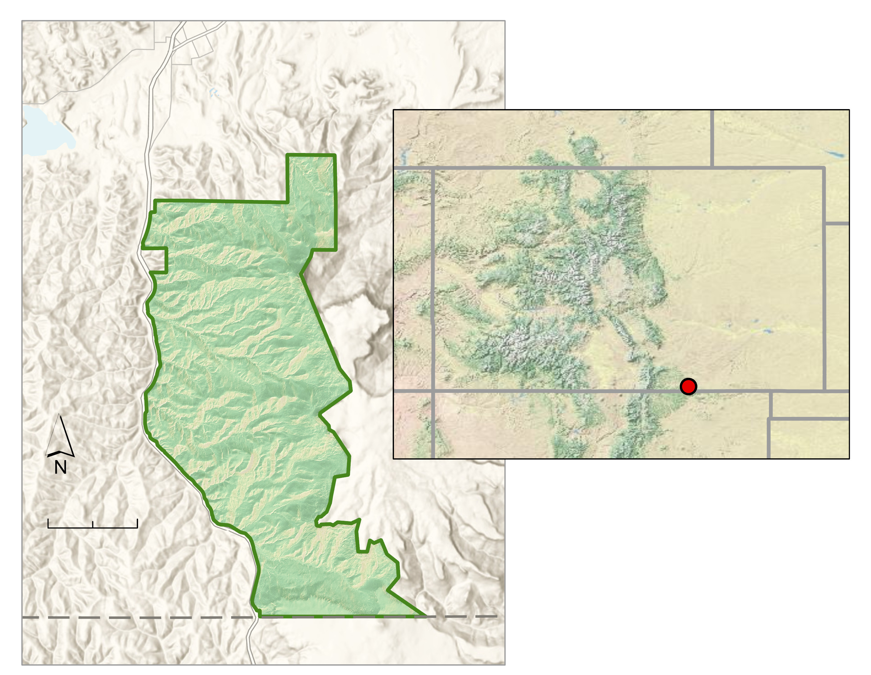
Study Area & Period
Fisher's Peak State Park
77.5 km²
Will be Colorado's 2nd largest state park
Study Period:
June 2019-August 2019
Trinidad
WY
NE
CO
Fisher's Peak
NM
0
1.5
3 Km
Study Area
Colorado
New Mexico
Notes:
Scott: Fisher's Peak is a great test site for evaluating a property's potential to enter a carbon market, and using remotely sensed data to streamline this process. Fisher's Peak State Park will be a 77.5 square kilometer area near the Colorado/New Mexico border. This unique property has been privately owned and experienced minimal anthropogenic influence for the last 50 years. Because of this, the area is highly biodiverse and acts as a wildlife corridor between the prairies and the Front Range. This property also borders the iconic Fisher's Peak montane formation, which causes steep elevation changes. This gradient facilitates a transition between pinon pine and juniper trees at lower elevations, Gambel oak and ponderosa pine at mid-elevations, and a mix of fir and pines at the highest elevation peaks. Based on the availability of our in situ data, our study period was June 2019 to August 2019.
------------------------------Image Information Below ------------------------------
•Image Credit: Scott Cunningham
•Image Source: NASA DEVELOP Fisher's Peak Ecological Forecasting Team

Slide 5
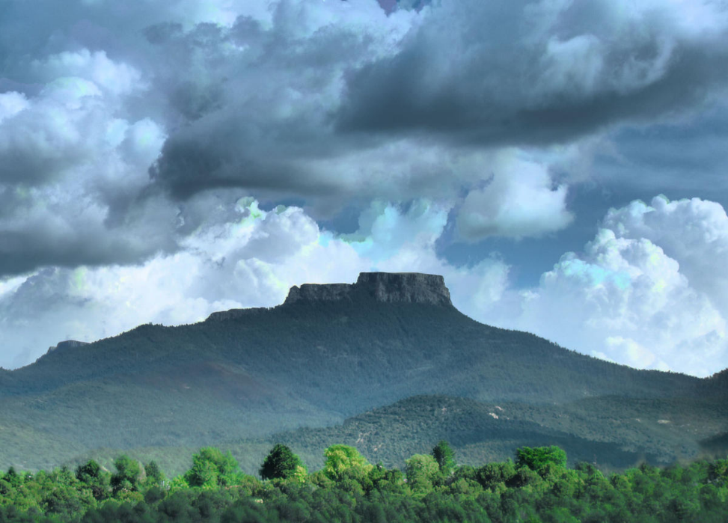
Community Concerns
The park will balance:
A growing recreation-based economy for the city of Trinidad
Ecological diversity
Preservation of major carbon sinks
Carbon market potential for partners
Image Credit: Michelle Goodall
Notes:
Scott: Fisher's Peak will be Colorado's 2nd largest state park and will balance recreational development for hiking and camping with conservation goals like preserving large carbon stocks and sections of old growth forest. The nearby city of Trinidad has high hopes for the growth of their recreation economy through park-based tourism. However, recreational use of the land will be designed with conservation in mind. Fisher's Peak has unique wildlife that includes the endangered New Mexico meadow jumping mouse, and a diverse mix of trees that alternate between fir, pine, juniper, and oak. At the start of the summer DEVELOP term, a comprehensive ecological inventory had not yet been conducted. Therefore, efforts from the DEVELOP team, the Evangelista Lab at Colorado State University, and project partners were combined to produce a comprehensive inventory in support of both economic and conservation goals.
------------------------------Image Information Below ------------------------------
•Image Credit: Michelle Goodall (Creative Commons)
•Image Source: https://www.krcc.org/post/fishers-peak-be-acquired-conservation-groups-enter-public-ownership

Slide 6
Partners
The Nature Conservancy
Colorado State Forest Service
Image Credits: Pixabay
Notes:
Scott: This project partnered with the Colorado State Forest Service and The Nature Conservancy. Both organizations have vast ecological knowledge and experience, but benefit from the cost and time efficient work that can be done with the aids of remote sensing and DEVELOP.
------------------------------Image Information Below ------------------------------
•Image Credit: Pixabay (Creative Commons)
•Image Source: https://www.pexels.com/photo/trees-in-forest-during-sunset-247421/

Slide 7
Objectives
Develop
a model for mapping biomass
Create
a biomass map of the area, pre-park development
Estimate
the property's potential for entering the carbon market
Forecast
high priority preservation areas
Image Credits: PNGKit, Kiss Clipart, and Vectors Market from www.flaticon.com
Notes:
Darby: In support of project partners and community concerns, the DEVELOP team had four main objectives. The first was to develop a random forest regression model using RStudio. This regression model was developed using in situ forest inventory data, high-resolution LiDAR aerial imagery, and satellite imagery. The second objective was to create a biomass map using the random forest regression model. This map focused on above ground biomass and was used to derive locations of high carbon storage. The map was provided to project partners to improve their understanding of the property's potential for entering the carbon market. Finally, the biomass map was used to forecast high priority preservation areas for park developers. These high priority areas were areas with large areas of old growth forest and high carbon storage.
------------------------------Image Information Below ------------------------------
•Image Credit: Kiss Clipart, PNGKit, and FlatIcon (Creative Commons)
•Image Sources: Creative Commons,
Decision Tree Icon: https://www.kissclipart.com/wordpress-decision-tree-plugin-clipart-wordpress-p-p7k40x/
Map Icon: https://www.pngkit.com/view/u2q8i1w7t4t4t4e6_how-to-create-a-map-icon-in-adobe/
Factory Icon: https://www.flaticon.com/free-icon/factory_234739
Leaf Icon: https://www.kissclipart.com/leaf-icon-png-clipart-computer-icons-clip-art-cijbs0/

Slide 8
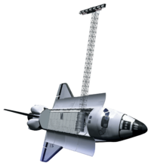
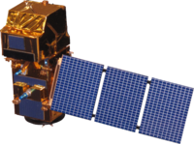
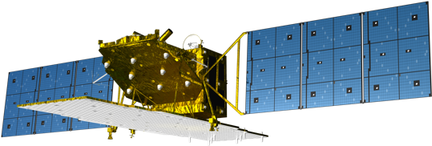
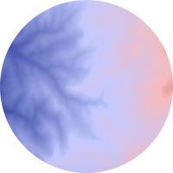
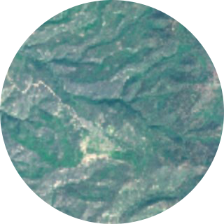
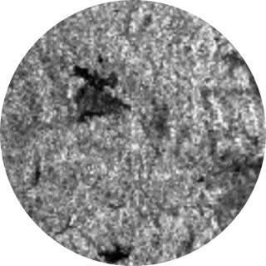
Methods: Satellites and Sensors
Landsat 8 OLI
SRTM
Sentinel-2 MSI
ALOS-2 PALSAR-2
Satellite Image Credits: NASA, Celina Vargas
Notes:
Darby: In service of project objectives, our team used Earth Observations from NASA's Landsat 8 OLI and SRTM, as well as the ESA's Sentinel-2 MSI and the Japanese ALOS-2 PALSAR-2.
------------------------------Image Information Below ------------------------------
•Image Credit: NASA (Landsat 8, SRTM, Sentinel-2 MSI) http://www.devpedia.developexchange.com/dp/index.php?title=List_of_Satellite_Pictures
•Image credit: Celina Vargas (ALOS-2 PALSAR-2) (https://www.kindpng.com/imgv/hboxbww_alos-2-satellite-hd-png-download/#)

Slide 9
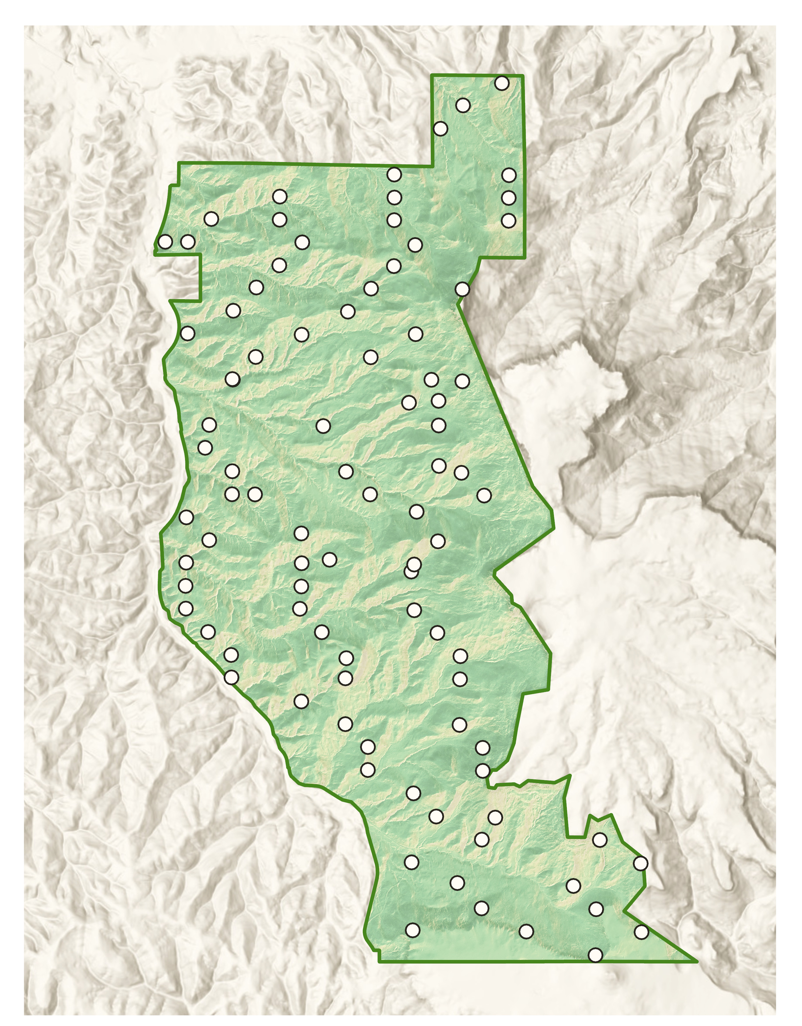
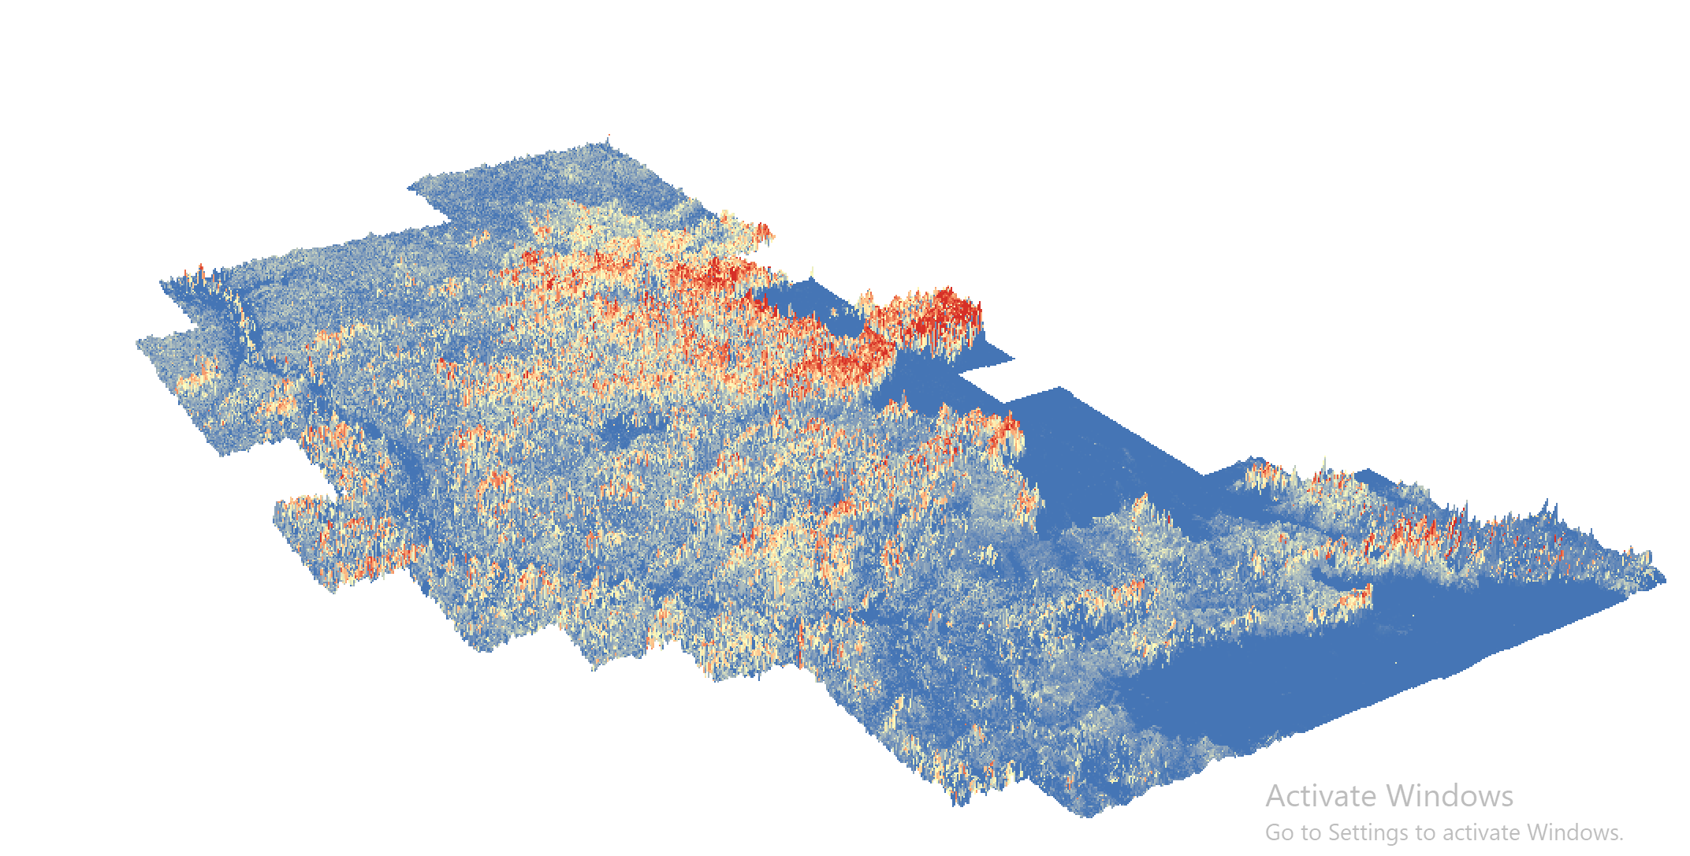
Methods: Ancillary Datasets – Model Data
Forest Inventory Timber Cruise
June 11 – July 11, 2019
High Resolution LiDAR Canopy Height
June 2019
Inventory Plot
*Plot size not to scale
Notes:
Darby: Besides the passive and active remote sensing data from those sensors, we used partner-provided Forest Inventory data and aerial LiDAR imagery. The forest inventory plots (shown on the left) provided ground truth training data for modeling biomass estimations. The LiDAR-derived canopy height data (shown at right) was evaluated for its usefulness as a predictor variable for our biomass model.
------------------------------Image Information Below ------------------------------
•Image Credit: Scott Cunningham
•Image Source: NASA DEVELOP Fisher's Peak Ecological Forecasting Team
Image Credit: Darby Levin
•Image Source: NASA DEVELOP Fisher's Peak Ecological Forecasting Team

Slide 10
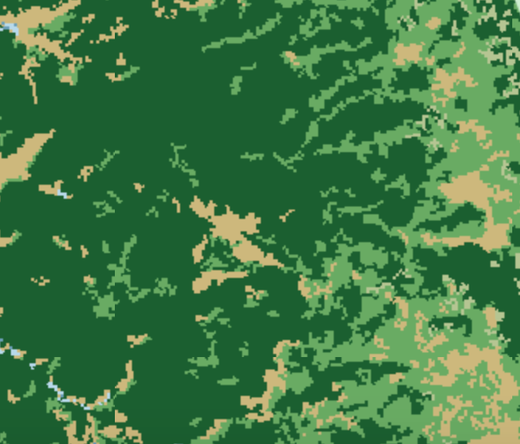
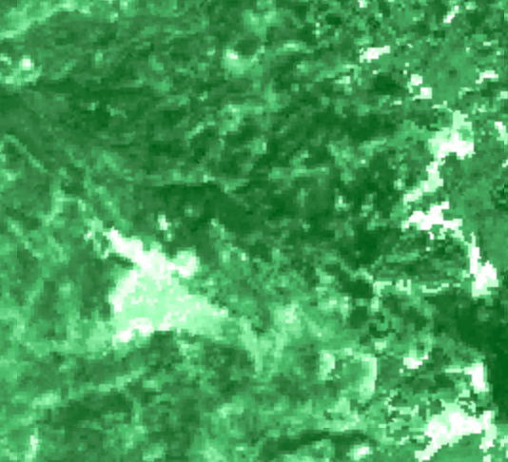
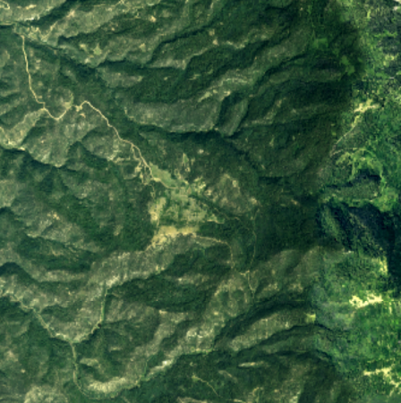
Methods: Ancillary Datasets - Verification
NLCD Percent Tree Cover
NLCD Landcover
NAIP
Notes:
Darby: NLCD landcover and percent tree cover products, and NAIP imagery were used for land cover verification of project end products.
------------------------------Image Information Below ------------------------------
•Image Credit: Darby Levin
•Image Source: NASA DEVELOP Fisher's Peak Ecological Forecasting Team

Slide 11
Methods: Training Data Processing
Equation: Y(kg)=exp^{B₀+(B₁*ln(DBH))} (Jenkins et al., 2003)
Sample Values of Biomass by Plot
Plot # | # Trees | Avg DBH (cm) | Biomass (kg) | Plot Area (m²) | Biomass (kg/ 10 m pixel) | Biomass (Mg/ ha)
10 | 14 | 35.9 | 12,391 | 1,067 | 1,764 | 176.4
270 | 9 | 22.9 | 796.7 | 637 | 184.3 | 18.43
480 | 7 | 33.4 | 1,799 | 804 | 376.9 | 37.69
Data Breakdown (Mg/ha)
Average | 79.17
Standard Deviation | 57.67
Max | 265.31
Min | 9.86
Notes:
Darby: We processed our in situ forest inventory data using Python 3.0 and Excel. This dataset included plot coordinates, species notes, and mature tree and sapling DBH (depth at breast height) measurements. Each tree's biomass was calculated using the above equation. Coefficients B0 and B1 were assigned based on the tree's species. The trees' biomass was then summed by plot. Since the forest inventory data was collected using variable radius plots, biomass values were resampled to 10m spatial resolution using the plot radius factor. This value, in kg/100m^2, was used for training our model. Final biomass values were converted into Mg/ha, the standard unit for biomass. Example values of our biomass by plot calculations can be seen in the table on the left and a breakdown of our training data distribution can be seen above in the table on the right.
Allometric Equation from Jenkins et al 2003.

Slide 12
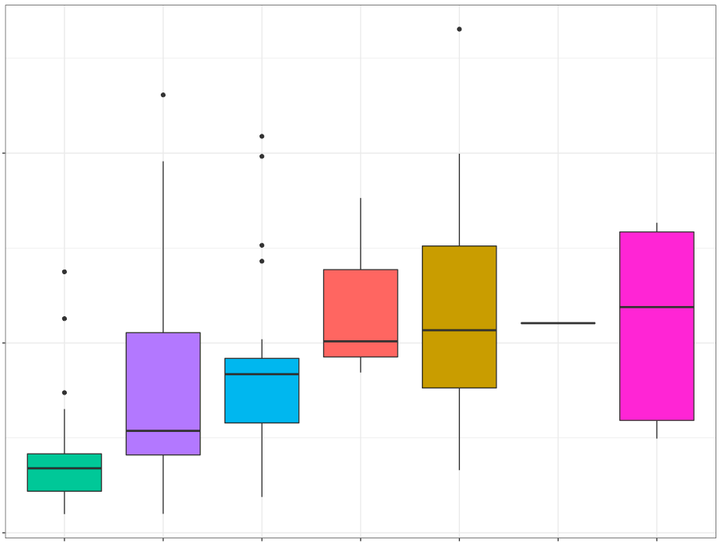
Methods: Training Data Processing
200
Biomass (Mg/ha)
100
0
Pinon Pine
Rocky Mt Juniper
Ponderosa Pine
Douglas Fir
Gambel Oak
NM Locust
White Fir
Dominant Tree Species
Notes:
Darby: In this plot, we show the distribution of biomass by dominant tree species for our training data. We sought to understand the impact of specific species on this area's biomass and carbon storage. Interestingly, ponderosa pine typically holds more biomass than shrubby species like Gambel Oak. However, in our forest inventory data, Gamble Oak contained a larger part of the biomass distribution, and our highest biomass plot was dominated by 26 Gambel Oak trees, while nearby Ponderosa Pine plots contained less than half of that biomass.
------------------------------Image Information Below ------------------------------
•Image Credit: NASA DEVELOP Fisher's Peak Ecological Forecasting Team
•Image Source: NASA DEVELOP Fisher's Peak Ecological Forecasting Team

Slide 13
Methods: Data Preparation
Allometric Equations
Resample to 10m
Field
Optical
Stack input rasters
Active
Resample to 10m
Topographic
Extract values at training points
Predictor Variables
Methodology
Model Application for Biomass Estimation
Resampled to 10m
Field Biomass Estimates by Plot
Random Forest Model Development, Predictor Selection
Allometric calculations
Field
Field
Field
Optical
Stack input rasters
Resampled to 10m
Biomass Predictors
Active
Derived
Error Analysis
Data
Image Processing
Image Processing
Image Processing
Image Processing
Data Products
Modeling
Output
Image Processing
Image Processing
Notes:
Lauren: In addition to our ground truth data, the team utilized LiDAR canopy height data, Landsat 8 and Sentinel 2 bands and indices, as well as ALOS derived HH, HV, and HH/HV bands. Additionally our topographic variables included SRTM-derived elevation, slope, and aspect northness and eastness. The predictor variable rasters from all sources were projected to WGS 84/UTM zone 13 and resampled to a 10m spatial resolution where necessary. This list of predictors was utilized for initial model comparisons and evaluated using correlation values and variable importance.
------------------------------Image Information Below ------------------------------
•Figure Credits: NASA DEVELOP Fisher's Peak Ecological Forecasting Team

Slide 14
Satellite/Sensors | Predictor Variables | OOB RMSE | OOB R² | Final Model?
Landsat 8 + SRTM | LS Wetness, SRTM northness, LS Greenness, SRTM elevation, LS Brightness, SRTM eastness, LS NIR, SRTM slope | 55.24 | 7.01 | No
Radar + Landsat 8 + SRTM | LS Wetness, SRTM northness, LS Greenness, SRTM elevation, LS Brightness, Sentinel VH, SRTM eastness, ALOS PALSAR HH | 54.98 | 11.66 | Yes
LiDAR + Landsat 8 + SRTM | LS Wetness, SRTM northness, LS Greenness, LiDAR Canopy Height, SRTM elevation, LS Brightness, SRTM eastness and slope | 55.77 | 5.23 | No
Notes:
Lauren: After analyzing our training data, the team moved into model development. We performed several model comparisons using combinations of topographic variables and both passive and active remote sensing data. To narrow the list of predictor variables for each run, the team performed a correlation analysis between the predictor variables and the forest inventory data, as well as a correlation analysis among the predictor variables. If two variables had a correlation of greater than |0.7| the variable with higher model importance was retained. This slide illustrates some of these model iterations and their accuracy metrics. Sentinel-2 models were not attempted because variable correlation was too high. The optimal combination of predictor variables was a mix of Landsat 8 tasseled cap variables, SRTM topographic variables, and Sentinel and ALOS PALSAR C and L band variables. This model gave us an RMSE of 54.98 Mg/ha and an out-of-bag R^2 value of 11.66.
------------------------------Image Information Below ------------------------------
•Table Credit: Lauren Lad
•Image Source: NASA DEVELOP Fisher's Peak Ecological Forecasting Team

Slide 15
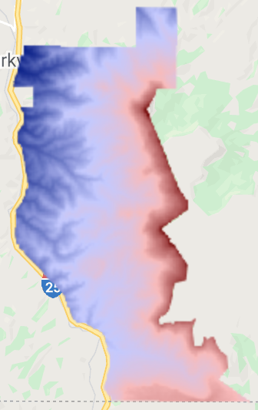
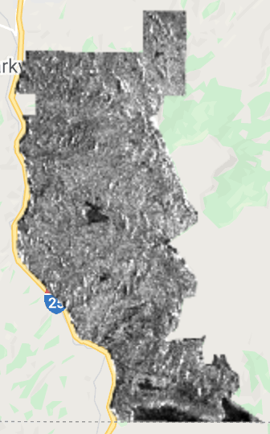
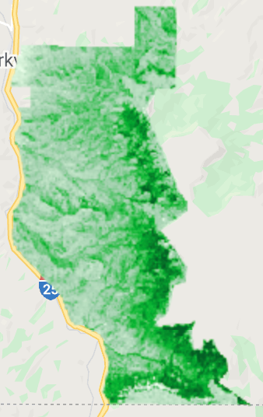
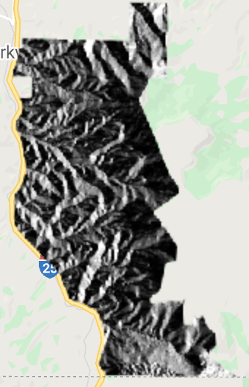
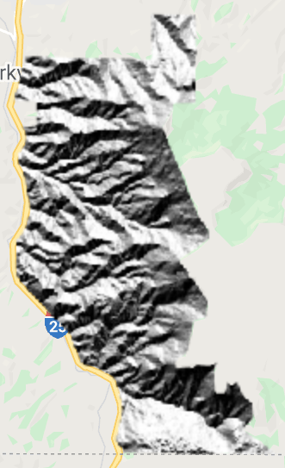
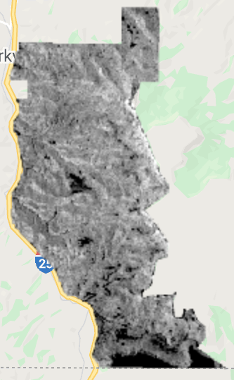
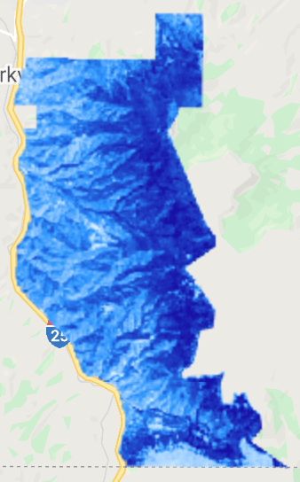
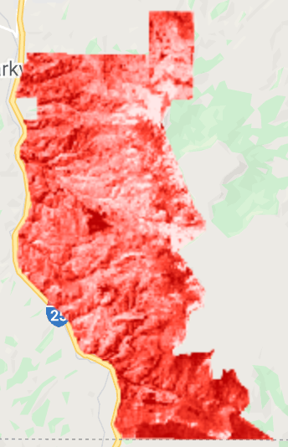
Methods: Predictor Variables
1. Wetness
2. Northness
3. Greenness
4. Elevation
5. Brightness
6. Sentinel VH
7. Eastness
8. ALOS HH
4.
8.
3.
7.
2.
6.
1.
5.
Notes:
Lauren: The final predictor variables included Landsat Tasseled cap wetness, greenness and brightness, SRTM northness, elevation, and eastness. It also included C band imagery from the Sentinel SAR VH dataset and the ALOS PALSAR HH band. These raster layers were stacked and exported from Google Earth Engine as a GeoTIFF. This TIFF was then imported into R, where it was used to rasterize our model and produce a predictive map of biomass for Fisher's Peak State Park.
------------------------------Image Information Below ------------------------------
•Image Credits: Darby Levin
•Image Source: NASA DEVELOP Fisher's Peak Ecological Forecasting Team

Slide 16
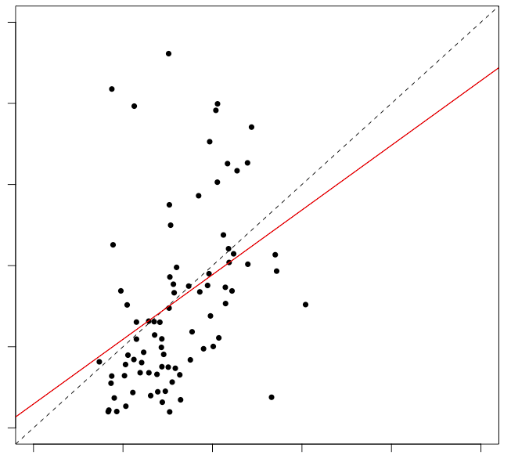
Results:
250
200
150
Actual Biomass (Mg/ha)
y=0.699x + 22.956
100
50
0
0
50
100
150
200
250
Predicted Biomass (Mg/ha)
Notes:
Lauren: This graph illustrates the predicted versus observed values from our predictive model. The dashed line represents the ideal 1:1 ratio of predicted to observed values. The solid red line represents the actual ratio of our data. The saturation point of predicted biomass is around 150Mg/ha. Although there were observed biomass values higher than this, our model viewed every value of 150Mg/ha and above as essentially the same. Overall, our model tended to underpredict biomass values. This may be in part because the in situ data was skewed towards lower values of biomass, which likely biased the model.

Slide 17
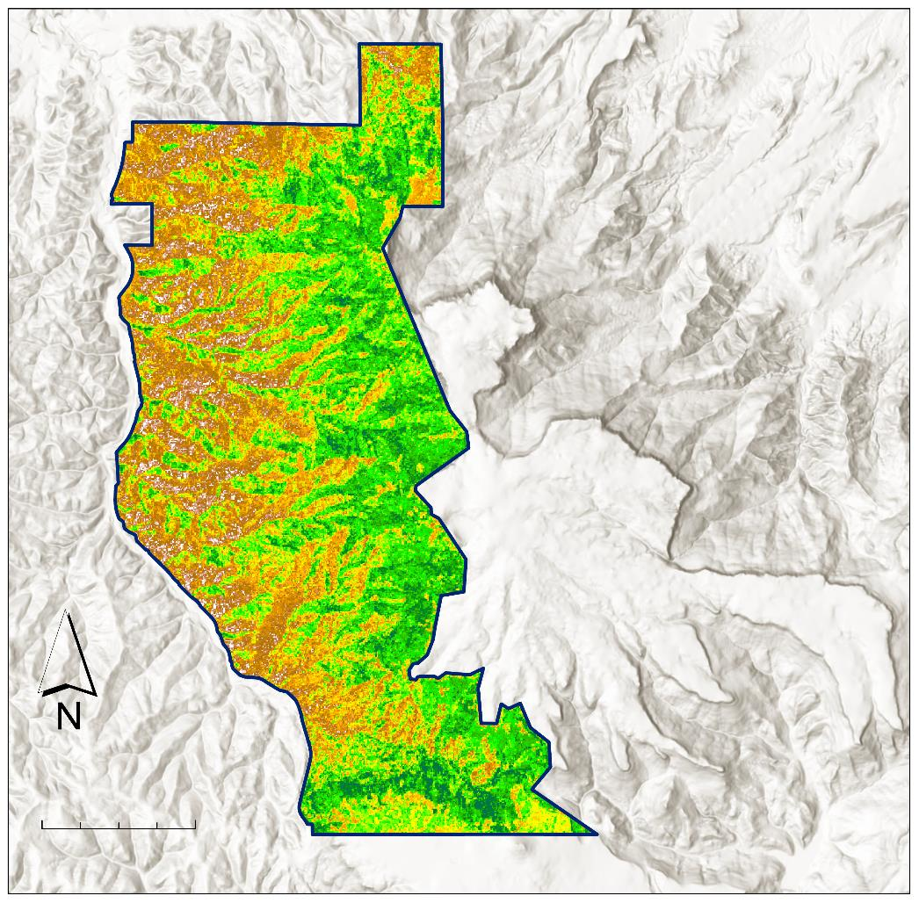
Results:
Biomass
Mg/ha
169
Total biomass = 6,554 Mg
0
Fisher's Peak
Boundary
0
1.5
3 Km
Notes:
Laura: Using our final predictor variables, which yielded an RMSE of 53.84 (slightly below our training data's standard deviation) and an R^2 of 11.66, the team produced this predictive biomass map. Based on our knowledge of the Fisher's Peak property, this map makes sense. The property generally increases in elevation from west to east, this increase in elevation is accompanied by a transition to old growth and tall stand species like Ponderosa pine. This transition also supports an increase in biomass from west to east. However, the southern edge of the property transitions into prairie land, which typically holds very little biomass.
------------------------------Image Information Below ------------------------------
•Image Credit: Scott Cunningham
•Image Source: NASA DEVELOP Fisher's Peak Ecological Forecasting Team

Slide 18
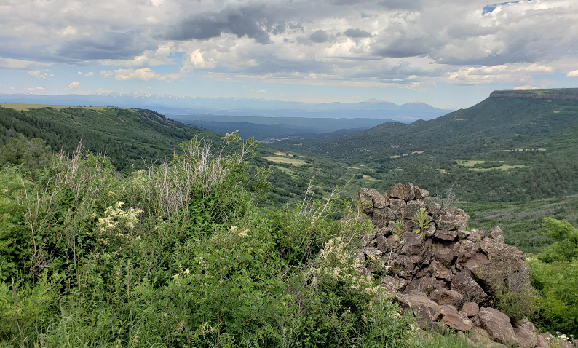
Conclusions:
Predictive biomass maps from in situ and remotely sensed data are feasible
More in situ data would make this model more robust
Radar data contributed more significantly to the biomass model than LiDAR data
Image Credit: Tony Vorster
Notes:
Laura: The team found that the creation of a predictive biomass map using forest inventory and remotely sensed data is possible. However, this model would benefit from a higher number of plots that are sampled on a fixed radius. Additionally, while previous studies have noted the usefulness of canopy height for biomass estimates, this model found that radar data from the ALOS PALSAR L-band was more useful. This could be the result of our inclusion of saplings in our biomass training data. Since the L-band penetrates forest canopies, it could pick up on saplings better than a canopy height dataset that only looks at the taller trees in an area. Finally, based on our carbon estimate of x offsets across the property, Fisher's Peak does/does not contain the carbon storage necessary for carbon market entry.
------------------------------Image Information Below ------------------------------
•Image Credit: Tony Vorster
•Image Source: NASA DEVELOP CO Node Science Advisors

Slide 19
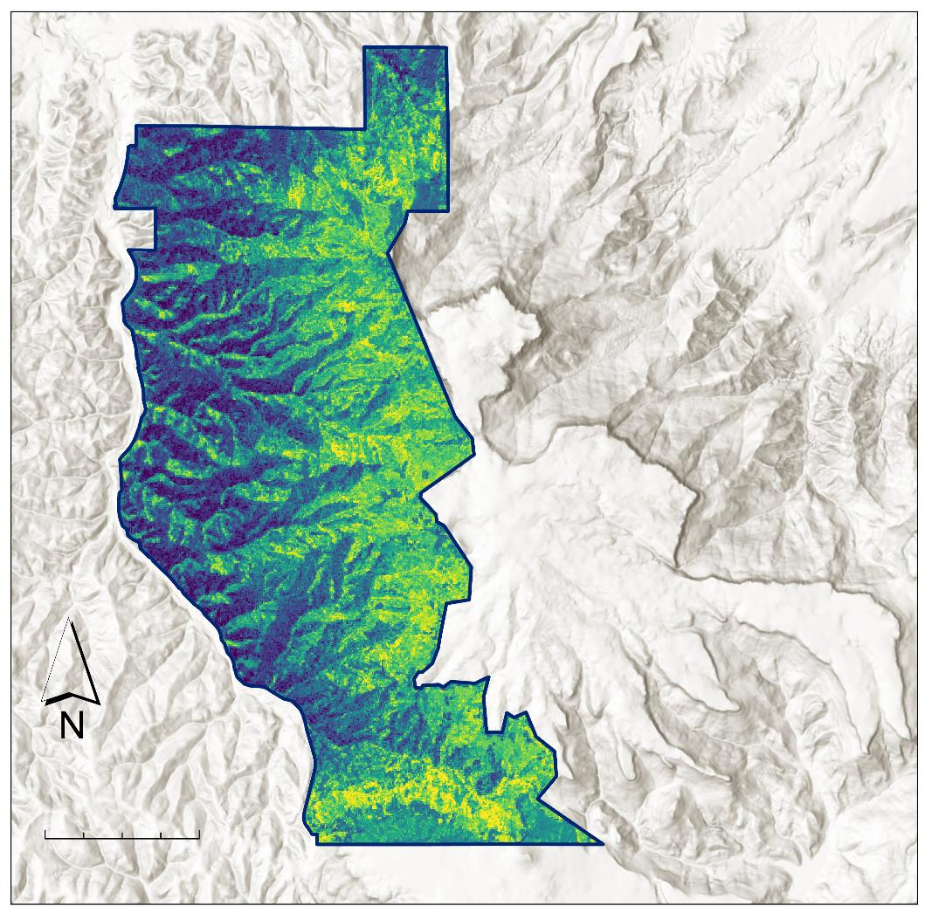
Conclusions:
Fisher's Peak contains 3,277 Metric tons of carbon
Stored Carbon
tC/ha
85
11
1 Metric ton = 1 carbon offset
Fisher's Peak
Boundary
0
1.5
3 Km
Notes:
Laura: Finally, based on our carbon estimate of 3,277 offsets across the property, Fisher's Peak does contain the carbon storage necessary for carbon market entry. However, the model that was used to estimate this carbon storage had a low R^2, so this metric should be used as a reference instead of as a definitive quantity.
------------------------------Image Information Below ------------------------------
•Image Credit: Scott Cunningham
•Image Source: NASA DEVELOP Fisher's Peak Ecological Forecasting Team

Slide 20
Limitations, Uncertainties, & Future Work
Number of Training Points
Access to Additional Data
Forest Inventory Sampling Assumptions
Resampling Assumptions
Notes:
Laura: Our forest inventory had 83 points of training data, so this model would likely benefit from another run using more training data points collected on fixed radius plots. This would potentially allow for the model to better capture the diversity on this highly heterogenous landscape.
A significant amount of biomass in Fisher's Peak is contained in saplings and in short, dense vegetation like Gambel oak. This meant that canopy height was not always the best proxy for biomass. More nuanced canopy structure variables (such as canopy density, and min/mean/and max canopy height) could have helped better capture this biomass. We were also unable to access the high-resolution LiDAR data from the Global Ecosystem Dynamics Investigation (GEDI) that may have helped us gain a more complete picture of canopy structure.
The way trees were classified as saplings may have also contributed to error in our model. The distinction (of having a DBH greater than 5 in) between a full-grown tree and a sapling was generalized and applied to all species. In this landscape, some full-grown trees, such as Gambel Oak, have thinner diameters at breast height, which may have skewed our calculations. Furthermore, the forest inventory data was sampled using a variable radius plot method for mature trees, but a fixed radius plot for saplings. This resulted in multiple steps of resampling; each of which potentially introduced error.
For future models of biomass, we recommend the use of fixed radius plots for sampling, the use of additional LiDAR predictor variables, and the support of upcoming Earth Observation missions such as GEDI from NASA and Biomass from the ESA.
------------------------------Image Information Below ------------------------------
•Image Credit: Powerpoint Icons
•Image Source:

Slide 21
The Fisher's Peak Ecological Forecasting team is thankful for our project partners and node advisors/mentors for making this project possible:
Partners:
Chris Pague, Senior Ecologist, The Nature Conservancy
Dr. Amanda Fordham, Science Information Manager, Colorado State Forest Service
Node advisors/mentors:
Dr. Paul Evangelista (Colorado State University, Natural Resource Ecology Laboratory)
Dr. Catherine Jarnevich (USGS, Fort Collins Science Center)
Peder Engelstad (Colorado State University, Natural Resource Ecology Laboratory)
Dr. Tony Vorster (Colorado State University, Natural Resource Ecology Laboratory)
Nicholas Young (Colorado State University, Natural Resource Ecology Laboratory)
Kristen Dennis (NASA DEVELOP, CO – Fort Collins Lead)
This material contains modified Copernicus Sentinel data 2019, processed by ESA.
This material contains modified Copernicus Sentinel data 2019, processed by ESA.
Notes:
Laura: We would like to take a moment to thank our partners and node advisors for their support and guidance throughout this term. {List all names} were immensely helpful in the development of this project, and our team's professional development.

Slide 22
Back-up Slides
Fisher's Peak
Ecological Forecasting
Mapping Biomass to Inform Conservation Planning of a Future State Park in Southern Colorado
Notes:
Hi everyone, thank you for joining the Fisher's Peak Ecological Forecasting team for our closeout presentation. Today we will be speaking on the last 10 weeks of "Mapping Biomass to Inform Conservation Planning of a Future State Park in Southern Colorado." [Introduce team members]

Slide 23
Introduction
Biomass = total mass of living matter, which functions as an estimation for carbon storage
Image Credit: Lukas Rodriguez
Notes:
Scott: Biomass quantification is becoming increasingly important for forest management and conservation. Biomass is the total mass of organic matter stored in living things, like vegetation, and can be used to derive carbon estimates. Sequestering carbon by preserving biomass can encourage conservation by allowing land-owners to generate revenue by selling carbon offsets. This requires a current understanding of a property's carbon inventory and biomass. Traditional methods of measuring biomass are limited to time and labor-intensive tools, such as field sampling. This project used Earth observations to evaluate the feasibility of using remotely-sensed data and machine learning algorithms as a supplement to, and potential replacement for in situ data collection.
------------------------------Image Information Below ------------------------------
•Image Credit: Lukas Rodriguez
•Image Source: Creative Commons, https://www.pexels.com/photo/trees-during-day-3573351/

Slide 24
Study Area & Period
Fisher's Peak State Park
77.5 km²
Will be Colorado's 2nd largest state park
Study Period:
June 2019-August 2019
Trinidad
WY
NE
CO
Fisher's Peak
NM
0
1.5
3 Km
Study Area
Colorado
New Mexico
Notes:
Scott: The Fisher's Peak property is a great testing site for evaluating potential for entering a carbon market, and using remotely sensed data to streamline this process. Fisher's Peak State Park will be a 77.5 square kilometer area near the Colorado/New Mexico border. This unique property has been privately owned and experienced minimal anthropogenic influence for the last 50 years. Because of this, the area is highly biodiverse and acts as a wildlife corridor between prairies and the front range. This property also borders the iconic Fisher's Peak montane formation, which provides steep elevation changes. These changes facilitate a transition between pinon pine and juniper trees at lower elevations, Gambel oak and ponderosa pine as elevation increases, and a mix of fir and pines as elevation peaks. Based on the availability of our in situ data, our study period was June 2019 to August 2019.
------------------------------Image Information Below ------------------------------
•Image Credit: Scott Cunningham
•Image Source: NASA DEVELOP Fisher's Peak Ecological Forecasting Team

Slide 25
Objectives
Create
maps of Fisher's Peak canopy height, canopy complexity
Develop
a model for mapping biomass
Map
biomass in the study area, pre-park development
Identify
areas of old growth forest and high carbon storage
Image Credits: PNGKit, Kiss Clipart, and Vectors Market from www.flaticon.com
Notes:
Darby: In support of project partners, the DEVELOP team had four main objectives. The first was to provide partners with maps of the area. These include a study area map, maps of canopy height and complexity, and a map showing the locations of dominant tree species. Next, we developed a random forest regression model using RStudio. This regression model was created using in situ forest inventory data, high-resolution LiDAR aerial imagery, and satellite imagery. The third objective was to create a biomass map using the output of our model. This map was used to derive locations of high carbon storage, and was provided to project partners to improve their understanding of the property's potential for entering the carbon market. Finally, the biomass map, in combination with earlier maps, was used to identify areas of old growth forest and high carbon storage. Overall, we aimed to determine the efficacy of using remote sensing imagery as a more cost-effective way to quantify biomass and carbon storage.
------------------------------Image Information Below ------------------------------
•Image Credit: Wikimedia Commons, Kiss Clipart, PNGKit, and FlatIcon (Creative Commons)
•Image Sources: Creative Commons,
Tree Icon: https://commons.wikimedia.org/wiki/File:Creative-Tail-Halloween-tree.svg
Decision Tree Icon: https://www.kissclipart.com/wordpress-decision-tree-plugin-clipart-wordpress-p-p7k40x/
Map Icon: https://www.pngkit.com/view/u2q8i1w7t4t4t4e6_how-to-create-a-map-icon-in-adobe/
Leaf Icon: https://www.kissclipart.com/leaf-icon-png-clipart-computer-icons-clip-art-cijbs0/

Slide 26
Remote Sensing for Biomass Estimation
Landsat 8 OLI
SRTM
Sentinel-2 MSI
ALOS-2 PALSAR-2
Image Credit: NASA DEVELOP, Google Earth Engine, Celina Vargas
Notes:
Remote sensing can
------------------------------Image Information Below ------------------------------
•Image Credit: NASA DEVELOP
•Image Source: DEVELOPedia, Google Earth Engine, Celina Vargas (https://www.kindpng.com/imgv/hboxbww_alos-2-satellite-hd-png-download/#)

Slide 27
Methods: Ancillary Datasets – Model Data
Forest Inventory Timber Cruise
June 11 – July 11, 2019
High Resolution LiDAR Canopy Height
June 2019
Inventory Plot
*Plot size not to scale
Notes:
Darby: Besides the passive and active remote sensing data from those sensors, we used partner-provided Forest Inventory data and aerial LiDAR imagery. The forest inventory plots (shown on the left) provided ground truth training data for modeling biomass estimations. The LiDAR-derived canopy height data (shown at right) was evaluated for its usefulness as a predictor variable for our biomass model.
------------------------------Image Information Below ------------------------------
•Image Credit: Scott Cunningham
•Image Source: NASA DEVELOP Fisher's Peak Ecological Forecasting Team
Image Credit: Darby Levin
•Image Source: NASA DEVELOP Fisher's Peak Ecological Forecasting Team

Slide 28
Methods: Training Data Processing
Equation: Y(kg)=exp^{B₀+(B₁*ln(DBH))} (Jenkins et al., 2003)
Sample Values of Biomass by Plot
Plot # | # Trees | Avg DBH (cm) | Biomass (kg) | Plot Area (m²) | Biomass (kg/ 10 m pixel) | Biomass (Mg/ ha)
10 | 14 | 35.9 | 12,391 | 1,067 | 1,764 | 176.4
270 | 9 | 22.9 | 796.7 | 637 | 184.3 | 18.43
480 | 7 | 33.4 | 1,799 | 804 | 376.9 | 37.69
Data Breakdown (Mg/ha)
Average | 79.17
Standard Deviation | 57.67
Max | 265.31
Min | 9.86
Notes:
Darby: We processed our in situ forest inventory data using Python 3.0 and Excel. This dataset included plot coordinates, species notes, and mature tree and sapling DBH (depth at breast height) measurements. Each tree's biomass was calculated using the above equation. Coefficients B0 and B1 were assigned based on the tree's species. The trees' biomass was then summed by plot. Since the forest inventory data was collected using variable radius plots, biomass values were resampled to 10m spatial resolution using the plot radius factor. This value, in kg/100m^2, was used for training our model. Final biomass values were converted into Mg/ha, the standard unit for biomass. Example values of our biomass by plot calculations can be seen in the table on the left and a breakdown of our training data distribution can be seen above in the table on the right.
Allometric Equation from Jenkins et al 2003.

Slide 29
Methods: Ancillary Datasets – Model Data
Forest Inventory Timber Cruise
June 11 – July 11, 2019
High Resolution LiDAR Canopy Height
June 2019
Inventory Plot
*Plot size not to scale
Notes:
Darby: Besides the passive and active remote sensing data from those sensors, we used partner-provided Forest Inventory data and aerial LiDAR imagery. The forest inventory plots (shown on the left) provided ground truth training data for modeling biomass estimations. The LiDAR-derived canopy height data (shown at right) was evaluated for its usefulness as a predictor variable for our biomass model.
------------------------------Image Information Below ------------------------------
•Image Credit: Scott Cunningham
•Image Source: NASA DEVELOP Fisher's Peak Ecological Forecasting Team
Image Credit: Darby Levin
•Image Source: NASA DEVELOP Fisher's Peak Ecological Forecasting Team

Slide 30
Methods: Training Data Processing
200
Biomass (Mg/ha)
100
0
Pinon Pine
Rocky Mt Juniper
Ponderosa Pine
Douglas Fir
Gambel Oak
NM Locust
White Fir
Dominant Tree Species
Notes:
Darby: In this plot, we show the distribution of biomass by dominant tree species for our training data. We sought to understand the impact of specific species on this area's biomass and carbon storage. Interestingly, ponderosa pine typically holds more biomass than shrubby species like Gambel Oak. However, in our forest inventory data, Gamble Oak contained a larger part of the biomass distribution, and our highest biomass plot was dominated by 26 Gambel Oak trees, while nearby Ponderosa Pine plots contained less than half of that biomass.
------------------------------Image Information Below ------------------------------
•Image Credit: NASA DEVELOP Fisher's Peak Ecological Forecasting Team
•Image Source: NASA DEVELOP Fisher's Peak Ecological Forecasting Team

Slide 31
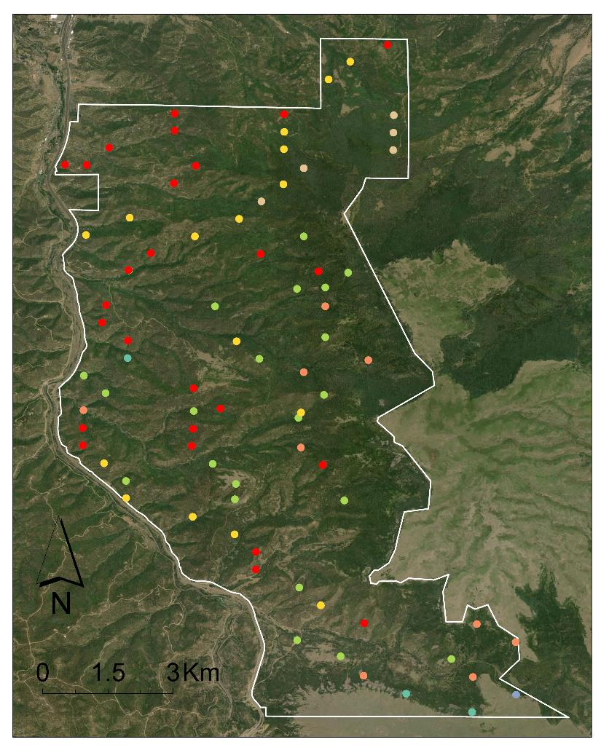
Methods: Training Data Processing
Dominant Species of Plot
Douglas Fir
Gambel Oak
NM Locust
Pinon Pine
Ponderosa Pine
Rocky Mt Juniper
White Fir
Notes:
This map shows the breakdown of dominant species by plot. The majority of plots are dominated by pinon pine.
------------------------------Image Information Below ------------------------------
•Image Credit: Scott Cunningham
•Image Source: NASA DEVELOP Fisher's Peak Ecological Forecasting Team

Slide 32
Methods: Data Preparation
Allometric Equations
Resample to 10m
Field
Optical
Stack input rasters
Active
Resample to 10m
Topographic
Extract values at training points
Predictor Variables
Methodology
Model Application for Biomass Estimation
Resampled to 10m
Field Biomass Estimates by Plot
Random Forest Model Development, Predictor Selection
Allometric calculations
Field
Field
Field
Optical
Stack input rasters
Resampled to 10m
Biomass Predictors
Active
Derived
Error Analysis
Data
Image Processing
Image Processing
Image Processing
Image Processing
Data Products
Modeling
Output
Image Processing
Image Processing
Notes:
Lauren: In addition to our ground truth data, the team utilized LiDAR canopy height data, Landsat 8 and Sentinel 2 bands and indices, as well as ALOS derived HH, HV, and HH/HV bands. Additionally our topographic variables included SRTM-derived elevation, slope, and aspect northness and eastness. The predictor variable rasters from all sources were projected to WGS 84/UTM zone 13 and resampled to a 10m spatial resolution where necessary. This list of predictors was utilized for initial model comparisons and evaluated using correlation values and variable importance.
------------------------------Image Information Below ------------------------------
•Figure Credits: NASA DEVELOP Fisher's Peak Ecological Forecasting Team

Slide 33
Methods: Predictor Variables
1. Wetness
2. Northness
3. Greenness
4. Elevation
5. Brightness
6. Sentinel VH
7. Eastness
8. ALOS HH
4.
8.
3.
7.
2.
6.
1.
5.
Notes:
Lauren: The final predictor variables included Landsat Tasseled cap wetness, greenness and brightness, SRTM northness, elevation, and eastness. It also included C band imagery from the Sentinel SAR VH dataset and the ALOS PALSAR HH band. These raster layers were stacked and exported from Google Earth Engine as a GeoTIFF. This TIFF was then imported into R, where it was used to rasterize our model and produce a predictive map of biomass for Fisher's Peak State Park.
------------------------------Image Information Below ------------------------------
•Image Credits: Darby Levin
•Image Source: NASA DEVELOP Fisher's Peak Ecological Forecasting Team

Slide 34
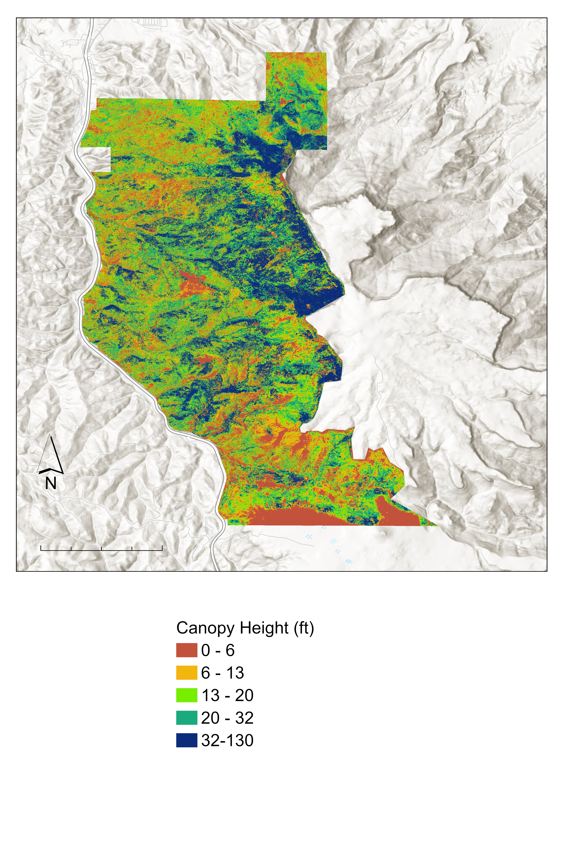
Canopy Height(ft)
Std Dev of Canopy Height (feet)
0 - 6
6-13
Within 10,000 m² pixels
13 - 20
28.2
20 - 32
32+
0
0
1.5
3 Km
0
2
4 Km
Notes:
The map on the left shows a LiDAR derived canopy height map. As you can seee, canopy height generally increases from west to east across the property, with low areas of canopy height near the southern border, and the highest canopy heights near the Fisher's Peak montane. The map on the right shows the deviation of canopy height from the average canopy height across the property.
------------------------------Image Information Below ------------------------------
•Image Credits: Scott Cunningham
•Image Source: NASA DEVELOP Fisher's Peak Ecological Forecasting Team

Slide 35
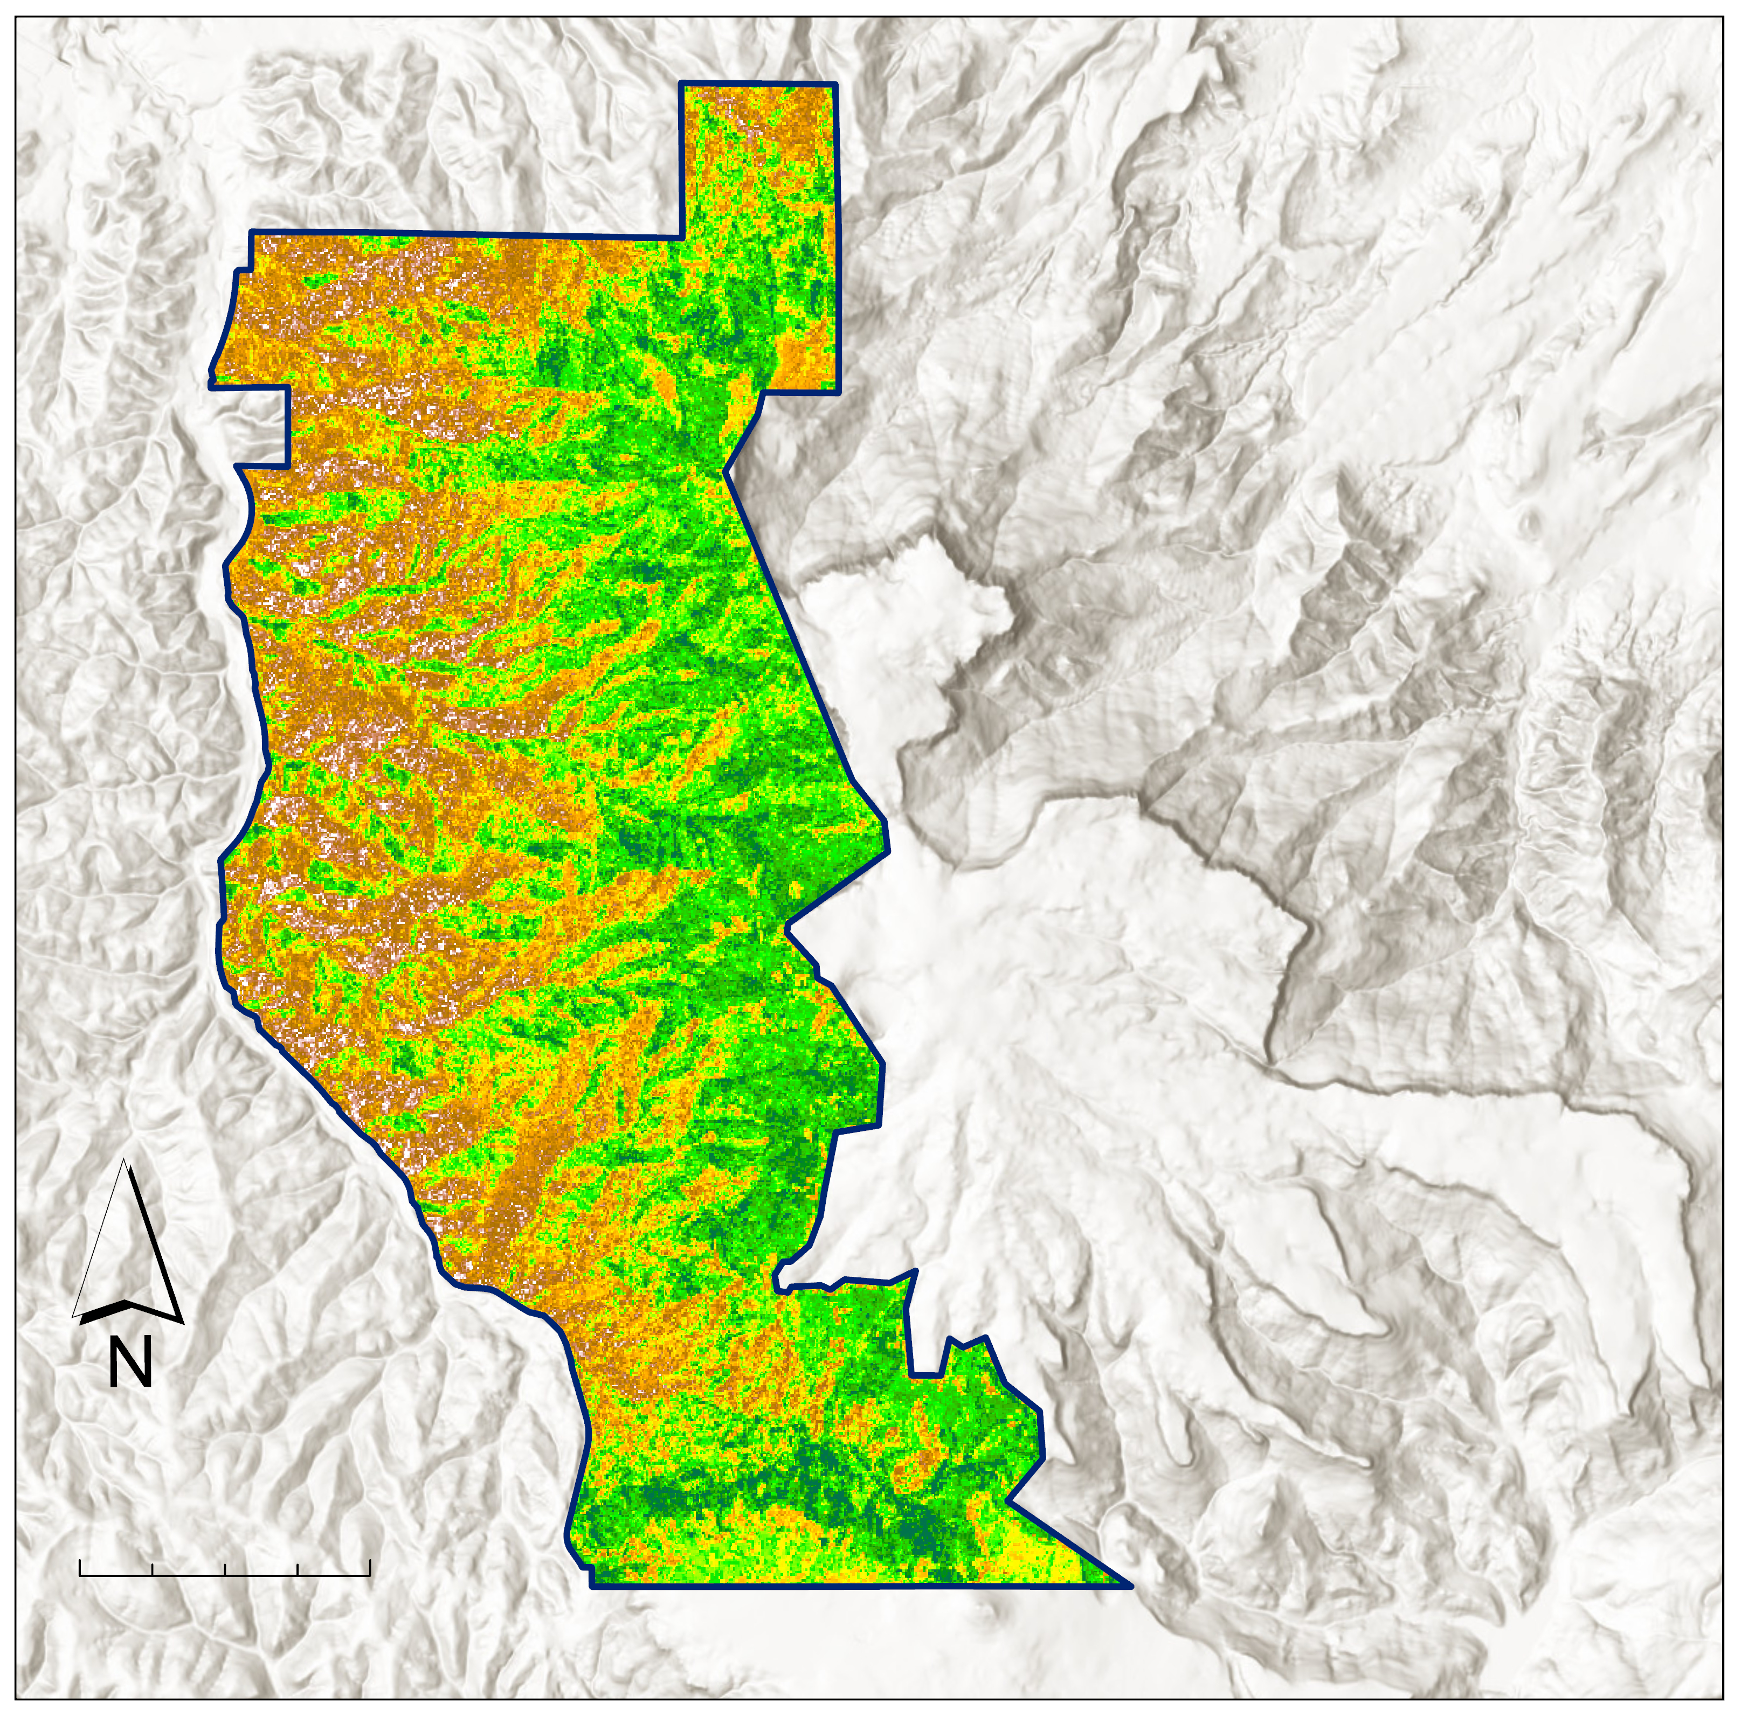
Results:
AGB Biomass
Mg/ha
169
Total biomass = 6,554 Mg
0
Fisher's Peak
Boundary
0
1.5
3 Km
Notes:
Laura: Using our final predictor variables, which yielded an RMSE of 53.84(slightly below our training data's standard deviation) and an R^2 of 11.66, the team produced this predictive biomass map. Based on our knowledge of the Fisher's Peak property, this map makes sense. The property generally increases in elevation from west to east, this increase in elevation is accompanied by a transition to old growth and tall stand species like Ponderosa pine. This transition also supports an increase in biomass from west to east. However, the southern edge of the property transitions into prairie land, which typically holds very little biomass.
------------------------------Image Information Below ------------------------------
•Image Credit: Scott Cunningham
•Image Source: NASA DEVELOP Fisher's Peak Ecological Forecasting Team

Slide 36
Conclusions:
Predictive biomass maps from in situ and remotely sensed data are feasible
More in situ data would make this model more robust
Radar data contributed more significantly to the biomass model than LiDAR data
Image Credit: Tony Vorster
Notes:
Laura: The team found that the creation of a predictive biomass map using forest inventory and remotely sensed data is possible. However, this model would benefit from a higher number of plots that are sampled on a fixed radius. Additionally, while previous studies have noted the usefulness of canopy height for biomass estimates, this model found that radar data from the ALOS PALSAR L-band was more useful. This could be the result of our inclusion of saplings in our biomass training data. Since the L-band penetrates forest canopies, it could pick up on saplings better than a canopy height dataset that only looks at the taller trees in an area. Finally, based on our carbon estimate of x offsets across the property, Fisher's Peak does/does not contain the carbon storage necessary for carbon market entry.
------------------------------Image Information Below ------------------------------
•Image Credit: Tony Vorster
•Image Source: NASA DEVELOP CO Node Science Advisors

Slide 37
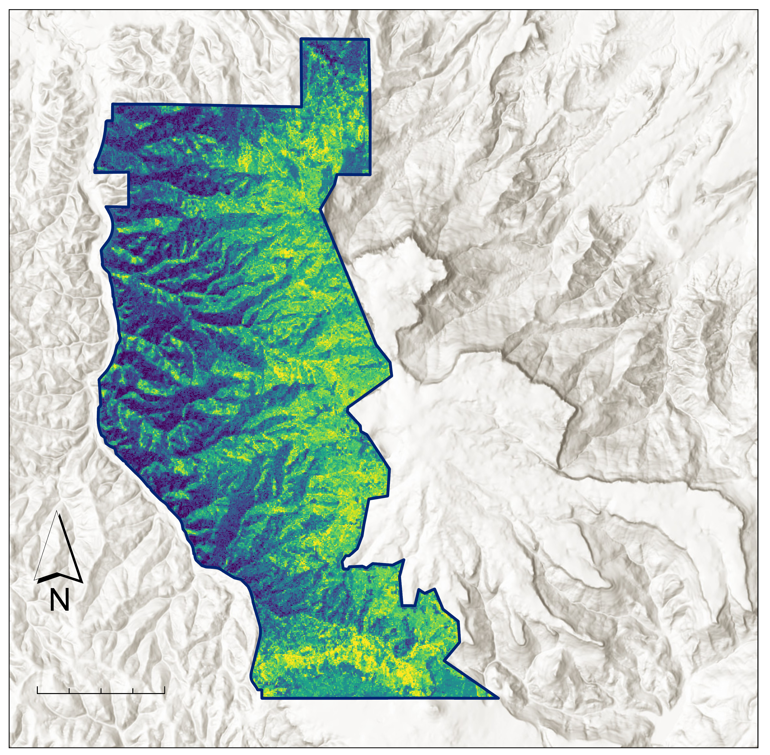
Conclusions:
Fisher's Peak contains 3,277 Metric tons of carbon
Stored Carbon
tC/ha
85
11
1 Metric ton = 1 carbon offset
Fisher's Peak
Boundary
0
1.5
3 Km
Notes:
Laura: Finally, based on our carbon estimate of 3,277 offsets across the property, Fisher's Peak does contain the carbon storage necessary for carbon market entry. However, the model that was used to estimate this carbon storage had a low R^2, so this metric should be used as a reference instead of as a definitive quantity.
------------------------------Image Information Below ------------------------------
•Image Credit: Scott Cunningham
•Image Source: NASA DEVELOP Fisher's Peak Ecological Forecasting Team

Slide 38
Limitations, Uncertainties, & Future Work
Number of Training Points
Access to Additional Data
Forest Inventory Sampling Assumptions
Resampling Assumptions
Notes:
Laura: Our forest inventory had 83 points of training data, so this model would likely benefit from another run using more training data points collected on fixed radius plots. This would potentially allow for the model to better capture the diversity on this highly heterogenous landscape.
A significant amount of biomass in Fisher's Peak is contained in saplings and in short, dense vegetation like Gambel oak. This meant that canopy height was not always the best proxy for biomass. More nuanced canopy structure variables (such as canopy density, and min/mean/and max canopy height) could have helped better capture this biomass. We were also unable to access the high-resolution LiDAR data from the Global Ecosystem Dynamics Investigation (GEDI) that may have helped us gain a more complete picture of canopy structure.
The way trees were classified as saplings may have also contributed to error in our model. The distinction (of having a DBH greater than 5 in) between a full-grown tree and a sapling was generalized and applied to all species. In this landscape, some full-grown trees, such as Gambel Oak, have thinner diameters at breast height, which may have skewed our calculations. Furthermore, the forest inventory data was sampled using a variable radius plot method for mature trees, but a fixed radius plot for saplings. This resulted in multiple steps of resampling; each of which potentially introduced error.
For future models of biomass, we recommend the use of fixed radius plots for sampling, the use of additional LiDAR predictor variables, and the support of upcoming Earth Observation missions such as GEDI from NASA and Biomass from the ESA.
------------------------------Image Information Below ------------------------------
•Image Credit: Powerpoint Icons
•Image Source:

