Slide 1
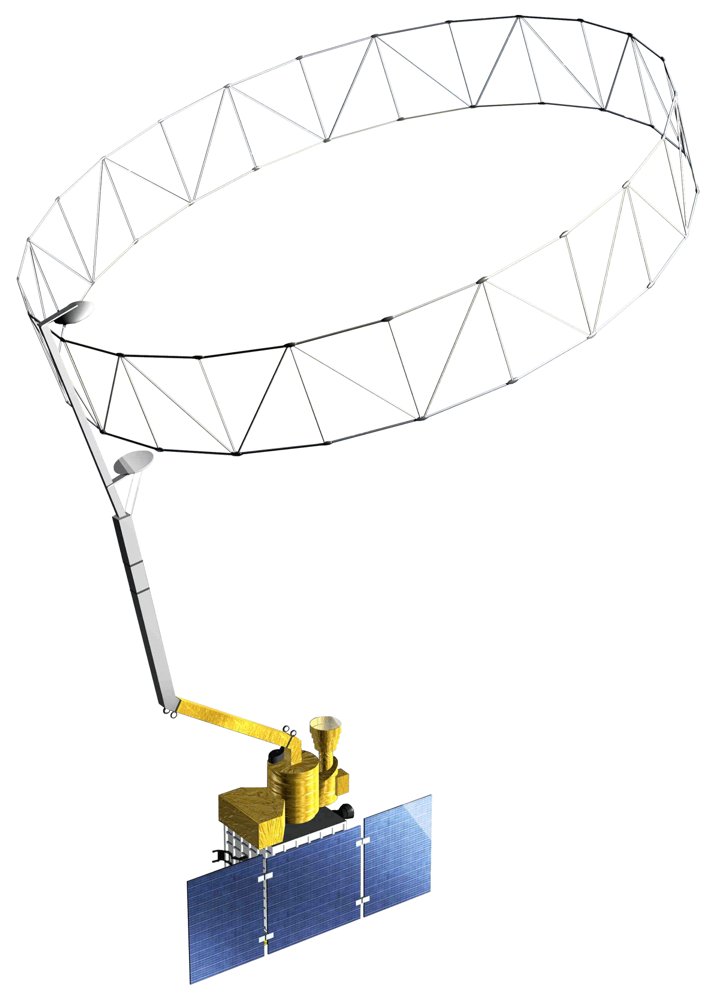
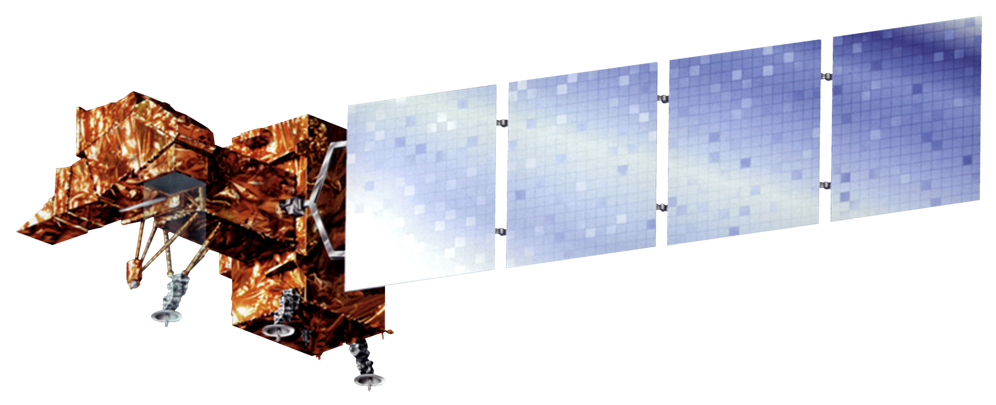
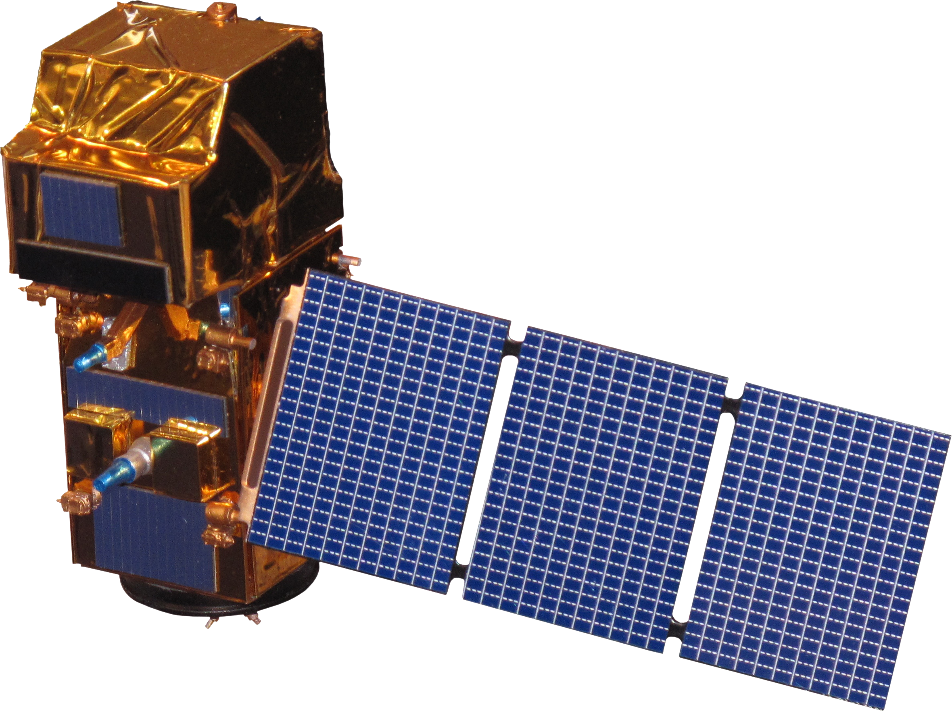
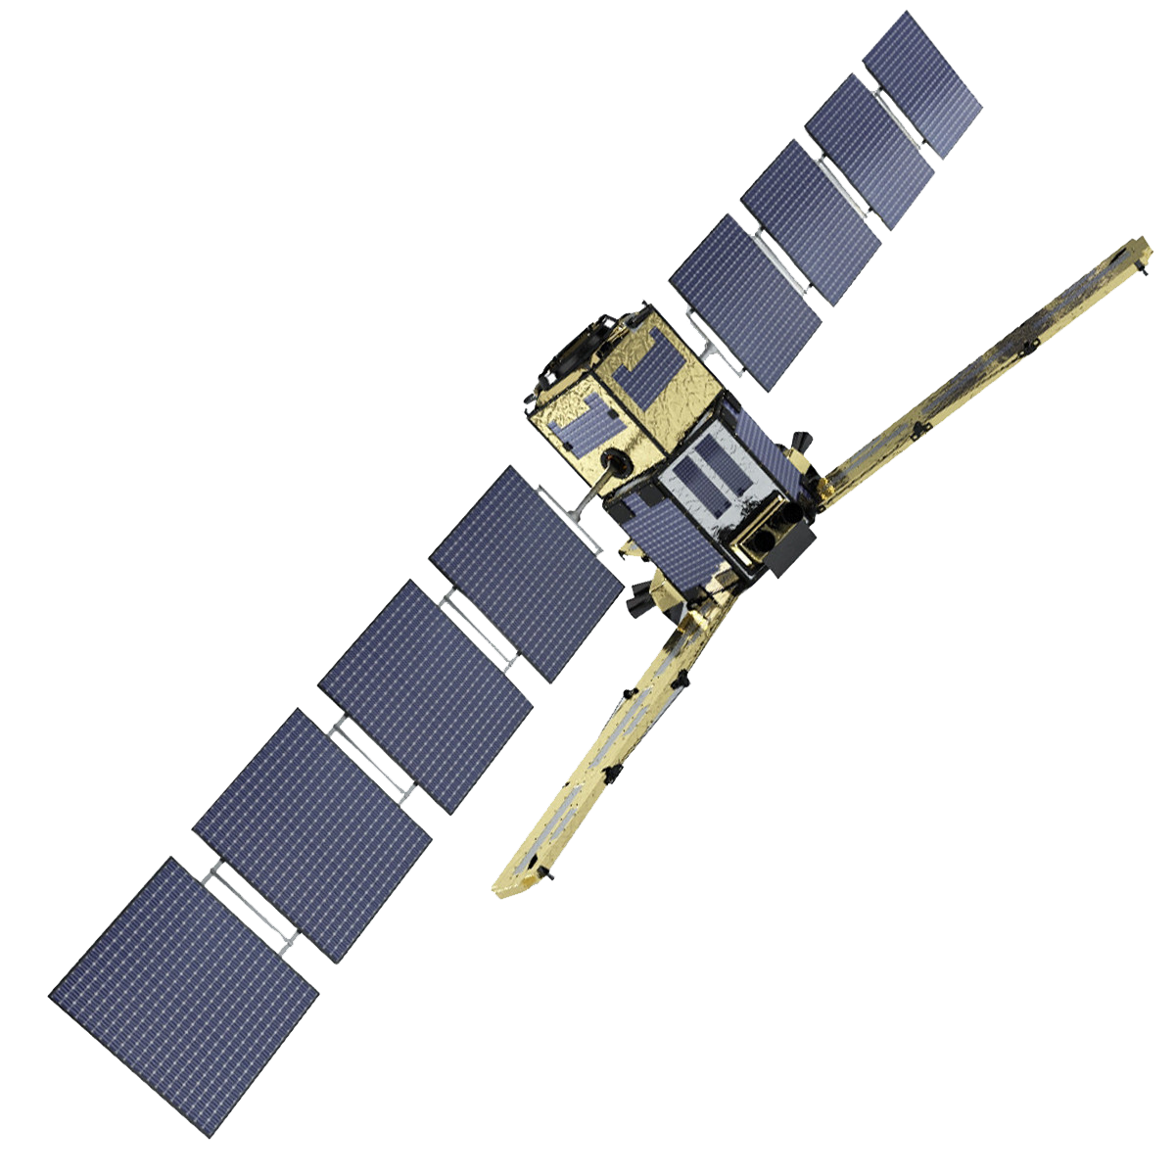
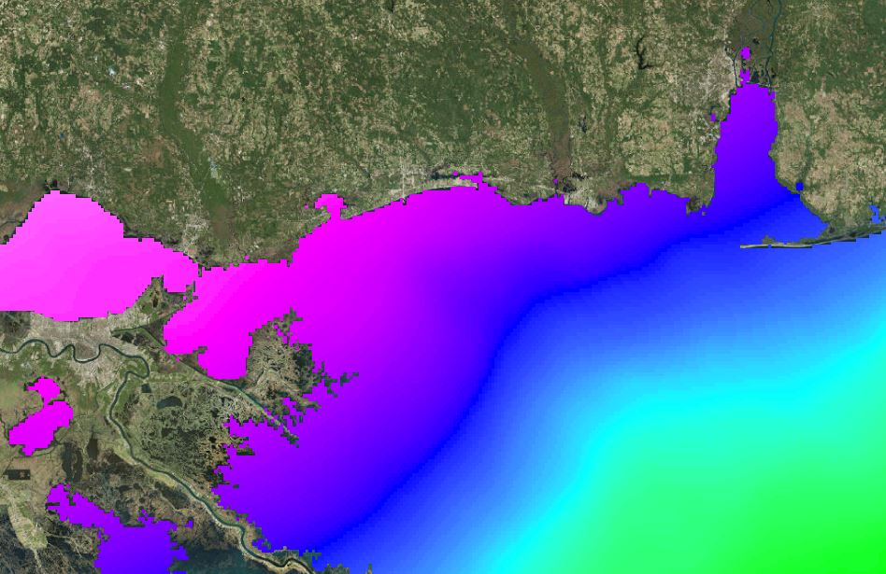
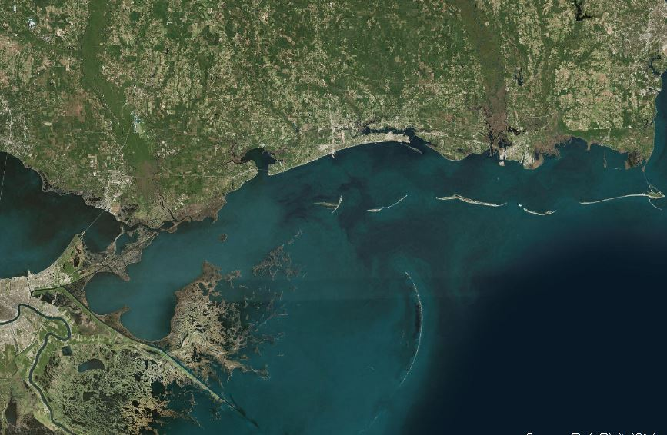
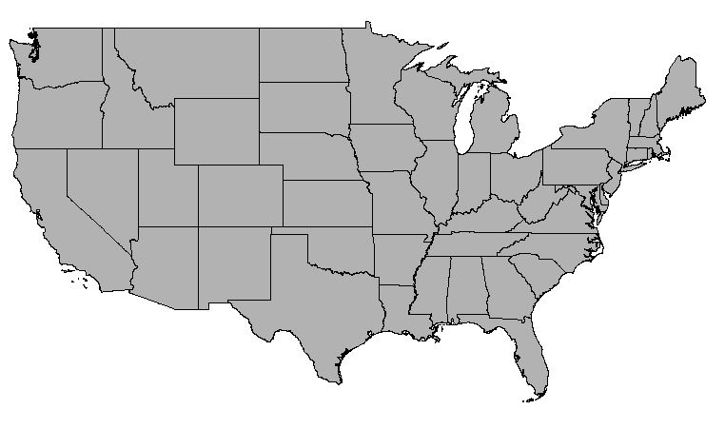
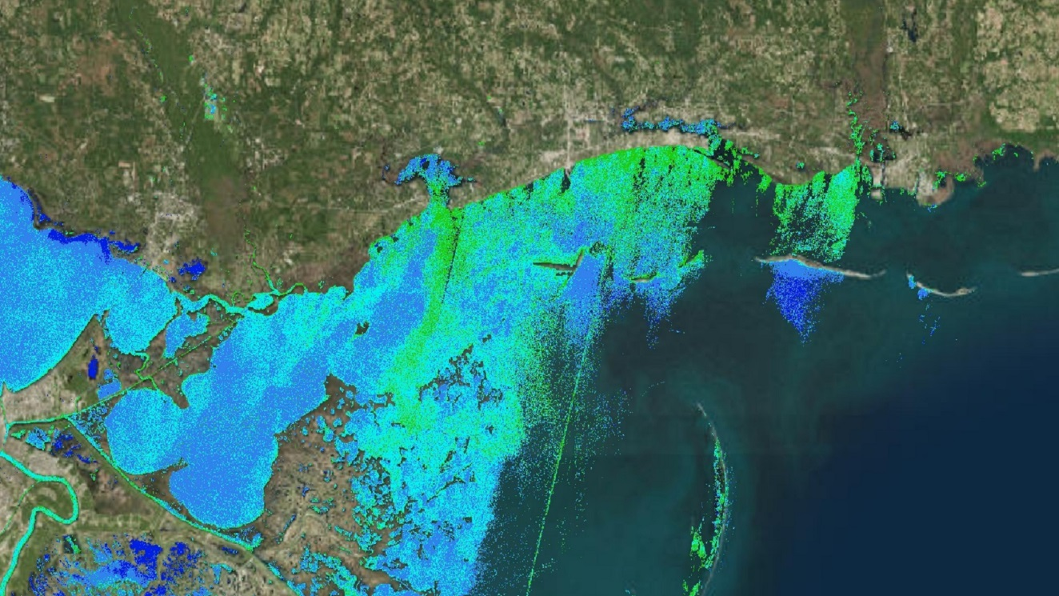
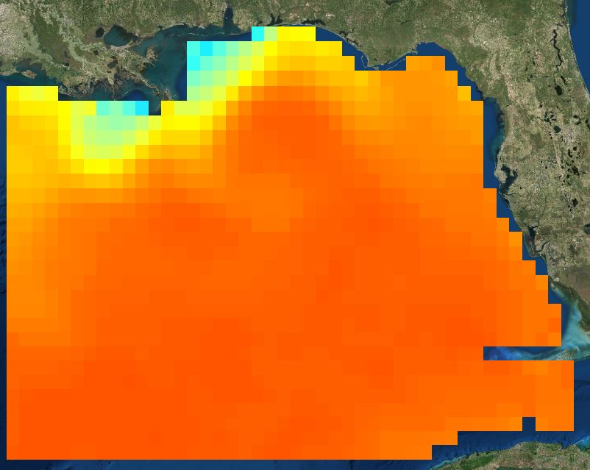
Synthesizing Trends in Water Quality Parameters Affecting Oyster Reef Health in the Mississippi Sound Using NASA Earth Observations
Abstract
Earth Observations
Commercially-harvested oysters are a significant ecological and economic driver in multiple coastal regions throughout the world. In the last decade, the Mississippi Sound has seen a rapid decline in oyster reef production, especially in the years following large ecological disturbances such as Hurricane Katrina in 2005 and the flooding of the Mississippi River in 2011. In partnership with the Mississippi Department of Marine Resources, the NASA DEVELOP team utilized remotely-sensed products in order to create a climatology and time series of specific water quality parameters that can have impact on oyster reef productivity. These parameters included salinity, sea surface temperature, chlorophyll-a, a_{DG} (absorption due to gelbstoff and detrital material), total suspended matter, and turbidity. The project utilized data from several Earth observing satellites including Aqua MODIS, SMAP, Landsat 5 TM, Landsat 7 ETM+, Landsat 8 OLI and TIRS, and MUR, as well as data from ESA’s Sentinel-2 MSI and SMOS. The results from this project could potentially assist the Mississippi Department of Marine Resources by providing products for additional mapping and assessment of future oyster reef health in the Mississippi Sound. These products will also allow the project partners to improve future management practices for species recovery and the creation of additional oyster reefs.
Aqua
Landsat 7
Sentinel 2
SMAP
Landsat 8
Landsat 5
SMOS
Results
Average January SST 2003-2016
Average January Monthly SST 2003-2016
Mississippi Sound
Lake Borgne
Western Sound
Chandeleur Gulf
Eastern Sound
Study Area
32 C
9 C
2016 Average Monthly Chlorophyll-a
Average April 2016 Chlorophyll-a
Western
Sound
Eastern
Sound
Lake
Borgne
Chandeleur Gulf
Objectives
< 1 mg/m³
1-3 mg/m³
3-5 mg/m³
5-10 mg/m³
>10 mg/m³
Develop a climatology and time series of water quality variables potentially affecting oyster reef production in the Mississippi Sound
Distinguish between large episodic and subtle events
Mississippi Sound Water Resources
Average Monthly TSM 2003-2016
Average TSM May 2016
Methodology
Data Products
Total Suspended Matter
Sea Surface Temperature
Chlorophyll-a
Turbidity
ADG
Sea Surface Salinity
40 mg/L
0 mg/L
Average Monthly SSS 2015 & 2016
Average SSS June 2016
Zonal Averages
Processing
Cell Statistics
Analysis
2016 Large box
2015 Large box
2015 Small box
2016 Small box
Time Series
Climatology
37 psu
32 psu
Team Members
Conclusions
There are severe limitations in remotely sensed data near coastal areas, including large differences in data quality at smaller geographic scales.
Higher resolution data from Aqua MODIS, Landsat 8, and Sentinel-2 are more likely to detect large ecological disturbances than SMOS, SMAP, and MUR data.
Emily Gotschalk
Project Co-Lead
Brigitte Moneymaker
Project Co-Lead
Katherine Cavanaugh
Project Partners
Mississippi Department of Marine Resources
Acknowledgements
Thank you to the Mississippi Department of Marine Resources: Scott Gordon, Charlie Robertson, Karen Clark, Robert Gruba, and Amber Jones. Thank you to our science advisors, Dr. Kenton Ross at NASA Langley Research Center, and Ben Holt and Dr. Severine Fournier at NASA Jet Propulsion Laboratory.
Jessica Gregory
Erika Higa
Catherine Stolfi
NASA Langley Research Center & NASA Jet Propulsion Laboratory – Spring 2017

