Slide 1
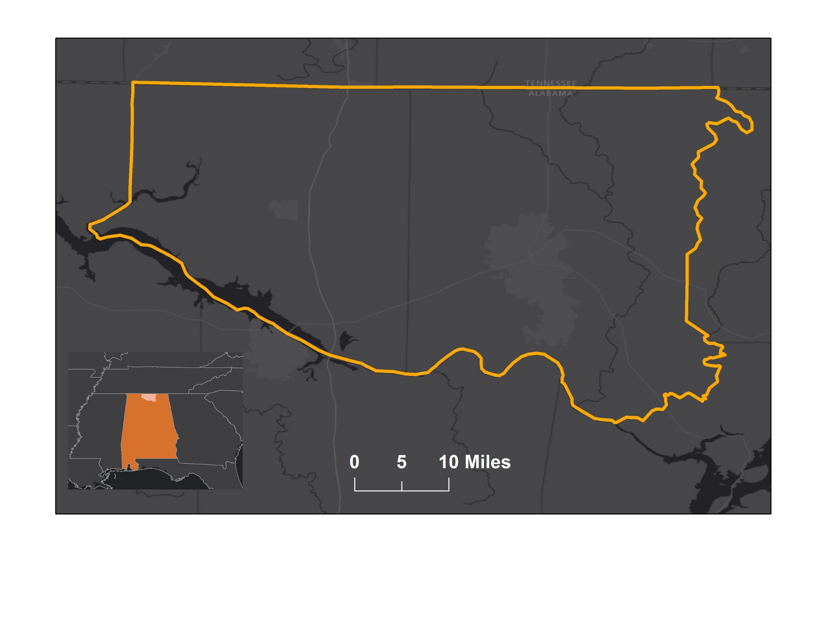
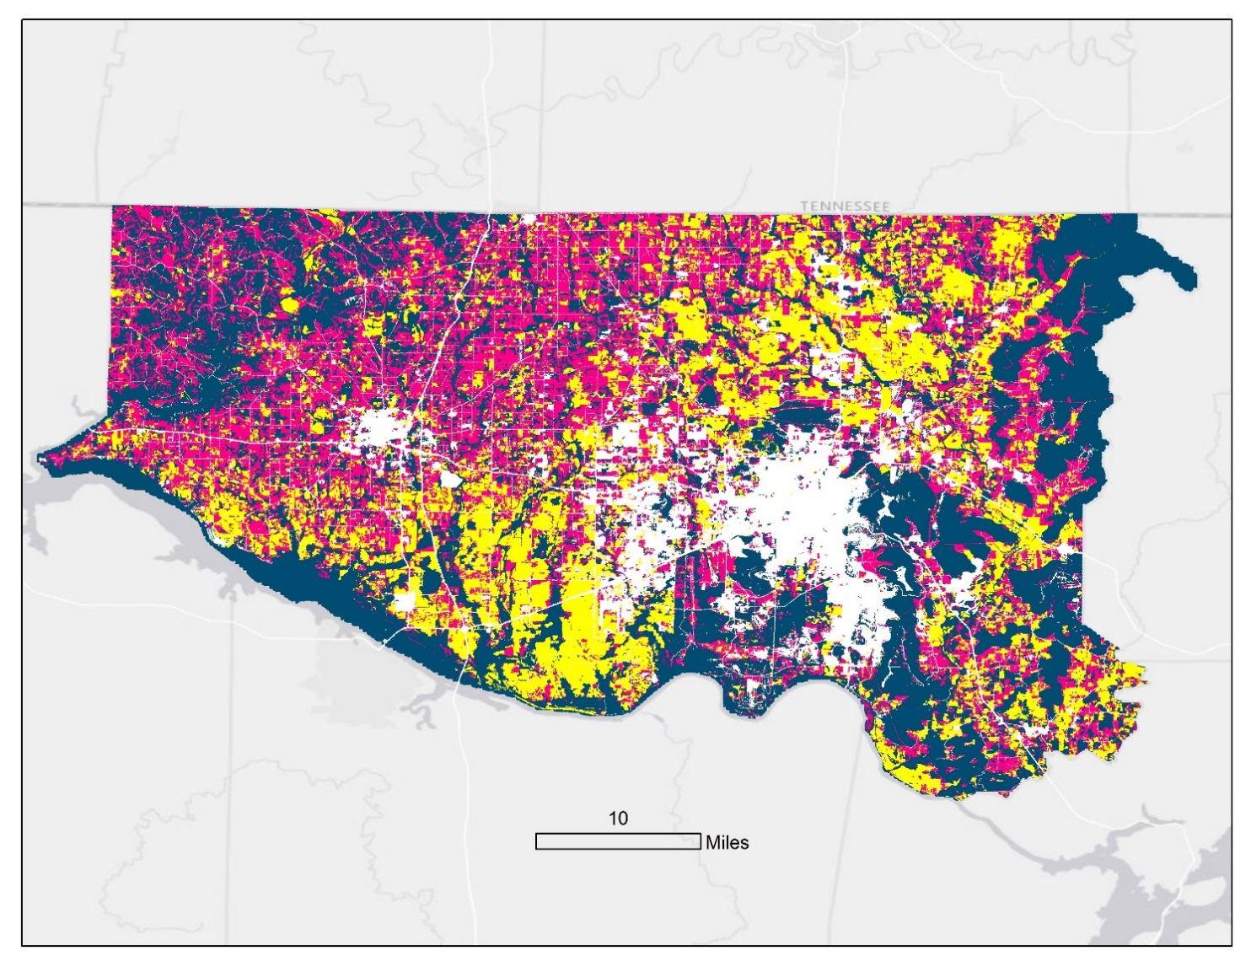
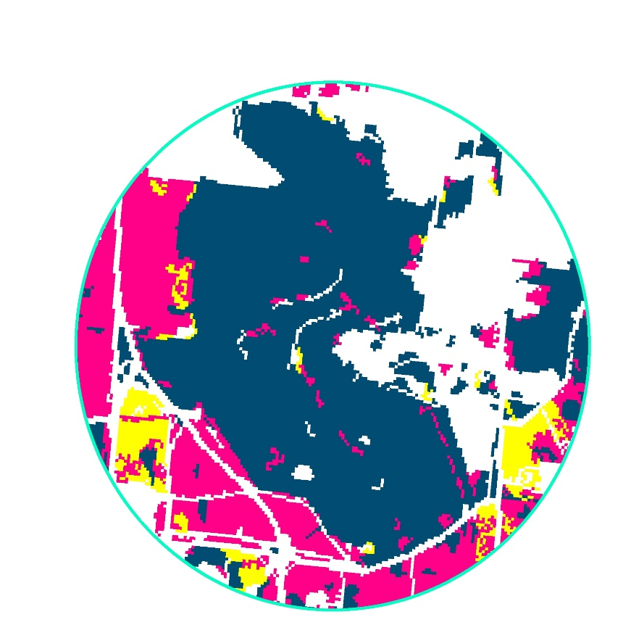
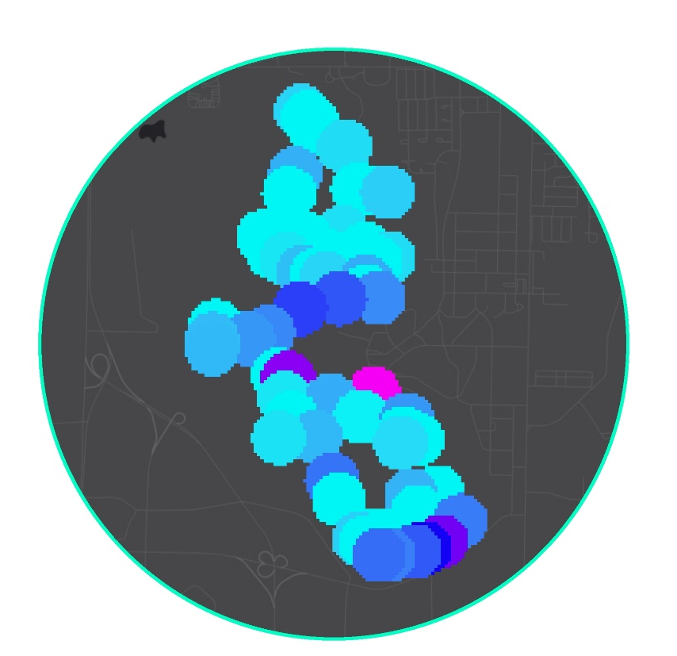
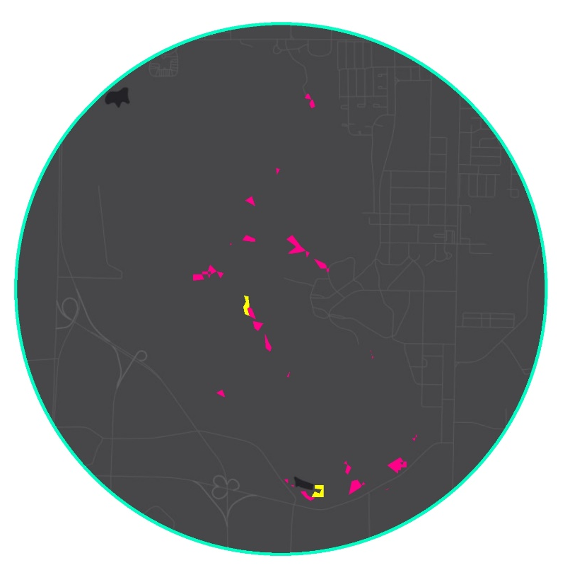


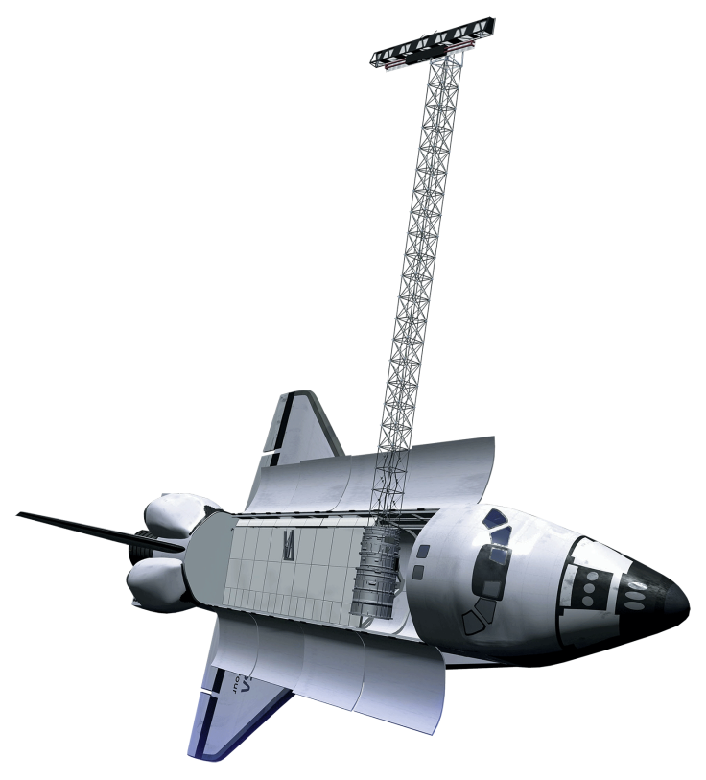



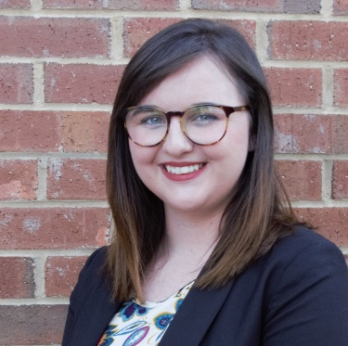
Spatial Modeling of the Fragmentation of Local Species Habitat from Increasing Urbanization in North Alabama
Abstract
Methodology
Least cloud cover Landsat image for each year
Maximum Likelihood Classifications: 5 land cover types
Urban Growth Rate Estimate
Compare classifications with NLCD
Alabama is one of the four most biodiverse states in the United States, and is the state with the overall greatest diversity of aquatic species in the U.S. This biodiversity is at risk as urbanization increases in Alabama. The Land Trust of North Alabama works to preserve green space and encourages stewardship through environmental education. The North Alabama Ecological Forecasting team partnered with the Land Trust of North Alabama to identify areas critical to maintaining local species habitat within Madison and Limestone counties. As urbanization increases within these counties, essential habitats are threatened. To identify where land cover changes are occurring and areas are most vulnerable to urbanization, the North Alabama Ecological Forecasting team conducted a supervised classification of land class types utilizing data from Landsat 5 Thematic Mapper (TM), Landsat 8 Operational Land Imager (OLI), and Shuttle Radar Topography Mission Version 4 (SRTM). The team then used the classification along with other parameters to produce an Urbanization Model Algorithm, Urbanization Prediction Tool, and a Landscape Fragmentation Map. These tools will enable the Land Trust of North Alabama to target land for acquisition and subsequent preservation and stewardship.
Urban Growth Analysis
Species Habitat Location and Buffer Sensitivity Information
End Product: Species Impact Map & Tool
Define Fuzzy Logic Model Parameters and Memberships
Suitability for Urban Development
Species Impact Analysis
Objectives
Analyze changes in landscape since 1985
Forecast urbanization to 2045
Identify at risk species and potential impact on their habitats
Provide the Land Trust of North Alabama with a useful tool to identify high risk areas and aid in decision-making in regards to conservation efforts
Results
Favorability for Development Map
Highly Suitable Land Available
Study Area
km
I
North Alabama Ecological Forecasting
Species Impact Maps
I
Favorability for Development
Mean Habitat Risk – Green Salamander
Green Salamander Habitats at Risk
Earth Observations
Landsat 5 TM
SRTM
Landsat 8 OLI
Conclusions
By 2045, at a growth rate of 1% per year, 25% of the land identified as highly suitable for urbanization will be developed, which accounts for 25% of the total area of Madison and Limestone Counties.
Areas located between Huntsville, Athens, and Decatur face the highest probability of being developed as urban growth continues.
All species studied are expected to be negatively impacted from increased urban development in north Alabama.
Project Partner
Land Trust of North Alabama
Acknowledgements
Team Members
Dr. Jeffery Luvall, NASA Marshall Space Flight Center
Dr. Robert Griffin, University of Alabama in Huntsville
Leigh Sinclair, University of Alabama in Huntsville, Information Technology and Systems Center
Marie Bostick, Land Trust of North Alabama
Andy Prewett, Land Trust of North Alabama
Hallie Porter, Land Trust of North Alabama
Maggi Klug, Alabama – Marshall Center Lead NASA DEVELOP
Mercedes Bartkovich, Alabama – Marshall Fellow NASA DEVELOP
Dashiell Cruz, Alabama – Marshall NASA DEVELOP
Christine Easterwood, U.S. Army Garrison, Redstone Arsenal
Rebecca John, Auburn University
Michael Barbour, Alabama Natural Heritage Program, Auburn University
Andrew Cantrell, Alabama A&M University
Nicholas McVey
Project Lead
Helen Baldwin-Zook
Emily Kinkle
Alabama – Marshall
Fall 2017

