Slide 1
Thailand Disasters
Monitoring Risk and Extent of Drought for Enhanced Decision Making and Resource Allocation in the Kingdom of Thailand
Sean McCartney (Project Lead)
Srisunee Wuthiwongyothin
Nobphadon Suksangpanya
Sahakait Benyasut
Chisaphat Supunyachotsakul
Thanapat Vichienlux

Slide 2
Study Area
Kingdom of Thailand
Area: 513,115 km²
Population: 66 million
One of the top three rice exporting nations in the world
47% of area is for agriculture
Notes:
The kingdom of Thailand is approximately 3-quarter the size of Texas and has roughly 66 million people.
Thailand is one of the top three rice exporting countries in the world.
47% of the total area in the country is dedicated for agriculture.

Slide 3
Image Credit: Xomiele
Drought is a major and common disaster in Thailand.
Drought greatly affects agriculture, economy, and livelihoods of citizens.
Government policies and expenditures are based on drought monitoring and assessment.
Community Concerns
Notes:
Image Source: https://farm5.staticflickr.com/4118/4825328806_289e43da00_o_d.jpg
Thailand is frequently affected by drought due to the variability of monsoon rains as well as other unfavorable meteorological conditions.
Moreover, drought has major impacts on agriculture, environment, economy, and livelihoods of citizens.
The most recent drought in 2015 is considered the worst drought in 15 years.
The Office of Agricultural Economics (OAE) of Thailand estimated the 2015 drought will reduce Thailand’s off-season crops export by higher than 30%.
During a drought, the Thai government needs to monitor and assess the risk and then enact policies to conserve and provide water for agriculture and the welfare of the people.

Slide 4
Objectives
Use four different drought indices to monitor meteorological, hydrological and agricultural drought in Thailand
Identify drought anomalies based on a climatological baseline
Image Credit: Tomas Castelazo
Notes:
Image Source: https://upload.wikimedia.org/wikipedia/commons/e/e1/Drought.jpg
The objectives of this project are:
To use 4 different drought indices to monitor meteorological, hydrological and agricultural drought in Thailand to assist in drought management and mitigation.
To identify extreme drought anomalies based on a climatological baseline.

Slide 5
Project Overview
Analyze 3 types of drought
(1-month temporal resolution):
Meteorological Drought:
Standardized Precipitation Index (SPI)
Hydrological Drought:
Streamflow Drought Index (SDI)
Agricultural Drought:
Scaled Drought Condition Index (SDCI)
Soil Moisture Index (SMI)
Image Credit: suburbanbloke
Notes:
Image Source: https://upload.wikimedia.org/wikipedia/commons/e/ee/Lac_Hume.jpg
In this project, we analyze cause and effects of drought based on Meteorological, Hydrological, and Agricultural droughts.
The Standardized Precipitation Index or SPI is used to monitor Meteorological drought.
The Stream-Flow Drought Index or SDI is used to monitor Hydrological drought.
Finally, the Scaled Drought Condition Index or SDCI is used to monitor Agricultural drought.

Slide 6
Earth Observations & Parameters
Precipitation
TRMM – TMI
Tropical Rainfall Measuring Mission
TRMM Multi-Satellite Precipitation Analysis (TMPA)
January 1998 – February 2015
GPM – GMI
Global Precipitation Measurement
Integrated Multi-satellite Retrievals for GPM (IMERG)
March 2015 – Present
Credit: NASA/Goddard Space Flight Center Scientific Visualization Studio
Notes:
There are several Earth Observing Satellites (EOS) used in this project.
First, The Tropical Rainfall Measuring Mission or TRMM and Global Precipitation Measurement or GPM are used to obtain precipitation over Thailand extent.
TRMM provides us the precipitation based on the TMPA algorithm from January 1998 to February 2015
GPM uses the IMERG algorithm to create a continuous data set with TRMM providing precipitation from March 2015 to present.

Slide 7
Earth Observations & Parameters
Land Surface Temperature (LST) &
Vegetation Index (NDVI)
Terra & Aqua
– Moderate Resolution Imaging Spectroradiometer (MODIS)
February 2000 – Present
Terra
Aqua
Credit: NASA/Goddard Space Flight Center
Notes:
Next, we need Land Surface Temperature and a Vegetation Index for calculating SDCI which is obtained from the MODIS sensor on board the TERRA and AQUA platforms.
The data is available from February 2000 to present.

Slide 8
Earth Observations & Parameters
Soil Moisture
SMOS
Soil Moisture and Ocean Salinity
Soil Moisture Index (SMI) derived from Palmer Model
01/01/2003 – present
(Obtained soil moisture product from Dr. John Bolton, NASA DEVELOP Science Advisor at GSFC)
Credit: ESA/AOES Medialab
Notes:
Additionally, we obtained a Soil Moisture product from Dr. John Bolton which is derived from the MIRAS sensor on board the Soil Moisture and Ocean Salinity platform based on the Palmer model.
The soil moisture product is compared with 3 drought indices.

Slide 9
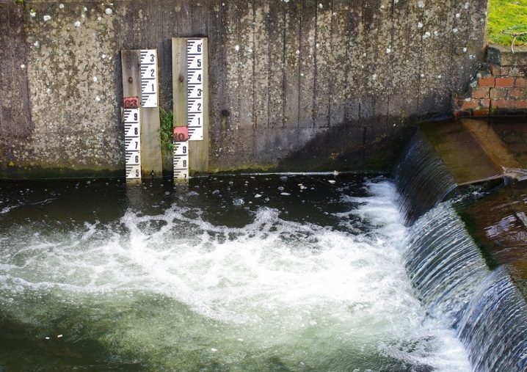
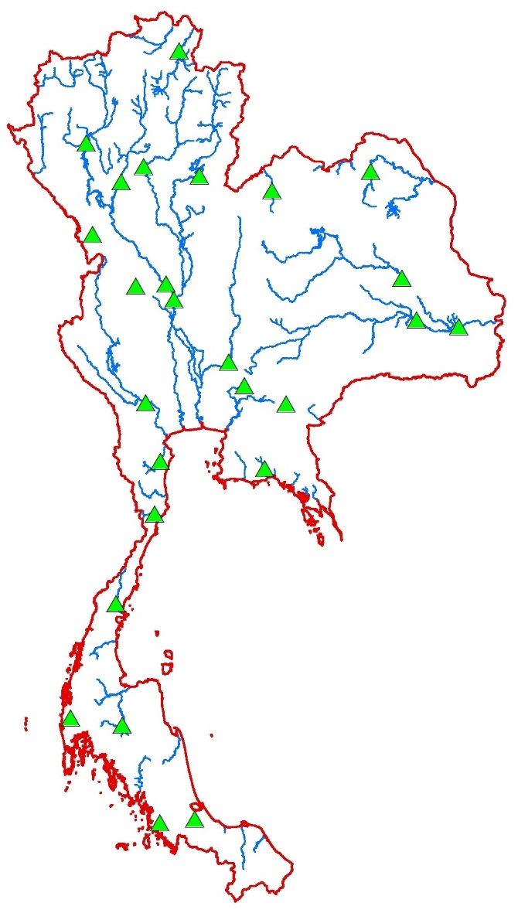
Earth Observations & Parameters
Streamflow
Image Credit: Julian Osley
Royal Irrigation Department, Thailand
26 Ground-based Stations:
In-situ streamflow measurements
April 1998 – March 2014
Data Source: Department of Water Resources, Thailand
Notes:
Image Source (left): http://www.geograph.org.uk/reuse.php?id=3870652&download=85af8db1&size=original
Finally, the in-situ stream-flow data is obtained from 26 ground-based stations located on the main streams and rivers in Thailand. These are shown as green triangles in the map on the right.
This stream-flow measurement is used for calculating Stream-flow Drought Index.

Slide 10
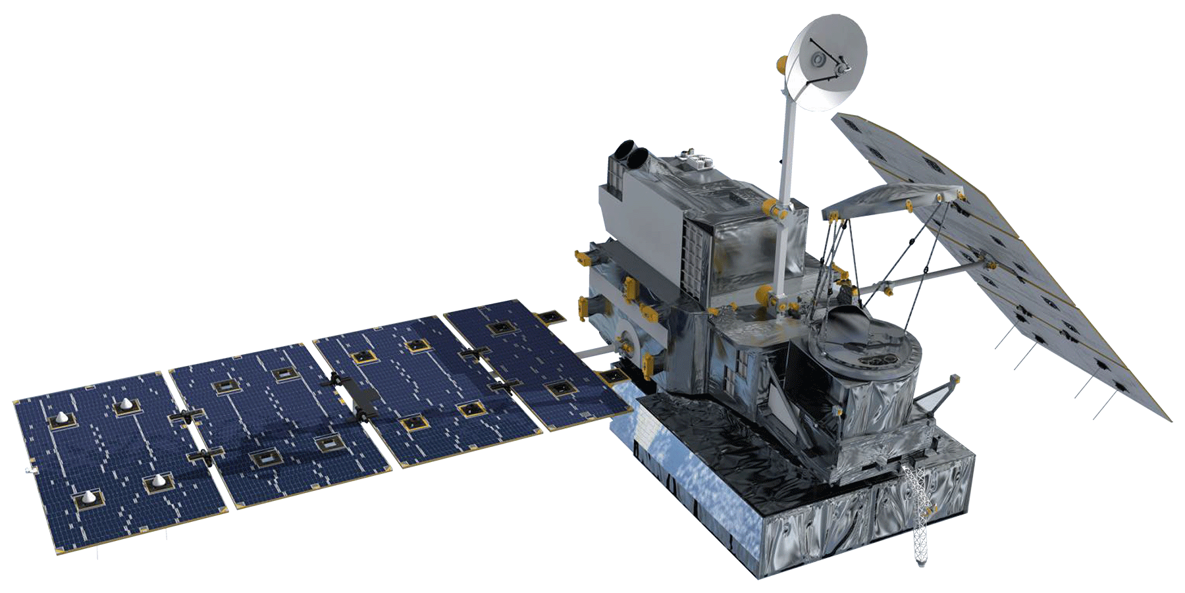
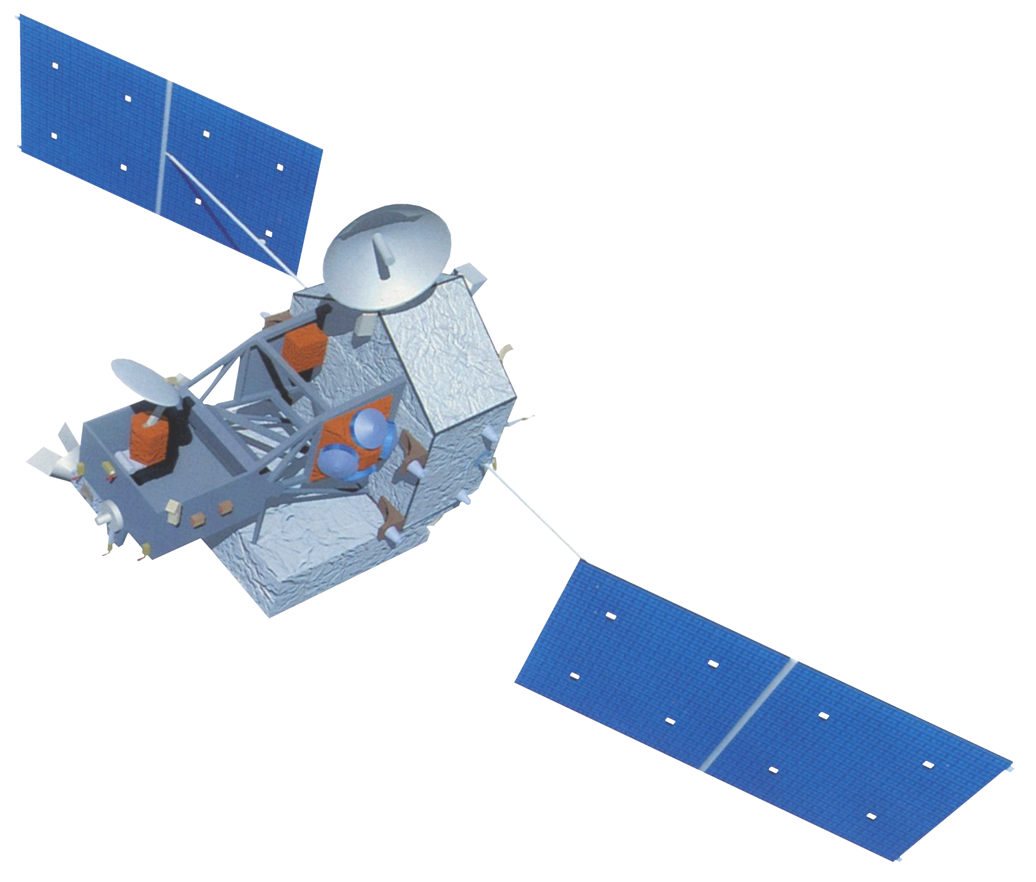
Methodology: SPI
(Standardized Precipitation Index)
GPM – GMI
30-min precipitation rate (mm/hr)
0.1°-Spatial Resolution
IMERG Level 3 product
Monthly Precipitation
Resampled to
0.1°-spatial resolution
MATLAB Script
SPI
1-month temporal resolution
05/2015
TRMM – TMI
Daily precipitation (mm)
0.25°-Spatial Resolution
3B42 Level 3 product
Notes:
To calculate the Standardized Precipitation Index, we obtained precipitation data from TRMM and GPM.
However, they have different temporal and spatial resolutions.
So, firstly, the spatial resolution of TRMM was upsampled to match GPM’s resolution.
The upsampling was done by area-based linear interpolation.
Then, the precipitation of GPM and TRMM was summed to a monthly temporal resolution.
Finally, the monthly precipitation is further calculated by statistical methods to determine the Standardized Precipitation Index. This process was written in a MATLAB script and the SPI was then automatically generated from the monthly precipitation.

Slide 11
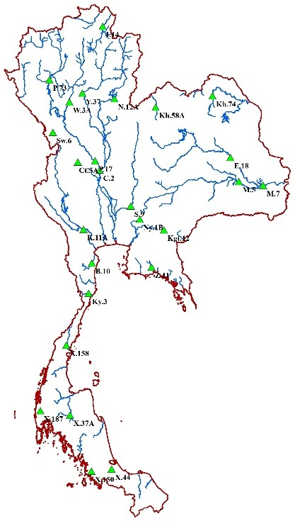
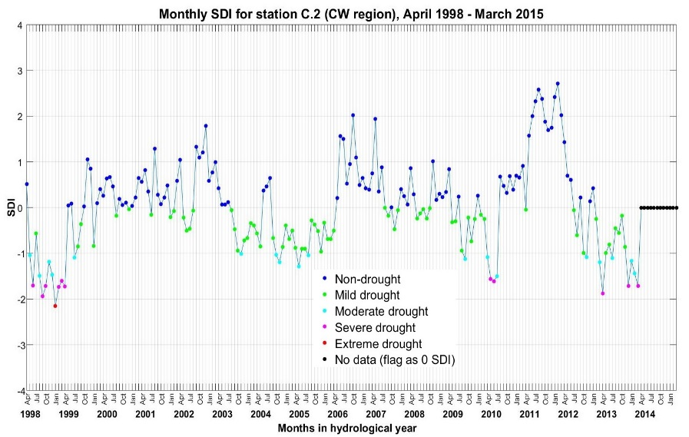
Methodology: SDI
(Streamflow Drought Index)
Streamflow Records
26 ground-based stations on the main streams and rivers
Monthly streamflow (m³)
04/1998 to 03/2014
SDI
1-month temporal resolution
Streamflow (m³)
MATLAB Script
Time (month)
Data Source: Department of Royal Irrigation, Thailand
Notes:
Next, the Stream-flow Drought Index was calculated from the monthly stream-flow data measured from ground-based stations on the main streams and rivers in Thailand.
A MATLAB script was also written to automatically calculate the Stream-flow Drought Index.

Slide 12
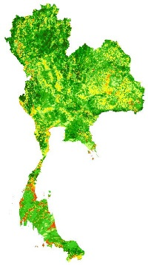
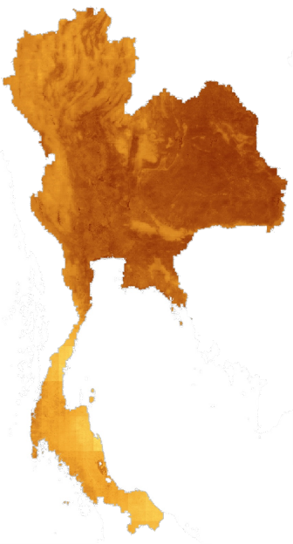
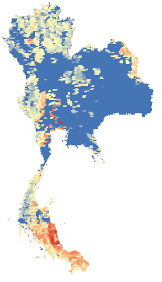
Methodology: SDCI
(Scaled Drought Condition Index)
NDVI
0.01°-spatial resolution
MOD13A3 and MYD13A3 products
SDCI
0.01°-spatial resolution
1-month temporal resolution
LST
0.05°-spatial resolution
MOD11C3 and MYD11C3 products
PythonScript
Monthly Precipitation
0.1°-spatial resolution
Notes:
Finally, the Scaled Drought Condition Index is based on 3 parameters which are NDVI, LST, and precipitation.
These data sets are in different spatial resolutions. So the spatial resolutions of LST and precipitation were upsampled to match the finest spatial resolution which is the 0.01 degree from the MODIS NDVI product.
Also, the data sets were summed to be monthly temporal resolution.
Finally, each data set was scaled and processed to determine the Scaled Drought Condition Index. This process was written by an R-script to automatically determine the Scaled Drought Condition Index.

Slide 13
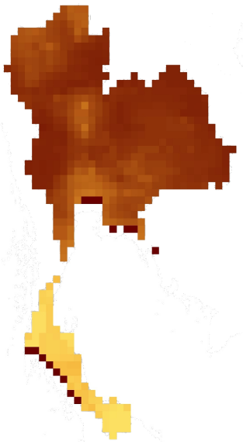
Results & Discussions
Four indices were utilized to monitor drought by two methods: first being spatial extent and second as a time series.
Scaled
Standardized
Drought
Precipitation
Condition
Index
Index
Soil
Streamflow
SDI
Moisture
Drought
Index
Index
Notes:
Now we have 4 indices to monitor 3 types of drought. We can use this information to create a monitoring system by looking at spatial extent and time series. I will get into the detail of these 2 methods.

Slide 14
Results & Discussions
Four indices were utilized to monitor drought by two methods: first being spatial extent and second as a time series.
Satellite-based index maps at monthly temporal resolution
Scaled
Standardized
Drought
Precipitation
Condition
Index
Index
Soil
Streamflow
SDI
Moisture
Drought
Index
Index
Notes:
First, we monitor the spatial extent of drought in Thailand by Satellite-based indices, SPI, SMI and SDCI. Spatial maps were created and analyzed at a monthly scale. We have the historical data from 2003 up to present.
From these maps, we can monitor drought by look at the effect of precipitation

Slide 15
Results & Discussions
Time series plots of four indices at any region
Notes:
Time series plots at any region were analyzed to compare all indices. This approach allowed us to derive anomalies and identify drought.

Slide 16
Results & Discussions
Notes:
In February 2005, all indices show extreme drought in the central region of Thailand. The index map at this time also substantiates the extreme drought conditions.

Slide 17
Image Credit: Sclan
Future Works
Create a near-real time drought monitoring tool using Earth observing satellites
Calculate the lag correlation for the datasets by taking monthly averages and then analyzing 1,2,3, and 4 month lag correlations.
Notes:
Image Source: https://pixabay.com/en/drought-smoke-ground-801369/
For the future work, the tools we created in this project will be extended into a Near-Real Time web-based service which can automatically monitor and analyze drought in 1-month temporal resolution. This will aid in mitigating risk and improve resource allocation in the country.
Calculate the lag correlation for the datasets by taking monthly averages and then analyzing 1,2,3, and 4 month lag correlations to demonstrate the relationship between all drought indices

Slide 18
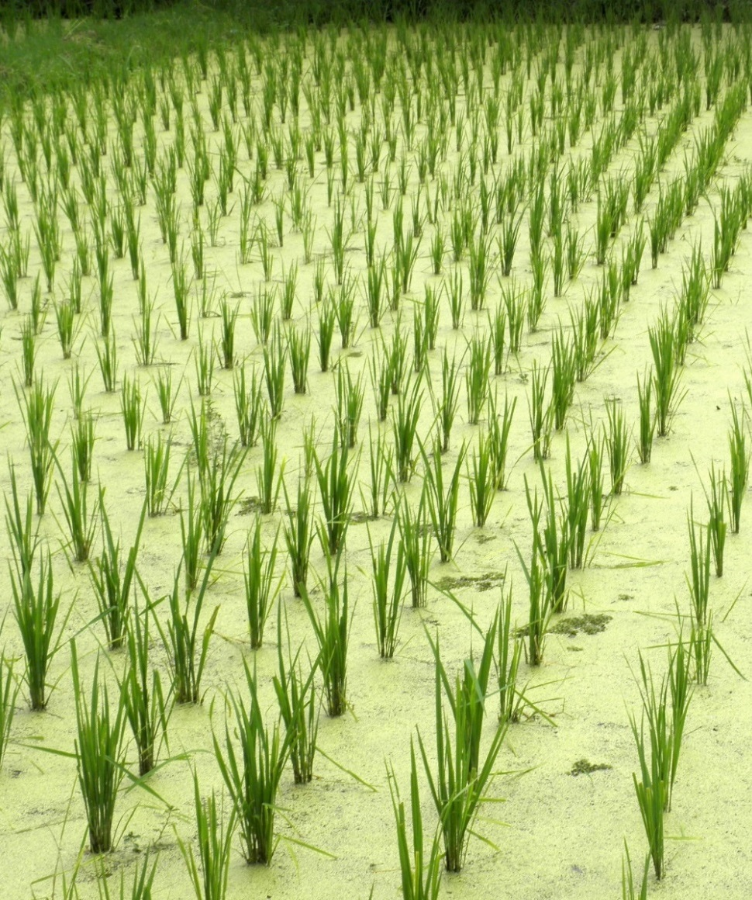
Outcome & Benefit
Allowing end users to access & characterize regional drought in Thailand
Better decision making processes of mitigating the impacts of drought.
Image Credit: U.S. Department of Agriculture
Image Credit: Quentar
Notes:
Image Source (left): https://farm6.staticflickr.com/5463/9018906362_be8656b61e_o_d.jpg
Image Source (right): https://upload.wikimedia.org/wikipedia/commons/0/07/Langkawi-pantai_cenang-rice-field.JPG
This drought monitoring system allows end users to access and characterize regional drought in Thailand, leading to better decision making processes that are necessary in mitigating the impacts of drought.

Slide 19
Advisors
Dr. John Bolten (NASA GSFC)
Dr. Kenton Ross (NASA Langley Research Center)
Colin Doyle (NASA GSFC)
Partners
Royal Thai Embassy Collaborator/Boundary Organization, POC: Bunyakiat Raksaphaeng
Asian Disaster Preparedness Center/SERVIR Mekong Collaborator/Boundary Organization POC: Pete Cutter
Thai Department of Disaster Prevention and Mitigation End-User
National Safety Council of Thailand End-User

Slide 20
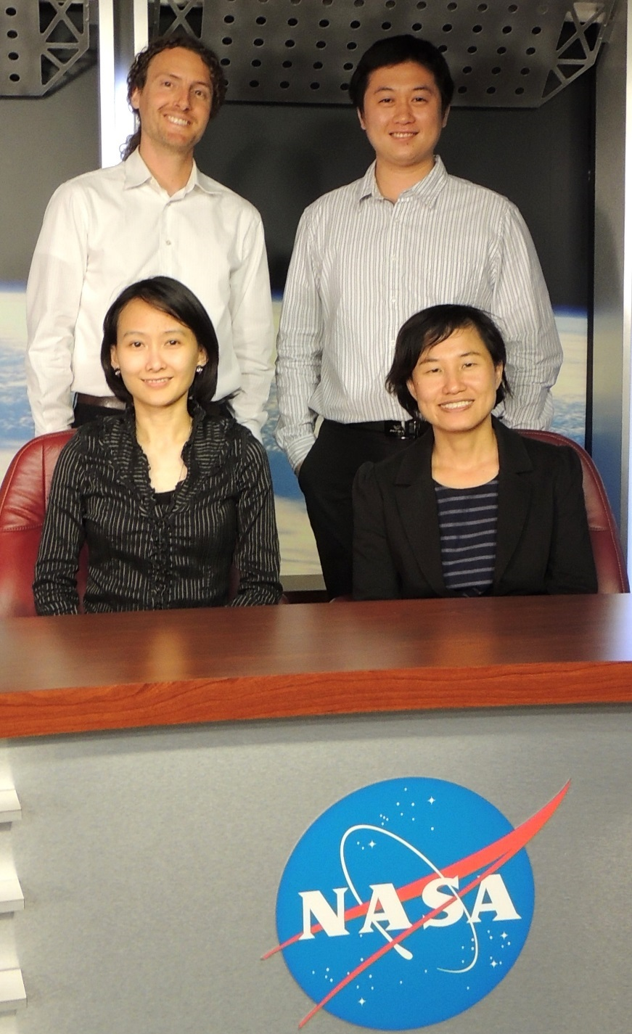
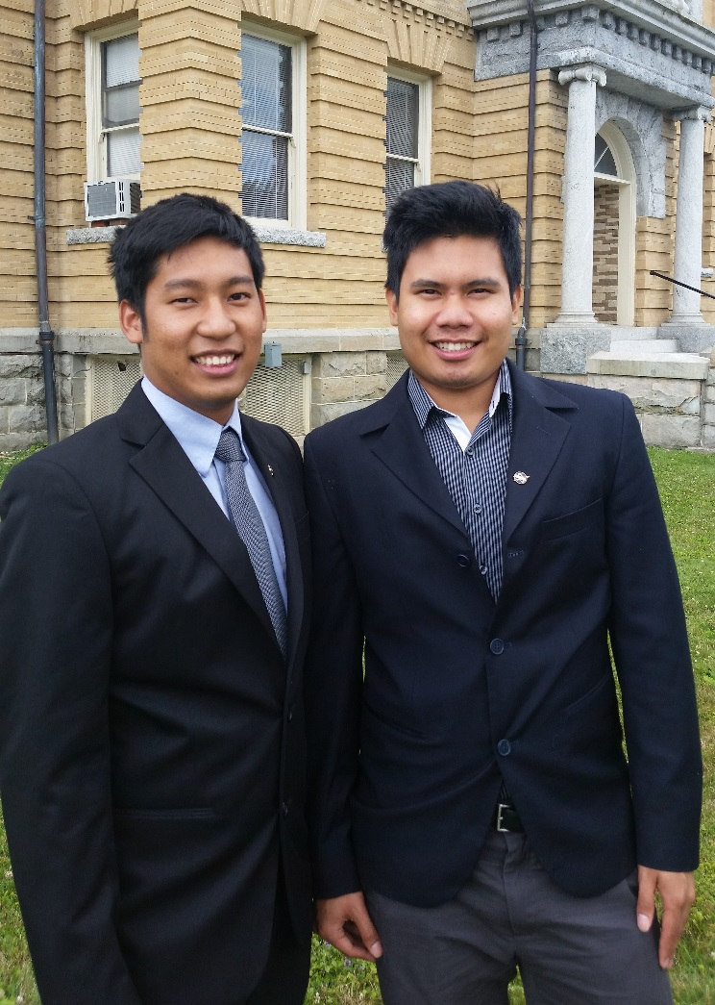
Thailand Disaster Project Team
Left: Thanapat Vichienlux
Right: Sahakait Benyasut
Top Left: Sean McCartney
Top Right: Nobphadon Suksangpanya
Bottom Left: Chisaphat Supunyachotsakul
Bottom Right: Srisunee Wuthiwongyothin

