Slide 1
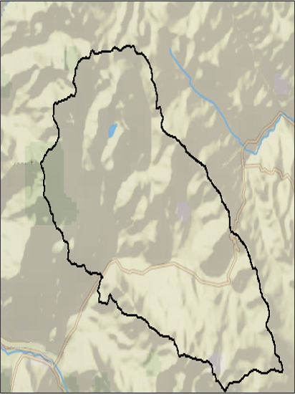
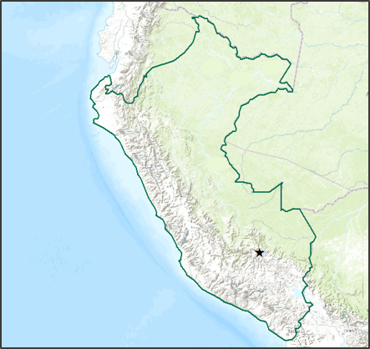
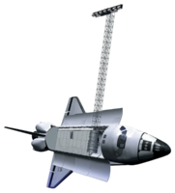
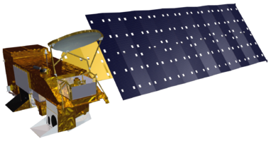
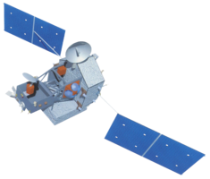
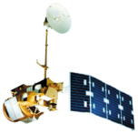
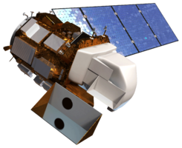
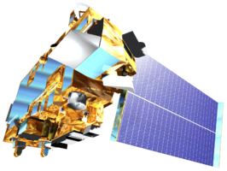
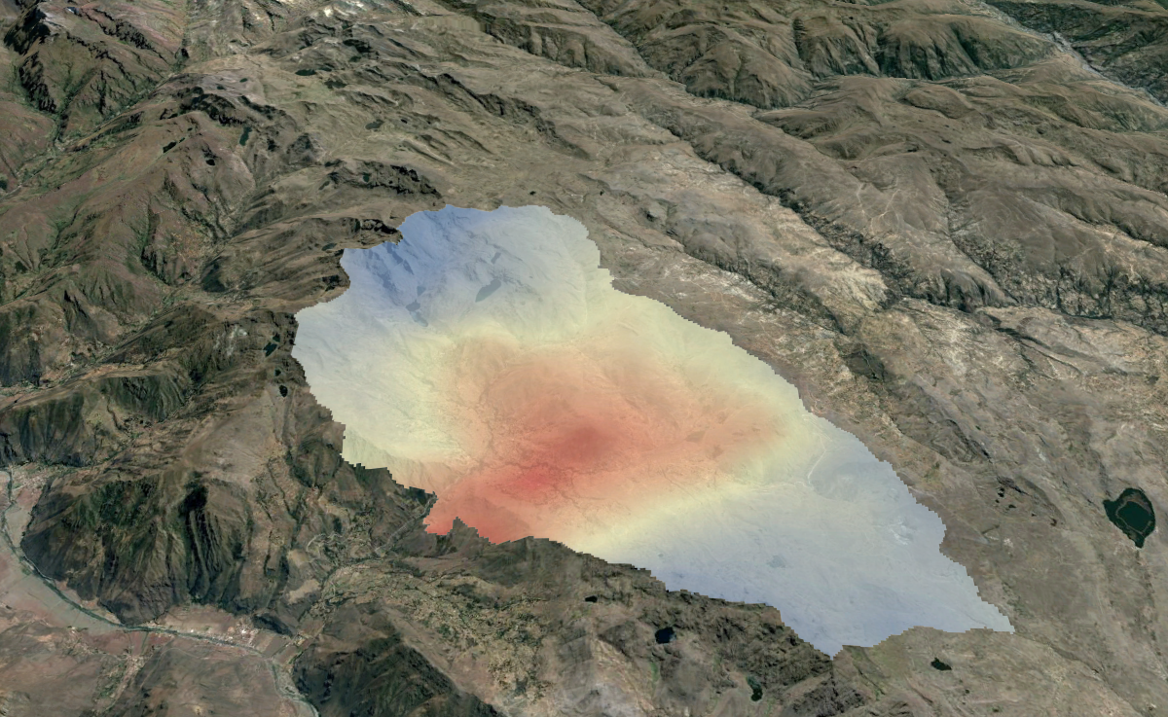
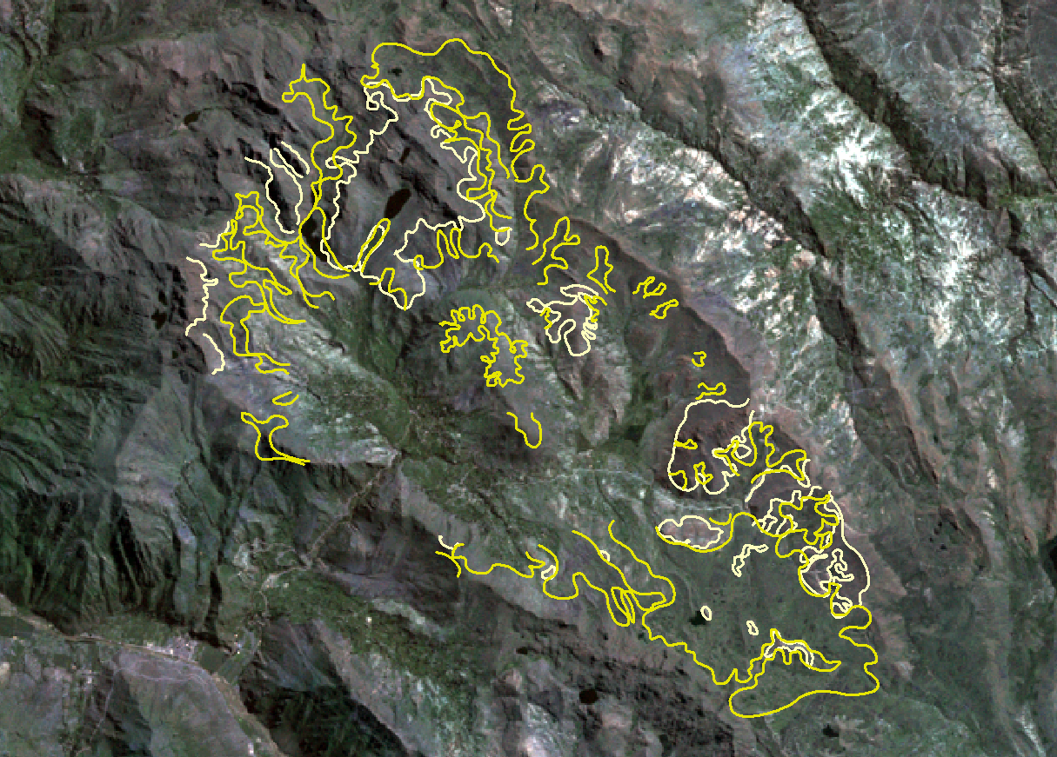
Peru Climate
Monitoring and Forecasting Shifting Climate and Land Use Change Impacts in Peru’s Parque de la Papa for Enhanced Agricultural Management
Rebekke Muench (Project Lead), Kayla McDonald, Ryan Murphy, Michael Sclater, Richard Rose, Dajon Begin
NASA DEVELOP National Program at NASA Langley Research Center
Abstract
Objectives
Changing climates are affecting agricultural production around the world. This impact will be particularly severe in tropical highland regions like the Peruvian Andes, where shifts in climate have caused changes in suitable areas for endemic crops. In the Parque de la Papa (Peruvian Potato Park), evidence suggests that potato cultivation has shifted to higher altitudes in response to increasing temperatures and pest populations. The primary concern is the current suitable lands within Parque de la Papa will eventually become unsuitable for traditional potato production. In addition, the impact of shifting climates threaten both agrobiodiversity and community livelihoods within the park and surrounding region. The objective of this project was to develop an increased understanding of changes in climate and their influence on potato cultivation in the park using NASA Earth observations. Land surface temperature data from the Aqua and Terra Moderate Resolution Imaging Spectroradiometer (MODIS) were used to derive growing degree days for the region. Historical and current precipitation was assessed using Tropical Rainfall Measuring Mission (TRMM) and Global Precipitation Measurement (GPM) data. Current and historical potato cultivation areas were estimated using Landsat 4, 5, 7, and 8. A digital elevation model (DEM) and a slope map were created from the Shuttle Radar Topography Mission (SRTM) data. These factors were incorporated into current and future suitability maps for potential potato cultivation .
Create growing degree days, elevation, slope, and precipitation factor maps
Use Landsat imagery to determine how potato crop locations have changed over the past 30 years
Develop a methodology that can be applied throughout Peru to determine potato suitability
Study Area
Peru
Methodology
Legend
Parque de la Papa
Peru
Acquisition
Processing
Analysis
N
Download TRMM, MODIS, Landsat, and SRTM data
Figure 1: Map depicting the location of the Parque de la Papa
Convert MODIS to degrees Celsius and account for cloud contamination
Create composite bands of Landsat imagery using ArcToolbox
Derive the slope from the SRTM digital elevation model using the slope ArcTool
Earth Observations
Use Python to process TRMM data
Determine Growing Degree Days using dnnpy Python script
Create polygons of the agricultural areas for 1990 and 2007
Interpolate TRMM data
Use ArcGIS to determine the maximum elevation and minimum elevation of the park
SRTM
Aqua
TRMM
Results
Landsat 5
Landsat 8
Terra
Conclusions
Temperature derived from MODIS was higher than expected.
Accumulated Growing Degree Days suggested shorter growing seasons at higher elevations within the park.
Average accumulated growing season precipitation estimated from TRMM analysis was 100 mm higher than ideal precipitation conditions for potatoes.
Agricultural activity shifted 200 m higher in elevation between 1990 and 2007.
Legend
> 2000
1200-1999
< 1200
Figure 2: Map depicts accumulated growing degrees over the course of the growing season from November - May.
Team Members
Legend
.
1990
2007
Figure 4: Movement of agricultural crops upper limits from 1990 to 2007.
Figure 3: Accumulated rainfall over the course of the growing season from November until May (red and orange) with comparisons to the recommended rainfall amounts (blue).
Project Partners
Acknowledgements
International Potato Center (CIP)
Dr. Noelle Barker
Dr. David Ellis
Asociacion para la Naturaleza y el Desarollo Sostenible (ANDES)
Emily Adams, Center Lead at Langley NASA DEVELOP
Dr. Kenton Ross, National Science Advisor, NASA DEVELOP
(Left to Right) Dajon Begin, Michael Sclater, Kayla McDonald, Ryan Murphy, and Rebekke Muench
Not pictured: Richard Rose
NASA Langley Research Center

