Slide 1
Peru
Health & Air Quality
Land Use Change in the Rapidly Developing Peruvian Amazon and Implications on Zoonotic Disease Incidence
Elizabeth Stapleton, Ariel Calle, Nataly Chacon, Nelson Huffaker, & Oliver Nguyen
Georgia – Athens
Notes:
Speaker Notes:
Good afternoon everyone. We are the Peru Health & Air Quality team and today we're going to discuss the work we've done within the last ten weeks related to the applications of NASA Earth observation and satellite data to explore land use change in the rapidly developing Madre de Dios region of Peru and the negative implications on zoonotic disease incidence. First, we'll take a moment to go around and introduce ourselves.

Slide 2
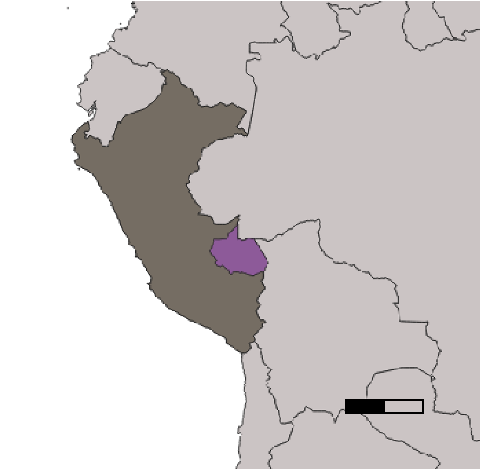
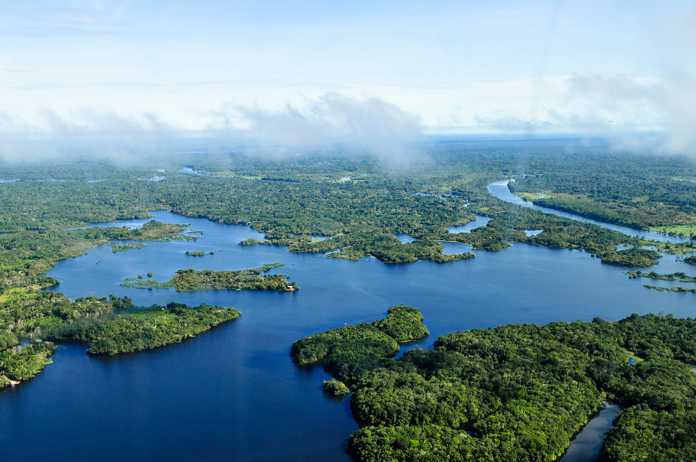
MADRE DE DIOS, PERU
Amazon Basin of Southeastern Peru
Biodiversity Hotspot
Capital: Puerto Maldonado
Study Period: 2000-2021
PERU
MADRE DE DIOS
0
500 Km
Image Credit: Neil Palmer/CIAT
Notes:
Speaker Notes:
The Madre de Dios region in southeastern Peru is the country's most sparsely populated department and a hotspot for biodiversity. Located at the borders of Bolivia and Brazil, this region is home to unique ecosystems including savannahs, western highland and cloud forests where the Andes mountain range lies, and lush old-growth rainforests. The capital of this region is Puerto Maldonado, a focal site to our Land Use & Land Cover change analysis.
Our study examined changes in land use and land cover in Madre de Dios, and we used satellite imagery from Landsat 5 and 8 to create classified maps for the years 2010, 2015, and 2020. The most recent classification was done in 2016 as part of the GeoBosques project by the Peruvian Ministry of the Environment. We also analyzed zoonotic disease incidence data from 2010 to 2021 provided by our partners at the Ministry of Health, with additional health data stretching back to 2000, to see if any trends or correlations exist between land use change and disease incidence.
Image Credit: Neil Palmer/CIAT
Image Source: https://www.flickr.com/photos/cifor/35073180044
Creative Commons License: Creative Commons Attribution 2.0 Generic

Slide 3
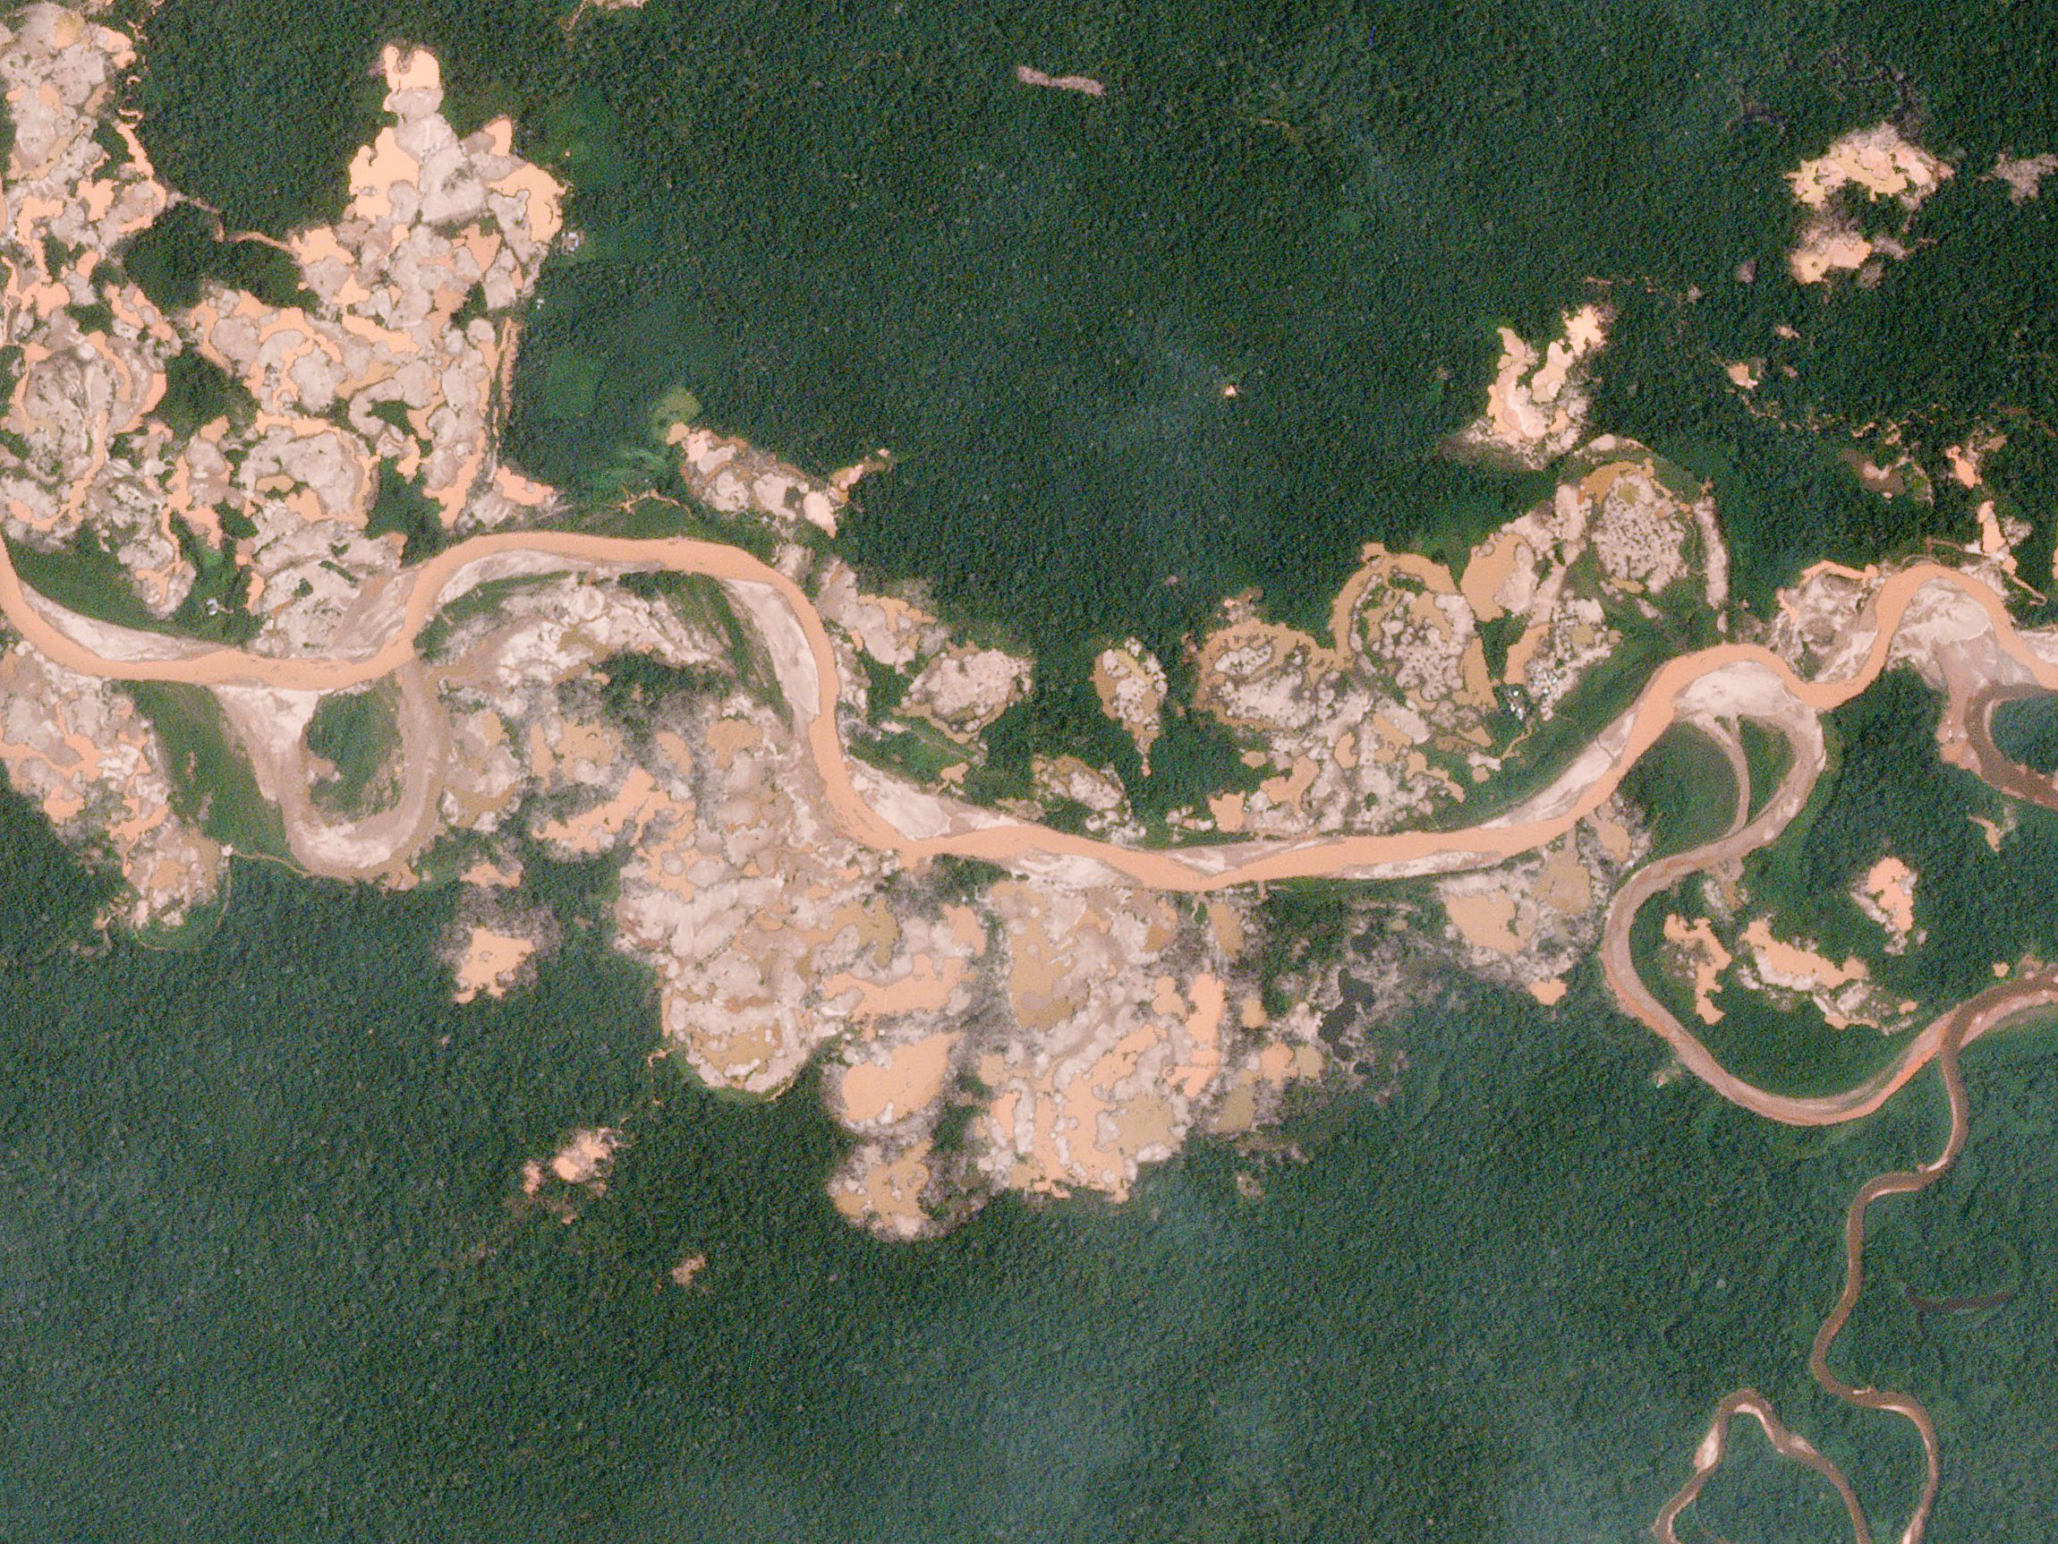
COMMUNITY CONCERNS
Rapid land use change
Illegal/legal gold mining
Deforestation
Urban & agricultural expansion
Zoonotic disease exposure
Increased incidence of dengue fever since 2000
Ongoing incidence of leishmaniasis
Lasting impacts of Covid-19 pandemic
Image Credit: Planet Labs, Inc.
Notes:
Speaker Notes:
In recent decades, Madre de Dios has become a hotspot for rapid land use changes. The area has suffered substantial deforestation due to gold mining operations which have increased dramatically since the 1980s. In 2012, the Interoceanic Highway was completed further exposing this area to development.
As deforestation and urbanization continue, interactions between humans and zoonotic disease vectors increase, potentially increasing the spread of such diseases. Currently, dengue fever and leishmaniasis are two diseases of particular concern to the Peruvian Ministry of Health, known by their acronym MINSA. Dengue incidence in the Amazon has risen notably since 2000 due to rapid urbanization increasing habitat for the disease’s vector, the Aedes aegypti mosquito. Leishmaniasis, which is transmitted by sand flies, tends to be associated with forest habitats; and as human development continues to encroach on forested areas, MINSA is concerned about increased incidence. These health concerns are compounded by the lasting effects of the Covid-19 pandemic which has already stretched the healthcare system thin in the region.
Image credit: Planet Labs, Inc.
Image source: https://www.planet.com/gallery/mining-peru/ Creative Commons license: Creative Commons Attribution-Share Alike 4.0 International

Slide 4
OBJECTIVES
Part 1: LULC Classification
Part 2: Land Use Change Analysis
Part 3: Disease Incidence Analysis
Notes:
Speaker Notes:
The scope of this project encompassed three main objectives: Part 1 which consisted of the LULC Classification for the Madre De Dios region involved the creation of a series of Land Use & Land Cover classified maps on Google Earth Engine using satellite data for the years 2010, 2015, 2020 using the Random Forests algorithm. Part 2 was the Land Use Change Analysis which looked at where certain land uses (such as forest, mining, urban to list a few) were expanding or receding by district. Part 3 was the Disease Incidence Analysis which explored trends between changes in land use and zoonotic disease incidence by district over the last two decades.

Slide 5
PARTNERS
End User Partners
Peru Ministry of the Environment (MINAM)
Peru Ministry of Health (MINSA)
Collaborating Partners
Lab for Ecohealth and Urban Ecology, Universidad Peruana Cayetano Heredia
Asociación para la Conservación de la Cuenca Amazónica (ACCA)
Peruvian Service for Natural Protected Areas
The National Commission for Aerospace Research and Development (CONIDA)
Instituto del Bien Común (IBC)
Notes:
Speaker Notes:
Our team partnered with the Peru Ministry of the Environment (MINAM) and the Ministry of Health (MINSA) to explore applications of remote sensing and satellite data to public health concerns related to land use change. Both agencies were interested in understanding the spatial dynamics of land use change to better target agency resources to protect human and environmental health in the Peruvian Amazon. We also collaborated with the Ecohealth lab of the University Peruana Cayetano Heredia, the Amazon Basin Conservation Association, Peruvian Service for Natural Protected Areas, the National Commission for Aerospace Research and Development, and the Bel Común Institute.

Slide 6
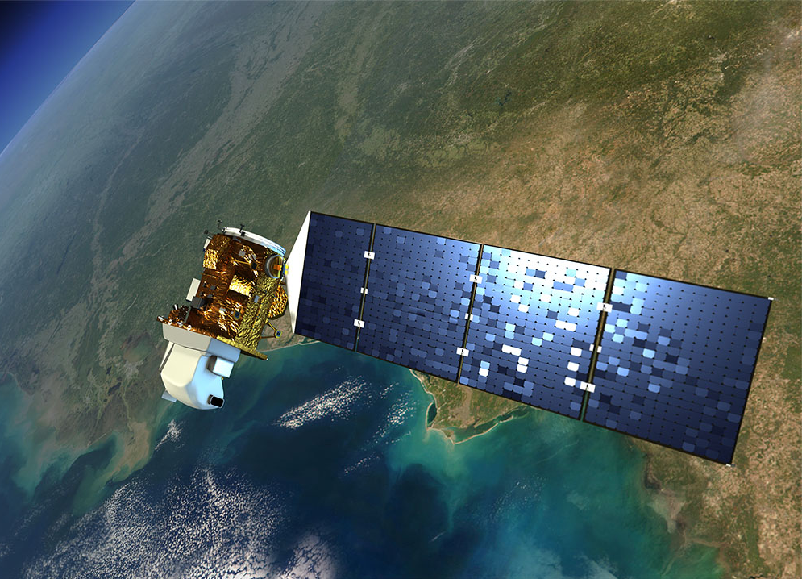
NASA SATELLITES/SENSORS USED
Sensors | Years
Landsat 5 Surface Reflectance Tier 1 | 2010
Landsat 8 Level 2, Collection 2, Tier 1 | 2015, 2020
Image Credit: NASA Goddard Space Flight Center
Notes:
Speaker Notes:
We used Google Earth Engine (GEE) to produce the Land Use and Land Cover (LULC) classified maps and Land Use Change Analysis results. Within GEE, we used publicly available satellite imagery collected by Landsat 5 Thematic Mapper for the year 2010 and Landsat 8 OLI for years 2015 and 2020. Landsat Surface Reflectance data were used to train the land cover classifications.
Image Credit: NASA Goddard Space Flight Center
Image Source: https://www.flickr.com/photos/gsfc/7630269434
(image licensed under Creative Commons, Attribution 2.0 Generic (CC BY 2.0))

Slide 7
METHODOLOGY: LULC CLASSIFICATION
Pre-Processing
Google Earth Engine
1. Identify Classes of Interest
4. Query/filter Satellite Imagery
5. Input into Random Forest Model + Classify
2. Collect Training Data
3. Google Earth Pro Validation
6. Accuracy Assessment
Notes:
Speaker Notes:
For the Land Use Land Cover maps, we first identified our classes of interest based on the most recent classification for the Madre de Dios region which was for 2016 which was a part of GeoBosques project conducted by the Peruvian Ministry of the Environment.
We used their output classifications as a base for creating our own training data that would be used by the Random Forest algorithm to classify the rest of the region. About 50-80 samples were collected per class which then required temporal validation on Google Earth Pro to verify that each training site was consistently the same class across all three years (2010, 2015, and 2020) and if so, it was then accepted into the model.
Continuing onto the Google Earth Engine platform, we queried Landsat from 2010, 2015, and 2020. We also used reference data from various partners and their previous products identifying certain land cover classes that we can use to help identify training polygons. We cleaned our satellite data by removing clouds and clipping it to the region of interest. Then we created training data on Google Earth Pro and created polygons to characterize samples of land for our classes. Finally, we input these training data into the Random Forest Model on Google Earth Engine and checked the validity using a confusion matrix.

Slide 8
METHODOLOGY: LULC CLASSIFICATION
Pre-Processing
 | Class | Index
 | Forest | 1
 | Secondary Vegetation | 2
 | Pastures | 3
 | Agriculture | 4
 | Mining | 5
 | Water | 6
 | Wetlands | 7
 | Urban | 8
1. Identify Classes of Interest
Ancillary Datasets
MapBiomas
Geobosques
RAMI
Sideteva
2. Collect Training Data
3. Google Earth Pro Validation
Notes:
Speaker Notes:
For the Land Use Land Cover maps, we first identified our classes of interest based on the most recent classification for the Madre de Dios region which was for 2016 which was a part of GeoBosques project conducted by the Peruvian Ministry of the Environment. We used their output classifications as a base for creating our own training data that would be used by the Random Forest algorithm to classify the rest of the region. About 50-80 samples were collected per class which then required temporal validation on Google Earth Pro to verify that each training site was consistently the same class across all three years (2010, 2015, and 2020) and if so, it was then accepted into the model.
Then we gathered Landsat data from 2010, 2015, and 2020. We also used reference data from various partners and their previous products identifying certain land cover classes that we can use to help identify training polygons. We cleaned our satellite data by removing clouds and clipping it to the region of interest. Then we created training data on Google Earth Pro and create polygons to characterize samples of land for our classes. Finally, we input these training data into the Random Forest Model on Google Earth Engine and check the validity using a confusion matrix.

Slide 9
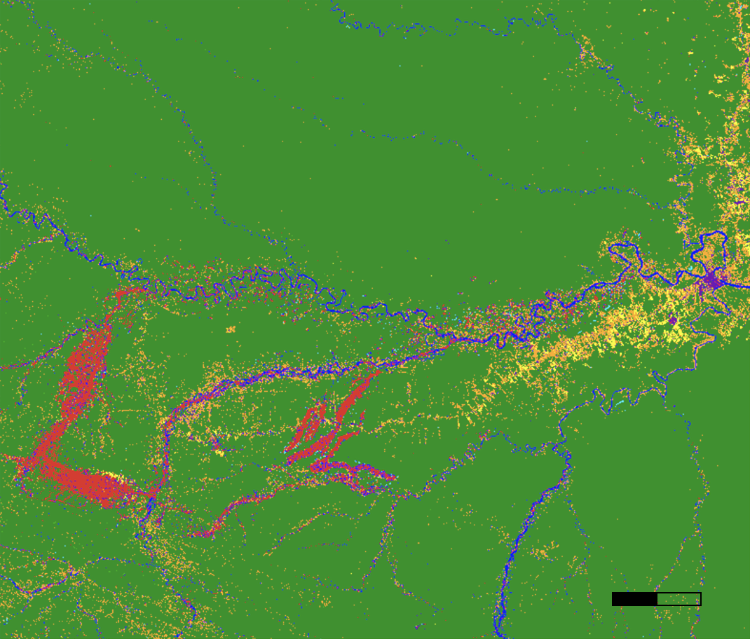
METHODOLOGY: LULC CLASSIFICATION
Google Earth Engine
4. Query/Filter Satellite Imagery
5. Supervised Classification via Random Forest
Land Cover Classes (2020)
Forest
Secondary Veg
Pastures
Agriculture
Urban
Water
Wetlands
Urban
6. Accuracy Assessment
0
10 km
Notes:
Speaker Notes: Within GEE, we used publicly available satellite imagery collected by Landsat 5 TM for the year 2010 and Landsat 8 OLI data for years 2015 and 2020. In addition, we used reference data from MapBiomas, Geobosques, RAMI (mining), Google Earth, and Sideteva (mining) for certain classes.
We also clipped to the region of Madre de Dios, removed clouds with less than 50% coverage, and filtered for 2010, 2015, and 2020 Landsat images. This is a false color image of Madre de Dios using Landsat 8, mosaicked and combined from 2020 Landsat images.
For each of the classes, we created training data or used already existing partner-provided training points. We selected training points by referencing pre-existing Land Use Land Cover classifications provided by GeoBosques with coverage for the Madre de Dios region up until 2016, and the documented protocol for landscape classification used by MapBiomas. This will constitute our LULC classification process, in conjunction with Google Earth Pro to identify whether or not select areas for each classes remained the same or changed to another class in 2020, or whether or not they were correctly identified as a class. If no change occurred, then this training data is applicable for all three of our target LULC years.

Slide 10
METHODOLOGY: LAND USE CHANGE
Data Processing
Data Analysis
Results from LULC Classification
2. Reclassify Rasters
3. Subtract Rasters for Each Analysis Period
1. Import to ArcGIS
Notes:
Speaker notes:
We used the LULC classification maps to analyze changes in land cover between 2010 and 2015, between 2015 and 2020 and for the entire period, from 2010 to 2020. We imported these maps to ArcGIS Pro where we used the raster calculator to combine these maps into change maps.

Slide 11
METHODOLOGY: LAND USE CHANGE
Data Analysis
Reclassify Rasters
Assign squared values to each land cover type
Reclassify each year: 2010, 2015, and 2020
Subtract Rasters for Each Analysis Period
Generates unique number value for each land transition type
Land transitions matrix showing unique values for each land transition type
Notes:
Speaker Notes:
To create these change maps, we first reclassified the land cover values for each year. Land cover types originally had values from 1 through 8. These values were reclassified as squares of the original values. This allowed us to subtract the land cover maps from each other to generate a raster map with unique values for each transition type. Areas which did not change had a value of 0 while areas that did change were assigned a unique value, as displayed in the land transitions matrix here.

Slide 12
METHODOLOGY: DISEASE INCIDENCE
Data Processing
Data Analysis
Results from LULC Classification
1. Obtain and Clean Disease Reports Data
4. Correlate Land Cover and Disease Incidence
2. Normalize by Population
5. Correlate Land Changes and Disease Incidence
3. Map and Visualize Disease Incidence
Results from Land Change Analysis
Notes:
Speaker notes: We explored disease incidence independently and in conjunction with our land use and land cover data. We obtained weekly disease incidence reports from MINSA for 2000 through 2021 for both dengue and leishmaniasis. These reports included the district in which the cases originated and the health centers at which they were reported for each week of the year.
We first cleaned, visualized, and spatialized these data. Then, we used these data in conjunction with results from the land use classification and land change analysis to evaluate correlations between land use and disease incidence.

Slide 13
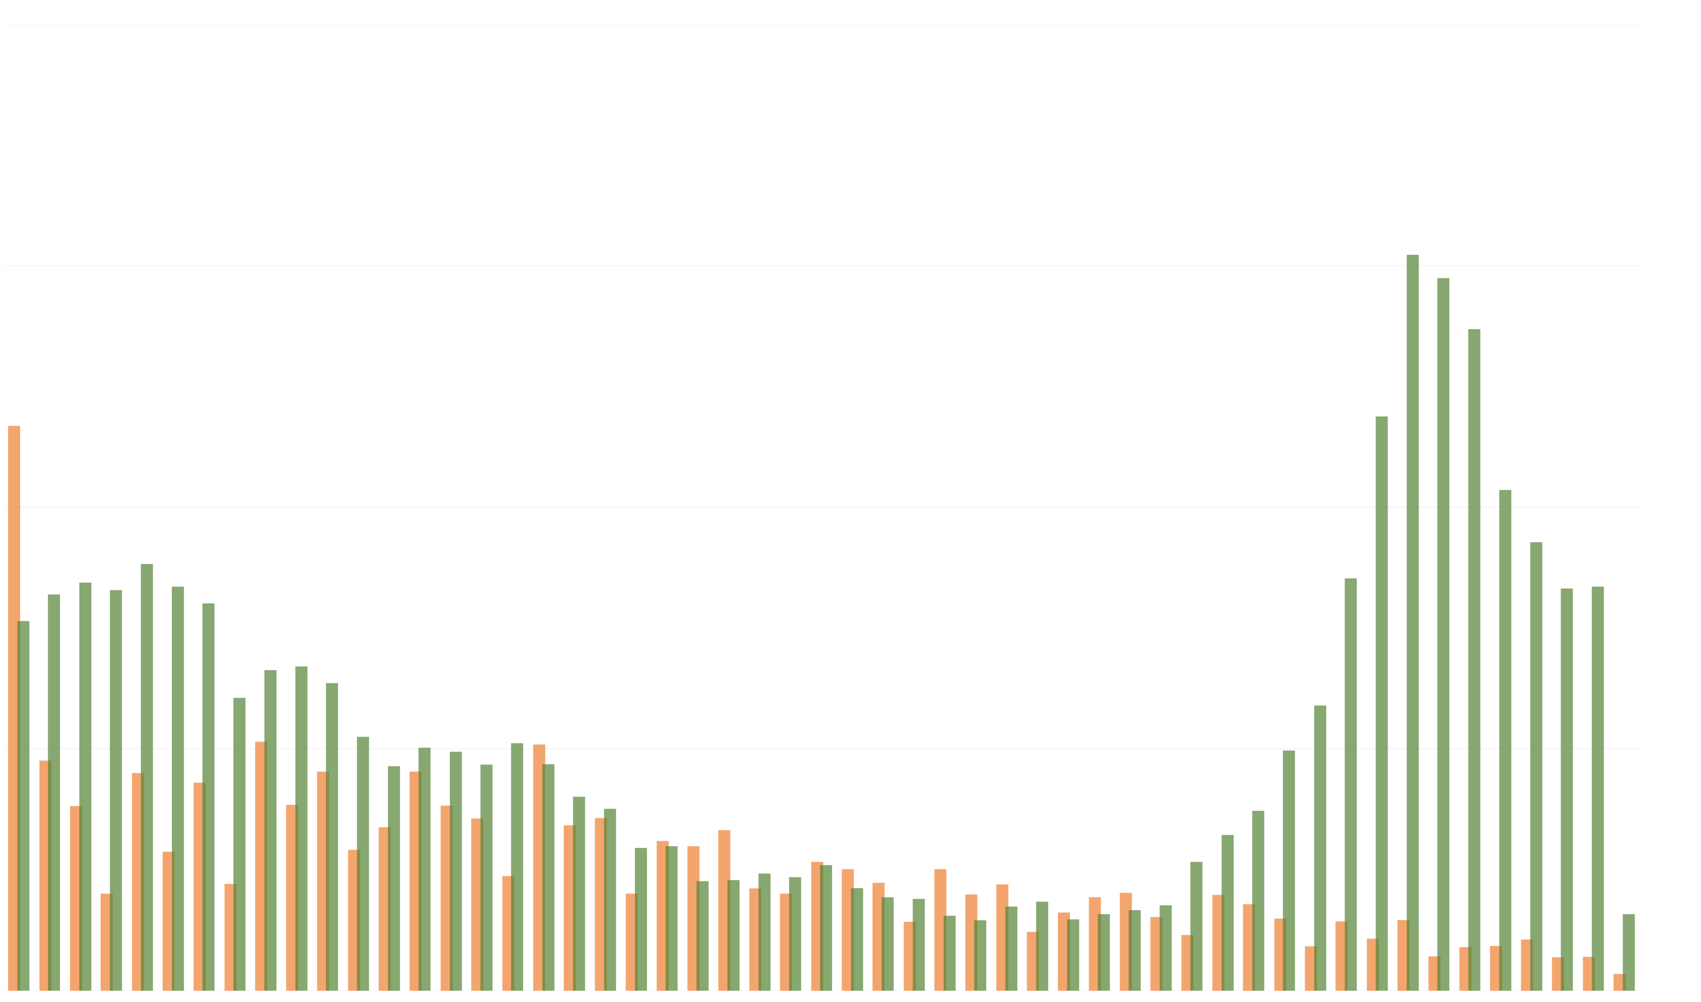
METHODOLOGY: DISEASE INCIDENCE
Data Processing
Cumulative Weekly Reports of Dengue & Leishmaniasis, 2000-2021
1. Obtain and Clean Disease Reports Data
1500
Dengue
Leishmaniasis
2. Normalize by Population
1000
Number of Reports
500
3. Map and Visualize Disease Incidence
January
December
Month
Notes:
We cleaned disease reports for both dengue and leishmaniasis and aggregated cases for each district by year. We used census data from 2007 and 2017 to interpolate district level populations for each year of the study period and to normalize disease incidence within each district by population.
We visualized disease reports across districts and through time to better understand the distribution of dengue fever and leishmaniasis across the region.

Slide 14
METHODOLOGY: DISEASE INCIDENCE
Data Analysis
Results from LULC Classification
4. Correlate Land Cover and Disease Incidence
Results from Land Change Analysis
5. Correlate land changes and disease incidence
5. Correlate Land Changes and Disease Incidence
Notes:
We also wanted to explore disease incidence in conjunction with our land use and land cover data. From our land use classification maps we calculated the percentage of each land cover type within each district. We used this district-level data to calculate the Pearson's correlation coefficient between each land cover class and the incidence of both dengue and leishmaniasis across the region.
We extended this method to consider the correlation between key land use changes and disease incidence. We calculated the percent change of key land cover types (forest loss, mining expansion, and urban expansion) in each district from 2010 to 2015, 2015 to 2020, and 2010 to 2010. Finally, we calculated Pearson's correlation coefficients between each key land class change and incidence of both dengue and Leishmaniasis.

Slide 15
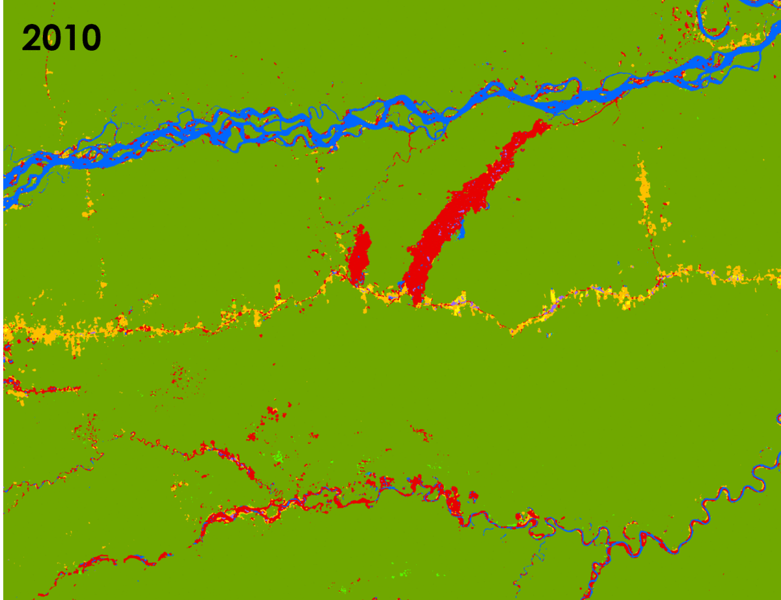
RESULTS: LULC CLASSIFICATION
Mining Areas in La Pampa Region
Land Class
Forest
Secondary Vegetation
Pastures
Agriculture
Mining
Water
Wetlands
Urban
0
4
8
km
Notes:
Speaker Notes:
Here is a gif of classified images from 2010-2020 of the La Pampa illegal mining area in Madre de Dios. In red are the mining areas. Yellow represents agriculture, green represents forest, and blue represents water. We were able to successfully show the changes in mining overtime. Highlighted across the center image is where you can see the Transoceanic highway that cuts across the Amazon forest

Slide 16
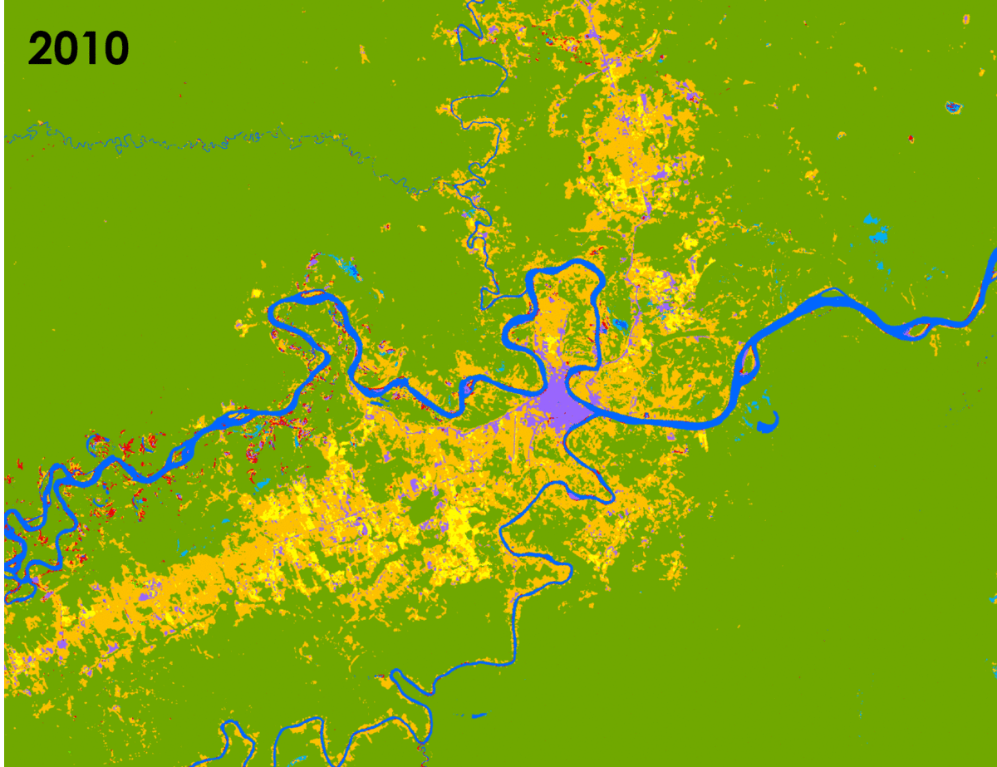
RESULTS: LULC CLASSIFICATION
Puerto Maldonado
Land Class
Forest
Secondary Vegetation
Pastures
Agriculture
Mining
Water
Wetlands
Urban
0
5
10
km
Notes:
Speaker Notes:
Here is a gif of classified images from 2010-2020 zoomed into Puerto Maldonado, a city in Madre de Dios. Urban areas are colored as purple, yellow is agriculture, orange is pastures, blue is water, and light blue are wetlands.

Slide 17
RESULTS: LULC Accuracy Assessment
Predicted Class
Validity of Model: Confusion Matrix
Year Score
2010: 0.985
2015: 0.970
2020: 0.990
Positive
Negative
Positive
TP
FN
Actual Class
Negative
FP
TN
Notes:
We then checked the validity of the model using a confusion matrix. A confusion matrix is a measurement of accuracy for machine learning. It is a table with 4 variables consisting of actual values and predicted values. We partitioned our training data into two parts: 70% for training and 30% for testing. We input this into a function in Google Earth Engine called .errorMatrix which takes our values and puts into an array, like the confusion matrix table shown above, to test the accuracy of our training data. We got abnormally high values (the maximum value is 1), which may indicate that our model may be too overfitting, or our training points are spatially autocorrelated.
TP= True Positive
FP= False Positive
TN= True Negative
FN= False Negative

Slide 18
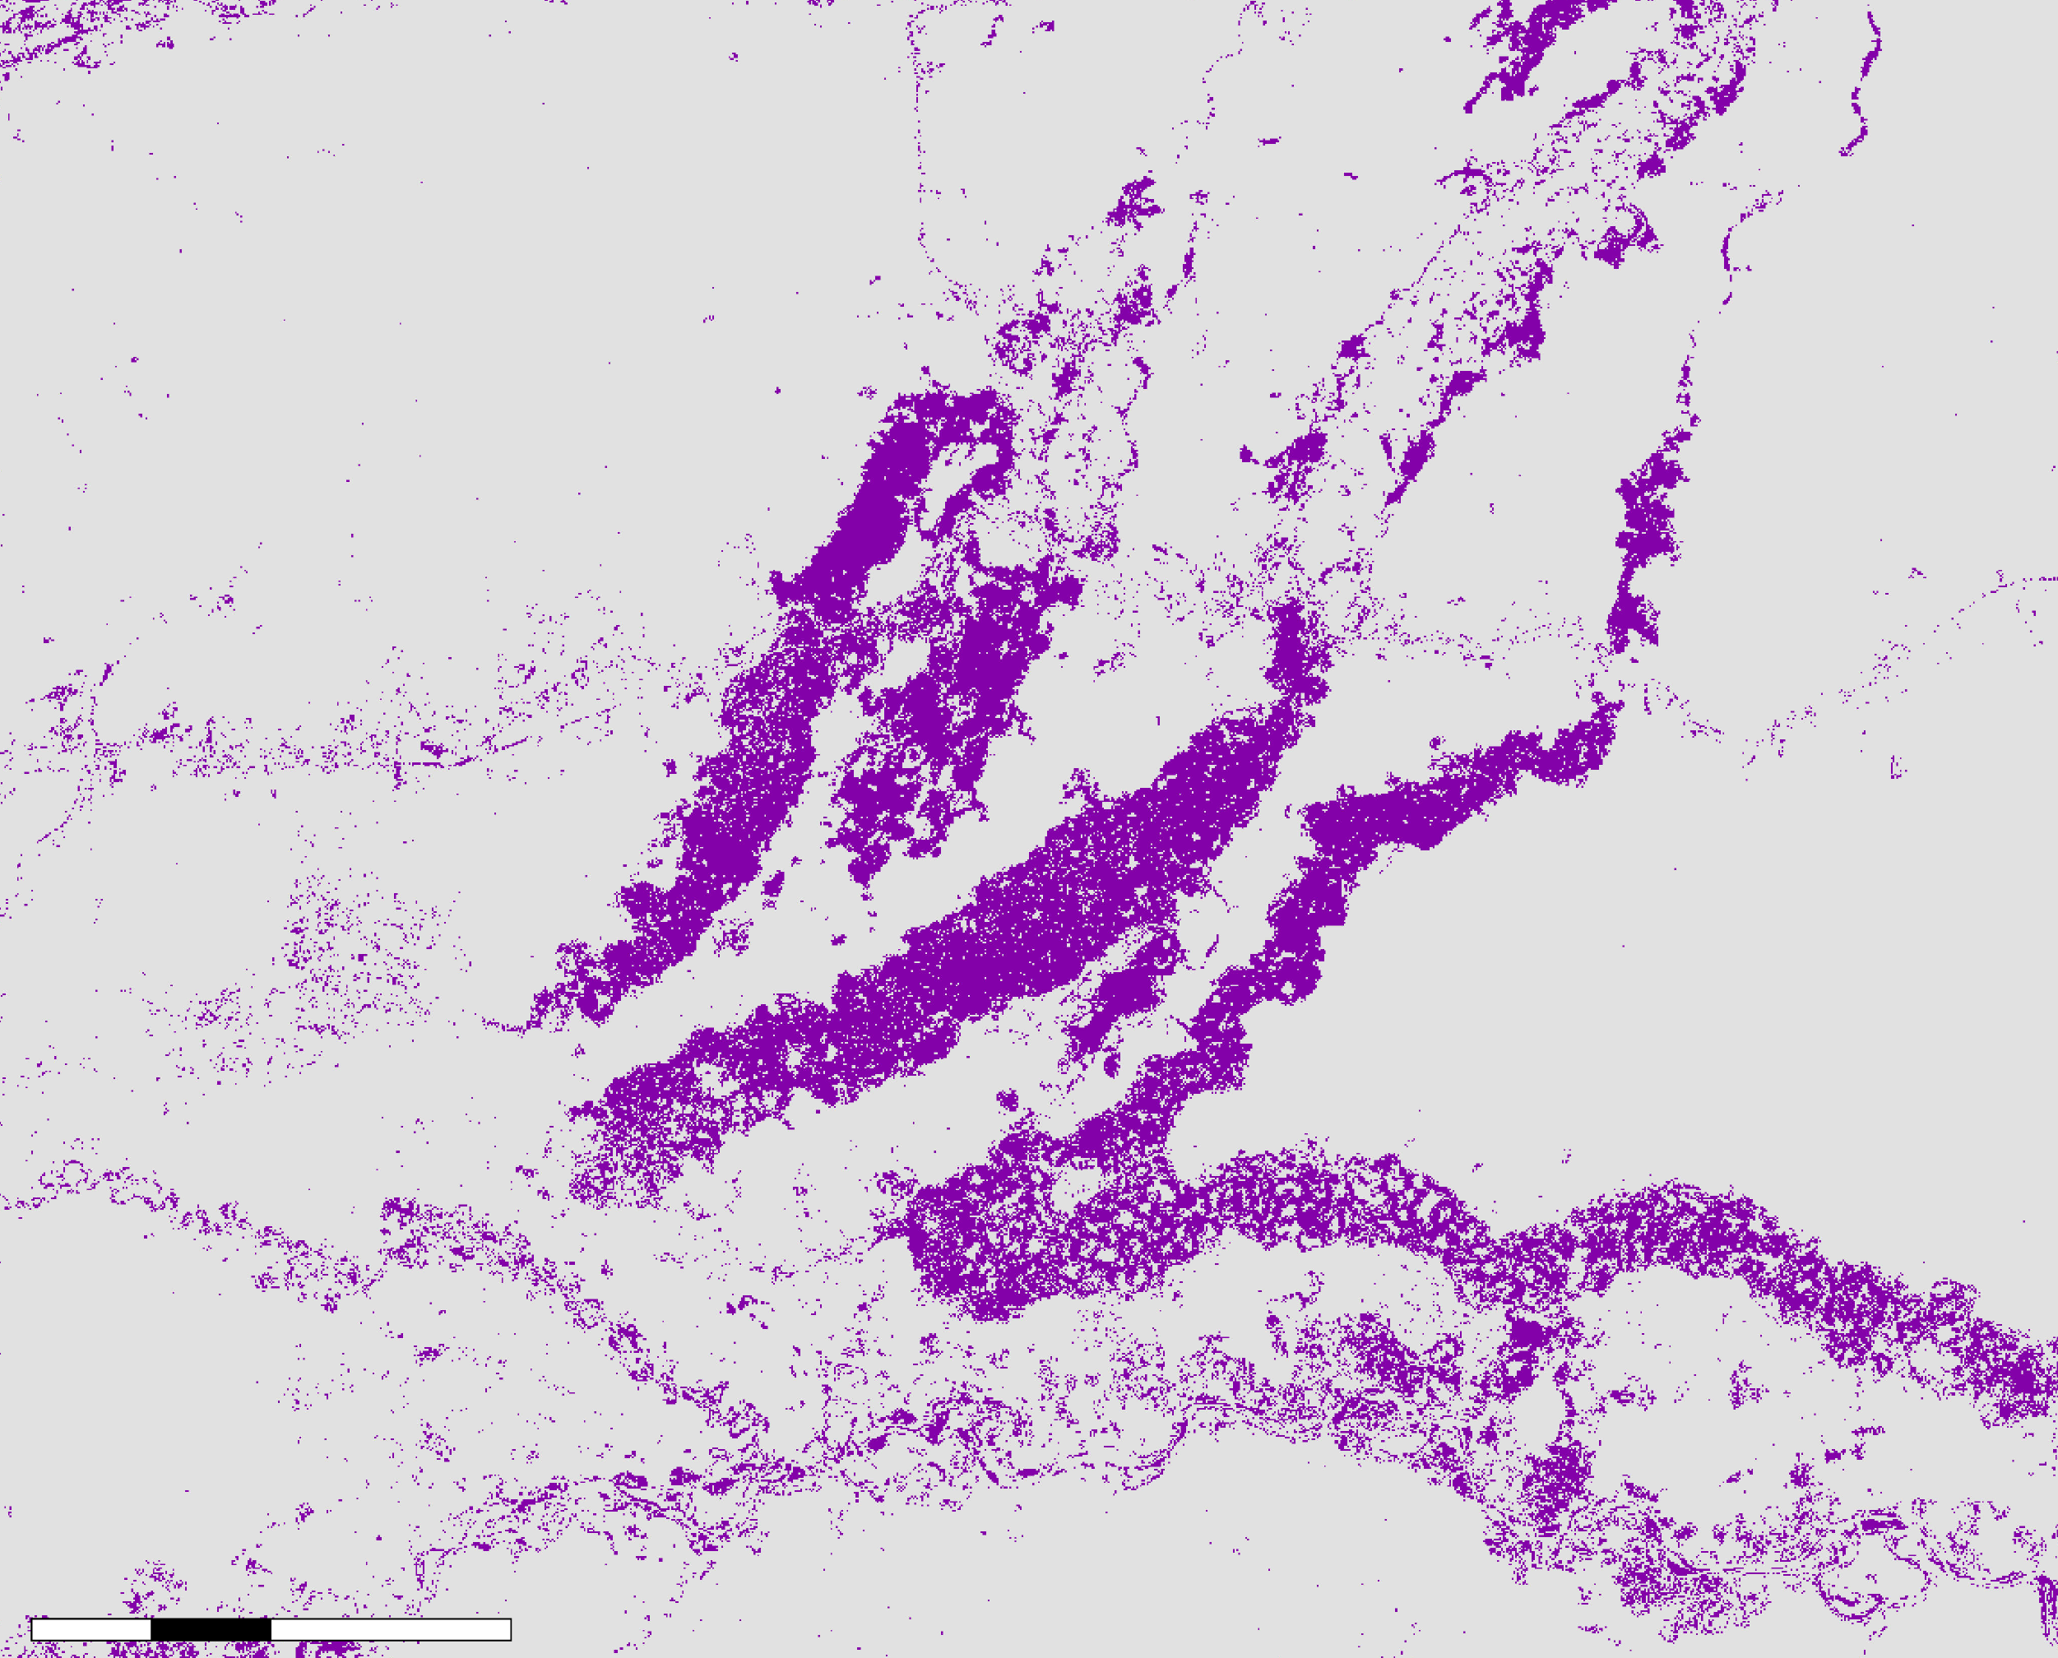
RESULTS: LAND CHANGE ANALYSIS
2010 – 2020
Mining expansion
Key Land Use Changes:
Mining expansion
Urbanization
Forest Loss
New mining areas
2 4 8 km
Notes:
Speaker notes:
From our land change analysis maps we were able to quantify the area within each district that underwent key land use changes during the study period. We calculated transitions to mining, transitions to urbanized areas, and loss of forest for each of Madre de Dios's 11 districts. We calculated these land changes between 2010 and 2015, between 2015 and 2020, and from 2010 to 2020. In this map, we see an example of areas that had transitioned from other land uses to mining between 2010 and 2020. Mining areas are shown in purple while areas that did not transition to mining are shown in gray. The Huepetuhe and Inambari districts had the highest proportion of their area transition to mining during this time; they were also the two districts to experience the greatest proportion of area lost to forest and the greatest proportional increase in urbanized areas.

Slide 19
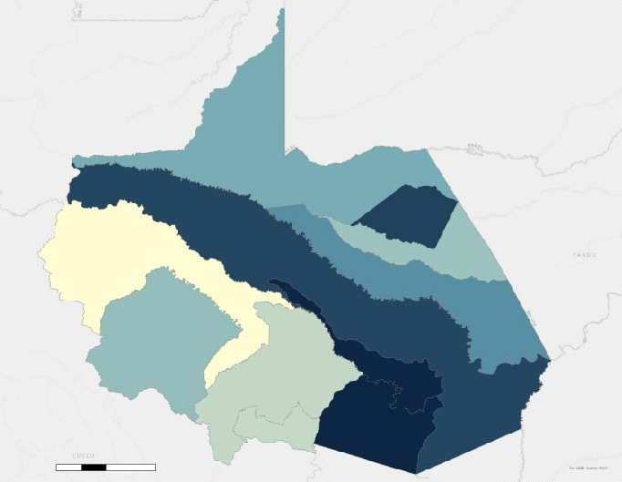
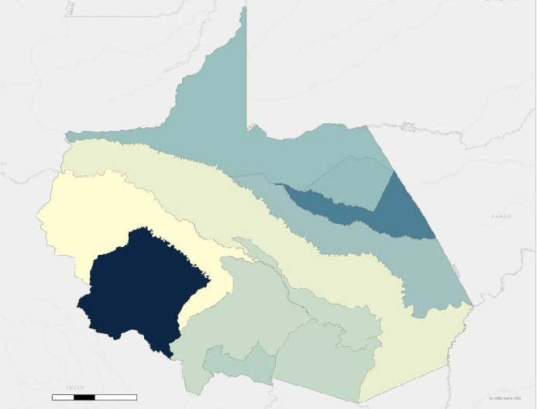
RESULTS: DISEASE INCIDENCE
2020
25
2020
25
Dengue incidence
cases per 1000
Leishmaniasis incidence
cases per 1000
0
0
20 40 80 km
20 40 80 km
Notes:
We examined dengue and leishmaniasis incidence through time across the region. These maps for 2020 show dengue and leishmaniasis incidence by district, controlling for population (cases per 1000 people). Although the distribution does vary by year, the distribution of the two diseases is consistently different, with higher incidence of leishmaniasis in more rural districts and dengue more prevalent in more urbanized districts.
Using these district-level disease incidence results and the district level land change quantifications, we were able to calculate Pearson's correlation coefficients between land changes and disease incidence to determine if key land changes appear to be statistically correlated with disease increases at the district level.

Slide 20
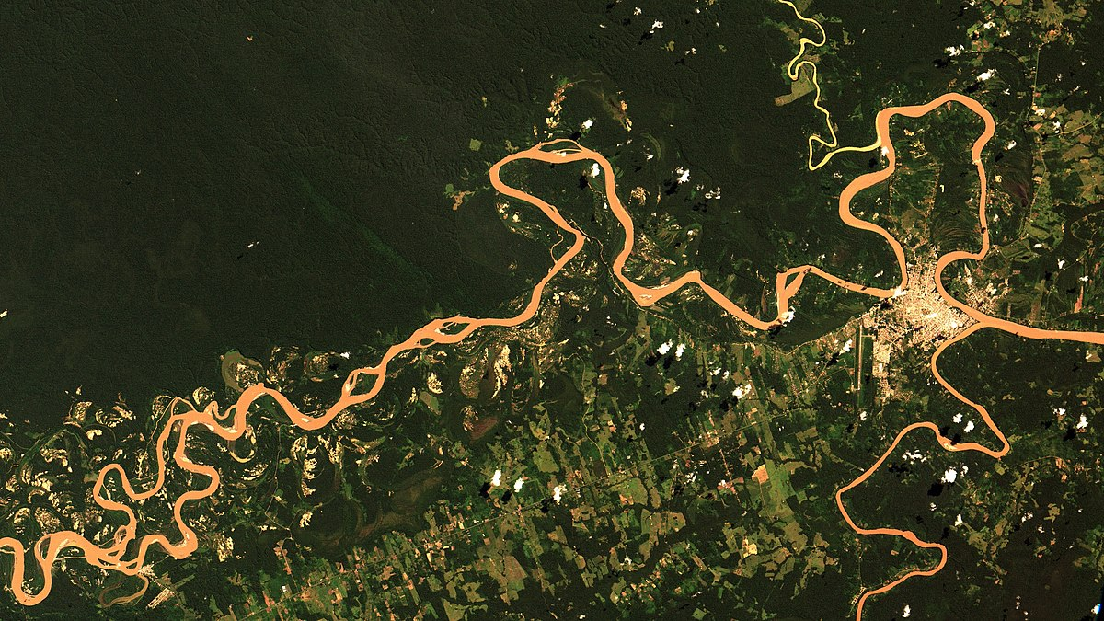
CONCLUSIONS
Increases in mining areas and decreases in forest cover over study period
Districts have different levels of land use change
Highest dengue and leishmaniasis incidence in different areas
Leishmaniasis in more rural/forested areas; Dengue in more urban districts
Dengue has seasonality component
Image Credit: Oton Barros
Notes:
Speaker Notes:
Health data shows that there has been an increase in Dengue since 2000. Different districts are experiencing different levels of land use change. The districts of Inambari and Huepetuhe experienced the greatest transitions to mining and urbanization and the greatest loss of forest. Areas where there are more roads have more land use change particularly changes in mining, urban, agriculture, and pastures. The highest incidents of Dengue and Leishmaniasis occur in different areas. The district with the highest average rate of dengue between 2010 and 2020 when normalized by population was the Inambari district. In contrast, the Manu district experienced the highest average incidence of leishmaniasis over this same time period, when normalized by population. Notably, the Manu district, although rural, was the fourth highest district in terms of forest loss. These outcomes confirm what past studies have suggested, that dengue incidence is typically higher in urbanized areas while leishmaniasis tends to occur when human populations settle near forested areas. Overall, there needs to be more modeling to show correlations between different land use changes and disease outbreaks.
Image Credit: Oton Barros
Image Source: https://www.flickr.com/photos/observacao-da-terra/47901787501
Creative Commons Attribution-Share Alike 2.0 Generic

Slide 21
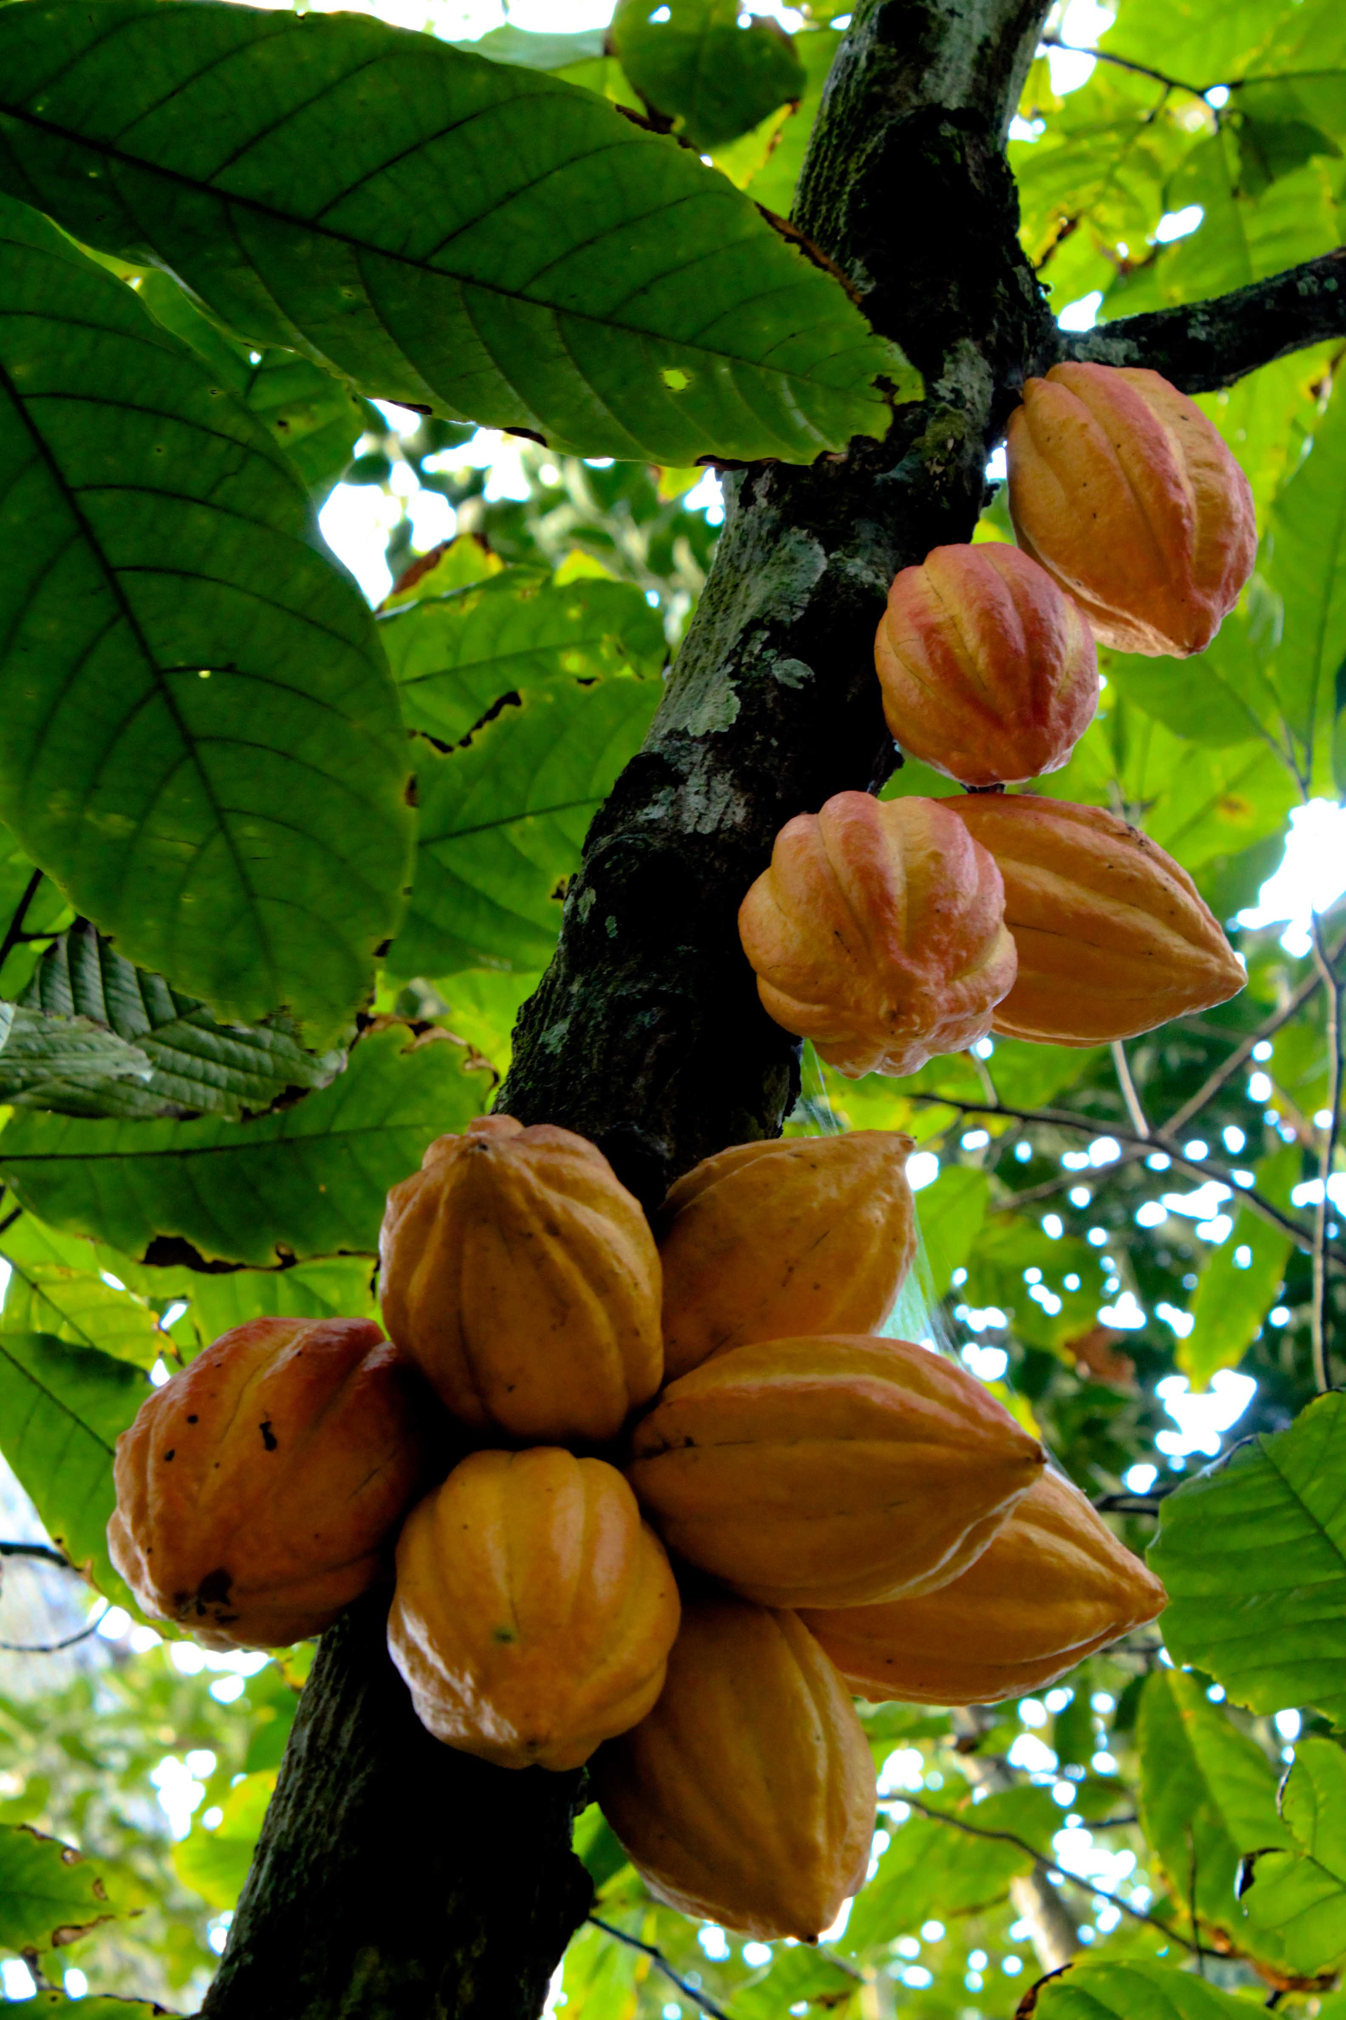
LIMITATIONS AND UNCERTAINTIES
Additional training data to fortify LULC maps
Disease reporting of coarse grain (districts)
Population heterogeneity (temporal and spatial)
Image Credit: Luiso Valles
Notes:
Speaker Notes:
We possibly need a higher resolution imagery to correctly define the classes and have a more accurate result. Perusat offers far more refined resolution and for the future should be considered if we were to focus on smaller areas in Madre de Dios. Other factors we might not be considering are other classes and factors that may paint a better picture surrounding the patterns with disease outbreaks (factors like humidity and temperature). We also need more training data, Random Forest works best with more than hundreds of pixels so it would be beneficial to run these models over more training pixel and multiple times. Because districts cover a relatively large area, aggregating disease reports by district means our spatial resolution is low. It would be helpful if we had more refined data set and disease reports at a smaller scale (like towns/villages). This is compounded by error in population estimates which are unable to account for densely-populated urban areas within otherwise rural districts. Finally, population estimates by district had to be interpolated from the most recent two census counts, which may not fully capture population fluctuations.
Image Credit: Luiso Valles
Image Source: https://commons.wikimedia.org/wiki/File:Matadecacao.jpg
Creative Commons License: Creative Commons Attribution 3.0 Unported

Slide 22
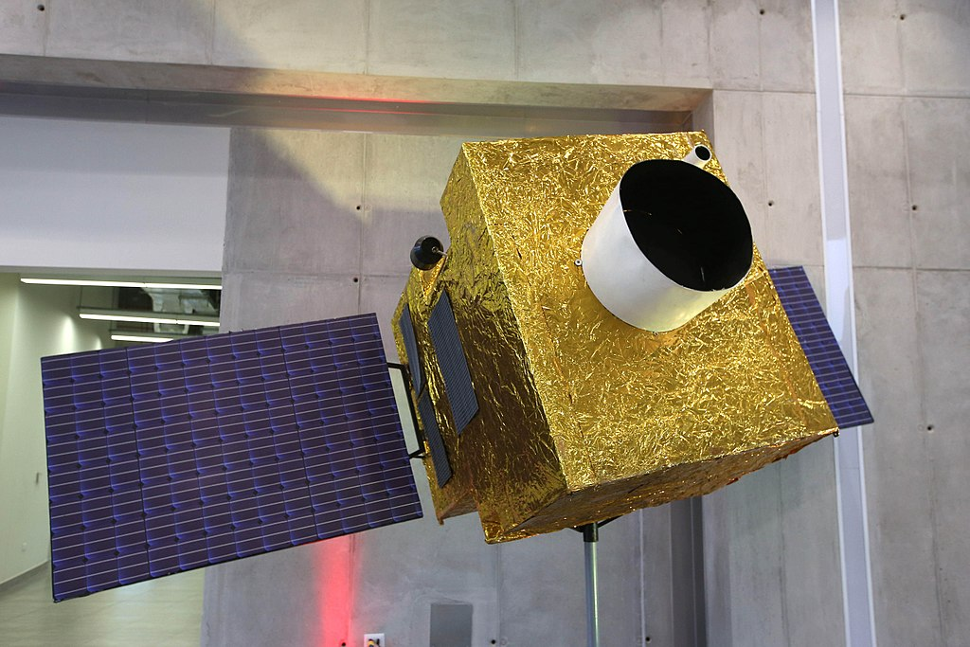
FUTURE WORK
Zoonotic disease risk models
Precipitation, humidity, seasonality, elevation
Extend to other diseases (rabies)
High resolution LULC mapping
PeruSat-1 to map focal areas
Four bands, very high resolution (<3 m)
Agricultural and forest type differentiation possible
Image Credit: Peru Ministry of Defense Gallery
Notes:
Speaker Notes:
Future work in continuation of this project that may be conducted during the second phase later this year includes risk modeling of zoonotic disease incidence. The output LULC maps may be incorporated to correlate certain class transitions over time with incidence of diseases based on the data collected by MINSA. Additional environmental variables can also be included in the risk models to analyze trends that may not be apparent such as humidity, elevation, seasonality, and precipitation. These factors have different relationships with disease incidence, such as Dengue only occurring below an elevation of 1500 meters. This analysis can also be extended to rabies with more comprehensive data on the disease.
Higher resolution mapping using PeruSat-1 may also be a future product capable of delineating crops and agriculture including Brazil nuts, palm oil and cocoa trees, something that isn't possible using the currently available satellite data with lower resolutions.
Image Credit: Peru Ministry of Defense Gallery
Image Source: https://flickr.com/photos/92793865@N07/29430573160
Creative Commons License: Creative Commons Attribution 2.0 Generic

Slide 23
We would like to recognize the valuable support of our partners:
Tatiana Pequeno, William Augusto Llactayo León, Raul Tinoco, Luis Quispe and Germán Marchan (MINAM); César Munayco (MINSA)
Ellen Delgado Florian, Armando Valdez-Vasquez, Camila Llarena Cayo, and Viviana Sánchez-Aizcorbe Hennings - Lab of Ecohealth and Urban Ecology at Universidad Peruana Cayetano Heredia
Sidney Novoa, Milagros Becerra, and Judith Westveer with Asociación para la Conservación de la Cuenca Amazónica (ACCA)
José Pasapera González with The National Commission for Aerospace Research and Development (CONIDA)
Miguel Macedo, Sandra Kathrin Hopfgartner and Andrea Bravo with Instituto del Bel Común (IBC).
We'd also like to acknowledge the support of our advisors Marguerite Madden, Sergio Bernardes and Xiao Feng, and fellow Darcy Gray and additional advising from Daniel Arturo Castillo Soto and Gabriel Carrasco Escobar

Slide 24
Backup LULC Classification Slides

Slide 25
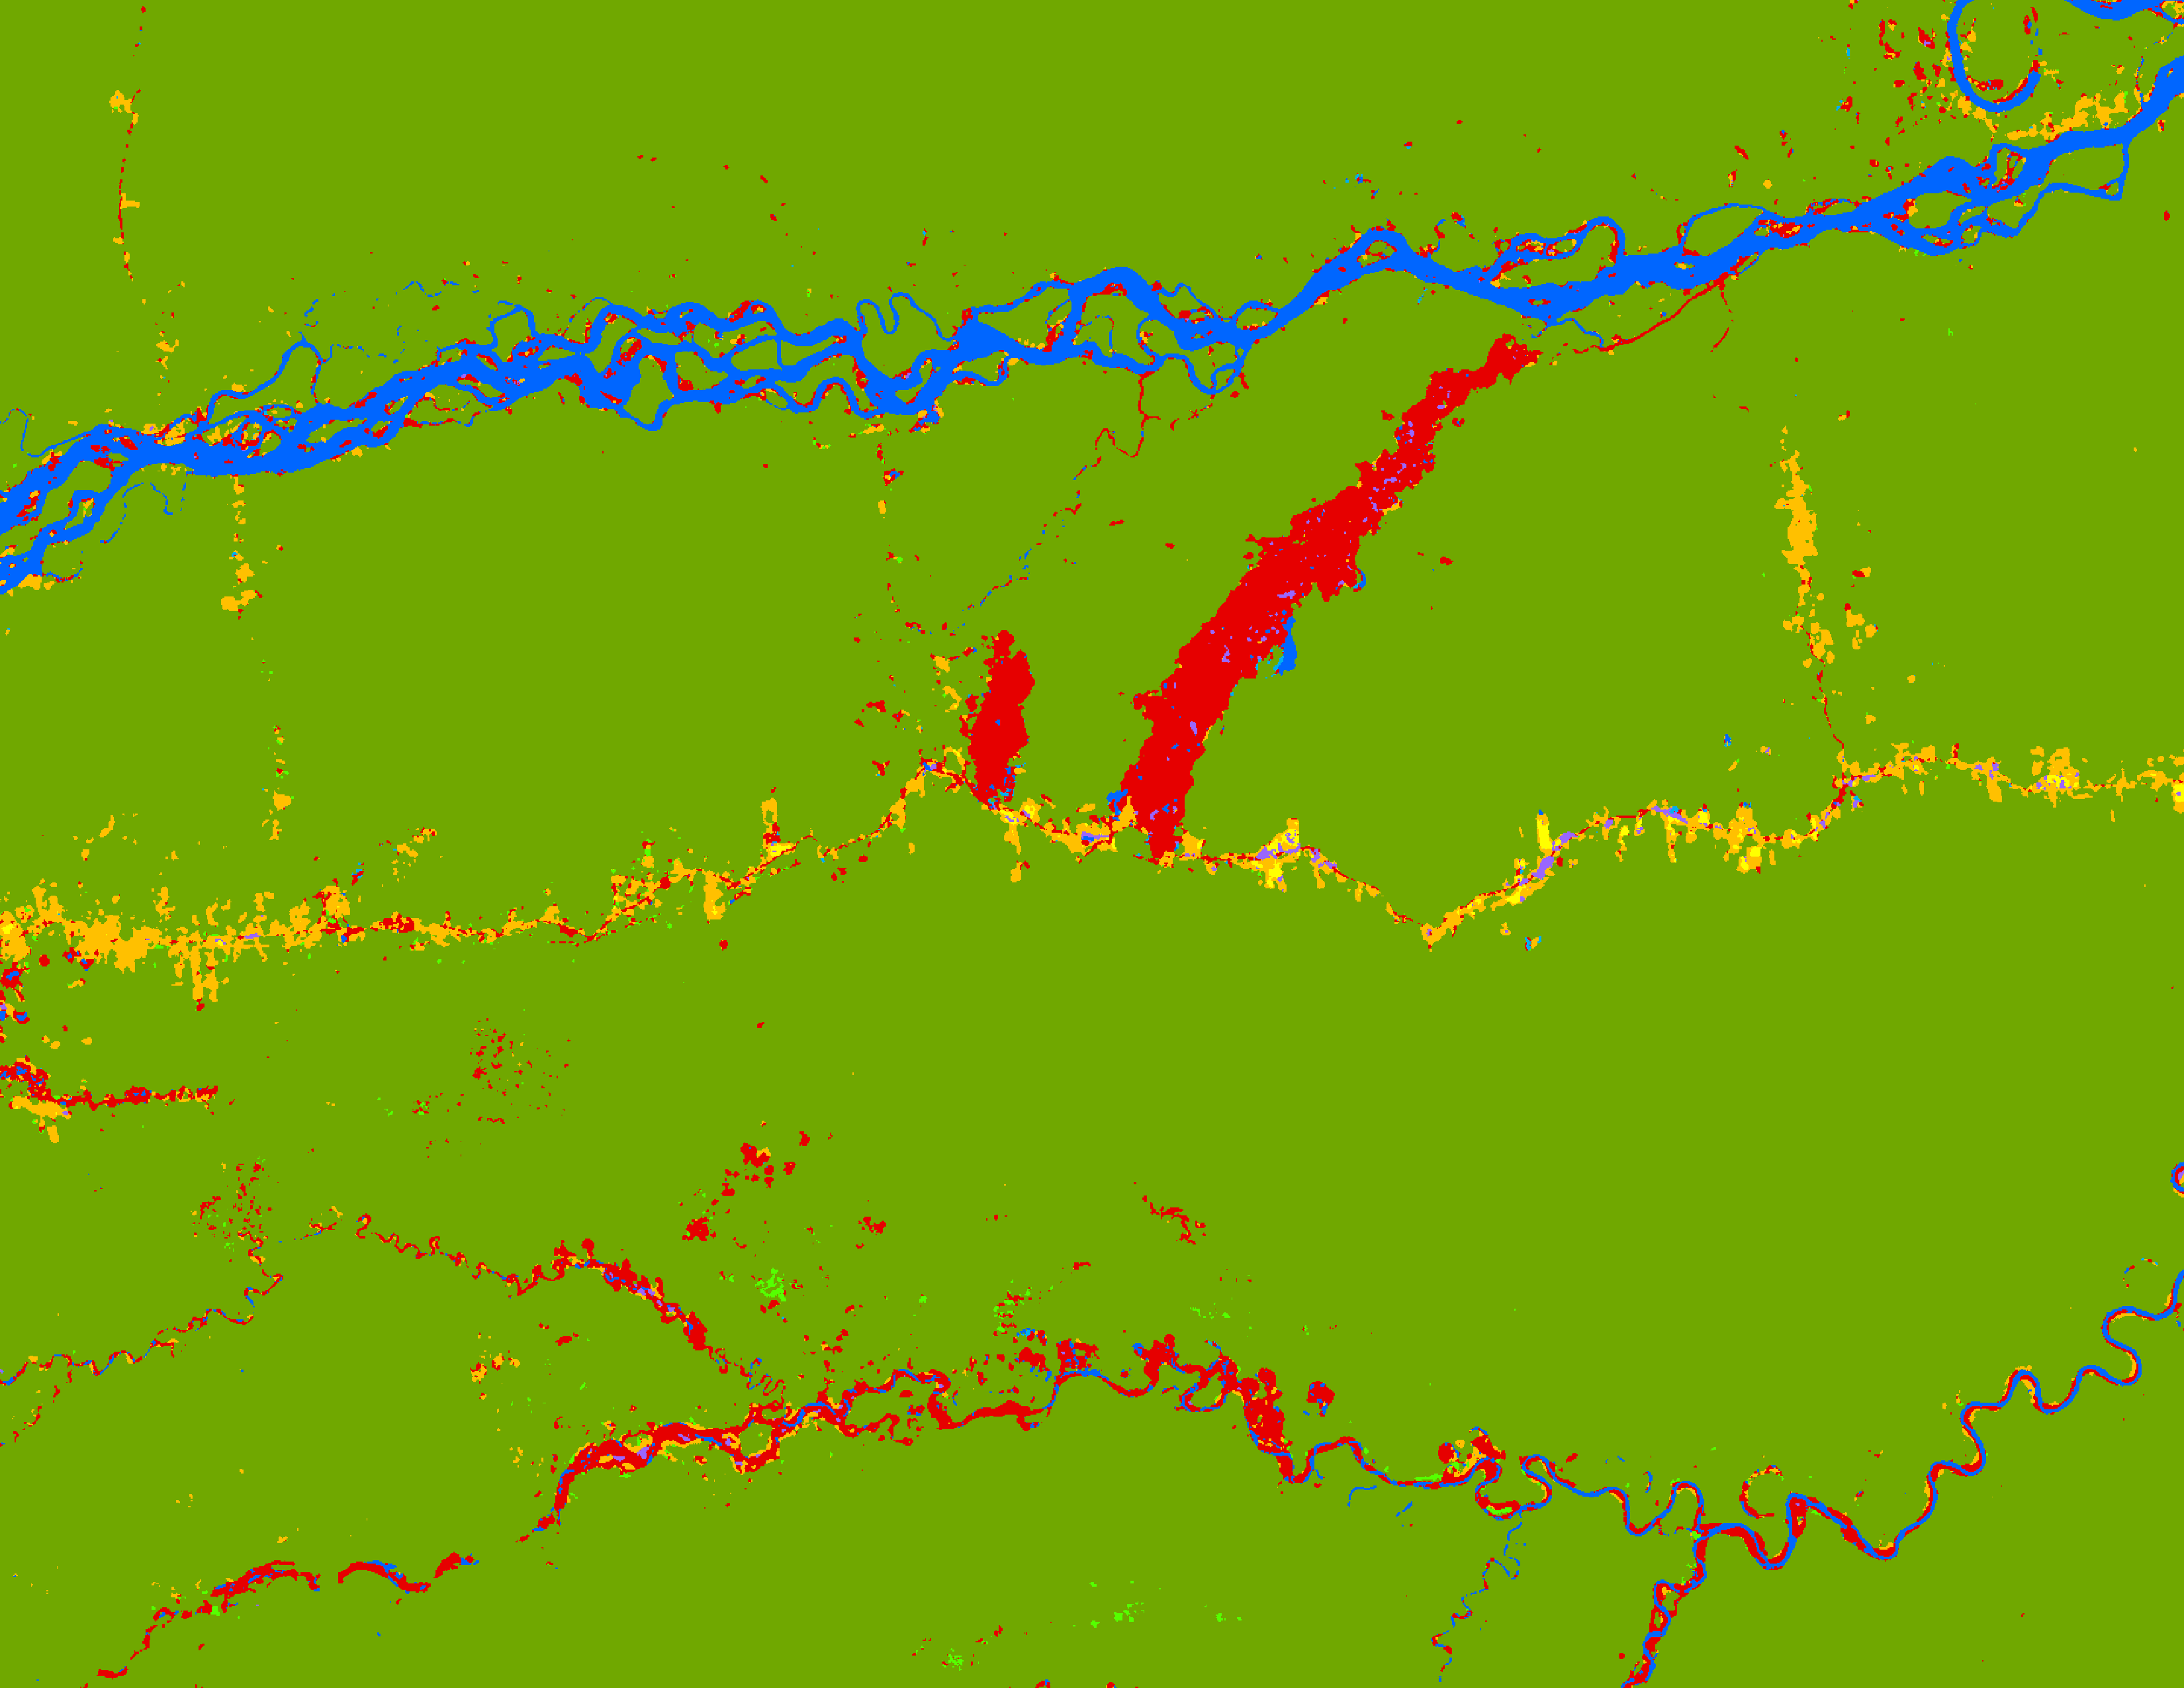
RESULTS: LULC CLASSIFICATION
Mining Areas in La Pampa Region
2010
Land Class
Forest
Secondary Vegetation
Pastures
Agriculture
Mining
Water
Wetlands
Urban
0
4
8
km
Notes:
Speaker Notes:
Individual classified images included in slide 15 for each time step. Here is a classified image zoomed into La Pampa illegal mining area in Madre de Dios for 2010. Urban areas are colored as purple, yellow is agriculture, orange is pastures, blue is water, and light blue are wetlands.

Slide 26
RESULTS: LULC CLASSIFICATION
Mining Areas in La Pampa Region
2010
Land Class
Forest
Secondary Vegetation
Pastures
Agriculture
Mining
Water
Wetlands
Urban
0
4
8
km
Notes:
Speaker Notes:
Highlighted is where you can see the Transoceanic highway that cuts across the Amazon forest

Slide 27
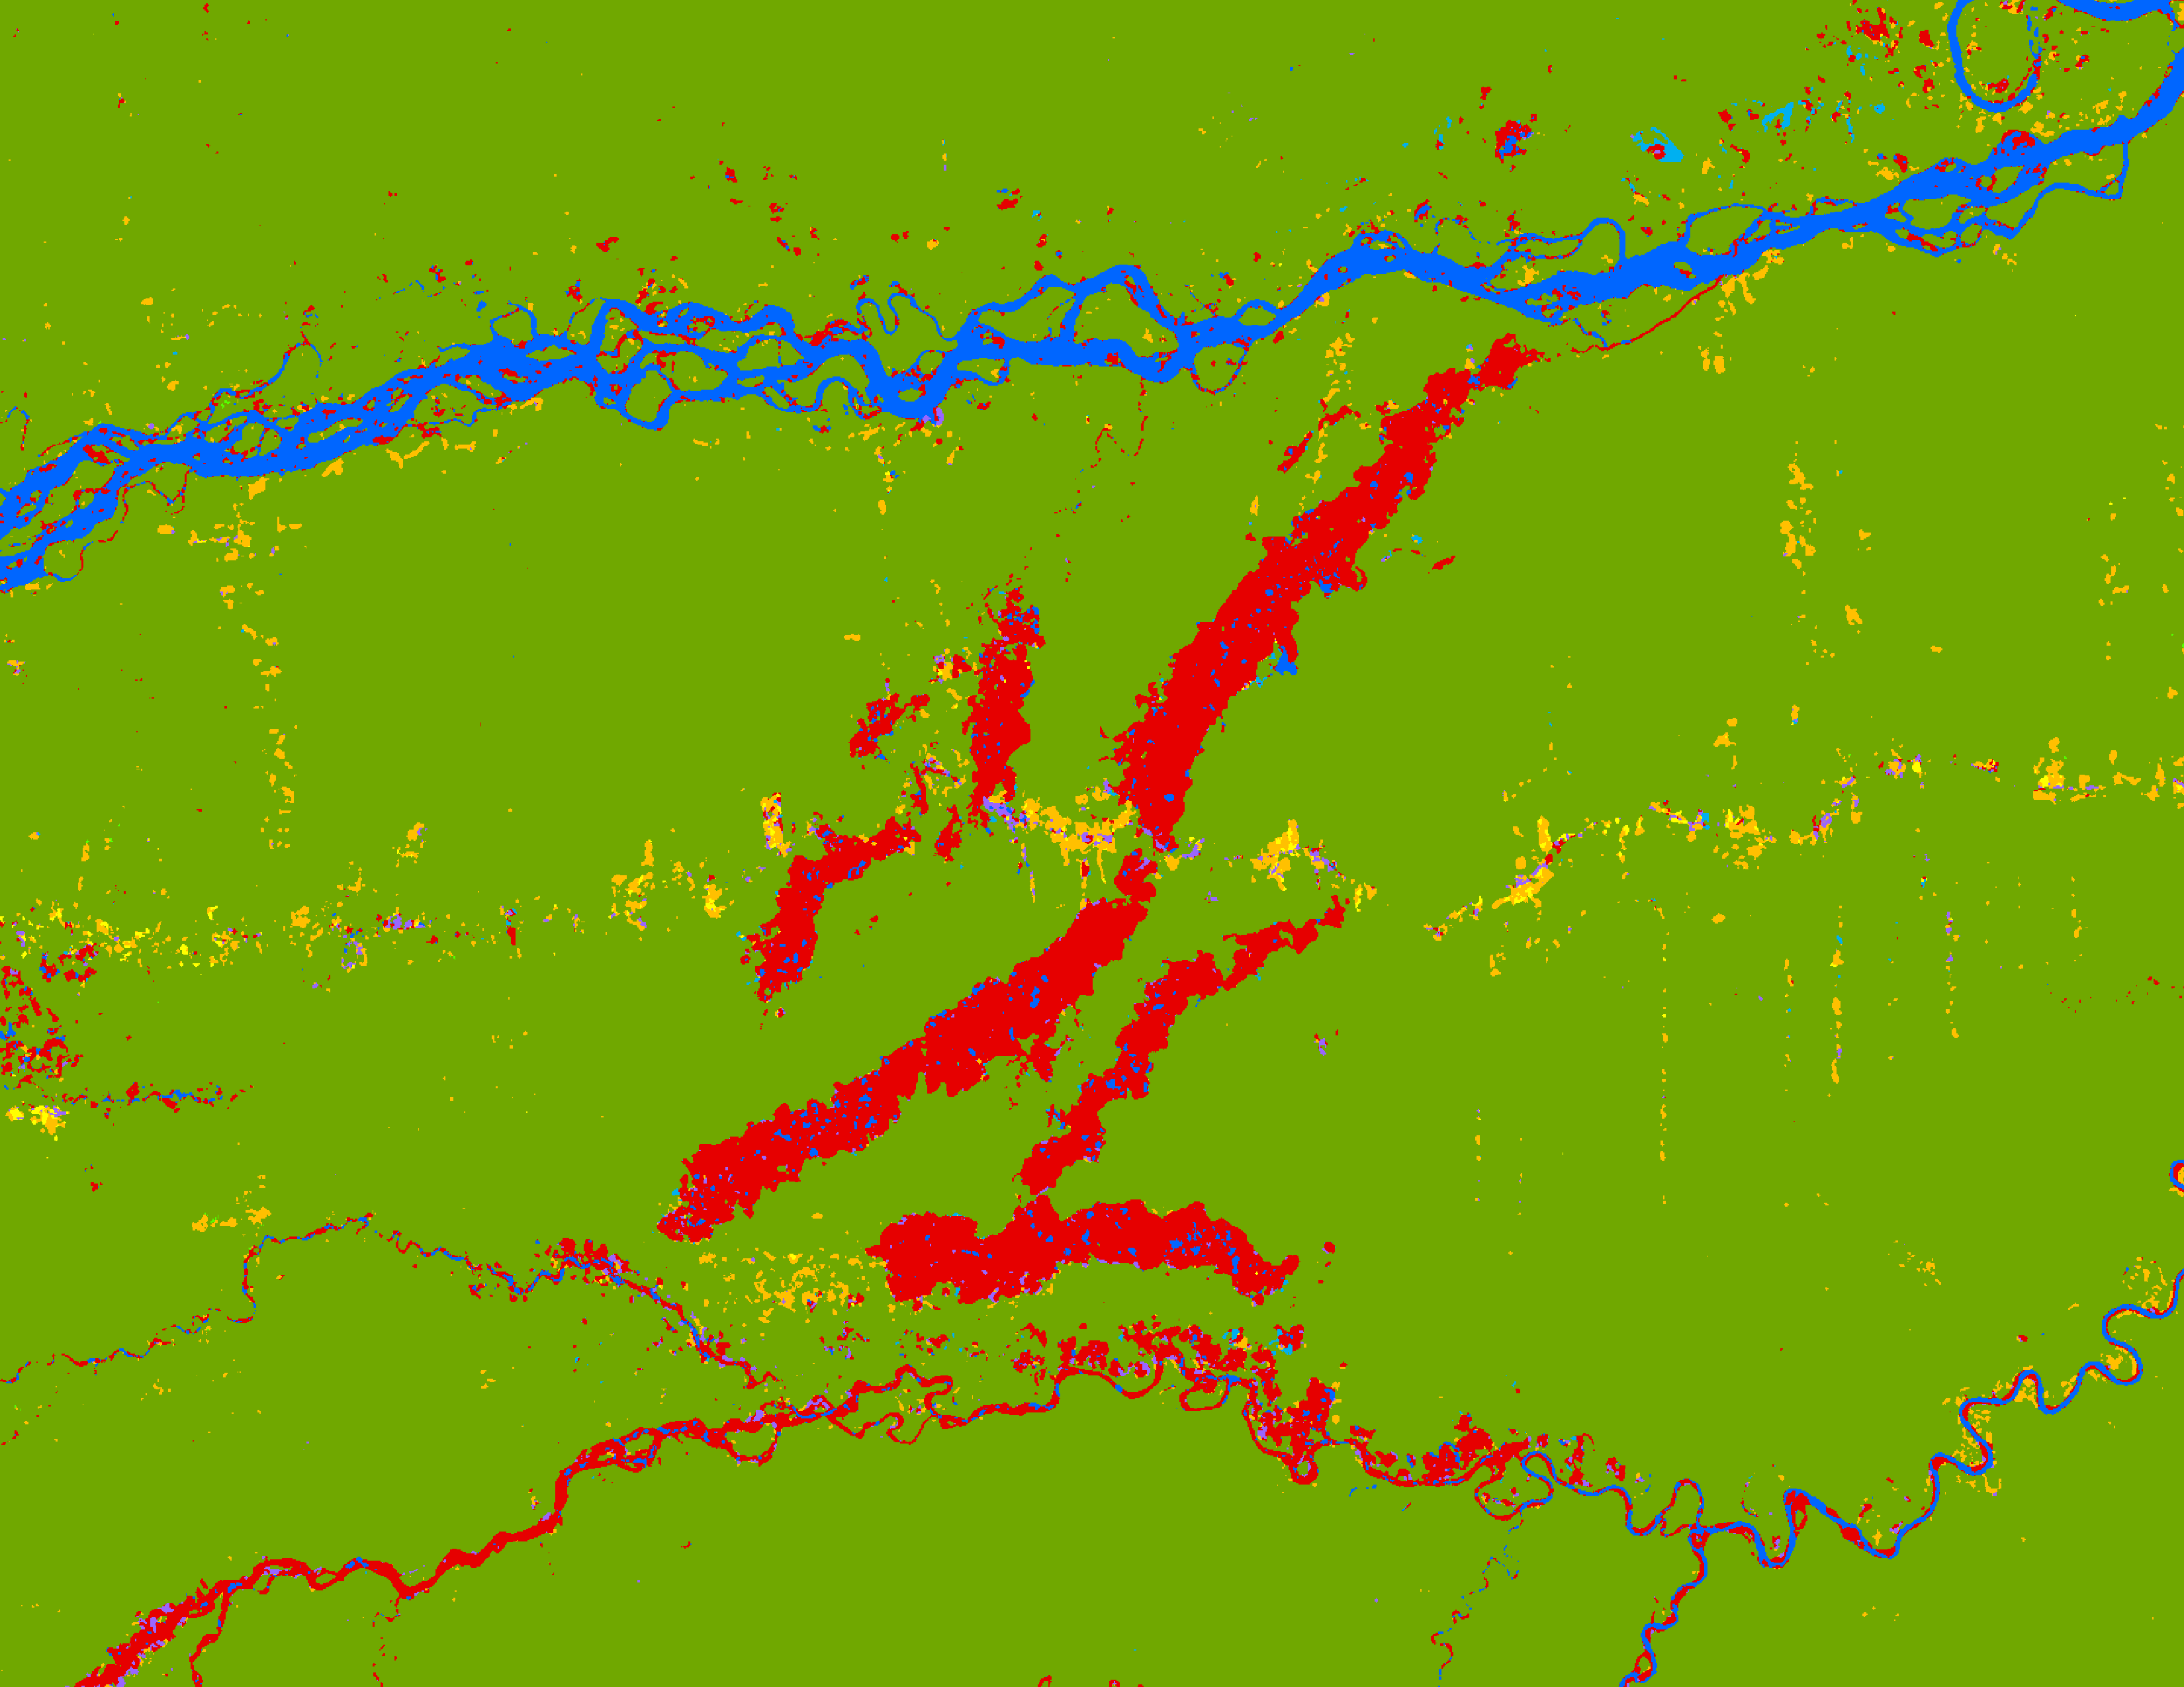
RESULTS: LULC CLASSIFICATION
Mining Areas in La Pampa Region
2015
Land Class
Forest
Secondary Vegetation
Pastures
Agriculture
Mining
Water
Wetlands
Urban
0
4
8
km
Notes:
Speaker Notes:
Individual classified images included in slide 15 for each time step. Here is a zoomed in photo of the La Pampa illegal mining area in Madre de Dios for 2015. In red are the mining areas. Yellow represents agriculture, green represents forest, and blue represents water. We were able to successfully show the changes in mining overtime.

Slide 28
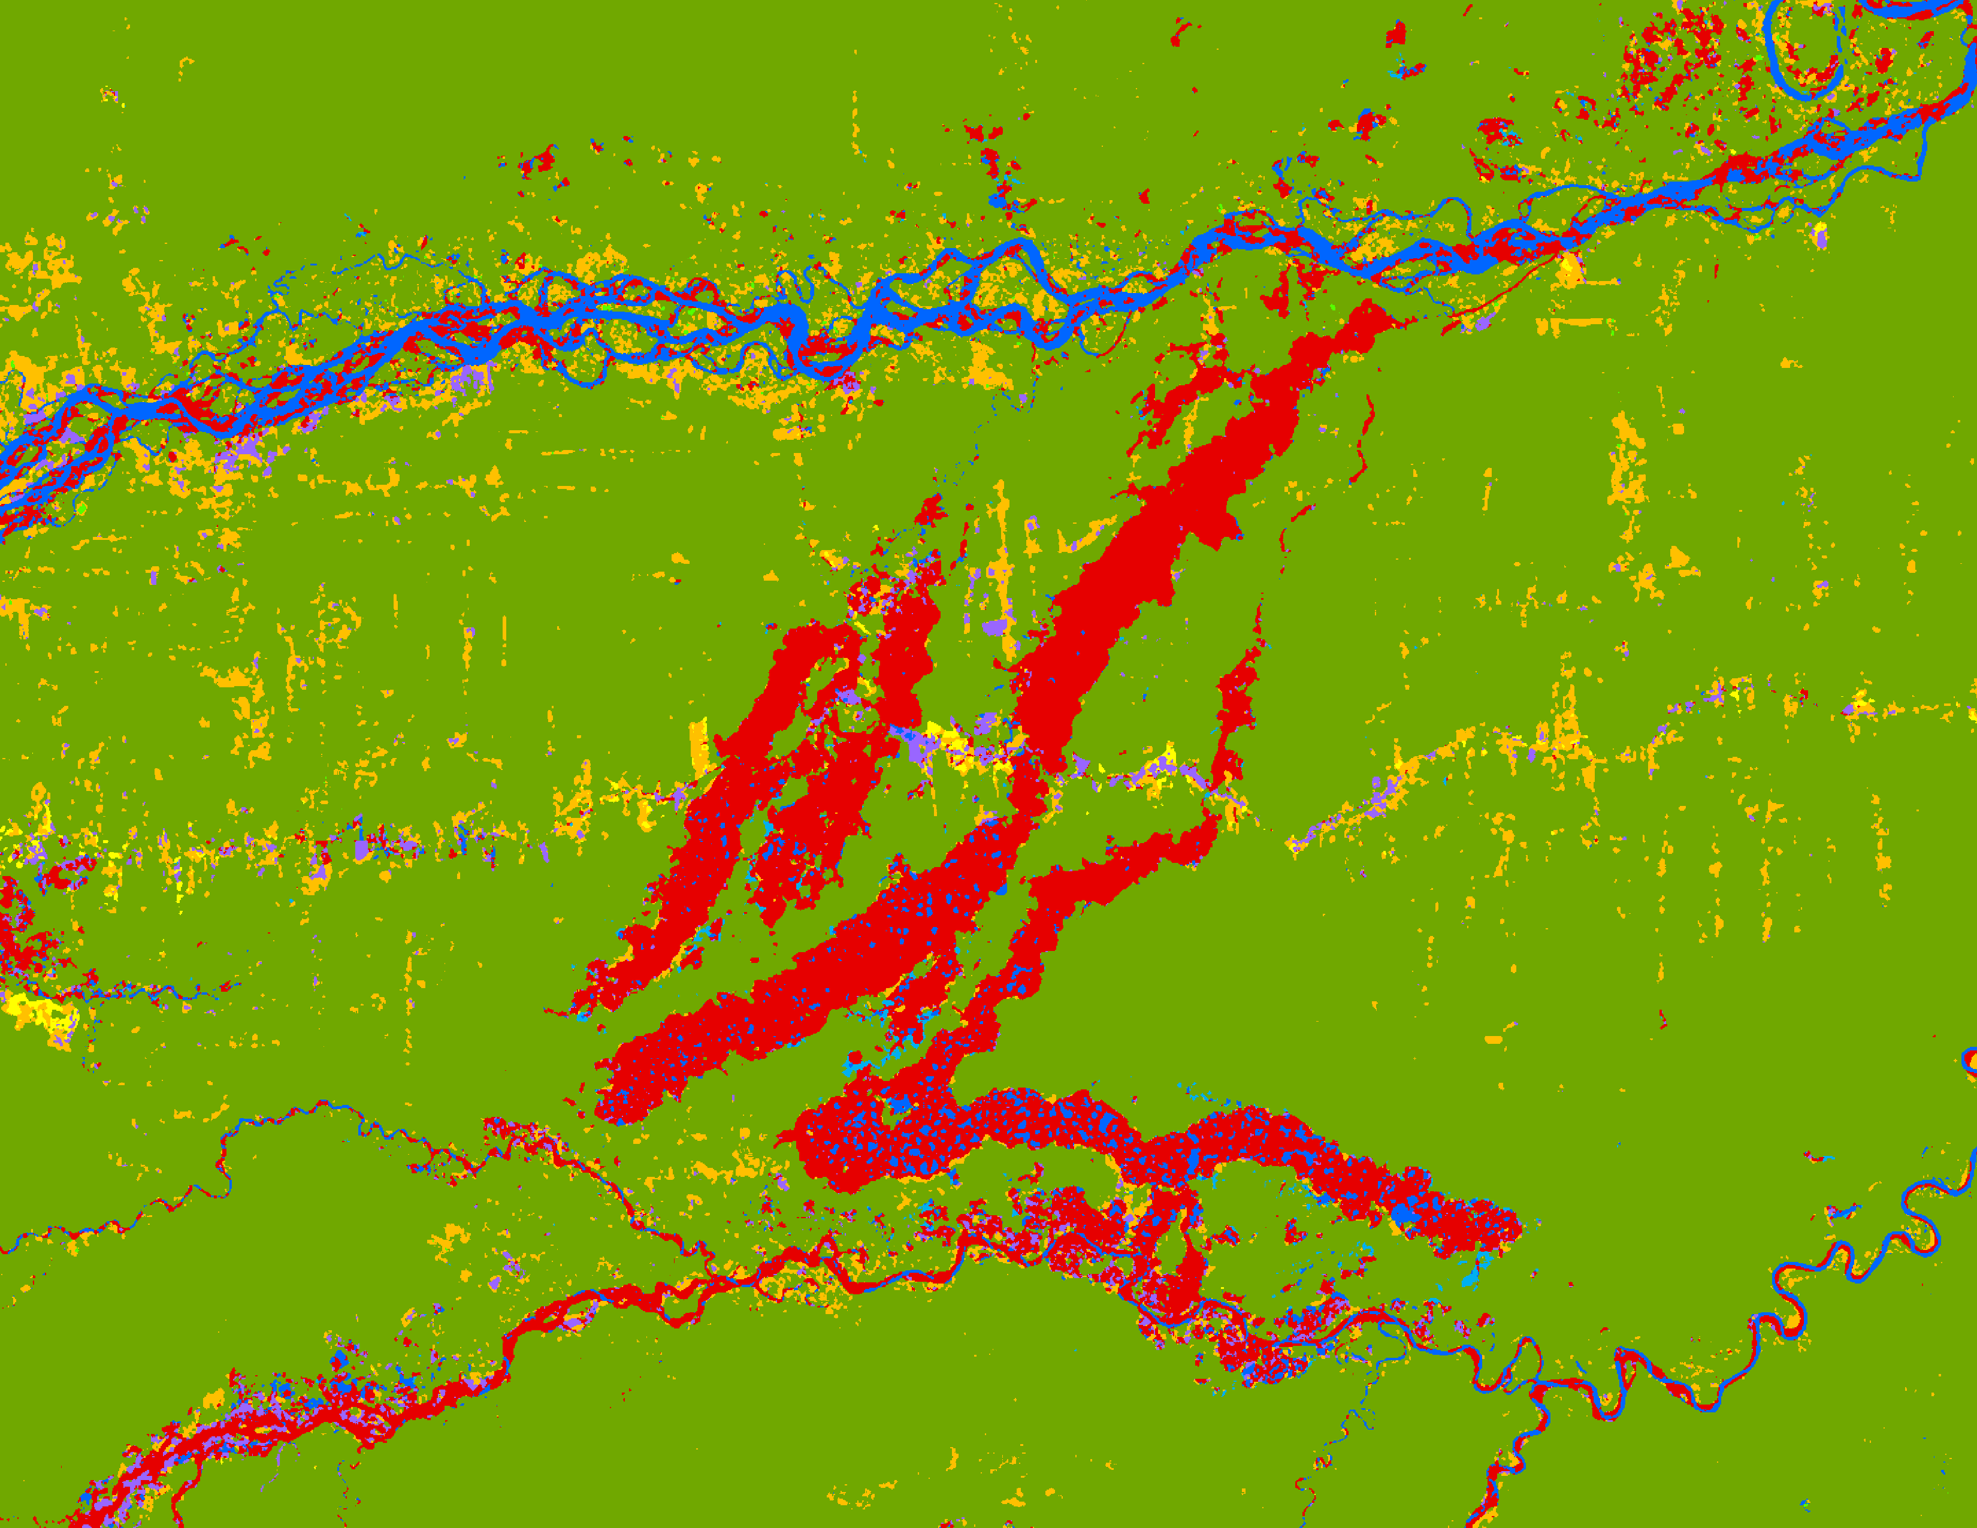
RESULTS: LULC CLASSIFICATION
Mining Areas in La Pampa Region
2020
Land Class
Forest
Secondary Vegetation
Pastures
Agriculture
Mining
Water
Wetlands
Urban
0
4
8
km
Notes:
Speaker Notes:
Individual classified images included in slide 15 for each time step. Here is a zoomed in photo of the La Pampa illegal mining area in Madre de Dios for 2020. In red are the mining areas. Yellow represents agriculture, green represents forest, and blue represents water. We were able to successfully show the changes in mining overtime.

Slide 29
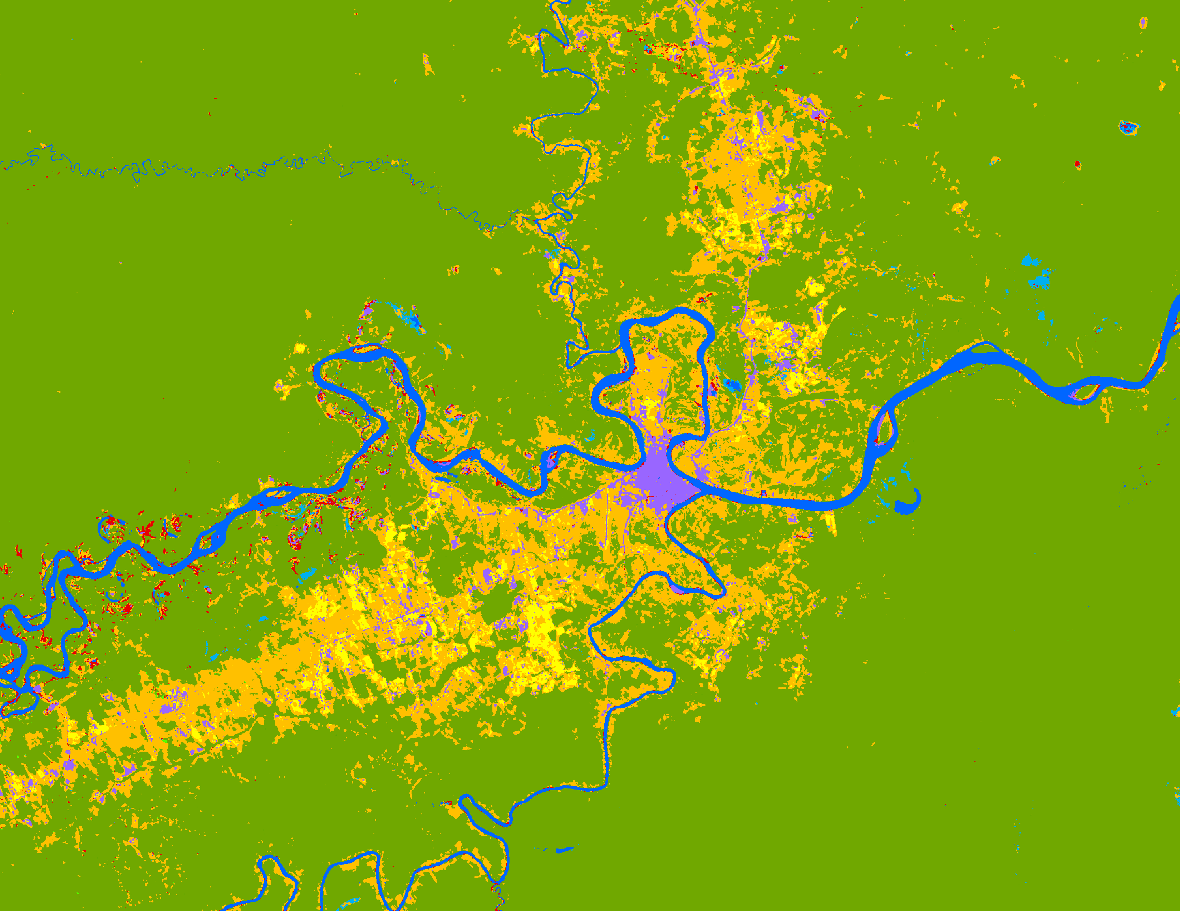
RESULTS: LULC CLASSIFICATION
Puerto Maldonado
2010
Land Class
Forest
Secondary Vegetation
Pastures
Agriculture
Mining
Water
Wetlands
Urban
0
5
10
km
Notes:
Speaker Notes:
Individual classified images included in slide 16 for each time step. Here is a classified image zoomed into Puerto Maldonado, a city in Madre de Dios for 2010. Urban areas are colored as purple, yellow is agriculture, orange is pastures, blue is water, and light blue are wetlands.

Slide 30
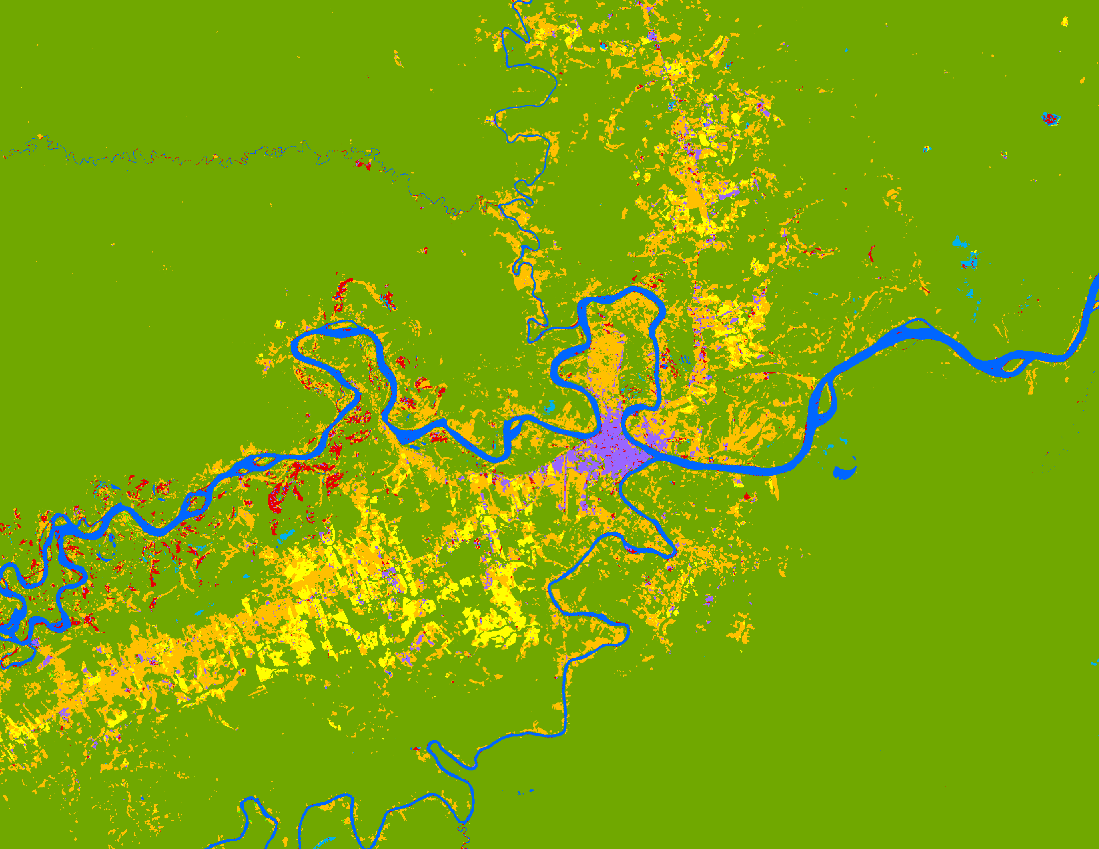
RESULTS: LULC CLASSIFICATION
Puerto Maldonado
2015
Land Class
Forest
Secondary Vegetation
Pastures
Agriculture
Mining
Water
Wetlands
Urban
0
5
10
km
Notes:
Speaker Notes:
Individual classified images included in slide 16 for each time step. Here is a classified image zoomed into Puerto Maldonado, a city in Madre de Dios for 2015. Urban areas are colored as purple, yellow is agriculture, orange is pastures, blue is water, and light blue are wetlands.

Slide 31
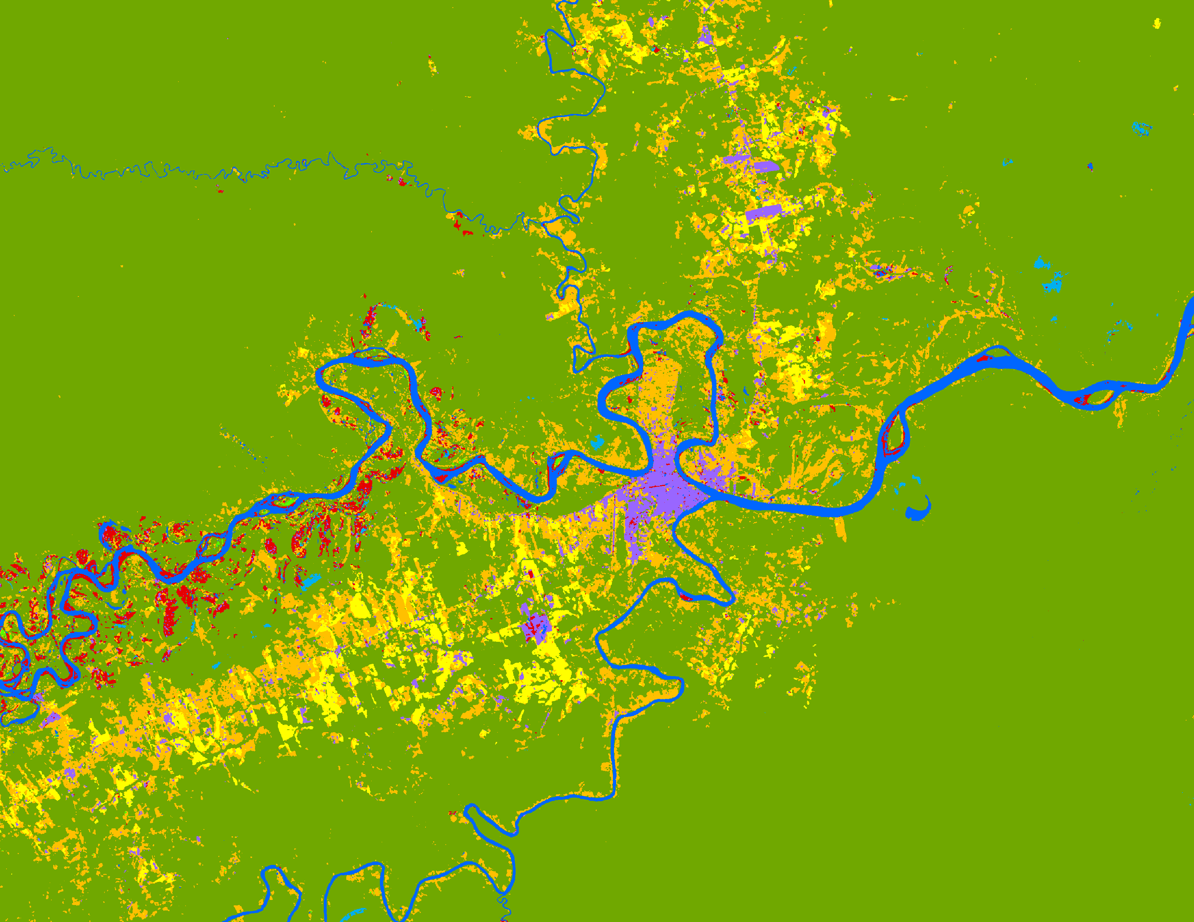
RESULTS: LULC CLASSIFICATION
Puerto Maldonado
2020
Land Class
Forest
Secondary Vegetation
Pastures
Agriculture
Mining
Water
Wetlands
Urban
0
5
10
km
Notes:
Speaker Notes:
Individual classified images included in slide 16 for each time step. Here is a classified image zoomed into Puerto Maldonado, a city in Madre de Dios for 2020. Urban areas are colored as purple, yellow is agriculture, orange is pastures, blue is water, and light blue are wetlands.

