Slide 1
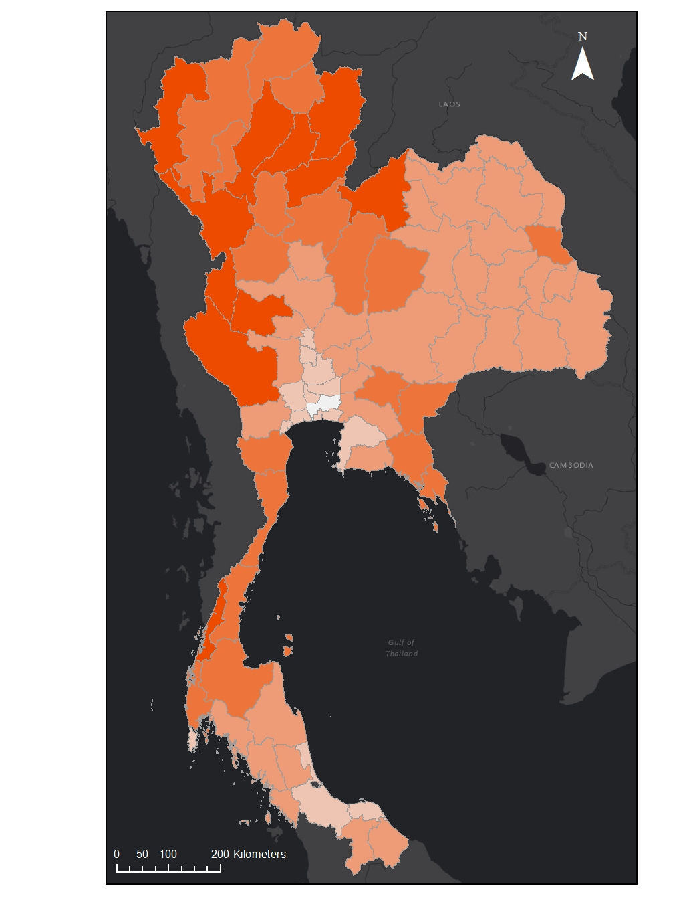
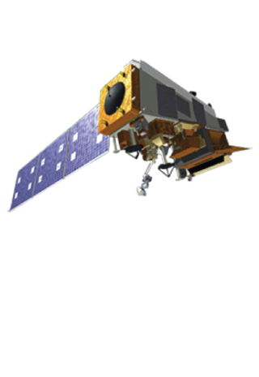
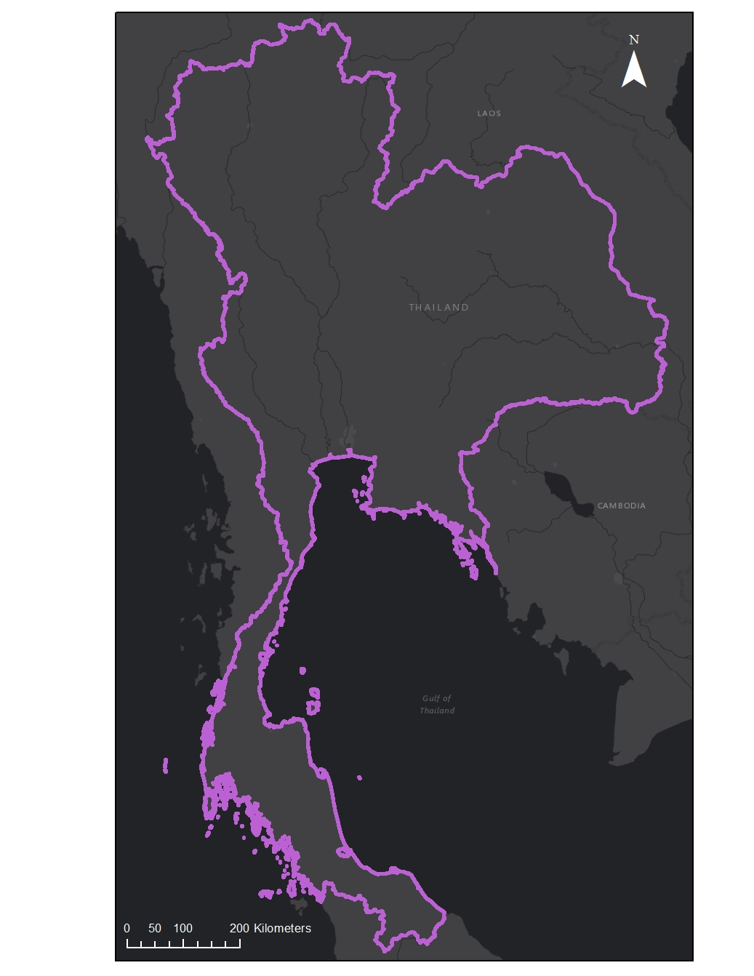
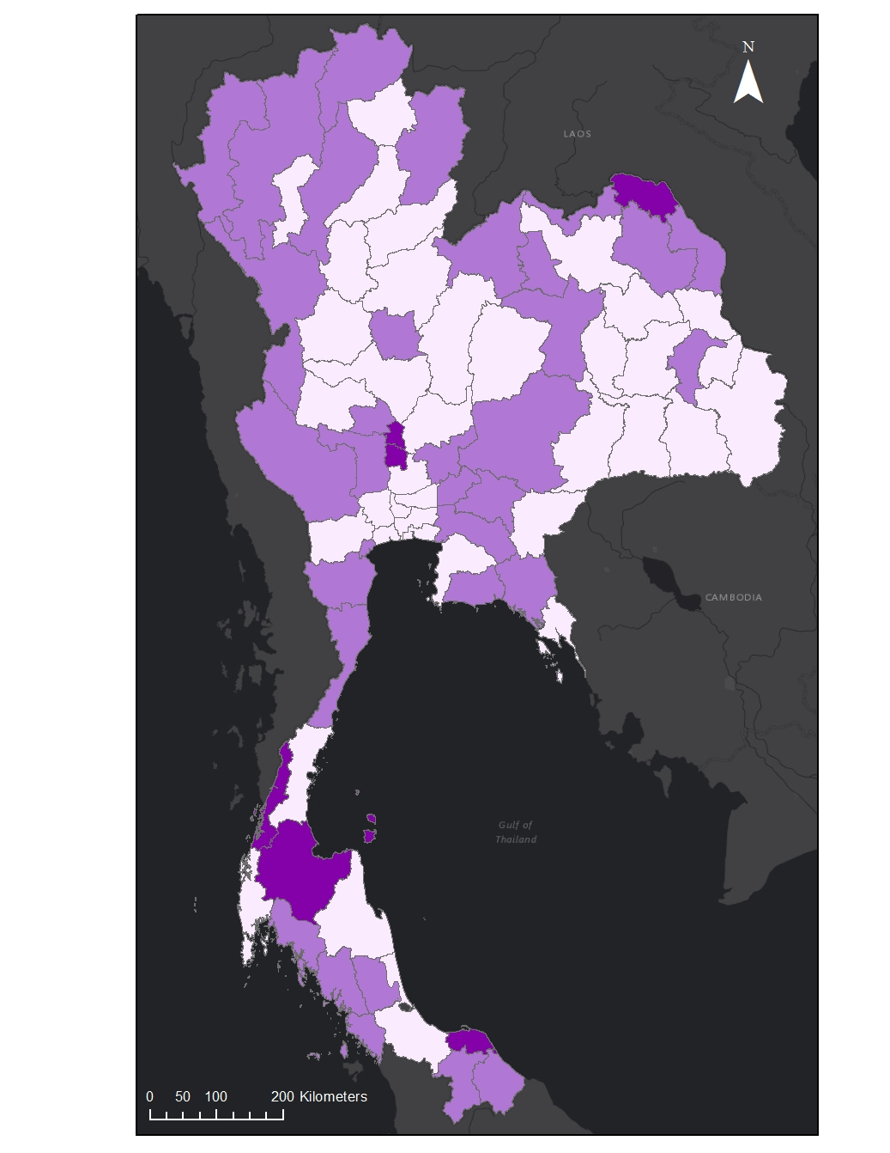
Utilizing Suomi NPP’s Day-Night Band to Assess Energy Consumption and investigate its Suitability as a Proxy for Poverty in Thailand
Abstract
Methodology
While poverty in Thailand has decreased from 67% in 1986 to 13% in 2012, 6.7 million people were still living within 20% of the poverty line in 2014. Economic uncertainty caused by recurring droughts and decreasing agricultural prices puts this vulnerable part of the population at risk of dropping below the national poverty line in the future. In order to address this issue, the DEVELOP team worked with the Office of Science and Technology (OSTC) at the Royal Thai Embassy, Asian Disaster Preparedness Center (ADPC), and the NASA SERVIR Coordination Office to formulate a new method of analyzing poverty within Thailand. This project utilized the monthly composite product for 2013-2015 produced by the Earth Observations Group (EOG) at National Oceanic and Atmospheric Administration (NOAA) and National Geophysical Data Center (NGDC). Additionally, this project incorporated socio-economic data from Thailand’s Ministry of Information and Communication Technology’s National Statistical Office and Ministry of Education’s National Education Information System to create an enhanced poverty index. This new poverty index will provide the Thai government a cost-effective way to analyze changes of poverty within the nation and inform policy making.
Socio-economic
data
Create Poverty Index
Enhanced Poverty Index
Correlate Indices
Suomi NPP VIIRS data
Create Night Time Light (NTL) Index
Explorations
Land Cover Type
Distance from Roads
Distance from Cities
Seasonality
Objectives
Results
Utilize light emissions at night to identify where poverty occurs in Thailand
Explore how night-time light intensity varies depending on factors such as seasons, distance from roads, distance from cities, and type of land cover
Produce enhanced poverty indices to help inform and support poverty reduction and aid efforts
Poverty Map Using Night-Time Light
The Poverty Map Using Night-Time Light (left) illustrates the predicted poverty on the provincial level. The rank of most impoverished to least impoverished was determined using the intensity of night-time light emissions and population within each province. The night-time light analyzed in this map is a weighted average covering all months in the study period.
Earth Observations
Study Area
Suomi NPP VIIRS
Thailand Cross-Cutting
Poverty Rank
Comparison Map
1- Least Impoverished
2
3
4
5 – Most Impoverished
Study Period
Area of Interest
The Comparison Map (right) explores the error of using night-time light as a proxy for poverty on the provincial level. It illustrates the absolute difference between the poverty rank as defined by socio-economic factors and the poverty rank as predicted by night-time light emissions during the study period.
Difference
Thailand
0
January 2013-December 2015
1
Acknowledgements
2
Dr. Jeffrey Luvall (NASA at NSSTC)
Dr. Robert Griffin (University of Alabama Huntsville)
Eric Anderson (NASA SERVIR Coordination Office)
Leigh Sinclair (University of Alabama Huntsville/Information Technology & Systems Center)
Kel Markert (NASA SERVIR Coordination Office)
Petter Cutter (Asian Disaster Preparedness Center)
Peeranan Towashiraporn (Asian Disaster Preparedness Center)
Gam Bunyakiat (Royal Thai Embassy)
Dashiell Cruz (NASA DEVELOP at MSFC)
Kittiphong Phongsapan (Asian Disaster Preparedness Center)
Dan Irwin (NASA SERVIR)
Conclusions
Night-time light is proven to be an indicator for poverty. The correlation coefficient between the poverty index and the night-time light index is 0.8277.
Summer has the highest night-time light intensity, while winter has the lowest.
Light intensity decreases as distance from city centers and roads increases.
Land cover classes have different average night-time light intensities. Forest is the least bright and urban is the brightest.
Due to differences in average light intensity between provincial and district levels, future work could include analysis using socioeconomic data at a higher resolution.
Team Members
Project Partners
Helen Baldwin
Team Co-Lead
Maggi Klug
Team Co-Lead
Krisda Tapracharoen
Chayanan Nan Visudchindaporn
The Royal Thai Embassy
Asian Disaster Preparedness Center (ADPC)
NASA SERVIR Coordination Office
NASA Marshall Space Flight Center – Summer 2017

