Slide 1
Atlanta Water Resources
Identifying Key Urban Areas to Reduce Stormwater Runoff and
Maximize Conservation Efforts in Metropolitan Atlanta
Christopher Cameron (Project Lead)
Jason Reynolds Wenjing Xu
Beatriz Avila
Alex Smith
Veronica Fay
Jacob Spaulding
Notes:
Hello, we are the Atlanta Water Resources Team.
This was the first term of a 2-term project with The Nature Conservancy of Georgia and the UGA DEVELOP Node. This term, the project focused on identifying key urban areas in metro Atlanta that would be ideal for reforestation and conservation efforts, which will not only help maximize the Nature Conservancy’s conservation efforts, but will reduce harmful volumes of stormwater runoff in Atlanta as well.

Slide 2
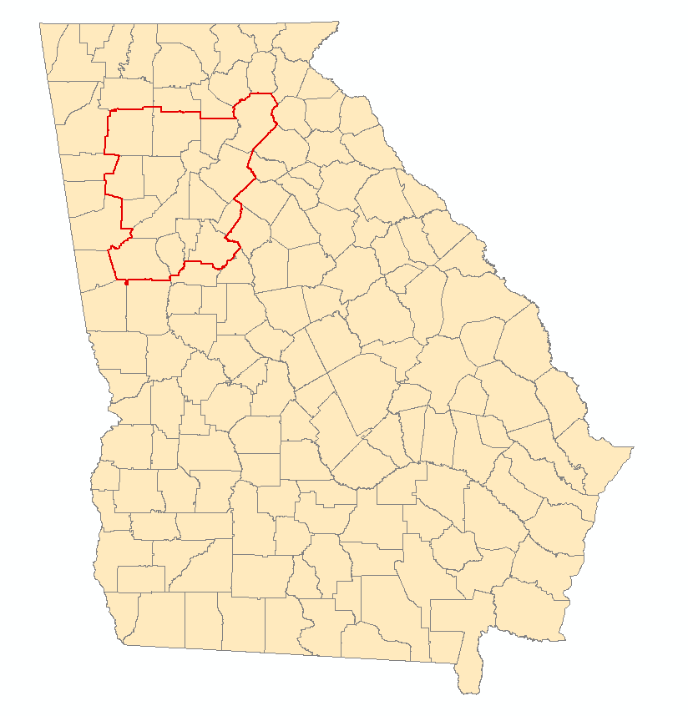
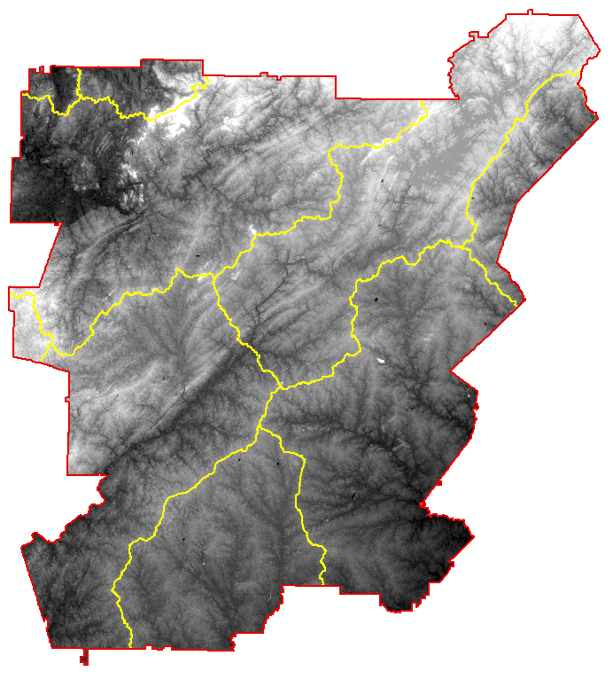
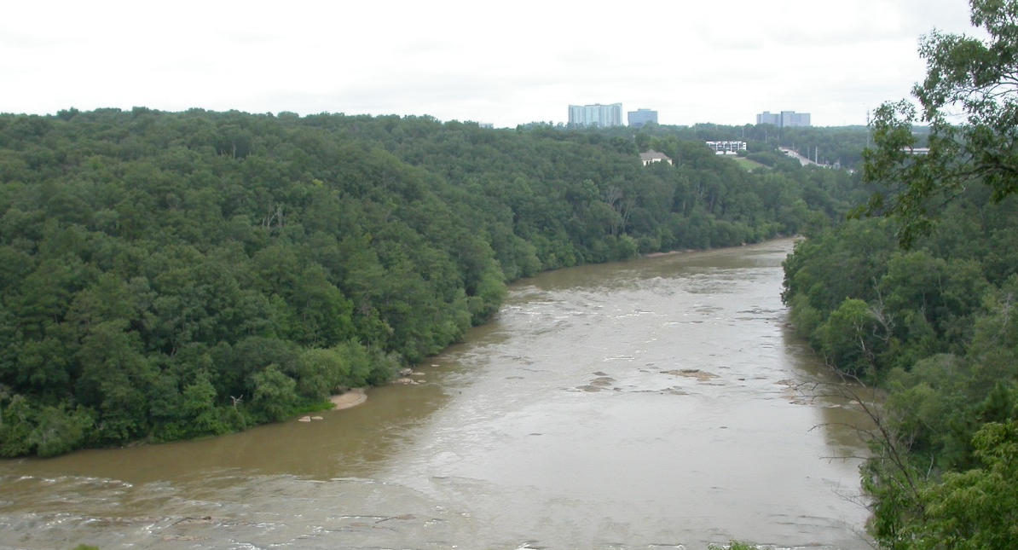
Study Area & Period
Metropolitan North Georgia Water Planning District (MNGWPD)
15 counties
9 major watersheds
Contains the greater Atlanta area
Population of approximately 5.2 million (U.S. Census, 2010)
Atlanta
Upper Chattahoochee
Etowah
Middle
Chattahoochee
Ocmulgee
Flint
Image Credit: David Cotten
Notes:
The study area focused on the Metropolitan North Georgia Water Planning District (approx. 12k km²), which was composed of the following 15 counties in GA: Bartow, Cherokee, Clayton, Cobb, Coweta, DeKalb, Douglas, Fayette, Forsyth, Fulton, Gwinnett, Hall, Henry, Paulding, and Rockdale. Nine major watersheds that cross/are contained in the MNGWPD are: Upper Chattahoochee, Middle, Chattahoochee, Upper Ocmulgee, Flint, Upper Tallapoosa, Etowah, Upper Oconee, Coosawattee, and Oostanaula.
It is notable to mention that our study area also contained the city of Atlanta , as it is one of the largest and most populated cities in the USA.
Our study period spans from 2001- 2015 . This timeframe allowed us a sufficient data collection period, and it also documented the pattern in Atlanta’s growth around and after the time of the 2008 national recession.

Slide 3
Objectives
Identify reforestation targets to help reduce harmful stormwater runoff
Analyze watershed processes using the Soil Water Assessment Tool (SWAT)
Model multiple land allocation scenarios for reforestation purposes using the Land Use Conflict Identification Strategy (LUCIS)
Image Credit: David Cotten
Notes:
The objectives of this project were designed to assist The Nature Conservancy with their on-going work in the Atlanta region and to provide a spatial analysis for their proposed reforestation efforts. We accomplished our objectives by identifying prime reforestation targets to help reduce harmful stormwater runoff and by modeling multiple land allocation scenarios for reforestation purposes using the Land Use Conflict Identification Strategy, or LUCIS model.
Initially, we intended to simulate and characterize the hydrological processes of the MNGWPD watershed and identify at- risk/ vulnerable areas within our study area with a Soil and Water Assessment Tool, or SWAT model. However, due to difficulties in obtaining the necessary data, the SWAT model will be implemented in the next term.

Slide 4
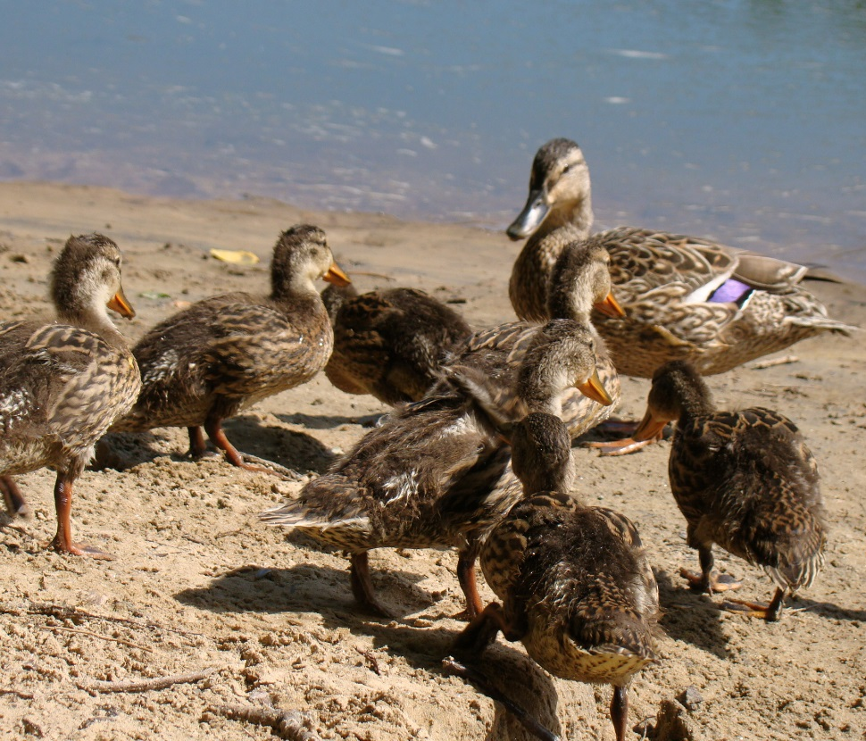
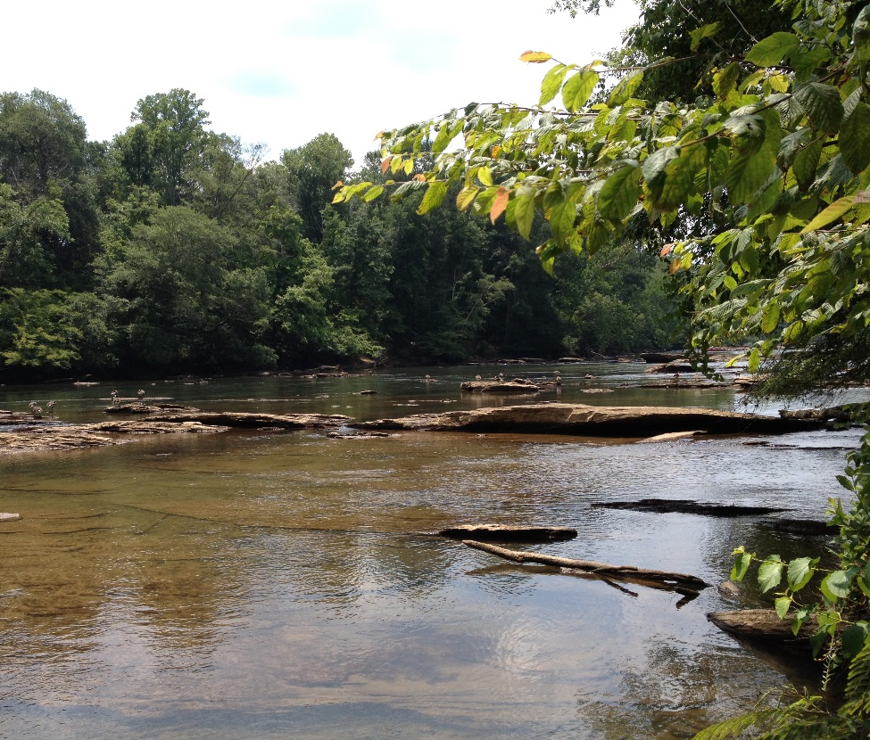
Image Credits: David Cotten
Community Concerns
Rising cost of municipal water management in metro Atlanta
Growth of Atlanta exacerbates stormwater management problems
Increased impervious surface cover could mean more pollution enters waterways through runoff
Notes:
Atlanta is one of the fastest growing cities in the nation, and it is considered a key player when it comes to Georgia’s regional water resource use discussions for two reasons: (1) Atlanta is Georgia’s largest city (2) The Chattahoochee river, which supplies this region and neighboring areas with most of its water, flows through the heart of the city. As of late, the costs of municipal water management in the metropolitan Atlanta area are rising due to an increased demand of infrastructure required to handle stormwater runoff. This predicament is expected to worsen as rapid, continued development in the city of Atlanta and its suburbs will expand areas of impervious surface cover, exacerbating stormwater management problems. In an attempt to relieve the extensive stormwater volumes that tax existing infrastructure, the Nature Conservancy suggested implementing green infrastructure in Atlanta and its surrounding areas.

Slide 5
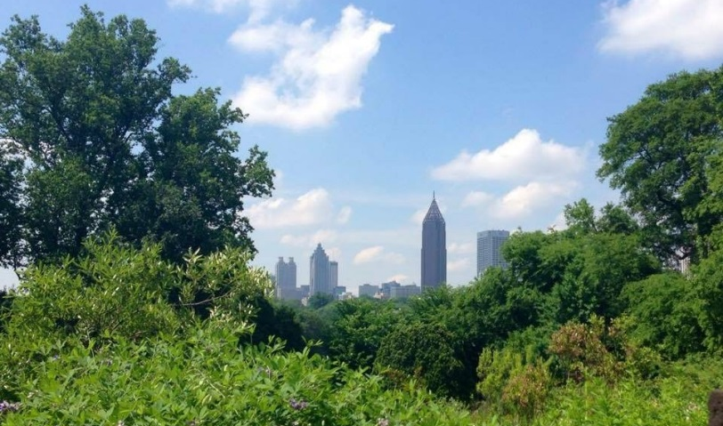
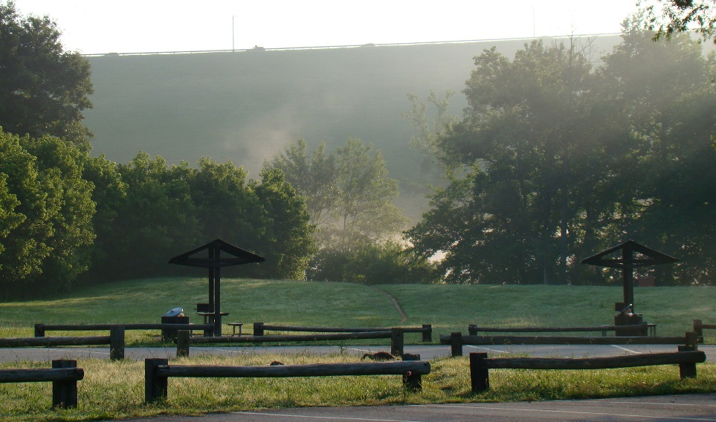
Green Infrastructure & Reforestation
By decreasing pollution in waterways, green infrastructure is an effective tool for managing water quality in cities (Livesly et al., 2011)
Urban forests are known to decrease stormwater runoff by allowing water to infiltrate and soil to absorb particles and contaminants
Image Credit: Hillary Essig
Image Credit: David Cotten
Notes:
Green infrastructure refers to a network of forests, wildlife habitats, parks, and natural areas within urban landscapes (McMahon, 2000). Green infrastructure has many direct and indirect benefits for local communities. For example, green spaces can enrich the quality of life for local residents by providing areas for recreational use and by enhancing the biodiversity and aesthetic beauty of an area (McMahon, 2000) . From an environmental standpoint, green infrastructure acts as natural remediator by… (summarize the two bullets on the slide). Because green infrastructure offers these ecofriendly benefits, there has been a push from Atlanta’s policy makers to construct and reforest more “green areas” to create an Atlanta Greenway.

Slide 6
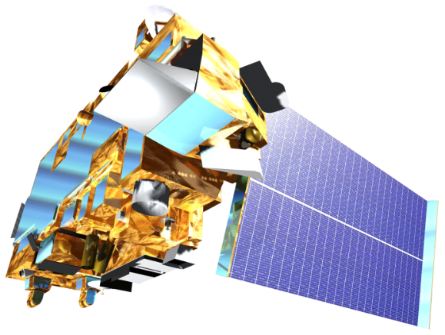
Landsat 8, OLI
Terra, ASTER
NASA Earth Observing Systems
Landsat 8 and Terra satellites were utilized in this project to produce land cover and topographic datasets
Notes:
To address the needs of the Nature Conservancy, we decided to implement a Land Use Conflict Identification Strategy or (LUCIS) model and a Soil and Water Assessment Tool or (SWAT) model. For these models’ input datasets, we obtained cloud-free Landsat 8 OLI images from October, 2015. Images were obtained for 2 Landsat scenes corresponding to the coverage of the MNGWPD by path-row. We also downloaded 30m ASTER DEMs for elevation data.
Both datasets were acquired through the USGS EarthExplorer website.

Slide 7
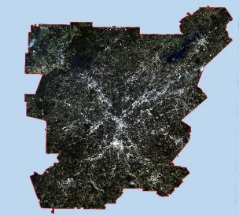
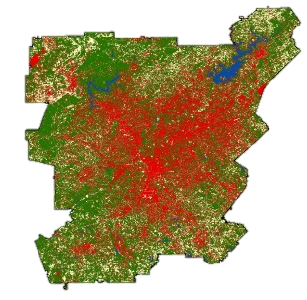
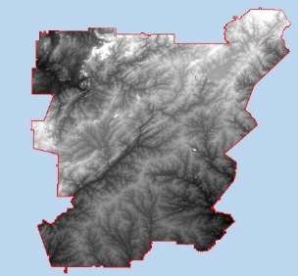
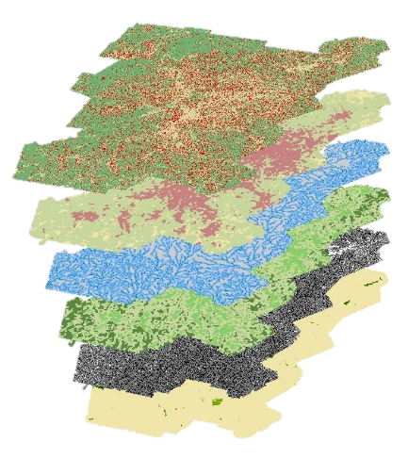
Methodology
Data Acquisition
Processing and Analysis
End Products
Landsat 8 Images
Atmospheric Correction
Supervised Land Cover Classification
Land Cover Classification
ASTER DEMs
LUCIS
Hydrologic Processes Model
LUCIS Suitability Maps
Ancillary Datasets
Notes:
The general methodology of the Atlanta Water Resources team is to integrate NASA EO datasets into both the LUCIS and SWAT models as necessary to produce suitability maps that will help identify prime locations for reforestation efforts as well as to generate hydrological outputs that can be used to determine the water quality of our region’s watersheds.
We hope to integrate SWAT outputs into the LUCIS methodology in the next phase of this project

Slide 8
Land Cover Classification
Processing
Mosaic
Atmospheric Correction
Classification
Training Sets
Maximum Likelihood Classification
Validation
Urban
Agriculture
Accuracy Assessment
Confusion Matrix
Water
Forest
Bare
0
40
End-Product
Km
Supervised 2015 Land Cover Classification
Notes:
The supervised land cover classification was performed in ENVI on our Landsat 8 images. This classification scheme is meant to reflect the major land use allocations in LUCIS. The accuracy assessment was done by generating 150 random points and interpreting them using NAIP imagery.

Slide 9
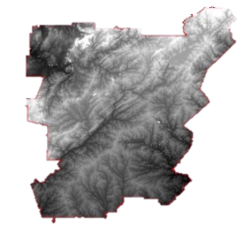
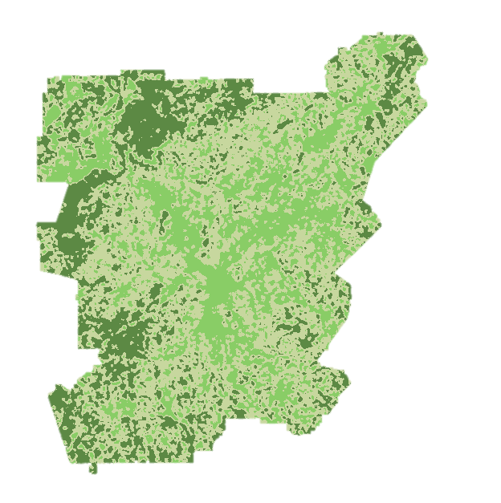
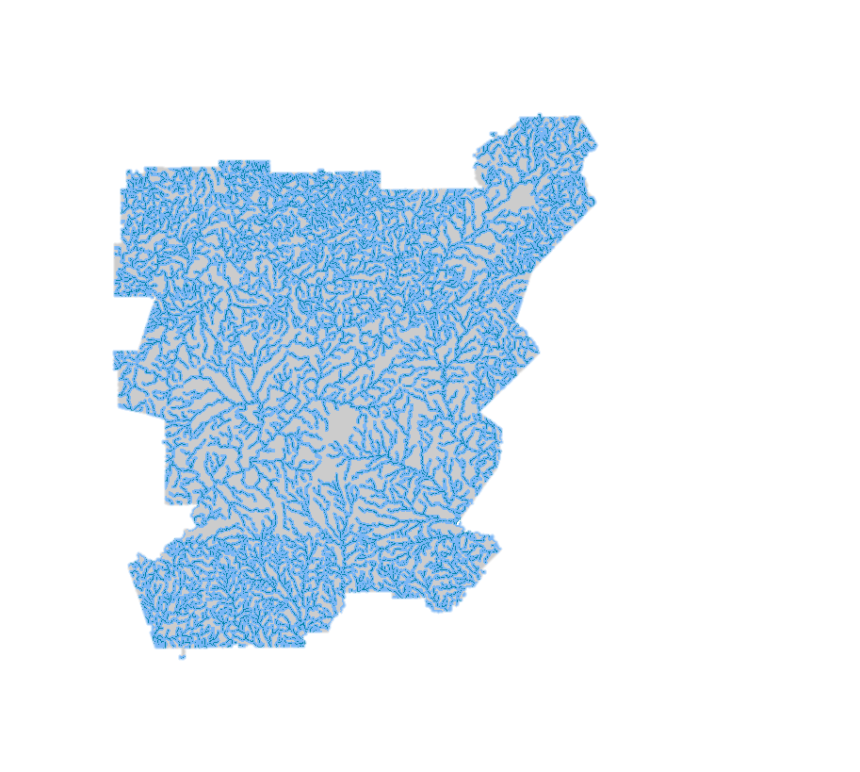
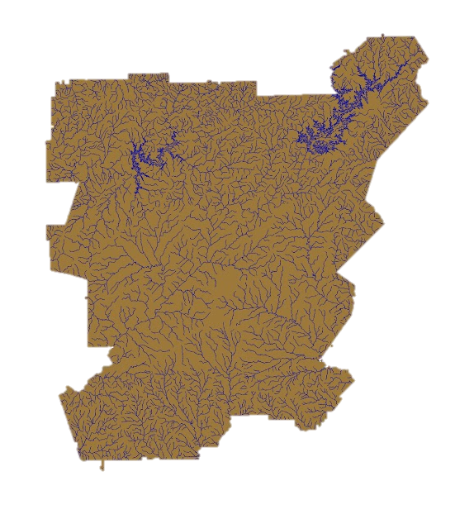
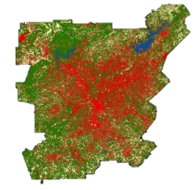
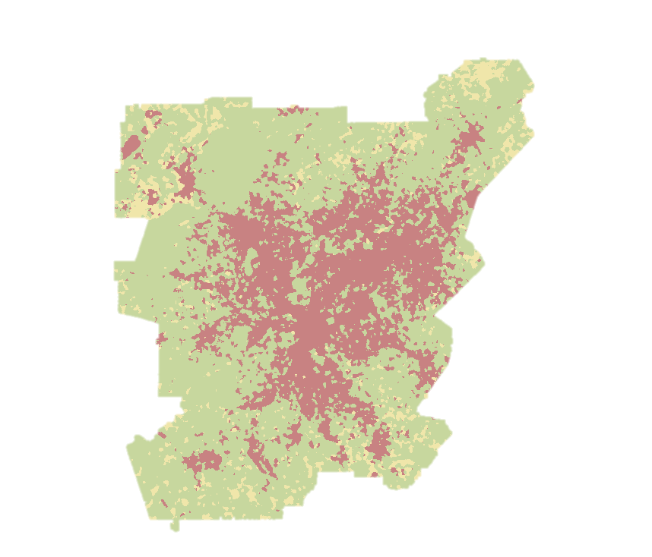
Land
Use
Conflict
Identification
Strategy (LUCIS)
Suitability Analysis
Integrates input datasets to create suitability data layers based on defined goals and objectives
Locates areas of potential land use conflict based on suitability prioritization and ranking
Produces flexible land use allocation scenarios based on goals and objectives that can be easily adapted
Notes:
LUCIS was developed by Carr and Zwick at the University of Florida. It was previously used in the UGA DEVELOP Miami Ecological Forecasting project (2014). LUCIS is a flexible model that can account for variations in stakeholder and local interest groups as it relates to land use allocation.
LUCIS Integrates a broad range of input datasets to create suitability data layers based on defined goals and objectives for primary land use categories (urban, agriculture, and conservation)
LUCIS Produces flexible land use allocation scenarios based on goals and objectives that can be adapted to a range of stakeholder and community preferences

Slide 10
Suitability: Urban
Objectives:
Identify locations that contribute pollutants by point source
Identify superfund sites, abandoned, and open bare land
Identify areas of high impervious surface not currently served by green infrastructure
Identify regions in close proximity to waterways
Identify areas of greater preference or suitability for development
Notes:
Overlay image layers (from top to bottom): Urban land cover, floodplain zoning, distance to waterways, superfund sites, neighborhood age, NPDES site.
Goal:
Minimize untreated stormwater flow into the Chattahoochee from impervious surfaces
Objective reasoning:
Higher compliance per watershed is preferred for retention ponds. Residential and commercial property owners can reduce impact fees by as much as 50% by demonstrating compliance. Easements granted to the city for future sanitary outfalls shall be executed by the landowner (less outfalls equals more access to city sewer for developers and less cost)
The City of Atlanta has managed several programs and initiatives aimed at identifying, assessing and remediating brownfield sites throughout the city. Brownfields is a real property whose expansion, redevelopment, or reuse may be complicated by the presences of potential hazardous substance, pollutant, or contaminant. Abandoned subdivision land is one large contiguous piece of property which make it more suitable than older neighborhoods to construct new development. Developers would prefer such property because of reduced purchasing cost and construction cost. Newer neighborhoods are preferred over older neighborhoods because the property is more “elastic”. Elastic meaning that it lacks the same repetitive patterns of older neighborhoods, which are more “static”.
The City Areas with lower property values can be of higher interest for development, as well as conservation. The reduced property value serves as an incentive for purchasing certain areas for development, but this is not always the case with a number of factors contributing to buyer preference. These lands are also of value for conservation and reforestation. Areas of lower property values and limited vegetation provides a unique opportunity for creating an equitable environment for people and to utilize under value land. Floodplain protection. The commissioner shall not authorize the approval of any permit authorizing the placement of fill or stored materials, or the construction of any building or other structure within the floodplain.

Slide 11
Suitability: Agriculture
Objectives:
Identify regions in close proximity to waterways
Identify regions with high topographic gradients
Identify regions with highly permeable soils
Identify agricultural land in close proximity to forest cover
Notes:
Overlay image layers (from top to bottom): Agricultural lands, waterways, soil permeability, agricultural land near forested areas, slope
Goal: Identify agricultural lands with a high potential to impact local water quality and stormwater runoff
Reasoning for Objectives:
Agricultural lands that are in a close proximity to streams and other waterbodies, have a higher risk of introducing organic nutrients, pesticides, and eroded sediment to these waterways during precipitation events.
2. Agricultural lands that have a higher slope will increase the amount of surficial runoff during a precipitation event. It is a hydrologic principle that water will always travel from
a higher elevation to a lower elevation.
3. Low permeability soils, such as soils with high clay content, have low infiltration rates during precipitation events. Low infiltration rates increase surficial ponding and surficial
runoff. Agricultural lands that have these types of soil have a higher risk of introducing higher volumes of surficial runoff and agricultural related nutrients to surrounding
waterways.

Slide 12
Suitability: Conservation
Objectives:
Identify existing protected areas/green spaces
Analyze existing proportions of local vegetation and forests
Identify associated land cover types for potential reforestation areas
Identify regions in close proximity to waterways
Prioritize reforestation targets
Notes:
Overlay image layers (from top to bottom): land cover change, associated land cover for forested areas, distance to waterways, percent forest cover, slope, protection status
Goal: Protect existing green infrastructure and identify opportunities to increase or expand green spaces
Objective Reasoning:
Locating areas near existing protected lands or green spaces could facilitate expansion of conservation management locally and provide existing conditions for reforestation plots.
Composition of existing vegetation communities could affect decisions related to reforestation – such as what types of trees to plant
Significant changes in adjacent land cover could affect the suitability (particularly soils and pollution) for forestation
Self explanitory

Slide 13
Results: Land Cover
Accuracy Assessment
 | Urban | Agriculture | Water | Vegetation | Bare Land | User Accuracy
Urban | 25 | 2 | 0 | 6 | 0 | 76%
Agriculture | 6 | 31 | 0 | 4 | 7 | 65%
Water | 0 | 0 | 6 | 0 | 0 | 100%
Vegetation | 2 | 1 | 0 | 57 | 1 | 93%
Bare Land | 0 | 1 | 0 | 0 | 2 | 67%
Producer Accuracy | 78% | 89% | 100% | 85% | 20% | 81%
Kappa |  |  |  |  | Kappa | 0.75
From 2001 to 2015, approximately one-third of this area (4,000 km²) experienced a change in land cover
Almost half of all land cover change was deforestation
Notes:
This is the confusion matrix for our 2015 Landsat-based classification
Kappa measures the strength of classification on a 0 to 1 scale- a 0.75 value is considered substantially accurate.
The majority of misclassification came from the bare land class. This is likely due to the low number of accuracy assessment points (total of 3) compared to the other classes.
Comparing the 2001 NLCD to our 2015 classification showed some trends: 32% of the study area changed its land cover type. Of this change, 47% of it is loss of forested land.

Slide 14
Results: LUCIS Analysis
Identifying Managed Lands with a High Potential to Impact Local Water Quality
The majority of open land (agriculture) with the highest potential to affect water quality occurs north of Atlanta
Downstream effects from these properties land management practices could be significant
Highest Potential
Lowest Potential
0
40
Km
Notes:
The significance of Fulton county as the lowest potential area in this image is likely the result of NoData values for soil permeability attained from the USDA.
The pending SWAT analysis will help to better understand downstream affects and the significance of open land management practices in this area

Slide 15
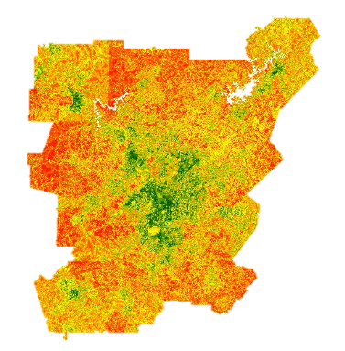
Results: LUCIS Analysis
Minimizing Untreated Stormwater Flow From Impervious Surfaces
Atlanta and its suburbs are major sources of impervious surface and stormwater runoff
These regions also represent areas with the highest potential to minimize stormwater flow through development of green infrastructure
Highest Potential
Lowest Potential
0
40
Km
Notes:
There is a high probability that further land use allocation in this area will rely primarily on the stakeholder interests in Atlanta.
This could be modeled or accounted for in the next phase of the LUCIS analysis, where we place to assess community land use preferences (with The Nature Conservancy’s help)

Slide 16
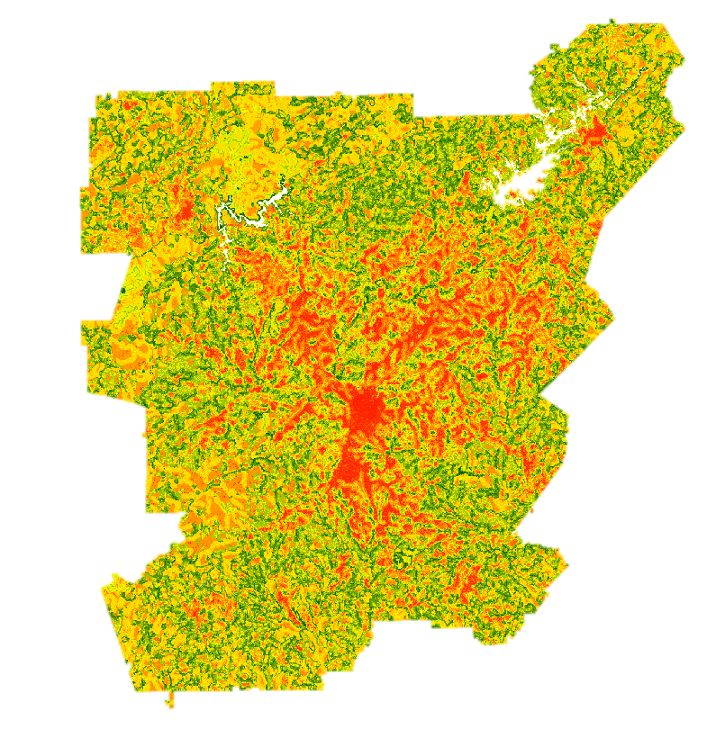
Results: LUCIS Analysis
Protecting Existing Green Infrastructure and Identify Reforestation Opportunities
Reforestation and green space development opportunities exist along several waterways adjacent to Atlanta
Existing protected areas or forests can be expanded to help promote this strategy as an alternative to municipal infrastructure
Highest Potential
Lowest Potential
0
40
Km
Notes:
The main location for reforestation and green space potential is along major waterways that cross sections of Atlanta and its suburbs.
Existing protected areas (parks, forests, etc.) can serve as reference points upon which further infrastructure can be expanded.

Slide 17
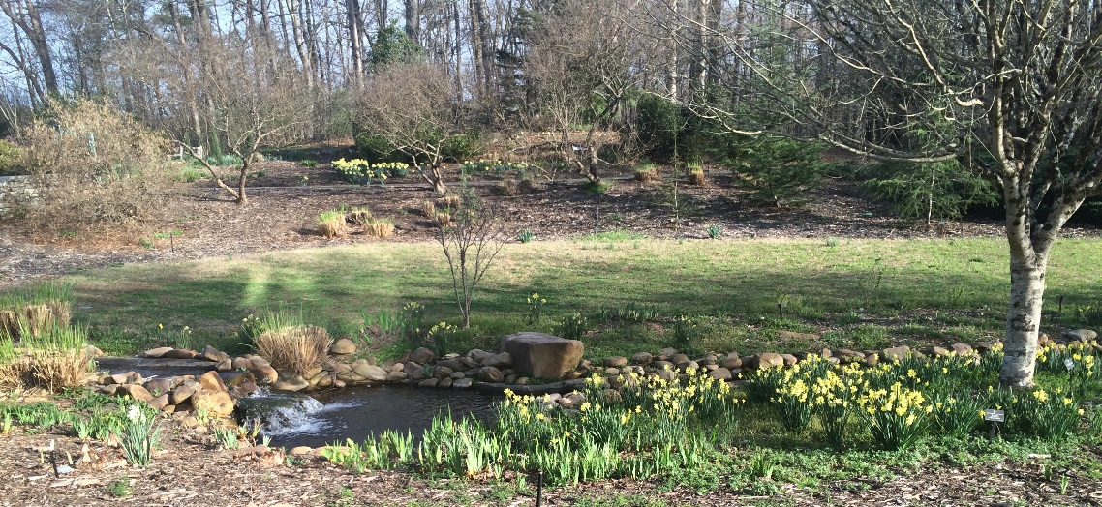
Conclusions
NASA datasets were successfully integrated with ancillary data to assess three water resource management goals
The LUCIS model determined areas of high impact or potential to affect local water quality
There are significant opportunities for reforestation and green space expansion to assist stormwater management around Atlanta
Existing urban infrastructure and associated land cover will have an important effect on water resource management
Image Credit: David Cotten
Notes:
The results of the LUCIS model analysis will provide project partners with an understanding of potential land use conflicts from a spatial and stakeholder perspective.
These results will allow The Nature Conservancy to identify lands for future conservation efforts relating to reforestation.

Slide 18
Errors and Uncertainties
Some datasets are incomplete
Land cover classification errors
LUCIS criteria weights should reflect the priorities of local stakeholders
Community preferences must be determined in order to identify conflict in land use allocation scenarios
The SWAT model will enhance the investigation of land management practices and water quality
Notes:
NoData values in existing datasets (such as soil permeability) can have a huge effect on model outputs
Misclassification of land cover in the 2015 Landsat 8 imagery occurred primarily in the bare land class
LUCIS weights will be refined/determined through communicating with The Nature Conservancy

Slide 19
Future Work
Acquire climate data and perform SWAT
Integrate SWAT results into LUCIS criteria
Determine community preferences for land use allocation
Combine LUCIS suitability layers to identify conflict between land uses
Generate multiple scenarios for forested land protection and reforestation strategies for water resource management
Notes:
The Atlanta Water Resources Project is scheduled to have a second term this upcoming summer. In the summer term, DEVELOPers will take make a more in-depth analysis of land use prioritization and allocation scenarios
The summer team members will also run the SWAT model for watershed characterization and contaminant mapping

Slide 20
Advisors
Dr. Marguerite Madden, UGA Center for Geospatial Research
Dr. Rosanna Rivero, UGA College of Environment and Design
Partners
Myriam Dormer, The Nature Conservancy
Sara Gottlieb, The Nature Conservancy
Others
David Cotten, UGA Center for Geospatial Research
Brandon Adams, UGA Center for Geospatial Research
Caren Remillard, NASA DEVELOP
Notes:
We would like to take the time to thank our Science Advisors Dr. Marguerite Madden and Dr. Rosanna Rivero for their guidance and continued support.
We would also like to thank our project partners Myriam Dormer and Sara Gottlieb of The Nature Conservancy, who are here with us today. They have had a very interactive role with this project, whether it be providing helpful ancillary datasets for the model or providing insightful feedback, which will help shape the project in the second term.
Lastly, thank you to David Cotton, Brandon Adams, and Caren Remillard

