Slide 1
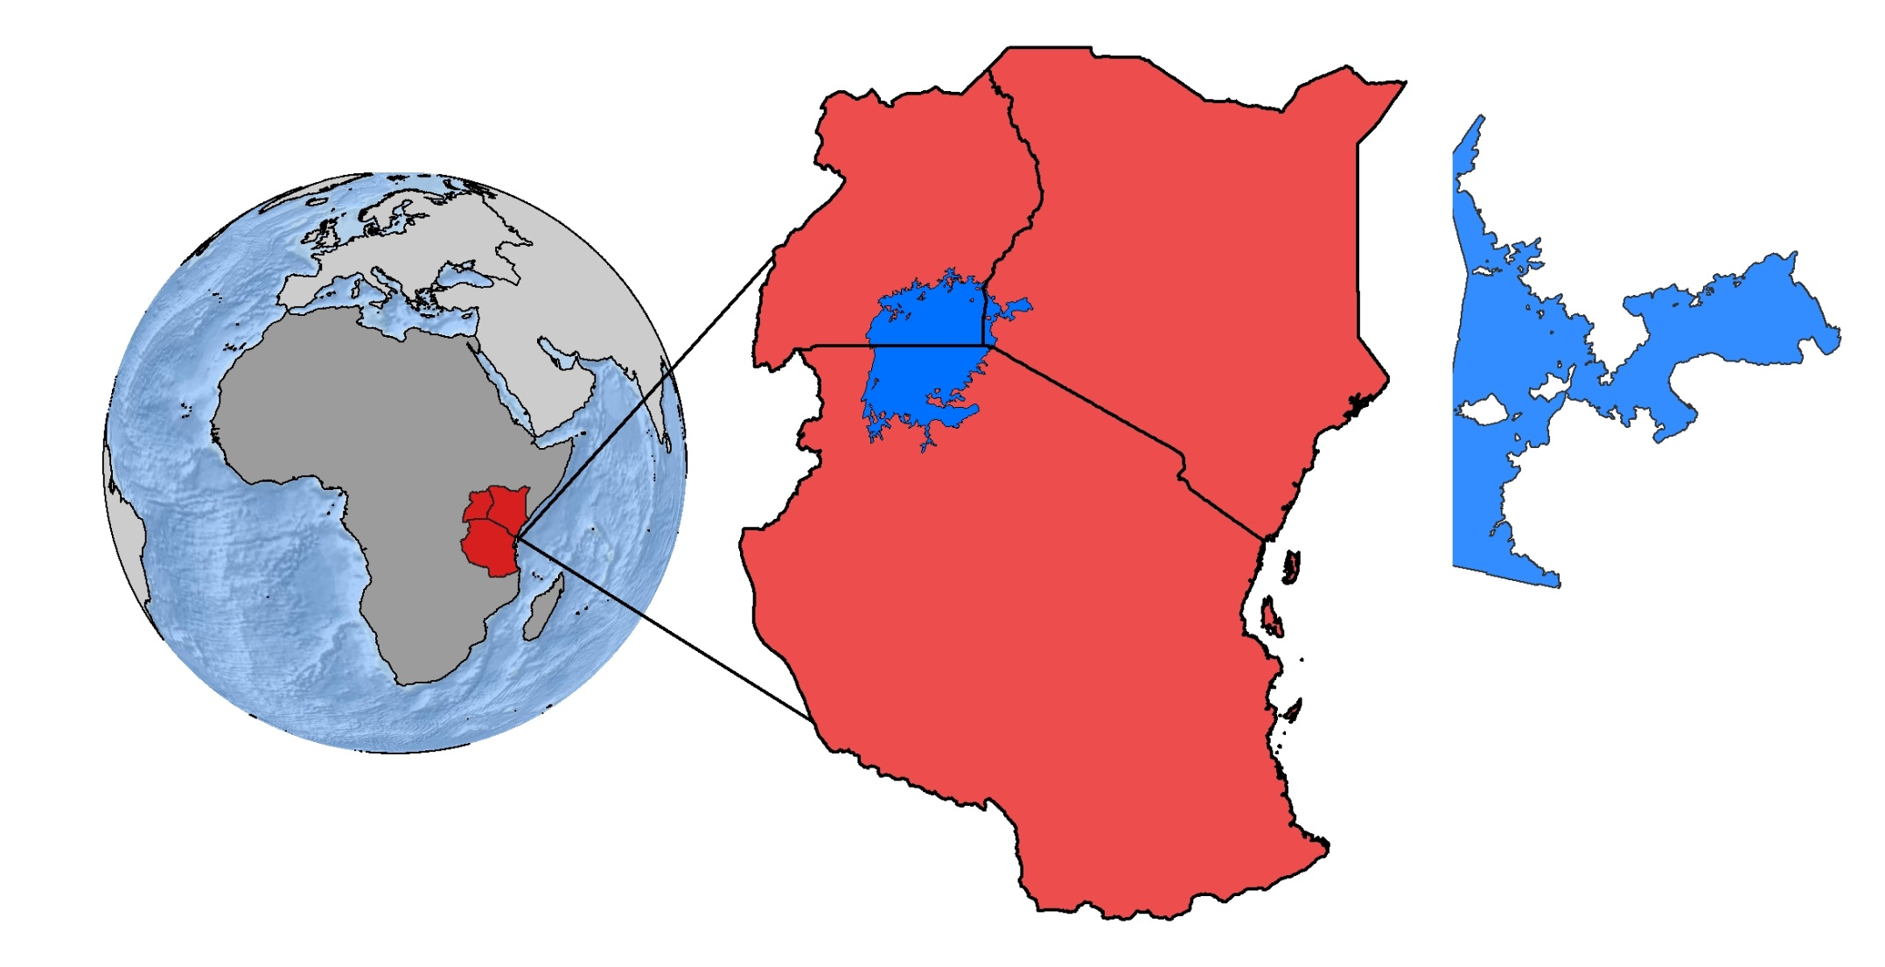
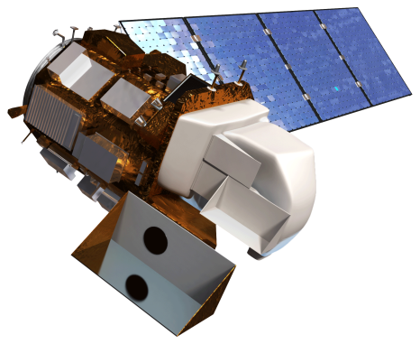
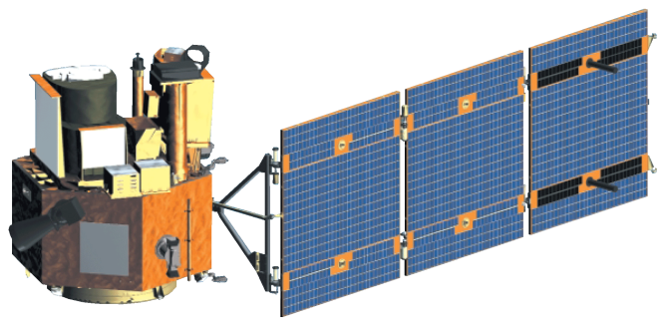
Lake Victoria Water Resources
Spatio-temporal analysis of Lake Victoria pollution and algal blooms using NASA Earth observations for improved water management
Jeanné le Roux (Project Lead), Daryl Ann Winstead, Christina Fischer, Sara Amirazodi, Austin Vacek
NASA DEVELOP National Program at NASA Marshall Space Flight Center
Abstract
Objectives
Develop an empirical method to distinguish water hyacinth from other algal growth in the Winam Gulf of Lake Victoria, Kenya
Identify the extent of water hyacinth in the Winam Gulf to enhance RCMRD methodologies
Create a time series map of aquatic vegetation
Study Area
Uganda
Kenya
Methodology
Tanzania
Winam Gulf, Kenya
Data Acquisition
Hyperion
Data Processing
Extract water
Data Analysis
Vegetation analysis
Worldview
Time series
TBD
TBD
Extract chlorophyll
TBD
Landsat 8
Lake Victoria
Earth Observations
Landsat 8 OLI & TIRS
EO-1 Hyperion
Results
Conclusions
TBD
TBD
Team Members
Project Partners
Acknowledgements
NASA SERVIR Coordination Office
NASA SERVIR - Eastern and Southern Africa
Regional Centre for Mapping of Resources for Development (RCMRD)
We would like to thank our collaborator, Africa Flores, for her guidance on this project.
We also would like to thank our science advisor, Dr. Jeffrey Luvall, our science mentor, Dr. Robert Griffin, and our center lead, Leigh Sinclair.
Furthermore, we would like to thank Dr. Robinson Mugo and James Wanjohi Nyaga of RCMRD for providing us with critical data and information.
Austin Vacek, Jeanné le Roux, Christina Fischer, Daryl Ann Winstead, Sara Amirazodi
NASA Marshall Space Flight Center

