Slide 1
South Slough Water Resources
Monitoring Changes in Water Quality to Identify Stressors in Eelgrass Extent Throughout the Coos Estuary
Maya Hall • Gabriel Halaweh • Sean McCollum • Zoë Siman-Tov
California – Ames | Summer 2023
Notes:
Good morning everyone and thank you for joining us! My name is (everyone introduces themselves), and we are the South Slough Water Resources Team. Today, we are going to share our research on “Monitoring Changes in Water Quality to Identify Stressors in Eelgrass Extent Throughout the Coos Estuary”.
To start, we want to acknowledge the fact that we are studying an area of southern Oregon that has been and still is stewarded by multiple tribal communities. We recognize that we are geographically removed from our study site and that the tribal communities have persevered despite forcible removal, negligence, and broken promises from the United States of America. We honor and are grateful to the Coos, Lower Umqua, and Siuslaw tribes who have protected and monitored these lands and waters.
Now to dive into the presentation, we’ll share some background information with you all.

Slide 2
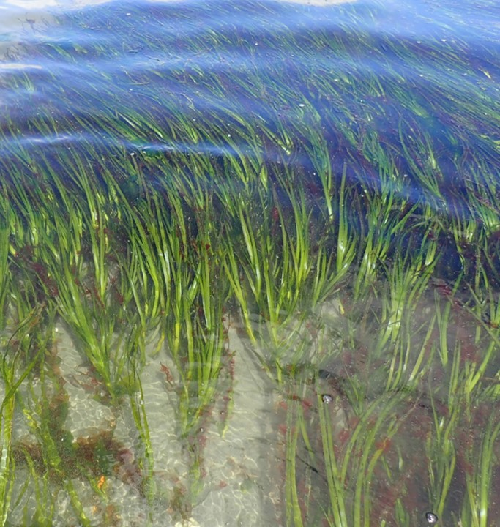
Background
A History of Decline
Washington
Oregon
Idaho
Temperate North Pacific
Nevada
California
1
0.1
0.01
0.001
Mean Meadow Area Relative to Initial Area
Recent Climate Anomalies
• 2013 – 2016 Marine Heat Wave (MHW)
• El Niño Southern Oscillation (ENSO)
• Record low Arctic sea ice (2018)
• 2021 Heat Wave
1 2 5 9 12 17 5
1950 1970 1990 2010
Year
Image Credit: Dunic et al. 2021, John Brew
Notes:
Eelgrass (Zostera marina) is a common seagrass species that forms meadows in coastal and estuarine habitats throughout the temperate northern hemisphere (Short et al., 2007). Eelgrass meadows provide a myriad of critical ecosystem services. Across their distribution, eelgrass meadows support local economies by providing nursery habitat for fishery species, serving as a vital food source for migratory wildlife, and increasing recreational opportunities for local communities (Nordlund et al., 2016).
Unfortunately, across the globe, seagrass populations have experienced major declines
In the temperate north pacific, meadow area size has decreased significantly – you can see this decline clearly in this generalized additive model from Dunic et al. 2021
Here, they plot mean meadow area as a proportion of the meadow area observed in initial surveys and display these quantities on a log10 scale, so moving from 1 to 0.1 indicates a 10-fold decrease in seagrass area over time. The green shade is the 95% confidence interval, which reflects the model fit to the black trend line, and the numbers at the bottom of the plot represent the number of meadows sampled in each decade
The steady decline in seagrass populations has an impact on estuary health, commercial fisheries, and community recreation
Numerous studies have found that contributing factors include warmer temperatures, anomalous weather events, and human habitat disturbance
------------------------------Image Information Below ------------------------------
•Image Credit: Dunic et al. 2021
•Image Source: Wiley Online Library, https://onlinelibrary.wiley.com/doi/full/10.1111/gcb.15684#pane-pcw-figures (CC by 4.0)
•Image Credit: John Brew
•Image Source: https://openverse.org/image/adfe2f05-28d5-4389-8ce7-0af53b55bf64?q=zostera%20marina (CC by 4.0)
•Image Credit: Basemap - ArcGIS Pro
•Image Source: Esri, HERE, Garmin, FAO, NOAA, USGS, OpenStreetMap contributors, and the GIS User Community

Slide 3
Study Area and Period
Study Area
Washington
Coos Estuary and South Slough
54 km²
Prior to 2013, eelgrass shoot density average was 33 shoots per m²
After 2013-2016 warm water event, eelgrass shoot density average was 5 shoots per m²
Oregon
California
Nevada
Coos Estuary
Study Period
N
Historic Eelgrass Extent
0 3.2 6.4
km
0 104 209
2016 - 2023
km
Base map - ESRI, HERE, Garmin, FAO, NOAA, USGS, © OpenStreetMap contributors, and the GIS User Community
Notes:
Our study focuses on the Coos Estuary with a special focus on the most southern region, which is named South Slough
Historically, eelgrass (Zostera marina) has been found throughout the estuary
Recent decades of warming have been exacerbated by instances of Marine Heat Waves (MHW), as well as El Niño Southern Oscillations (ENSO)
Combined, these environmental and climatological effects have led to significant eelgrass declines
To better understand these declines and the variables that govern them, we analyzed water quality and eelgrass presence data from 2016 to 2023
------------------------------Image Information Below ------------------------------
•Image Credit: NASA DEVELOP South Slough Team
•Image Source: 1) Base map - ESRI, HERE, Garmin, FAO, NOAA, USGS, © OpenStreetMap contributors, and the GIS User Community, 2) Eelgrass layer – Pacific Marine and Estuarine Fish Habitat Partnership, PSMFC GIS, 3) Background of inset – NASA/USGS Landsat 9 OLI-2

Slide 4
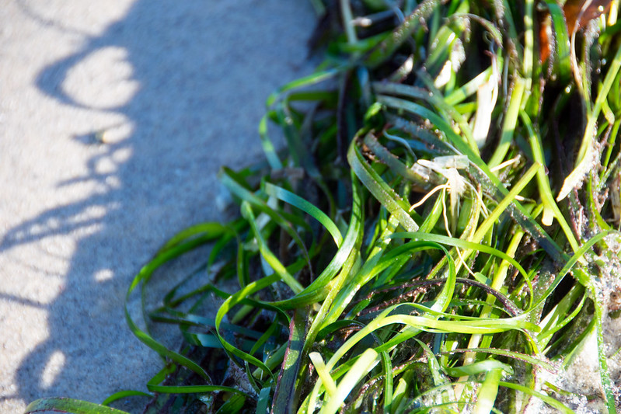
Project Partners
South Slough National Estuarine Research Reserve (SSNERR)
Confederated Tribes of the Coos, Lower Umpqua, and Siuslaw Indians (CTCLUSI)
Image Credit: SSNERR (Left), Paul Asman and Jill Lenoble (Right)
Notes:
During this project we partnered with the South Slough National Estuarine Research Reserve (SSNERR) and the Confederated Tribes of the Coos, Lower Umpqua, and Siuslaw Indians' (CTCLUSI) Natural Resources Department
Together, SSNERR and CTCLUSI have worked to monitor and protect the estuary.
------------------------------Image Information Below ------------------------------
•Image Credit: South Slough National Estuarine Research Reserve
•Image Source: https://openverse.org/image/355d7dc5-8eb9-4ed9-b746-055d2d575a53?q=south%20slough%20oregon (CC BY 2.0)
Image Credit: Paul Asman and Jill Lenoble
Image Source: https://openverse.org/image/e7798ed4-4dac-4ea7-8ba1-9b5b5519eb2a?q=zostera%20marina (CC BY 2.0)

Slide 5
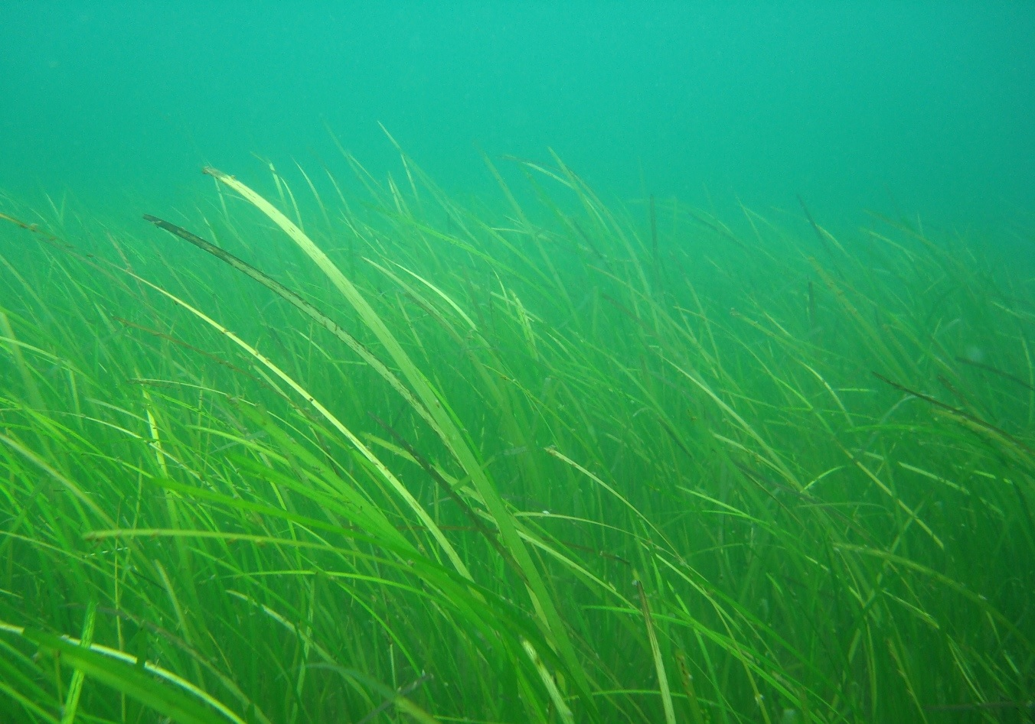
Community Concerns
Habitat Resilience
Climate Change
Community Recreation
Commerical Disruptions
Image Credit: Genet (Diskussion)
Notes:
Habitat resilience is crucial for the continuation of the vital ecosystem services that eelgrass provides to both humans and wildlife alike
------------------------------Image Information Below ------------------------------
•Image Credit: Genet (Diskussion)
•Image Source: https://commons.wikimedia.org/w/index.php?curid=116660872 (Creative Commons Attribution-Share Alike 4.0 International)

Slide 6
Community Concerns
Habitat Resilience
Climate Change
Community Recreation
Commerical Disruptions
Image Credit: South Slough National Estuarine Research Reserve
Notes:
The impact of climate change has been increasingly significant and is of particular concern for our partners as they aim to protect the vital habitat of the Coos estuary and South Slough.
------------------------------Image Information Below ------------------------------
•Image Credit: South Slough National Estuarine Research Reserve
•Image Source: https://openverse.org/image/355d7dc5-8eb9-4ed9-b746-055d2d575a53?q=south%20slough%20oregon (CC By SA 2.0)

Slide 7
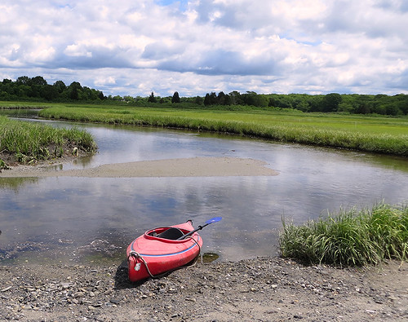
Community Concerns
Habitat Resilience
Climate Change
Community Recreation
Commerical Disruptions
Image Credit: National Oceanic and Atmospheric Administration
Notes:
In addition, these habitats are valuable recreation spaces that promote community well-being and offer ways for individuals and groups to connect with nature.
------------------------------Image Information Below ------------------------------
•Image Credit: Narragansett Bay National Estuarine Research Reserve
•Image Source: National Oceanic and Atmospheric Administration (NOAA) - https://openverse.org/image/cc91b26f-5e58-4cfb-9b82-87d870b91a0e?q=estuary%20recreation (Public Domain)

Slide 8
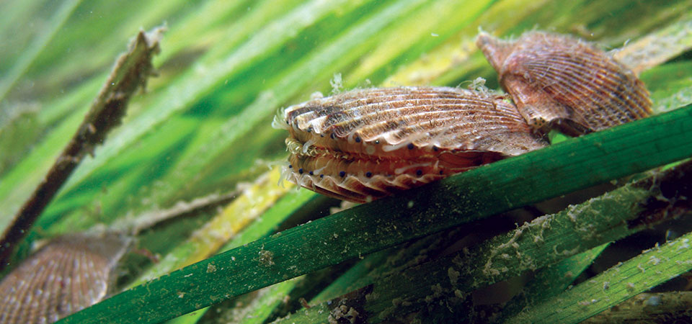
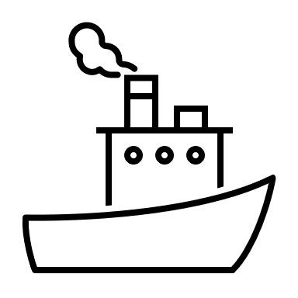
Community Concerns
Habitat Resilience
Climate Change
Community Recreation
Image Credit: National Oceanic and Atmospheric Administration
Commerical Disruptions
Notes:
Lastly, given that eelgrass supports a variety of fishery species, it is important to monitor and protect the eelgrass meadows in the Coos estuary
------------------------------Image Information Below ------------------------------
•Image Credit: National Oceanic and Atmospheric Administration
•Image Source: https://www.flickr.com/photos/40322276@N04/33610554751 (CC BY 2.0)

Slide 9
Objectives
Use NASA Earth Observations to analyze eelgrass presence and investigate the drivers of eelgrass decline.
Eelgrass Extent Maps
Water Quality Time Series Analyses
Google Earth Engine (GEE) Tutorial
Notes:
Our objectives include creating maps of the Coos Bay eelgrass to help our partners better understand the distribution of eelgrass populations, as well as examine the locations of significant eelgrass population losses
Additionally, we aimed to create water quality time series analyses to provide insight into the potential environmental and climatological drivers behind eelgrass declines
Lastly, we produced a written tutorial for our partners so that they could extract information about the Bay and South Slough independently through Google Earth Engine
------------------------------Image Information Below ------------------------------
•Image Source and Credit: Microsoft 365 Icons

Slide 10
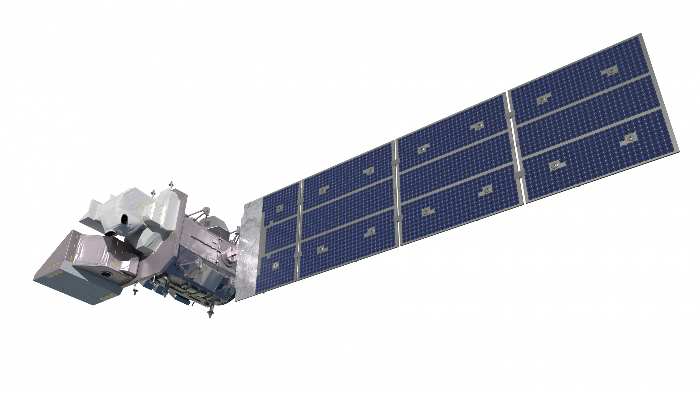
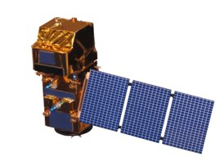
NASA Satellites and Sensors
NASA
European Space Agency
Landsat 8 OLI
2013
Landsat 9 OLI-2
2021
Sentinel-2 MSI
2015
Image Credits: NASA, Rama
Notes:
For our project, we used imagery from Landsat 8 and 9, and Sentinel-2. Data from Landsat were retrieved at a 30m spatial resolution. These data were used to specify the study area, as well as examine the entire Coos Estuary. Landsat 8 and 9 were initially used to explore eelgrass and water quality; however, the spatial resolution of 30 meters did not provide enough detail. To address this, we ultimately used Sentinel-2 MSI imagery, which produces data at a spatial resolution of 10 meters.
------------------------------Image Information Below ------------------------------
•Image Credit for Lansat 8 and Landsat 9: NASA
•Image Sources: https://svs.gsfc.nasa.gov/10812 ; NASA SVS | Landsat 9 Spacecraft Animations and Stills
•Image Credit for Sentinel-2: Rama CC BY-SA 2.0 fr
•Image Source: https://en.wikipedia.org/wiki/Sentinel-2#/media/File:Sentinel_2-IMG_5873-white_(crop).jpg

Slide 11
Methodology: Satellite Comparison
Landsat 8 OLI
Sentinel-2 MSI
N
0 1.6 8
km
Notes:
We used Sentinel-2 data due to the higher spatial resolution. Here is a comparison of Landsat 8 OLI data and Sentinel-2 MSI data. The Landsat data are much more coarse, which makes it difficult to remotely sense eelgrass beneath the water.
------------------------------Image Information Below ------------------------------
•Image Credit: Basemap - ArcGIS Pro
•Image Source: Esri, HERE, Garmin, FAO, NOAA, USGS, OpenStreetMap contributors, and the GIS User Community
•Image Credit: South Slough Team
•Image Source: ORCAA (ESA Sentinel-2 MSI)

Slide 12
Methodology: Eelgrass Extent Maps
Normalized Difference Aquatic Vegetation Index (NDAVI)
Training Points and Accuracy
Updated Map Showing Eelgrass Presence
Spectral Data of Study Site
Existing Eelgrass Extent Map
Notes:
Our partners were interested in updated eelgrass presence maps. To produce these, we obtained spectral data of the Coos Estuary from Landsat and Sentinel-2 using a tool called the Optical Reef Area Assessment (ORCAA) tool, which was built by a previous DEVELOP team.
We then calculated the Normalized Difference Aquatic Vegetation Index (NDAVI) to preliminarily assess whether eelgrass could be detected from the Sentinel-2 imagery. Based on this preliminary assessment, we decided to create a training model that would be able to determine eelgrass presence or absence. To accomplish this, we relied on the 2016 eelgrass extent map from the Pacific Marine and Estuarine Partnership (PMEP), as well as our NDAVI map and true color Sentinel-2 images, and generated training points using several different classification schemes in ArcGIS Pro. The result of training yielded a model that depicts current eelgrass presence within the estuary, and more specifically, within South Slough.
------------------------------Image Information Below ------------------------------
•Image Credit: Basemaps - ArcGIS Pro
•Image Source: Esri, HERE, Garmin, FAO, NOAA, USGS, OpenStreetMap contributors, and the GIS User Community
•Image Credit: True Color and NDAVI maps – Landsat 9 OLI-2
•Image Source: NASA/USGS
•Image Credit: Orange Layer
•Image Source: Pacific Marine and Estuarine Fish Habitat Partnership, PSMFC GIS

Slide 13
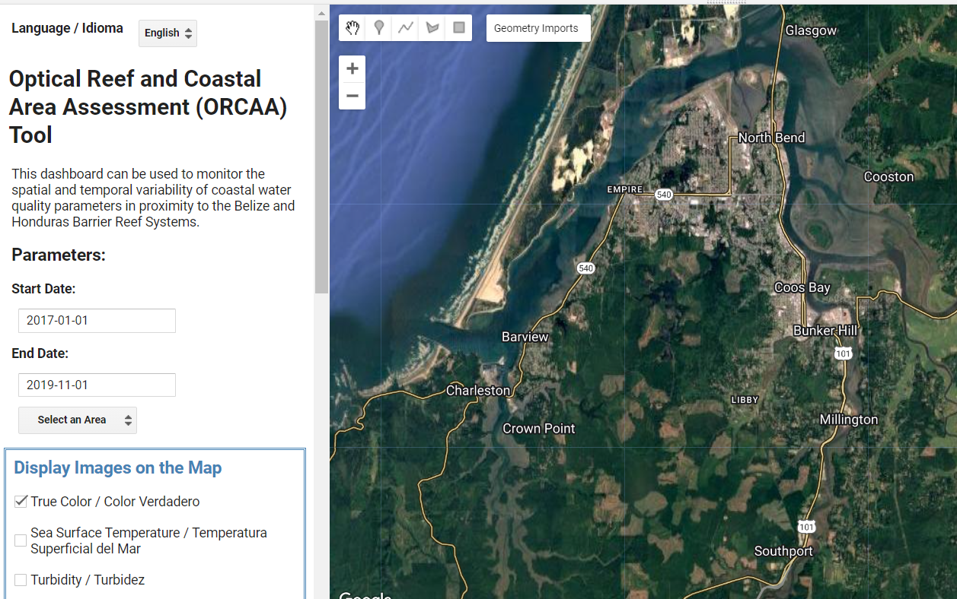
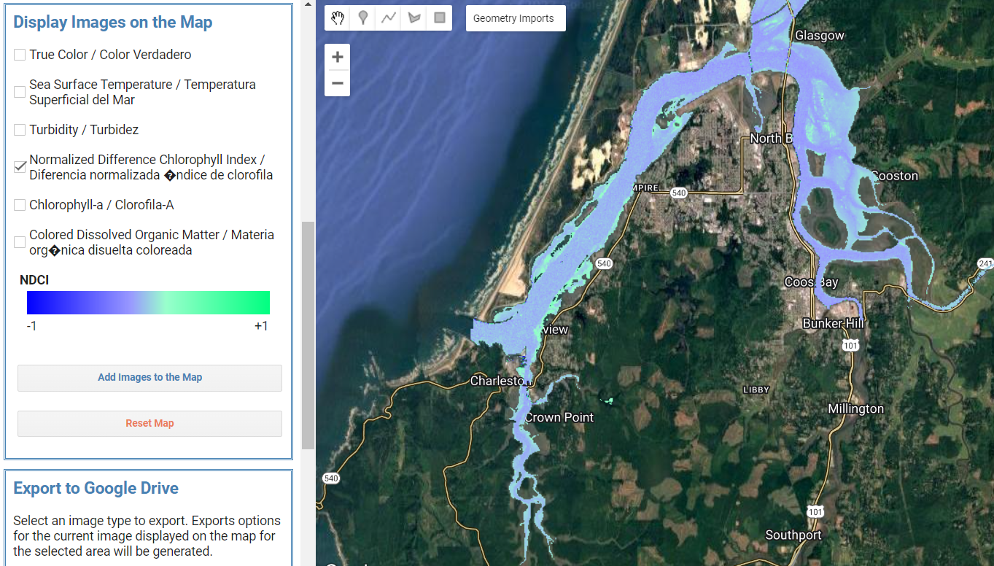
Methodology: ORCAA Tool
User Interface
Extracting Data
Notes:
Here is an example of the ORCAA Tool in Google Earth Engine. On the left is the user interface upon running the tool. On the right is an example of using the tool to generate a water quality parameter.
------------------------------Image Information Below ------------------------------
•Image Credit: Screenshot of User Interface (South Slough Team)
•Image Source: ORCAA Tool (Public Domain)
•Image Credit: Screenshot of Producing Parameter Map (South Slough Team)
•Image Source: ORCAA Tool (Public Domain)

Slide 14
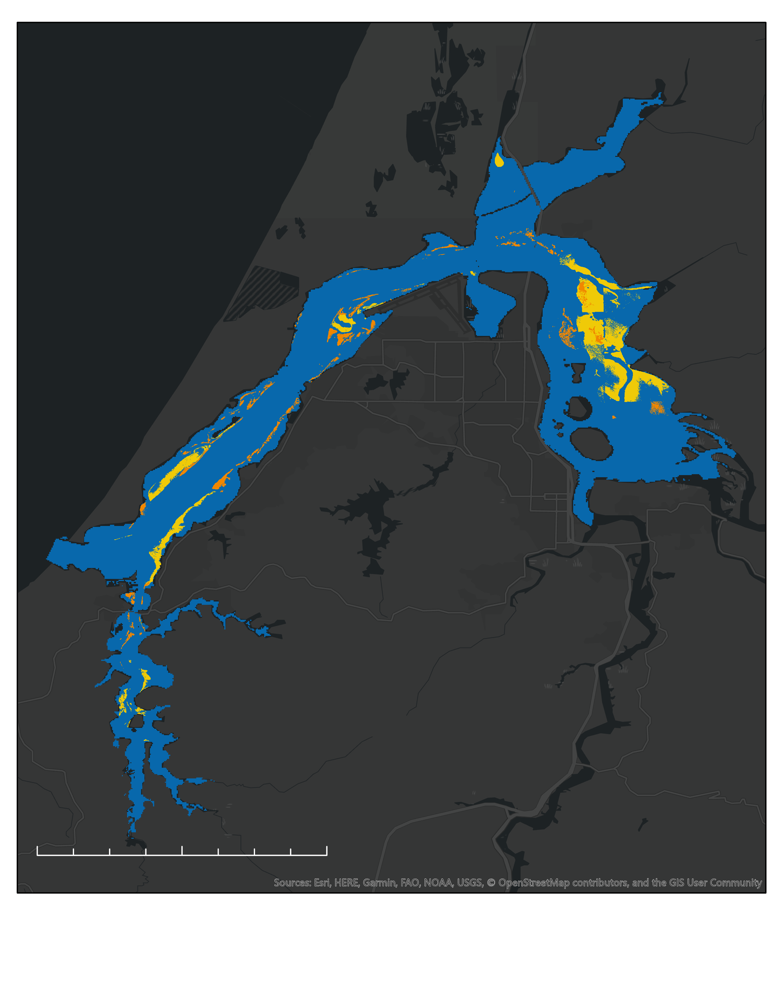
Methodology: Training
Existing Eelgrass Extent 2016
Support Vector Machine
Esri, HERE, Garmin, FAO, NOAA, USGS, OpenStreetMap contributors, and the GIS User Community
Notes:
This slide shows an example of the existing eelgrass extent map from 2016 and the points produced during the maximum likelihood classification. Maximum likelihood classification is a method of determining different class distributions within an image. For our purposes, we were interested in classifying pixels as "eelgrass" or "non-eelgrass". To achieve these designations, we imported Sentinel-2 data and ancillary datasets into ArcGIS Pro and used the Classification Tools provided in the ArcGIS Pro application.
Here are two examples of the steps in the process. In the image on the left, the eelgrass is depicted in orange. These orange polygons were imported from an existing shapefile from the Pacific Marine and Estuarine Partnership, and were used to inform previously known eelgrass areas within the map. The image on the right shows pixels classified as eelgrass after performing image classification.
------------------------------Image Information Below ------------------------------
•Image Credit: Basemap - ArcGIS Pro
•Image Source: Esri, HERE, Garmin, FAO, NOAA, USGS, OpenStreetMap contributors, and the GIS User Community
•Image Credit: South Slough Team
•Image Source: ORCAA (ESA Sentinel-2 MSI)

Slide 15
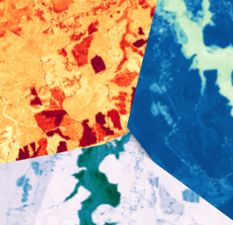
Methodology: Water Quality Time Series
Normalized Difference Aquatic Vegetation Index (NDAVI)
Normalized Difference Chlorophyll Index (NDCI)
Normalized Difference Turbidity Index (NDTI)
Sentinel-2 & Landsat Imagery
Raster Calculation and Visualization
Final Maps of SAVs, Chlorophyll-a, and Turbidity
Optical Reef and Coastal Area Assessment (ORCAA) Tool
Notes:
In addition to producing updated eelgrass maps, our team created a series of water quality maps to help our partners better understand the external influences potentially driving eelgrass presence or absence.
We used an existing GEE tool called ORCAA, as well as Planet and USGS Landsat data to compile seasonal collections of images. These images were filtered to include only the least cloudy days, as well as only images at high tide. Once the appropriate images were acquired, we performed a number of indices in ArcGIS Pro and ORCAA, which were then visualized within ArcGIS Pro to produce final water quality time series maps.
------------------------------Image Information Below ------------------------------
•Image Credit: South Slough Team
•Image Source: Landsat 9 OLI-2 Imagery Processed in ArcGIS Pro

Slide 16
Methodology: Normalized Difference Aquatic Vegetation Index (NDAVI)
Identifies Submerged Aquatic Vegetation (SAV)
Near-Infrared
Blue
&
=
NIR
-
Blue
More Vegetation
=
NDAVI
Less Vegetation
NIR
+
Blue
0 1
Notes:
To detect submerged aquatic vegetation, or SAVs, we utilized the near-infrared and blue bands within each image. The normalization of the blue band creates the output known as the Normalized Difference Aquatic Vegetation Index (NDAVI). This index is sensitive to photosynthetic organisms beneath the surface of the water and may reveal where eelgrass is likely to be present.
------------------------------Image Information Below ------------------------------
•Image Credit: South Slough Team
•Image Source: Landsat Imagery Processed in ArcGIS Pro
•Image Credit: South Slough Team
•Image Source: Sentinel-2 Imagery Processed in ArcGIS Pro

Slide 17
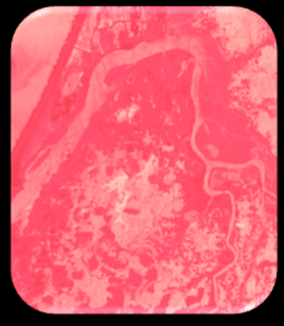
Methodology: Chlorophyll-A
Red-Edge
Red
Identifies Chlorophyll-A
&
=
Red-Edge
Red
Less Chlorophyll-a
More Chlorophyll-a
-
=
NDCI
0 3
+
Red-Edge
Red
Notes:
In addition to calculating NDAVI, it is possible to detect levels of chlorophyll-a in the water. Chlorophyll-a is form of chlorophyll that is used in photosynthesis. Plants and algae both use this pigment, so to better understand where photosynthetic organisms are within the Coos Estuary, we followed an equation that was first presented in a 2012 publication by Mishra and Mishra (2012) and then adapted by Buma and Lee in 2020. The equation aims to predict chlorophyll-a concentrations in estuarine and coastal waters. As a result, the Normalized Difference Chlorophyll Index (NDCI) can be used to detect both eelgrass presence and algal blooms.
------------------------------Image Information Below ------------------------------
•Image Credit: South Slough Team
•Image Source: Landsat 8 Imagery Processed in ArcGIS Pro
•Image Credit: South Slough Team
•Image Source: Sentinel-2 Imagery Processed in ArcGIS Pro

Slide 18
Methodology: Normalized Difference Turbidity Index (NDTI)
Differentiates Sediment from Water
Red
Green
&
=
-
Red
Green
More Turbid
=
NDTI
Less Turbid
Red
0 21
+
Green
Notes:
Turbidity is defined as the measure of relative clarity of a liquid and can have significant impacts on the health of an aquatic ecosystem. Higher turbidity scatters light that would otherwise penetrate through the water column. Turbidity can be caused by clay, silt, and other organic and inorganic matter. Additionally, turbidity can be caused by algae in the water. In order to adequately capture measures of turbidity, we used the red and green bands to calculate the Normalized Difference Turbidity Index, which shows us where the water is the most cloudy and therefore where eelgrass is likely obscured.
------------------------------Image Information Below ------------------------------
•Image Credit: South Slough Team
•Image Source: Landsat Imagery Processed in ArcGIS Pro
•Image Credit: South Slough Team
•Image Source: Sentinel-2 Imagery Processed in ArcGIS Pro

Slide 19
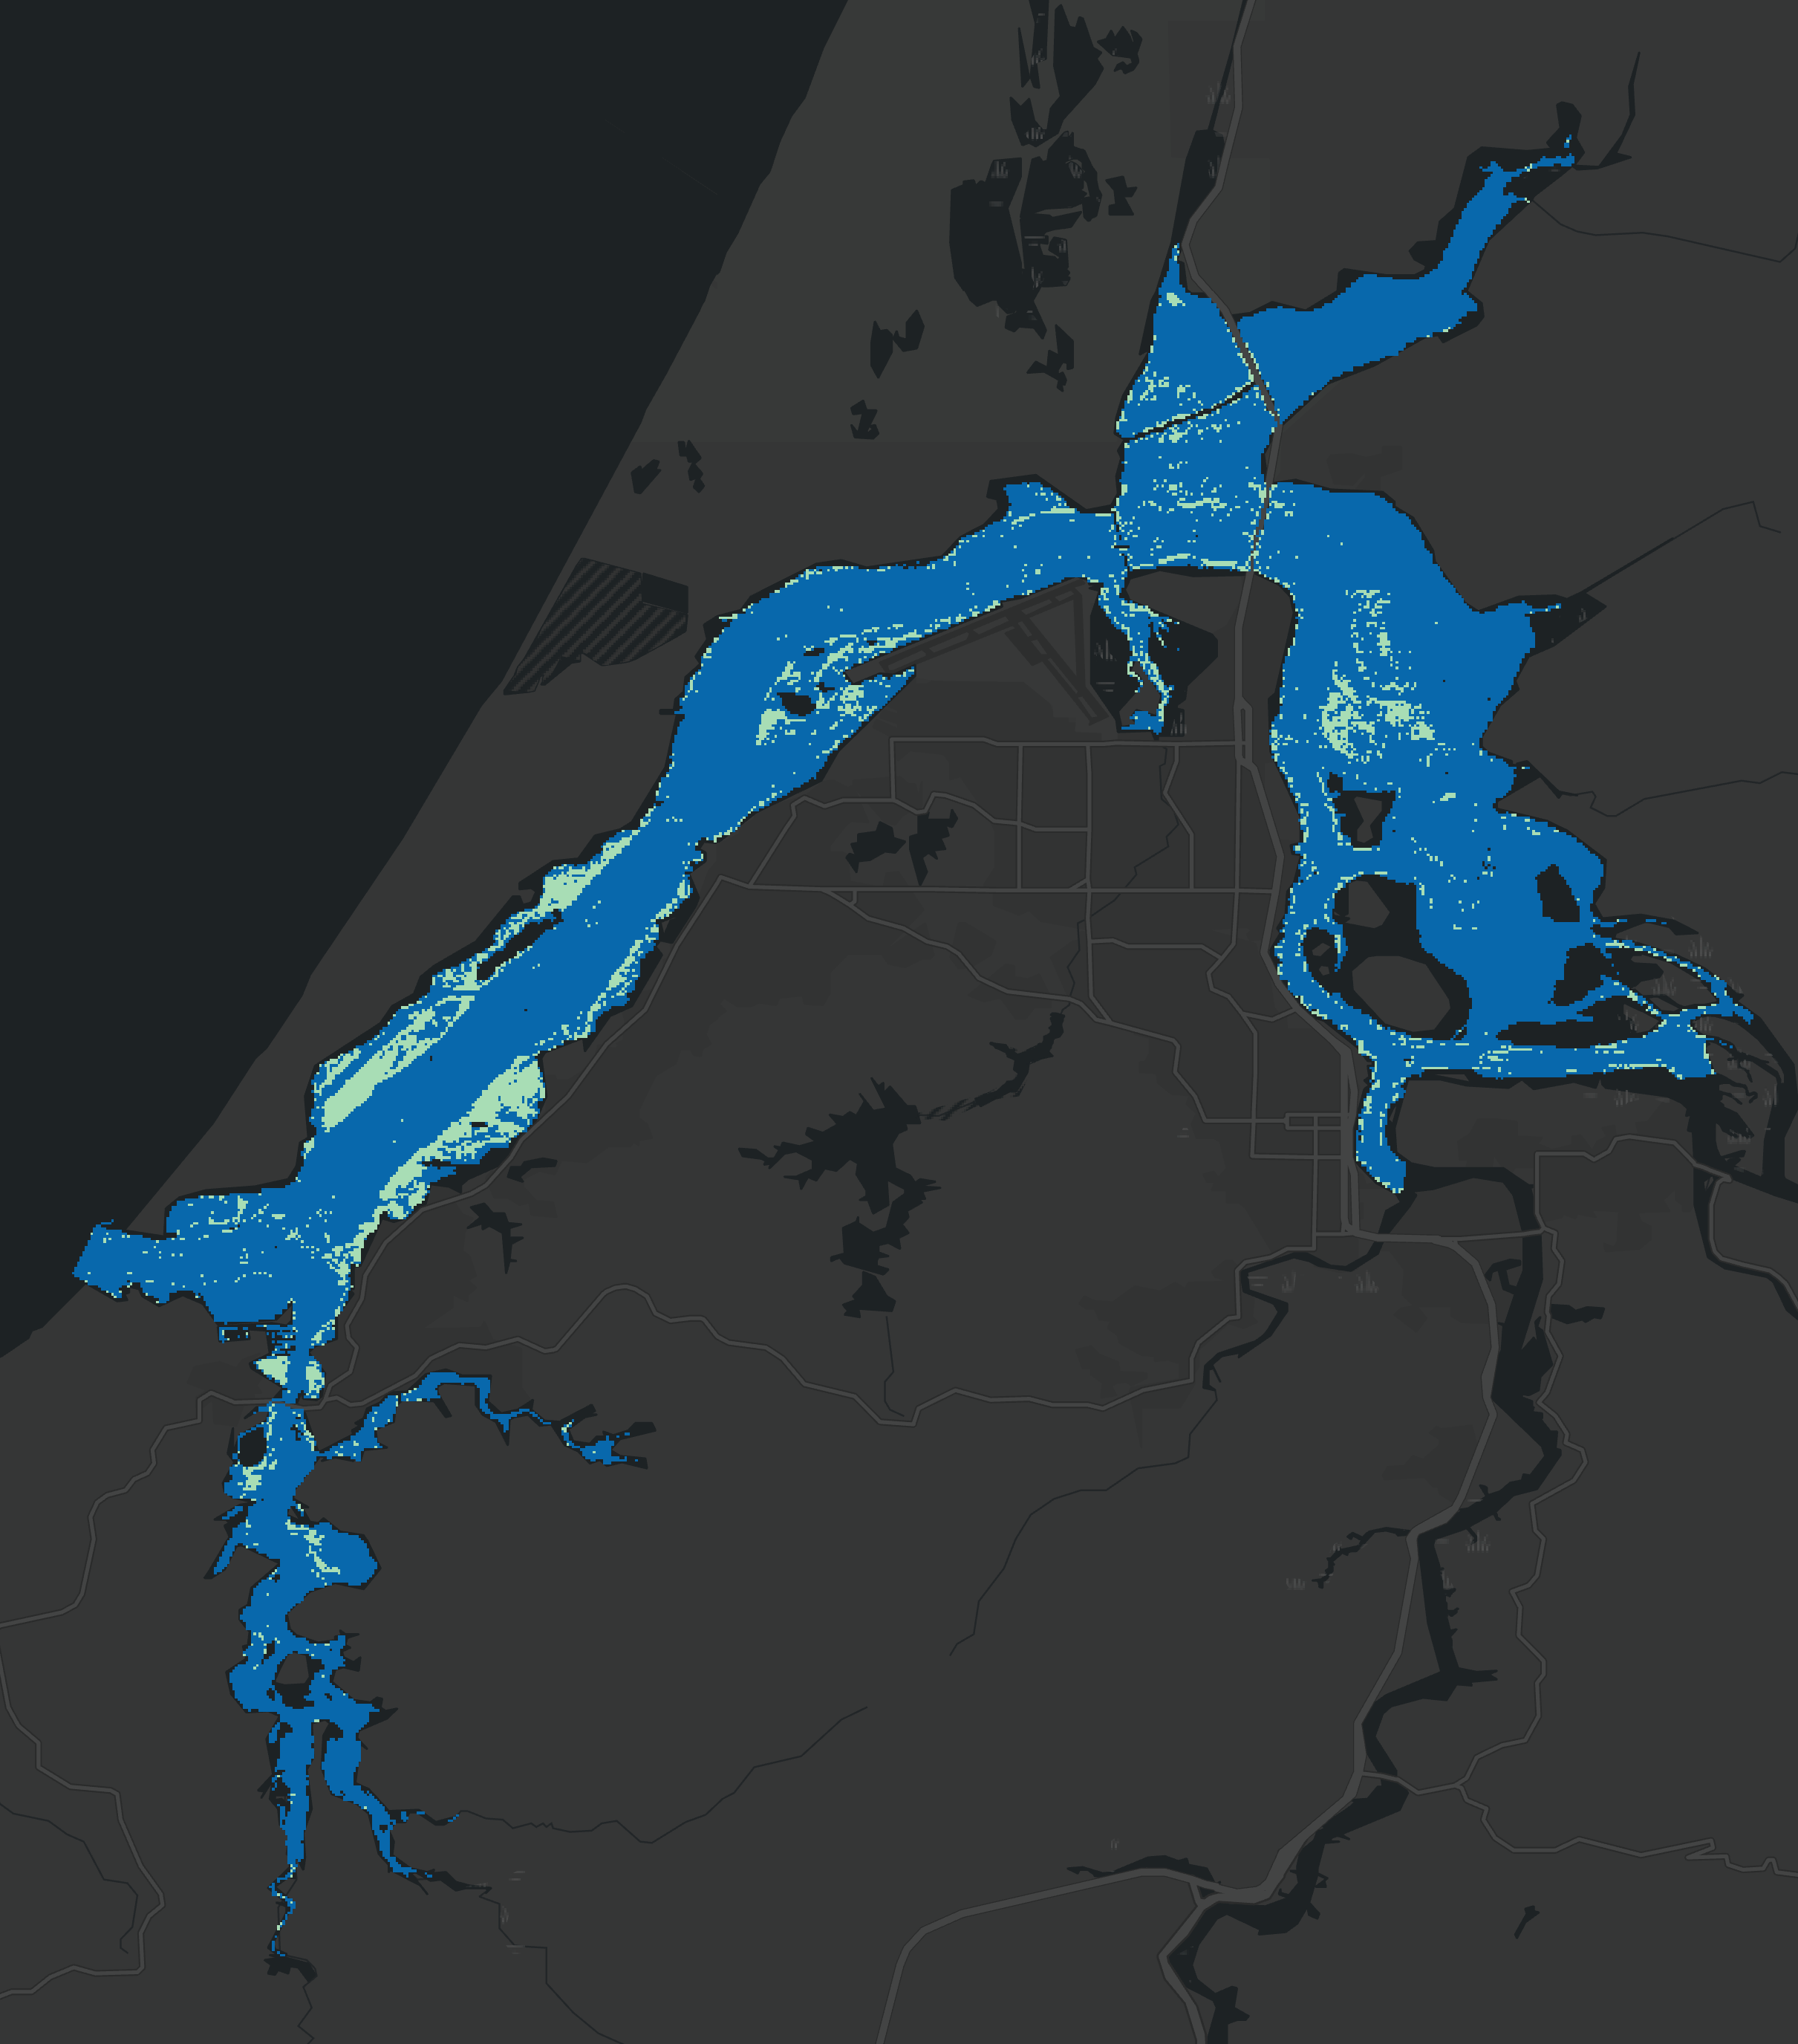
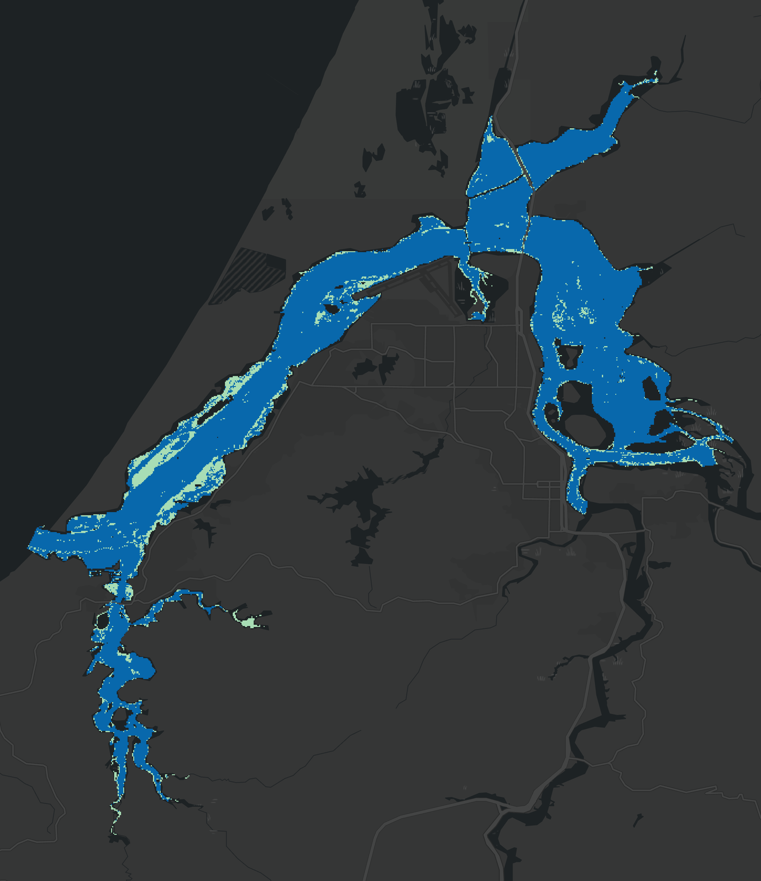
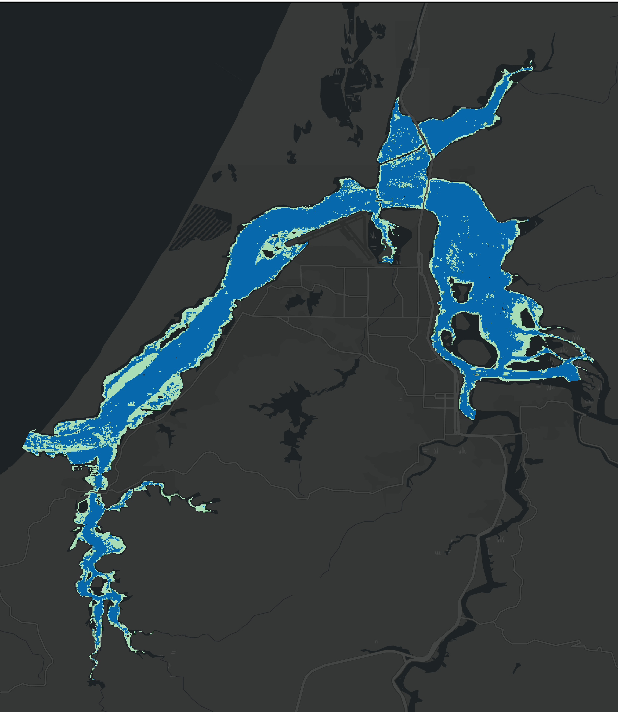
Results: Classification of Eelgrass
Support Vector Machine
2016 Eelgrass Extent
Random Trees
Maximum Likelihood
N
Medium Confidence '16
Predicted Eelgrass
High Confidence '16
Water
0 4 8
km
Esri, HERE, Garmin, FAO, NOAA, USGS, OpenStreetMap contributors, and the GIS User Community
Notes:
Here, we have the previously mapped eelgrass extent in 2016 and the results of supervised classification using Support Vector Machine, Random Trees, and Maximum Likelihood methods. As you can see, the predicted distribution of eelgrass presence is inconsistent across these methods. Each of these methods have distinct advantages and disadvantages that make them appropriate for different datasets. For our data, Support Vector Machine demonstrated the greatest accuracy of the three methods, with a Kappa of .24 and an overall accuracy of XX%. Now, to highlight some of the challenges and successes of the SVM classification, lets take a closer look at a couple regions in the estuary.
------------------------------Image Information Below ------------------------------
•Image Credit: Basemap - ArcGIS Pro
•Image Source: Esri, HERE, Garmin, FAO, NOAA, USGS, OpenStreetMap contributors, and the GIS User Community
•Image Credit: South Slough Team
•Image Source: ORCAA (ESA Sentinel-2 MSI)

Slide 20
Results: Eelgrass Classification Accuracy
2016 Eelgrass Extent
Support Vector Machine
N
Predicted Eelgrass
Medium Confidence '16
0 4 8
High Confidence '16
km
Water
Esri, HERE, Garmin, FAO, NOAA, USGS, OpenStreetMap contributors, and the GIS User Community
Notes:
Here is a closer look at the eastern portion of the estuary, and you can better see the similarities and differences between the 2016 map and our supervised classification. While supervised classification captures the general shape of this patchy meadow, it fails to capture its density and extent. Meanwhile, we see the incorrect classification of pixels along the waters edge as eelgrass which is likely due to spectral mixing with land.
------------------------------Image Information Below ------------------------------
•Image Credit: Basemap - ArcGIS Pro
•Image Source: Esri, HERE, Garmin, FAO, NOAA, USGS, OpenStreetMap contributors, and the GIS User Community
•Image Credit: South Slough Team
•Image Source: ORCAA (ESA Sentinel-2 MSI)

Slide 21
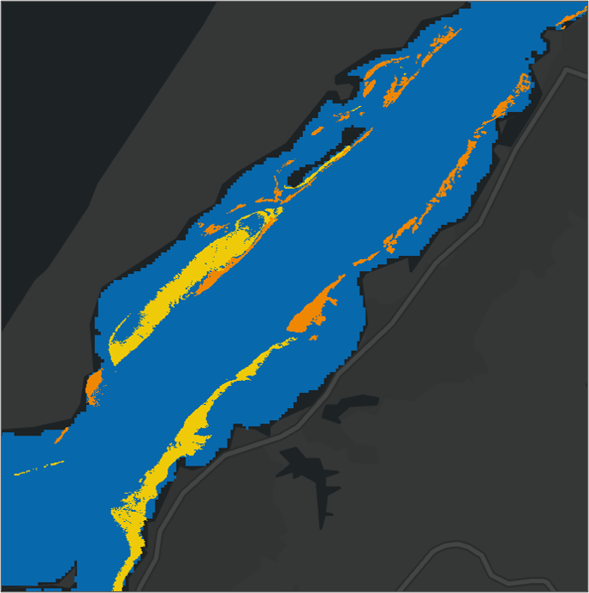
Results: Eelgrass Classification Accuracy
2016 Eelgrass Extent
Support Vector Machine
N
Predicted Eelgrass
Medium Confidence '16
0 4 8
High Confidence '16
km
Water
Esri, HERE, Garmin, FAO, NOAA, USGS, OpenStreetMap contributors, and the GIS User Community
Notes:
Here is a close look just north of the mouth of the estuary where the 2016 maps illustrate seagrass meadows along the tidal flats of the estuary. Our supervised classification illustrates these meadows well but identifies additional pixels as eelgrass, which may be due to confusing other macrophytes as eelgrass. These aspects of under and overestimation of eelgrass extent caused by various interfering factors highlight the limited accuracy we are able to achieve with supervised classification in this system.
------------------------------Image Information Below ------------------------------
•Image Credit: Basemap - ArcGIS Pro
•Image Source: Esri, HERE, Garmin, FAO, NOAA, USGS, OpenStreetMap contributors, and the GIS User Community
•Image Credit: South Slough Team
•Image Source: ORCAA (ESA Sentinel-2 MSI)

Slide 22
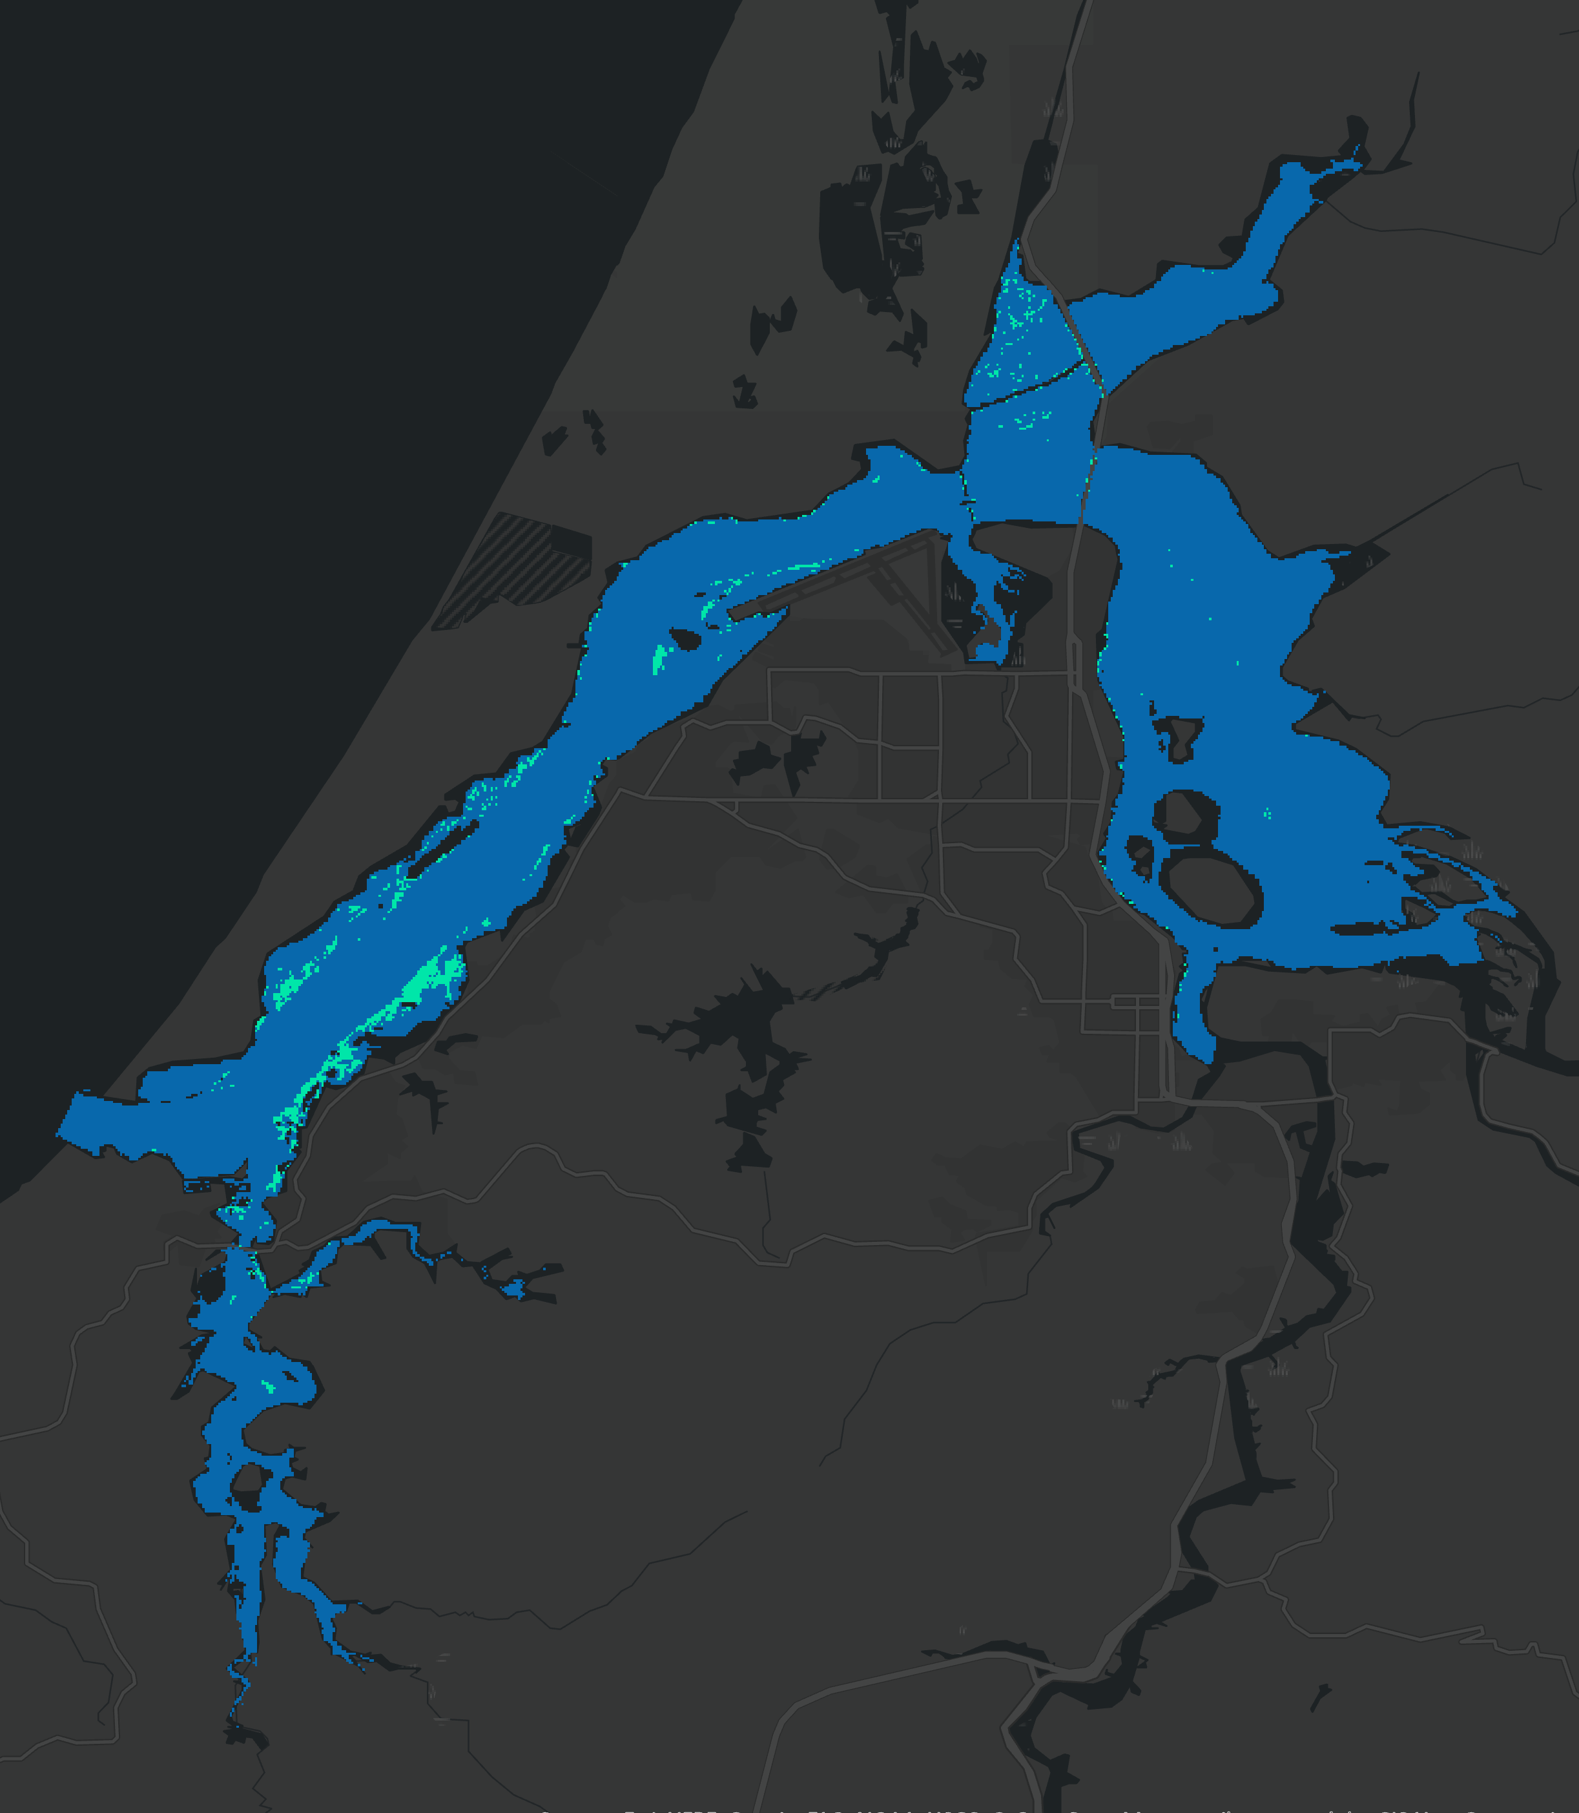
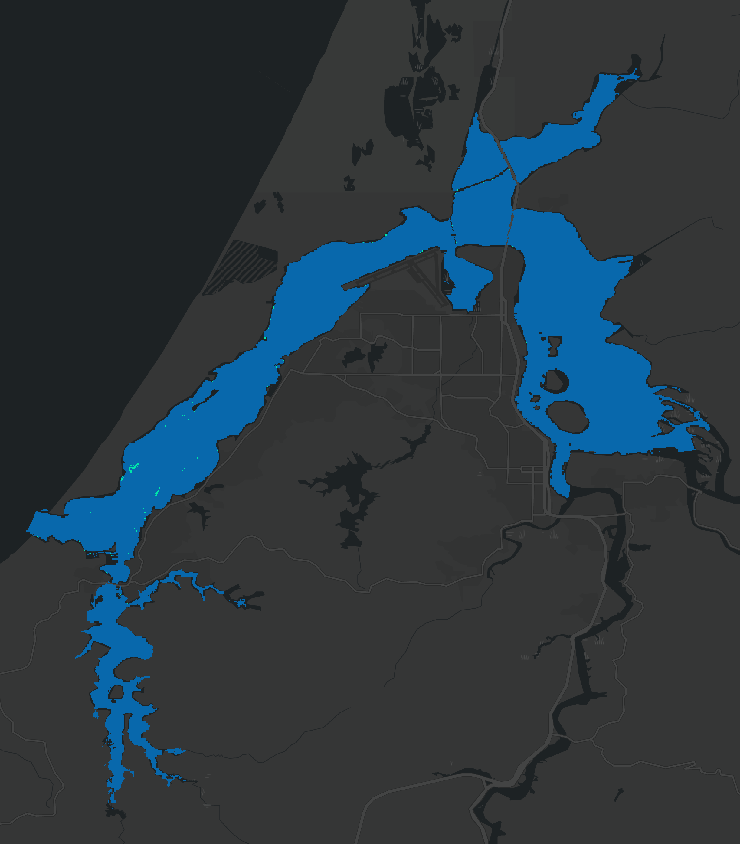
Results: Three-Year Comparison with SVM
2016
2020
2023
N
N
Predicted Eelgrass
0 4 8
km
Water
Esri, HERE, Garmin, FAO, NOAA, USGS, OpenStreetMap contributors, and the GIS User Community
Notes:
Now, with after training the algorithm with the 2016 imagery, we were able to estimate eelgrass presence across years for which we had Sentinel-2 imagery. Here, we have a time-series map of eelgrass extent in 2016, 2020, and 2023. As you can see, our supervised classification reveals a clear decline in the presence of eelgrass through out the estuary from 2016 to today.
------------------------------Image Information Below ------------------------------
•Image Credit: Basemap - ArcGIS Pro
•Image Source: Esri, HERE, Garmin, FAO, NOAA, USGS, OpenStreetMap contributors, and the GIS User Community
•Image Credit: South Slough Team
•Image Source: ORCAA (ESA Sentinel-2 MSI)

Slide 23
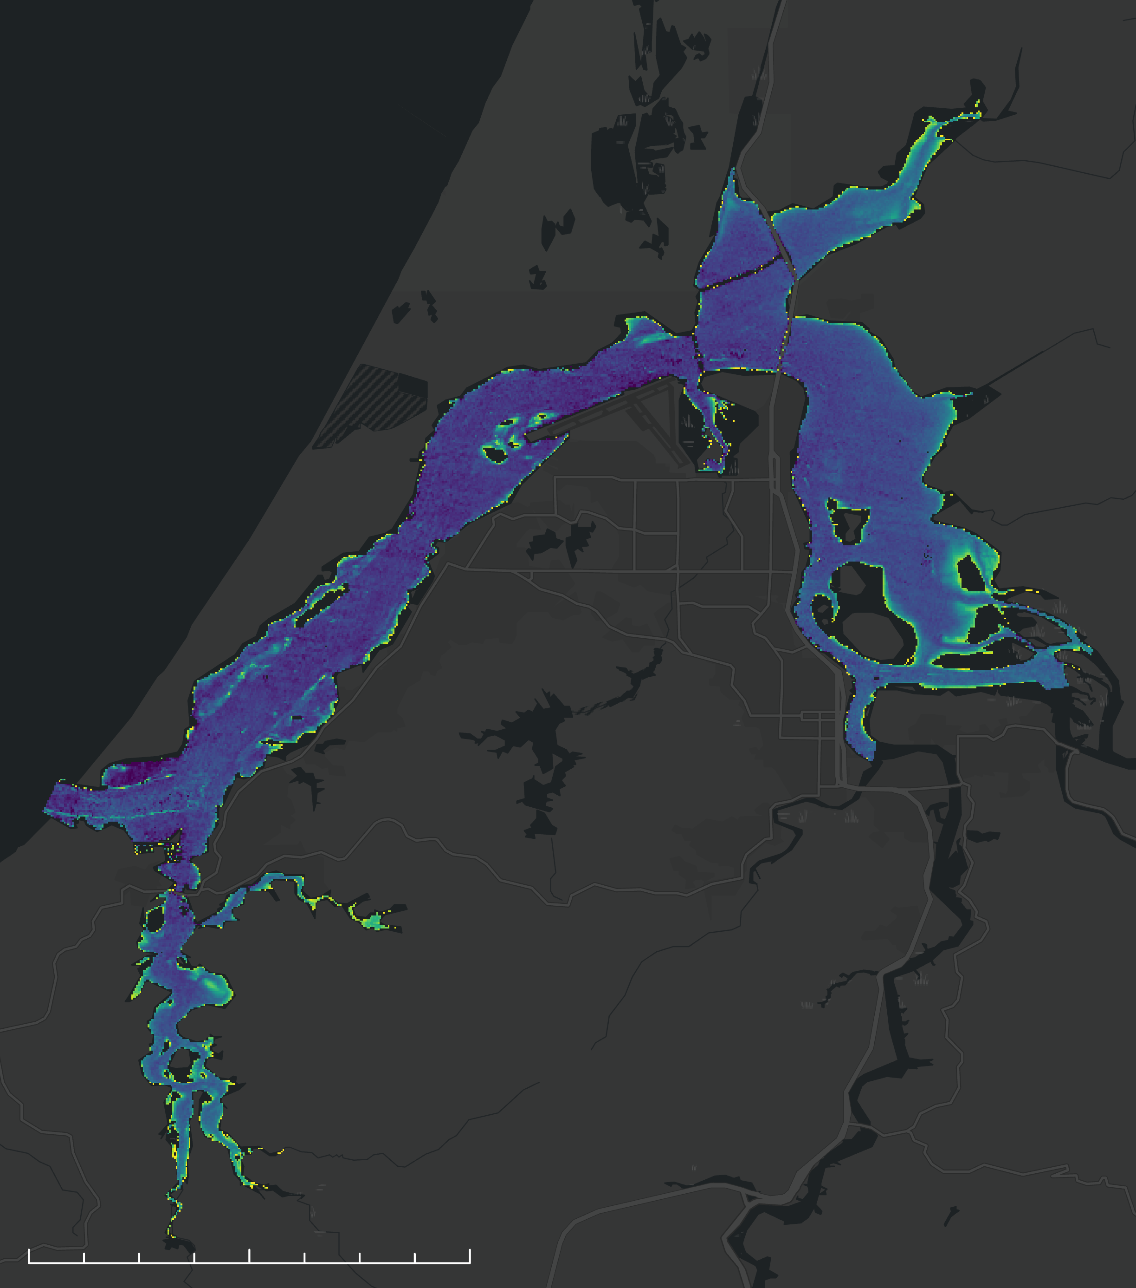
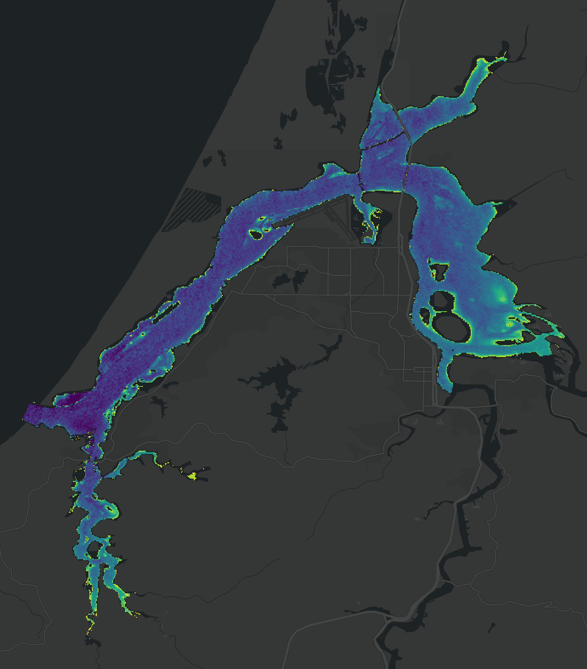
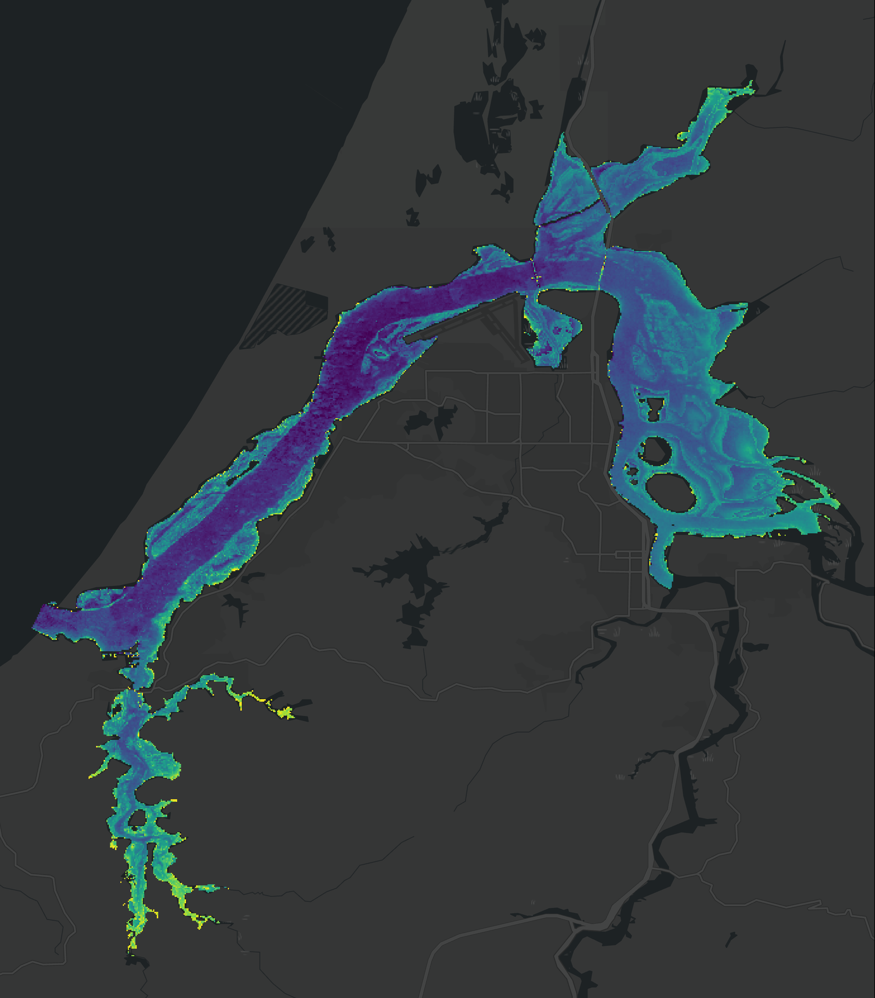
Results: Normalized Difference Aquatic Vegetation (NDAVI)
2016
2020
2023
N
SAV
1.0
0 4 8
km
0
Esri, HERE, Garmin, FAO, NOAA, USGS, OpenStreetMap contributors, and the GIS User Community
Notes:
In addition to supervised classification, we were able to use various indices to gain insight into the presence of submerged aquatic vegetation and water quality conditions. Here, using NDAVI, we visualized SAV extent from 2016 to 2023. This index does not distinguish eelgrass from other macrophytes so we cannot draw conclusions about eelgrass but these maps are useful for quickly identifying areas of interest for macrophyte decline or recovery. Paired with supervised classification, NDAVI can be a powerful tool for monitoring SAV, though it faces some of the same constraints as classification including spectral mixing from land, water column interference, and signals from other photosynthetic organisms.
------------------------------Image Information Below ------------------------------
•Image Credit: Basemap - ArcGIS Pro
•Image Source: Esri, HERE, Garmin, FAO, NOAA, USGS, OpenStreetMap contributors, and the GIS User Community
•Image Credit: South Slough Team
•Image Source: ORCAA (ESA Sentinel-2 MSI)

Slide 24
Results: Normalized Difference Chlorophyll Index (NDCI)
2016
2020
2023
N
Chlorophyll-a
3.0
0 4 8
km
-0.75
Esri, HERE, Garmin, FAO, NOAA, USGS, OpenStreetMap contributors, and the GIS User Community
Notes:
Another useful index is the Normalized Difference Chlorophyll Index (NDCI). This index represents the presence of photosynthetically-active organisms in the water and provides insight into the concentration of chlorophyll-a. Typically, this index may be used to identify algae or macrophytes. Understanding NDCI may help provide context for obscured SAV signals, as well as greater instances of cloudy or turbid water.
------------------------------Image Information Below ------------------------------
•Image Credit: Basemap - ArcGIS Pro
•Image Source: Esri, HERE, Garmin, FAO, NOAA, USGS, OpenStreetMap contributors, and the GIS User Community
•Image Credit: South Slough Team
•Image Source: ORCAA (ESA Sentinel-2 MSI)

Slide 25
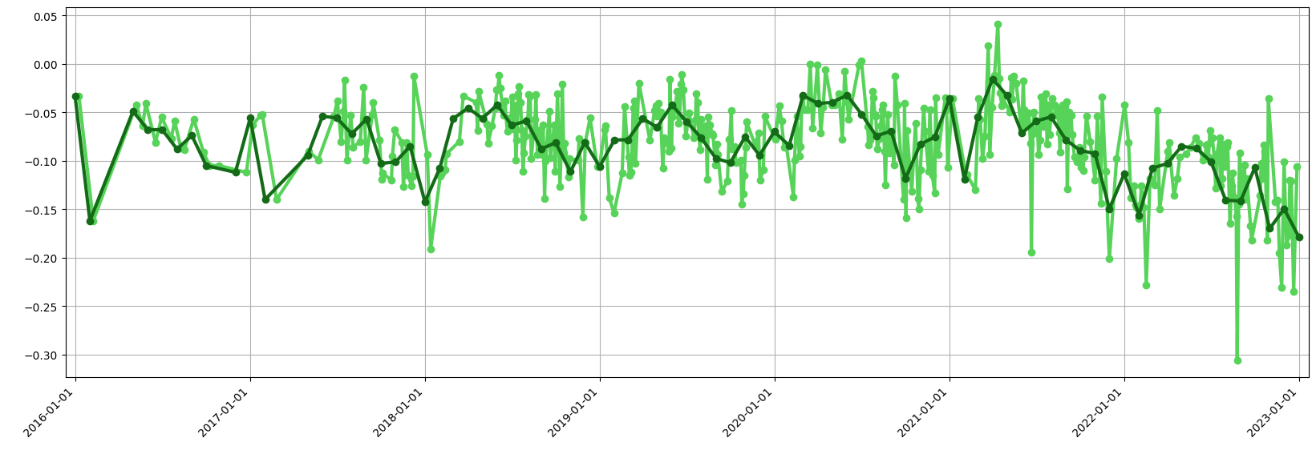
Results: Normalized Difference Chlorophyll Index (NDCI)
0.05
0
-0.05
-0.10
Daily
Normalized Difference Chlorophyll Index (NDCI)
-0.15
Monthly
-0.20
-0.25
-0.30
2016
2017
2018
2019
2020
2021
2022
2023
Year
Notes:
This is the concentration of Chlorophyll A in the water
The activity of these photosynthetic organisms is seasonal and usually peaks towards the start of spring.
------------------------------Image Information Below ------------------------------
•Image Credit: Basemap - ArcGIS Pro
•Image Source: Esri, HERE, Garmin, FAO, NOAA, USGS, OpenStreetMap contributors, and the GIS User Community
•Image Credit: South Slough Team
•Image Source: ORCAA (ESA Sentinel-2 MSI)

Slide 26
Results: Normalized Difference Turbidity Index (NDTI)
2016
2020
2023
N
Turbidity
21
0 4 8
-0.61
km
Esri, HERE, Garmin, FAO, NOAA, USGS, OpenStreetMap contributors, and the GIS User Community
Notes:
As a final water quality parameter, we used ORCAA to capture turbidity across the summer season for 2016, 2020, and 2023. The presence of high turbidity adds complexity to sensing eelgrass in the estuary. Additionally, monitoring the turbidity may reveal hotspots of sediment input into the estuary.
------------------------------Image Information Below ------------------------------
•Image Credit: Basemap - ArcGIS Pro
•Image Source: Esri, HERE, Garmin, FAO, NOAA, USGS, OpenStreetMap contributors, and the GIS User Community
•Image Credit: South Slough Team
•Image Source: ORCAA (ESA Sentinel-2 MSI)

Slide 27
Results: ORCAA and in situ Turbidity Data
30
In situ
15
ORCAA
0
2016
40
Turbidity (NTU – in situ/Normalized - Satellite)
20
0
2020
35
15
0
2022
Jan Mar May Jul Sep Nov
Notes:
In this result we compare the in situ data against the ORCAA data
When compared, this data has a very weak positive correlation (0.09), which is likely due to how the data is calculated
The in situ is representative of a small handful of water quality monitoring stations, while the ORCAA data is a calculation of the whole Coo's Bay
This demonstrates that while the water quality stations are high in precision, they may not be representative state of the bay.
------------------------------Image Information Below ------------------------------
•Image Credit: South Slough Team
•Image Source: Created in Google Colab with matplotlib

Slide 28
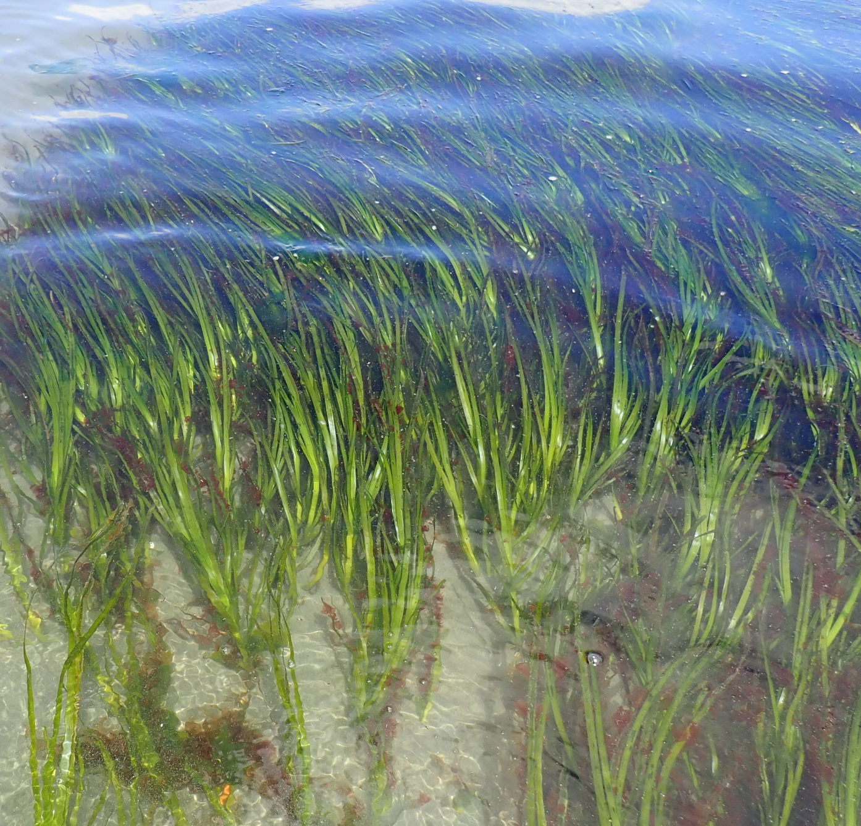
Conclusions
Satellite remote sensing offers the potential to visualize broad water quality trends in the Coos Estuary
Indices such as NDAVI are useful for exploratory investigations into potential eelgrass meadows
In situ measurements are highly recommended and can improve eelgrass identification and classification by satellites
Image Credit: John Brew
Notes:
We conclude that satellite data is a helpful tool to assist with identifying water quality trends in the Coos Estuary. However, the weather conditions, as well as the spatial resolution and tidal cycle, lend complexity to the analyses.
In addition, we found that the Normalized Difference Aquatic Vegetation Indices (NDAVI) were helpful for identifying potential hotspots of eelgrass.
Finally, we determined that in situ measurements such as density counts and UAS mapping would significantly improve our ability to use satellite data to identify and classify eelgrass in the estuary.
------------------------------Image Information Below ------------------------------
•Image Credit: Basemap - ArcGIS Pro
•Image Source: Esri, HERE, Garmin, FAO, NOAA, USGS, OpenStreetMap contributors, and the GIS User Community
•Image Credit: South Slough Team
•Image Source: ORCAA (ESA Sentinel-2 MSI)
•Image Credit: John Brew
•Image Source: https://openverse.org/image/adfe2f05-28d5-4389-8ce7-0af53b55bf64?q=zostera%20marina (CC by 4.0)

Slide 29
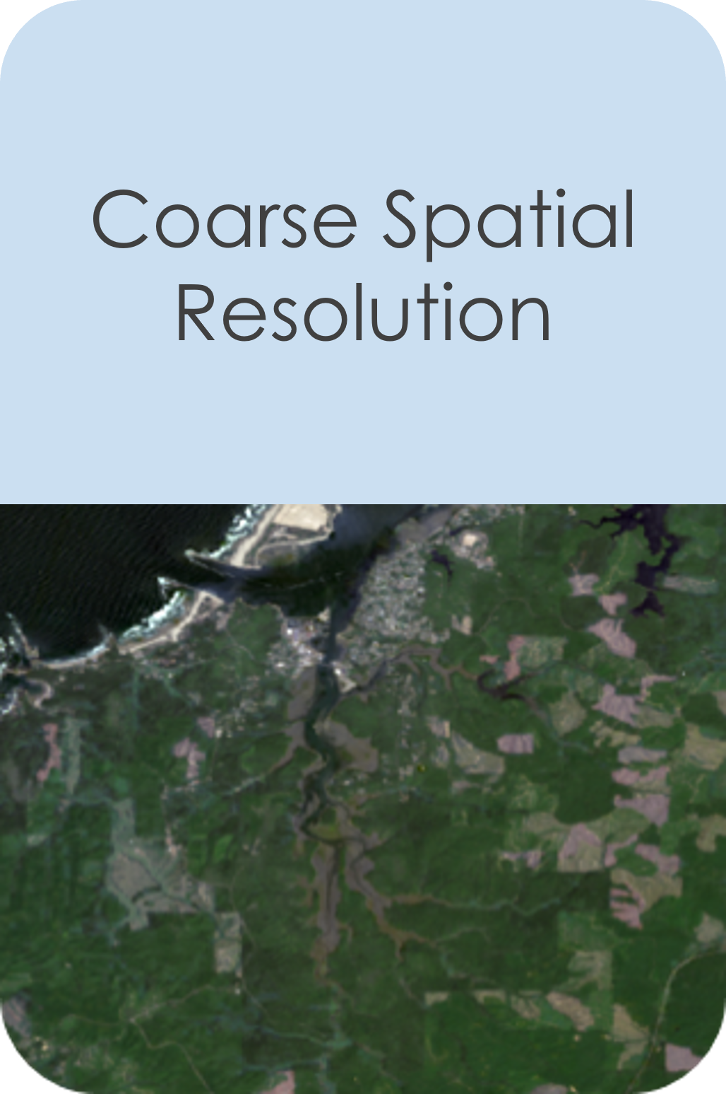
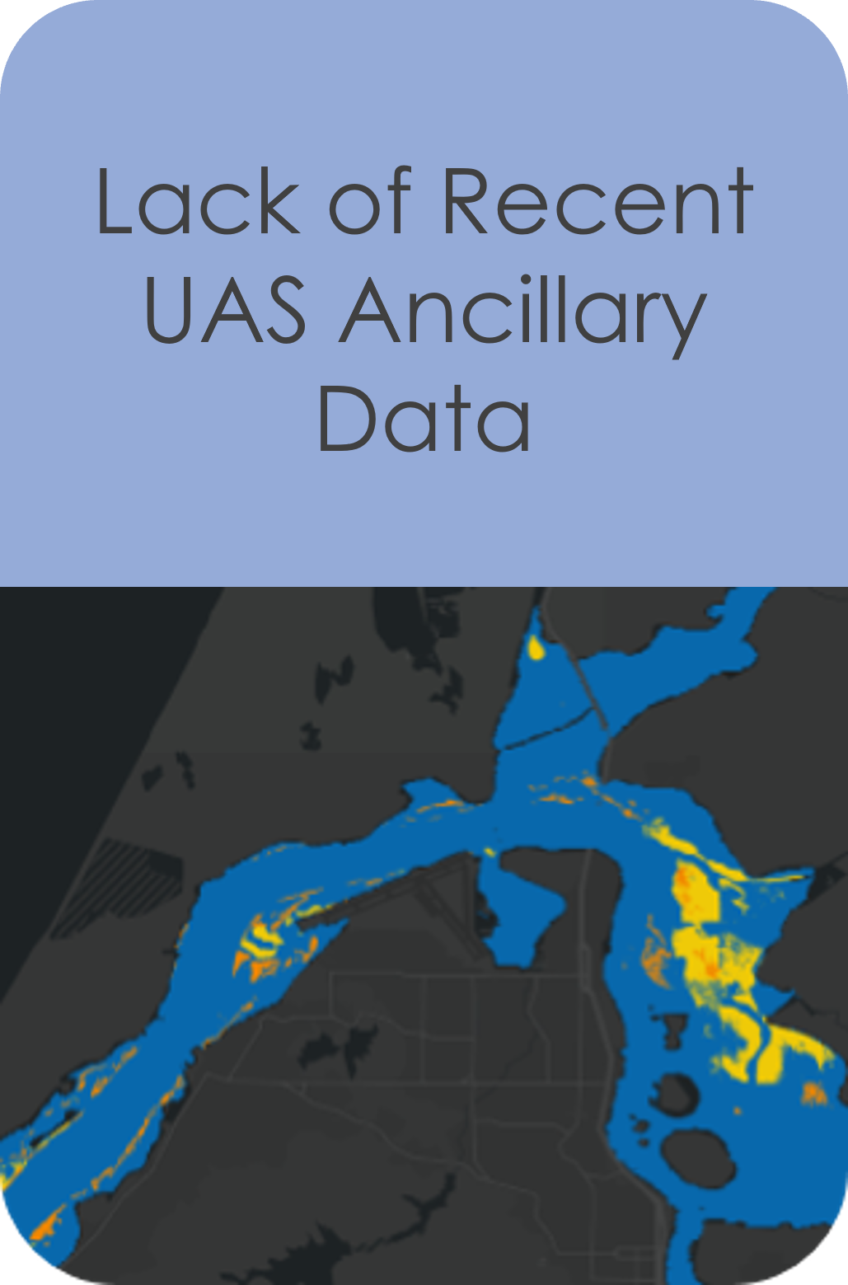
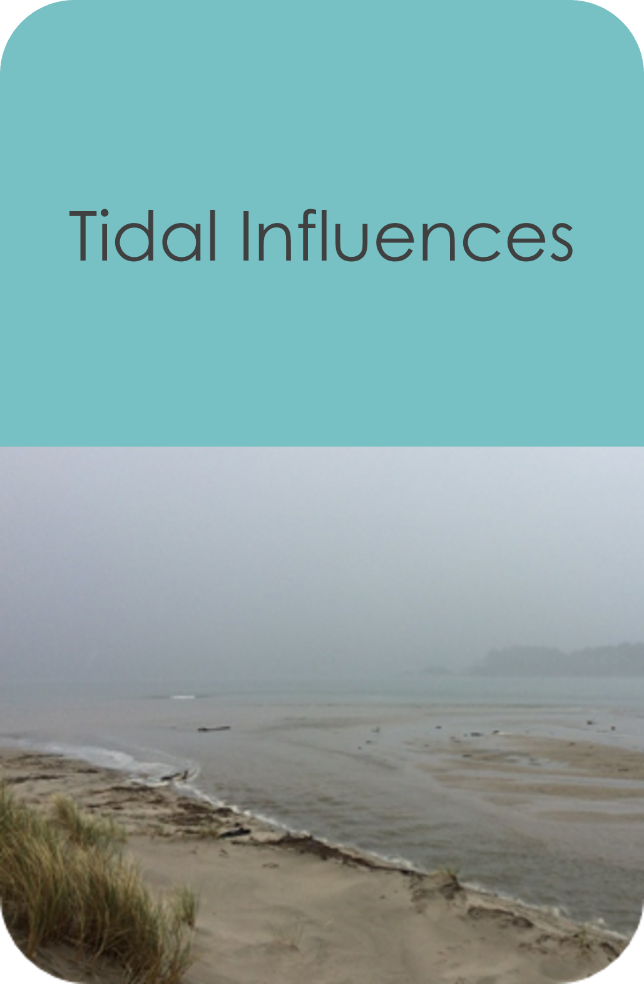
Errors and Uncertainties
Image Credit: Sam Beebe
Notes:
Our errors and uncertainties included coarse spatial resolution. While Sentinel-2 was useful at looking at the estuary as a whole, the resolution was not fine enough to easily identify eelgrass. Additionally, our study site conditions included high periods of cloud cover and precipitation, which reduced the available satellite imagery. Additionally, our study site only had 2016 UAS data, which meant that our classification training was limited to older the eelgrass extent. Updated UAS mapping attempts could improve our training accuracy. Finally, we also had to consider tidal phases since our study subject was submerged. The influence of tides may have obscured or eelgrass in certain parts of the estuary.
------------------------------Image Information Below ------------------------------
•Image Credit: Basemap - ArcGIS Pro
•Image Source: Esri, HERE, Garmin, FAO, NOAA, USGS, OpenStreetMap contributors, and the GIS User Community
•Image Credit: South Slough Team
•Image Source: True color Landsat 9 OLI-2 – NASA/USGS
•Image Credit: South Slough Team
•Image Source: True color Landsat 9 OLI-2 – NASA/USGS
•Image Credit: Sam Beebe
•Image Source: https://openverse.org/image/ad726cb7-0014-45c7-91ca-ab6a62dd1fed?q=oregon%20estuary CC BY 2.0

Slide 30
Future Work
Incorporate density counts of eelgrass into analyses
Classify eelgrass using updated UAS data
Integrate higher resolution data into our methods
Use additional estuaries for algorithm training
Notes:
Future work on this project would include using higher resolution data products to better capture the eelgrass. We also would use density counts of eelgrass in our analyses to provide another in situ measurement for comparison with satellite data. Likewise, we would incorporate updated eelgrass maps from UAS transects so that our classification could be improved. Lastly, we would train with additional Oregon estuaries for greater training points.
------------------------------Image Information Below ------------------------------

Slide 31
We would like to sincerely thank our...
Science Advisors
Dr. Juan Torres-Pérez, Dr. Liane Guild, and Britnay Beaudry
Partners
South Slough National Estuarine Research Reserve (SSNERR) and the Confederated Tribes of the Coos, Lower Umqua, and Siuslaw Indians' (CTCLUSI) Natural Resources Department
Alicia Helms, Jenni Schmitt, Jennifer Kirkland, and Janet Niessner
Fellow
Lisa Tanh, for guiding and supporting this project
This material contains modified Copernicus Sentinel data (2016 - 2023), processed by ESA.
Notes:
Thank you very much to our science advisors Dr. Juan Torres-Pérez, Dr. Liane Guild, and Britnay Beaudry
Thank you also to our partners South Slough National Estuarine Research Reserve (SSNERR) and the Confederated Tribes of the Coos, Lower Umqua, and Siuslaw Indians' (CTCLUSI) Natural Resources Department
Finally, thank you to our Fellow Lisa!

