Slide 1
Colorado Springs Health & Air Quality
Using Earth Observations to Monitor Wildfire Smoke and Air Pollution for Enhanced Air Quality Management in Colorado Springs, Colorado
Olivia Etherton • Jeanette Moritz • Joshua Stokes • Ephrata Yohannes
Virginia – Langley | Spring 2023
Notes:
Hello and welcome! We are Olivia Etherton, Jeanette Moritz, and Joshua Stokes, the Colorado Springs HAQ team! Today, we'll be giving an overview of our methods, findings, and takeaways for how we used Earth observations to monitor wildfire smoke and air pollution for enhanced air quality management.

Slide 2
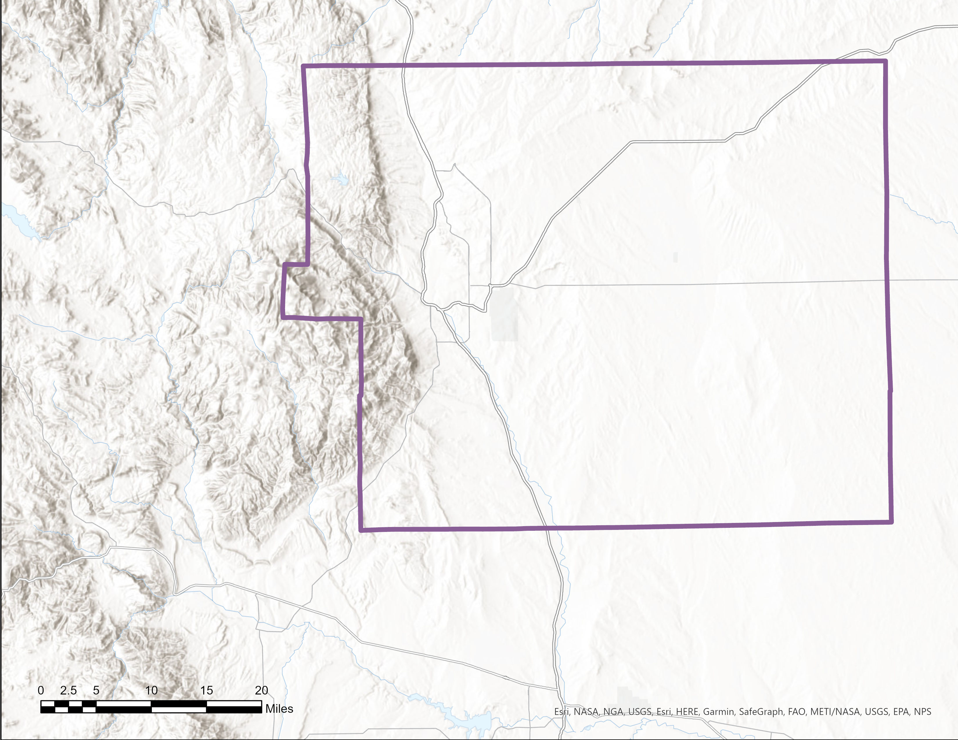
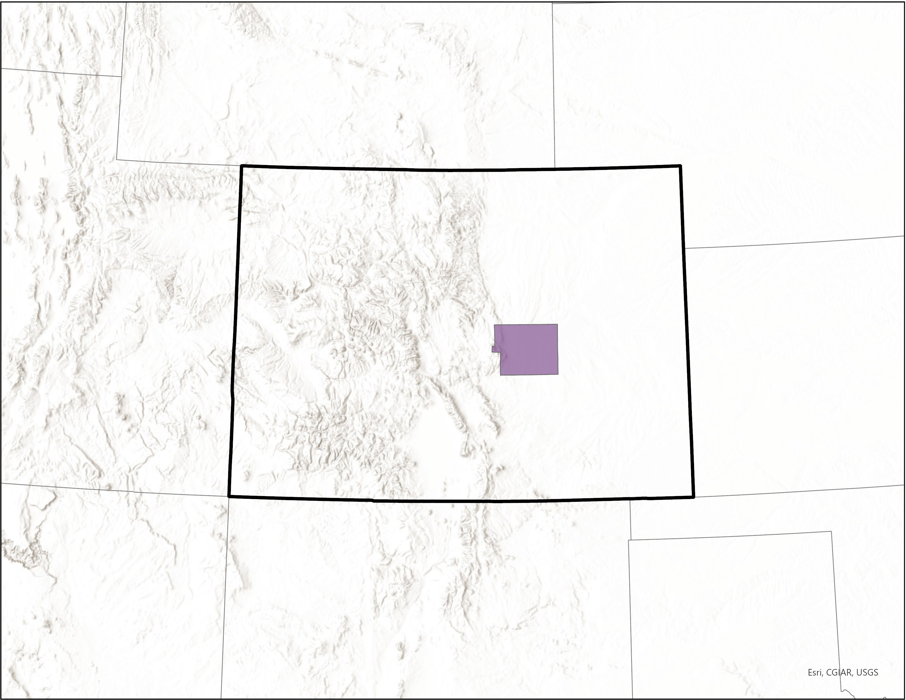
El Paso County
Colorado Springs
El Paso County
STUDY AREA & PERIOD
Colorado Springs
Colorado Springs,
CO
2007 – 2022
CO
N
0
2.5
5
10
15
20
Miles
Notes:
Our study examined air quality and pollution trends in Colorado Springs, Colorado, shown on the slide. Situated at the foot of Pikes Peak, Colorado Springs is one of the state's most rapidly growing cities. Some projections even put it on pace to become the largest city in CO in the next few decades. However, like many cities on Colorado's Front Range, CO Springs struggles with air pollution and is on the verge of non-compliance with Clean Air Act-mandated ozone regulations. Increasely frequent and intense Coloradan wildfires only worsen the air quality challenges the city faces.
------------------------------------------Citations below--------------------------------------------
City projected growth statistics: https://coloradosprings.gov/plancos/page/plancos-appendix-state-city-snapshots
Map
North arrow icon credit: SKETCH ICON; acquired from The Noun Project; Source: https://thenounproject.com/icon/compass-3060970/ (CCBY3.0)
Basemap credit: Esri, HERE, Garmin, SafeGraph, FAO, METI/NASA, USGS, EPA, NPS (2023)

Slide 3
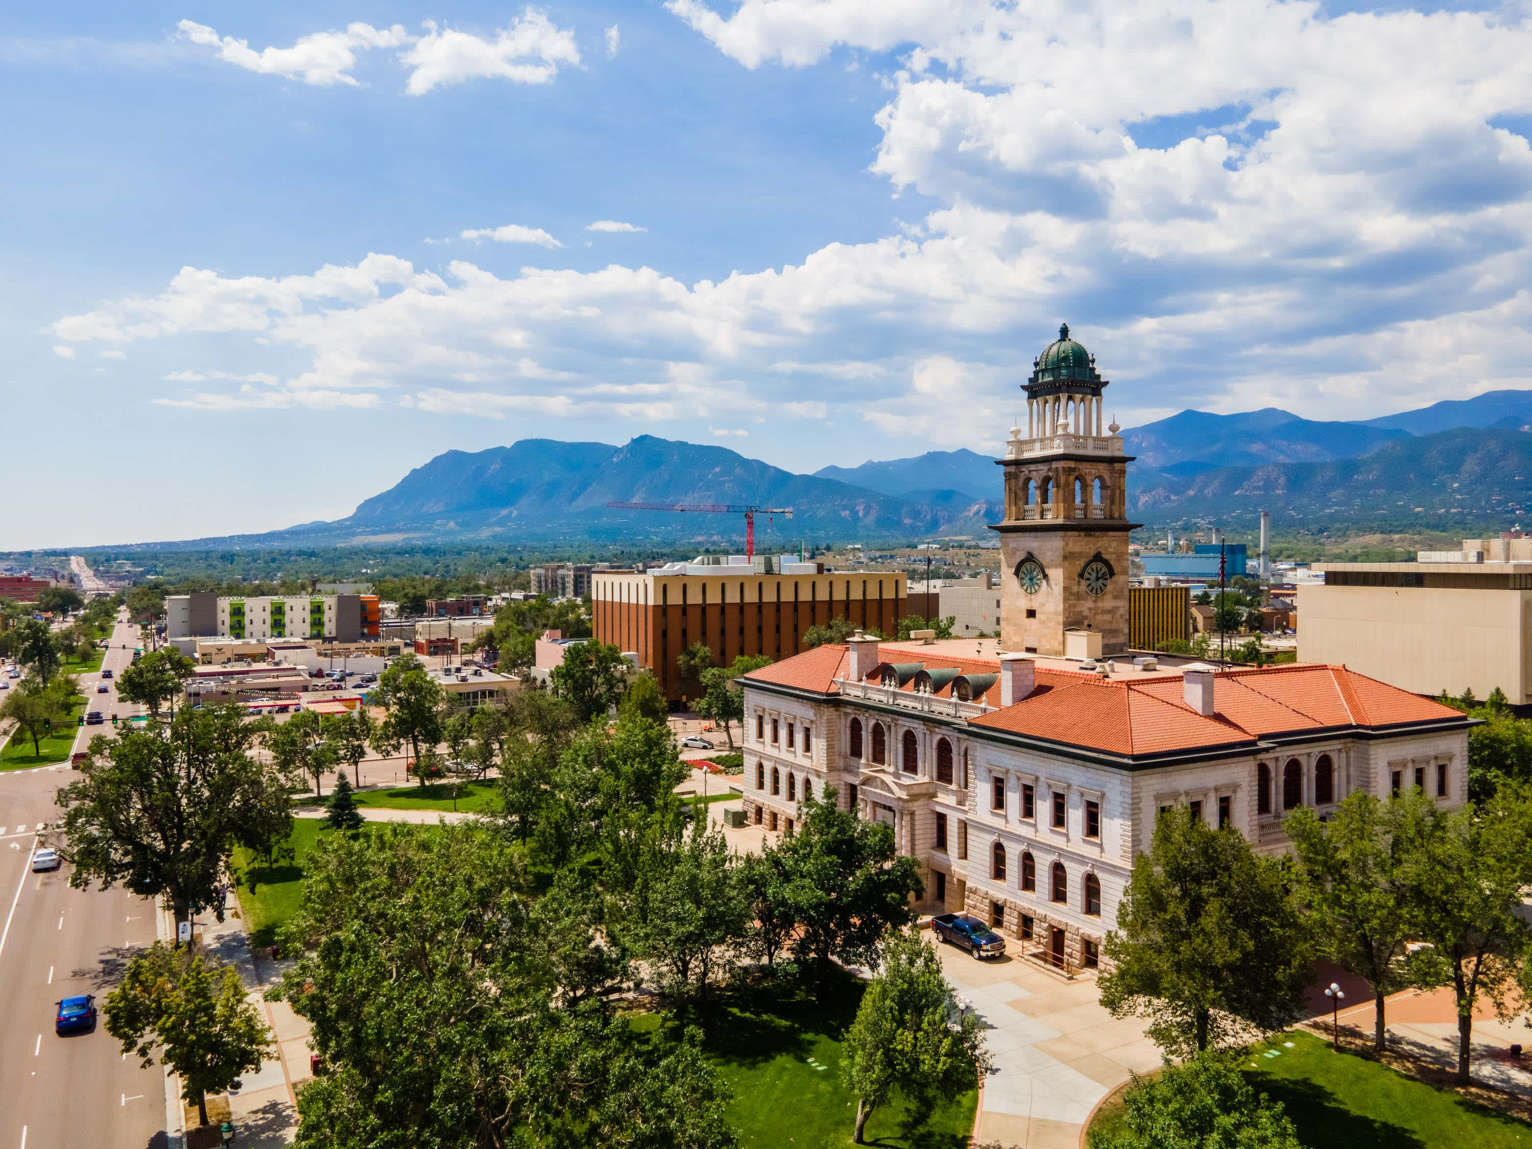
PARTNER
City of Colorado Springs,
Office of Innovation
Image Credit: City of Colorado Springs
Notes:
Our team collaborated with Colorado Springs' Office of Innovation, where Carlos Tamayo served as the team lead. The City partnered with DEVELOP to address its concerns about the high air pollution it experiences and explore ways to protect the health of its citizens while improving their air quality management and disaster resilience. The City is already taking other measures to achieve this: it recently completed a city-wide emissions inventory, is a participant in the EPA's Ozone Advance program, and is in the process of deploying a new network of air quality monitors this year.
---------------------------------------------Citations below----------------------------------------------
Image provided by project partners with permission (City of Colorado Springs)

Slide 4
COMMUNITY CONCERNS
Air pollution & adherence to Clean Air Act air quality standards
Adverse health impacts & risks from exposure to poor air quality
Intensifying wildfire regimes in the region & the City's large wildland-urban interface
Notes:
Pollutants of particular concern to Colorado Springs include ground-level ozone and particulate matter, each of which the Clean Air Act requires the EPA to regulate by setting National Ambient Air Quality Standards. The City is expected to exceed the 70ppb national ozone standard very soon, putting its ozone levels beyond safe & legal limits. While the majority of Colorado Springs' ozone emissions are anthropogenic in origin, particulate matter pollution is primarily a concern during wildfires, which generate smoke plumes that contribute to acute air quality events. Both pollutants pose risks to human health, and can be harmful to the respiratory and cardiovascular systems. Particulate matter with a diameter of 2.5 microns or smaller, called PM2.5, is especially harmful to human health. These air quality challenges are made more urgent by the fact that wildfires in the region have become increasingly intense and frequent, fueled by climate change. Colorado has experienced at least 20 of its largest fires in this century alone, 15 of which occurred between 2012-2021. With nearly 20% of Colorado Springs’ growing population living in the wildland-urban interface, the transition zone between human development and wildlands, the risk of wildfires & their associated air quality hazards is especially steep.
----------------------------------------------Citations below----------------------------------------------
Icon credit: Microsoft PowerPoint

Slide 5
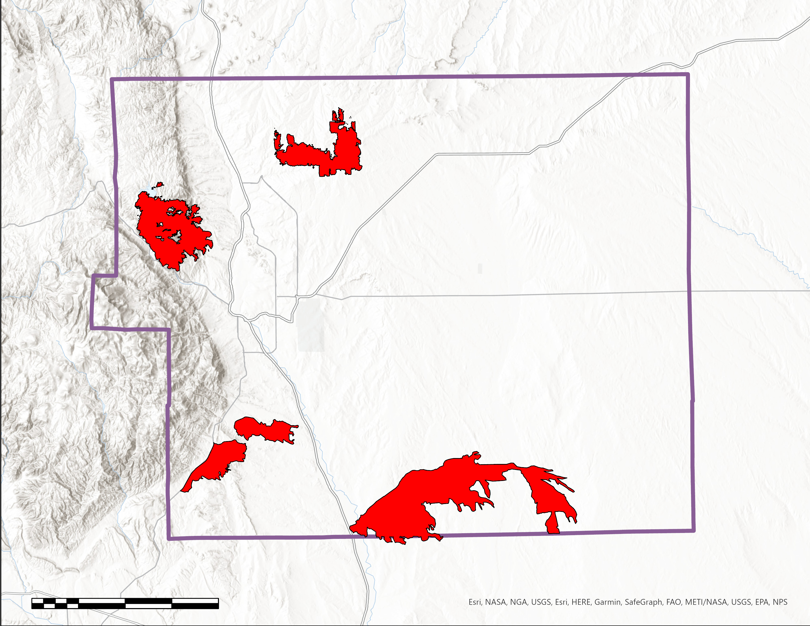
CASE STUDIES
TA-25 Fire (2008)
Black Forest Fire
Quarry Fire (2009)
Waldo Canyon Fire
Waldo Canyon Fire (2012)
Black Forest Fire (2013)
0
2.5
5
10
15
20
Miles
Fire Perimeters
El Paso County
N
MM 117 Fire (2018)
Notes:
This map shows the burn areas of major wildfires that occurred near Colorado Springs between 2007 and 2021. Within the scope of our project, we were able to look into two of these as case studies. The Waldo Canyon Fire, in June of 2012, was the most destructive in Colorado's history until the Black Forest Fire surpassed it one year later. Due to the location of each fire, wind patterns, satellite launch dates and transect passes, our case study analyses differed in the combination of data we were able to apply.
------------------------------------------Citations below--------------------------------------------
Map
Large Fire Perimeter shapefiles 2007 – 2022: InterAgencyFirePerimeterHistory All Years View Feature Layer ; retrieved from the National Interagency Fire Center
North arrow icon credit: SKETCH ICON; acquired from The Noun Project; Source: https://thenounproject.com/icon/compass-3060970/ (CCBY3.0)
Basemap credit: Esri, HERE, Garmin, SafeGraph, FAO, METI/NASA, USGS, EPA, NPS (2023)

Slide 6
OBJECTIVES
Examine baseline & seasonal trends in air quality using MODIS aerosol optical depth (AOD) & TROPOMI nitrogen dioxide (NO₂) datasets
Cross-validate air quality trends using CALIOP aerosol products & in situ observations
Analyze impact of wildfires on the City's air quality using case studies of major fire events
Notes:
JM
The goal of our project was to explore whether NASA Earth Observations can be leveraged to enhance Colorado Springs' air quality management. Our objectives were to, first:
Analyze baseline & seasonal trends in aerosol optical depth, which can be used as a proxy for particulate matter pollution, at PM2.5 microns, - as well as nitrogen dioxide, an ozone precursor, to use as a proxy for ozone trends.
Cross validate Air Quality trends using CALIOP LiDproducts and in situ observations from the EPA
Analyze the spatial impacts of wildfires on the city's Air Quality using case studies of major fire events.
----------------------------------------------Image Citations Below----------------------------------------------
Icon credit: Microsoft Powerpoint

Slide 7
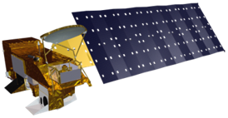
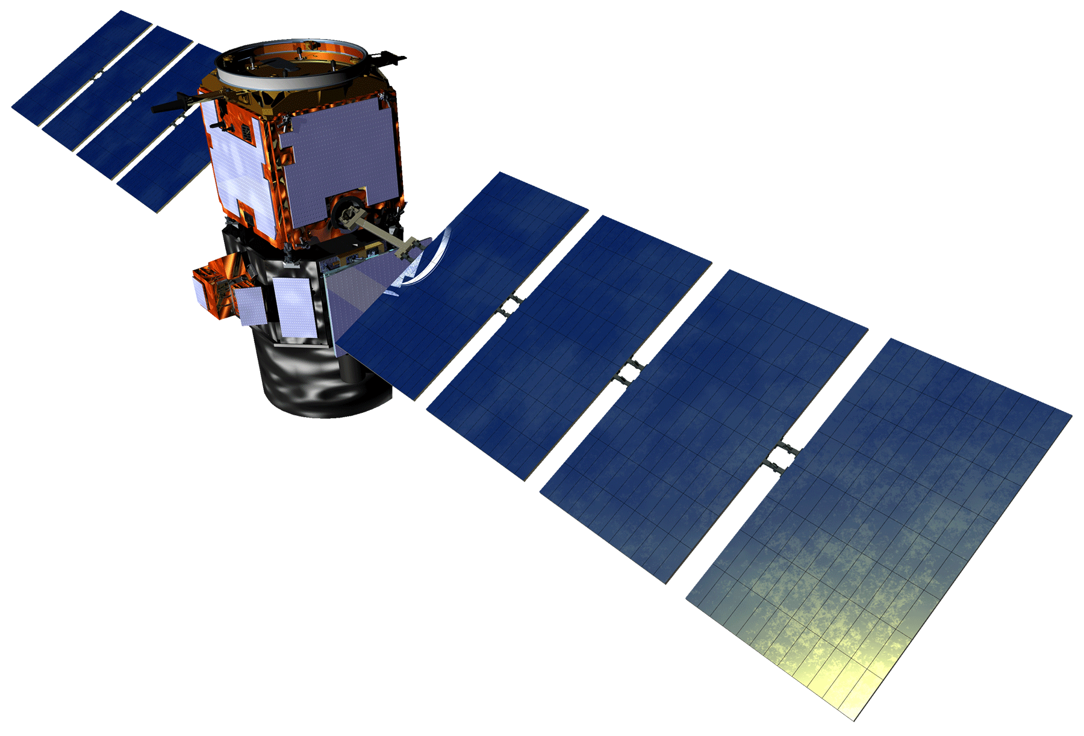
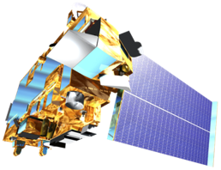
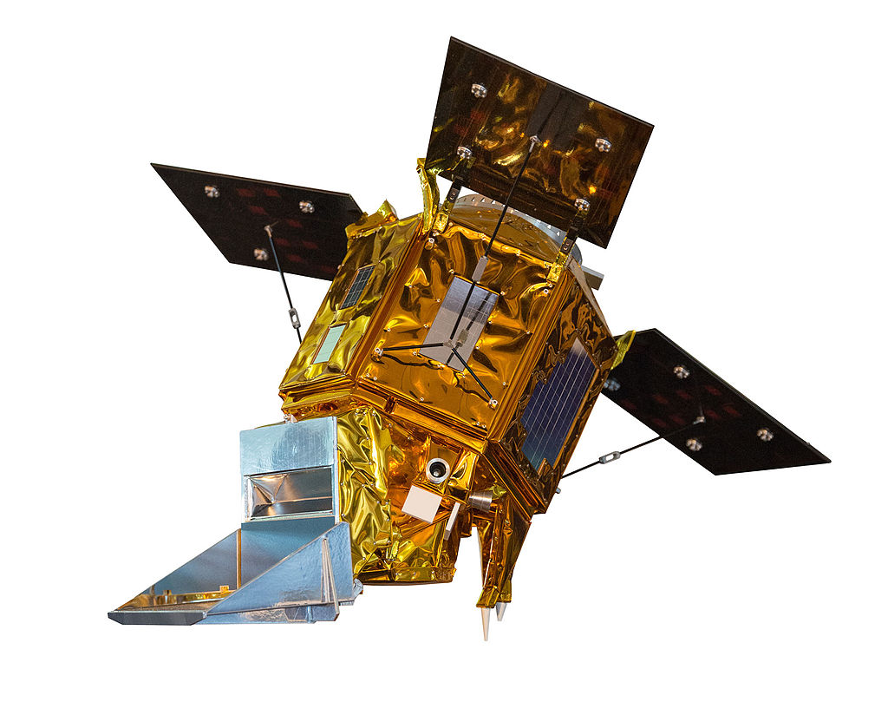
EARTH OBSERVATIONS
Aqua: MODIS – Aerosol
Optical Depth,
MAIAC Product
CALIPSO: CALIOP –
VFM &
Aerosol Profile
​Terra: MODIS – Aerosol Optical Depth, MAIAC Product
TROPOMI
CALIOP
Sentinel 5P: TROPOMI – NO₂
2007
MODIS
2018
2022
Image Credits: ESA, NASA
Notes:
To achieve our objectives, we utilized air quality measurements from 4 major Earth observations. We used CALIPSO CALIOP to examine LiDAR aerosol profiles, and Aqua and Terra MODIS for measurements of aerosol optical depth and the MAIAC product, an algorithm that improves accuracy of cloud detection, aerosol retrievals and atmospheric correction, and finally, Sentinel-5P TROPOMI to assess NO2 measurements. Level 2 data were used from MODIS and CALIOP, with Level 3 data from TROPOMI.
Terra Aqua MODIS Moderate Resolution Imaging Spectroradiometer
MAIAC Multi-Angle Implementation of Atmospheric Correction
TROPOMI TROPOspheric Monitoring Instrument
Cloud-Aerosol LiDAR and Infrared Pathfinder Satellite Observations
Cloud Aerosol L I DAR with Orthogonal Polarization
----------------------------------------------Image Citations Below--------------------------------------------------------
Aqua MODIS credit: NASA
Aqua MODIS source: https://pace.oceansciences.org/gallery_more.htm?id=149
Terra MODIS credit: NASA
Terra MODIS source: https://science.nasa.gov/get-involved/toolkits/spacecraft-icons
CALIPSO CALIOP credit: NASA
CALIPSO CALIOP source: https://science.nasa.gov/get-involved/toolkits/spacecraft-icons
Sentinel-5P credit: SkywalkerPL
Sentinel-5P source: https://commons.wikimedia.org/wiki/File:Sentinel_5P_model.jpg (CC BY 3.0)
Background, Pixabay: https://pixabay.com/photos/milky-way-stars-night-sky-2695569/
Earth | NASA Image and Video Library

Slide 8
METHODS
Raw Data
Pre-Processing & Processing
End Products
Sensor Observations
MODIS
(MAIAC)
AOD
Google Earth Engine
Statistical Analyses
Case Studies
Visualizations
AOD Trend Maps (PM_{2.5})
TROPOMI
NO₂
JupyterLab
Aerosol Subtypes and Extinction Coefficient Plots
CALIOP
VFM & Aerosol Profile
ArcGIS Pro
NO₂ Trend Maps as (O₃)
In Situ Observations
EPA: O₃, PM_{2.5}
Notes:
We first acquired data from our EO and Atmospheric observation sources as well as in situ observations from the EPA air quality ground monitors.
Google Earth Engine for TROPOMI, MODIS, JupyterLab Python for CALIOP, and ArcGIS Pro were used to analyze, graph, and plot the sensors Level 2, Level 3 data. (MS Excel was used for EPA data.)
End products were made and we are still working on validation analysis and comparing to in situ data.
what methods/platforms were used for the different EO/parameters. i.e. GEE used for TROPOMI, python for caliop, etc

Slide 9
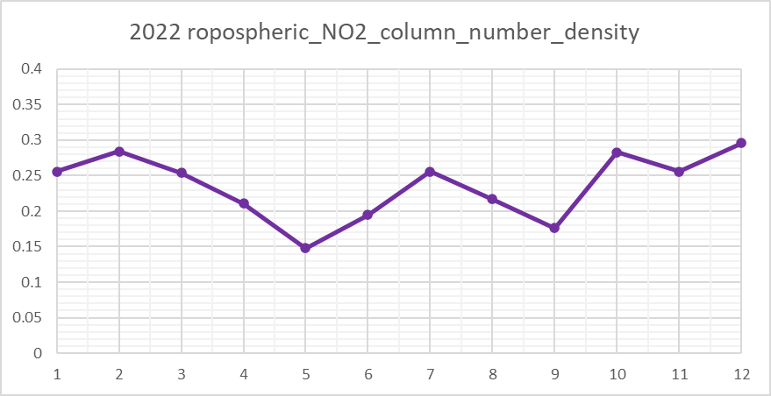
RESULTS – NO₂
2022 Yearly NO₂ Concentration
0.40
0.35
0.30
0.25
Concentration
(mol/m²)
0.20
0.15
0.10
0.05
0
J
F
M
A
M
J
J
A
S
O
N
D
Month
Image Credit: ESA
Notes:
We used S-5P to measure the concentration of atmospheric NO2 over the past years. NO2 is a precursor chemical to O3, which is critical for protecting the Earth in the upper atmosphere, but is a hazardous pollutant at lower altitudes, like in the upper troposphere. Through TROPOMI NO2 measurements, we can by proxy assess the level of O3 pollution happening near CO Springs. This graph shows trends corresponding with expected seasonal variation in NO2 emissions.
u
NO2 is released in the air when fossil fuels such as coal, oil, gas or diesel are burned at high temperatures. NO2 forms from emissions from cars, trucks and buses, power plants, and off-road equipment. This graph represents the yearly trend with a visualization of the median for each month.

Slide 10
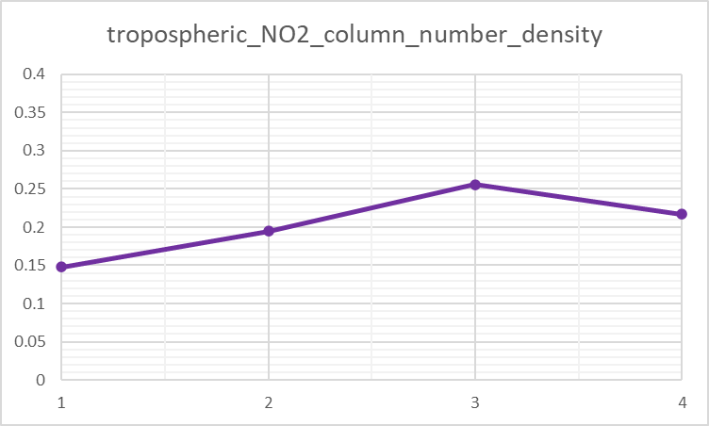
RESULTS – NO₂
2022 Monthly NO₂ Concentration
Sentinel-5p TROPOMI
0.40
0.35
0.30
0.25
Concentration
(mol/m²)
0.20
0.15
0.10
0.05
0
M
J
J
A
Month
Image Credit: ESA
Notes:
This graph shows average monthly NO2 concentration, in mol/m2, from May-Aug, the fire season in Colorado. During this time of the year, temperatures are high and NO2 concentrations steadily increase. We’re able to use this information to help understand the summer NO2 concentrations and overall trend for this season.

Slide 11
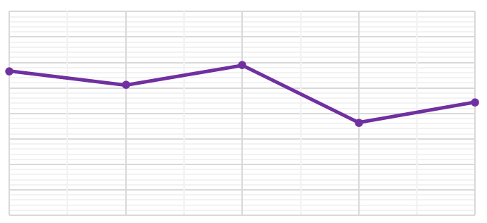
RESULTS – NO₂
2022 -2023 NO₂ Concentrations Associated with Sweetwater Fire
Sentinel-5p TROPOMI
0.40
0.35
0.30
0.25
Concentration (mol/m²)
0.20
0.15
0.10
0.05
0
Oct
Nov
Dec
Jan
Feb
Month
Image Credit: ESA
Notes:
In this comparison, we are examining NO2 concentrations in the months directly after a wildfire event known as the Sweetwater Fire.
Ex of possible wording according to Dr. Ross's suggestions:
In this comparison, we are examining NO2 concentrations the month of and directly after a wildfire event known as the Sweetwater Fire. (which occurred where relative to CoSpr?) We can see that NO2 fluctuates but does not change notably for the period in which the fire occurred. This observation, in combo with literature on the subject, suggest that we shouldn't expect to see changes in NO2 concentrations track with wildfire events. It is much more likely that anthropogenic sources, such as industry and the interstate-25 through Colorado Springs, are responsible for any fluctuations.

Slide 12
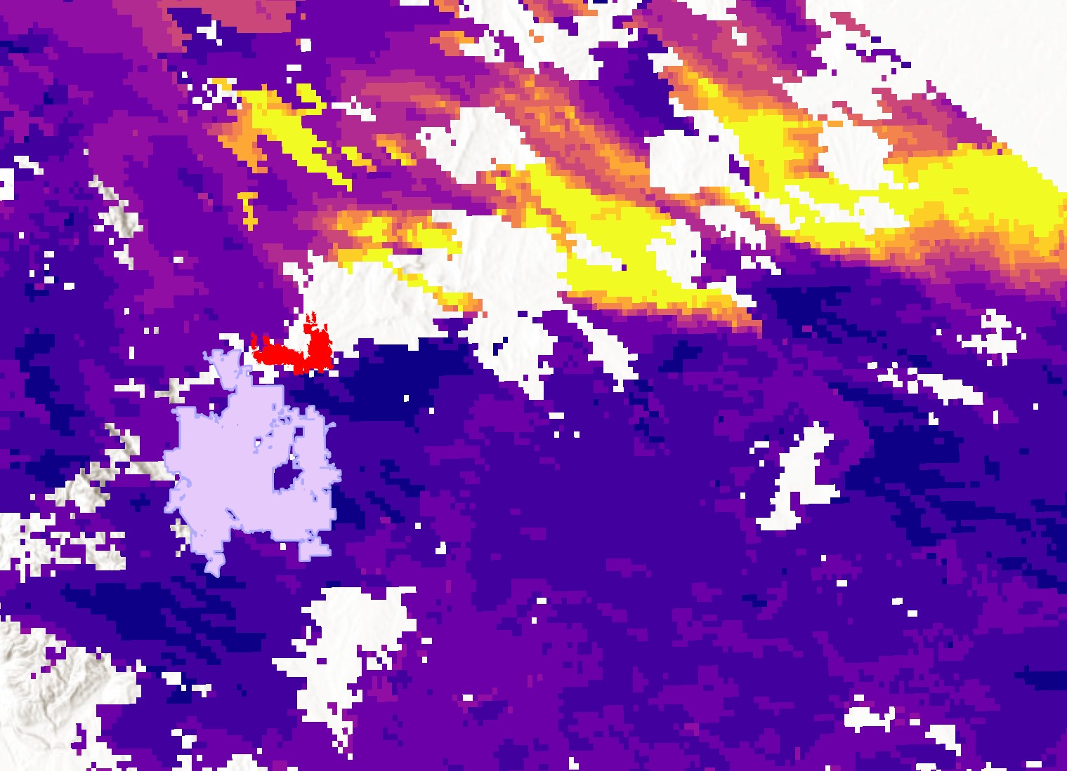
RESULTS – Aerosol Optical Depth
Terra/Aqua MODIS
Black Forest Fire (2013)
N
Aerosol Optical Depth (AOD) –
a proxy for fine particulate matter (PM_{2.5})
Colorado Springs
Black Forest Fire
≥ 1.0
0.0
0
6.25
12.5
25
37.5
50
Miles
Image Credit: NASA
Notes:
As mentioned previously, we acquired Terra & Aqua MODIS data on aerosol optical depth. AOD measures the extinction of light as it passes through the atmosphere, and can therefore tell us about the distribution of aerosols above our study area. We used it as a proxy for PM2.5, to examine trends in particulate matter related to wildfire events. In this map, we examined Black Forest Fire – which ignited June of 2013 at the northeastern edge of Colorado Springs. The map shows 95th percentile AOD values from one day of the fire, June 12. (This day was chosen because it had relatively cloud-free retrievals.) AOD is measured on a unitless scale, where anything > 0.5 constitutes high aerosol loading. AOD on this map is represented on a scale from 0 to 1, with yellow representing the highest AOD. From burn area on the map, in red, you can see the smoke plume travel east, away from the fire and from Colorado Springs. Most of the missing pixels indicate cloud cover, however some, like those directly adjacent to the fire were actually smoke plumes thick enough that our cloud-mask misclassified them. Had this plume traveled over the city, these high AOD values suggest the air quality could have been dangerous to the community.
------------------------------------------Citations below--------------------------------------------
Map Credit
Basemap: Esri, NASA, NGA, USGS
Black Forest Fire Perimeter shapefile: InterAgencyFirePerimeterHistory All Years View Feature Layer ; retrieved from the National Interagency Fire Center
North arrow icon credit: SKETCH ICON; acquired from The Noun Project; Source: https://thenounproject.com/icon/compass-3060970/ (CCBY3.0)

Slide 13
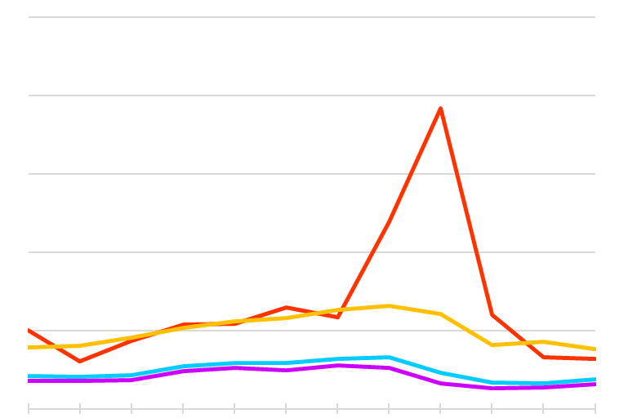
RESULTS – Aerosol Optical Depth
Terra/Aqua MODIS
Multi-Year Comparison of Monthly AOD Trends
1.0
0.8
AOD > 0.5 constitutes high aerosol loading
AOD
0.6
0.4
2020 –
historic fire season in Colorado
0.2
0.0
Jan
Mar
May
July
Sept.
Nov.
2020 (95th Percentile)
2007 - 2021 Mean
2009 (95th Percentile)
2007 - 2021 Median
Image Credit: NASA
Notes:
The near daily, global coverage of MODIS data allowed us to compare annual and sub-annual AOD trends around Colorado Springs. This plot shows a multi-year comparison of monthly AOD trends. The blue and purple lines show mean and median monthly averages for the entire study period. AOD values of 0.1 - 0.15 are considered typical, and these show us that, on average, AOD remained within the expected range year to year. The orange and red trend lines you see correspond to 95th percentile AOD values for 2 different years. In 2009, the highest AOD values for any month never breached a value of 0.3. Comparatively, 2020 experienced a major spike beginning in the summer months. This spike coincides with one of the worst fire seasons Colorado has experienced. Although fire events that year were not necessarily concentrated around our study area, these data support the idea that it’s important to examine how long-range smoke transport, not just local fires, can contributed poor air quality in Colorado Springs.

Slide 14
RESULTS – Aerosol Subtypes
CALIPSO CALIOP
CALIOP LiDAR Level 2 Vertical Feature Mask granule, V.4.2, Feature Classification Flags, feature types and aerosol subtypes
CALIOP Aerosol Subtypes Vertical Profile
July 7, 2012 nighttime CALIPSO transect
8
No Signal
7
Terrain
6
Elevated Smoke
5
Polluted Dust
4
Altitude (AMSL) (km)
Clean Continental
3
Shown: CALIPSO transect during the 2012 Waldo Canyon Fire
Polluted Continental/
Smoke
2
Dust
1
0
Not Aerosol
38.4
38.5
38.6
38.7
38.8
Latitude
Image Credit: NASA
No Signal
No Signal
No Signal
No Signal
No Signal
Terrain
Terrain
Terrain
Terrain
Terrain
Terrain
Elevated Smoke
Elevated Smoke
Elevated Smoke
Elevated Smoke
Clean Continental
Clean Continental
Clean Continental
Clean Continental
Polluted Continental
Polluted Continental
Polluted Continental
Polluted Continental
Dust
Dust
Dust
Dust
Not Aerosol
Not Aerosol
Not Aerosol
Not Aerosol
Notes:
Now looking at data from CALIPSO's CALIOP, Here is a vertical profile of the aerosol subtypes from CALIOP's Level 2 Vertical Feature Mask granule (V4.2). These Aerosol subtypes are plotted from a 100km square buffer (1° x 1°) from the center of Colorado Springs, CO. The data within the Feature Classification Flags parameter is plotted here with the surface and subsurface feature types, labeled "Terrain" in the legend, representing the ground. Tropospheric aerosol subtypes can be seen of: Clean Continental, Polluted Continental/Smoke, Polluted Dust, and Elevated Smoke. Note the polluted dust that starts at 1.5 KM Above Mean Sea Level at the blue arrow. To plot the feature types and aerosol subtypes, we adapted code from two previous DEVELOP teams.
"Not Aerosol" in the legend is cloud OR "clear air" feature type.
CALIPSO CALIOP has a 5 km long-tract and 0.07 km (or 70 m) swath/width
From MHEST (Mixing Height Estimation Toolbox) and ASMOKRE (Automated Satellite Mixing height Observations and Known Remote Estimations)
DEVELOP Fall 2020 & Spring 2021 Southern Idaho Health & Air Quality teams I & II
------------------------------------------Citation below--------------------------------------------
Subset LARC CALIPSO site, NASA ASDC, and CALIPSO NASA/French Space Agency Cloud-Aerosol Lidar and Infrared Pathfinder Satellite Observation (CALIPSO) satellite, Adapted code from: NASA DEVELOP Idaho HAQ I & II team of Fall 2020 & Spring 2021 teams, and Dr. Kenton Ross
Data: CALIPSO CALIOP, "CAL_LID_L2_VFM-Standard-V4-20.2012-07-07T09-03-23ZN_Subset.hdf" granule.

Slide 15
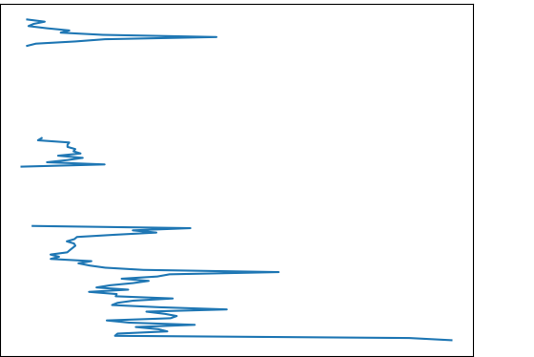
RESULTS – Extinction Coefficient
CALIPSO CALIOP
CALIOP LiDAR Level 2, Aerosol Profile granule, V.4.2, 532 nm Extinction Coefficient
Mean 532 nm Extinction Coefficient to Altitude,
July 7, 2012, Colorado Springs, CO
10
8
6
Altitude (AMSL) (km)
Shown: CALIPSO transect during the 2012 Waldo Canyon Fire
4
2
0.00
0.05
0.10
0.15
0.20
Mean 532 nm Extinction Coefficient (km⁻¹)
Notes:
This is the same nighttime transect by CALIPSO from the previous slide, during the 2012 Waldo Canyon Fire. Here we visually plotted the mean 532nm extinction coefficient, from the Level 2 LiDAR Aerosol Profile granule. Note at 1.5km on the y-axis of Altitude, the spike at 0.25. This aligns with other studies of polluted dust at 0.25. This was the same altitude where we saw the Polluted Dust aerosol subtype at 1.5 km on the previous slide.
Currently, we are still looking into analyzing derived PM2.5 calculations from CALIOP's 532nm extinction coefficient to in situ US EPA ground monitors, which other past studies have done as well.
[[This graph shows an average of the extinction coefficient every 5km within the 100km buffer around Colorado Springs. ::
Mean 532nm extinction coefficient compared to altitude, within 100km from the center of Colorado Springs, CO, on July 7, 2012:]]]
------------------------------------------Citations below--------------------------------------------
Data: Subset LARC, "CAL_LID_L2_05KmAPro-Standard-V4-20.2012-07-07T09-03-23ZN_Subset.hdf"
Adapted Code from: NASA, https://www-calipso.larc.nasa.gov/products/CALIPSO_DPC_Rev4x92.pdf
References: CALIPSO User Manual
Toth, T. D., Zhang, J., Reid, J. S., & Vaughan, M. A., 2019. A bulk-mass-modeling-based method for retrieving particulate matter pollution using CALIOP observations. Atmospheric Measurements Techniques, 12, 1739–1754. https://doi.org/10.5194/amt-12-1739-2019
Toth, T. D., Zhang, J., Vaughan, M. A., Reid, J. S., & Campbell, J. R. (2022). Retrieving particulate matter concentrations over the contiguous United States using CALIOP observations. Atmospheric Environment, 274, 118979. https://doi.org/10.1016/j.atmosenv.2022.118979

Slide 16
LIMITATIONS & UNCERTAINTIES
Spatiotemporal limits on data availability
Few in situ air quality monitors in Colorado Springs from EPA — make for limited validation of remotely sensed observations
CALIOP transects are single-shots of specific times
TROPOMI operational mid-2018, onward
Cloud & snow cover
Notes:
Validation of our Earth observation data was limited because Colorado Springs only has one active EPA ground sensor for PM2.5, none currently for NO2, and no AERONET network sensors. More dispersed in situ data would help data validation.
Due to CALIOP's smaller swath size, data measurements are limited.
Heavy cloud & snow cover interferes with sensor readings, and at times imagery is processed with cloud-masking.
Additionally, Satellite launch dates also limited our study time period.
---
in order to increase the accuracy of retrievals, but this has the added function of masking out thick smoke plumes.
Aqua & CALIPSO are in the "A-Train" cycle of 16-day/233-day repeat cycle, sun-synchronous orbit, however their sensors have different ground swaths Aqua (MODIS Spectroradiometer at 2,330km) and CALIOP (IIR / Imaging Infrared Radiometer at 5km long-tract and 70m (or 0.07 km) swath/width

Slide 17
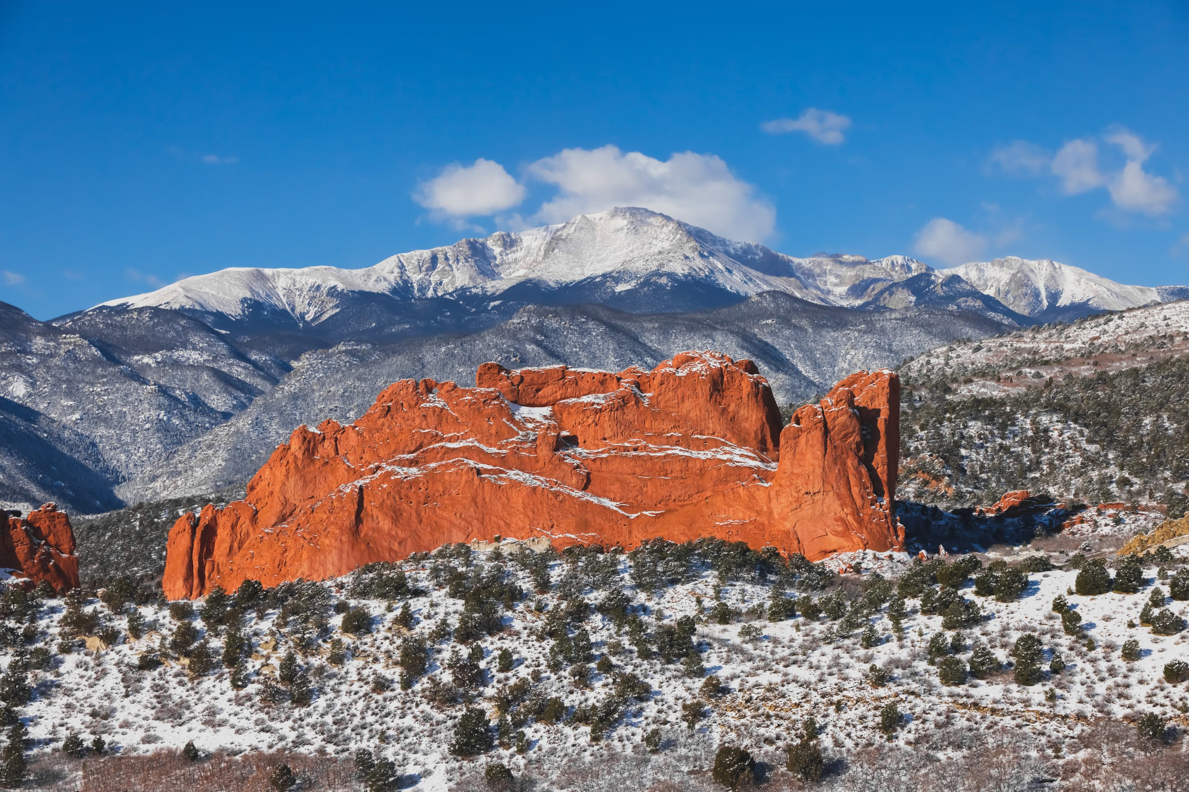
CONCLUSIONS
Earth observations elucidate spatiotemporal trends in air quality
Uneven spatial distribution of air quality-related satellite parameters during wildfire events supports Colorado Springs's efforts to add air quality monitoring stations that are well distributed across the city.
Image Credit: City of Colorado Springs Office of Innovation
MODIS & CALIOP data show spikes in indicators of poor air quality following fire events (PM_{2.5}, aerosols)
Notes:
Our work showed us that NASA EO can capture spatiotemporal trends in air quality. TROPOMI allowed us to examine annual and sub-annual NO2 trends, while MODIS and CALIOP data were informative about aerosol concentrations and composition during wildfire events. However, while these tools show potential to improve Colorado Springs’ air quality management, more work needs to be done if they are to support decision making in real time. Our findings support Colorado Spring's decision to install a city-wide network of ground monitors. These are suited to provide the kind of accurate and timely information on intra-urban spatial trends important during air quality events.
**Since preparing this presentation, we were able to compare satellite data to in-situ measurements. While unable to share results with you at this time, it’s worth mentioning that any future work will have the advantage of improved ground validation data.
------------------------------------------Citation below--------------------------------------------
Photo credit: City of Colorado Springs Office of Innovation (image provided by partners with permission)

Slide 18
FUTURE WORK
TEMPO - April 2023 launch
hourly pollutant measurements over US
(MODIS soon to be decommissioned)
Analyze specific CALIPSO transects in study area to incorporate Toth et al.'s CALIOP derived PM_{2.5} algorithm (2019, 2022)
Account for long-range smoke transport —
broaden spatial analysis & employ meteorological modeling
Incorporate in situ data from Colorado Springs' air quality monitor network deployment in future analysis
(2023 deployment)
Notes:
MODIS will be decommissioned soon, however, NASA's VIIRS sensor can be used for aerosol analysis, and TEMPO will soon aid in air quality applications.
- We can also further analyze and validate derived PM2.5 calculations from CALIOP's 532nm extinction coefficient that were within our study area.
The soon-to-be deployed ground monitors in Colorado Springs will allow for more data validation analysis.
-Additionally, Incorporating smoke transport in the Front Range, with meteorological models would be highly benifical.
----
For MAIAC (The EPA in situ monitors did not show a spike on wildfire days alone, or compared to MODIS MAIAC AOD, nor readily for CALIOP, which could be due to location from the ground monitor, the height of the ground monitor in altitude, smoke plume distribution and location, and wind from the Front Range, etc.)
------------------------------------------Citations below--------------------------------------------
Image Credit: https://tempo.si.edu/
MODIS AOD to PM2.5 per NASA ARSET: https://appliedsciences.nasa.gov/sites/default/files/D2P3_AODPMEx.pdf
CALIOP-derived calculations method from Dr. Travis Toth:
Toth, T. D., Zhang, J., Reid, J. S., & Vaughan, M. A., 2019. A bulk-mass-modeling-based method for retrieving particulate matter pollution using CALIOP observations. Atmospheric Measurements Techniques, 12, 1739–1754. https://doi.org/10.5194/amt-12-1739-2019
Toth, T. D., Zhang, J., Vaughan, M. A., Reid, J. S., & Campbell, J. R. (2022). Retrieving particulate matter concentrations over the contiguous United States using CALIOP observations. Atmospheric Environment, 274, 118979. https://doi.org/10.1016/j.atmosenv.2022.118979

Slide 19
Colorado Springs Office of Innovation:
Carlos Tamayo
Samantha Bailey
Deborah Newman
NASA Advisors & DEVELOP Support Team:
Dr. Travis Toth
Dr. Kenton Ross
Lauren Childs-Gleason
Cecil Byles
Olivia Landry
Laramie Plott
Southern Idaho Health & Air Quality I & II teams (Fall 2020 & Spring 2021)
Great Salt Lake Health & Air Quality team (Spring 2023)
This material contains modified Copernicus Sentinel-5P TROPOMI data (2007 - 2022), processed by European Space Agency (ESA).
Notes:
We would love to acknowledge the Colorado Springs Office of Innovation and our NASA Advisors and Support Team.
CITATIONS:
CALIPSO is a joint mission between NASA and the French Space Agency (CNES).
MHEST and ASMOKRE adapted from Southern Idaho Health & Air Quality I Team (Fall 2020)

