Slide 1
HUNTSVILLE
Urban Development
Utilizing NASA Earth Observations to Evaluate Urban Tree Canopy and Land Surface Temperature for Green Infrastructure Development and Urban Heat Mitigation in Huntsville, AL
Greta Paris, Sabine Nix, Thomas Quintero, Amanda Tomlinson
Alabama – Marshall

Slide 2
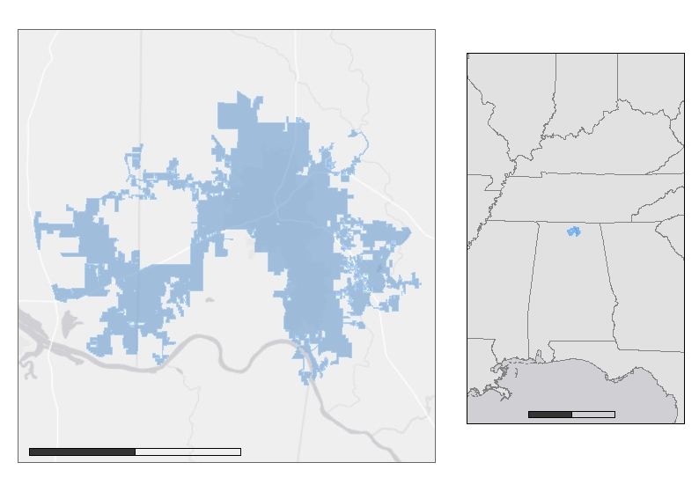
PROJECT OVERVIEW
Study Area
Huntsville, Alabama
Population: 200,574
Climate: Humid subtropical
Case study areas: Downtown, Oak Park, Research Park, Owens Cross Roads, Harvest
IL
IN
OH
MO
KY
Huntsville
AR
TN
NC
SC
MS
AL
GA
Study Period
2010 to 2019
Summer months: June 1st – August 31st
LA
FL
0 200
Miles
0 20
Miles
Notes:
The study area for our project is Huntsville, Alabama and the study period that we chose was from 2010-2019, because these are the years that Huntsville has experienced significant urban expansion due to population increase caused mainly by a surge in job opportunities in the engineering industry. The population of Huntsville, AL is 200,574 according to the U.S Census Bureau in July of 2019. Huntsville, AL lies within the humid subtropical climate zone causing the area to have very hot humid summers, and mild winters. We will be examining a few areas of the city more closely, Oak Park and Owen's Crossroads, as these are areas the partners expressed interest in due to their varying levels of development.
Sources: https://www.census.gov/quickfacts/huntsvillecityalabama
The Study Area Map utilizes a city boundary shapefile provided by the City of Huntsville GIS Department, the state boundary shapefile is sourced from the United States Census Bureau, the base map is provided by Esri.

Slide 3
COMMUNITY CONCERNS
20 million hectares of forest are projected to be lost in the US to population growth and associated urban expansion by 2040.
Tree canopy loss could result in an enhanced urban heat island (UHI) effect.
The UHI effect can lead to health issues for those with existing medical conditions such as asthma, diabetes, or COPD.
Image Credit: Amanda Tomlinson
Image Credit: Anivron
Notes:
Huntsville is the fastest growing city in Alabama with a population growth rate of nearly 11% from 2010 to 2019 (City of Huntsville Urban Development, Long-Range Planning Division, 2020). This rapid growth comes with rapid urban expansion, and it is projected that 20 million hectares of trees will be lost in the United States to population growth and the associated urban expansion by the year 2040. This loss in tree canopy could result in an enhanced urban heat island effect. An urban heat islands are caused by urban development involving the replacement of forested areas with impervious surfaces such as asphalt or concrete. These kinds of surfaces hold onto heat which can raise temperatures in more urban areas in comparison with the surrounding forested areas. These raised temperatures caused by the urban heat island effect can lead to health problems for vulnerable populations, especially those with existing medical conditions such as asthma, diabetes, or pulmonary disorders.
Alig, R., (2010). Urbanization in the US: land use trends, impacts on forest area, projections, and policy considerations. Journal of Resources, Energy, and Development. 7(2), 35-60. https://doi.org/10.3233/RED-120068.
Image Credit:
Anivron, licensed under the Creative Commons Attribution-Share Alike 3.0 Unported license.
https://commons.wikimedia.org/wiki/File:Downtown_Huntsville,_Alabama.jpg

Slide 4
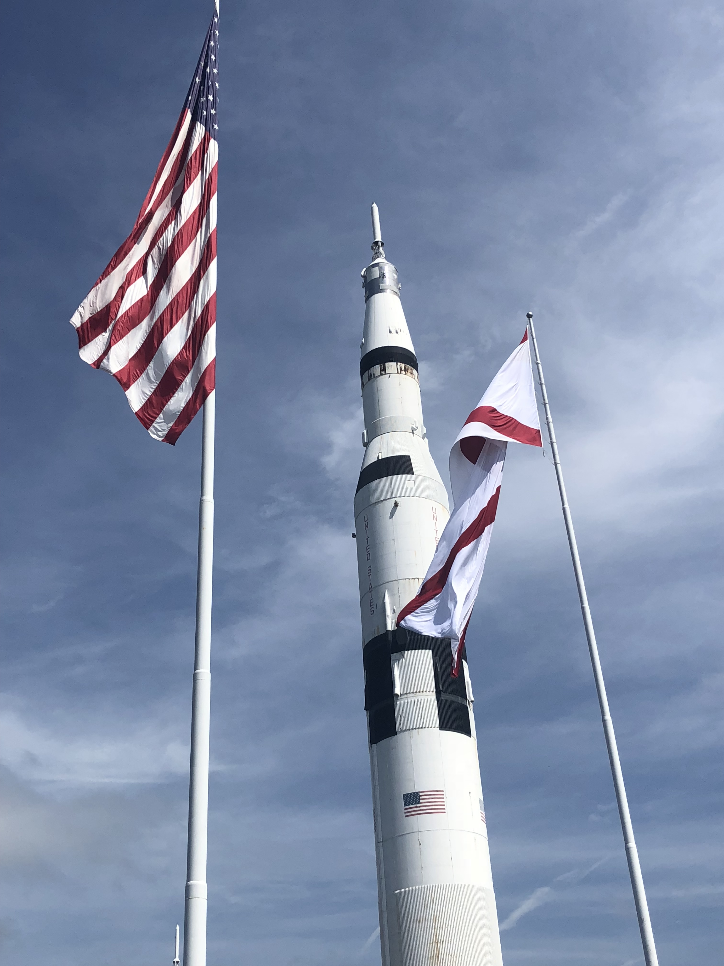
PARTNERS
The City of Huntsville
Urban and Economic Development
The City Council
Geographic Information Systems (GIS)
Urban and Long-Range Planning
City Planning
Landscape Management
City Engineering
Image Credit: Amanda Tomlinson
Notes:
The team worked with several departments that are a part of The City of Huntsville. These included Urban and Economic Development, the City Council, GIS, urban and Long-Range Planning, City Planning, Landscape Management, and City Engineering.
This is the City’s first investigation into urban heat islands as there were concerns raised by constituents regarding tree loss and the relating change in temperature.
Image Credit:
Taken by participant Amanda Tomlinson

Slide 5
PROJECT OBJECTIVES
Investigate and analyze correlations between tree canopy coverage and land surface temperature (LST)
Quantify the impacts of Huntsville’s urban expansion on decreasing tree canopy coverage and increasing impervious surface coverage
Identify hot spots within the city that are experiencing the UHI Effect and the vulnerable populations within them
Communicate our findings through an ArcGIS StoryMap
Notes:
Our project objectives were to:
Investigate and analyze correlations between changes in tree canopy cover and Land Surface Temperature
-This was done through a suite of time-series maps and several statistical analyses
Quantify the impacts of Huntsville’s urban expansion on decreasing tree canopy coverage and increasing impervious surface coverage
This was done through classifying images of NDVI and NDBI and calculating changes between land cover and LST, and using statistical tests to quantify these changes
Identify hot spots within the city that are experiencing UHI and identifying the vulnerable populations that might remain within these hot spots
This was done by examining LST throughout the city by census tracts and incorporating health and census variables to address at-risk populations within the city
This will help us to create a heat vulnerability map!
Communicate our findings through an ArcGIS StoryMap

Slide 6
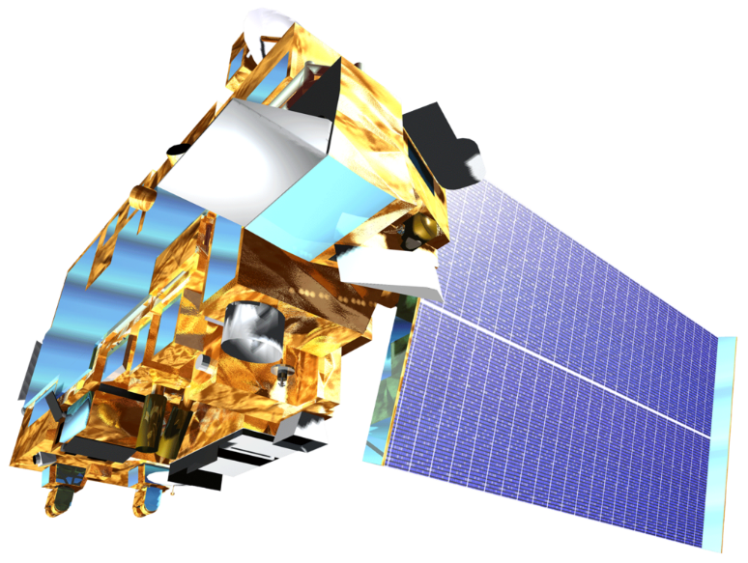
SATELLITES & SENSORS
Landsat 5 Thematic Mapper (TM)
International Space Station (ISS)
ECOsystem Spaceborne Thermal Radiometer Experiment on Space Station (ECOSTRESS) and Global Ecosystem Dynamics Investigation (GEDI)
Terra Moderate Resolution Imaging Spectroradiometer
(MODIS)
Landsat 8
Operational Land Imager (OLI) and Thermal Infrared Sensor (TIRS)
Image Credits: NASA
Notes:
The team utilized several different satellites and sensors in order to investigate the existence of the urban heat island in Huntsville. We used the LANDSAT 5 TM and the Landsat 8 OLI to create land cover maps. The Landsat 5 TM, Landsat 8 OLI and TIRS, Terra MODIS, and ECOSTRESS were used to calculate land surface temperature. Finally, the team used GEDI to analyze tree canopy cover.
Image Credits: NASA (Public Domain)

Slide 7
ANCILLARY DATASETS
Data Source | Parameter
United States Census Bureau Topologically Integrated Geographic Encoding and Referencing | Population Data
Centers for Disease Control | Health Statistics
USGS National Land Cover Database | Land Cover Images
USDA National Agriculture Imagery Program | Digital Ortho-photography
Notes:
The team also utilized some ancillary datasets. The US Census Bureau Tigerline data was used in our Urban Heat Health Risk Map by incorporating population data. Health statistics from the Centers of Disease Control also went into the Heath Risk map to help determine what census tracts in Huntsville are most susceptible to heightened temperatures. We also used NLCD land classification data to perform a supervised land classification while using NAIP imagery to create a training dataset to verify these classifications.

Slide 8
METHODOLOGY: OVERVIEW
End Products
Day / Night LST
LST/ Land Cover Timeseries
ArcMap
Land Cover
2010 -2019
Urban Heat Health Risk
NASA EOs
Health Data
Google Earth
Engine
LST
2010 - 2019
UHI Identification
R Studio
Principal Component Analysis
GEDI
Tree Survey
Tree Canopy Cover Survey
R Studio /
ArcPro
Notes:
Methodology: Overview
Speaker Notes:
All of the NASA Eos that we used in this project were acquired and processed within Google Earth Engine, with the exception of Terra MODIS and ECOSTRESS, which were acquired through AppEEARS and will be discussed in a later slide. All Google Earth Engine imagery was cloud masked and reduced by calculating monthly medians.
Using the imagery, we conducted two types of classifications based on NLCD land cover classes, and calculated LST.
Next, the team acquired data related to heat vulnerability from the CDC, Census Bureau, and the City of Huntsville. Specifically, we looked at health data, the population over 65, and the age of homes/subdivisions. This data were collected at the census tract level, and remote sensing data was also averaged over census tracts to use in analysis with the heat vulnerability data.
The team produced a timeseries of LST and Land Cover over time, a heat island identification tool, a tree canopy cover survey map, and an urban heat health risk analysis.
Image Credits:
All Images in this slide were generated by the team from Landsat 8 OLI and TIRS Imagery or Census Tract Data for the City of Huntsville.
Gear Icons are modified Powerpoint ClipArt

Slide 9
METHODOLOGY: LAND COVER
Threshold Classification
Normalized Difference Built Up Index
Landsat 5
National Land Cover Database
Landsat 8
Normalized Difference Vegetation Index
Supervised Classification
Notes:
Methodology: Land Cover
Speaker Notes:
Acquisition
We acquired all imagery within Google Earth Engine. To look at land cover, the team utilized Landsat 5 between 2010 and 2011, Landsat 8 between 2013 and 2019, and Sentinel-2 for 2019.
We also referenced the NLCD land cover dataset within Google Earth Engine to classify our images
All the images acquired were taken between June and July of the given year. This is because the urban heat island effect is most prominent (and therefore most hazardous to urban populations) in the summer.
The team processed all imagery within Google Earth Engine. First, we applied a cloud mask to all the images, and then calculated the Normalized Difference Vegetation Index, or NDVI, and the Normalized Difference Built Up Index, or NDBI. Then, the images were combined by calculating the median to end up with one image per summer per year.
Next, the team classified the imagery within Google Earth Engine. First, we utilized a threshold method on the indices we calculated, and then we conducted a supervised classification using NLCD data.
Lastly, the team validated the classifications using a dataset created manually within [ArcMap / GEE?] referencing [NAIP / Google Earth] imagery and created a confusion matrix.
Image Credits:
All Images in this slide were generated by the team from Landsat 8 OLI Imagery.

Slide 10
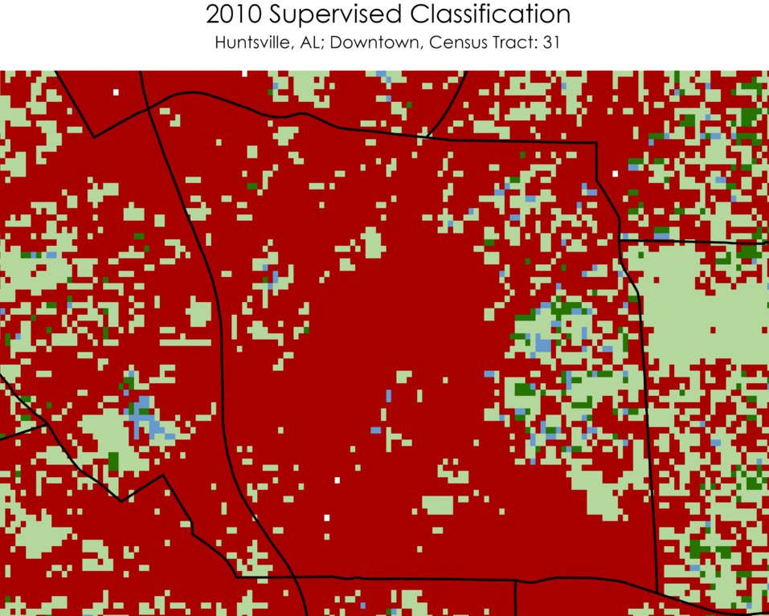
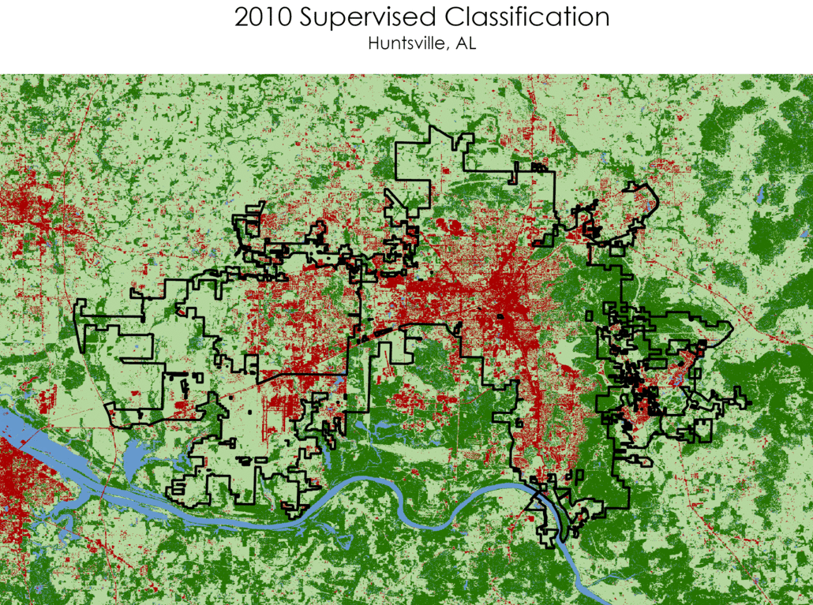
RESULTS: LAND COVER 2010 - 2019
Land Cover Classes
N
Tree
Other Pervious
Impervious
Water
0 2 miles
0 32 miles
Notes:
Results: Land Cover – 2010 - 2019
Speaker Notes:
This slide illustrates the land cover classifications on Landsat Imagery between 2010 and 2019. As seen in the gif, the downtown area of Huntsville is consistently classified as having a high level of impervious cover.

Slide 11
RESULTS: LAND COVER VALIDATION
Manually classified 152 random points on 2011 and 2017 NAIP Imagery
Overall accuracy ranged from 70.0% to 75.0%
2017 Classification
 | Tree | Non-Tree Vegetation | Impervious | Water
Tree | 41 | 8 | 1 | 0 | 50
Non-Tree Vegetation | 19 | 51 | 6 | 0 | 76
Impervious | 0 | 6 | 9 | 0 | 15
Water | 5 | 1 | 0 | 5 | 11
 | 65 | 66 | 16 | 5 | 152
2017 Reference
Notes:
Results: Land Cover Validation
Speaker Notes:
To validate our land cover classifications, we created confusion matrices for 2011, 2015 and 2017 based on manually classified NAIP imagery. For each year, we manually classified roughly 150 randomly selected points, and then created confusion matrices using R Studio.
Our overall accuracy for 2017 was calculated to be 70%.

Slide 12
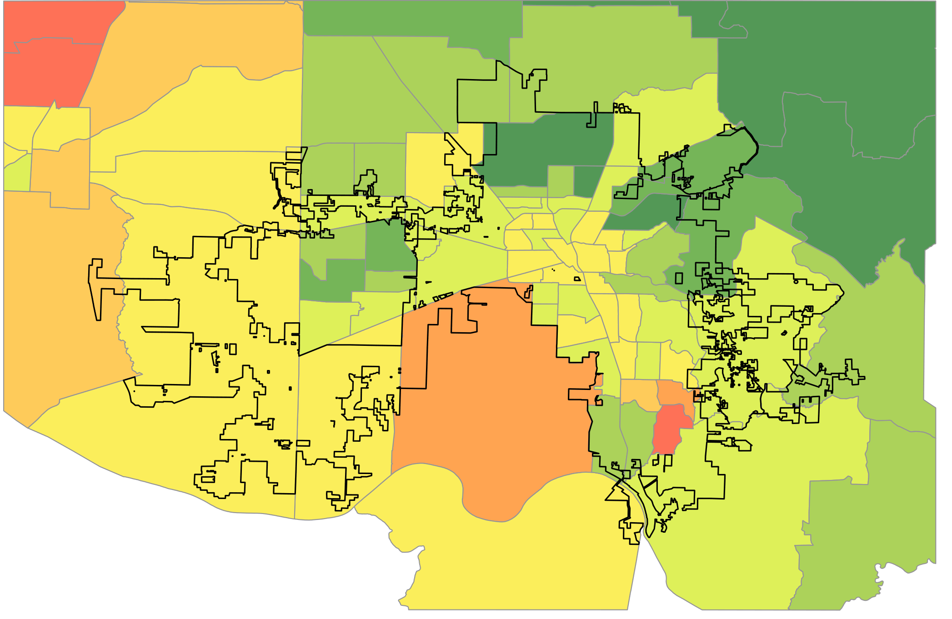
RESULTS: TREE COVER 2010 to 2019
Percent Difference in Tree Cover
≤ -4%
≤ -2%
≤ 0%
≤ 2%
≤ 4%
≤ 6%
≤ 8%
≤ 14%
City of Huntsville
Census Tracts
Overall 3% gain in tree cover
N
0
10
20 miles
Notes:
Results: Tree Cover Change from 2010 - 2019
Speaker Notes:
This slide illustrates the change in Tree Cover from 2010 – 2019 averaged by census tracts in the City of Huntsville area. The most severe decrease in tree cover is in tract 202.02 with a loss of 8.06%. Overall, there was a 3% gain in tree coverage.

Slide 13
METHODOLOGY: TREE CANOPY SURVEY
Processing
Tree Cover > 40%
Data Acquisition
Histograms of Plant Area Index (PAI) and Height
Level 2B LiDAR
Esri
World
DEM
Pass Quality Inspection
2019 LST Map
First and Last Return Subtraction
Notes:
Methodology: Tree Canopy Survey
Speaker Notes:
Acquisition
From Earth Data website Level 2B data: includes biophysical variables and tree height data. Also includes tree cover %.
The team converted the raw clipped files from NASA EarthData to files editable in ArcGIS in R using the rGEDI package.
Then a Histogram was produced of Plant Area Index (PAI) (AKA Leaf Area Index) and Tree height to describe tree canopy structure. Plant Area Index is a measurement of leaf area index for the whole plant which is a fraction of how many layers of vegetation inhibit sunlight before reaching the ground. In the graphic, green layers would be vegetation layers and the brown would be the ground.

Slide 14
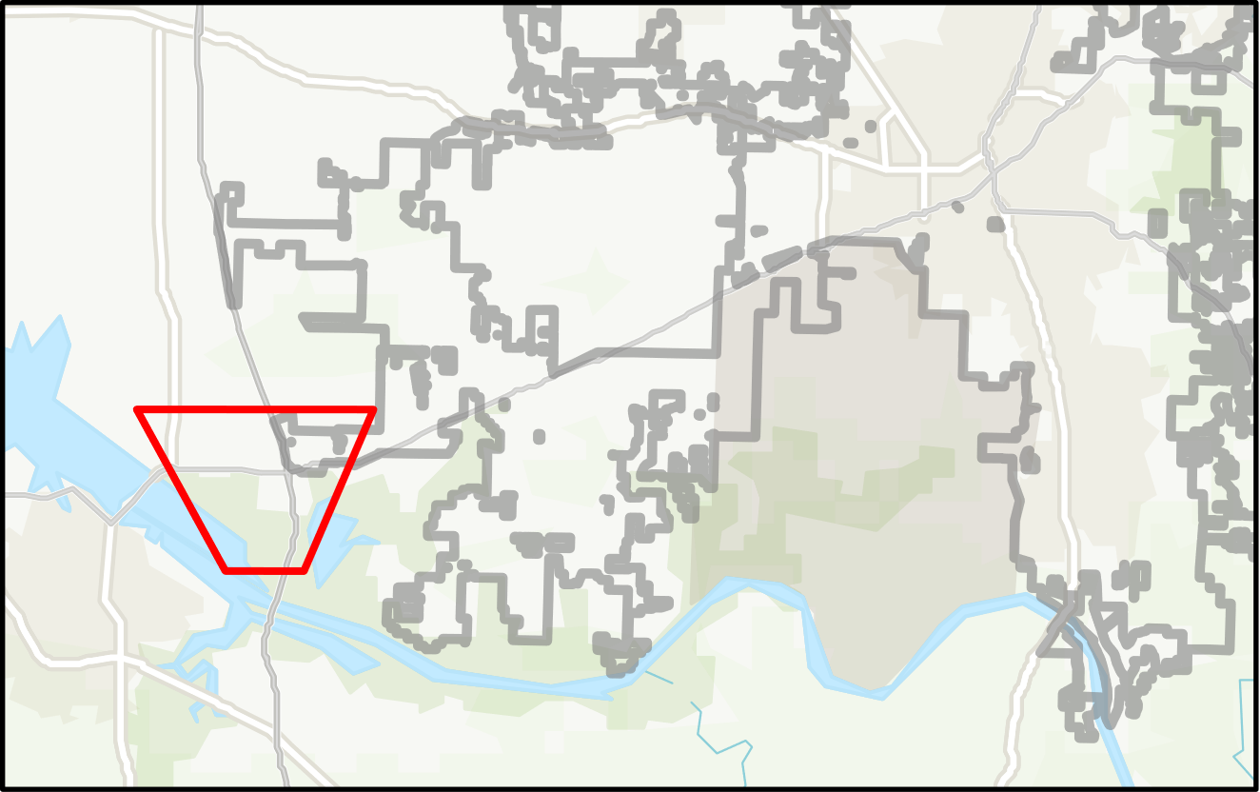
RESULTS: GEDI TREE CANOPY SURVEY
Distribution of Plant Area Index
Count
2,000
Mean: 3
0
1
2
3
4
5
6
7
8
9
Distribution of Tree Height (feet)
Count
500
Mean: 82
0
LST (°F)
22
110
200
106
City of Huntsville
Trees
70
N
0
0.1
0.2 miles
GEDI – Global Ecosystem Dynamics Investigation
Notes:
Results: GEDI Tree Canopy Survey
Speaker Notes:
Southwest Huntsville was highlighted because of the crossing GEDI transects and to show the impact that forested areas have on decreasing LST. Notice how trees effectively decrease LST in the area the developed neighborhood. The average height of trees in Huntsville is 88 feet (27 meters) with a plant area index of 3.

Slide 15
METHODOLOGY: LAND SURFACE TEMPERATURE
LST Calculation
(K to °F)
Landsat 5, 8
NDVI to Emissivity
LST Timeseries
MODIS
LST
(K to °F)
Day vs Night LST Maps
ECOSTRESS
Notes:
Methodology: Land Surface Temperature (LST)
Speaker Notes:
Acquisition
As with the imagery required for classifying land cover, we acquired all imagery within Google Earth Engine. To calculate LST, we used Landsat 5 and Landsat 8. All the images acquired were taken between June and July of the given year. This is because the urban heat island effect is most prominent (and therefore most hazardous to urban populations) in the summer.
The team processed all imagery within Google Earth Engine. First, we applied a cloud mask to all the images, and then calculated the Normalized Difference Vegetation Index, or NDVI. Lastly, we calculated LST for each image. Then, the images were combined by calculating the median to end up with one image per summer per year.
Finally, we analyzed the LST images in comparison with the Land Cover maps. Specifically, we conducted a regression analysis comparing LST change over time to change in tree cover and impervious surfaces over time. The MODIS and Ecostress data were used to create a set of maps comparing daytime LST to nighttime LST for 2019.
Image Credits: All images are from DEVELOP team processed imagery

Slide 16
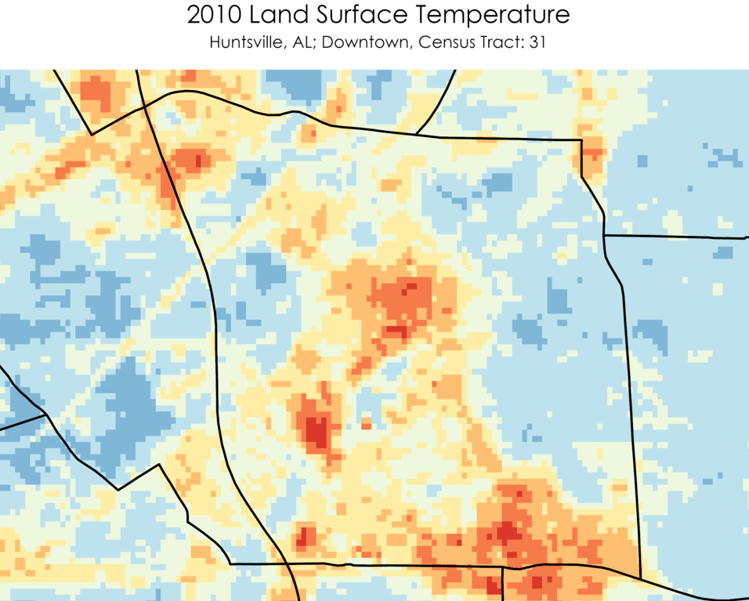
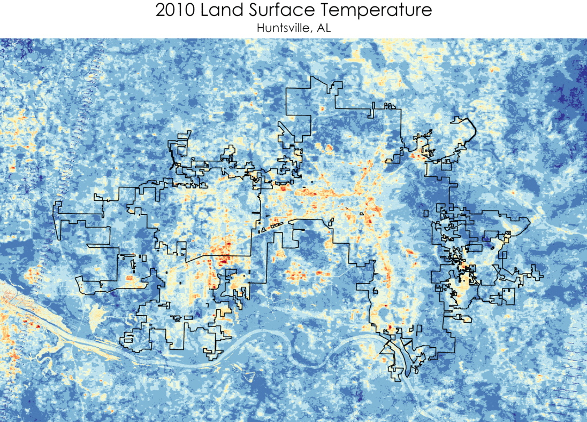
RESULTS: LST 2010 to 2019
LST (°F)
N
<70
70-74
74-78
78-82
82-86
86-90
90-94
94-98
98-102
102-106
0 2 miles
0 32 miles
Notes:
Results: Land Surface Temperature 2010 - 2019
Speaker Notes:
This slide illustrates the LST calculated Landsat 8 Imagery between 2010 and 2019. As seen in the gif, the downtown area of Huntsville is consistently one of the hottest regions of the city.

Slide 17
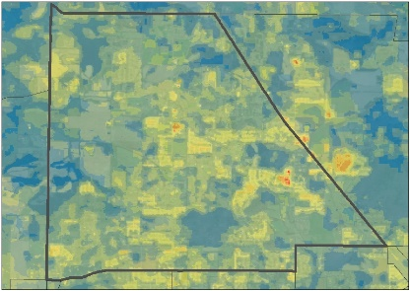
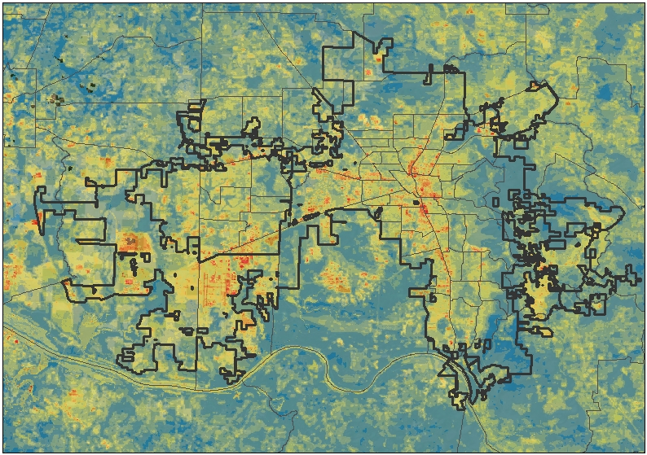
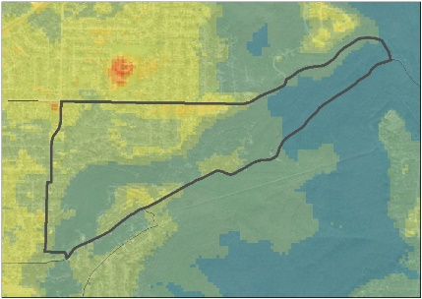
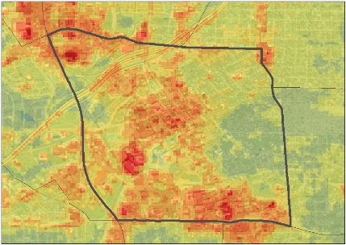
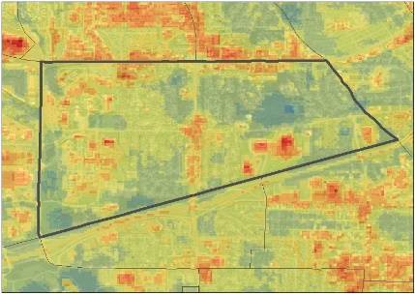
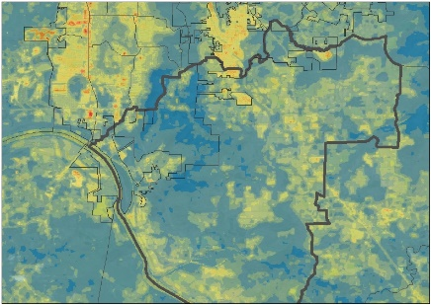
RESULTS: UHI IDENTIFICATION
Harvest
Mean LST for Summer 2019 (̊ F)
LST (°F)
63.4 – 74.1
Oak Park
74.1 – 78.0
78.0 – 82.0
Monte Sano State Park
82.0 – 86.0
86.0 – 90.0
90.0 – 94.0
Downtown
94.0 – 98.1
98.1 – 102.2
102.2 – 106.2
Research Park
106.2 – 139.9
Huntsville City Boundary
Census Tracts
N
0 10
Owens
Cross
Roads
Miles
Notes:
Results: Urban Heat Island Identification Map
Speaker Notes:
The Urban Heat Island map uses Landsat 8 TIRS images for LST averaged over June-August 2019 at a resolution of 100 meters to identify heat islands in Huntsville. We highlighted 5 census tracts representative of key areas in the city including tract 105.01 which is Harvest, AL, 9.02 which is Oak Park, 31 which is Downtown Huntsville, 15 which is Cummings Research Park, and 113 which is Owens Cross Roads. Harvest is a suburb of Huntsville that is mainly comprised of residential and agricultural areas, Oak Park is a mainly residential area but it leads into Monte Sano State Park which has mountainous terrain and dense forest cover, Downtown Huntsville is highly developed which is likely the reason for high LST values in this area, Cummings Research Park has a mixture of open land and development, and Owens Cross Roads is largely rural land with residential developments.

Slide 18
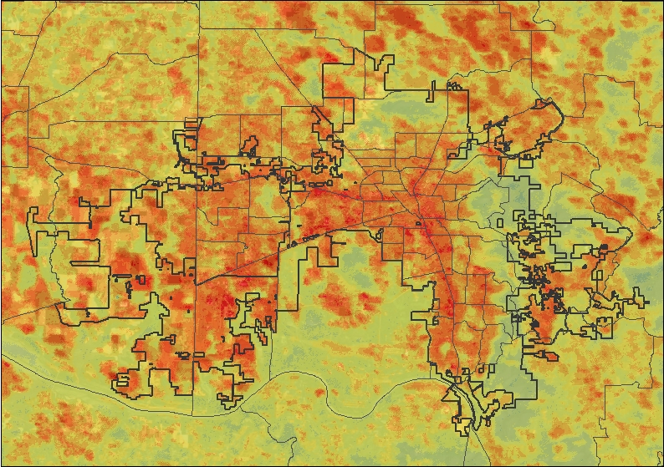
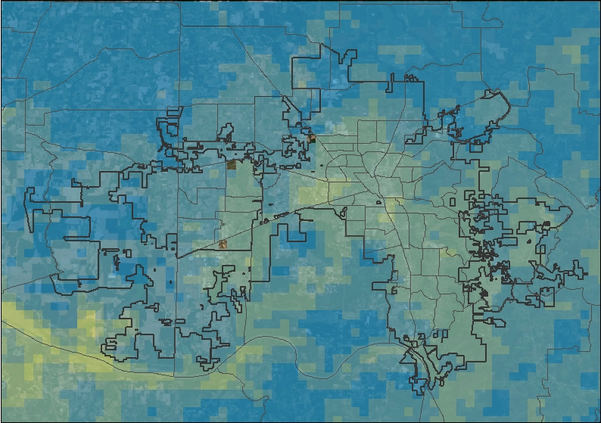
RESULTS: UHI IDENTIFICATION
Day
Night
LST (°F)
Daytime and Nighttime LST Comparison for June 12, 2020 (̊ F)
N
0 10
Miles
62.2 – 64.5
84.3 – 87.7
64.5 – 67.1
87.7 – 91.1
67.1 – 70.4
91.1 – 95.0
70.4 – 73.6
95.0 – 98.9
73.6 – 77.1
98.9 – 110.2
77.1 – 80.5
Huntsville City Boundary
80.5 – 84.3
Census Tracts
Notes:
Results: Urban Heat Island Identification Map
Speaker Notes:
The second set UHI Identification maps utilized ISS ECOSTRESS and Terra MODIS imagery for the same day (June 12th, 2020) to show a comparison of LST throughout the city during the day and at night. These maps show where heat is absorbed the most during the day throughout the city and the nighttime LST indicates that these hotter regions retain that heat through the night. These areas are more highly developed areas with much impervious surface cover, so this shows that UHI effect is not only a threat during the daytime, it is quite impactful during the night as well.

Slide 19
RESULTS: LST CHANGE 2010 to 2019
Change in LST (°F)
+0 to 2
+2 to 4
+4 to 6
+6 to 8
City of Huntsville
Census Tracts
N
0
10
20 miles
Notes:
Results: Land Surface Temperature (LST) Change from 2010 - 2019
Speaker Notes:
This slide illustrates the change in LST from 2010 – 2019 and defined by census tracts in the City of Huntsville area. The most severe increase in LST is in Downtown. Overall, every census tract has increased in LST over time.

Slide 20
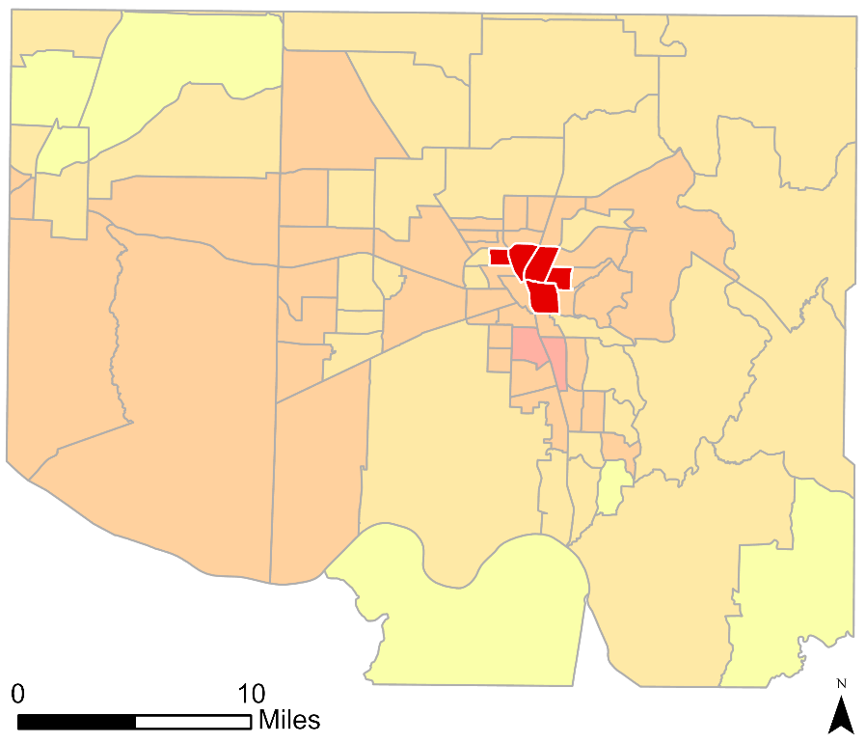
RESULTS: TIMESERIES - LST INCREASE
Tracts with Highest LST Increase
0 10 Miles
N
LST Change (2010 – 2019) °F
Tree Cover
Impervious
Cover
LST
+ 0 to 2
+6 to 8
Census Tracts
+ 2 to 4
+ 4 to 6
Notes:
Results: Timeseries – Tracts with Highest LST Increase
Speaker Notes:
The team created timeseries graphs for each of the five census tracts that experienced the largest increases in LST. The timeseries graphs were created using the supervised classification maps and LST maps averaged over each census tract.
The five census tracts experiencing the highest rates of LST increase were all concentrated in the downtown region of Huntsville. While the city overall experienced an increase of roughly 4 degrees F, these five census tracts experienced increases of close to 8 degrees Fahrenheit.
These tracts have some of the lowest tree cover in the city, and relatively high amounts of impervious surface cover.
Increasing green space or tree cover in these tracts may help mitigate the extreme temperatures populations in downtown Huntsville experience.

Slide 21
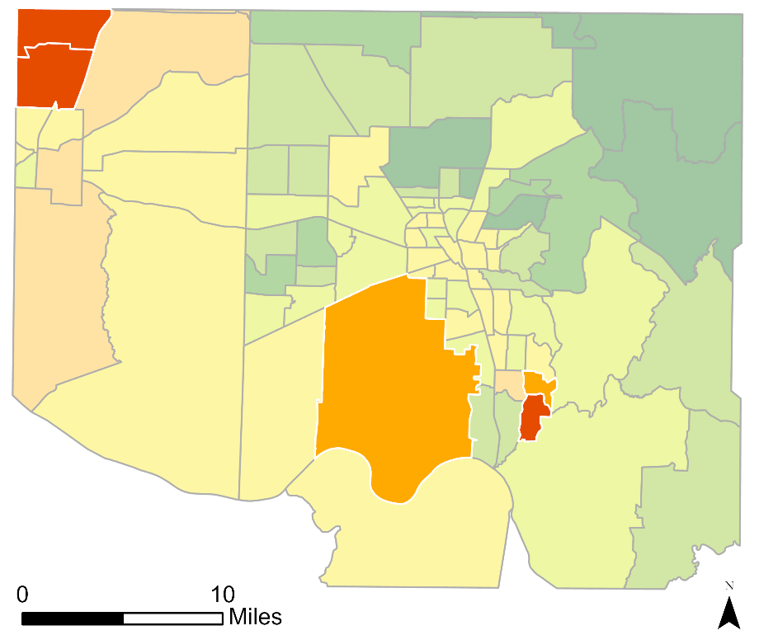
RESULTS: TIMESERIES – TREE LOSS
Tracts with Most Tree Cover Loss
0 10 Miles
N
Tree Cover Change (2010 to 2019)
≤ -4%
≤ -2%
≤ 0%
≤ 2%
≤ 4%
≤ 6%
≤ 8%
≤ 14%
City of Huntsville
Census Tracts
Tree Cover
Impervious
Cover
LST
Notes:
Results: Timeseries – Tracts with Most Tree Cover Loss
Speaker Notes:
The team looked more closely at the five census tracts that experienced the highest rates of tree cover loss over the study period. The timeseries graphs were created using the supervised classification maps and LST maps averaged over each census tract.
Each of the five census tracts experiencing the highest rates of tree cover loss shared similar percent cover values for tree cover and impervious cover. Each census tract had around 20% impervious cover or less, and tree cover ranging roughly from 20% to 60%.
While these areas may be experiencing a loss of tree cover due to development, most of these census tracts are not experiencing a substantial increase in impervious cover at the same time.

Slide 22
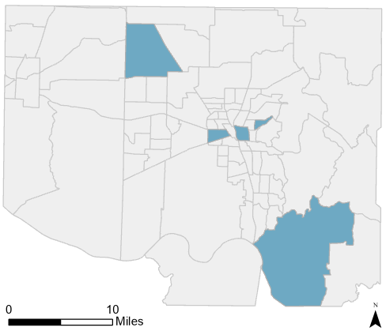
RESULTS: TIMESERIES – CASE STUDY TRACTS
Case Study Census Tracts
0 10 Miles
N
All Census Tracts
Case Study Tracts
Tree Cover
Impervious
Cover
LST
Notes:
Results: Timeseries – Case Study Tracts
Speaker Notes:
Based on suggestions from the City of Huntsville, the team conducted a closer analysis of four census tracts that are of particular interest to the partners. Some of these census tracts are known to be the site of recent development. The timeseries graphs were created using the supervised classification maps and LST maps averaged over each census tract.

Slide 23
RESULTS: LST AND LAND COVER
Line of Best Fit:
y = -2.636ln(x) + 89.148
R²: 0.4024
Notes:
Results: LST and Land Cover
Speaker Notes:
The literature surrounding urban heat islands describes that impervious surfaces tend to exacerbate the UHI effect, while trees and other vegetation types can help mitigate extreme temperatures. To better understand the relationship between land cover and LST in Huntsville, the team plotted each census tract’s percent tree cover and LST, as well as each census tract’s impervious surface cover and LST.
As expected, the data from Huntsville confirms that census tracts with higher percentages of tree cover have substantially lower temperatures. The graph above demonstrates that LST decreases logarithmically with increasing tree cover. This finding suggests that tree planting in census tracts experiencing a more extreme UHI effect may play an important role in mitigating extreme temperatures. The graph above also indicates that small differences in tree cover may have outsized effects on urban heat when the census tract has between 0 and 10% tree cover, while increasing the percent tree cover above 40 or 50% has a less noticeable effect on temperature. This finding may also be due, in part, to the fact that census tracts with less tree cover tend to have higher rates of impervious cover, which also plays a role in affecting LST.

Slide 24
RESULTS: LST AND LAND COVER
Line of Best Fit:
0.1723x + 78.18
R²: 0.5982
Notes:
Results: LST and Land Cover
Speaker Notes:
This slide depicts a scatter plot of impervious surface and LST.
The data from Huntsville demonstrates that LST increases linearly with increasing impervious surface cover. Census tracts with higher impervious surface cover tend to have higher temperatures.
When looking at these scatter plots, however, it is important to remember that impervious surface cover and tree cover are not entirely independent from each other. The extreme temperatures experienced by some census tracts are most likely caused by a combination of low tree cover and high impervious surface cover.

Slide 25
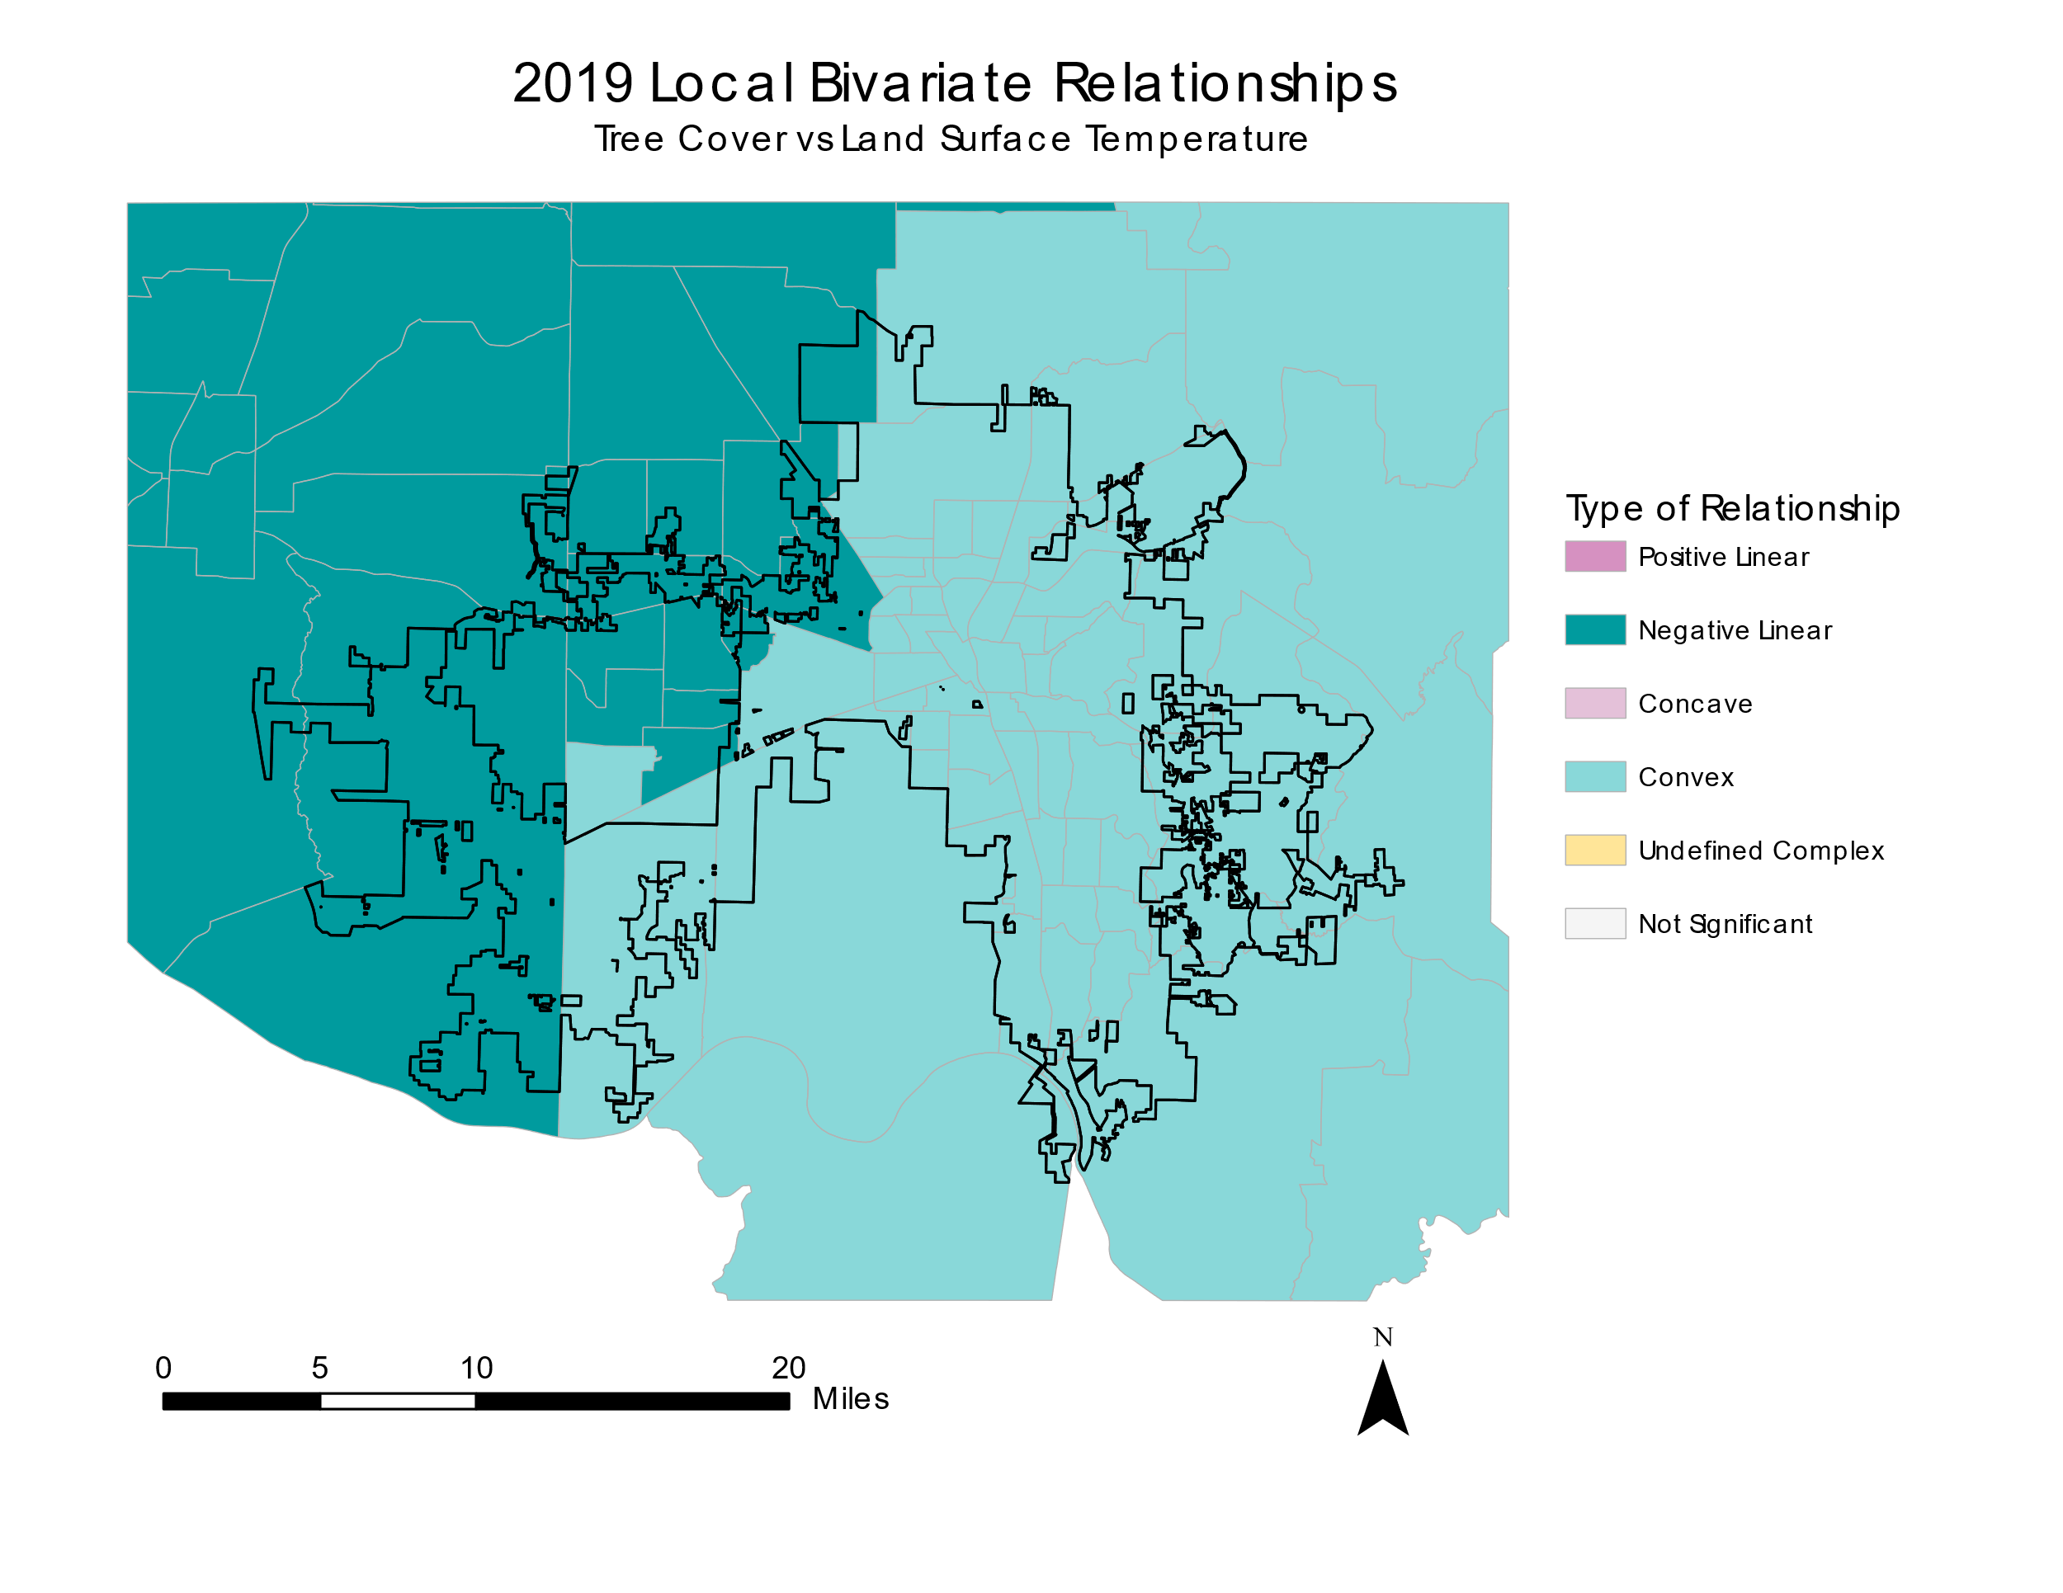
RESULTS: BIVARIATE RELATIONSHIPS MAP
Bivariate Relationships
Negative Linear
Negative Convex
City of Huntsville
Census Tracts
LST decreases drastically with increased tree cover. This relationship holds throughout all areas of Huntsville.
N
0
10
20 miles
Notes:
Results: Local Bivariate Relationships Map
Speaker Notes:
A local bivariate analysis compares the relationship between 2 variables to determine how they are correlated above a 90% confidence interval. This map shows the relationships of tree loss to LST change. When significant, the relationship between the 2 variables are linearly negative, concave or more complicated. This linearly negative result is what we expect because as tree cover declines, we would expect LST to increase.

Slide 26
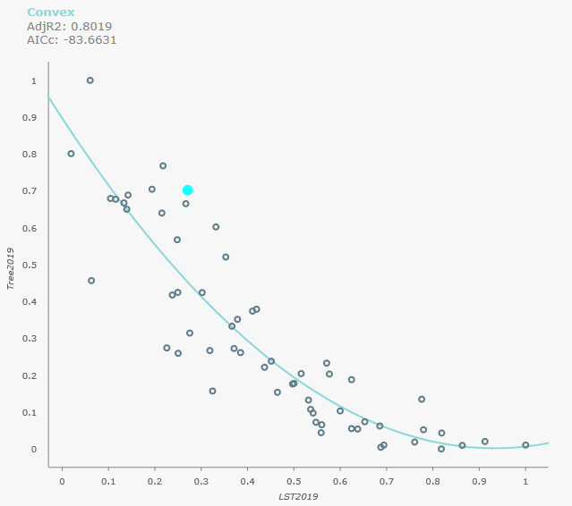
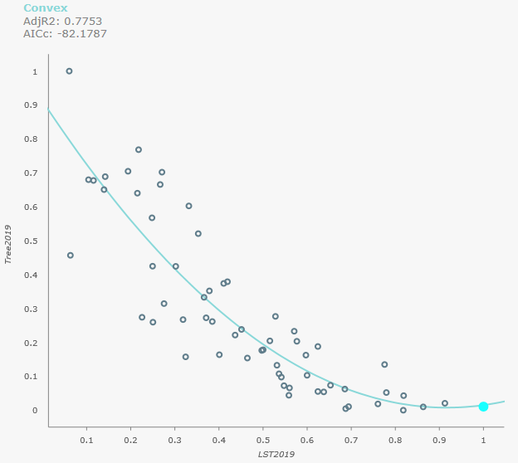
1
RESULTS: BIVARIATE CHARTS
Oak Park
Tree Cover
1
0
1
LST
LST
1
Downtown
N
Oak Park has much lower LST because of its higher tree cover.
Downtown has much higher LST because of its lower tree cover.
0
10
20 miles
Bivariate Relationships
Tree Cover
Negative Linear
Negative Convex
City of Huntsville
Census Tracts
0
LST
1
Notes:
Results: Local Bivariate Relationships Map
Speaker Notes:
A local bivariate analysis compares the relationship between 2 variables to determine how they are correlated above a 90% confidence interval. This map shows the relationships of tree loss to LST change. When significant, the relationship between the 2 variables are linearly negative or concavely negative. This negative result is what we expect because as tree cover declines, we would expect LST to increase.

Slide 27
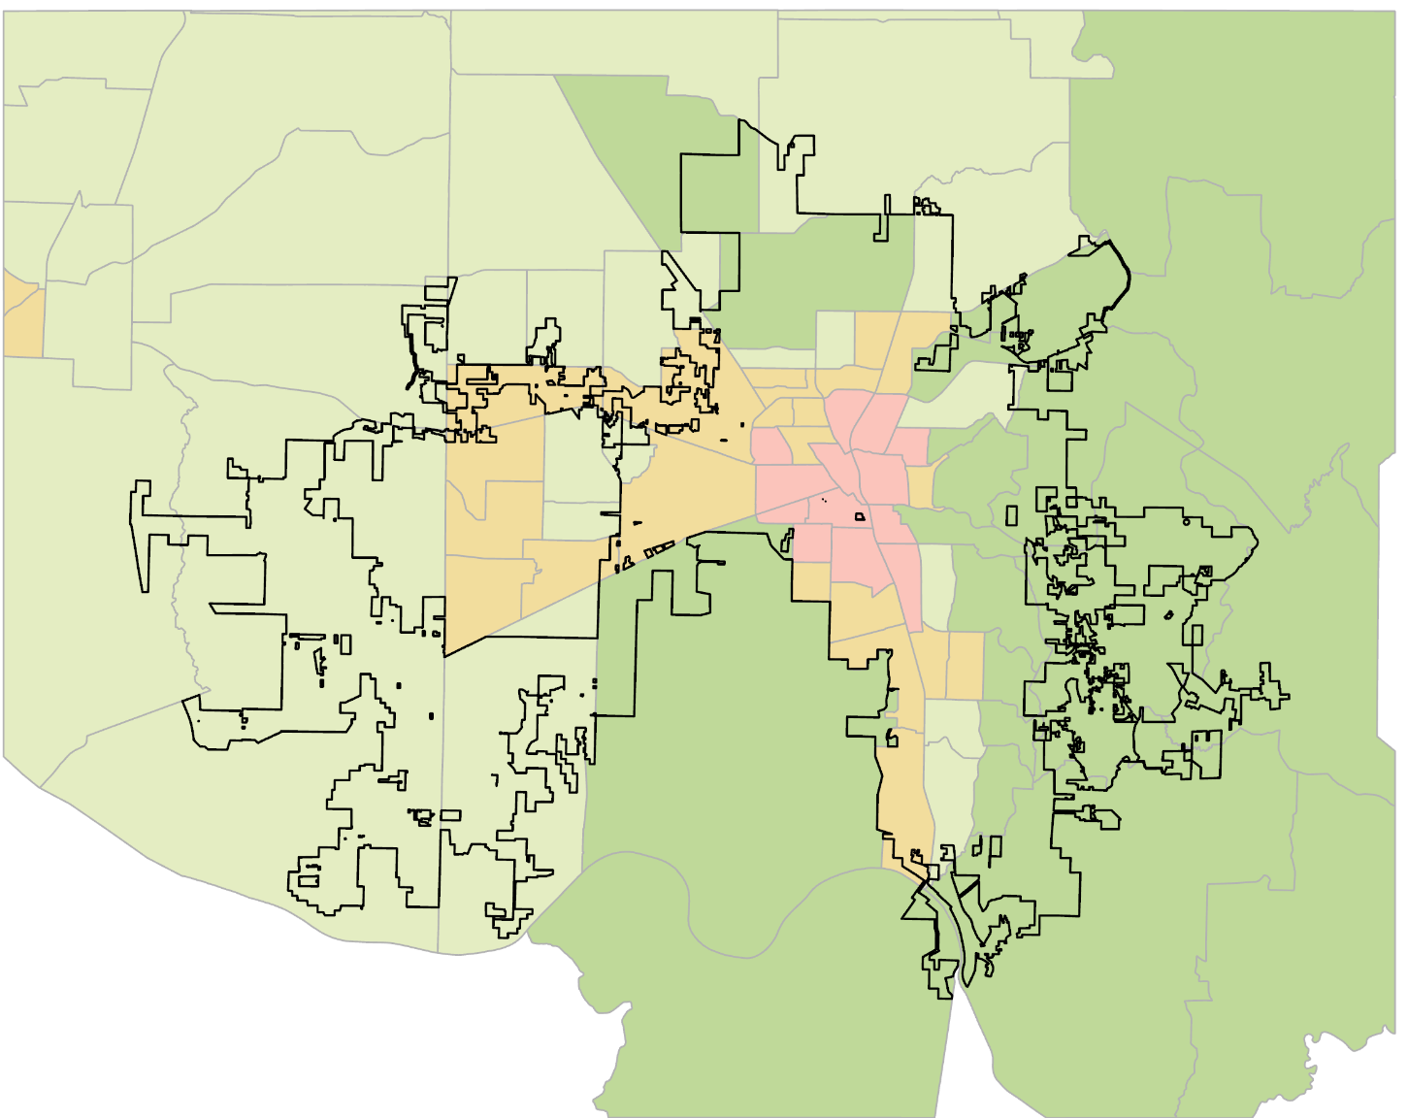
RESULTS: MULTIVARIATE CLUSTERING
Multivariate Clusters
Cluster 1
Cluster 2
Cluster 3
Cluster 4
City of Huntsville
Census Tracts
N
0
10
20 miles
Notes:
Results: Multivariate Clustering
Speaker Notes:
Multivariate clustering groups areas (in this case census tracts) together based on shared standardized variables. The variables we selected were LST, Tree cover, and impervious cover. 4 main clusters were identified.

Slide 28
RESULTS: MULTIVARIATE CLUSTERING
Multivariate Clustering Box-Plots
2
1
1
Standardized Values
2
3
Cluster 1
Cluster 2
Cluster 3
Cluster 4
City of Huntsville
Census Tracts
0
4
N
-1
0
10
20 miles
Tree Covered Area
Developed Area
LST 2019
Notes:
Results: Multivariate Clustering
Speaker Notes:
The resultant map shows Cluster 1 (moderately low tree cover, moderately high developed area, and moderately high LST), Cluster 2 (moderate tree cover, moderately low developed area, and moderately low LST), Cluster 3 (very low tree cover, very high developed area, and very high LST), and Cluster 4 (very high tree cover, very low developed area, and very low LST). High LST = very low tree cover and very high developed area.

Slide 29
METHODOLOGY: HEAT VULNERABILITY
CDC Health Data
EO Data over Census Tracts
Principal Component Analysis
Urban Heat Health Risk Map
Census Age Data
Data Acquisition and Processing
Statistical Analyses
End Product
Notes:
Methodology: Heat Vulnerability
Speaker Notes:
Acquisition
Most of the heat vulnerability data was acquired from the CDC and the Census, and the age of subdivisions data was acquired directly from the City of Huntsville
The team processed the data in R, and averaged remote sensing indices (NDVI, NDBI and LST) over census tracts
The team conducted statistical analyses to examine the relationship between the remote sensing indices and heat vulnerability data, including Principal Component Analysis (PCA), OLS Regression, and Pearson’s Correlation
Image Credits: All images are derived from DEVELOP team generated map layers

Slide 30
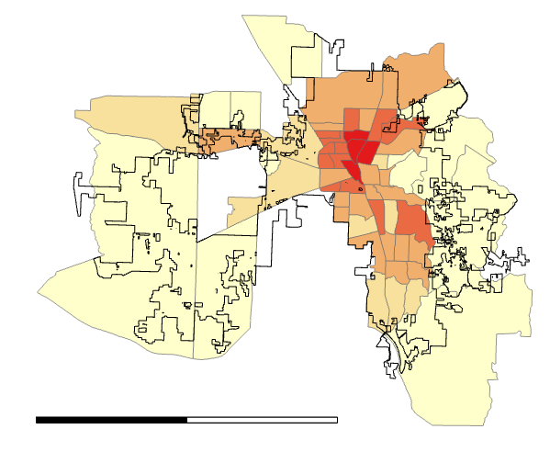
RESULTS: URBAN HEAT HEALTH RISK MAP
Overall Heat Vulnerability
Huntsville City Limits
Census Tracts
Lowest vulnerability
N
Highest vulnerability
No data
0
20
Miles
Notes:
Results: Urban Heat Health Risk Map
Speaker Notes:
The Urban Heat Health Risk Map takes into account CDC epidemiological data such as those diagnosed with asthma, COPD, heart disease, and obesity. Also factored in are census data for people over the age of 65. The most vulnerable citizens in Huntsville live in the Northern Downtown Huntsville Area.

Slide 31
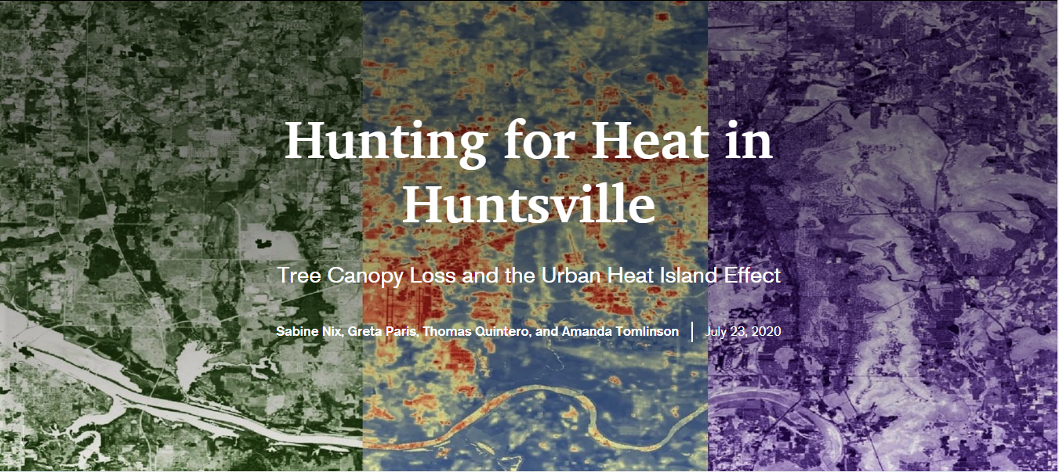
ARCGIS STORYMAP
Notes:
ArcGIS StoryMap
Speaker Notes:
The team created an ArcGIS StoryMap to serve as a community outreach tool. The overall extent of our project was included in this StoryMap and it was created in a way that it could be communicated to all audiences. This tool can be used by the City of Huntsville to inform citizens about tree canopy loss and UHI effect within the city.
::presentation includes StoryMap demo::

Slide 32
CONCLUSIONS
LST has increased by approximately 4 ̊ F while tree cover has increased by 3% across the city from 2010-2019.
Urban expansion in Huntsville has not substantially impacted tree canopy cover from 2010-2019.
LST has a linear increase in developed areas and decreases logarithmically in relation to tree cover.
Highly developed areas such as Downtown Huntsville and the Huntsville International Airport exhibited the highest temperatures.
From our areas of interest, North Downtown Huntsville had one of the highest Heat Vulnerability scores.
Notes:
Conclusions
Speaker Notes:
We determined that LST has increased by approximately 4 ̊ F across the city (with some census tracts seeing increases as high as 8 ̊ F) while tree cover has increased by 3 % across the city from 2010-2019. Urban expansion in Huntsville has not substantially impacted tree canopy cover from 2010-2019 We found that LST has a linear increase in developed areas and decreases logarithmically in relation to tree cover. Through our UHI Identification Maps we found that highly developed areas such as Downtown Huntsville and the Huntsville International Airport exhibited the highest temperatures. From our areas of interest, North Downtown Huntsville had one of the highest Heat Vulnerability scores.

Slide 33
FUTURE WORK & LIMITATIONS
Future Work:
A second term of this project is proposed for Fall 2020.
This project will focus on mapping flood risk and stormwater runoff in relation to urban expansion.
The team will expand upon green infrastructure analysis to aid partners in decision-making processes.
Limitations:
Through creating confusion matrices for land cover classification, the overall accuracies for the validated years ranged between 70%-75%.
Cloud cover varied year to year and may have reduced some results.
GEDI transects were not available for the entire study area.
Notes:
Future Work & Uncertainties
Speaker Notes:
Future Work:
A second term of this project will take place in the Fall of 2020. This project will focus on mapping flood risk and stormwater runoff in relation to urban expansion. The team will expand upon green infrastructure analysis to aid partners in future decision-making processes.
Uncertainties:
Through the creation of confusion matrices for Land Cover Classification, our overall accuracies for the validated years ranged between 70%-75%. Cloud cover varied from year to year and may have reduced some results. GEDI transects were not available for the entire study area as they did not run through Downtown Huntsville.

Slide 34
Advisors:
Dr. Jeffery Luvall, NASA Marshall Space Flight Center
Dr. Robert Griffin, University of Alabama in Huntsville
A. R. Williams, NASA DEVELOP
DEVELOP Mentors:
Helen Baldwin, NASA SERVIR
Christine Evans, University of Alabama in Huntsville
Madison Murphy, Optimal GEO
Partners:
The City of Huntsville
Urban and Economic Development: Shane Davis
City Council: Francis Akridge
City Planning: Lady Kassama
GIS: Amy Kenum and Nicholas Haney
Urban and Long-Range Planning: Dennis Madsen and Ken Newberry
City Engineering: Kathy Martin and Gary Gleason
Landscape Management: Marc Byers
Notes:
The NASA DEVELOP Huntsville Urban Development Team at MSFC would like to thank our Science Advisors, DEVELOP Mentors, and our Project Partners. Without all of them, this project would not be possible!
Advisors:
Dr. Jeffrey Luvall, NASA MSFC
Dr. Robert Griffin, University of Alabama in Huntsville
A. R. Williams, NASA DEVELOP
DEVELOP Mentors:
Helen Baldwin, NASA SERVIR
Christine Evans, University of Alabama in Huntsville
Madison Murphy, Optimal GEO
Partners:
[placeholder: still deciding how to display our partners]

